Slide 1
Hypotonia, neuromuscular disorders
Dr. Redab Al-Ghawanmeh

Slide 2
Objectives
Floppy infant
SMAs
Neuropathies
Muscular dystrophies
Congenital myopathies
Myotonic dystrophy
Myasthenic syndromes
Malignant hyperthermia

Slide 3
Floppy infant
A floppy infant is an infant with decreased muscle tone
Tone is often defined as resistance to passive movement at a joint.
Muscle tone alterations may also be concluded from a child's posture.
Postural tone is the prolonged contraction of antigravity muscles in response to low intensity stretch of gravity
The maintenance of normal tone requires intact central and peripheral nervous systems

Slide 4
Assessment of the floppy infant
History taking, Look into the following:
FHx: Three-generation pedigree, consanguinity, recurrent infantile deaths, parental age, Hx of neuromuscular diseases
Maternal Hx: systemic disease, drug Hx, unrecognized myotonic dystrophy
Pregnancy: fetal movement, drug exposure, poly-/oligohydramnios, breech presentation
Delivery: asphyxia, APGAR, resuscitation, cord gases
Postnatal: feeding, alertness, respiratory effort, spontaneous activity
Course of floppiness

Slide 5
Clinical signs in a floppy infant
Frog like posture
Slipping through the fingers on vertical suspension
Ragdoll appearance on ventral suspension
The traction response showing head lag and excessively rounded back
Associations: Flat occiput, hair loss from occipital region, arthrogryposis, congenital dislocation of the hips and inguinal hernia

Slide 6
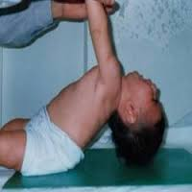
Traction response

Slide 7
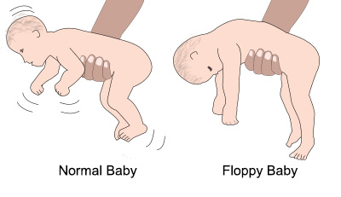
Horizontal suspention

Slide 8
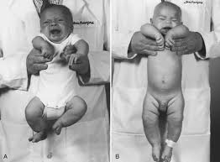
Vertical suspension

Slide 9
Causes
Hypotonia may be due to a disease affecting:
1) the motor unit (consisting of the anterior horn cell in the spinal cord, its axon in the peripheral nerve, the neuromuscular junction, and the muscle fibers it supplies)
2) the suprasegmental structures or the "upper motor neuron" (the spinal cord, brainstem, cerebellum, and the cerebral hemispheres)

Slide 10
Clues to central nervous system pathology
Presence of abnormalities of other brain functions(eg. decrease LOC, seizures)
Dysmorphic features
Fisting of the hands
Scissoring on vertical suspension
Malformations of other organ
Normal or brisk deep tendon reflexes

Slide 11
Central disorders that could result in a floppy infant
Hypotonic Cerebral palsy
Chromosomal disorders including Down’s syndrome and Prader Willi
Genetic disorders like familial dysautonomia and Lowe’s syndrome
Peroxisomal disorders like Zellweger’s syndrom
Metabolic disorders like
Cerebral malformations
Inborn errors of metabolism like GM1 gangliosidosis

Slide 12
Clues to motor unit disorders
Absent or depressed DTR
Fasciculations
Muscle atrophy
No abnormalities of other organs

Slide 13
Causes of peripheral weakness
Neonatal myotonic dystrophy
Neonatal myasthenia
Neonatal myopathies eg central core myopathy
SMAs
Hereditary sensorimotor neuropathies
Infantile botulism
Congenital myasthenic syndrome
Muscular dystrophies

Slide 14
Investigations
Suspect central cause:
Electrolyte, and glucose, thyroid function, neuroimaging,
EEG, genetic review and karyotype if dysmorphic features, TORCH, metabolic work up
Suspect peripheral cause:
CK, neurophysiologic studies, muscle biopsy, molecular genetics as appropriate

Slide 15
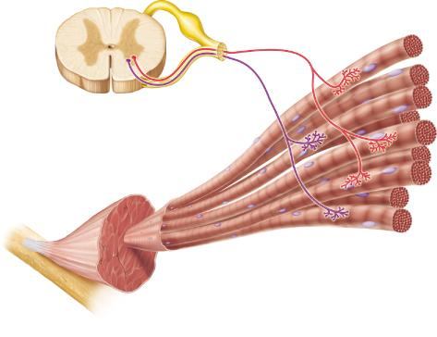
Motor unit

Slide 16
Spinal muscular atrophies
Genetic, AR
The genetic defects associated with SMA types I-III are localized on chromosome 5q13.
The incidence of spinal muscular atrophy is about 1 in 10,000 live births with a carrier frequency of approximately 1 in 50
Progressive degeneration of the anterior horn cells in the spinal cord and motor nuclei in brain stem
Symmetrical proximal muscle atrophy

Slide 17
SMA1 (Werding Hoffmann)
Presentation: 0-6 m
Die<2 y
Floppy infant
bell-shaped chest, paradoxical breathing
Tongue fasciculation
Absent reflexes
Contractures, forearm pronation
Never sit unsupported

Slide 18
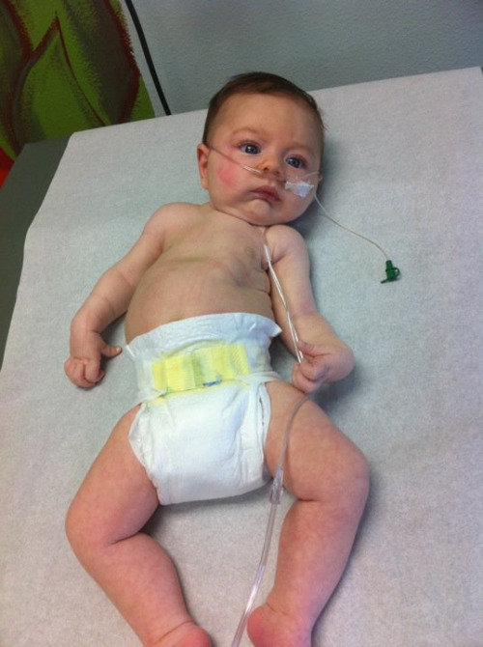
SMA1

Slide 19
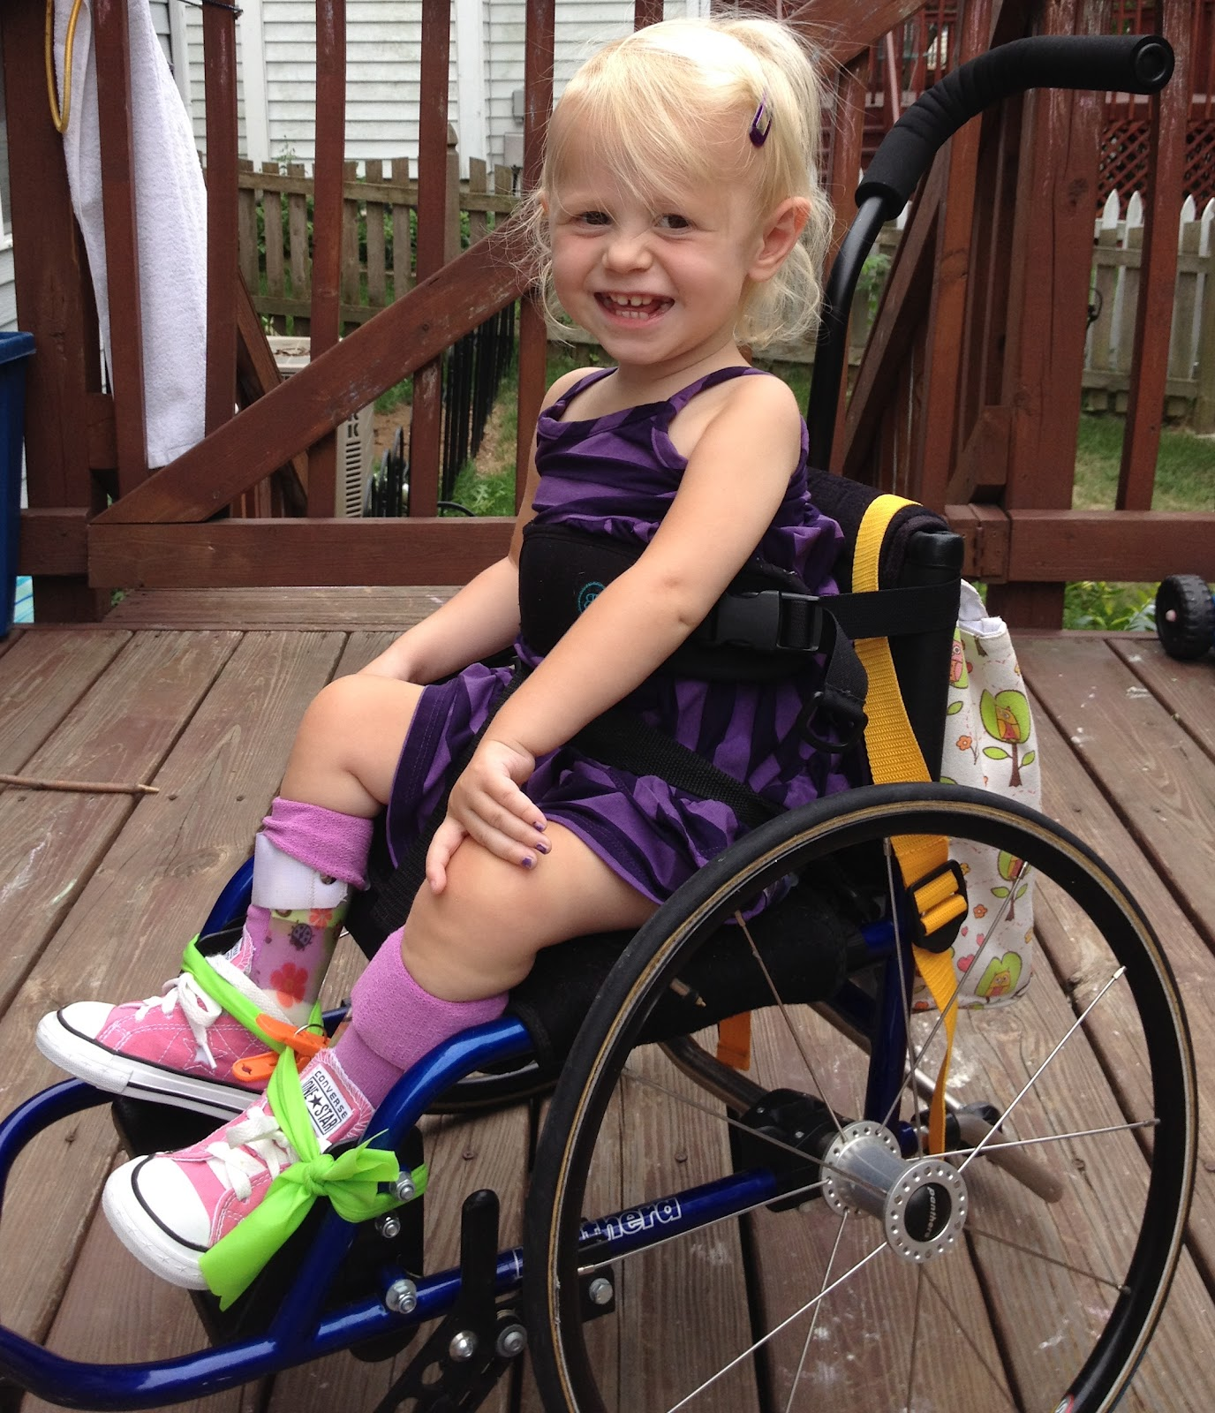
SMA2
Present: 7-18 m
Die<20y
Sit but never walk unsupported
Deteriorating lung function

Slide 20
SMA3 (Kugelberg-Welander)
Present >18m
slowly progressive proximal weakness. Most children with SMA III can stand and walk but have trouble with motor skills, such as going up and down stairs.
Walks unsupported at some stages
Bulbar dysfunction occurs late in the disease.

Slide 21
SMA type IV
SMA type IV (adult onset): Onset is in adulthood (mean onset, mid 30s).
In many ways, the disease mimics the symptoms of type III.
Overall, the course of the disease is benign, and patients have a normal life expectancy.

Slide 22
SMA type zero
Sever ,antenatal onset
Arthrogryposis multiplex congenita
Ventilator dependent at birth

Slide 23
Investigations
Genetic testing, Both prenatal and postnatal tests are now commercially available.
The creatine kinase (CK) level is typically normal in SMA type I and normal or slightly elevated in the other types.
EMG

Slide 24
Treatment
Symptomatic therapy: minimizing contractures, preventing scoliosis, good nutritional support, prevent infections
nusinersen (Spinraza), the first drug approved to treat children (including newborns) and adults with SMA. Nusinersen is an antisense oligonucleotide (ASO) designed to treat SMA caused by mutations in chromosome 5q that lead to SMN protein deficiency.
The recombinant AAV9-based gene therapy, onasemnogene abeparvovec, was approved in May 2019 for SMA type 1 in children aged 2 years or younger.

Slide 25
Neuropathies
Hereditary and acquired
-Hereditary sensorimotor neuropathies(charcot-marie-tooth disease)
AD
Onset 2-40 Y, mostly school age
Slowly progressive, symmetrical, distal muscle weakness and wasting. Affect feet first. Later weakness of intrinsic hand muscles
Toe walking, falls, later foot drop. Foot deformities: pes cavus, high arch
Areflexia. Mild distal sensory loss
Slow nerve conduction velocity, DNA test for duplication in PMP22(70-80%)

Slide 26
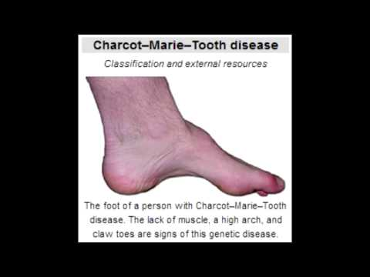

Slide 27
Acquired neuropathies
Guillian –Barre (acute)
Chronic inflammatory demyelinating polyneuropathy (CIDP)

Slide 28
Guillian –Barre syndrome
Incidence: 1-2/100000
Acute inflammatory demyelinating polyneuropathy
A prodromal illness within the previous 4 weeks, URTI or GE. Implicated organisms include: mycoplasma, EBV, CMV, influenza A and B, coxsacki virus. Combylobacter jejuni
Progressive motor weakness, ascending, involving more than one limb, relative symmetry, mild sensory involvement. Progression of the weakness max after 2 wk in 50% of the patient, 3 wk in 80% and 4 wk in the rest
Areflexia, autonomic dysfunction
CSF: elevated protein ,WBC less than 10
Nerve conduction abnormality

Slide 29
GBS, cont..
Miller-fisher syndrome
-Probably a variant of GBS
-Triad of ataxia, ophthalmoplegia and areflexia
-Brain stem encephalitis
Management:
-Careful monitoring of the respiratory function
-Intravenous immunoglobulin
-Plasmaphoresis

Slide 30
Muscular dystrophies- Dystrophinopathies
A number of clinical phenotypes result from mutations in the dystrophin gene at Xp21: Duchenne/Becker muscular dystrophy, X-linked cardiomyopathy and myalgia and cramps
This leads in Duchenne/Becker to decreased muscle content of the structural protein dystrophin: in DMD the dystrophin content is 0-5% of normal, and in BMD the dystrophin content is 5-20% of normal

Slide 31
Clinical presentation
The initial feature in most boys with DMD is a gait disturbance
Onset always before 5y, often before 3y
Toe walking and frequent falling
Often , Hx of delayed achieving of motor milestones, global developmental delay is not uncommon
Intellectual impairment
Symmetric proximal weakness. Waddling gait, Gower sign is present, increased lordiosis
Calf muscle hypertrophy

Slide 32
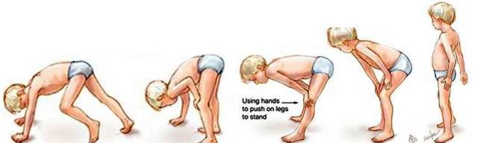
Gower sign

Slide 33
DMD..
Loss of independent ambulation by 13y (in BMD by 16y), wheelchair 8-12 y old
Cardiomyopathy, annual screening
Scoliosis
Respiratory: deterioration of vital capacity to less than 20% of normal to nocturnal hypoventilation
Leading cause of death is cardio/respiratory complications.

Slide 34
Diagnosis
CK is 10 times the upper limit of normal then declines about 20% per year
Gene mutation
Muscle biopsy: little or no dystrophin staining
Management:
-Prednisone
-Aim is to maintain function and prevent contraction; orthoses, scoliosis surgery
-Psychological support

Slide 35
BMD
Presentation similar to DMD but variable severity/onset
slow progression
Life expectancy is longer
Biopsy: patchy dystrophin staining
Other muscular dystrophies:
-Limb girdle muscular dystrophy
-Facioscapulohumeral dystrophy

Slide 36
Congenital muscular dystrophies
A group of conditions presenting at birth or early childhood with hypotonia, weakness and contractions
static or only slight progression
CK normal or slightly elevated
Some are associated with disorders of myelin or neuronal migration or congenital eye abnormalities

Slide 37
Congenital myopathies
Hypotonia and motor delay
Static or slowly progressive
CK normal
Muscle biopsy: myopathic without dystrophic changes
-Central core disease
-Minicore disease
-Nemalin rod myopathy
-Centronuclear myopathy

Slide 38
Myotonic dystrophy
Multisystem disorder transmitted by autosomal dominant inheritance with variable penetrance
-Amplification or “trinucleotide-repeat”
-severity depends on length of expansion
-Anticipation: repeat length expand in next generation, so more sever disease with earlier onset

Slide 39
Myotonic dystrophy..
Cataract, ptosis
Frontal baldness
Myopathic face
Polyhydramnios, reduced fetal movement
Hypotonia, nn. respiratory distress
Arthrogryposis
Myotonia (not at birth):delayed relaxation (prolonged contraction) voluntary contraction
Learning difficulties
Endocrinopathies: insulin resistance, gonadal failure

Slide 40
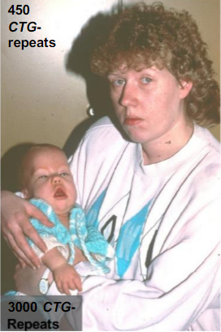
Myotonic dystrophy
Anticipation of the CTG-repeat expanion
 | Repeats (N<30) | Course | Symptoms
grandmother | 150 | mild | cataract
mother | 450 | moderate | Myopathic face, dysarthria
child | 3000 | sever | nn. Resp.distress, mental retardation

Slide 41
Diagnosis
Clinical features
Family history
Molecular genetic study

Slide 42
Myasthenic syndromes
Disorders in neuromuscular transmission due to autoantibodies or gen defect
Weakness and fatigability on exercise

Slide 43
Myasthenia gravis
Onset 1-17 y
Insidious or sudden onset(with febrile illness)
M:f (1:4)
weakness (proximal)and fatigability, with diurnal variation
Ptosis, ophthalmoplegia
Dysphagia, dysphonia, dyspnea
Antibodies:80% acetylcholine receptor (AChR) antibodies positive
14% muscle specific kinase (MuSK) antibodies positive
Thymoma 10%
Dx: AB, neurophysiology, Tensilon test or trial of pyridostegmine
Rx: anticholinesterase, immunotherapy in sever cases(prednisolone, azathioprine, IVIG, plasma exchange

Slide 44
Transient neonatal myasthenia
Transplacental transfer of AChR antibodies
10-15% of myasthenic mothers
Hypotonia, weakness, bulber and resp. insufficiency within 4 days of birth
Dx: AB, response to cholinesterase inhibitors

Slide 45
Congenital myasthenic syndrome
Genetic disorder, AR
Onset 0-24m
Hypotonia, weakness, bulber, resp. weakness, weak cry, feeding difficulties, recurrent chest infections, episodic apnea
Dx: family Hx, negative AB, response to anticholinesterases, electrophysiology, molecular studies

Slide 46
Drugs that impair neuromuscular junction transmission and may increase weakness
Aminoglycosides. Tobramycin. Gentamycin. ...
Fluoroquinolones. Ciprofloxacin. Norfloxacin. ...
Tetracyclines. Clindamycin. ...
Penicillins - considered safe, though anecdotes of ampicillin causing resp depression.
Macrolides. Azithromycin. ...
Quinolones.
Ritonavir.

Slide 47
Malignant hyperthermia
Presents as generalized muscle rigidity, tachycardia, tachypnea, rhabdomyolysis, acidosis, hyperkalemia, myoglobinuria, raised CK and hyperthermia( occurs late)
Triggers: inhalational anesthetics(isoflurane, desflurane..) , depolarizing muscle relaxant(succinylcholine)
Associated with: dystrophin deficient muscular dystrophies, myotonic dystrophy
Rx: ICU management of fluid balance and rhabdomyolysis and possible renal involvement, Dantrolene
Very important to warn patients with neuromuscular disorders of the increased risk of anesthetic reactions, so to inform anesthetists before GA and appropriate anesthetic agents can be used

Slide 48
Thank you

