Slide 1
Autism Spectrum Disorder
Dr. Redab Ghawanmeh

Slide 2
Autism is a condition that manifests in early childhood and is characterized by qualitative abnormalities in social interactions, markedly aberrant communication skills, and restricted repetitive and stereotyped behaviors. A heterogeneous group of disorders includes the trait of autism.
ASD includes a variety of disorders that have been called autistic disorder, pervasive developmental disorder, Asperger syndrome, Rett syndrome, and fragile X syndrome

Slide 3
"Pervasive developmental disorder" had been used to describe disorders including ASD and conditions with some traits characteristic of autism. Asperger syndrome refers to high-functioning individuals with ASD; these are people who have normal or superior intellectual abilities. People with Asperger syndrome may lack the communication abnormalities characteristic of ASD. Rett syndrome and fragile X syndrome are genetic conditions with characteristic findings in addition to ASD. People with Rett syndrome and fragile X syndrome may or may not also exhibit ASD or autistic traits

Slide 4
Signs and symptoms
Behavioral and developmental features that suggest autism include the following:
Developmental regression
Absence of protodeclarative pointing
Abnormal reactions to environmental stimuli
Abnormal social interactions
Absence of smiling when greeted by parents and other familiar people
Absence of typical responses to pain and physical injury
Language delays and deviations
Susceptibility to infections and febrile illnesses
Absence of symbolic play
Repetitive and stereotyped behavior

Slide 5
Possible findings upon examination
Abnormal motor movements (eg, clumsiness, awkward walk, hand flapping, tics)
Dermatologic anomalies (eg, aberrant palmar creases)
Abnormal head circumference (eg, small at birth, increased from age 6 months to 2 years, normal in adolescence )
Orofacial, extremity, and head/trunk stereotypies (eg, purposeless, repetitive, patterned motions, postures, and sounds)
Self-injurious behaviors (eg, picking at the skin, self-biting, head punching/slapping)
Physical abuse inflicted by others (eg, parents, teachers)
Sexual abuse: External examination of genitalia is appropriate; if bruises and other evidence of trauma are present, pelvic and rectal examinations may be indicated

Slide 6
Regular screening of infants and toddlers for symptoms and signs of autistic disorder is crucial because it allows for early referral of patients for further evaluation and treatment. Siblings of children with autism are at risk for developing traits of autism and even a full-blown diagnosis of autism. Therefore, siblings should also undergo screening not only for autism-related symptoms but also for language delays, learning difficulties, social problems, and anxiety or depressive symptoms.

Slide 7
causes
Although the etiology of autism is unknown, hypotheses include genetic abnormalities, obstetric complications, exposure to toxic agents, and prenatal, perinatal, and postnatal infections.
Maternal rubella is associated with significantly higher rates of autism and other conditions in children.
Tuberous sclerosis is associated with autism as a comorbid disorder.
Approximately 10% of children with a pervasive developmental disorder exhibit a known medical condition.

Slide 8
maternal use of valproate or SSRI during pregnancy is associated with a significantly increased risk for autism in offspring
Severe, early-gestation maternal hypothyroxinemia is associated with an increased risk of having a child with autism

Slide 9
Parental age
Meta-analyses of epidemiologic studies have shown that autism risk in offspring increases with advancing age of either parent.
The adjusted relative risk for autism was 1.52 in the offspring of mothers aged 35 years or older compared with mothers aged 25-29 years.
Hultman et al found that, after controlling for maternal age, offspring of men aged 50 years or older were 2.2 times more likely to have autism than offspring of men aged 29 years or younger.

Slide 10
On the other hand, anecdotal reports that autism may be linked with vaccinations (eg, for measles, mumps, and rubella) have not been supported by broader research. Research from the CDC indicates that the number of childhood vaccines administered, either in a single day or during a child's first 2 years, has no effect on the risk of developing an autism spectrum disorder (ASD)
Parents should be encouraged to fully immunize their children.

Slide 11
Epidemiology
Reported rates of autism spectrum disorder have been rising in many countries over the past 2 decades. It remains unclear how much of these data represent an actual increase and how much reflect changes in diagnostic definitions and practices, as well as increasing awareness among the general public and within the medical profession
According to survey results from parents across the United States, 1 in 40 children (2.5%) has ASD, representing an estimated 1.5 million children ages 3 to 17 years.
Autistic disorder is most common in boys who have the 46,XY karyotype (ie, the normal male karyotype). In some studies, fragile X is reported in approximately 10% males with autistic disorder.

Slide 12
Diagnostic criteria
The definition of ASD in the Diagnostic and Statistical Manual of Mental Disorders, Fifth Edition (DSM-5) encompasses the previous manual's autistic disorder (autism), Asperger's disorder, childhood disintegrative disorder, and pervasive developmental disorder not otherwise specified. ASD is characterized by the following:
Deficits in social communication and social interaction
Restricted repetitive behaviors, interests, and activities (RRBs)
restricted repetitive behaviors

Slide 13
Screening tests
The Infant and Toddler Checklist, also known as the Communication and Symbolic Behavior Scales. ITS CSBS
The Modified Checklist for Autism in Toddlers, Revised (M-CHAT-R)
It's intended for toddlers between 16 and 30 months of age.
childhood Autism screening test. CAST

Slide 14
Management
The established therapies for autistic disorder are nonpharmacologic and may include individual intensive interventions. Individuals with autism spectrum disorder and unspecified pervasive developmental disorder typically benefit from behaviorally oriented therapeutic programs developed specifically for this population. Autistic children should be placed in these specialized programs as soon as the diagnosis is suspected.

Slide 15
Nonpharmacologic therapy
Intensive individual special education
Speech, behavioral, occupational, and physical therapies (eg, assisted communication, auditory integration training, sensory integration therapy, exercise/physical therapy)
Social skills training in some children with autism spectrum disorder, including those with comorbid anxiety disorders; children with autism spectrum disorder and comorbid ADHD may benefit less from social skills training

Slide 16
Pharmacotherapy
No pharmacologic agent is effective in the treatment of the core behavioral manifestations of autistic disorder, but drugs may be effective in treating associated behavioral problems and comorbid disorders (eg, self-injurious behaviors, movement disorders). The possible benefits from pharmacotherapy must be balanced against the likely adverse effects on a case-by-case basis
Medications that could be used:
Second-generation antipsychotics (eg, risperidone, aripiprazole, ziprasidone)
SSRI antidepressants (eg, fluoxetine, citalopram, escitalopram)
Stimulants (eg, methylphenidate)

Slide 17
Practice guidelines
The American Academy of Child and Adolescent Psychiatry's practice guidelines for the assessment and treatment of children and adolescents with ASD include the following recommendations:
Questions about core symptoms of ASD should be a routine part of psychiatric and developmental assessments of young children.
If screening reveals significant ASD symptomatology, a thorough evaluation should be performed and possible comorbid diagnoses should be considered.
Children with ASD should undergo a multidisciplinary assessment, including a physical examination, a hearing screen, communication and psychological tests, and genetic testing.
Clinicians should help families obtain educational and behavioral interventions, such as applied behavioral analysis (ABA) programs.
Pharmacotherapy should be offered for specific target symptoms or comorbid conditions.
Clinicians should maintain an active role in the planning of long-term treatment.
Families should be asked about the use of alternative/complementary treatments.

Slide 18
Prognosis
The prognosis in patients with autism is highly correlated with their IQ. Low-functioning patients may never live independently; they typically need home or residential care for the rest of their lives. High-functioning patients may live independently, hold jobs successfully

Slide 19
Comorbid disorders
Anxiety
ADHD
Bipolar disorder
Depression
Developmental coordination disorder
Epilepsy
Intellectual disability
Obsessive–compulsive disorder

Slide 20
Gastrointestinal disorders, particularly constipation and chronic diarrhea, are more common in children with autism spectrum disorder. The risk of gastrointestinal disorders increases with the severity of autism symptoms

Slide 21
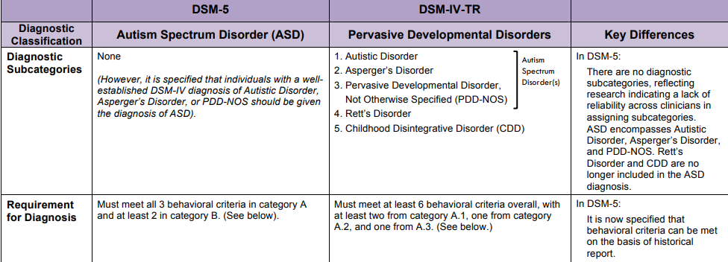

Slide 22
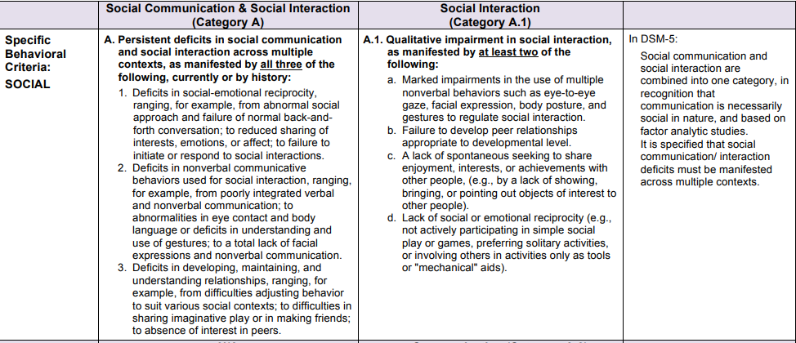

Slide 23
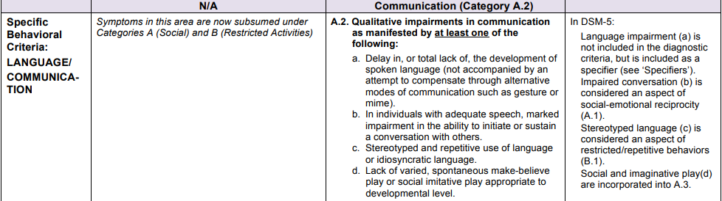

Slide 24
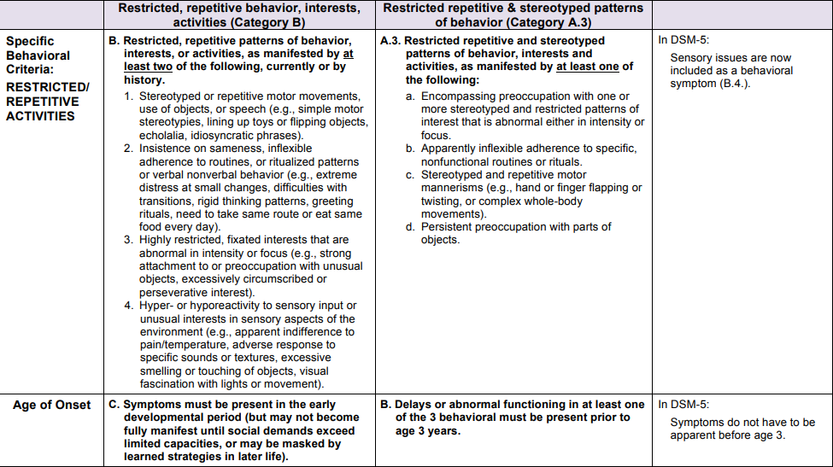

Slide 25
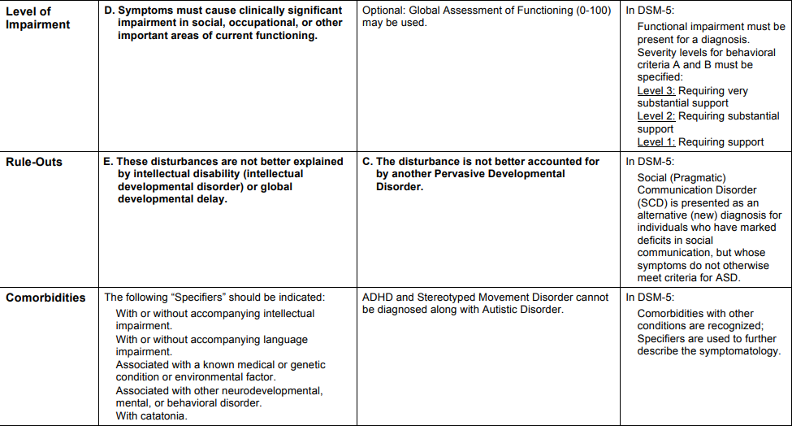

Slide 26
Attention Deficit Hyperactivity Disorder (ADHD)

Slide 27
Attention deficit hyperactivity disorder (ADHD) is a developmental condition of inattention and distractibility, with or without accompanying hyperactivity.
There are 3 basic forms of ADHD described in the Diagnostic and Statistical Manual, Fifth Edition (DSM-5) of the American Psychiatric Association: inattentive; hyperactive-impulsive; and combined.

Slide 28
Inattentive
This must include at least 6 of the following symptoms of inattention that must have persisted for at least 6 months to a degree that is maladaptive and inconsistent with developmental level:
Often fails to give close attention to details or makes careless mistakes in schoolwork, work, or other activities
Often has difficulty sustaining attention in tasks or play activities
Often does not seem to listen to what is being said, even hen directly addressed
Often does not follow through on instructions and fails to finish schoolwork, chores, or duties in the workplace (not due to oppositional behavior or failure to understand instructions)

Slide 29
Inattentive…
Often has difficulties organizing tasks and activities
Often avoids or strongly dislikes tasks (such as schoolwork or homework) that require sustained mental effort
Often loses things necessary for tasks or activities (school assignments, pencils, books, tools, or toys)
Often is easily distracted by extraneous stimuli
Often forgetful in daily activities

Slide 30
Hyperactivity/impulsivity
This must include at least 6 of the following symptoms of hyperactivity-impulsivity that must have persisted for at least 6 months to a degree that is maladaptive and inconsistent with developmental level:
Fidgetiness (tapping hands or feet, squirming in seat)
Leaving seat in classroom or in other situations in which remaining seated is expected
Running about or climbing excessively in situations where this behavior is inappropriate (in adolescents or adults, this may be limited to subjective feelings of restlessness)
Difficulty playing or engaging in leisure activities quietly

Slide 31
Hyperactivity/impulsivity…
Unable to be or uncomfortable being still for extended periods of time (may be experienced by others as “on the go” or difficult to keep up with)
Excessive talking
Blurting out answers to questions before the questions have been completed
Difficulty waiting in lines or awaiting turn in games or group situations
Interrupting or intruding on others (for adolescents and adults, may intrude into or take over what others are doing)

Slide 32
Other
Onset is no later than age 12 years
Symptoms must be present in 2 or more situations, such as school, work, or home
The disturbance causes clinically significant distress or impairment in social, academic, or occupational functioning
Disorder does not occur exclusively during the course of schizophrenia or other psychotic disorder and is not better accounted for by mood, anxiety

Slide 33
Epidemiology
According to a study by CDC researchers, more than 1 in 10 (11%) US school-aged children (4–17 years)
In children, ADHD is 3–5 times more common in boys than in girls
The predominantly inattentive type of ADHD is found more commonly in girls than in boys.

Slide 34
Causes
Genetics
Parents and siblings of children with ADHD are 2-8 times more likely to develop ADHD than the general population, suggesting that ADHD is a highly familial disease.
Environment
Hypotheses exist that include in utero exposures to toxic substances, food additives or colorings, or allergic causes. However, diet, especially sugar, is not a cause of ADHD.

Slide 35
Diagnosis
The diagnosis requires the symptoms of ADHD to be present both in school and at home, meet the criteria defined by DSM-5
Evaluation of ADHD requires comprehensive medical, developmental, educational and psychosocial evaluation to confirm the presence, persistence, pervasiveness and functional complications of core symptoms and identify coexisting disorders
Blood tests, neuroimaging or EEG are not routinely required, unless they are indicated by clinical evaluation

Slide 36
Coexisting behavioral or emotional disorders
Depression
Anxiety disorder
Learning disabilities
Substance use
Oppositional defiant disorder

Slide 37
Imaging Studies
Brain imaging, such as functional MRI or single photon emission computed tomography (SPECT) scans have been useful for research, but no clinical indication exists for these procedures because the diagnosis is clinical.
In the largest imaging study of ADHD conducted, investigators found that five regions of the brain were slightly smaller in children with ADHD compared to children without the disorder
They were found to have reductions in the volumes of the accumbens, the amygdala, the caudate, the hippocampus, and the putamen, as well as reductions in intracranial volume. Effect sizes were highest in most subgroups of children (< 15 years) versus adults (>21 years).

Slide 38
The therapeutic approach to ADHD
In some cases, environmental restructuring and behavioral therapy alone has been effective.
Developments in behavioral parent training (BPT) and behavioral classroom management (BCM) have also proven useful.
Behavioral psychotherapy often is successful when used in conjunction with an effective medication regimen.
The medications of choice are stimulants
For adults with ADHD stimulants represent the best first-line therapeutic option.
For related areas of functioning, such as social skills and academic performance, medications combined with behavioral treatments may be indicated.

Slide 39
Medical Care
Stimulants (methylphenidate, dextroamphetamine)
stimulants are the first-line therapy and probably the most effective treatment.
All stimulants have similar efficacy but differ by dosing, duration of action, and adverse effect profiles in individual patients.
Targeted symptoms include impulsivity, distractibility, poor task adherence, hyperactivity, and lack of attention
Care should be taken to not dose too close to bedtime because stimulants may cause significant insomnia.

Slide 40
Medical Care..
Other common adverse effects include appetite suppression and weight loss, headaches, and mood effects (depression, irritability).
Stimulants may exacerbate tics in children with underlying tic disorders.
no evidence that stimulant treatment increases or decreases the risk for subsequent substance use disorders in children and adolescents with ADHD when they reach young adulthood
Stimulant medications do enhance mental executive functions for those with ADHD.

Slide 41
Other medications
Atomoxetine (Strattera), selective norepinephine reuptake inhibitor, has become a second-line and, in some cases, first-line treatment in children and adults with ADHD
Tricyclic antidepressants (imipramine, desipramine, nortriptyline) have been found effective in numerous studies in children with ADHD; however, because of potential adverse effects, they are rarely used for this purpose

Slide 42
Behavioral psychotherapy
Behavioral psychotherapy often is effective when used in combination with an effective medication regimen. Behavioral therapy or modification programs can help diminish uncertain expectations and increase organization.
Working with parents and schools to ensure environments conducive to focus and attention is necessary.

Slide 43
Cognitive therapy for adults with ADHD
Metacognitive therapy involves the principles and techniques of cognitive and behavioral therapies to enhance time management. In doing so, these have made adult patients with ADHD better able to counter the anxiety and depressive symptoms they experience in task performance. Metacognitive therapy has proven to be more effective than supportive interventions and represents a viable therapeutic approach. [

Slide 44
Psychosocial interventions
A number of psychosocial treatments are effective. These include behavioral parent training (BPT) and behavioral classroom management (BCM). These are best used in conjunction with psychopharmacological approaches.
Emerging evidence shows that nonpharmacological treatments should be considered the first treatment for children with ADHD. For preschoolers, intervention is best with parental training. For school-aged children, interventions of group training for parents and classroom behavioral approaches might be enough. Severe cases benefit from medication and behavioral interventions.

Slide 45
Activity
In one study of the effect of physical activity on children's attention, researchers found that intense exercise has a beneficial effect on children with ADHD. It can improve their attention and may help their school performance.

Slide 46
In April 2019, the FDA approved the first medical device to treat childhood ADHD. The prescription-only device is indicated for patients ages 7 to 12 years old who are not currently taking prescription ADHD medication. The trigeminal nerve stimulation (TNS) system is the size of a cell phone and generates a low-level electrical pulse to the branches of the trigeminal nerve. Approval was based on a clinical trial of 62 children that showed that subjects using the device had statistically significant improvement in their ADHD symptoms compared with the placebo group.

Slide 47
Thank you

