Slide 1
Child Development
Dr. Redab Al-Ghawanmeh

Slide 2
Introduction
Principles of development
Domains of development
Developmental assessment
Screening tools
Red flags

Slide 3
Development is the individual level of functioning, a child is capable of, as a result of maturation of the nervous system.
Developmental assessment, milestones acquisition occur at a specific rate and in an orderly and sequential manner

Slide 4
Principles of development
Development is continuous process from conception to maturity
Sequence of development is same in all children but rate varies
Development intimately related to maturation of CNS
Proceeds in a cephalocaudal direction

Slide 5
Certain primitive reflexes, should be lost before corresponding voluntary movement occurred
Genetic and environmental factors contribute positively and negatively

Slide 6
Milestones
Acquisition of a key skill
– Median age : age at which half population acquire the skill
– Limit : age at which a skill should have been achieved, - 2SD from the mean

Slide 7
Developmental milestones serve as the basis of most standardized assessment and screening tools
Developmental monitoring not only should be aimed at identifying children who have low function but at directing the focus of anticipatory guidance to help promote normal development

Slide 8
Domains of development
Gross motor
Fine motor
Language
Social, cognitive
**Vision and hearing developmental assessment
Delay in specific domain or global developmental delay

Slide 9
Developmental delay?
Developmental regression?
What is the value of developmental screening?

Slide 10
Why is it necessary?
• Reassure if normal development pattern and timings
• Spot regression
• Any genetic disorder to make?
• Identify those with specific areas of impairment or global concerns
Allows early support or interventions eg. hearing aids, physiotherapy

Slide 11
When to suspect abnormalities in development
Hx from parents, (majority of patients)
Examination:
-during routine examination and developmental screening
- by follow up examination in high risk babies

Slide 12
Risk factors for possible developmental problems in Hx
Prenatal: use of drugs or alcohol, viral infections, ..
Perinatal: prematurity, LBW, obstetric complications
Neonatal: encephalopathy, infections, hyperbilirubinemia..
Post natal: encephalitis, sever epilepsy..
Family hx: consanguinity, inherited disorders..
Social hx: ability to deal with a disabled child..

Slide 13
Developmental screening
The AAP recommends that all children be screened for developmental delay and disabilities at well child doctor visit at:
9 months
18 months
24 or 30 months
Additional screening might be needed if a child is at high risk for developmental problem, eg: preterm, low birth weight and others

Slide 14
Developmental screening
Different tools, eg. Denver II scale, commonly used.
Checked in regular well-child clinic visit
Parents usually, not always, the first to pick up possible developmental delay

Slide 15
Examination: observation and interactive assessment
Should take in a place in a room with toys appropriate for child
With one or both parents but with no helping
Chair and table
Child s behavior and interaction with parents during hx taking should be observed prior to p/e
Hearing and vision assessment

Slide 16
Prerequisties:
Infant or child in a good temper
Should not be hungry , tired, had convulsion prior or under effect of sedative drugs

Slide 17
Examination
General, growth parameters,(HC), dysmorphic features, neurologic exam
child placed in different postures
Hearing and vision
Muscle tone, landau reflex
Primitive reflexes
Consider the corrected age in preterm babies

Slide 18
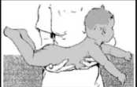
Landau reflex

Slide 19
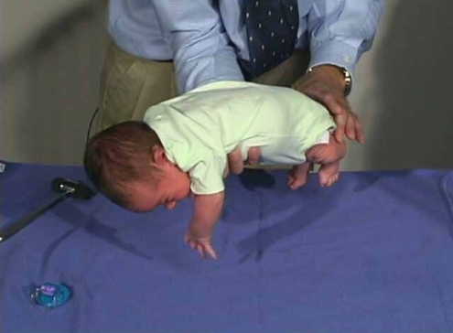
Ventral suspension

Slide 20
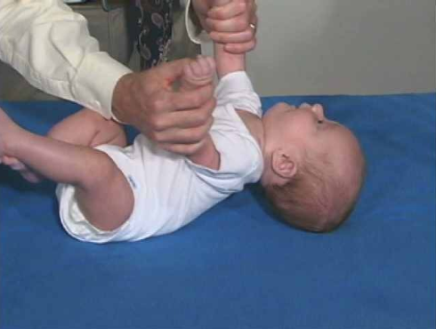
Traction response

Slide 21
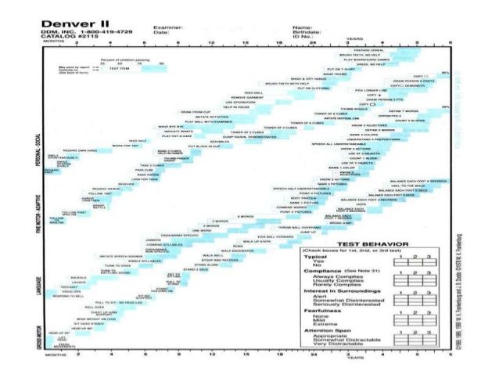

Slide 22
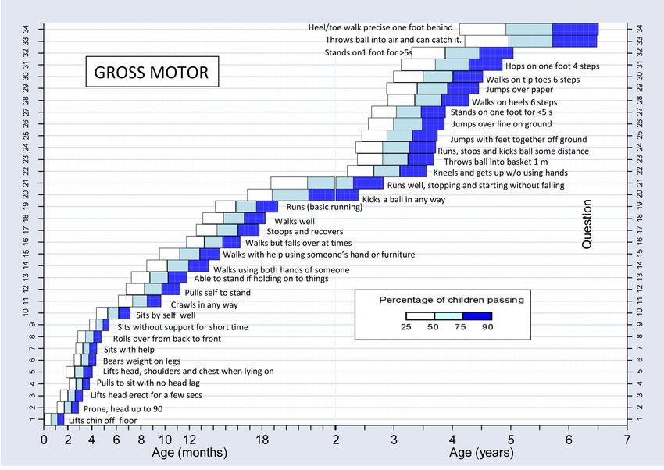
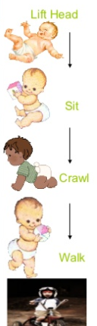

Slide 23
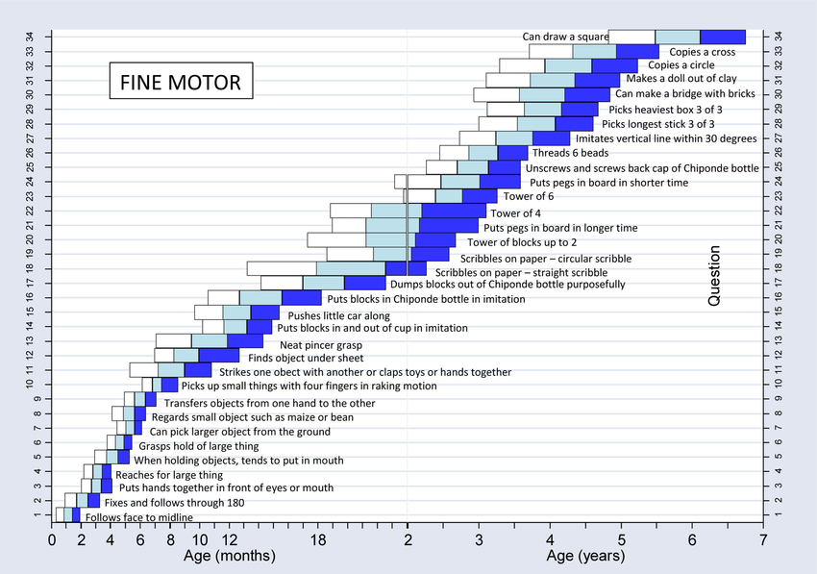

Slide 24
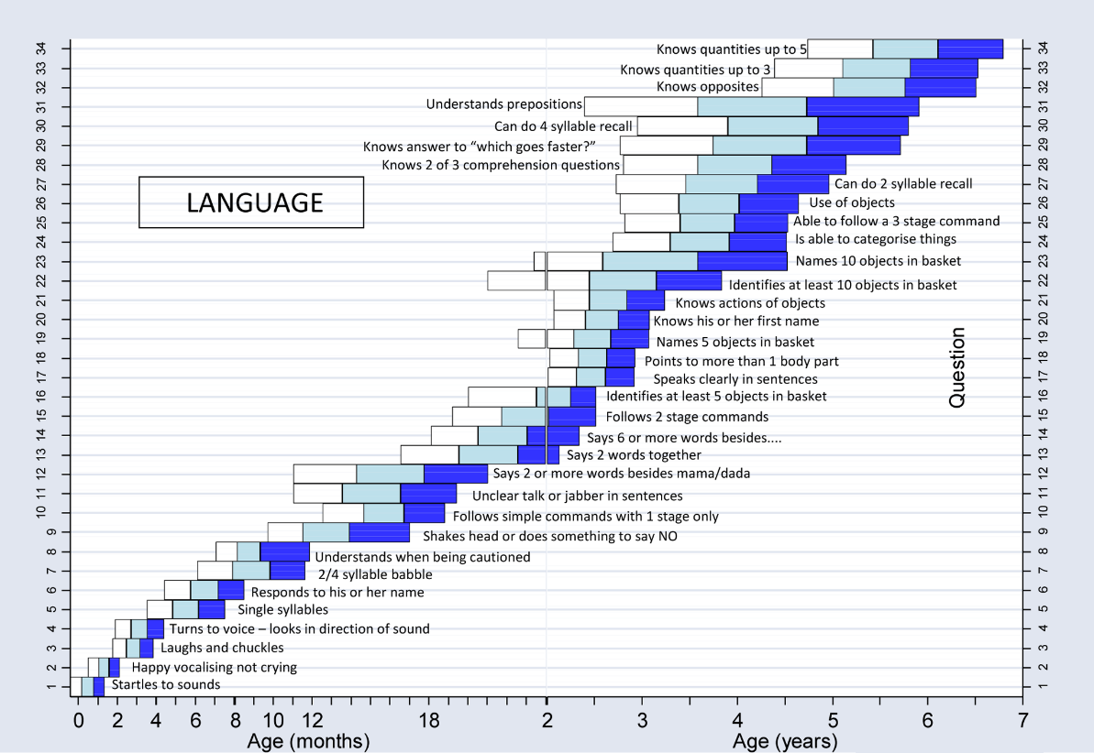

Slide 25
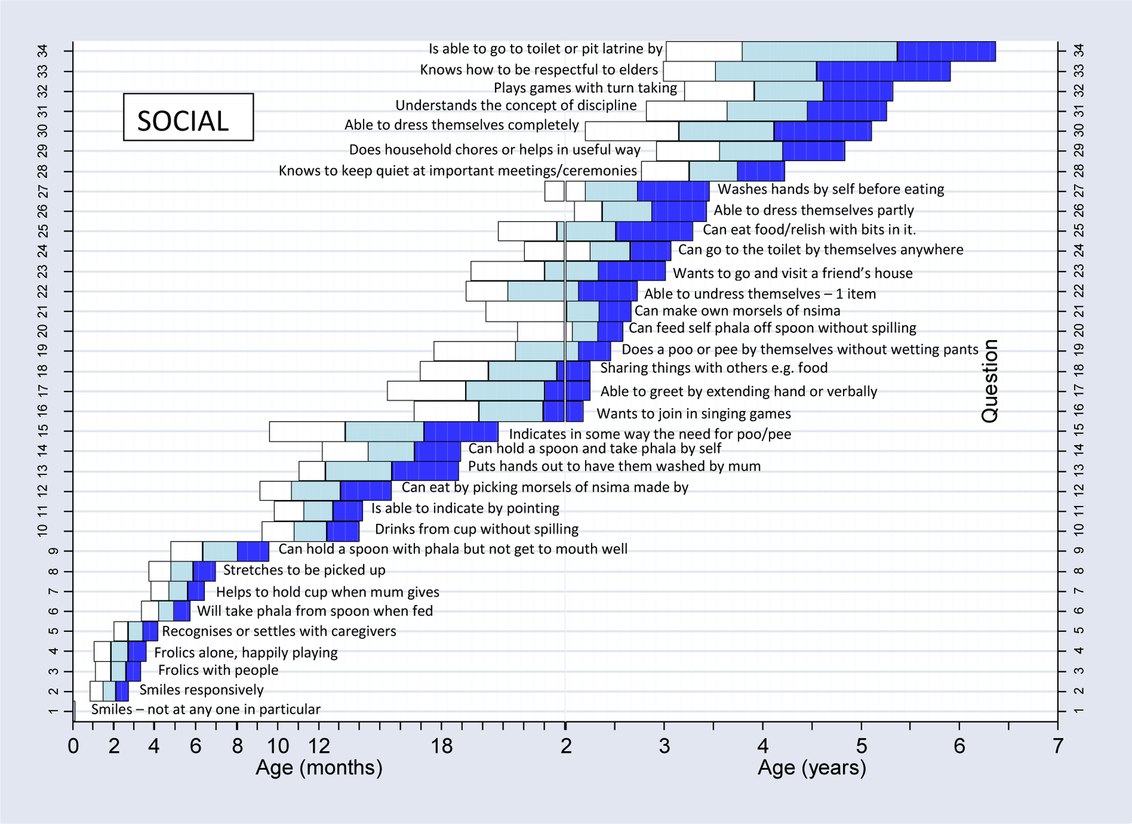

Slide 26
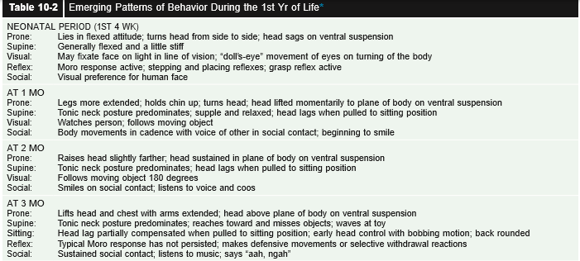
First year

Slide 27
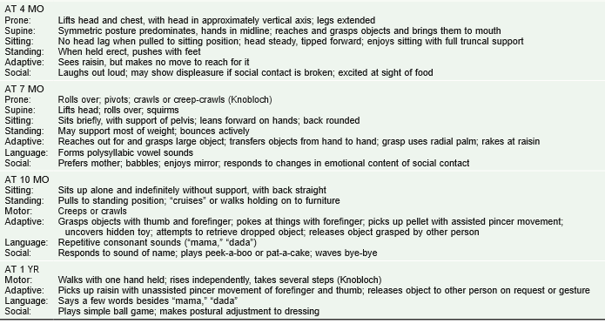
First year, cont..

Slide 28
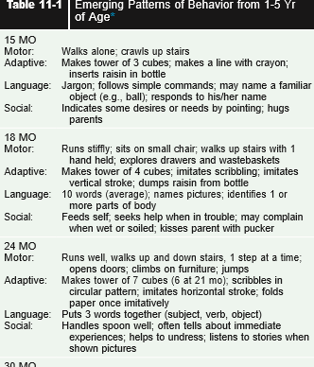
1-5 years

Slide 29
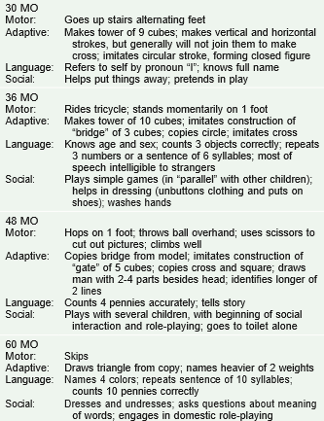

Slide 30
Red flags
Any loss of skills at any age.
0-3m,
- persistent fisting after 3m - failure to respond to environmental stimuli, evaluate for hearing loss
4-6m
-poor head control, evaluate for hypotonia
-failure to reach for objects by 5m, evaluate for motor or visual deficit

Slide 31
6-12m
-Persistent of primitive reflexes
-Absent babbling by 6m
-Inability to recognize sounds by 10m

Slide 32
12-24m
-Hand preference before 18 m
-Inability to walk up and down stairs by 24m
-Advanced non communicative speech, eg. Echolalia, evaluate for pervasive developmental disorders
Delayed language development require hearing assessment in all ages

Slide 33
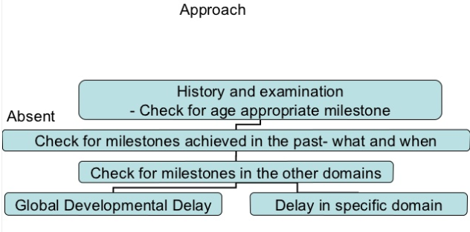

Slide 34
Cerebral palsy

Slide 35
Cerebral palsy
Non progressive(static) disorder of motor function and movement, usually manifest early in life as a result of CNS damage to the developing brain

Slide 36
Risk factors
Prenatal: infection, multiple births, placental thrombosis, maternal metabolic dis. Eg. DM, intrauterine exposure to toxins
Perinatal: hypoxic ischemic encephalopathy, periventricular leukomalacia, strock, hyperbilirubinemia
Postnatal: strock, trauma, infection

Slide 37
Classification
According to extremity involved:
Monoplegic, hemiplegic, diplegic, quadriplegic
According to neurological dysfunction:
Spastic(most common), ataxic, dyskinetic (dystonic, chorioathetoid), mixed

Slide 38
Diagnosis: Hx + P/E
The usual presentation is delay in motor milestones
No loss of function by hx, disease is not progressive
On exam: hypotonia, spasticity, persistent primitive reflexes, underdevelopment of parachute reflex
Serial examinations may be necessary to assure the diagnosis of CP, esp. when hx is not reliable.

Slide 39
Associated conditions
MR
epilepsy
Ophthalmological defects
Hearing impairments
Speech and language disorders

Slide 40
Evaluation
Detailed hx and p/e
Neuroimaging , MRI preferred
Screen for associated conditions
Monitor for nutrition, growth swallowing problems
Testing for coagulation disorders considered in hemiplegic CP
Genetic and metabolic testing, not routinely, in atypical cases
EEG, if convulsion

Slide 41
Management
Multidisciplinary team:
-physiotherapy, occupational therapy, speech therapy, special education, orthopedic, psychological counselling, nutrition
Goal of trt: to maximize function and optimize development

Slide 42
Complications
Dental caries, GER with aspiration pneumonia, constipation, bronchial dysplasia, skin ulcers and bed sores, join contractures hip dislocation and scoliosis, strabismus and decrease visual acuity, hearing loss
Increase incidence of ADHD, depression

Slide 43
Thank you

