Slide 1
Cardiac Infections:
ARF and Endocarditis
Marwan shalabi, md
Assistant professor in pediatric infectious diseases.

Slide 2
Acute Rheumatic fever (ARF)

Slide 3
OUTLINES
Etiolgy.
Epidemiology
- Pathophysiology
- Jones criteria
- Diagnosis
- Treatment
- Complications
- Prevention
- Prognosis

Slide 4
ETIOLOGY
Proceeded by GAS pharyngitis.
ABT to treat GAS pharyngitis prevents rheumatic fever.
ABT prophylaxis prevents ARF recurrence
serotypes of GAS (M types 1, 3, 5, 6, 18, 29) are more frequently isolated

Slide 5
EPIDEMIOLOGY
Why more frequent in developing countries:
  Host factors:
    genetic susceptibility
    Lack of appropriate medical care.
    Poverty and crowing.
  Pathogen factors
    Certain GAS are rheumatogenic serotypes (types 1, 3, 5, 6, and 18)
Most common form of acquired heart disease
peaks : 5-15 yr of age
Once happened increased risk of recurrence

Slide 6
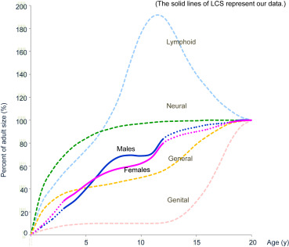

Slide 7
PATHOGENESIS
Cytotoxicity theory:
  GAS toxin leads to ARF and rheumatic heart disease.
Immunologic theory
  Latency.
  Cross antigenicity of several GAS and tissues (e.g., heart valve, sarcomere, brain, joint)

Slide 8
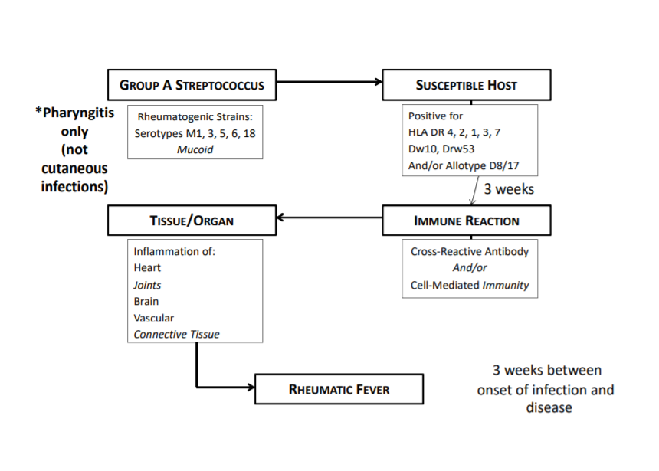

Slide 9
Jones Criteria
MAJOR MANIFESTATIONS | MINOR MANIFESTATIONS | EVIDENCE OF GAS INFECTION
Carditis Polyarthritis Erythema marginatum Subcutaneous nodules Chore | Arthralgia Fever High ESR or CRP Prolonged P-R | Positive throat culture or rapid strep. test or ASO titer
Guidelines for the Diagnosis of Initial or Recurrent Attack of Rheumatic Fever (Jones Criteria, Updated 2015) 2 major or 1 major and 2 minor criteria PLUS evidence of preceding GAS infection needed to diagnose ARF recurrent ARF: presence of 3 minor criteria PLUS evidence of preceding GAS infection.

Slide 10
Jones Criteria
Initial attack:
  2 major manifestations, plus evidence of recent GAS infection.
  Or 1 major and 2 minor manifestations, plus evidence of recent GAS infection.
  Chorea alone, plus evidence of recent GAS infection.
Recurrent attack: 2 major, or 1 major and 2 minor, or 3 minor manifestations , plus evidence of recent GAS infection
Carditis is now defined as clinical and/or subclinical (echocardiographic valvulitis)
Arthritis: monoarthritis or polyarthralgia

Slide 11
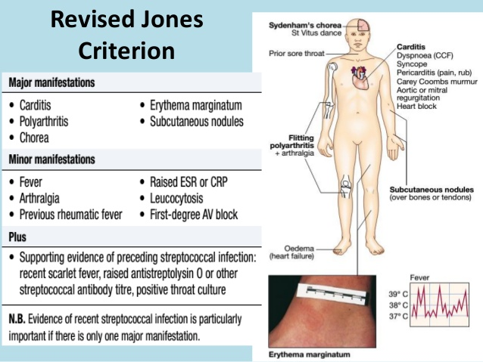

Slide 12
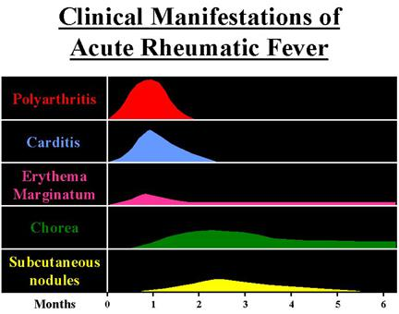
Clinical manifestation- Onset & Duration

Slide 13
Migratory Polyarthritis
In 75% of ARF.
larger joints (knees, ankles, wrists, and elbows
Migratory
Arithritis is the earliest manifestation
Last weeks if untreated.
Response to salicylates is characteristic
Not deforming
inverse relationship between the severity of arthritis and severity of cardiac involvment

Slide 14
Carditis
50-60% of all ARF
subclinical carditis accepted in revised jones criteria 2015.
  subclinical carditis defined: without a murmur but with echocardiographic evidence of valvulitis
  clinical carditis (with a valvulitis murmur)
Pancarditis: but mainly Endocarditis (valvulitis)
MR or MR+AR
insufficiency is characteristic
mitral and/or aortic valvular stenosis usually appears in years
tachycardia and cardiac murmur
Most serious ARF complication, May require valve replacement, if recurrent

Slide 15
Sydenham chorea
10-15% of ARF.
could be Isolated, frequently subtle
Emotional lability, incoordination, poor school performance, uncontrollable movements, and facial grimacing, all exacerbated by stress and disappearing with sleep, are characteristic.
Later than arthritis or carditis (ASO may disappear when chorea presents)
Occurs in 10-15% of pts with acute RF
- Occasionally unilateral
-lasts 3 m to 2-3 yrs , no permeant damage

Slide 16
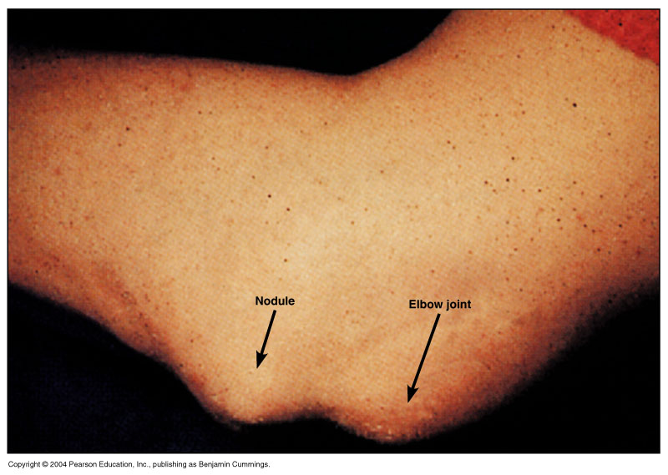
Subcutaneous Nodules
rare (≤1%
firm nodules
along the extensor surfaces of tendons near bony prominences
Corollates with significant rheumatic heart disease.

Slide 17
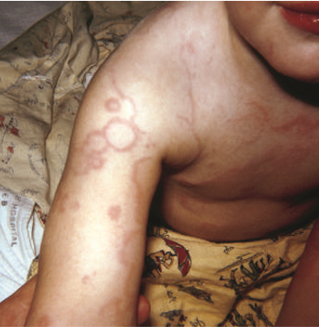
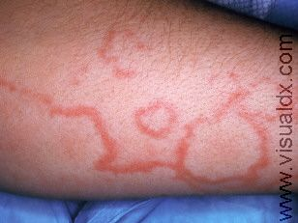
Erythema marginatum
On trunk and extremities, but not on the face
accentuated by warming the skin

Slide 18
Minor Criteria
Arhtralgia: (only if arthritis is not used as a major criterion)
Fever, more than 38.0°
elevated acute phase reactants
prolonged P-R interval on ECG (unless carditis is a major criterion)

Slide 19
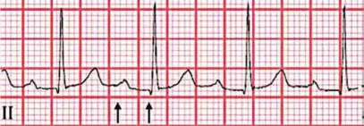
First-degree heart block with prolonged PR interval (interval between arrows), which may be present as a minor criterion for acute rheumatic fever.

Slide 20
Recent GAS Infection
Must have.
ARF devlpes 2-4 wk post GAS pharyngitis.
1/3 have no Hx of pharyngitis.
80-85% have high ASO.
95-100% have an elevation if 3 different antibodies (antistreptolysin O, anti–DNase B, antihyaluronidase)
Clinical findings of acute rheumatic fever generally coincide with peak antistreptococcal antibody responses.

Slide 21
DDX of arf
ARTHRITIS | CARDITIS | CHOREA
Juvenile idiopathic arthritis | Viral myocarditis | Huntington chorea
Reactive arthritis (e.g., Shigella, Salmonella, Yersinia) | Viral pericarditis | Wilson disease
Serum sickness | Infective endocarditis | SLE
Sickle cell disease Malignancy SLE Lyme disease (Borrelia burgdorferi) Pyogenic arthritis Post strep RA | Kawasaki disease Congenital heart disease Mitral valve prolapse Innocent murmurs | Cerebral palsy Tic disorder Hyperactivity

Slide 22
bed rest (esp if caditis present).
ABT:
  PCV V K 10 days.
  Or Amoxcillin oral for 10 days
  Or Benzathenine Penicillin G X 1 intramuscular
  If PCN allergic: erythromycin, azithromycin or clindamycin

Slide 23
Antiinflammatory Therapy
Early treatment may mask the disease.
Use Acetaminophen early if still unsure if DX.
Salicylates.:
  50-70 mg/kg/day QID PO X 3-5 days
  Then 50 mg/kg/day in 4 QID PO X 3 wk
  Then half that 2-4 wk
Corticosteroids. If Carditis present.
  prednisone is 2 mg/kg/day QID X 2-3 wk
  followed by half the dose for 2-3 wk
  then by 5 mg/24 hr every 2-3 days.
Repeat if ARF rebounded
Carditis Rx: Steroid, Digoxcin, fluid and salt restriction, diuretics, and oxygen
  .

Slide 24
Sydenham Chorea rx
Late: usually anti-inflammatory not needed.
Sedatives:
  phenobarbital, drug of choice
  Alternate choices: haloperidol or chlorpromazine
  Plus minus corticosteroids.

Slide 25
COMPLICATIONS
“Acute Rheumatic Fever licks the joints and bites the heart” (Laseque 1884)

Slide 26
PROGNOSIS
50-70% of carditis recover.
Worsoning carditis may occur in subsequent attacks.
ARF recurrence 50% risk with each GAS pharyngitis
ARF Recurrence is highest in the 1st 5 yr
20% of patients who present with “pure” chorea who are not given secondary prophylaxis develop rheumatic heart disease within 20 yr.

Slide 27
Prevention
primary prevention:
  DX and treat GAS pharyngitis X 10 days before ARF appears.
  Effective if PCN given in first 9 days of pharyngitis
secondary prevention:
  Maitance ABT since recurrence likely.
  Benzathine PCN G IM X 1 Q 4 weeks
  Or PCV V K PO
  Or Sulfa
  Macrolide if PCN allergic

Slide 28
Duration of Prophylaxis by AHA
CATEGORY | DURATION
Rheumatic fever without carditis | 5 yr or until 21 yr of age, whichever is longer
Rheumatic fever with carditis but without residual heart disease (no valvular disease) | 10 yr or until 21 yr of age, whichever is longer
Rheumatic fever with carditis and residual heart disease (persistent valvular disease) | 10 yr or until 40 yr of age, whichever is longer; sometimes

Slide 29
Endocarditis

Slide 30
WHO DEVELOPS PEDIATRIC ENDOCARDITIS?
Marked decline in Rheumatic HD
80-90% occur in congenital HD
  (VSD, PDA, TOF, aortic valve abnormalities; operated patients with S-P shunts, prosthetic material)
  Not ASD
Central venous catheters, pacemakers, IV drug users
10% in normal hearts
Highest risk: Aortic valve prosthesis or systemic-pulmonary shunt

Slide 31
Etiology
STREPTOCOCCI (~ 45%)
  Viridans 35%
  Enterococci ~ 5%
  S. pneumoniae, beta streptococci (GBS) - ~ 7%
STAPHYLOCOCCI: especially post-op, foreign body-associated or in normal hearts (~ 40%)
  S. aureus ~ 30%
  Coagulase-negative staph ~ 10%

Slide 32
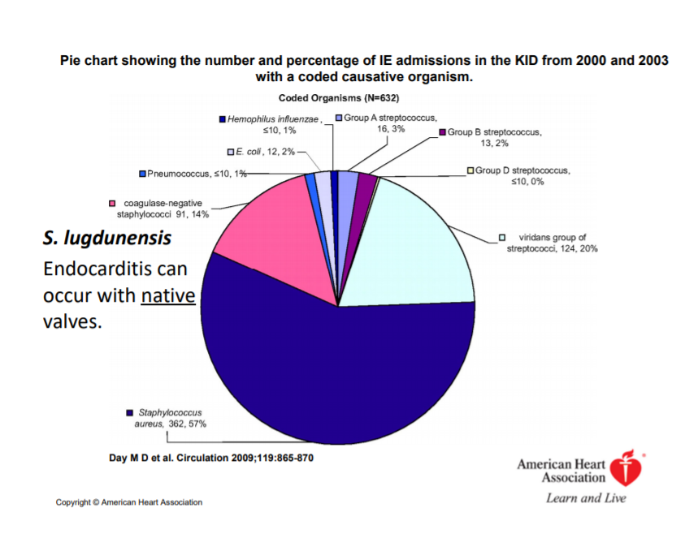

Slide 33
Etiology
HACEK group: ~ 5%:
  Haemophilus species, Actinobacillus actinomycetemcomitans, Cardiobacterium hominis, Eikenella corrodens, Kingella kingae
  fastidious Gram-negative coccobacilli
Others ~ 5-7%
  Fungi, especially Candida ~ 2-5%
  Gram-negative enterics ~ 3%
Culture-negative ~ 5%

Slide 34
INFECTIVE ENDOCARDITIS
Pathogenesis
Areas of turbulent flow (jet effect, eddies)
  Stenosis (valves, coarct)
  Small VSD
Endothelial disruption results (also occurs with indwelling line)
Sterile fibrin-platelet thrombus develops on the disrupted surface
Entrapment of bacteria from “stray bacteremia” initiates focus of infection; platelets and fibrin deposit to form vegetation. Receptors are involved (MSCRAMM’s).

Slide 35
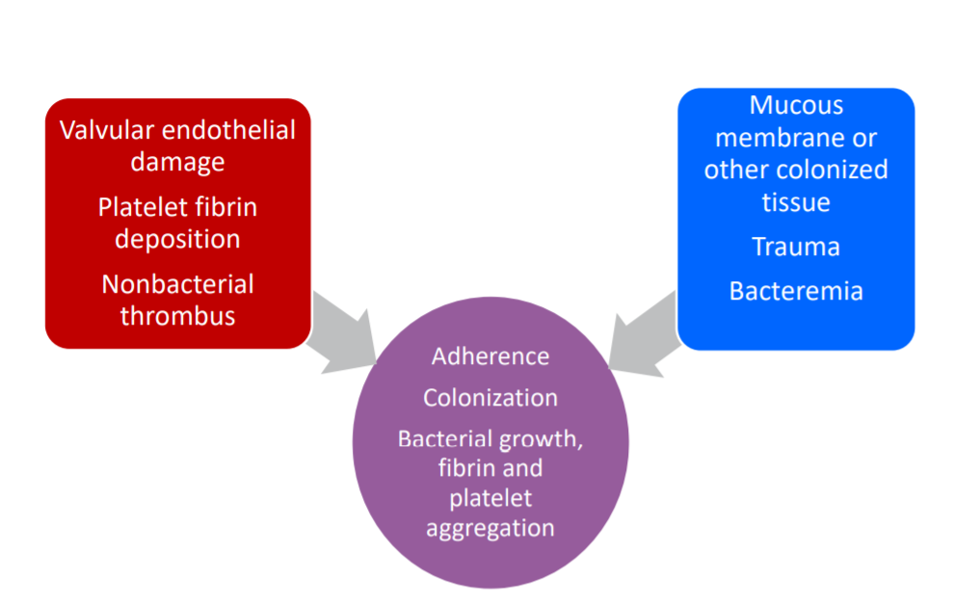
INFECTIVE ENDOCARDITIS
Pathogenesis

Slide 36
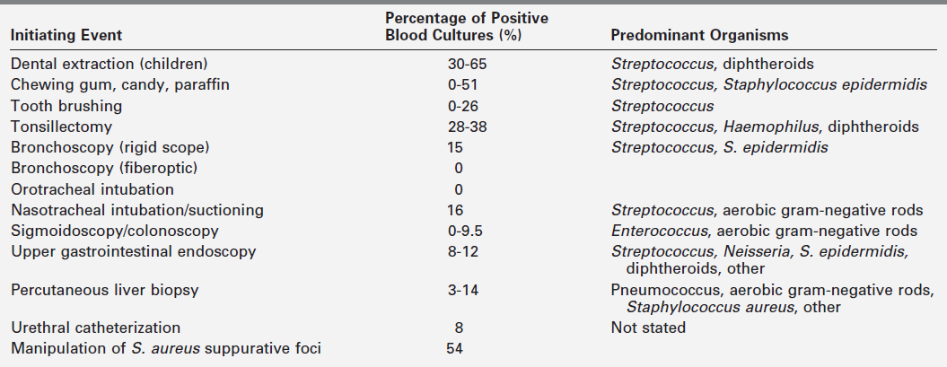
Asymptomatic bacteremia occurs in:
From Everett ED, Hirschmann JU. Transient bacteremia and endocarditis prophylaxis: a review. Medicine (Baltimore) 1977;56:61–77.
© 1977, The Williams & Wilkins Company, Baltimore.

Slide 37
INFECTIVE ENDOCARDITIS
Clinical Syndromes
Acute Presentation
  High fever, toxicity, ± CHF
  S. aureus most common; β strep, S. pneumoniae
  Early post-op; normal heart; indwelling lines
Subacute Presentation (more common)
  Insidious, non-toxic, malaise, immune phenomena
  Viridans strep most common pathogen
  Also fungal, HACEK agents, coagulase-negative staph
  Extracardiac manifestations are less common than in adults (splenomegaly, hematuria, immune phenomena)

Slide 38
C/P
Causes of the clinical picture and complications:
  Embolization
  Hear damage
  Circulating immune complexes

Slide 39
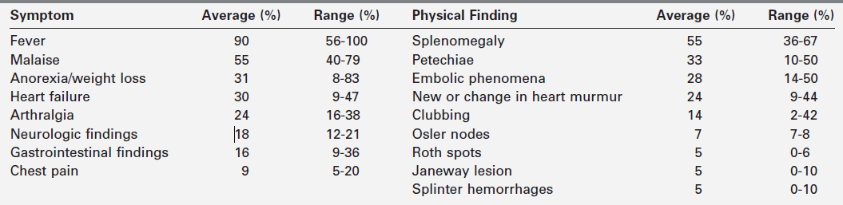
C/P

Slide 40
INFECTIVE ENDOCARDITIS
Evaluation
3 or more blood cultures (separate venipunctures) over 6-24 hours before therapy:
  Continuous bacteremia is the rule in endocarditis
Trans-thoracic Echo (~ 80% sensitive, higher than in adults)

Slide 41
INFECTIVE ENDOCARDITIS
Evaluation
Role of Trans-esophageal Echo (TEE) in kids is evolving:
  Better imaging of aortic root structures
  Superior in individuals with thick chest walls, obesity
  Superior with prosthetic valves
  Superior for vegetations, abscesses

Slide 42
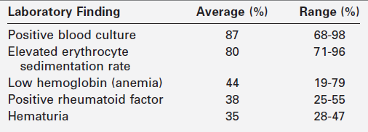
Selected Laboratory Findings of
Bacterial Endocarditis in Children

Slide 43
INFECTIVE ENDOCARDITIS
Diagnostic Criteria
Duke Criteria:
    Definite IE: Pathologic evidence, or 2 majors, or 1 major and 3 minors, or 5 minors
    Possible IE: 1 major and 1 or 2 minors, or 3-4 minors alone
    Rejected: Firm alternate diagnosis; or resolution of illness or absence of evidence of IE at surgery or autopsy after ≤ 4 days of antibiotics

Slide 44
INFECTIVE ENDOCARDITIS
Revised Duke Criteria (2000)
MAJOR CRITERIA
  Positive blood cultures
    Typical IE organism from ≥ 2 cultures or
    Persistently positive cultures (≥ 2 BC at least 12 hr apart or all of 3 or majority of ≥ 4 BC at least 1 hr apart)
    Single positive for C. burnetii or IgG > 1:800
  Evidence of endocardial involvement
    Positive echocardiogram or
    New valvar regurgitation

Slide 45
INFECTIVE ENDOCARDITIS
Revised Duke Criteria (Cont.)
MINOR CRITERIA
  Predisposing heart disease or IVDA
  Fever 38° C
  Vascular phenomena (Janeway lesions, emboli, conjunctival hemorrhages, mycotic aneurysms, strokes)
  Immunologic phenomena (nephritis, Osler nodes, Roth spots, rheumatoid factor)
  Positive blood cultures not meeting major criterion

Slide 46
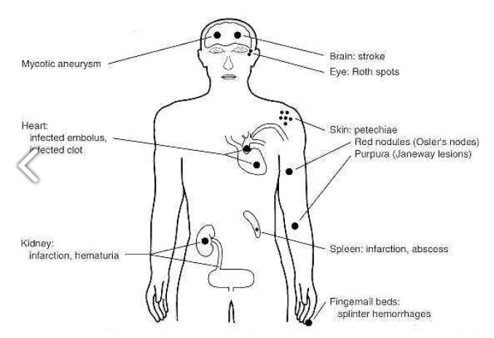

Slide 47
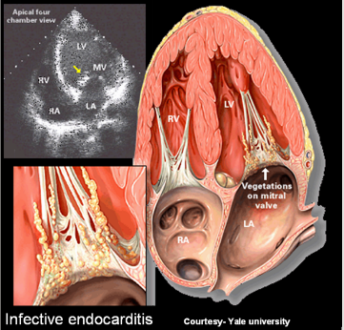

Slide 48
Vascular phenomena
  Janeway lesions
  Emboli
  Conjunctival hemorrhages
  Mycotic aneurysms
  Strokes

Slide 49
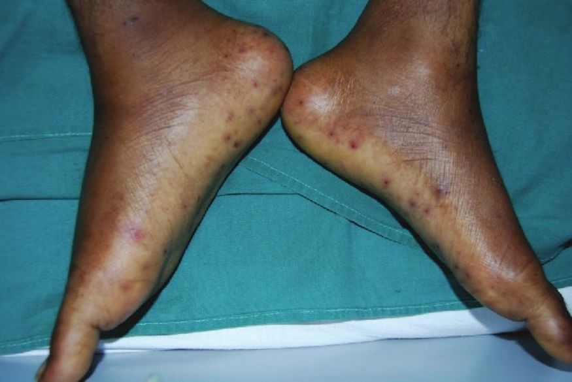
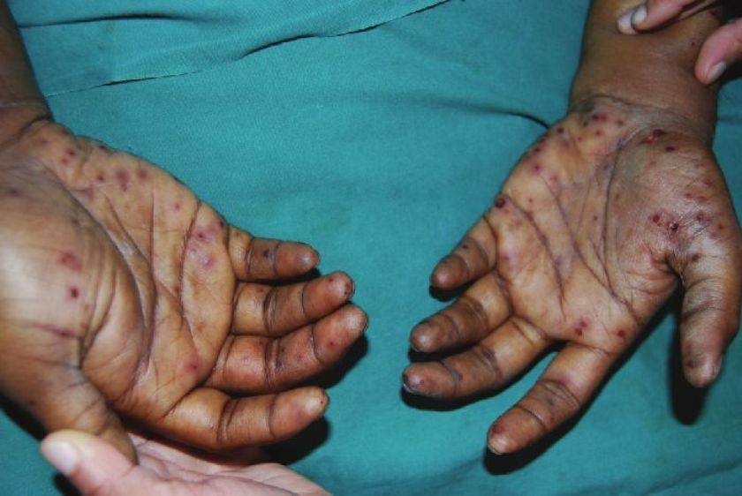
Janeway lesions
painless small erythematous or hemorrhagic lesions on the palms and soles

Slide 50
Immunologic phenomena
  Nephritis
  Osler nodes
  Roth spots
  Rheumatoid factor
  Splinter hemorrhages

Slide 51
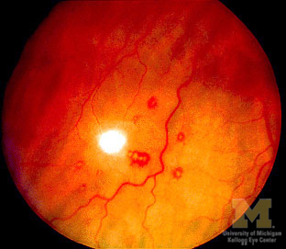
  Roth Spots
"white-centered" hemorrhages
not specific for endocarditis

Slide 52
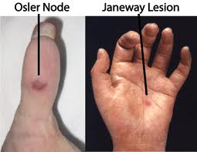
Osler Nodes
Osler nodes :tender, pea-sized intradermal nodules in the pads of the fingers and toes

Slide 53
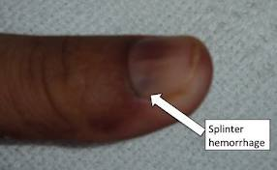
splinter hemorrhages
  linear lesions beneath the nails.
may present vasculitis produced by circulating antigen-antibody complexes..

Slide 54
INFECTIVE ENDOCARDITIS
Treatment I
PROLONGED
PARENTERAL
BACTERICIDAL ANTIBIOTICS

Slide 55
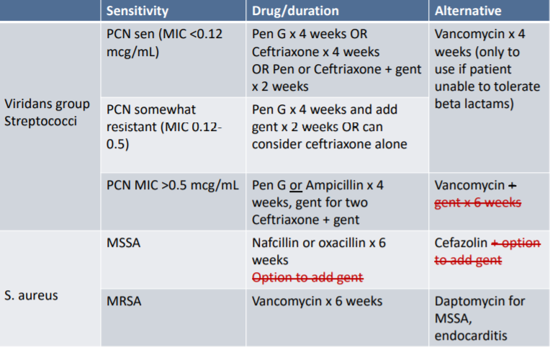
RX in native valve IE

Slide 56
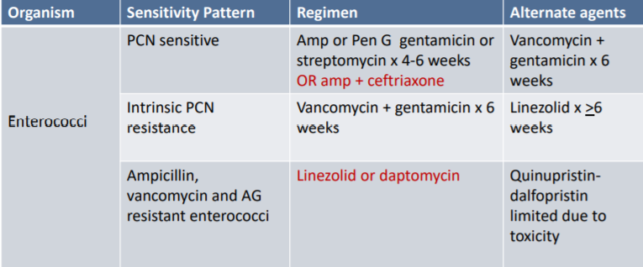
RX in native valve IE

Slide 57
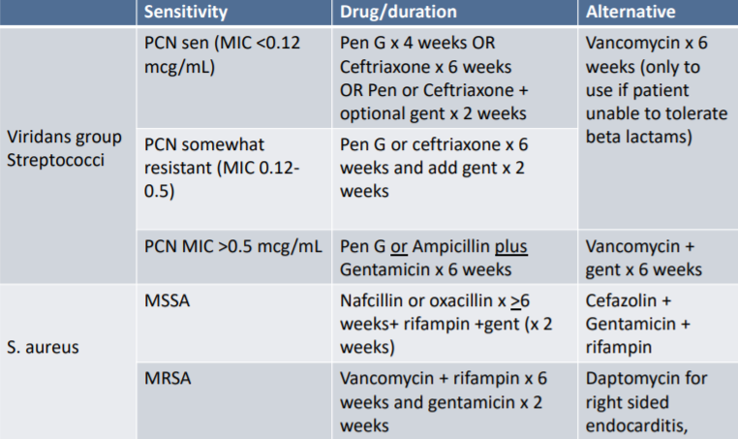
RX in posthetic valve IE

Slide 58
INFECTIVE ENDOCARDITIS
Treatment II
HACEK Agents
  Ceftriaxone 4 weeks, or Ampicillin and Gentamicin 4 weeks

Slide 59
“CULTURE - NEGATIVE”
ENDOCARDITIS INCLUDES
Partially treated endocarditis
Nutritionally deficient streptococci
Fungal endocarditis
Q fever (rare) Chlamydia
Bartonella quintana
Rx: 4-6 weeks of amp-sulbactam or vancomycin and gentamicin, possibly with cipro. Ceftriaxone and gentamicin ± doxycycline if Bartonella suspected

Slide 60
HIGH RISK FOR COMPLICATIONS
Prosthetic valve IE
Left-sided IE
Staphylococcus aureus IE
Fungal IE
Previous episode of IE
Prolonged symptoms (≥3 months)
Cyanotic CHD
Systemic-pulmonary shunts
Poor clinical response to antibiotics

Slide 61
PREVENTION OF IE
Maintain good oral hygiene
Antibiotic prophylaxis now recommended only for dental procedures in those with:
  Prosthetic valve
  History of previous IE
  Congenital heart disease
    Unrepaired cyanotic CHD
    Repaired CHD in 1st 6 months after repair
    Repaired CHD with residual defect
  Heart transplant with valve dysfunction
Wilson: Circulation 2007; 115

Slide 62
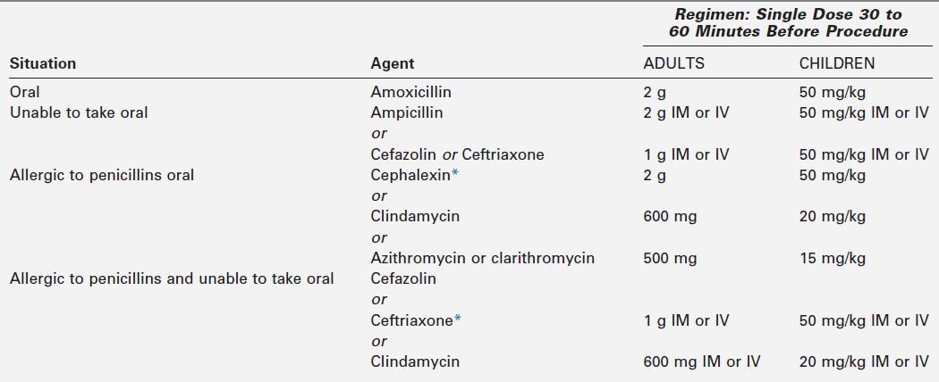
Endocarditis Prophylaxis Regimens for a Dental Procedure
Wilson W, Taubert KA, Gewitz M, et al. Prevention of infective endocarditis: guidelines from the American Heart Association.
Circulation 2007;116:1736–54.

Slide 63


