Slide 1
Connective tissue diseases
Dr. Dhikra Nabil

Slide 2
Connective tissues
Two proteins:
Collagen: tendons, ligaments, skin, cornea, cartilage, bone, and blood vessels.
Elastin: ligaments and skin

Slide 3
Connective tissue diseases
Rheumatoid Arthritis(RA)
Scleroderma
Granuolomatosis with polyangiitis
Chrug- Strauss syndrome
Systemic Lupus Erythematosus (SLE)
Microscopic polyangiitis(MPA)
Polymyositis/ dermatomyositis
Mixed Connective Tissue Disease (MCTD)
Undifferentiated connective tissue diseases

Slide 4
Causes
Genetics
Environmental

Slide 5
Arthritis
Swelling or effusion, or presence of two of the following:
  Limitation of range of motion
  Tenderness or pain of motion
  Increased heat in the joint
A manifestation of several disorders

Slide 6
Review of system in the differential diagnosis of childhood joint pain and swelling
Dermatologic | SLE | Malar rash and hair loss
 | Dermatomyositis | Gottron's papules
 | Systemic JIA | Evanescent pink macular rash
 | HSP | Lower extremity purpuric lesions

Slide 7
Ophthalmologic | Oligoarthritis or psoriatic JIA | Asymptomatic chronic anterior uveitis
 | Enthesitis related arthritis | Acute symptomatic uveitis (pain, redness)
 | Kawasaki disease | Conjunctival injection without discharge
 | Sjogren's syndrome | Dry eyes with keratitis
Oral | SLE | Painless oral ulcers on palate
 | Behcet Disease | Large extremely painful oral ulcers

Slide 8
Respiratory | CF or immunodeficiency | Recurrent pneumonia
 | Wegener's granulomatosis | Destructive upper tract lesions
 | SLE or systemic JIA | Pleuritis
 | SLE or scleroderma | Interstitial lung disease
 | Churg-Strauss syndrome | Eosinophilic pneumonia
Cardiovascular | ARF or endocarditis | New heart murmur
 | SLE, systemic JIA, or ARF | Pericarditis
 | SLE or scleroderma | Raynaud phenomenon
 | Takayasu arteritis | Absent pulses

Slide 9
Gastrointestinal | IBD, SLE, or vasculitis | Weight loss or poor growth
 | IBD | Diarrhea and abdominal pain
 | Reactive arthritis | Preceding infectious gastroenteritis
 | HSP | Intermittent colicky abdominal pain
Genitourinary | Gonococcal arthritis | Pustular urethritis or cervicitis
 | Reactive arthritis | Non-gonococcal urethritis
 | Behcet disease or IBD | Large painful genital ulcerations

Slide 10
Hematologic | SLE or hemoglobinopathy (eg, SCD) | Hemolytic anemia
 | SLE | Pancytopenia
 | Bleeding disorders | Hemarthrosis
Neurologic | SLE | Seizures and psychosis
 | SLE or fibromyalgia | Difficulty concentrating
 | SLE, vasculitis, or hypercoagulability | Stroke
 | Vasculitis | Asymmetric polyneuropathy
 | Dermatomyositis and polymyositis | Proximal muscle weakness

Slide 11
Classification of childhood arthritis
American College of Rheumatology ( ACR)
European League Against Rheumatism ( EULAR)
International League of Associations for Rheumatology ( ILAR)

Slide 12
Rheumatic diseases
defined by the constellation of results of the physical examination, autoimmune marker and other serologic tests, tissue pathology, and imaging.
-JIA
-SLE
- JUVENILE DERMATOMYOSITIS

Slide 13
Juvenile Idiopathic Arthritis (JIA)

Slide 14
Juvenile Idiopathic Arthritis (JIA)
Is a common, rheumatic disease of children and a major cause of chronic disability.
It is characterized by a synovitis of the peripheral joints manifesting in soft tissue swelling and effusion.

Slide 15
JIA classification
Systemic onset JIA (SoJIA)
  arthritis with fever and rash.
Oligoarthritis
  < 5 joints in the first 6 months of illness.
  Polyarthritis
    > 4 joints in the first 6 months of illness.

Slide 16
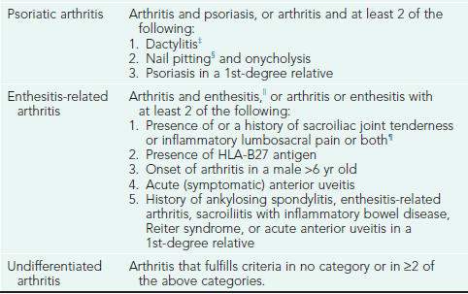

Slide 17
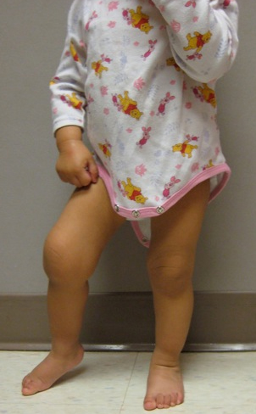
Eighteen-month-old girl with arthritis in her right knee. Note the flexion contracture of that knee.

Slide 18
Criteria for the Classification of Juvenile Rheumatoid Arthritis
Age at onset: <16 yr
Arthritis (swelling or effusion, or the presence of 2 or more of the following signs: limitation of range of motion, tenderness or pain on motion, increased heat) in ≥1 joints
Duration of disease: ≥ 6 wk
Onset type defined by type of articular involvement in the 1st 6 mo after onset:
Polyarthritis: ≥5 inflamed joints
Oligoarthritis: ≤4 inflamed joints
Systemic disease: arthritis with a characteristic intermittent fever
Exclusion of other forms of juvenile arthritis

Slide 19
ETIOLOGY.
Unknown etiology
Autoimmune disease AND Genetic susceptabilty factors
Environmental (infection,trauma,and stress).
Possible external triggers include viruses (parvovirus B19, rubella, Epstein-Barr virus),
Host hyperreactivity to specific self antigens (type II collagen), and enhanced T-cell reactivity to bacterial or mycobacterial heat shock proteins.

Slide 20
EPIDEMIOLOGY.
Describe in all races and geographical areas
The incidence of JRA is ≈13.9/100,000 children/yr among white children ≤15 yr of age, with a prevalence of ≈113/100,000 children.
Female predominance 2:1

Slide 21
CLINICAL MANIFESTATIONS
Initial symptoms
  subtle or acute
  morning stiffness
  easy fatigability, particularly after school in the early afternoon
  joint pain
  joint swelling
  Joint stiffness
  limp
  Restriction of movement
  Eye symptoms
  Systemic manifestation .

Slide 22
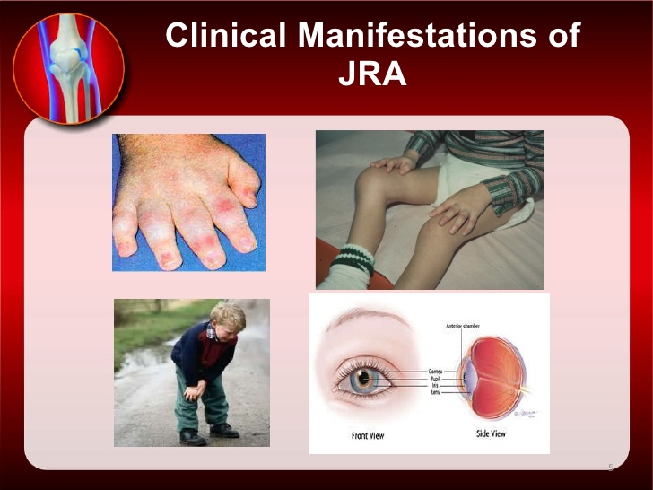

Slide 23
Oligoarthritis (pauciarticular disease)
Persistent vs. extended
predominantly affects the joints of the lower extremities, such as the knees and ankles .
Isolated involvement of upper extremity large joints is not characteristic of this type of onset.
Involvement of the hip is almost never a presenting sign of JRA.

Slide 24
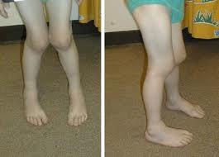

Slide 25
Polyarthritis
is generally characterized by involvement of both large and small joints of both upper and lower extremities .
As many as 20–40 joints may be affected in the more severely involved child, although inflammation of only ≥5 joints is required as a criterion for classification of this type of onset.
Rheumatoid factor (+ve / –ve)

Slide 26
Rheumatoid nodules on the extensor surfaces of the elbows and over the Achilles tendons, while unusual, are associated with a more severe course
Micrognathia reflects chronic temporomandibular joint disease.
Cervical spine involvement of the apophyseal joints occurs frequently with a risk of atlantoaxial subluxation and potential neurologic sequelae.

Slide 27
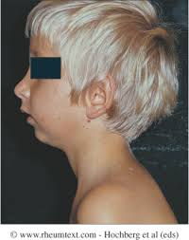
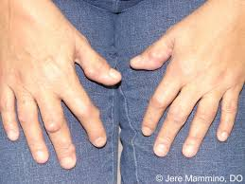
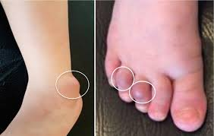
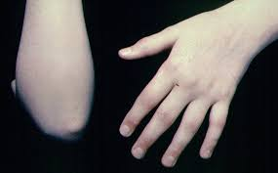

Slide 28
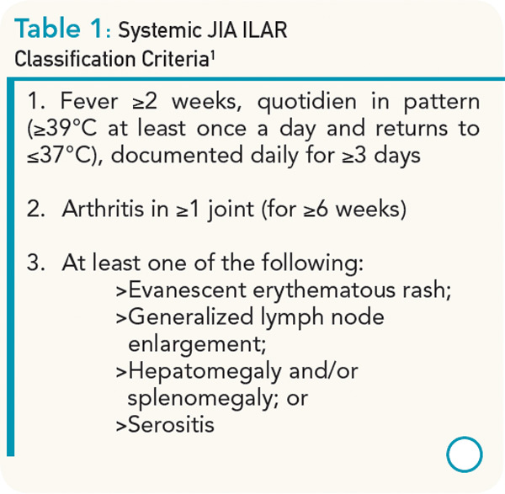

Slide 29
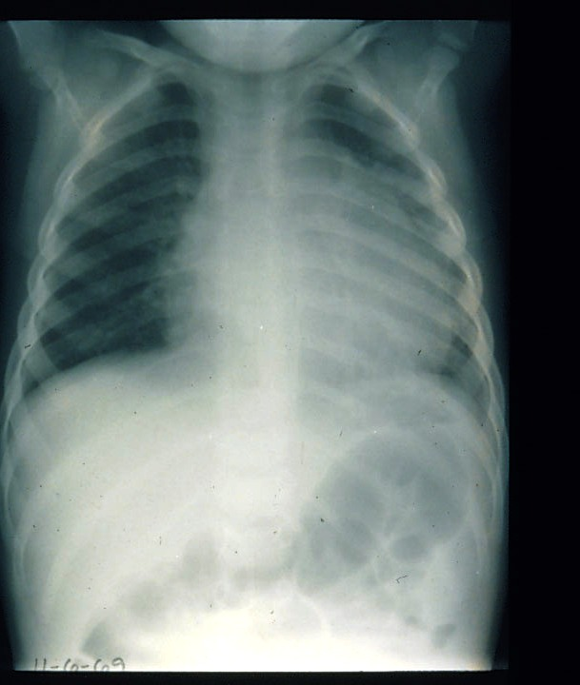
Child with pericardial effusion due to systemic onset juvenile idiopathic arthritis (JIA).
serositis (pericarditis)

Slide 30
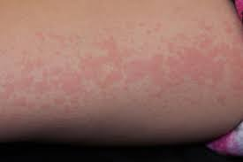
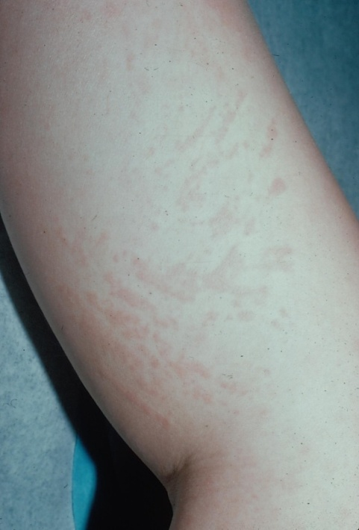
Systemic juvenile idiopathic arthritis (JIA) rash
Salmon-colored, erythomatous non pruritic macules

Slide 31
DIAGNOSIS
Based on a history compatible with inflammatory joint disease and a physical examination that confirms the presence of arthritis
No one pathognomonic finding
The classic intermittent fever , the typical rash and objective arthritis highly suggestive of systemic-onset JRA.

Slide 32
Laboratory abnormalities
  elevated erythrocyte sedimentation rate (ESR) and C-reactive protein (CRP),
  leukocytosis,
  thrombocytosis,
  anemia of chronic disease.
  anti-cyclic citrullinated peptide (CCP) antibody has very high specificity for rheumatoid arthritis may detected before RF (poor prognosis)
  Carriage of HLA27 antigen is associated with increased risk of developing enthesitis –associated arthritis
  ANA is associated with increased risk of iridocyclitis in pt with oligoarthritis
  RF is positive only in 5% of pt when polyarticular disease occur after 8 yrs of age

Slide 33
 | Systemic onset JIA | Pauciarticular onset JIA | Polyarticular onset JIA
Percent of JIA patients | 10 to 15 | 50 | 30 to 40
Sex | F = M | F > M | F > M
Age | any <17 years | peak 2 to 3 years, rare >10 | peaks 2 to 5, 10 to 14 years
Joints | any | large joints, but rarely hips | any, rare to start in hip
Fever, rash, lymphadenopathy, hepatosplenomegaly | yes | no | no
Uveitis | rare | 20 percent, esp ANA + | less frequent

Slide 34
 | Systemic onset JIA | Pauciarticular onset JIA | Polyarticular onset JIA
Laboratory abnormalities
- Leukocytosis | marked | no | no
- Anemia | marked | no | mild
- Elevated ESR | marked | mild | mild
- ANA | absent | low titer common | low titer common in younger
- Rheumatoid factor | rare | absent | 10 to 20 percent in those >10 years
Destructive arthritis | >50 percent | rare | >50 percent
Disease modifying drugs | commonly used | rarely used | commonly used

Slide 35
Differential diagnosis of joint pain or swelling in children
Trauma
Irritable hip and transient synovitis
septic arthritis and osteomyelitis,
Infection: bacterial ,viral ,Lyme disease
Hematologic: leukemia ,bleeding diatheses, and hemoglobinopathies
Tumor: Musculoskeletal neoplasia (eg, osteosarcoma), lymphoma, and neuroblastoma
Leg-Calve- Perthes disease
Slipped capital femoral epiphysis
Diagnosis of JIA requires the exclusion of all the above diagnoses.

Slide 36
Management
Remissions and relapses
No cure but treatable
Relieve pain ,reduce inflammation ,preserve joint function ,maintain normal growth and development

Slide 37
Management
Screen for uveites by periodic slit-lamp ophthalmologic examinations of all patients
Require multidisciplinary team (MDT) approach
  dietary evaluation and counseling to ensure appropriate calcium, vitamin D, protein, caloric intake;
  physical and occupational therapy.
  A social worker

Slide 38
Medical management
    Nonsteroidal anti-inflammatory drugs (NSAIDs) : Ibuprofen ,Naproxen ,Piroxicam
    Disease modifying anti rheumatic drugs (DMAR)
      Under supervision of rheumatologist
      methotrexate the safest, most efficacious, and least toxic given once weekly
      azathioprine and cyclophosphamide, are reserved for the few children who do not respond to less aggressive therapy.
    Joints steroid injections
    Corticosteroid : oral or IV methyleprednisolone
      Toxicity :-
        Cushing syndrome, growth retardation, and osteopenia
    TNF-α blockers :block the immune protein TNF etanercept infliximab

Slide 39
Systemic Lupus Erythematosus (SLE) in children

Slide 40
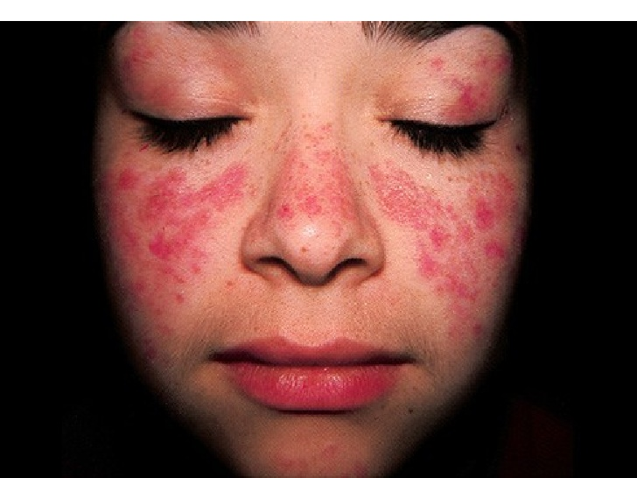

Slide 41
Systemic lupus erythematosus (SLE) in children is fundamentally the same disease as in adults with similar etiology, pathogenesis, clinical manifestations, and laboratory findings.
However, the care of children and adolescents with SLE is very different from that of adults because of the impact of the disease and its therapy on physical and psychological growth and development.

Slide 42
Systemic lupus erythematosis
A chronic inflammatory multi-systemic autoimmune disease characterized by widespread inflammation of blood vessel and connective tissue
The primary pathology is of persistent polyclonal B-cell stimulation resulting in autoantibody production with wide spread tissue antibody production ,with the widespread tissue deposition of immune complex

Slide 43
The pathogenesis of SLE remains largely unknown, but several genetics, hormonal and environmental factors.
Prevalence of SLE in children and adolescents (1-6/100,000) .
More among African-Americans, Asians, Hispanics, Native Americans, and Pacific Islanders for both adult and pediatric populations.
SLE predominantly affects females

Slide 44
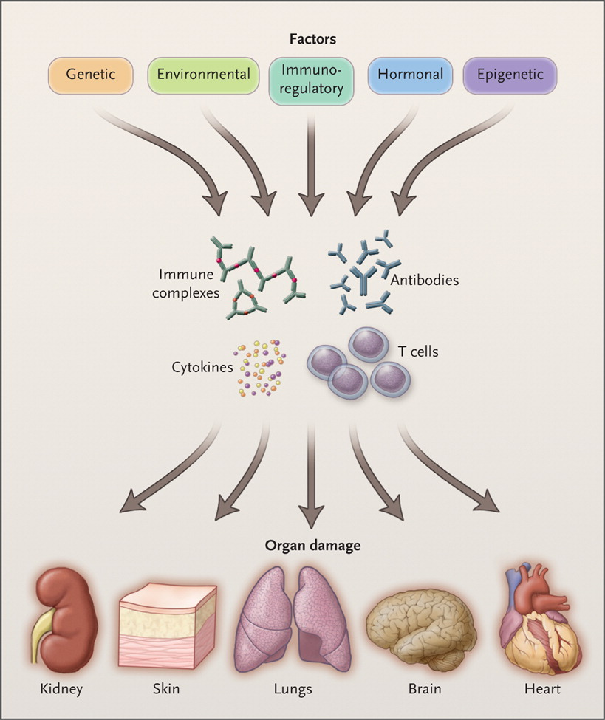

Tsokos GC. N Engl J Med 2011;365:2110-2121.
Overview of the Pathogenesis of Systemic Lupus Erythematosus.
Notes:
Figure 1. Overview of the Pathogenesis of Systemic Lupus Erythematosus. Genetic, environmental, hormonal, epigenetic, and immunoregulatory factors act either sequentially or simultaneously on the immune system. The action of pathogenic factors results in the generation of autoantibodies, immune complexes, autoreactive or inflammatory T cells, and inflammatory cytokines that may initiate and amplify inflammation and damage to various organs. The target organ affected may be further damaged by local factors.

Slide 45
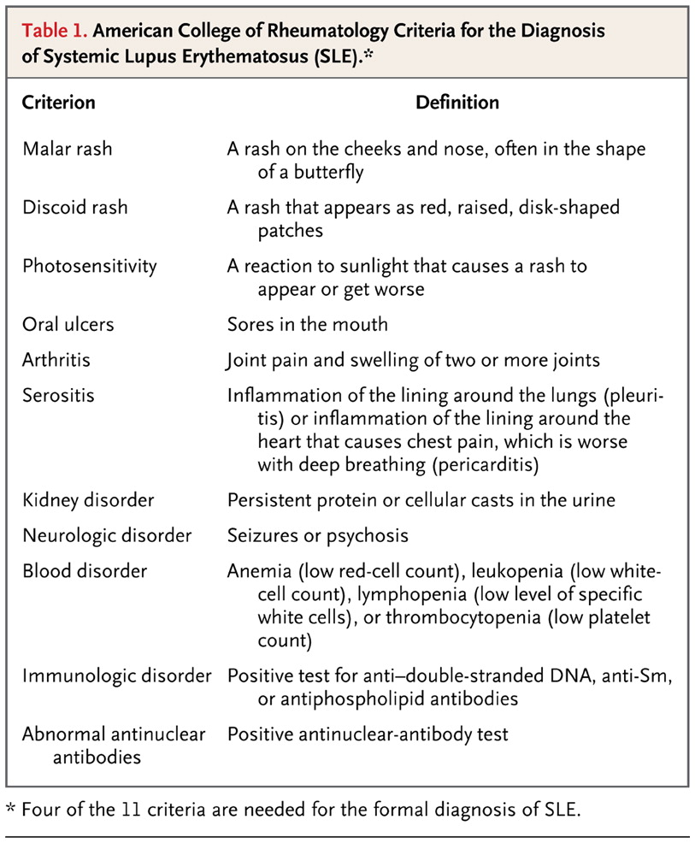
Tsokos GC. N Engl J Med 2011;365:2110-2121.
American College of Rheumatology Criteria for the Diagnosis of Systemic Lupus Erythematosus (SLE).

Slide 46
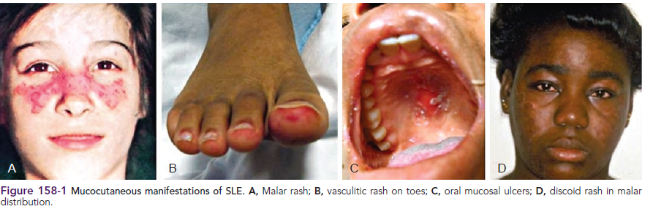

Slide 47
Signs and symptoms
The disease can affect a wide range of organ systems
Generalized symptoms such as fever , weight loss , and malaise are common
Other common signs and symptoms include fever ,anorexia ,Raynauds phenomenon , vasculitis , chorea, neuropathy, depression, and cognitive changes

Slide 48
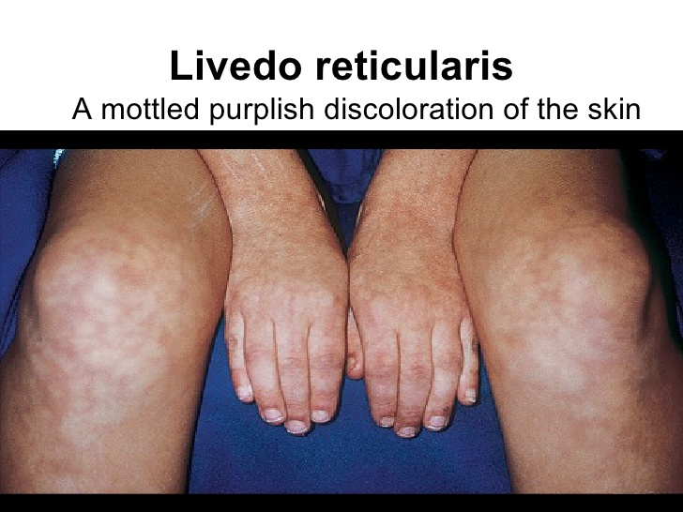

Slide 49
Laboratory findings
Complete blood counts
  Leukopenia ,anemia ,thrombocytopenia
15% coombs test- positive
ESR frequently elevated
CRP with active SLE is normal but elevated may be due to infectious causes especially bacterial infection
Urine analysis for proteinuria and hematuria

Slide 50
Laboratory findings
Complements :- C3& C4 are frequently reduced due to increased consumption
ANA is positive in 95-100% of patients usually at titer 1:320 or above
Anti double -strand DNA sensitive and specific , raised particularly in lupus nephritis
Anti-smith antibody are specific for lupus and are related to CNS involvement, positive in only 30% ,lack sensitivity as diagnostic test
Antiphospholipid antibodies found in approximately 50-60% of pediatric SLE patients , increase risk of thrombosis
Anticardiolipin antibodies are detected in up to 50% of children with lupus ,associated with episode of arterial and venous thrombosis

Slide 51
Autoantibodies Found in Systemic Lupus Erythematosus Antibody Manifestation
Coombs antibodies : Hemolytic anemia
Antiphospholipid antibodies :Antiphospholipid antibody syndrome : Lupus anticoagulant ,Coagulopathy
Antithyroid antibodies : Hypothyroidism
Antiribosomal P antibody : Lupus cerebritis

Slide 52
Treatment
Mild SLE:
  NSAID
  Hydroxychloroquine
Moderate SLE
  High-dose glucocorticoids
  Mycophenolate mofetil
Sever SLE
  Cyclophosphamide
  Prednisone

Slide 53
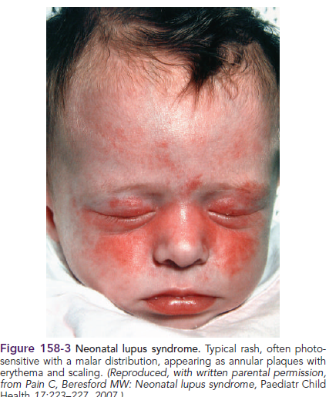
Neonatal lupus

Slide 54
Results from the passive transfer of maternal immunoglobulin G autoantibodies to the fetus.
The vast majority of are associated with maternal anti-Ro and anti-La antibodies

Slide 55
Clinical manifestations of neonatal lupus
Characteristic annular or macular rash typically affecting the face (especially the periorbital area), trunk, and scalp
Typically appears within the 1st 6 wk of life after exposure to ultraviolet light and lasts 3-4 mo.
Infants may also have cytopenias and hepatitis,
Congenital heart block is the most feared complication.
Conduction system abnormalities range from prolongation of the PR interval to complete heart block, with development of progressive cardiomyopathy

Slide 56
Course and prognosis
Cutaneous and hematological manifestations are reversible
Congenital heart block is permanent
Hepatic fibrosis is occasional
Some risk of SLE in teenage or adult year

Slide 57
Management:
Symptomatic for transient manifestations
Heart block may need pace maker

Slide 58
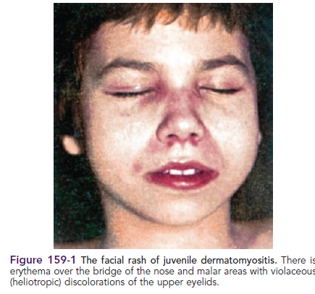
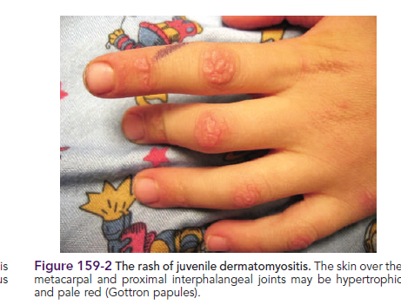
Juvenile dermatomyositis (JDM)and Polymyositis

Slide 59
Non –suppurative myositis with characteristic skin rash and vasculitis
Girls more than boys
Peak incidence 4-10 yrs of age
juvenile polymyositis involves direct T-cell invasion of muscle fibers similar to that seen in adult polymyositis ,accounts 3-6% of cases.

Slide 60
CLASSIFICATION AND DIAGNOSTIC CRITERIA
Classic rash plus 3 of the following:
Weakness
Muscle enzyme elevation
Electromyographic changes
Muscle biopsy

Slide 61
CLASSIFICATION AND DIAGNOSTIC CRITERIA
Characteristic cutaneous changes :-
  heliotrope dermatitis (reddish-purple rash on the upper eyelids with periorbital edema) and
  Gottron's papules (erythematous, papulosquamous eruption over the dorsal surfaces of the knuckles)
Symmetrical weakness of the proximal muscles

Slide 62
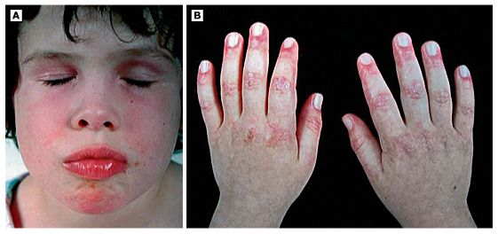
Clinical images of typical juvenile dermatomyositis
A) Heliotrope discoloration of the eyelids, and malar or facial erythema and
(B) scaly, red rash on the knuckles with Gottron's papules.

Slide 63
Elevation of the serum level of one of the muscle enzymes
  Creatine kinase (CK)
  Lactate dehydrogenase (LDH)
  AST
  Aldolase
ANA positive in some
Electromyography: useful to distinguish myopathic from neuropathic causes of muscle weakness (myopathy vs. denervation)

Slide 64
Muscle biopsy
Is indicated in cases of myositis without the pathognomonic rash.
Muscle biopsy displaying fiber necrosis and inflammation, small vessel occlusive vasculitis

Slide 65
Magnetic resonance imaging
MRI scan of quadriceps muscle can be used in equivocal cases to confirm the presence of inflammatory myositis

Slide 66
Treatment
Suppression of inflammatory response and prevention of the loss of muscle function and joint range of motion
Assessment of the ventilatory effort and swallowing
Corticosteroids prednisone or pulse methylprednisolone
Methotrexate
In severe cases cyclosporine or cyclophosphamide
For skin manifestation :Hydroxychloroquine and intravenous immunoglobulin

Slide 67
Prognosis
Variable
Usually good with adequate treatment
Recurrent rate 10-20%
Small percent develop extensive muscle wasting ,severe contracture and wide spread calcinosis
Dermatomyositis in children is not associated with increase risk of cancer as in adult

Slide 68
Familial Mediterranean Fever
FMF

Slide 69
FMF
Autosomal recessive.
Brief acute self-limited episodes of fever and polyserositis.
Have irregular intervals.
Associated with the development of amyloidosis.

Slide 70
Etiology
Responsible gene: on short arm of chr. 16p13.3( MEFV)
More than 70 mutations, the most common ones:
  M694V (20-67% of cases, full penetrance, if homozygous; more sever and higher risk of amyloidosis))
  V726A (7-35%, milder disease, less amyloidosis)
  M694I
  M680I
  E148Q( low penetrance, very mild)

Slide 71
Epidemilogy
Primarily among ethnic groups of Mediterranean origin (Sephardic Jews, Turks ,Armenians, Arabs)
The carrier frequency is estimated to be 1 in 5 persons
Onset : 65% before 5 years, 90% before 20 years, may present as early as 6 months of age

Slide 72
Pathogenesis
The exact pathogenesis of acute episodes is unknown.
FMF mutations lead to a gain-of-function and IL-1B-dependent inflammation, with a gene dosage effect.
These results explains why:
  many heterozygous carriers of FMF mutations have biochemical evidence of inflammation
  As many as 30% of symptomatic FMF patients have only one demonstrable mutation
  IL-1 inhibitors have a therapeutic effect in FMF

Slide 73
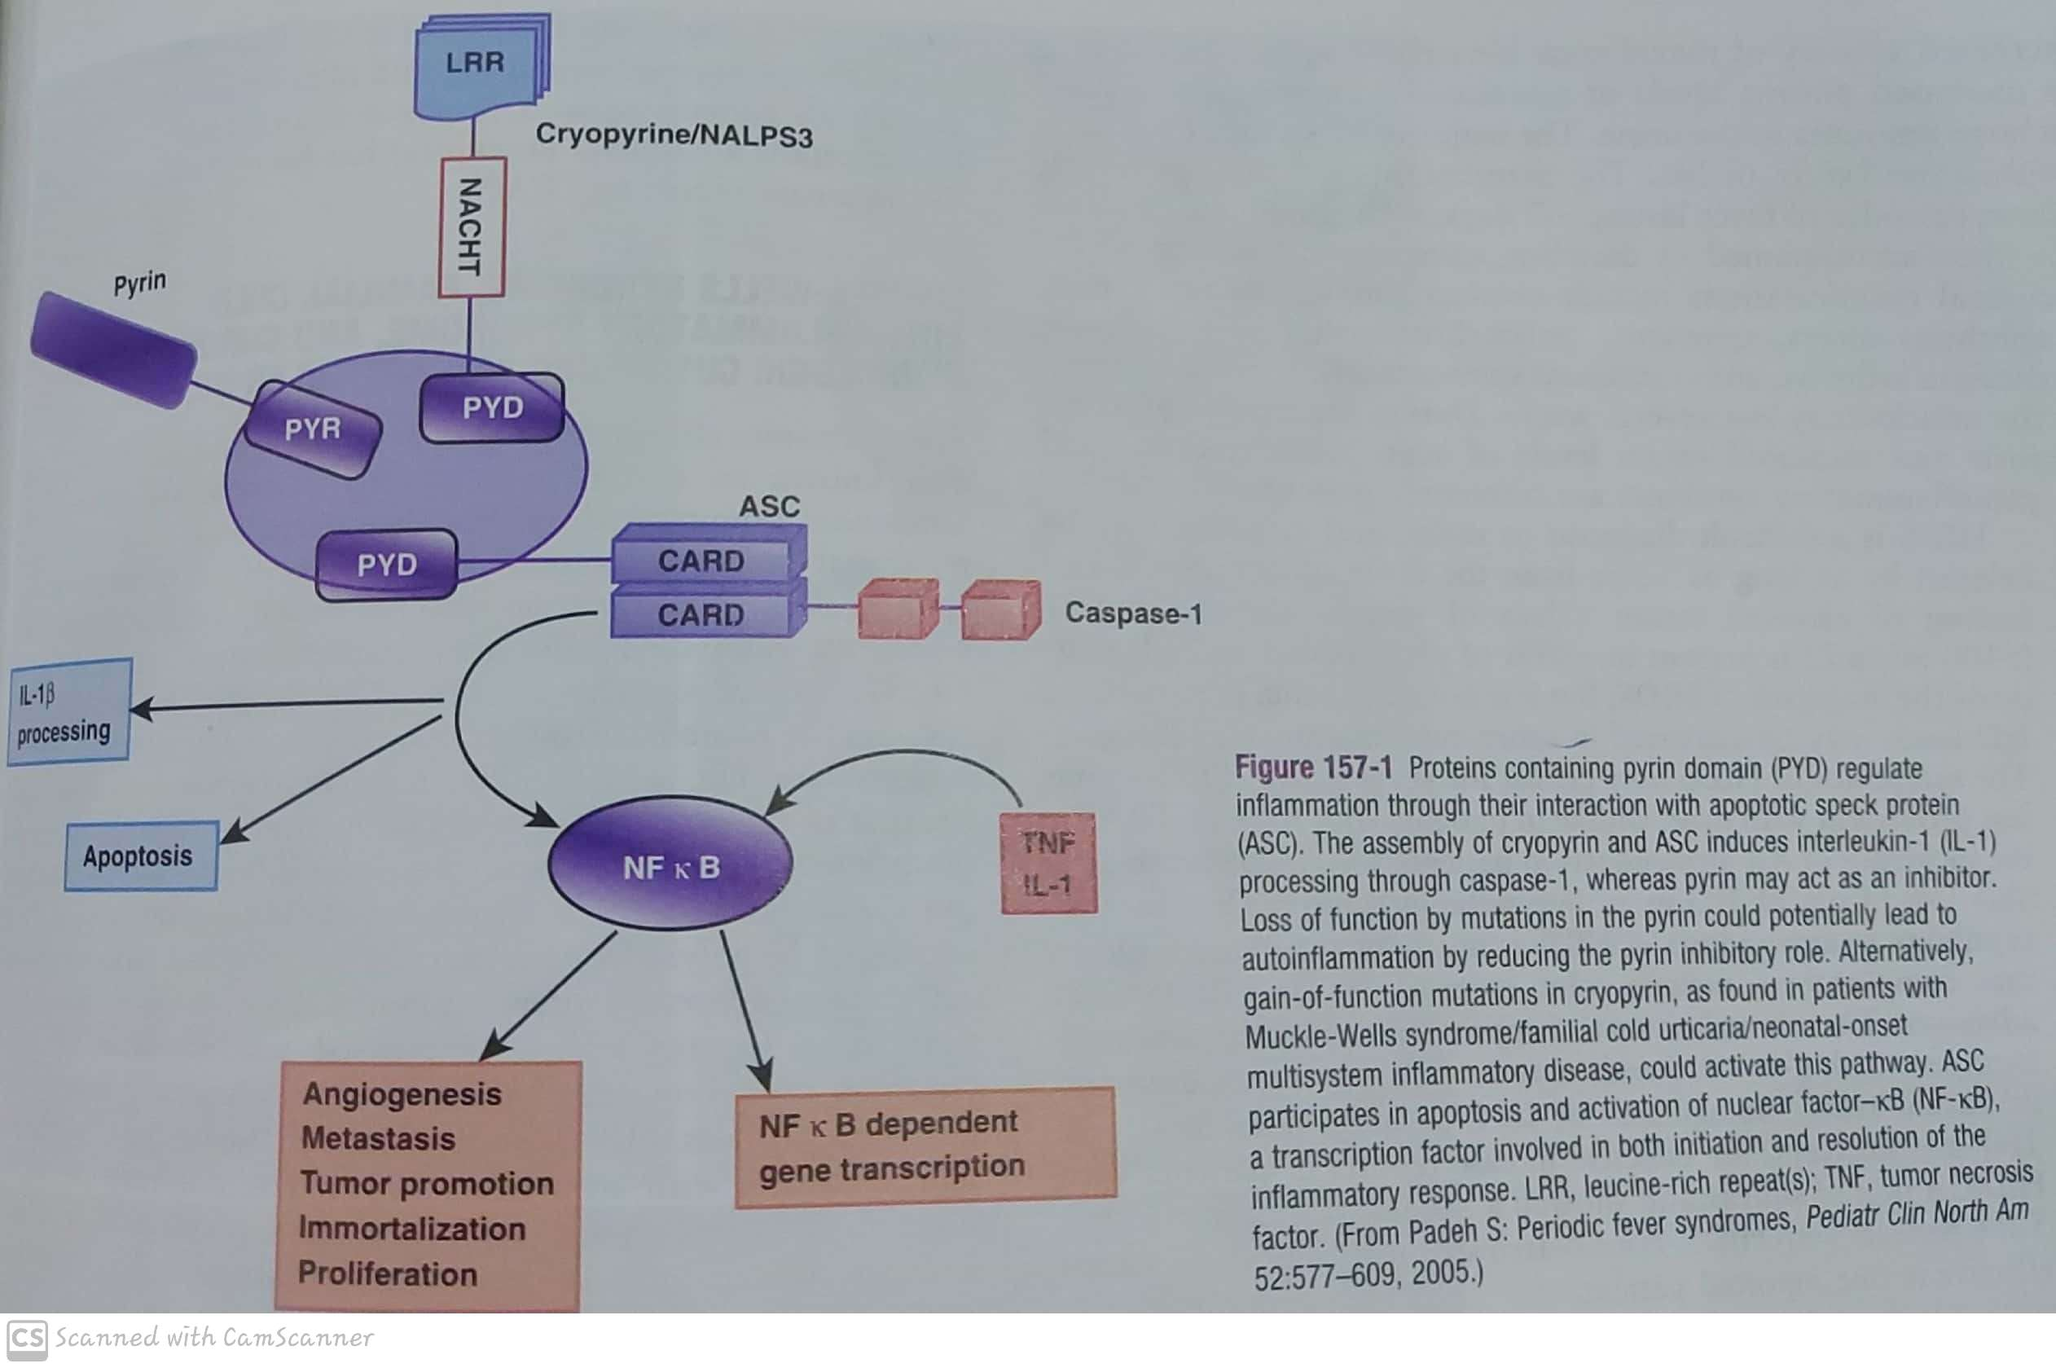

Slide 74
Clinical manifestations
fever plus 1 or more:
Pleuritic chest pain, sterile peritonitis ;sever abdominal pain), arthritis , rash.
  Pleural pain20%: typically unilateral
  Abdominal pain 90%: generalized or localized to one quadrant
  Arthritis or arthralgia 85% : in large joints, large neutrophil-rich effusion, nonerosive, nondestructive
  Erysipeloid erythematous rash overlies the ankles and dorsum of foot

Slide 75
Other clinical findings(Rare)
Scrotal pain; inflammation of tunica vaginalis testis( acute scrotum)
Pericaditis
Febrile myalgia
Exercise-induced myalgia (common in children)
Association with other forms of vasculitis( ex. HSP 5% of pediatric cases)
Splenomegaly
Neurological involvement

Slide 76
FMF episodes
May be triggered by menses, stress, infections, surgery
Acute episodes last 1-4 days
Between flares: symptom-free with persistent elevation of inflammatory markers
Attack frequency :from weekly to 1-2 flares/year

Slide 77
Diagnosis
Clinical manifestations plus genetic testing
Clinically:
  Duration, recurrence, documentation of fever, characteristic serositis, synovitis, erysipeloid rash, responsiveness to daily colchicine prophylaxis, absence of other causative factor.
Genetic testing is diagnostic

Slide 78
Treatment
Attacks can be prevented by prophylaxis daily oral colchicine
20-30 % shows improvement( decrease number and severity of attacks)
5-10% no response
Biological treatment: like IL-1 inhibitor Anakinra is good for cases not responding to colchicine

Slide 79
Colchicine
Reduce the frequency of acute attack
Decrease development of amyloidosis
May produce partial regression in amyloidosis
Untreated amyloidosis will end in renal failure within 3-5 years
GI side effects reduce the compliance
Toxic effect: Acute myopathy, BM hypoplasia
Safe during pregnancy to mother and fetus, and during lactation
No effect on male or female fertility

Slide 80
Complications and prognosis
Renal amyloidosis: 30-50% of children, 75% of adult
Manifestation of serum amyloidosis A (SAA):
  Proteinuria, nephrotic syndrome, renal failure.
  Transplantation may be required
Mortality from FMF usually results from the complications of renal failure and amyloidosis:
  Infections, thromboembolism, uremia.
Others: joint contracture, abdominal adhesion, impairments in social development.

Slide 81
Amyloidosis
Serum AA : acute phase reactant: deposit most commonly in : kidney, GI, lungs, spleen,, testes, thyroid. Adrenals.
Rarely cardiac amyloidosis may develop
Macroglossia and neuropathy NOT seen in amyloidosis of FMF
Diagnosis confirmed by rectal or renal biopsy
Might proceed overt FMF attacks, due subclinical manifestations

Slide 82
Amyloidosis
Risk factors:
Homozygousity of M694V
Polymorphism of serum AA gene
Non compliance with colchicine
Male gender
Positive FHX of AA amyloid
Country of origin

Slide 83
Kawasaki
Acute febrile illness of childhood
Leading cause of acquired hear disease in children in the developed countries
Vasculitis, coronary arteries

Slide 84
Etiology
Unknown
Epidemiologic and clinical features support the infection origin with a genetic role in the pathogenesis

Slide 85
Epidemiology
80% less than 5 years( median age 2-3 years)
More among patient of Asian and pacific islander background.

Slide 86
Pathology
Vasculitis of medium-sized arteries
Edema of endothelial and smooth muscle cells , with intense inflammatory infiltration of the vascular wall initially with PMN cells then by macrophages, lymphocytes( CD8+T cell), plasma cells.
IgA plasma cells prominent in inflammatory infiltrate
In sever vessels, all layers are affected with destruction of internal elastic lamina.
Weakness of vessel wall lead to the aneurysm
Thrombi may be formed and lead to blood flow obstruction
Arterial stenosis and occlusion occurs due to progressive vascular wall fibrosis

Slide 87
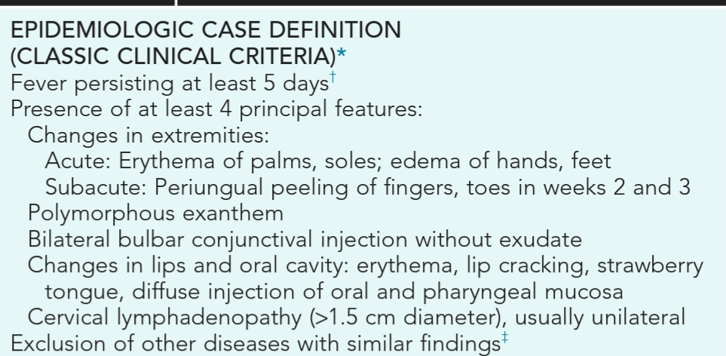
Clinical manifestation

Slide 88
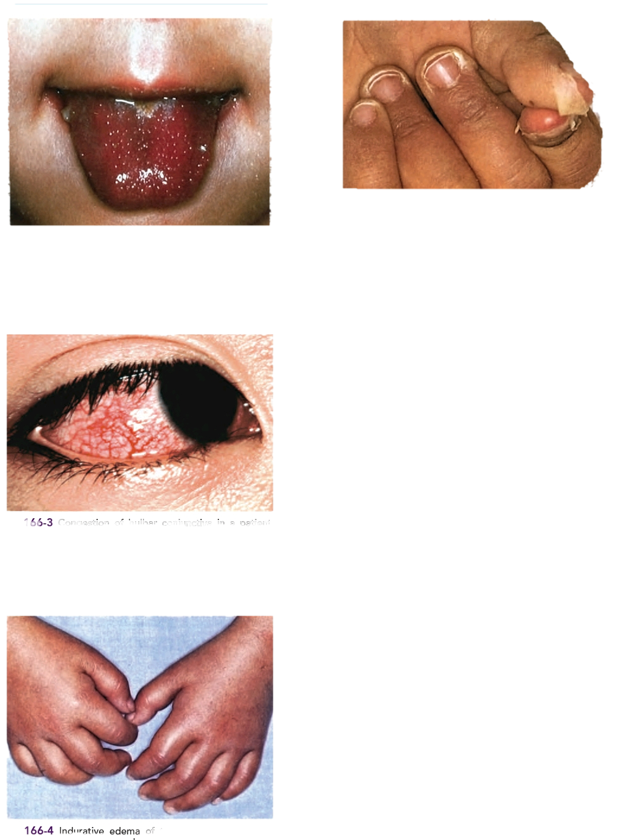

Slide 89
Other associated symptoms might occur 10 days prior to the diagnosis
Respiratory 30% or GI 65% symptoms
Irritability; reflect aseptic meningitis
Mild hepatitis
Hydrops gallbladder
Urethritis, meatitis with sterile pyurea
Arthritis, arthralgia

Slide 90
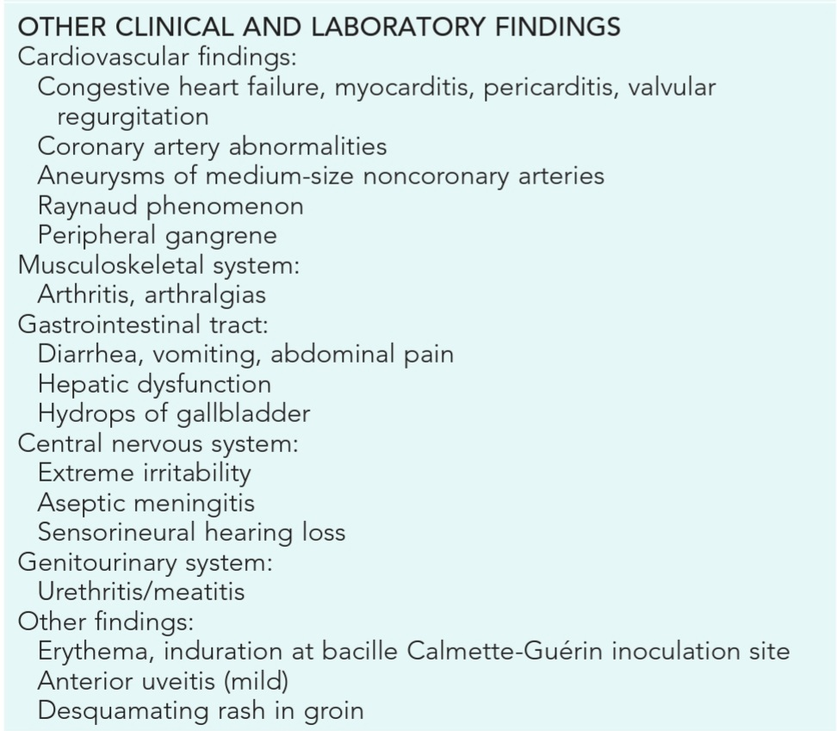

Slide 91
Cardiovascular involvement
Cardiac involvement is the most important manifestation
Tachycardia out of proportion to fever, with diminished left ventricular systolic function which rarely might lead to shock
Pericarditis with pericardial effusion can occur
Mitral regurge in 25% at presentation
Coronary artery aneurysm in 25% of untreated patient within 2-3 weeks
Aneurysm in other arteries (axillary, popliteal, iliac…)

Slide 92
Phases of Kawasaki disease
In the absence of treatment:
Acute febrile phase(1-2 wks):
Fever plus acute signs of the illness
Subacute phase(for 2 weeks):
Desquamation, thrombocytosis, coronary aneurysms
Highest risk of sudden death if aneurysms developed
Convalescent phase( 6-8 wks):
Begins when all clinical signs of KD disappeared
Continues untie ESR is normal

Slide 93
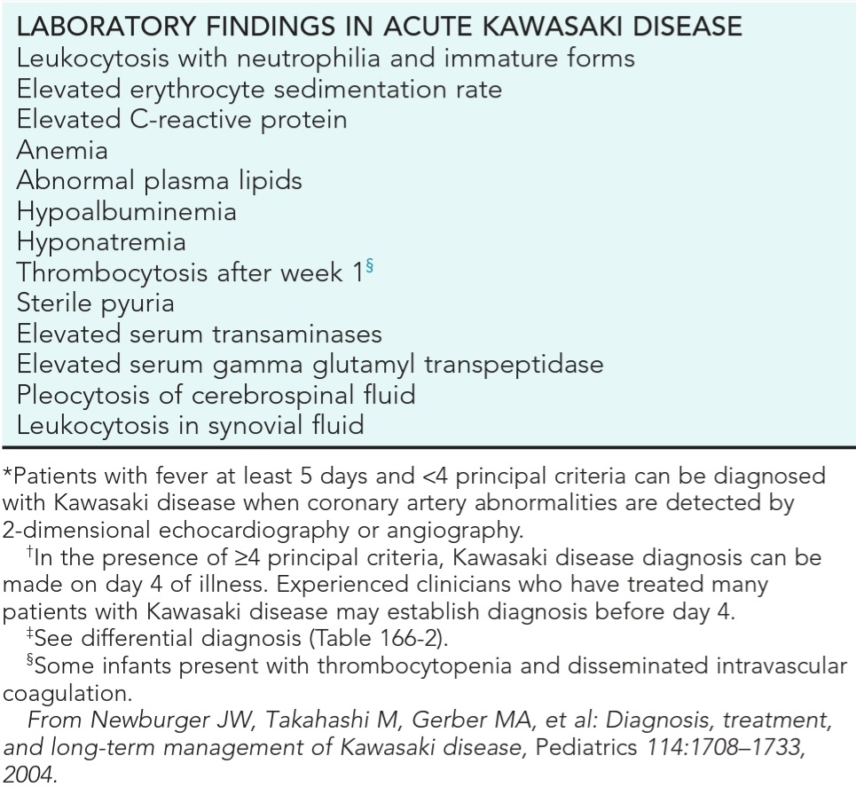

Slide 94
Echocardiogram
At diagnosis then after 2-3 weeks of illness
If normal, repeat 6-8 weeks after onset of illness
If abnormal echo or recurrent symptoms, more frequent echo needed
If no coronary abnormality, repeat echo and do lipid profile in 1 year, then cardiologic follow up every 5 years

Slide 95
Diagnosis
Classic KD: fever for at least 4 days and at least 4 of 5 of the other principle characteristics of the illness
Atypical or incomplete KD: persistent fever but with fewer than 4 of the characteristics
Incomplete cases high in infants and have higher risk to develop coronary artery abnormalities

Slide 96
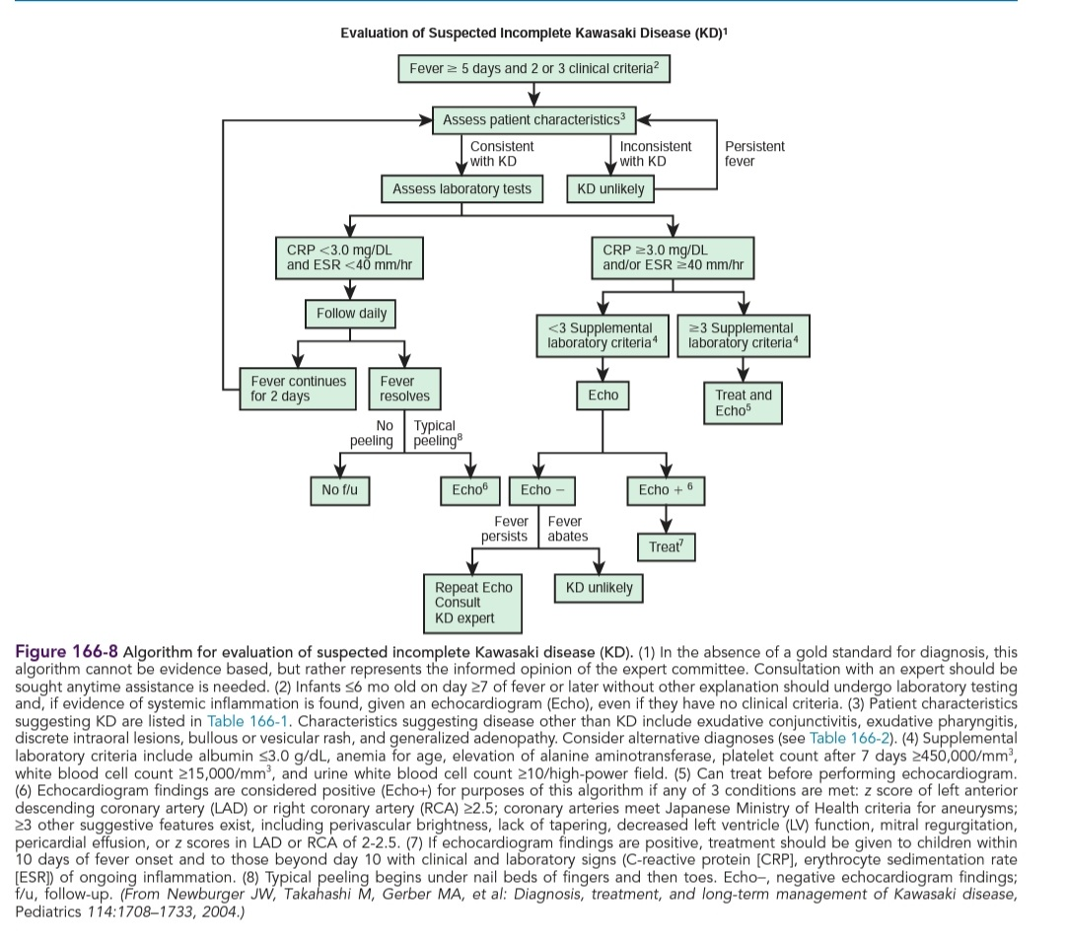

Slide 97
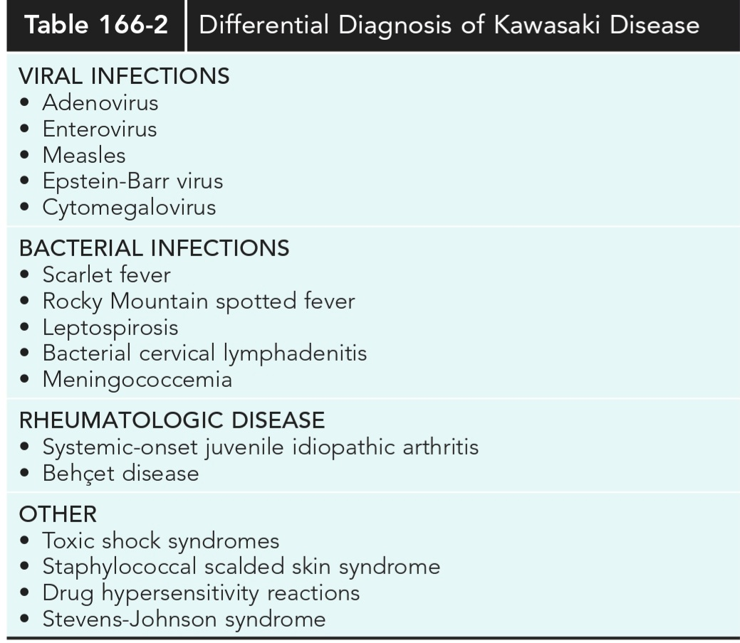

Slide 98
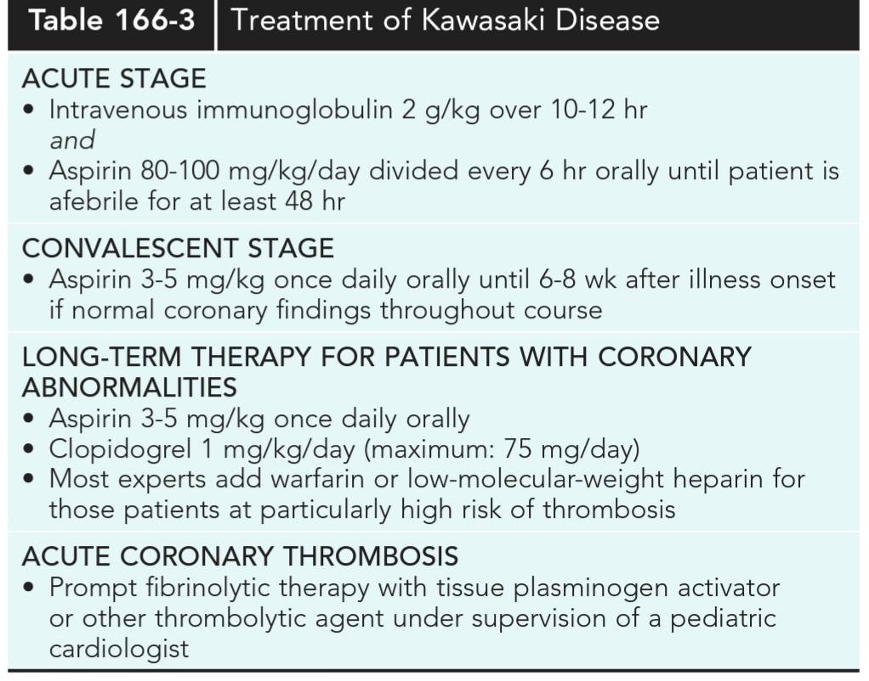
Treatment

Slide 99
Complications
Coronary artery aneurisms
Acute thrombosis
Reyes syndrome : patient should receive annual influenza vaccine
Delay in life-attenuated vaccines for 11 months, due IVIG interfere with immune response

Slide 100
Prognosis
Majority of cases return to normal health
Acute KD recurs in 1-3%
50% of coronary artery aneurysm regress to normal by 1-2 years, but thickness of myointimal wall and function might be affected.
Giant aneurysms: unlikely to resolve, lead to thrombosis and stenosis
Might need coronary artery bypass grafting or heart transplantation
Occurrence of atherosclerotic heart diseases in adulthood is unclear

Slide 101
THANK YOU

