Slide 1
Cyanotic Congenital Heart Diseases
Hamzeh Almomani, MBBS ,MSc
Assistant Professor- Pediatric Cardiology
The Hashemite University

Slide 2
Cyanosis – bluish discoloration of the skin and nail beds and mucus membranes appears when tissues are deprived of adequate amount of O2.
It becomes visible when hemoglobin, approximately 5 gms/dl circulates unbound to O2 and the measured O2 saturation drops below 85%

Slide 3
Cyanosis can occur when:
  Blood flow to the lungs is decreased or insufficient (ebstien anomalies , TA+restrictive VSD , PA +intact septum,…)
  Deoxygenated or desaturated blood is pumped to the body due to:
    Right to left shunting lesions when blood flow to the lungs is decreased and there is a communication between the intracardiac chambers or great vessels (ex. TOF).
    Mixing lesions where blood flow to the lungs is increased or normal and there is a connection between the great arteries (ex. Single ventricle without pulmonary stenosis or tricuspid atresia)
    Pulmonary hypertension or pulmonary vascular disease and a communication between the intracardiac chambers or great vessels (A-V CANAL with Eisenmerger’s complex)

Slide 4
Cyanotic heart disease
Decreased pulmonary blood flow-Oligemic lung: Tetralogy of fallot ,Tricuspid atresia, Pulmonary atresia, Ebsteins Anomaly
Increased pulmonary blood flow -Plethoric lung: Transposition of great vessels, Total Anomalous Pulmonary Venous return, Double outlet RV, truncus arteriosus ,Single ventricle

Slide 5
Clinical consequences of cyanosis
Polycythemia
Anemia
Clotting abnormalities
Hypercyanotic episodes or tet spells
CNS injury caused by abscess or embolic events.
Pulmonary hypertension
Endocarditis

Slide 6
Cardiac findings in cyanotic heart diseases
Tachypnea but usually without retraction
Lack of crackles or abnormal breath sounds unless congestive heart failure supervenes
Heart murmur that may be absent in serious forms of cyanotic heart defects
A continuous murmur (of patent ductus arteriosus) that may indicate restricted pulmonary blood flow through the ductus.
Chest x-ray films that may show cardiomegaly, abnormal cardiac silhouette, increased or decreased pulmonary vascular markings
Little or no increase in PO2 with oxygen administration

Slide 7
Congenital Cyanotic heart disease approach
Chest x-ray films. Chest x-ray films may reveal pulmonary causes of cyanosis and the urgency of the problem. They can also hint at the presence or absence of cardiac defects and the type of defect.
Arterial blood gases in room air. Arterial blood gases in room air confirm or reject central cyanosis. An elevated P CO2 suggests pulmonary or central nervous system problems. A low pH may be seen in sepsis, circulatory shock, or severe hypoxemia.
Hyperoxic test. Repeating arterial blood gases while the patient breathes 100% oxygen helps separate cardiac causes of cyanosis from pulmonary or central nervous system causes.

Slide 8
ECG if cardiac origin of cyanosis is suspected.
Umbilical artery line. A PO2 value in a preductal artery (such as the right radial artery) that is 10 to 15 mm Hg higher than that in a postductal artery (an umbilical artery line) suggests a right-to-left ductal shunt.
Prostaglandin E1 . If a cyanotic defect is suspected based on these laboratory tests, prostaglandin E 1 should be started or made available

Slide 9
CYANOTIC DISEASE
The 5 T’s of cyanotic heart disease
TOF(Tetralogy of fallot)
TGV(Transposition of great vessels)
Tricuspid atresia
Truncus arteriosus
Total anomalous of pulmonary venous drainage
Hypoplastic left heart syndrome
DORV
Pulmonary atresia
Ebstein anomaly, single ventricle

Slide 10
Tetralogy of Fallot
TOF is the most common cyanotic heart disease.
4 features
  VSD
  Overriding Aorta
  Infundibular Pulmonic Stenosis(more severe with advancing age with R to L shunt increase)
  RVH
Severity depend on PS.

Slide 13
Clinical features
Mild degree of RV out flow obstruction may present by congestive heart failure due to ventricular septal defect
By time RV hypertrophy increase and out flow become more narrow and cyanosis will appear in mucous membrane +lips + mouth +finger nails + toe nails
FTT +dyspnea
Hyper cyanotic spells after exercise/cry and squatting position.
Clubbing
Chronic hypoxia –Polycythemia -Thrombosis(CVA)
Infective endocarditis-Cerebral abscess -Hemiplegia

Slide 14
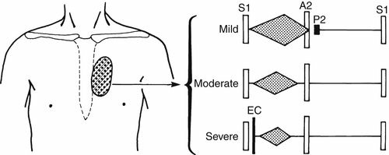
Long loud ejection systolic murmur(Due to PS)
  No PSM!
  During cyanotic episodes murmur is inaudible

Slide 15
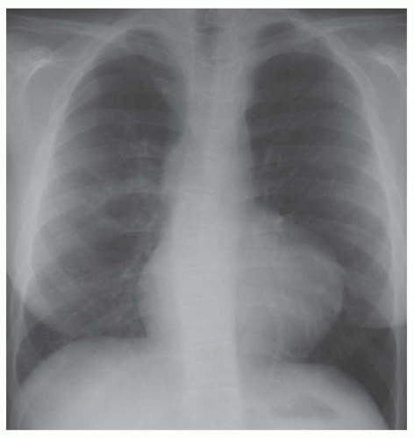
Chest X-Ray
Narrow base cardiac shape like wooden shoe
Large aorta
Oligemic lungs

Slide 16
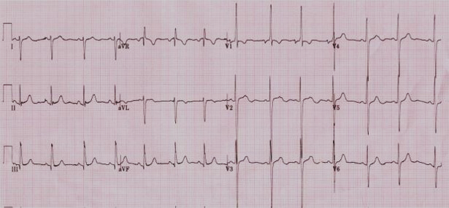
Right axis deviation.
RVH.
P wave …. tall or peaked or bifid .

Slide 17
TOF: Complications
Cerebral thrombosis due to polycythemia or dehydration
Brain abscess (headache+ nausea + vomiting +convulsion)
Bacterial endocarditis
Congestive heart failure 1st few months of life?

Slide 18
Paroxysmal Hypercyanotic Attacks
Known as hypoxic or TET spells
In 1st 2 ys of life
The child become hyperpnenic and restless -increased cyanosis -gasping –shock.
Most frequently in the morning or with vigorous crying
The murmur disappear due to diminished blood flow to the lungs
The spells lasts from few min to hours rarely fatal
  Short spells followed by generalized weakness and sleep
  Severe spells progress to unconsciousness convulsion +hemi paresis
Decrease in pulmonary blood flow will lead to hypoxia and acidosis

Slide 19
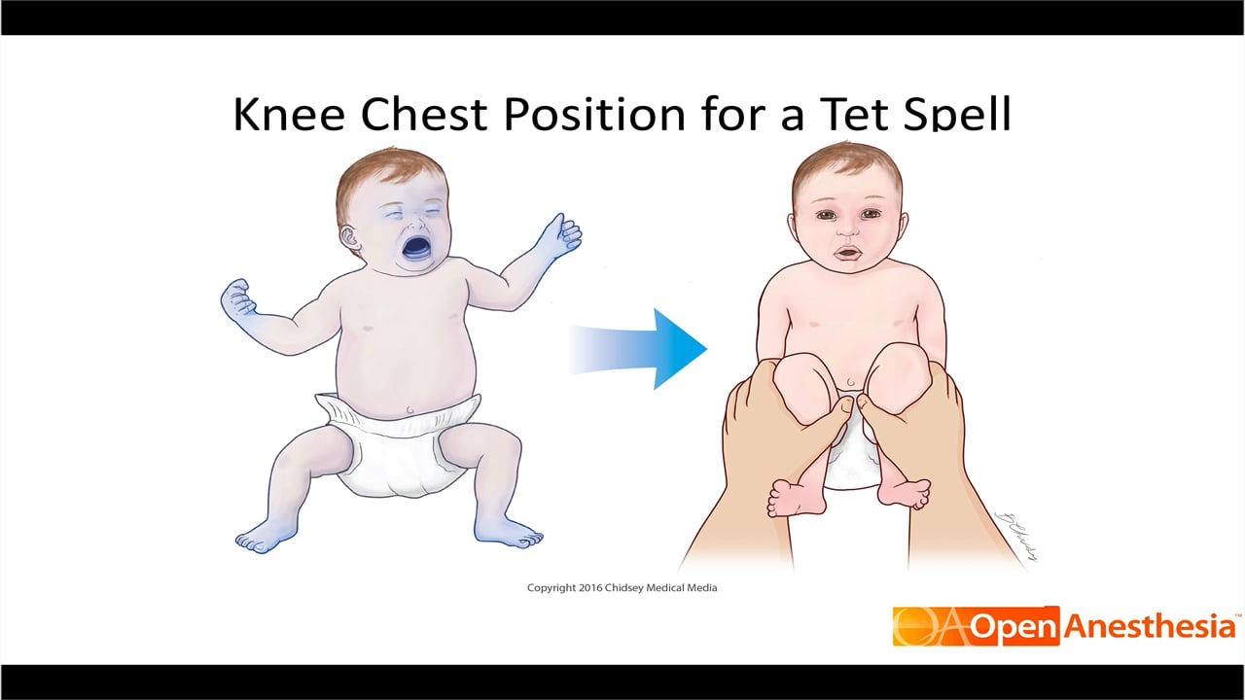
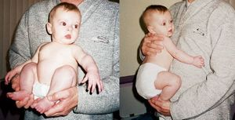
Management of Hypercyanotic Spell
Usually selflimiting
If prolonged need Rx
Calming the infant, placing the infant in the knee-chest position
Oxygen is usually administered, but it has little demonstrable effect on arterial oxygen saturation
Intravenous bolus of fluid

Slide 20
Management of Hypercyanotic Spell
Morphine sulfate, 0.2 mg/kg administered subcutaneously or intramuscularly, suppresses the respiratory center and abolishes hyperpnea.
Acidosis should be treated with sodium bicarbonate (NaHCO 3 ), 1 mEq/kg administered intravenously. The same dose can be repeated in 10 to 15 minutes.
  NaHCO3 reduces the respiratory center-stimulating effect of acidosis.
Propranolol, 0.01 to 0.25 mg/kg (average 0.05 mg/kg) administered by slow intravenous push, and causes relaxation of sub pulmonary infundibular area ,reduces the heart rate and may reverse the spell.

Slide 21
Management of Hypercyanotic Spell
Phenylephrine-Vasoconstrictor , 0.02 mg/kg administered intravenously, may be effective.
Ketamine, 1 to 3 mg/kg (average of 2 mg/kg) administered intravenously over 60 seconds, works well. It increases the systemic vascular resistance and sedates the infant.

Slide 22
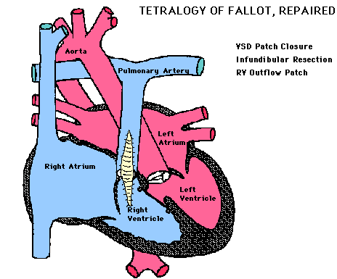
Surgical correction of TOF
In NB: PGE1 to keep the ducts open, it will cause relaxation of the smooth muscles of the ductus arteriosus.
Total surgical correction consists of two main steps: closure of the VSD with a patch and reconstruction of the right ventricular outflow tract.
TOF is typically treated by open heart surgery for total repair electively in the first year of life (the best time is Complete Repair at age of 4-6 months but depending on pulmonary artery anatomy and symptoms and size of the baby)

Slide 23
Surgical correction of TOF
    But needs to be planned fairly urgently In symptomatic patients showing :
        Worsening blood oxygen levels.
        Severe cyanotic spells
        Dependence on prostaglandins from early neonatal period to keep patency pf ductus arteriosus
  A two-stage repair (initial systemic to arterial shunt placement ( Blalock-Thomas-Taussig shunt surgery)) followed by total surgical repair) may be done in some cases

Slide 24
Tricuspid atresia

Slide 25
Incidence and Pathophysiology
It represents approximately 2%-3% of all CHDs.
It is the 3 rd most common cyanotic cardiac condition.
It is a complex lesion with many variations.
In this lesion:
  The tricuspid valve does not develop.
  An ASD or patent foramen ovale must be present for the fetus or infant to survive.
  The RV is hypoplastic (underdeveloped).

Slide 26
The VSD can be of varying size.
The pulmonary artery may be in the normal position or transpose with the aorta.
There may be pulmonary stenosis of varying degrees.
The Newborn may depend on the ductus arteriosus for pulmonary blood flow.

Slide 27
Tricuspid atresia is usually classified according to the presence or absence of PS and TGA.
The great arteries are normally related in about 70% of cases and are transposed in 30%.

Slide 28
CLINICAL MANIFESTATIONS
Cyanosis is usually severe from birth. Tachypnea and poor feeding usually manifest.
On Physical Examination :
  Cyanosis, either with or without clubbing, is always present.
  A systolic thrill is rarely palpable when associated with PS.
  Hepatomegaly may indicate an inadequate interatrial communication or CHF.

Slide 29
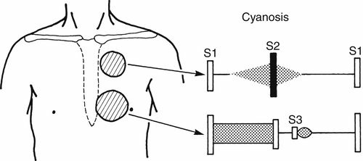
  Auscultation :
    The S2 is single.
    A grade 2-3/6 systolic murmur of VSD is usually present at the lower left sternal border.
    A continuous murmur of PDA is occasionally present.

Slide 30
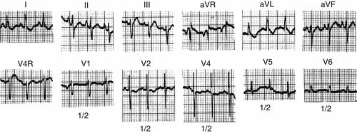
ECG Findings:
“Superior” QRS axis (between 0 and -90 degrees) is characteristic.
LVH is usually present;
RA dilatation or combined atrial Dilatation (CAH) is common.

Slide 32
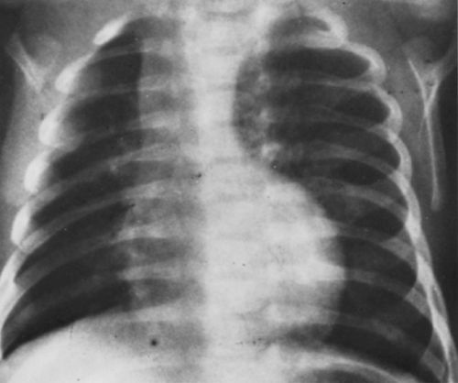
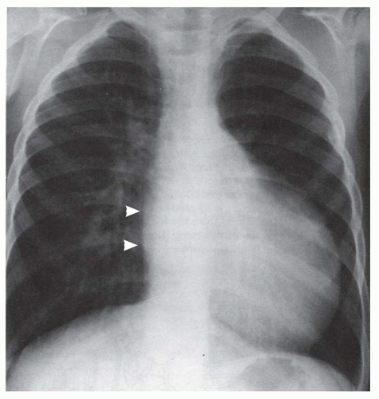
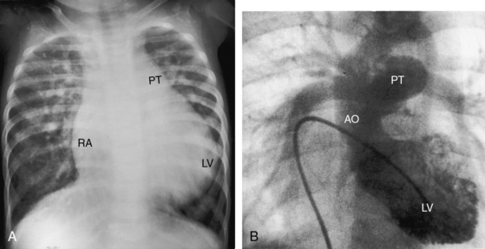
Chest X-ray findings:
The heart size is normal or slightly increased, with enlargement of the RA and LV.
Pulmonary vascularity decreases in most patients, although it may increase in infants with TGA.
Occasionally, the concave PA segment may produce a boot-shaped heart, like the x-ray findings of TOF.

Slide 34
Management of TA
Medical:
  Prostaglandin E1 should be started in neonates with severe cyanosis to maintain the patency of the ductus before planned cardiac catheterization or cardiac surgery.
SURGICAL- SINGLE VENTRICLE STAGED CORRECTION:
  Shunt or pulmonary bandage
  Bidirectional Glenn shunt
  The modified Fontan operation

Slide 35
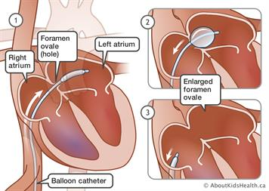
      The Rashkind procedure (balloon atrial septostomy) to improve the RA-to-LA shunt, especially when the interatrial communication is considered inadequate by echo studies.

Slide 36
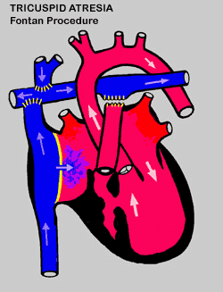
  Shunt or pulmonary bandage
  Bidirectional Glenn shunt:
      the creation of an anastomosis between the superior vena cava and the pulmonary arteries.
      Usually between 3 and 6 mo. of age.
      To reduces the volume load on the left ventricle and may decrease the chance of left ventricular dysfunction developing later in life.
  The modified Fontan operation
      Usually performed between 1.5 and 3 yr of age,
      Was performed by anastomosing the right atrium or atrial appendage directly to the pulmonary artery, and now is performed by anastomosing IVC to the pulmonary artery.

Slide 37
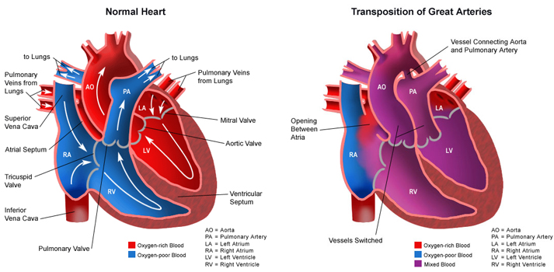
D-transposition of the Great Arteries

Slide 38
d-TGA
D-TGA occurs in about 5% of all congenital heart defects.
male-female ratio of 3:1
The most common cyanotic defect presents with cyanosis at neonatal period.
The degree of saturation will depend on the degree of mixing of the 2 “parallel” circuits.
The mixing sites are: ASD, PDA, and VSD.
The more mixing, the higher the “effective pulmonary blood flow”

Slide 39
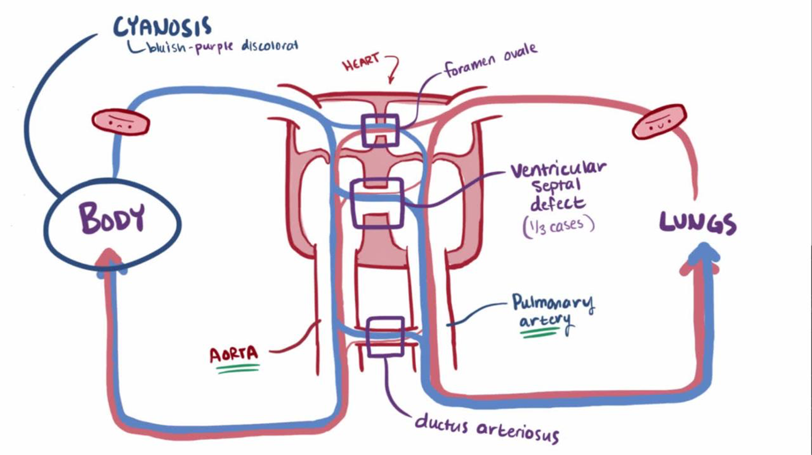
Ao is anterior, arises from right ventricle
PA posterior, arises from left ventricle
Systemic venous blood returns to RV and is ejected into aorta
Pulmonary venous blood returns to LV and is ejected into PA

Slide 40
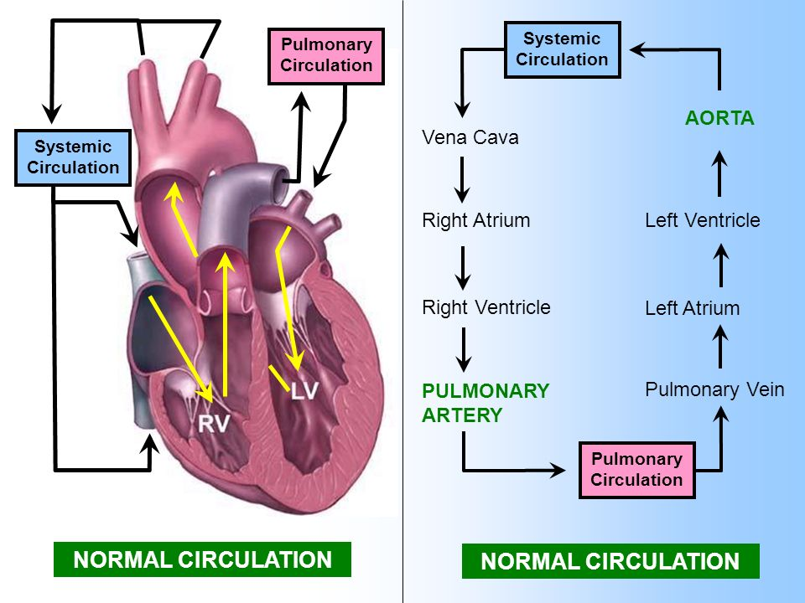
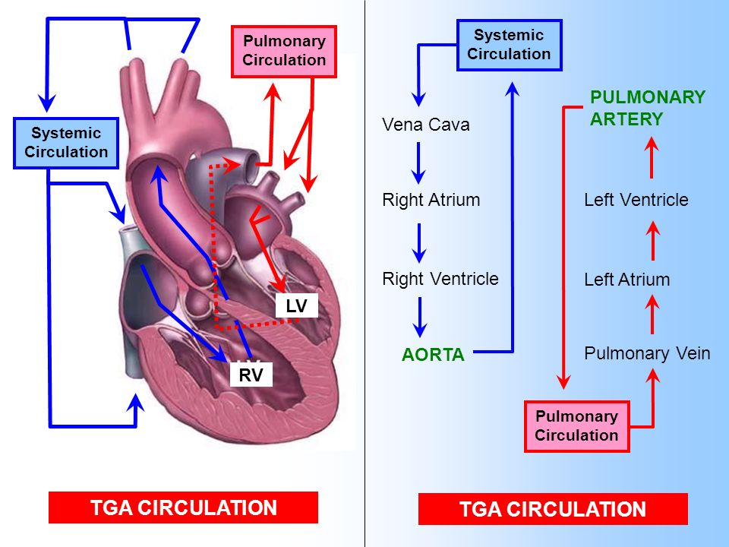

Slide 41
CLINICAL Findings
History
  History of cyanosis from birth is always present.
  Signs of congestive heart failure (CHF) with dyspnea and feeding difficulties develop during the newborn period?
Physical Examination
  Moderate to severe cyanosis is present, especially in large, male newborns. Such an infant is tachypnic but without retraction unless CHF supervenes.
  The S2 is single and loud. No heart murmur is heard in infants with an intact ventricular septum.
  If CHF supervenes, hepatomegaly and dyspnea develop

Slide 42
Laboratory Studies
  Severe arterial hypoxemia with or without acidosis is present. Hypoxemia does not respond to oxygen inhalation .
  Hypoglycemia and hypocalcemia are occasionally present.

Slide 43
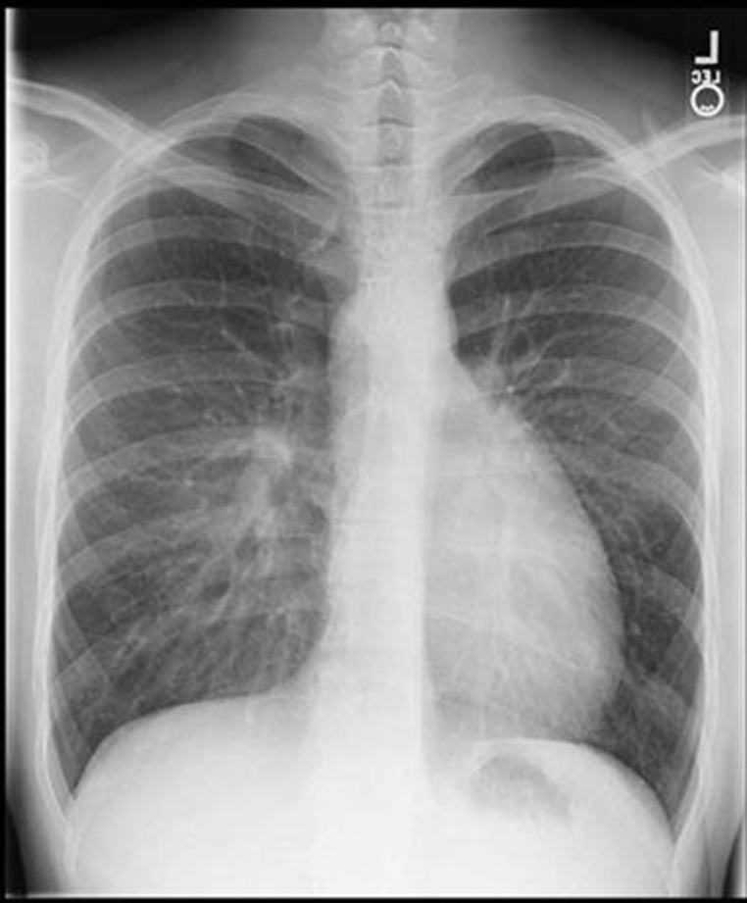
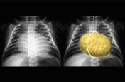
Chest X-ray findings:
Narrow mediastinum due to anterior-posterior orientation of great arteries and small thymus
Cardiomegaly is present w/ increased pulmonary vascular markings
d-TGA CXR: “egg on a string”

Slide 44
There is a rightward QRS axis (i.e., +90 to +200 degrees).
Right ventricular hypertrophy (RVH) is usually present after the first few days of life.
Combined ventricular hypertrophy (CVH) may be present in infants with large VSD, PDA, or pulmonary vascular obstructive disease, because all these conditions produce an additional left ventricular hypertrophy (LVH).

Slide 45
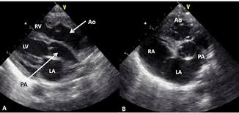
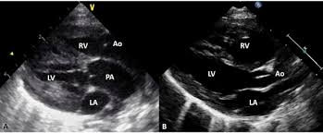
Echocardiography
Two-dimensional echo and color flow Doppler studies usually provide all the anatomic and functional information needed for the management of infants with D-TGA.

Slide 46
Medical RX
Initial management of d-TGA: goal is to improve mixing
The following measures should be carried out before an emergency cardiac catheterization (if performed) or a surgical procedure:
  Arterial blood gases should be obtained, and a hyperoxic test should be carried out to confirm the presence of a cyanotic congenital heart defect.
  Metabolic acidosis should be corrected, and hypoglycemia and hypocalcemia should be treated.
  Prostaglandin E1 infusion should be started to improve arterial oxygen saturation by reopening the ductus. This should be continued throughout the cardiac catheterization and until the time of surgery.
  Oxygen should be administered for severe hypoxia. Oxygen may help lower pulmonary vascular resistance and increase PBF, resulting in increased systemic arterial oxygen saturation..
  CHF may be treated with digoxin and diuretics

Slide 47
Before surgery, cardiac catheterization and a balloon atrial septostomy (i.e., the Rashkind procedure) are often carried out to have some flexibility in planning surgery.
  An increase in the oxygen saturation of 10% or more and a minimal interatrial pressure gradient are considered satisfactory results of the procedure

Slide 48
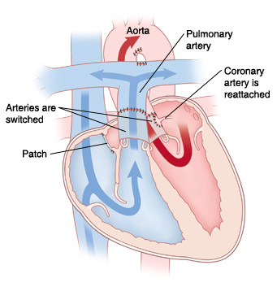
Surgical management of d-TGA:
Arterial switch procedure
  The arterial trunks are transected and “switched” to restore “normal” anatomy
  The coronary arteries are resected and re-implanted.

Slide 49
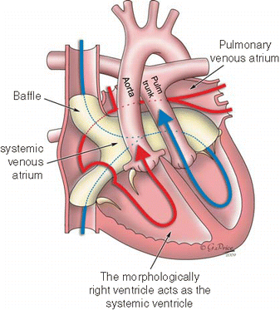
There are other types of surgical correction of d-TGA depends on many clinical and anatomical factors as:
  Intra-atrial repair surgeries such as the Senning , Mustard operation
  Nikaidoh operation, or others
  REV

Slide 50
Total Anomalous Pulmonary Venous Return(TAPVR)

Slide 51
TAPVR
TAPVR accounts for 1% of all congenital heart defects.
There is a marked male preponderance for the infracardiac type (male-female ratio of 4:1).
No direct communication exists between the pulmonary veins and the LA. Instead, they drain anomalously into the systemic venous tributaries or into the RA.

Slide 52
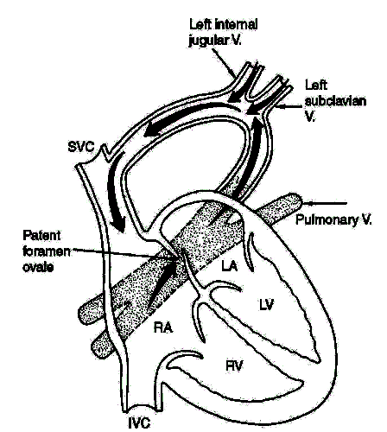
PATHOLOGY
Depending on the drainage site of the pulmonary veins, the defect may be divided into the following four types :
Supracardiac:
    (50% of TAPVR patients). The common pulmonary venous sinus drains into the right SVC through the left vertical vein and the left innominate vein

Slide 53
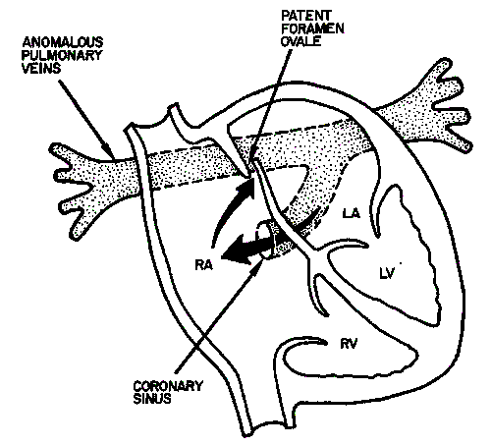
Cardiac:
  (20% of TAPVR patients). The common pulmonary venous sinus drains into the coronary sinus or right atrium.

Slide 54
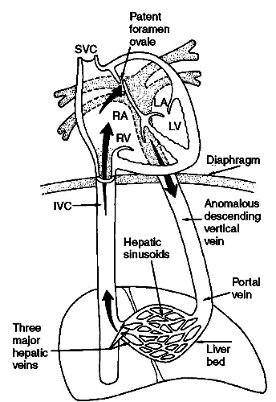
Infracardiac (subdiaphragmatic):
  (20% of TAPVR patients). The common pulmonary venous sinus drains to the portal vein, ductus venosus, hepatic vein, or inferior vena cava (IVC).

Slide 55
Mixed type: (10% of TAPVR patients). This type is a combination of the other types.

Slide 56
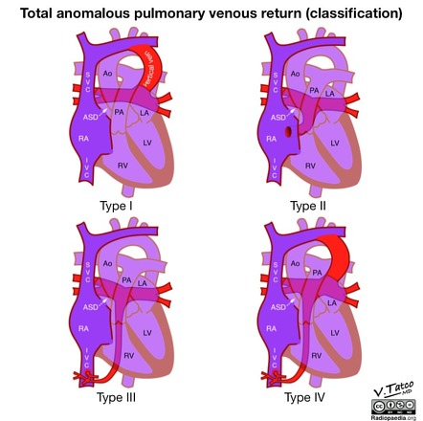

Slide 57
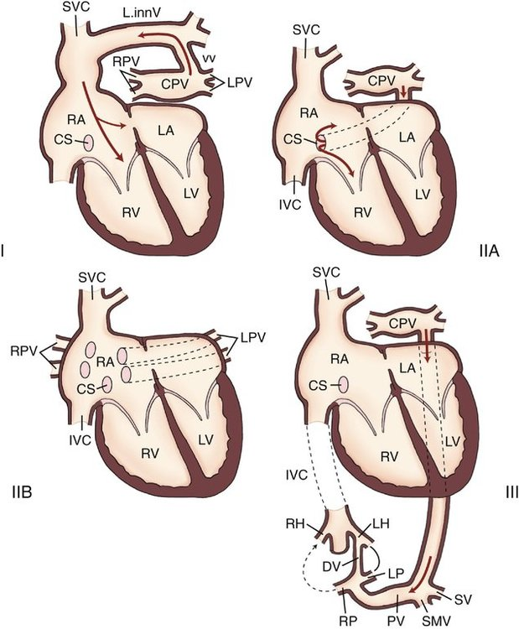

Slide 58
An interatrial communication, either an ASD or PFO, is necessary for survival.
The left side of the heart is relatively small.
Many patients with supracardiac and cardiac types of TAPVR and most patients with the infracardiac type have pulmonary hypertension secondary to obstruction of the pulmonary venous return.

Slide 59
CLINICAL MANIFESTATIONS
Clinical manifestations differ, depending on whether there is obstruction to the pulmonary venous return
Without Pulmonary Venous Obstruction
History
  1. CHF with growth retardation and frequent pulmonary infection are common in infancy.
  2. A history of mild cyanosis from birth is present.
Physical Examination
  The infant is undernourished and mildly cyanotic.
  Signs of CHF (e.g., tachypnea, dyspnea, tachycardia, hepatomegaly) are present.
  Precordial bulge with hyperactive RV impulse is present.
  Characteristic quadruple rhythm is present.
  The S2 is widely split and fixed, and the P2 may be accentuated.
  A grade 2-3/6 ejection systolic murmur is usually audible at the upper left sternal border.
  A mid-diastolic rumble is always present at the lower left sternal border

Slide 60
With Pulmonary Venous Obstruction
History
  Marked cyanosis and respiratory distress develop in the neonatal period with failure to thrive.
  Cyanosis worsens with feeding, especially in infants with the infracardiac type, resulting from compression of the common pulmonary vein by the food-filled esophagus.
PHYSICAL EXAMINATION
Moderate to marked cyanosis and tachypnea with retraction are present in newborns or undernourished infants.
Cardiac findings may be minimal.
A loud, single S2 and gallop rhythm are present.
Heart murmur is usually absent. If present, however, it is usually a faint ,ejection-type systolic murmur at the upper left sternal border.
Pulmonary crackles and hepatomegaly are usually present.

Slide 61
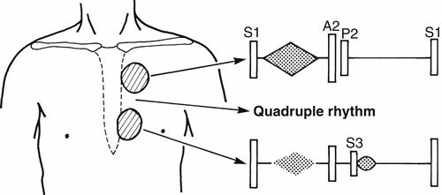

Slide 62
Electrocardiography.
WITHOUT OBSTRUCTION
  RVH of the so-called volume overload type (i.e., rsR' in V1) and occasional RA dilatation are present.
WITH OBSTRUCTION
  Invariably, RVH in the form of tall R waves in the right precordial leads is present. RA dilatation is occasionally present.

Slide 63
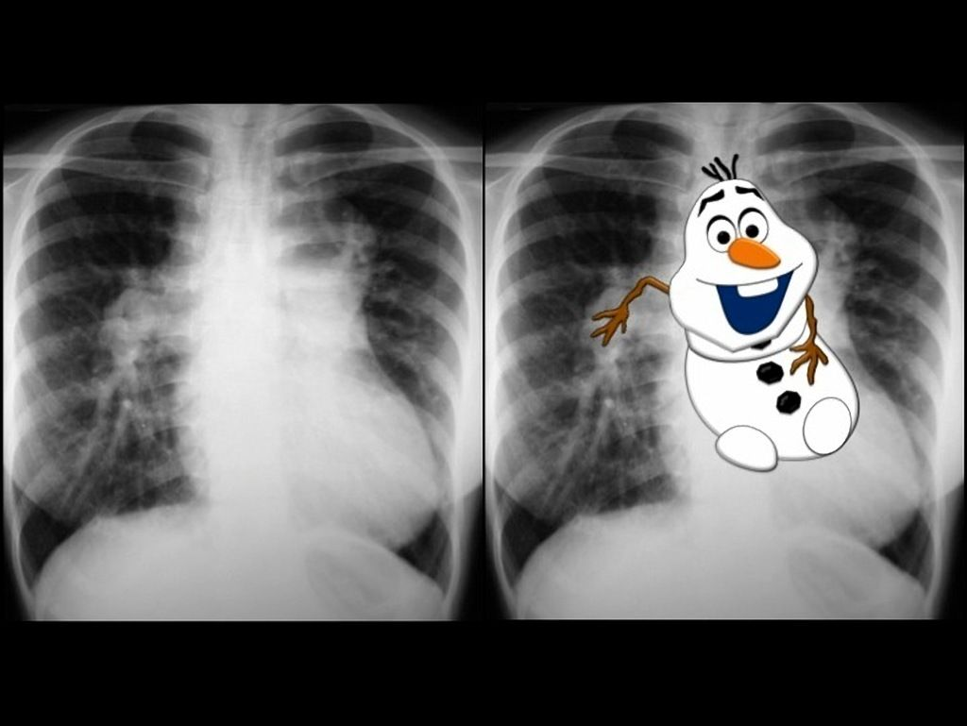
Chest X-ray Studies
WITHOUT OBSTRUCTION
Moderate to marked cardiomegaly involving the RA and RV is present with increased pulmonary vascular markings.
“Snowman” sign or figure-of-8 configuration may be seen in the supracardiac type, but rarely before 4 months of age
WITH OBSTRUCTION
The heart size is normal or slightly enlarged. The lung fields reveal findings of pulmonary edema ,These findings may be confused with pneumonia or hyaline membrane disease.

Slide 64
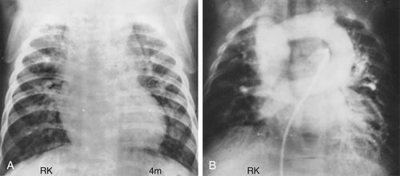

Slide 65
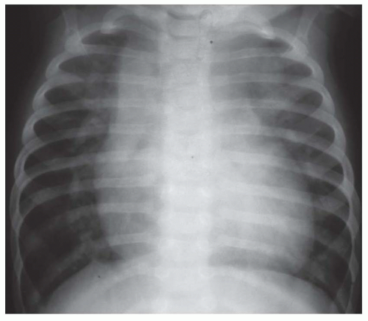

Slide 67
Management of TAPVR
    Medical and surgical:
    O2 supplementation for desaturation, loop Diuretics for pulmonary edema, NAHCO3 for Metabolic acidosis correction.
Proper anti-failure therapies with diuretics and/or digoxin should be given to baby, then surgical redirection can be done during neonatal period, all of the four pulmonary veins are reconnected to the left atrium, and any other associated heart defects must be closed surgically.
Infants with severe pulmonary edema resulting from the infracardiac type and from other types with obstruction should be intubated and receive ventilator
    Therapy with oxygen and positive end-expiratory pressure, if necessary, before cardiac catheterization and surgery.
    If the size of the interatrial communication appears to be small and immediate surgery is not indicated, balloon atrial septostomy or blade atrial septostomy may be performed to enlarge the communication.

Slide 68
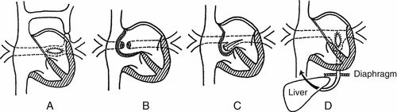
Surgical Correction of TAPVR:

Slide 69
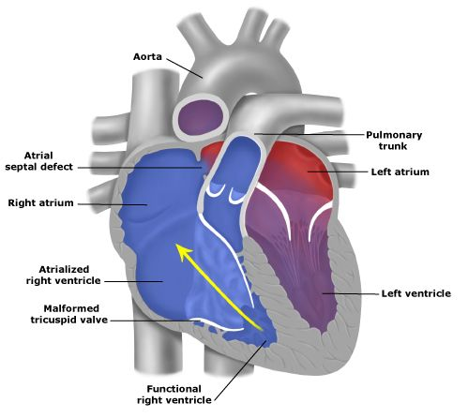
Ebstein anomaly

Slide 70
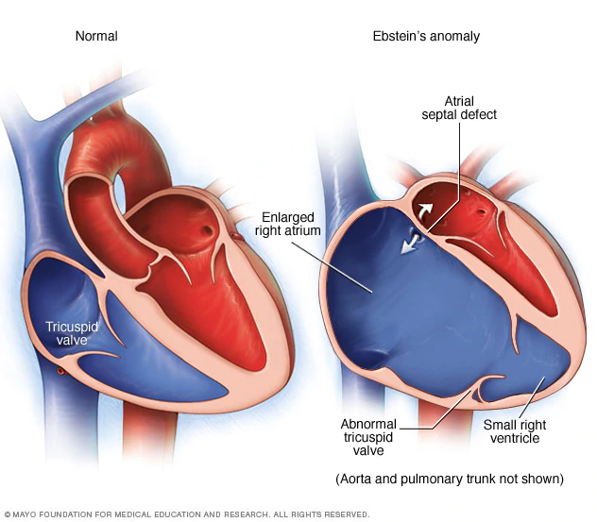
PATHOLOGY
There is downward displacement of the septal and posterior leaflets of the tricuspid valve into the RV cavity, so that a portion of the RV is incorporated into the RA (i.e., atrialized RV) and functional hypoplasia of the RV results. TR is usually present, and the RA is dilated and hypertrophied.
An interatrial communication (e.g., PFO, true ASD) with a right-to-left shunt is present in all patients.

Slide 71

The RV free wall is often dilated and thin. Fibrosis is present in both RV and LV free walls; this may be responsible for severe symptoms early in life and LV dysfunction in later life.
WPW syndrome is frequently associated with the anomaly and predisposes the patient to tachyarrhythmias.

Slide 72
Clinical manifestation
In severe cases, cyanosis and CHF develop during the first few days of life. Some subsequent improvement coincides with reduction of the pulmonary vascular resistance.
Children with milder cases may complain of dyspnea, fatigue, cyanosis, or palpitation on exertion.
A history of SVT is occasionally present.

Slide 73
Clinical manifestation
Mild to severe cyanosis is present, as well as clubbing of the fingers and toes in older infants and children.
Characteristic triple or quadruple rhythm is audible. This rhythm has a widely split S2, in addition to split S1, S3, and S4.
A soft, systolic regurgitant murmur of TR is usually audible at the lower left sternal border .
A soft, scratchy, mid-diastolic murmur is present at the same location.
Hepatomegaly is usually present.

Slide 74
ECG:
Characteristic ECG findings of RBBB and RA dilatation are present in most patients with this condition
First-degree AV block is frequent, occurring in 40% of patients.
WPW syndrome is present in 20% of patients with occasional episodes of SVT

Slide 75
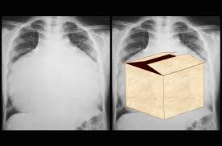
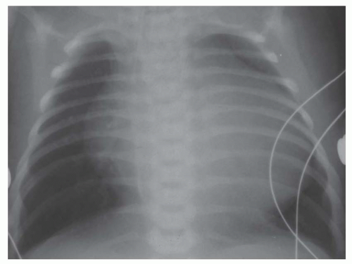
Chest x ray findings
In mild cases, the heart is almost normal in size and has normal pulmonary vascular markings.
In severe cases, an extreme cardiomegaly (principally involving the RA) with a balloon-shaped heart and decreased pulmonary vascular markings are present. Some of the largest heart sizes are found in newborns with this condition.

Slide 76
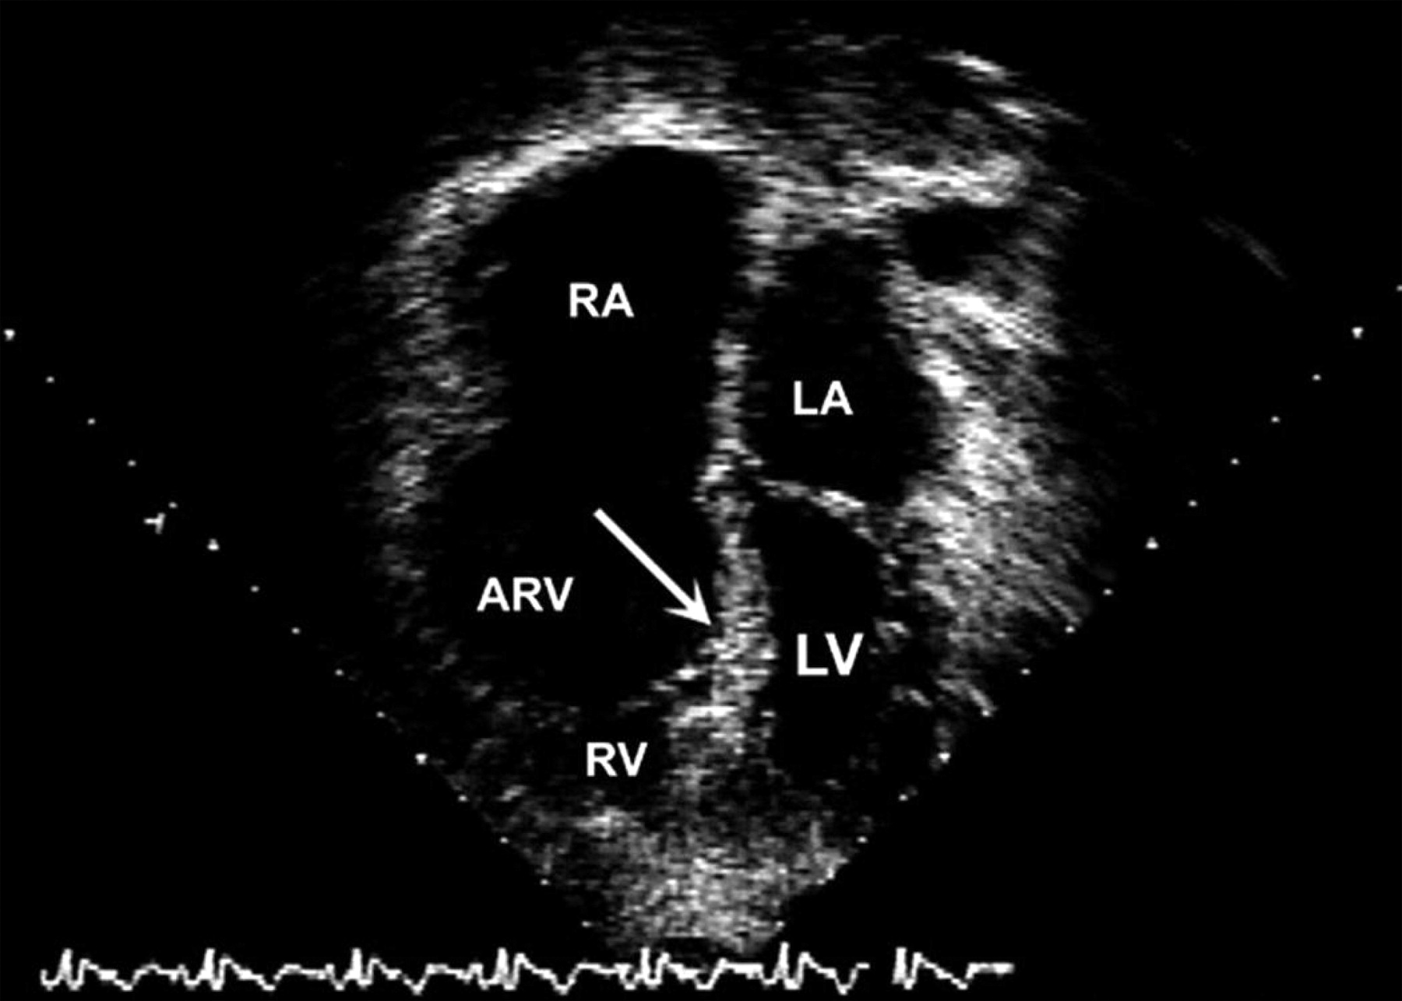
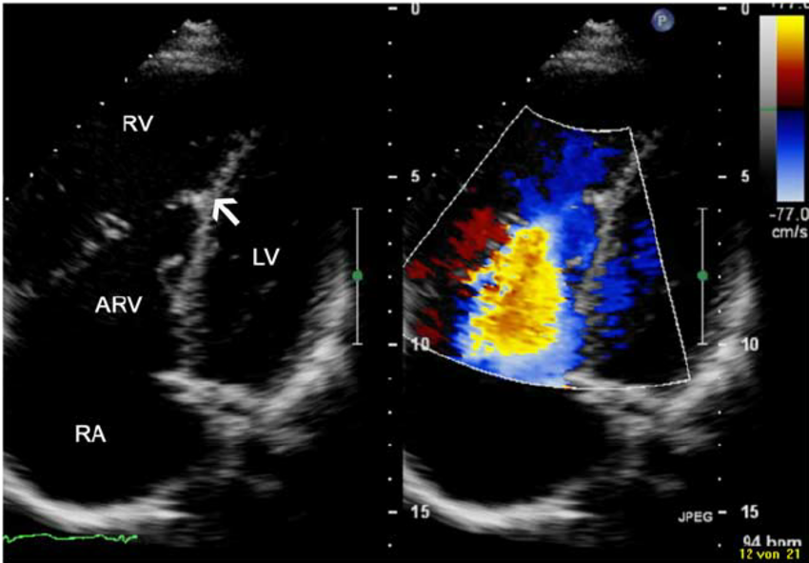
2D-Echocardiogram

Slide 77
Management:
Medical management in a newborn with cyanosis:
    In case of extreme cyanosis, prostaglandin E1 infusion is indicated
    In case of Critically ill newborns may require inotropic support (Milrinone infusion ) until surgical intervention is done or the clinical situation is improved
    IN severe cases with small RV: PGE1, systemic to pulmonary shunt, then staged surgery as Glenn procedure and fontan operation ( it is preformed to reduce the blood volume on the right ventricle)

Slide 78
Management:
Medical management of symptomatic Infant and children Ebstein patients includes:
    Heart failure management to get the best clinical situation with inotropic agent (Milrinone, digoxin), and the loop diuretic before evaluation for early planned surgical correction
Medical management of symptomatic adult Ebstein patients includes:
    Diuretic therapy for right side heart failure
    Antiarrhythmic drug if there is any abnormalities
    Anti-failure medication for left side systolic dysfunction
    Surgical intervention

Slide 79
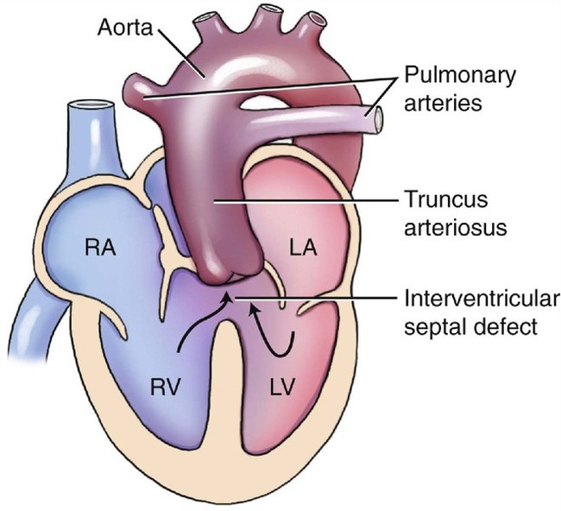
Truncus Arteriosus
Persistent truncus arteriosus occurs in <1% of all congenital heart defects
  Only a single arterial trunk with a truncal valve leaves the heart and gives rise to the pulmonary, systemic, and coronary circulations.
  A large perimembranous,infundibular VSD is present directly below the truncus
Evidence of DiGeorge syndrome with hypocalcemia is present in 33% of patients.

Slide 80
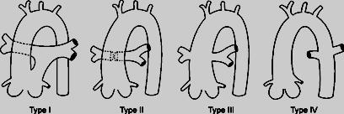
This anomaly is divided into four types according to Collett and Edwards' classification .

Slide 81
Clinical manifestation
Cyanosis may be seen immediately after birth.
Signs of CHF develop within several days or weeks after birth
History of dyspnea with feeding, failure to thrive, and frequent respiratory infections is usually present in infants

Slide 82
Varying degrees of cyanosis and signs of CHF with tachypnea and dyspnea are usually present.
The peripheral pulses are bounding, with a wide pulse pressure.
A systolic click is frequently audible at the apex and upper left sternal border.
The S2 is single.
A harsh (grade 2-4/6), systolic murmur, which suggests VSD, is usually audible along the left sternal border.
An apical rumble with or without gallop rhythm may be present when the PBF is large.
A high-pitched, early diastolic, decrescendo murmur of truncal valve regurgitation may be audible.
Rarely is a continuous murmur heard over either side of the chest

Slide 83
Chest x ray findings
Cardiomegaly is usually present, with increased pulmonary vascularity. A right aortic arch is seen in 30% of cases.

Slide 84
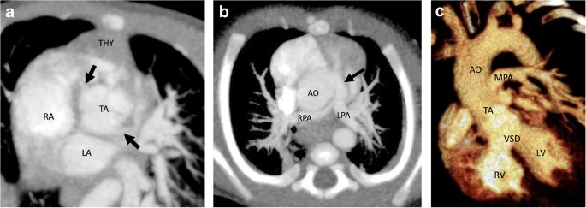

Slide 85
Management:
In case of normal pulmonary arteries with increased pulmonary blood flow (In the 1st few weeks of life):
    Anticongestive medications; as pulmonary vascular resistance falls, heart failure symptoms worsen and surgery is indicated, usually within the 1st few months
    Delay of surgery much beyond this time period may increase the likelihood of pulmonary vascular disease.
In case of small hypoplastic pulmonary arteries with decreased pulmonary blood flow and severe cyanosis :
    PGE1 is started and shunt is done to increased PBF and augment growth of pulmonary arteries after proper imaging for evaluation of pulmonary arteries with catheterization or CT angiogram

Slide 86
THANK YOU FOR YOUR ATTENTION

