Slide 1
Acyanotic Congenital Heart Diseases
Hamzeh Almomani, MBBS ,MSc
Assistant Professor- Pediatric Cardiology
The Hashemite University

Slide 2
Left-to-Right Shunt Lesions :
    Atrial Septal Defect (ASD) .
    Ventricular Septal Defect (VSD).
    Atrioventricular Septal Defect (AV Canal) .
    Patent Ductus Arteriosus (PDA) .
    Partial anomalous pulmonary venous return(PAPVR) .
    Aortopulmonary window(OPW) .
Obstructive lesions:
    Aortic stenosis .
    Pulmonary stenosis .
    Coarctation of aorta.
    Others .

Slide 3
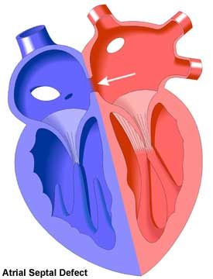
Atrial Septal Defect

Slide 4
Introduction
ASD is an acyanotic CHD characterized by defect in the interatrial septum causing a left to right flow between the atria.
Resulting in spectrum from : asymptomatic to right sided overload, PAH , even atrial arrhythmias
Pathophysiology :Shunting occurs during late ventricular systole and early diastole

Slide 5
INCIDENCE
ASD constitutes 8-10% of congenital heart defects in children.
Incidence = 56 per 100,000 live births
Recent estimates are much higher (100 per 100,000 live births), likely due to increased recognition in the era of common use of echocardiography.

Slide 6
ETIOLOGY
Actual etiology of this congenital defect is unknown.
Factors include:
Genetic factor:
  The genetic basis of ASD is not completely understood.
  some homeobox gene defects....... familial cases of ASDs, such as NKX2- chromosome-5, which has an autosomal dominant inheritence and AV conduction defect.
  HOLT-ORAM Syndrome.......mutations in the transcription factor TBX5, essential in development of both the heart and upper limbs.
  Many other syndromes like
    DOWN syndrome
    Noonan syndrome
    Patau’s syndrome
    Edward’s syndrome
Environmental factor including antenatal use of teratogenic drugs, congenital infection

Slide 7
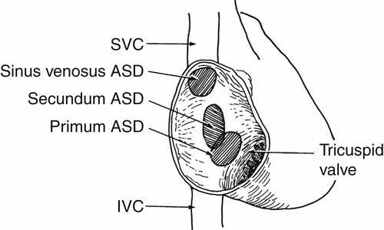
Classification according to location
Secundum ASD (75-85%) are located in the region of the fossa ovalis.
Primum ASD (10-15%) occur in the lower portion of the atrial septum.
Sinus venosus defects (5-10%) are located near the orifice of the superior vena cava.
Sinus venosus defects of IVC type (1%)
Coronary sinus defects(Less than 1% of ASDs)(in which a defect between the coronary sinus and the left atrium allows a left-to-right shunt to occur through an “unroofed” coronary sinus

Slide 9
Secundum ASD
Most common type.
Single or Multiple.
May be associated with other ASDs.
Typically located within the area bordered by the limbus of the fossa ovalis.
May be associated with
  Partial anomalous venous return most commonly of the right upper pulmonary vein.
  Pulmonic stenosis
  Mitral valve prolapse (10-20% have a functional mitral valve prolapse, may be related to changing LV geometry associated with RV volume overload)

Slide 10
Secundum ASD

Slide 11
Primum ASD
Occur if the septum primum does not fuse with the endocardial cushions, leaving a defect at the base of the interatrial septum that is usually large.
Usually not isolated – primum ASDs are typically associated with
  anomalies of the AV valves (such as cleft mitral valve)
  and defects of the ventricular septum (VSDs) or a common AV canal.
May associated with Discrete subaortic stenosis

Slide 12
Sinus venosus ASD
Make up Characterized by malposition of the insertion of the SVC or IVC straddling the atrial septum.
Often associated with anomalous pulmonary venous return – the RU/RM pulmonary veins may connect with the junction of the SVC and RA in the setting of a superior sinus venosus ASD.

Slide 14
Coronary Sinus Septal Defects
Defects in the inferior/anterior atrial septum region that includes the coronary sinus orifice.
Defect of at least a portion of the common wall separating the coronary sinus and the left atrium – AKA “unroofed coronary sinus”
Can be associated with a
  persistent left SVC draining into the coronary sinus
  or Partial and total anomalous pulmonary venous return

Slide 15
Patent Foramen Ovale
Not truly an “ASD” because no septal tissue is missing.
Oxygenated blood from the IVC crosses the foramen ovale in utero.
At birth, the flap normally closes due to
    Reduced right heart pressure and PVR
    Elevated LA pressure.
Flap fusion is complete by age two in 70-75% of children; the remainder have a PFO.

Slide 16
Natural History of ASDs
Most small ASDs close spontaneously in infants.
Spontaneous closure is unusual in children and adults; defects often become progressively larger.
Advanced pulmonary hypertension seldom occurs before the third decade.
Infective endocarditis does not occur in patients with isolated ASDs.

Slide 17
Natural History of ASDs
Cerebrovascular accident, resulting from paradoxical embolization through an ASD, is a rare complication but important
Increased prevalence of PFO and cryptogenic stroke; less clear for ASD.

Slide 18
Natural History of ASDs
Mitral stenosis may occur as a result of rheumatic fever in a case of ASD (Lutembacher syndrome).

Slide 19
Natural History of ASDs
Atrial fibrillation and /or Atrial flutter is a late complication
Risk of atrial arrhythmias increases with age and PA pressure.

Slide 20
Clinical Manifestations
Vary with the size of defect.
  Small defect: Asymptomatic and is usually diagnosed during a routine health check up.
  Large defect: Symptomatic and patients usually present with Failure to thrive, Easy fatigability. Increased perspiration, Recurrent Pulmonary infections, or Platypnea Orthodeoxia
    Most patients with a significant shunt flow ratio (Qp:Qs > 1.5:1) will be symptomatic .

Slide 21
Clinical Manifestations
Platypnea-orthodeoxia is a rare syndrome characterized by orthostatic provocation of a right-to-left shunt across an atrial septal defect or a patent foramen ovale
  Platypnea (dyspnea induced by the upright position and relieved by recumbency) and orthodeoxia (arterial desaturation in the upright position with improvement during recumbency) are features of this rare disorder

Slide 22
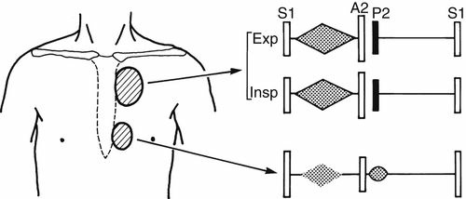
Physical Exam Findings
Wide, fixed splitting of S2 (delayed closure of pulmonic valve with reduced respiratory variation)
Mid systolic pulmonary flow or ejection murmur ,Usually over 2nd intercostal space ,Peaks in early-to-mid systole, ends before S2
Palpable RV heave
Mid-diastolic murmurs are the result of augmented tricuspid flow.

Slide 23
ECG Findings
Right atrial enlargement d/t volume overload (tall P wave)
RAD, rSR’ in V1
  LAD with rSR’ in V1 is suggestive of Ostium primum defect
  AV delay – often with primum ASD in association with LAFB and RBBB (the rim of an ostium primum defect is near the His bundle).
Atrial tachyarrhythmia – A.fib, Atrial flutter

Slide 24
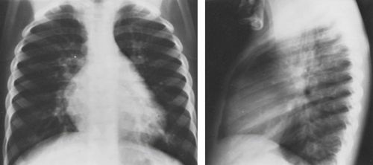
Chest X-Ray Findings
Dilation of RA and RV
Enlarged main pulmonary arteries and pulmonary vessels.

Slide 25
2D Color Doppler TTE

Slide 26
3 D-ECHO

Slide 27
Amplatzer - Occlusion Device

Slide 28
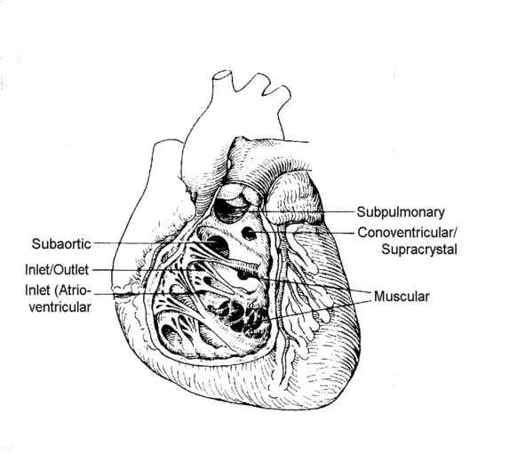
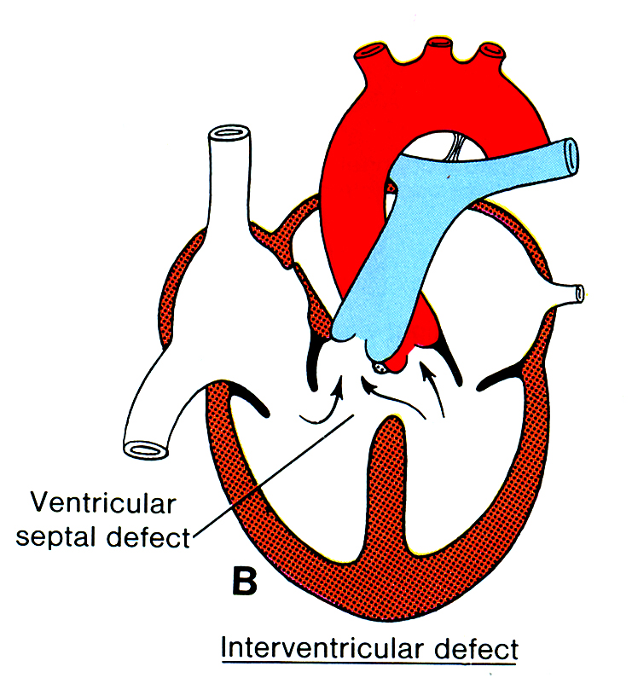
Ventricular Septal Defect (VSD)

Slide 29
Isolated VSD - most commonly recognized CHD
50 % when associated with other major defects .
75-80% of small VSD’s close spontaneously by late childhood
10-15% of large VSD’s close spontaneously
60% of defects close before age 3, and 90% before age 8

Slide 30
Associated syndromes
Chromosomal Disorders associated with VSD
  Trisomy 21: 40% of T21 will have VSD
  Trisomy 13, 18: 18% of T13, 31% of T18 will have VSD
  22q11 deletion: – Tetrology of Fallot is most common anomaly – VSD with or without aortic arch anomaly is second most common
  Holt-Oram (Hand-heart syndrome): TBX5 gene found on Chromosome 12

Slide 31
Classification
TYPE I Conal, Supracristal, Infundibular, Subarterial
TYPE II – Perimembranous
TYPE III Inlet/ AV canal type
Type IV – Muscular

Slide 32
TYPE I (Conal, Supracristal, Infundibular, Subarterial, subpulmonic, doubly committed, outlet) VSDs
These defects lie beneath the pulmonic valve and communicate with the RV outflow tract above the supraventricular crest
are associated with aortic regurgitation secondary to the prolapse of the right aortic cusp.
Conduction system is not in surgical proximity

Slide 33
TYPE II – Perimembranous(infracristal,conoventricular) VSD
lie in the LV outflow tract just below the aortic valve.
Most common (80%)
Perimembranous VSDs are associated with pouches or aneurysms of the septal leaflet of the tricuspid valve, which can partially or completely close the defect. In addition, an LV-to-RA shunt may be associated with this defect
Danger area- inferior and posterior region of defect

Slide 34
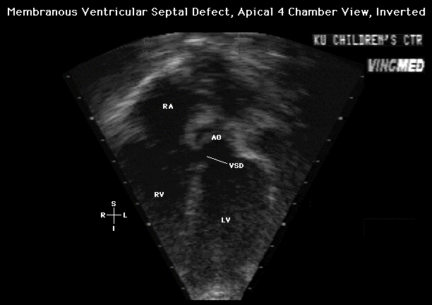
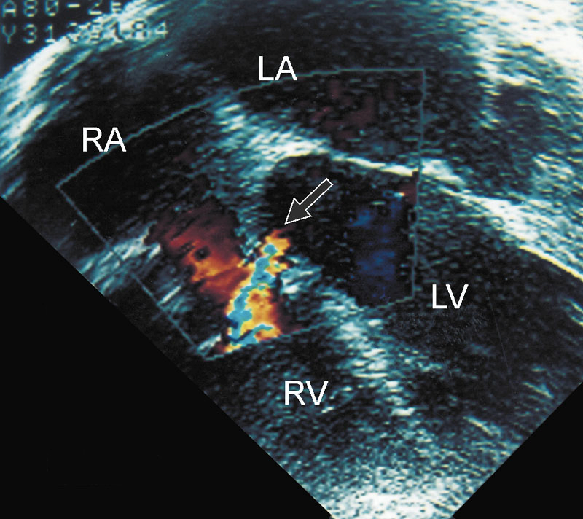
Echocardiogram: Membranous VSD

Slide 35
TYPE III AV Canal type / Inlet VSDs
5% of all VSDs
Located posteriorly
Conduction system at risk – close proximity to AV node
Common bundle courses around inferior aspect of defect

Slide 36
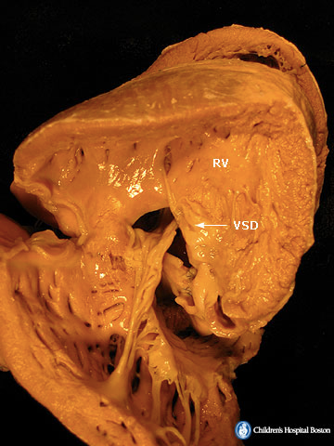
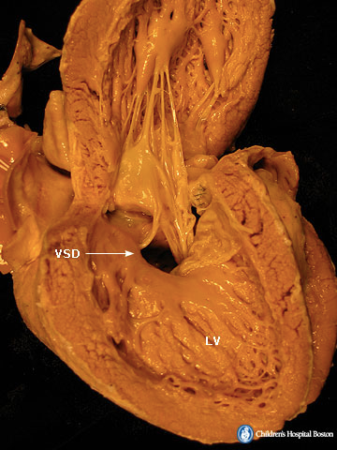
Endocardial Cushion (Inlet VSD)

Slide 37
Type IV: muscular VSDs (trabecular)
Muscle tissue all around the defect
often multiple and the term Swiss-cheese septum has been used to describe multiple muscular VSDs.
These VSDs account for 5-20% of all defects.
May be either
  anterior,
  in the inlet septum,
  mid-muscular
  or apical

Slide 38
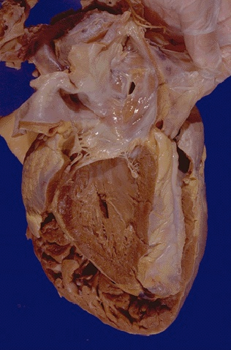
Muscular VSD

Slide 39
CLINICAL FINDINGS
Precordium is hyperkinetic with a systolic thrill at LSB
S1&S2 are masked by a PSM at Lt.sternal border
max. intensity of the murmur is best heard at 3rd,4th&5th Lt interspace.
Lt. 2nd space –widely split &variable ,accentuated P2
Delayed diastolic murmur at the apex &S3

Slide 40
Pathophysiology and clinical manifestation
After birth , PVR falls (2-4 weeks until 8 weeks) ------ Large flow across shunt if large VSD Causes increased PA pressure (initially flow related), increased PV return, hence LA enlargement and LV overload
PH initially flow related and reversible

Slide 41
Pathophysiology and clinical manifestation
Later, ----- Intimal proliferation and medial hypertrophy leads to fixed irreversible PH
Flow through the lungs decreases as PVR increases, hence shunt volume decreases
Eventually PVR > SVR, hence R to L shunt across VSD ,Cyanosis, Eisenmenger

Slide 42
Pathophysiology and clinical manifestation
A small restrictive VSD
  75% spontaneously close < 2yrs
  Rarly produce PH
  Patient is asymptomatic.
  Murmur can be present since a few days after birth.

Slide 43
Pathophysiology and clinical manifestation
A moderately restrictive VSD
  Variable increased PVR in less than 2 years
  Frequent respiratory tract infections. CHF (rare). Cyanosis is absent
  Functional aerobic capacity is usually moderately reduced with early fatigability but unusual CHF.

Slide 44
Pathophysiology and clinical manifestation
A large or non-restrictive VSD
  Rarely close spontaneously
  Produce PH in less than 2 years
  More frequent respiratory tract infections. Defective growth. Moderate cyanosis at times with exertion Congestive heart failure frequent in the first years of life (one of the most frequent causes of CHF during the first year of life).
  Functional capacity markedly reduced

Slide 45
Pathophysiology and clinical manifistation
An Eisenmenger VSD
  Net right-to-left shunt.
  Infants with Eisenmenger may become
    easily fatigued, especially during crying spells and at feeding time
    Low tolerance for extra exertion
    Shortness of Breath (dyspnea) and/or rapid breathing
    Fainting (syncope)
    Difficulty eating, breathing or sucking ,Poor weight gain, Slow growth or other physical retardation

Slide 46
Natural History
Spontaneous closure is known, primarily with perimembranous and muscular VSDs with restrictive VSD may close spontaneously during childhood and sometimes in adult life
(Subarterial, doubly committed) and inlet VSDs are rarely close

Slide 47
Natural History
A perimembranous vsd , (Subarterial, doubly committed) vsd,
  Progressive AR. (vuenturi effect)
  Subaortic and subpulmonary stenosis
  Left ventricular to right atrial shunt
A moderately restrictive VSD
  Left atrial and ventricular dilation and dysfunction
  Variable increase in pulmonary vascular resistance..
A large or nonrestrictive VSD
  Ventricular volume overload early in life
  Progressive rise in pulmonary artery pressure
  A fall in left-to-right shunting.

Slide 48
VUENTURI EFFECT

Slide 49
Natural History
Patients with large vsd- symptom develop soon after birth.
CHF manifested by- dyspnea/repeated pulmonary infections/hepatomegaly/sweating/failure to thrive.
Irreversible pulmonary vascular disease after 1-2 yrs of age.
Some children with isolated vsd develop Subpulmonic stenosis are not at risk of pulmonary vascular disease

Slide 50
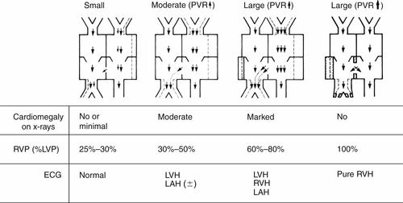
ECG
Small restrictive VSDs…. Normal tracing
Medium-sized VSDs
  Broad, notched P wave characteristic of left atrial overload
  Signs of LV volume overload — deep Q and tall R waves with tall T waves in leads V5 and V6
With further progression, the ECG shows biventricular hypertrophy; P waves may be notched or peaked.
Signs of atrial fibrillation are often present Large VSDs
Right ventricular hypertrophy with right-axis deviation….Presence of RAD represents elevated RVP and PAP

Slide 51
KATZ WATCHTEL SIGN
The Katz Wachtel phenomenon — large biphasic QRS complexes in V2-4. This is the classic ECG pattern of BVH, most commonly seen in children with ventriculo-septal defect (VSD).

Slide 52
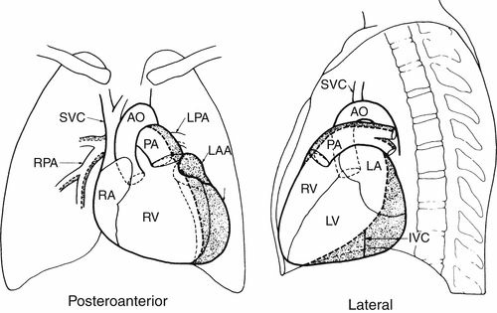
CHEST X-RAY
Cardiomegaly : proportional to the volume overload. Mainly LV, LA and RV enlargement.
Increased pulmonary blood flow.
RV may not be as enlarged as anticipated as it receives the shunt into its outflow tract.

Slide 53
Doppler Echo

Slide 56
Cardiac catheterization

Slide 57
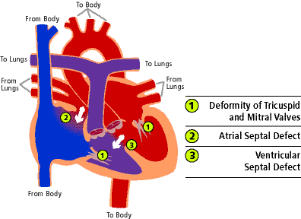
Atrioventricular Septal Defect
AVSD results from incomplete fusion the the endocardial cushions, which help to form the lower portion of the atrial septum, the membranous portion of the ventricular septum and the septal leaflets of the triscupid and mitral valves.
They account for 4% OF ALL CHD.

Slide 58
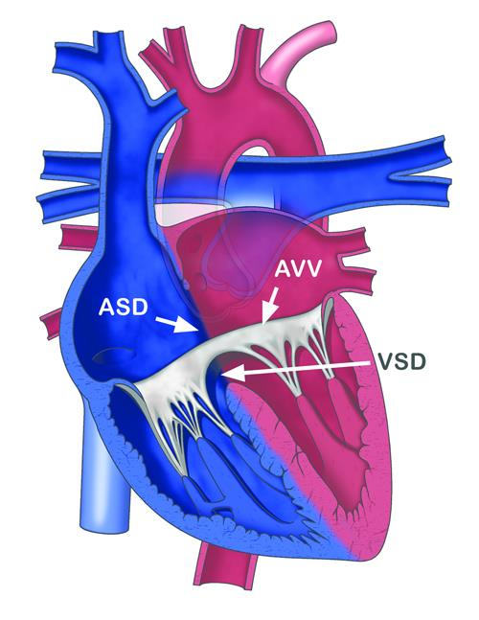
Abnormal development of the atrioventricular septum
Involves the primum atrial septum and the inlet ventricular septum

Slide 59
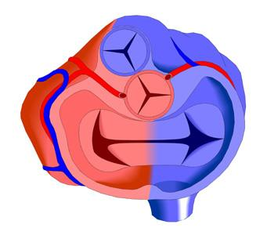
Abnormal development of the AV valves
Involve septal portions of the mitral and tricuspid valve
Lower attachment on AV septum creates large primum ASD
Higher attachment on AV septum results in larger VSD
Common AV valve
No or abnormal septal attachments of the AV valves
Single anterior and single posterior leaflets bridging the septal orifice

Slide 60
Posterior displacement of atrioventricular node
  Results in changes in electrocardiogram (In approximately 50% of patients)
      Prolonged PR interval
      “Superior” QRS axis (left axis deviation)
  Increases risk of surgically induced heart block

Slide 61
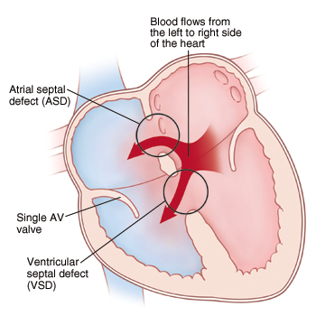
Variations in terms based upon anatomic deformities
May be called: complete, transitional, intermediate, partial, and unbalanced defects
Complete AVSD
  Most common in Trisomy 21 (Down syndrome) patients
    Single AV Valve orifice
Partial AVSD
  Most common in non-Down syndrome patients
  Two separate AV Valve orifices
  Usually asymptomatic

Slide 62
Pathophysiology
Left-to-right shunt across ASD,VSD with early presentation of CHF and risk of early Pulmonary vascular disease.
Cleft in mitral valve and Incompetent valves and clinical consequences

Slide 63
Clinical Presentation
Incomplete AVSD maybe indistinguishable from ASD - usually asymptomatic.
Congestive heart failure in infancy.
Recurrent pulmonary infections.
Failure to thrive.
Exercise intolerance, easy fatigability.
Late cyanosis from pulmonary vascular disease w/ R to L shunt.

Slide 64
Clinical Signs:
Hyperactive precordium with a systolic thrill at LLSB
Normal or accentuated 1st heart sound
Narrow split of S2
P2 increased in intensity
A grade 3-4/6 holosystolic murmur--- VSD
Pulmonary systolic ejection murmur w/thrill—P. overflow
Holosystolic murmur at apex w/radiation to axilla--MR
Mid-diastolic rumbling murmur at Left Sternal border—Large L-R shunt

Slide 65
Electrocardiogram of a patient with complete AVSD demonstrating left axis deviation with a superior QRS axis.

Slide 66
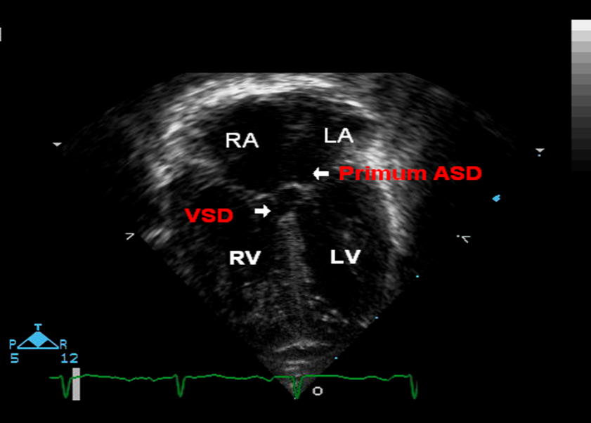

Slide 67
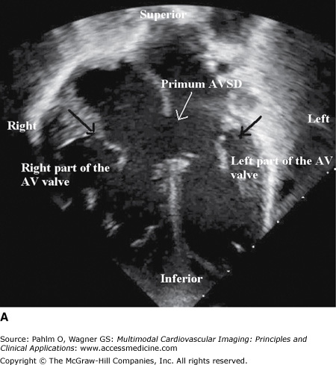

Slide 68
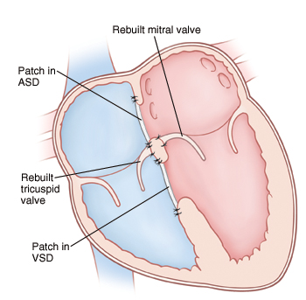
Treatment
Surgery is always required.
Treat congestive symptoms.
Pulmonary banding maybe required in premature infants or infants < 5 kg.
Correction is done during infancy to avoid irreversible pulmonary vascular disease.
Mortality low w/incomplete 1-2% & as high as 5% with complete AVSD.

Slide 69
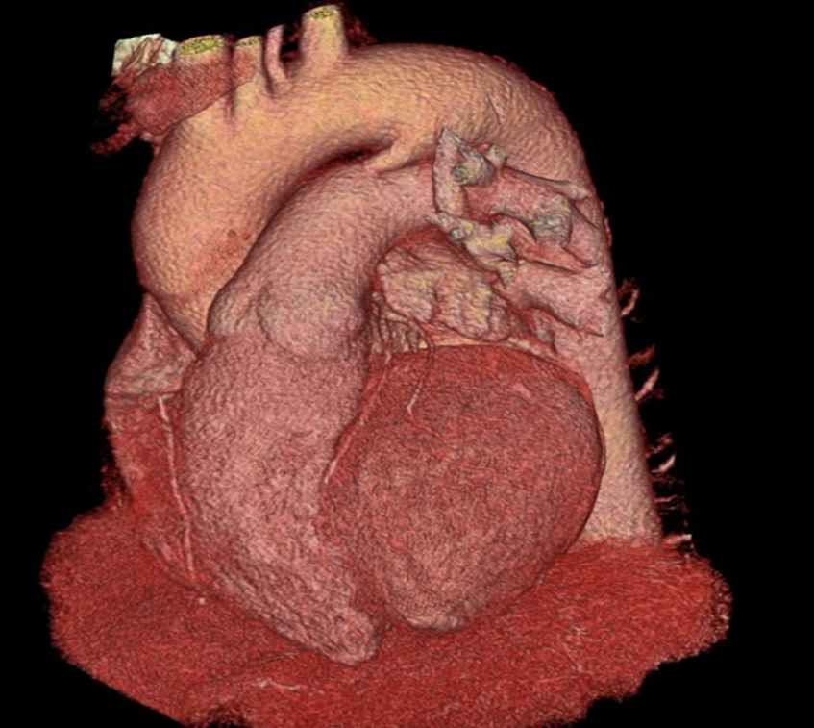
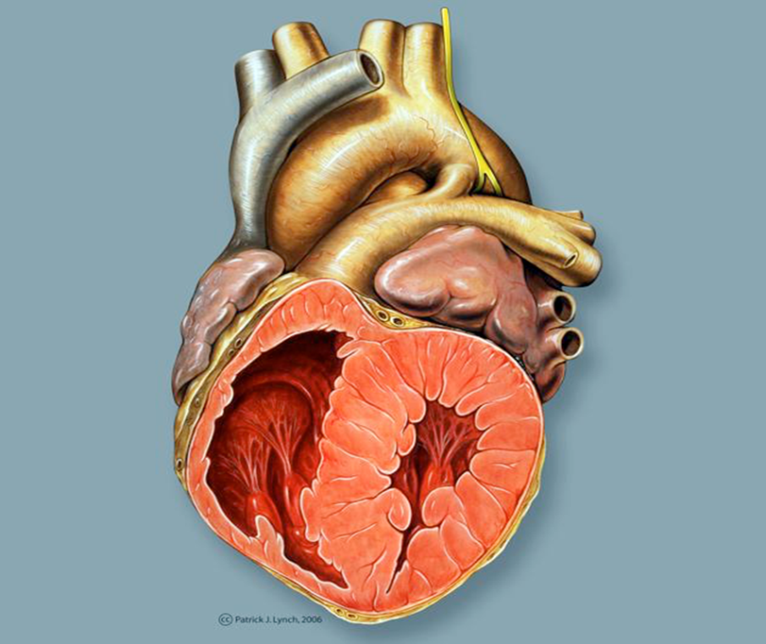
Patent Ductus Arteriosus

Slide 70
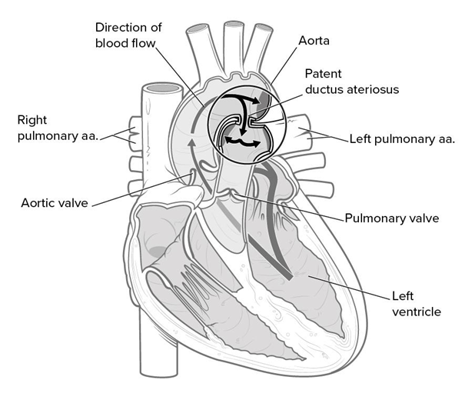
Communication between the pulmonary artery and the aorta
Location – distal to left subclavian
Maternal rubella, prematurity

Slide 71
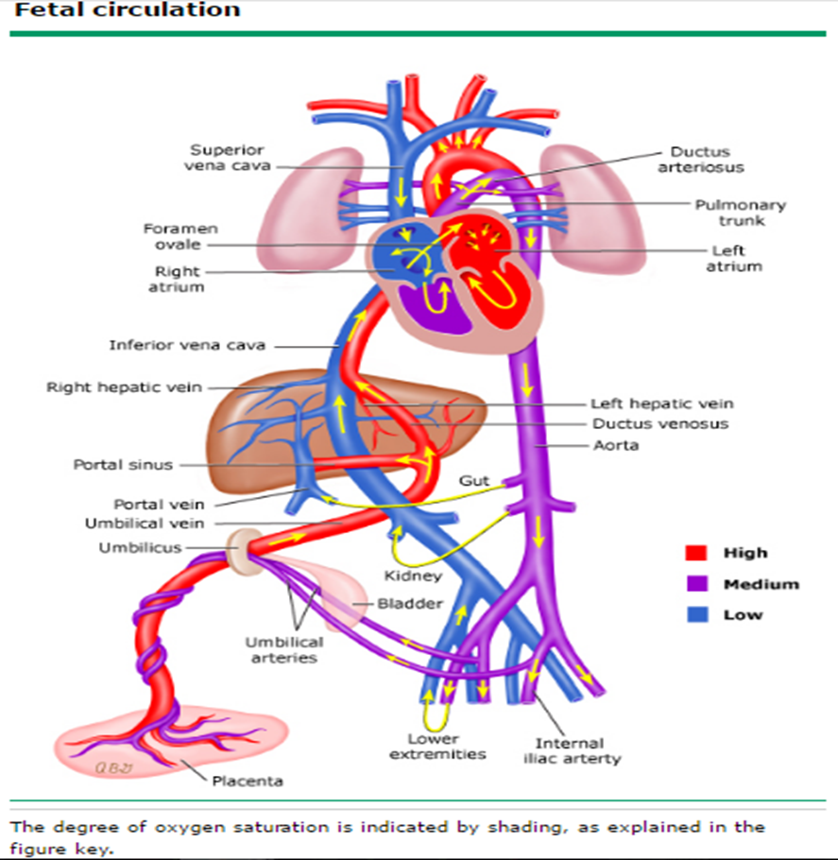
Anatomy
During fetal life, the ductus arteriosus is a normal structure that allows most of the blood leaving the right ventricle to bypass the pulmonary circulation and pass into the descending aorta.
Typically, only about 10% of the right ventricular output passes through the pulmonary vascular bed.
The ductus arteriosus is a remnant of the distal sixth aortic arch
Connects the pulmonary artery at the junction of the main pulmonary artery and the origin of the left pulmonary artery to the proximal descending aorta just after the origin of the left subclavian artery.

Slide 72
Functional closure
In the fetus,
  the oxygen tension is relatively low, because the pulmonary system is nonfunctional.
  Coupled with high levels of circulating prostaglandins due to:
          The little amount of pulmonary circulation
          The high levels of production in the placenta.
At birth,
  the placenta is removed, eliminating a major source of prostaglandin production,
  the lungs expand, activating the organ in which most prostaglandins are metabolized.
  oxygen tension in the blood markedly increases. Pulmonary vascular resistance decreases with this activity.

Slide 73
Normally, functional closure of the ductus arteriosus occurs by abrupt contraction of the muscular wall by about 15 hours of life in healthy infants born at term.
A second stage of closure(Anatomical) related to fibrous proliferation of the intima is complete in 2-3 weeks.

Slide 74
Etiology ….Prematurity
IN preterm neonates has been suggested to be due to
  Poor prostaglandin metabolism because of immature lungs.
  high reactivity to prostaglandin
  reduced calcium sensitivity to oxygen in vascular smooth muscle cells due to immaturity of the smooth muscle within the structure

Slide 75
Etiology ….Implicated teratogens
Congenital rubella infection,
Fetal alcohol syndrome
Maternal amphetamine use
Maternal phenytoin use

Slide 76
Etiology….Genetics
Familial cases of patent ductus arteriosus (PDA) have been recorded, but a genetic cause has not been determined.

Slide 77
Etiology ….Other
Other causes include
  Low birth weight (LBW),
  High altitude and low atmospheric oxygen tension,
  Hypoxia.

Slide 78
Clinical presentation
Irritable, feed poorly, fail to gain weight and sweat excessively
Increased respiratory effort and respiratory rates
prone to develop recurrent upper respiratory infections and pneumonia

Slide 79
Physical Examination
Murmur: systolic at LUSB/Left Infraclavicular, may progress to continuous (machinery) may be only a systolic ejection murmur, or may be a crescendo/decrescendo systolic murmur that extends into diastole
Accentuated S1 , mitral delayed diastolic murmur related to increased flow through left atrium and ventricle.
Narrowly or paradoxically split S2_ (large shunts) related to premature closure of the pulmonary valve and a prolonged ejection period across the aortic valve

Slide 80
Physical Examination
Wide pulse pressure – bounding peripheral pulses …related to
  The high left ventricular stroke volume, which may cause systolic hypertension.
  The low diastolic pressure in the systemic circulation as blood runs off from the aorta into the pulmonary circulation.
Hyperkinetic apex releated to the large left ventricular stroke volume
Continuous thrill in 2nd lt ICS
The apical impulse is laterally displaced
Dilatation of the ascending aorta , Aortic ejection click – preceding the continuous murmur, Aortic ejection systolic murmur – drowned by the loud continuous murmur
Differential cyanosis and clubbing is pesent in shunt reversal

Slide 81
ECG
With a small patent ductus arteriosus (PDA), the electrocardiographic (ECG) findings are typically normal.
Left ventricular hypertrophy and Left atrial enlargement may be present with a larger PDA. .
In the presence of significant pulmonary hypertension, there may be evidence of right ventricular hypertrophy.

Slide 82
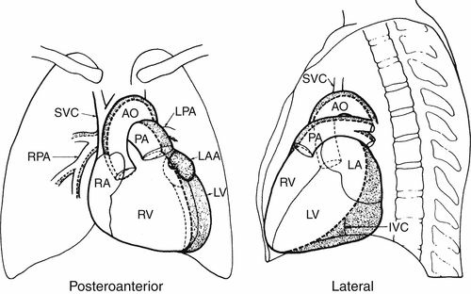
CXR
Chest radiographic findings are normal until the magnitude of the ratio of pulmonary to systemic circulation (QP/QS) exceeds 2:1(significant shunt)
With marked pulmonary over circulation, pulmonary edema may occur.
Accentuated peripheral pulmonary vascular markings and increased pulmonary venous markings may be noted. .
Prominence of the main pulmonary artery segment is an early sign of increased pulmonary artery pressure and flow.

Slide 83
Doppler Echocardiography
Gold standard for diagnosing PDA

Slide 85
Complications:
Heart failure
Infective endarteritis
Eisenmenger
Rare complications
  -aneurysmal dilatation of the pulmonary artery or the ductus
  -calcification of the ductus

Slide 86
Treatment :
Fluid restriction and watchful waiting: In a premature N.B, a PDA often closes spontaneously
If premature newborn is symptomatic and has a significant PDA after few days (3 days of life!) :
    Fluid restriction
    Mechanical ventilation
    Closure trial with medications(Pharmacologic Management) (only for preterm births)
      Ibuprofen
      Paracetamol
    Anti-failure medications (lasix ,digoxin)

Slide 87
In full-term babies, children and adults who have small PDAs without any medical symptom or problem, follow up might be enough.
    If non-significant asymptomatic PDA(mild L-R shunt) and silent (no murmur): needs f/u
    If non-significant asymptomatic PDA(mild L-R shunt) and murmur: needs f/u, and better to be closed

Slide 88
  Interventional closure of PDA:
  Trans-catheter closure
      Intravascular coils
      Amplatzer patch
  Surgical ligation --Left thoracotomy

Slide 90
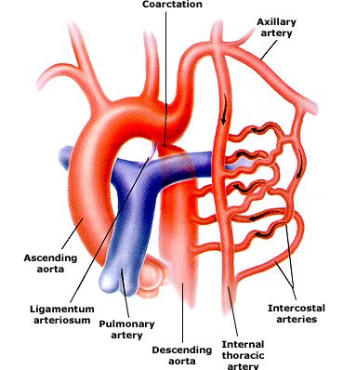
  COA
Discrete narrowing of the thoracic aorta
  Distal to left subclavian artery
    At ductus arteriosis
  Proximal to left subclavian artery
Rarely long segment or tubular hypoplasia

Slide 91
Epidemiology/ Pathogenesis
6-8% of all congenital heart defects
Male: Female 2-5:1
Sporadic; rare familial
Congenital
  Most common
Acquired
  Inflammation/Arteritis, eg, Takayasu
    Mid-thoracic, abdominal aorta
  Severe atherosclerosis

Slide 92
Pathogenesis/Pathology
Mechanism unknown
  Genetic defects?
  Intrauterine defects, eg impaired blood flow → altered endothelial development?
Medial thickening + intimal hyperplasia → posterolateral ridge encircling lumen
Surgical specimens:
  ↑ collagen
  ↓ smooth muscle mass in pre vs poststenotic areas
  Cystic medial necrosis: disarray of elastic tissue

Slide 93
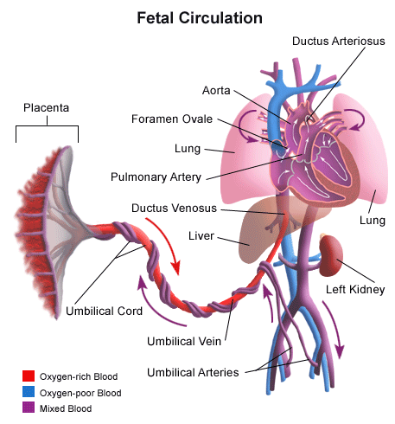
Being born can be a problem
In utero:
  High PVR, low SVR
  90% cardiac output: → PDA → descending ao
At birth:
  ↑ SVR
  ↓ PVR
  PFO and PDA closure
  CO through ascending aorta

Slide 94
Clinical Manifestations
Neonates
  Absent/delayed femoral pulse
  Differential cyanosis if severe and large PDA R→L shunt
  Heart failure/ shock in first days of life
Children
  Delayed diagnosis in mild coarctation
  Chest pain with exercise, cold extremities, claudication
Adults
  Hypertension
  Claudication

Slide 95
  Differential Blood Pressure
Classic findings
  Hypertension in upper extremities
      Mechanical obstruction
      ↑ renin secretion → volume expansion
      Less sensitive baroreceptor reflex
      Reduced arterial compliance
  Decreased/ delayed femoral pulse
  Low blood pressure in lower extremities

Slide 96
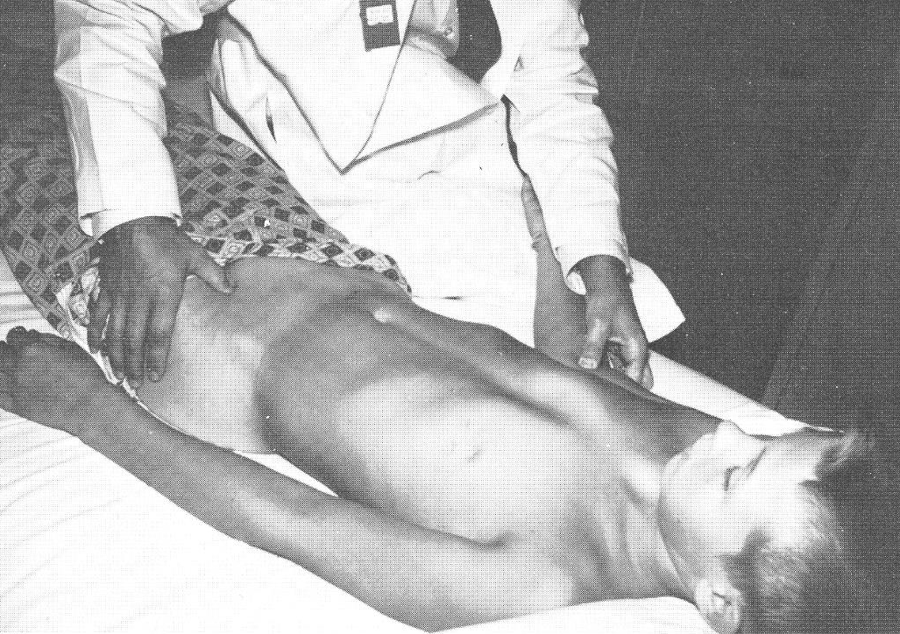
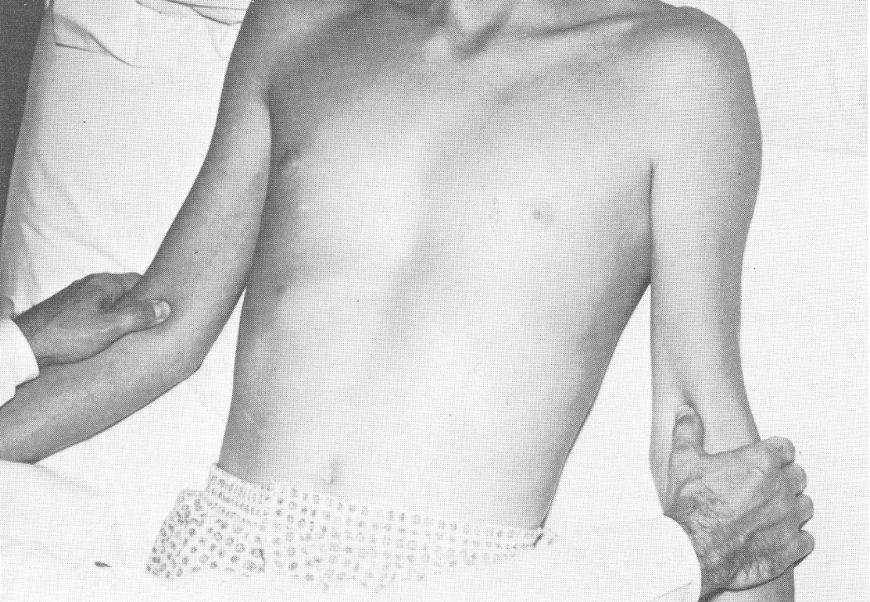

Slide 97
Neurologic Comorbidities
Increased frequency of intracranial aneurysms
Dilation of collateral spinal arteries → compress spinal cord

Slide 98
Cardiac Exam
Often normal without co-existing defects.
Continuous murmur if large collateral vessels.
Systolic ejection click and/or murmur if bicuspid aortic valve.
Vascular murmur from flow across Coarctation itself.

Slide 99
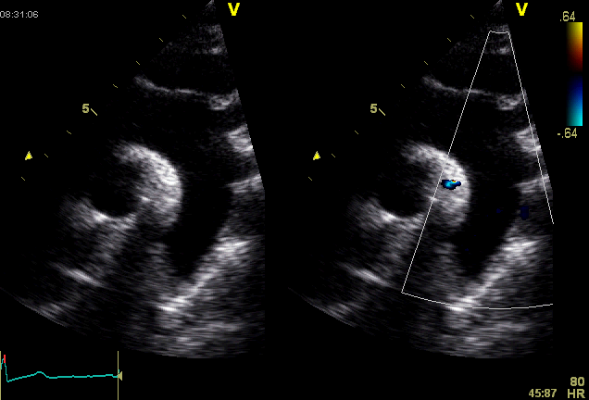
ECHO
Normal Aortic Arch

Slide 100
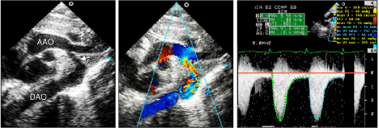
COARCTATION

Slide 101
ECG
Neonates
  Sinus tachycardia
  Right ventricular hypertrophy
  Right axis deviation
  Left ventricular hypertrophy (more rare and more late and in the cases with assotiated lesions)
Children
  Left ventricular hypertrophy
  Left axis deviation (think of AVC, DORV)
  Right ventricular hypertrophy if pulmonary hypertention

Slide 102
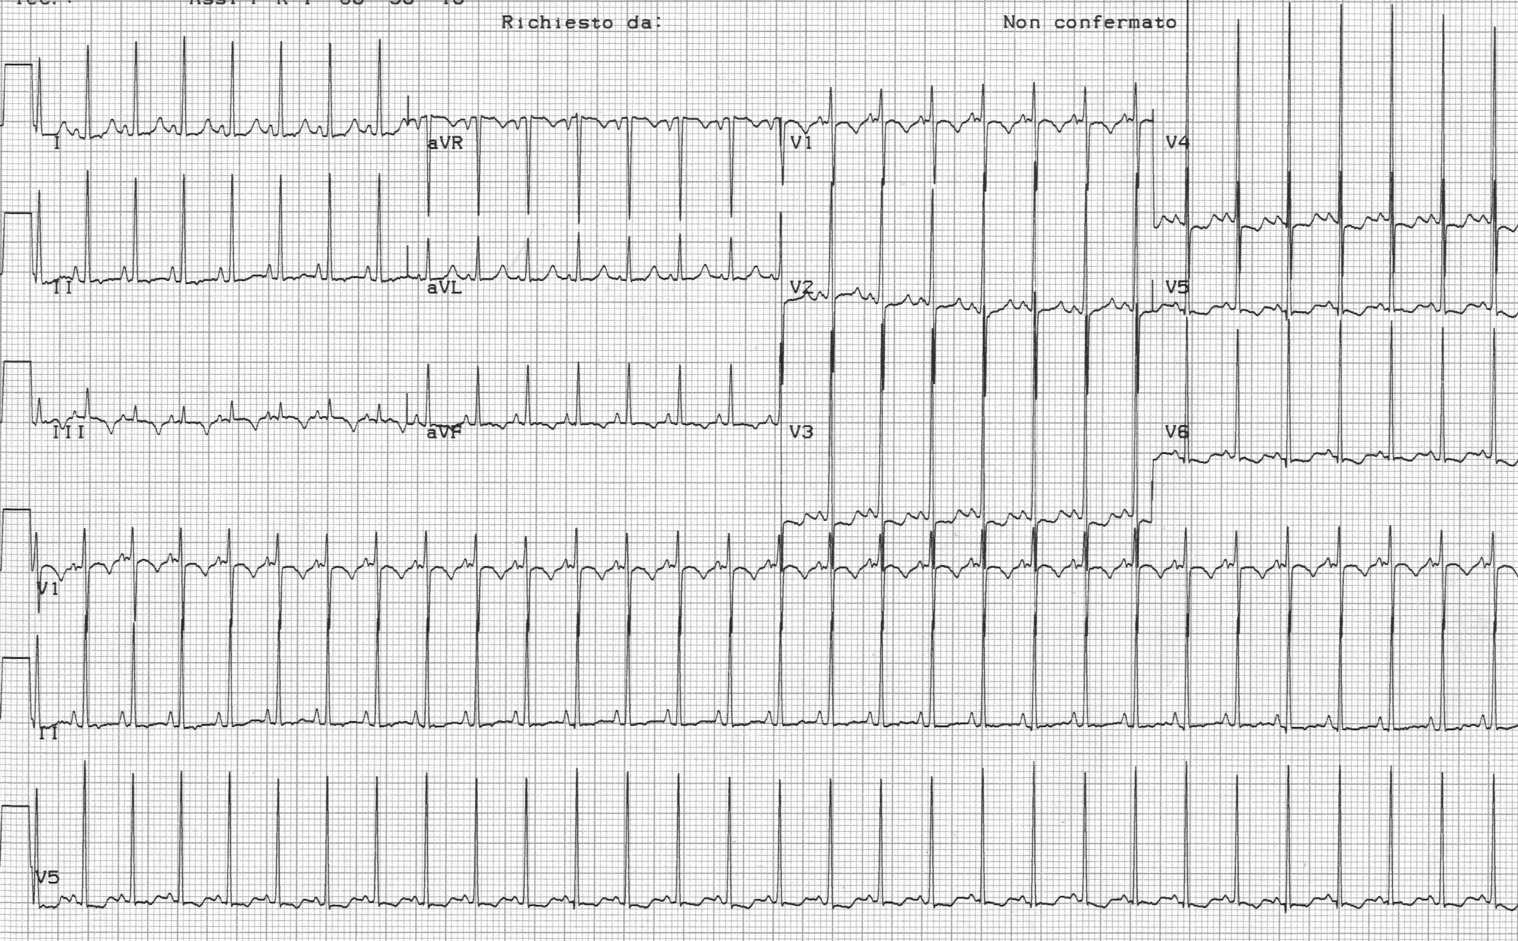

Slide 103
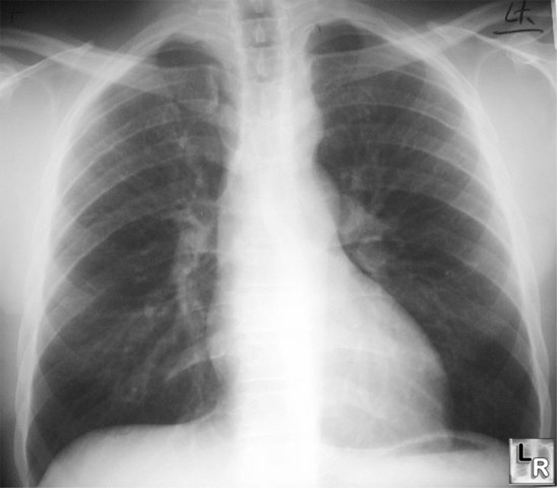
CXR
Infants with severe disease: cardiomegaly, heart failure
Notching posterior ribs: erosion by collaterals
“3” Sign: Indentation of aortic wall with pre and poststenotic dilatation

Slide 104
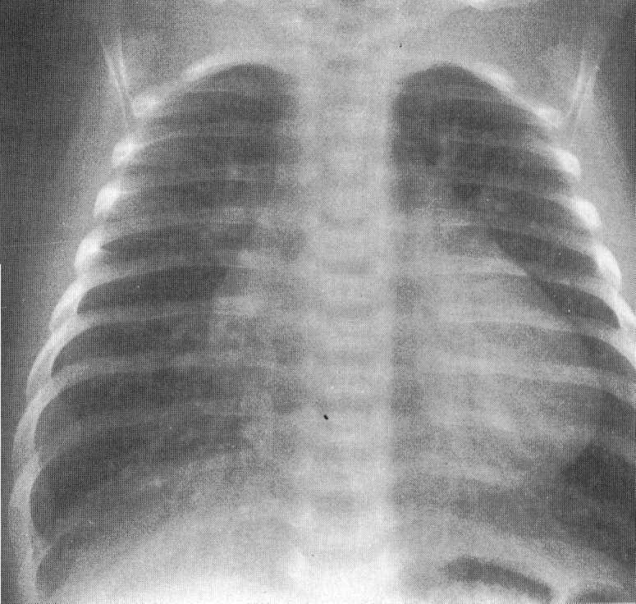

Slide 105
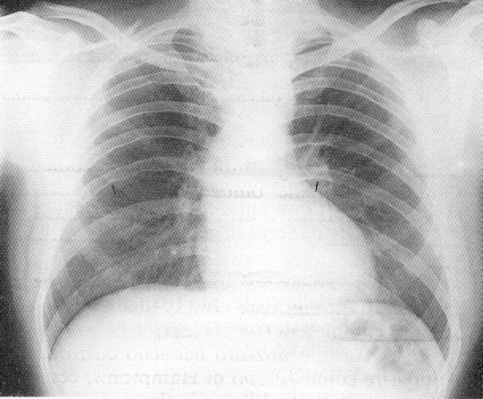

Slide 106
COA: Early neonatal presentation management
  Prostaglandin E1 (0.05-0.1 mcg/kg/min) infusion to open DA.
  Anti-failure medication for congestive heart failure (CHF) treatment.
  Inotropic medications (as dopamine, dobutamine, or epinephrine) may be used in case of lv dysfunction assotiated with hypotention.
  Renal function and urine output monitoring.
  ABGs and metabolic acidosis monitoring.
  After stabilization with medication , N.B will be ready for surgical intervention.

Slide 107
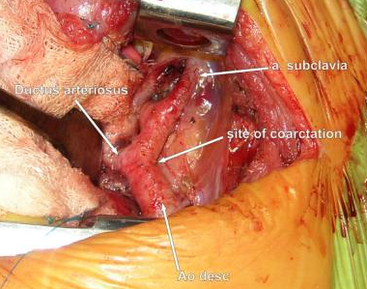
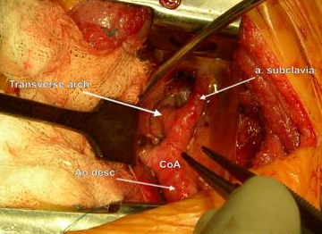
Surgery

Slide 108
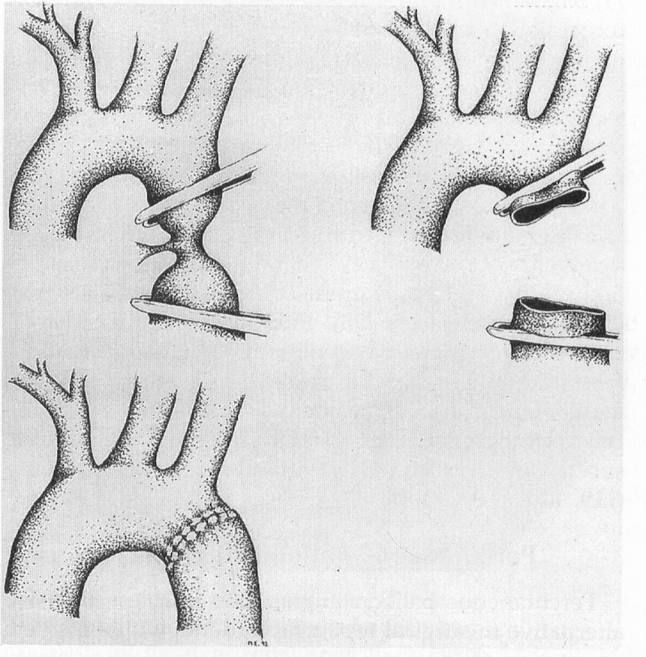
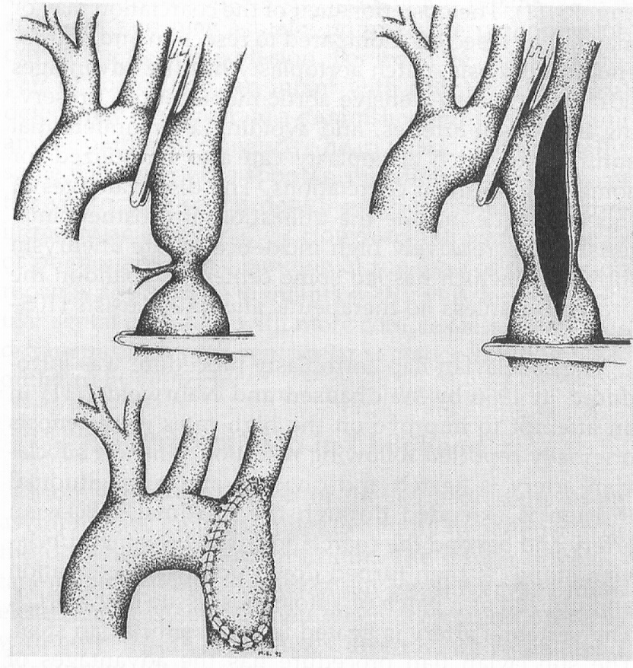
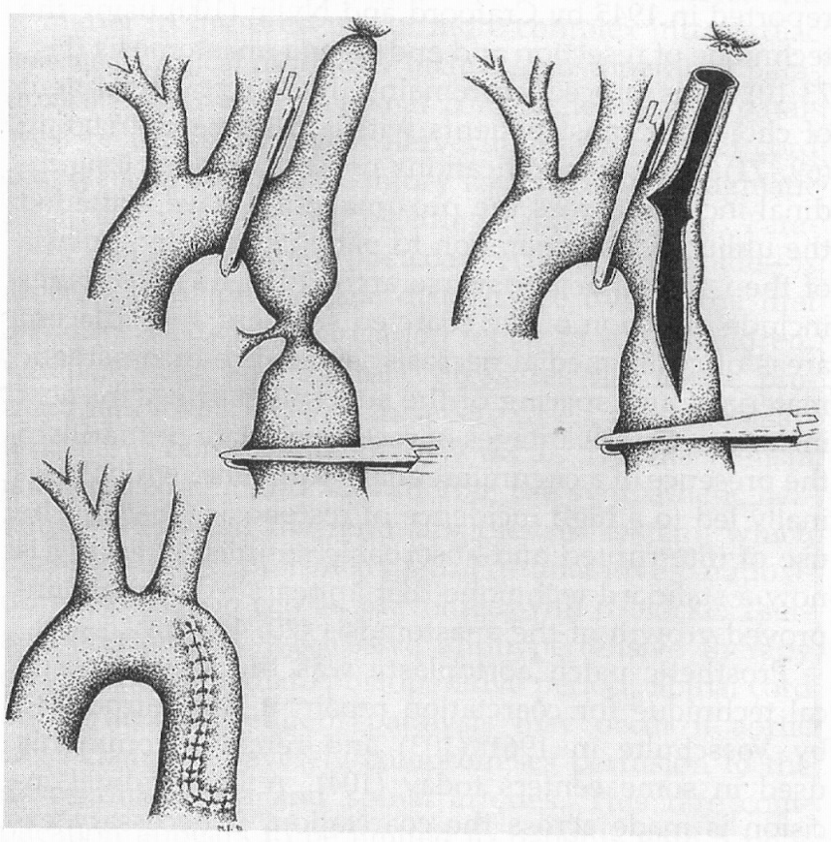

Slide 109
COA:Late presentation of coarctation of the aorta
  If there is Significant hypertension or congestive heart failure (CHF), Surgical relief of the aortic obstruction or hemodynamic interventional techniques (as balloon angioplasty with stent) is indicated
  Proper imaging with MRA or Aortic arch MRI may be needed for proper evaluation to select the best way of coarctation intervention

Slide 110
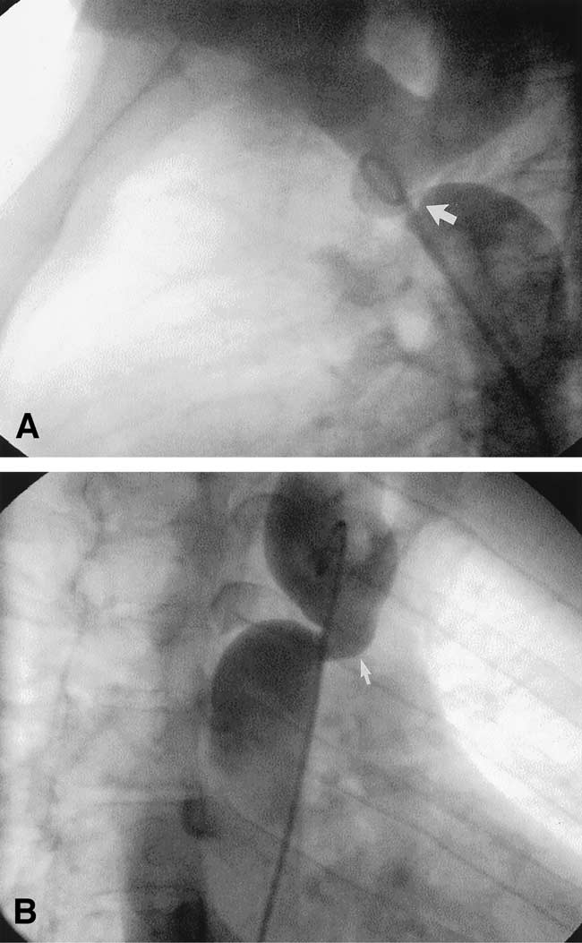
Cardiac Catheterization

Slide 111
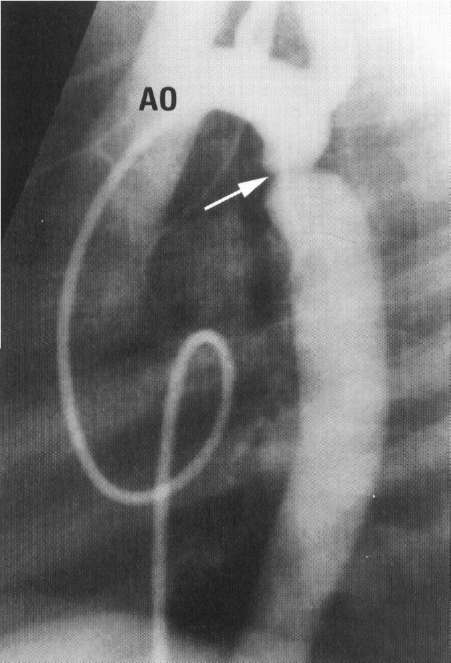
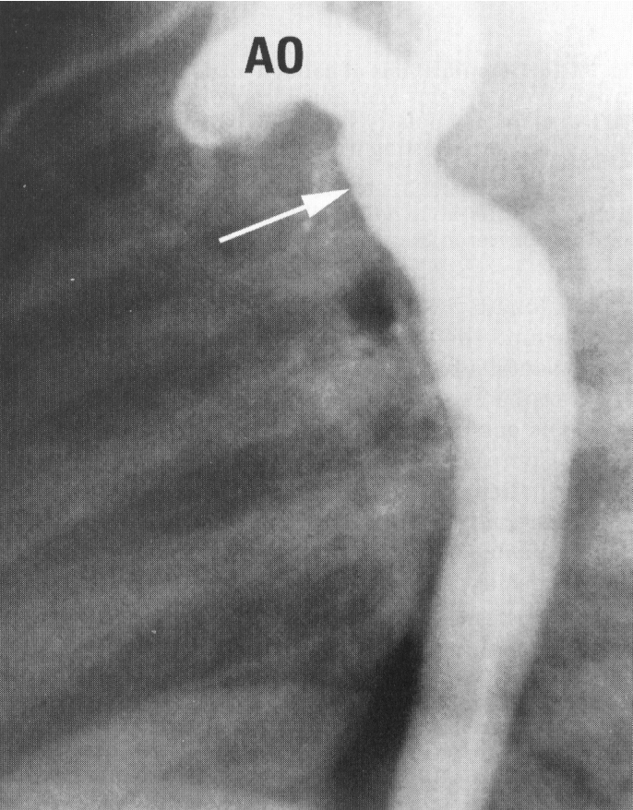
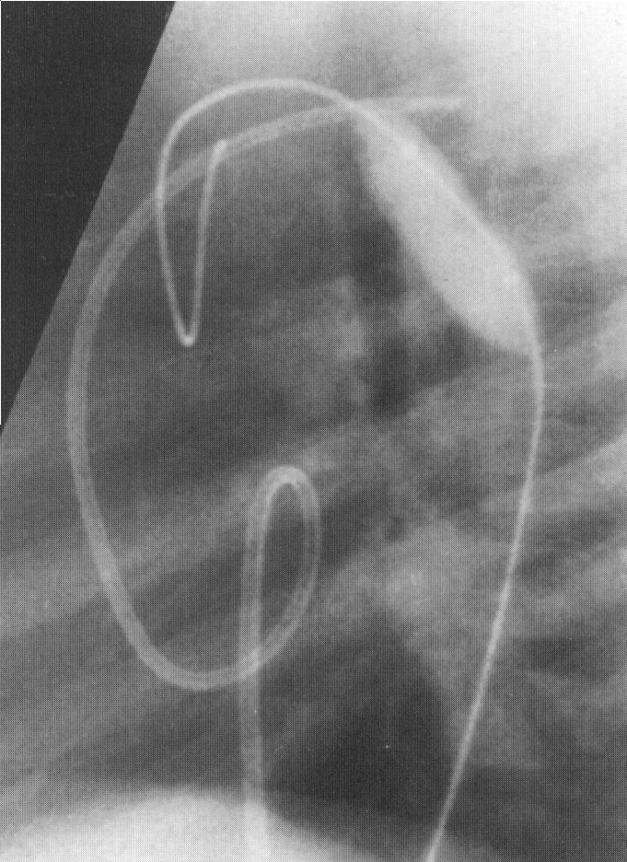

Slide 112
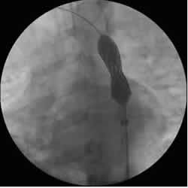
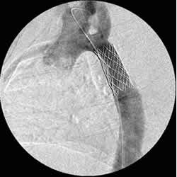

Slide 113


Balloon Angioplasty (BA)

Slide 114
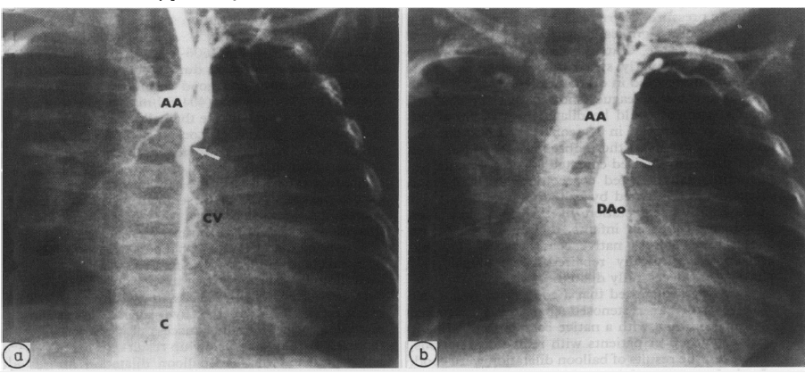

Slide 115
THANK YOU FOR YOUR ATTENTION

