Slide 1
Fluid therapy in children
Dr Doaa Al Qaoud
Peds nephrologiest

Slide 2
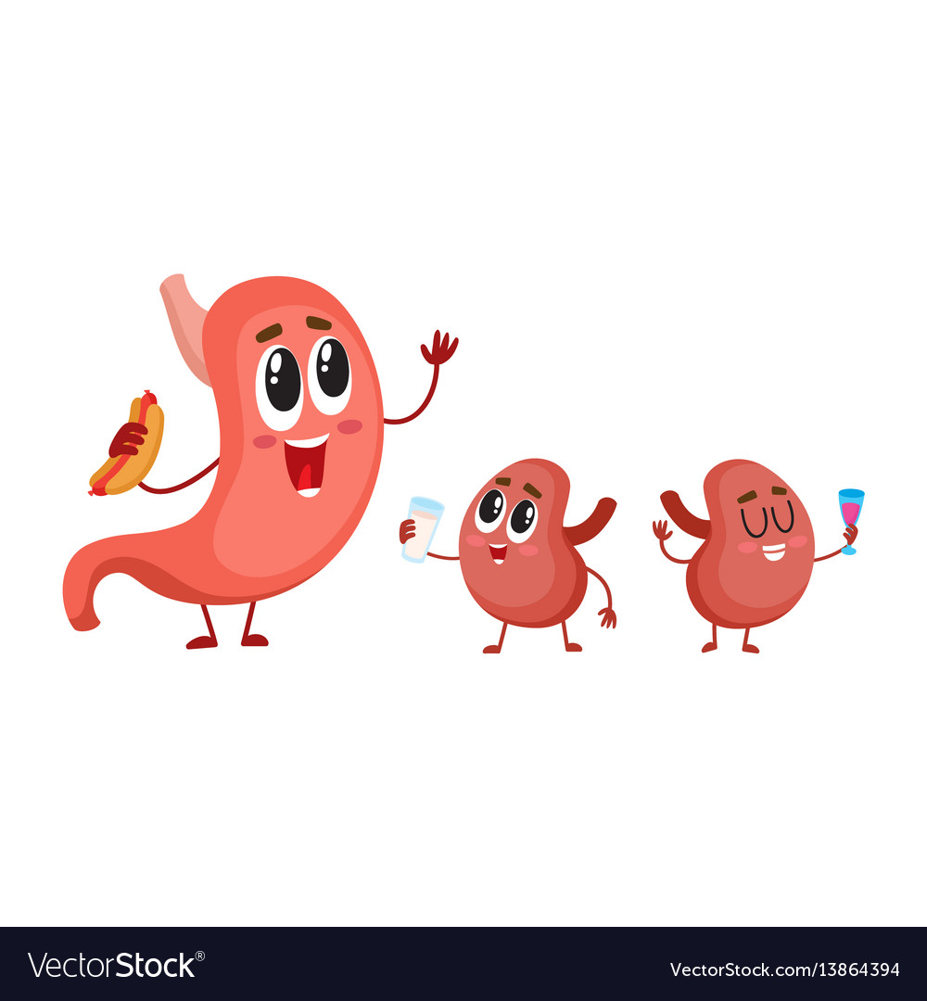

Slide 3
Definitions
Maintenance fluid
Replacement fluid
Ongoing losses
Dehydration
Body composition and total body waight
Osmolality

Slide 4
Water is the most plentiful constituent of the human body.
Total body water (TBW) has 2 compartments..
Intracellular and Extracellular
Intracellular …30-40%
Extracellular …20-25%

Slide 5
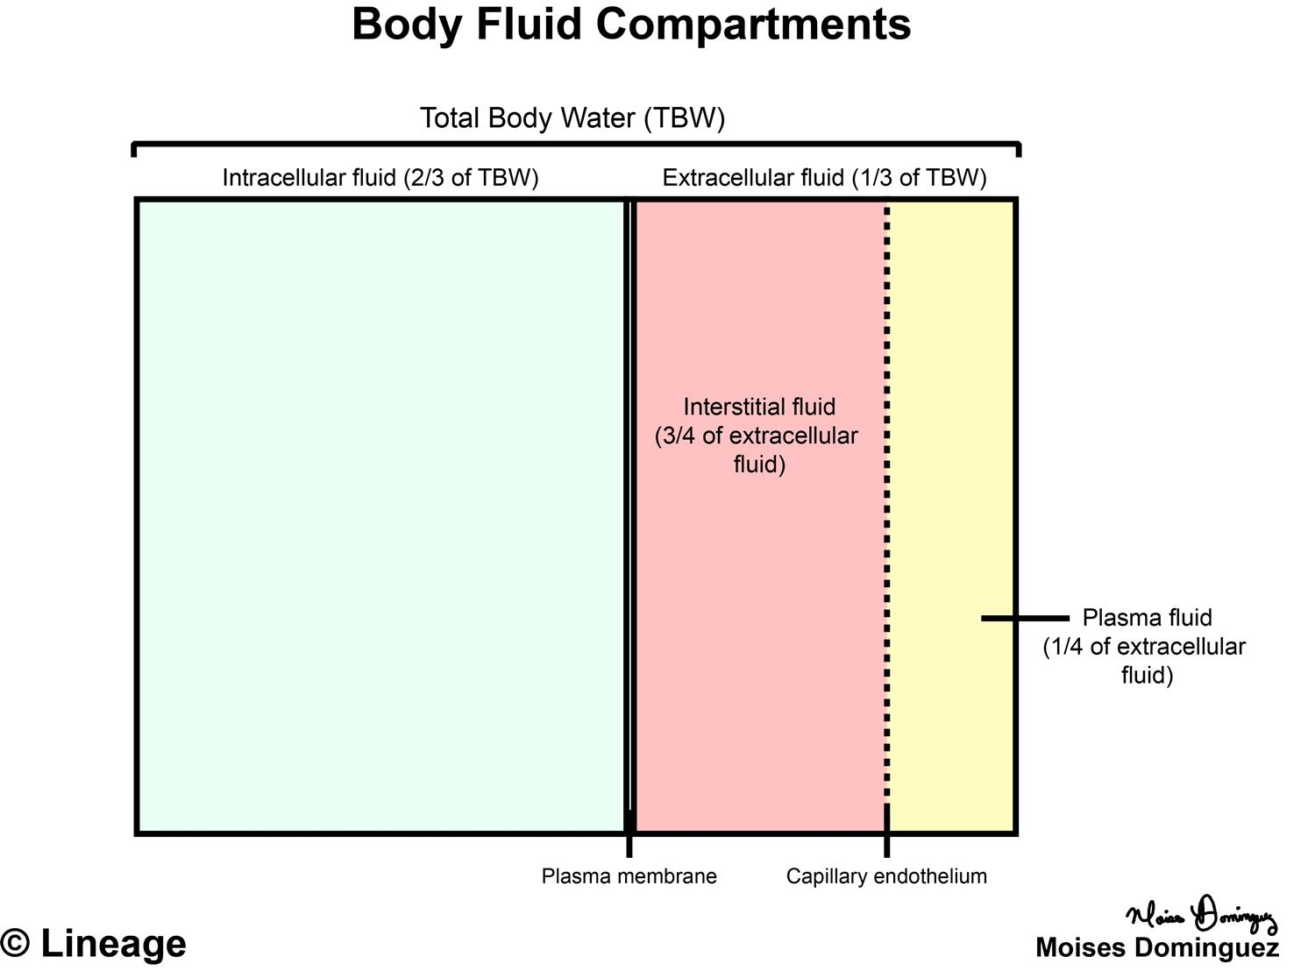

Slide 6
Regulation of intravascular volume
Plasma osmolality (285-295 mOsm/kg).
If plasma osmolality increase ……stimulate thirst….. And increase anti diuretic hormone(ADH)
ADH regulate Urinary water loss .
Renin angiotensin system…????
Atrial natriuretic peptide.?????

Slide 7
Maintanance fluids therapy
Why ?
content….. Water, glucose,sodium,potassium and chloride.
Used to replace normal on going losses of electrolyte from the urine and stool. And water losses from the urine, stool ,skin and the lungs.
Glucose…..%

Slide 8
Daily water losses are measurable (urine and stool),and not measurable from skin and lungs(insensible).

Slide 9
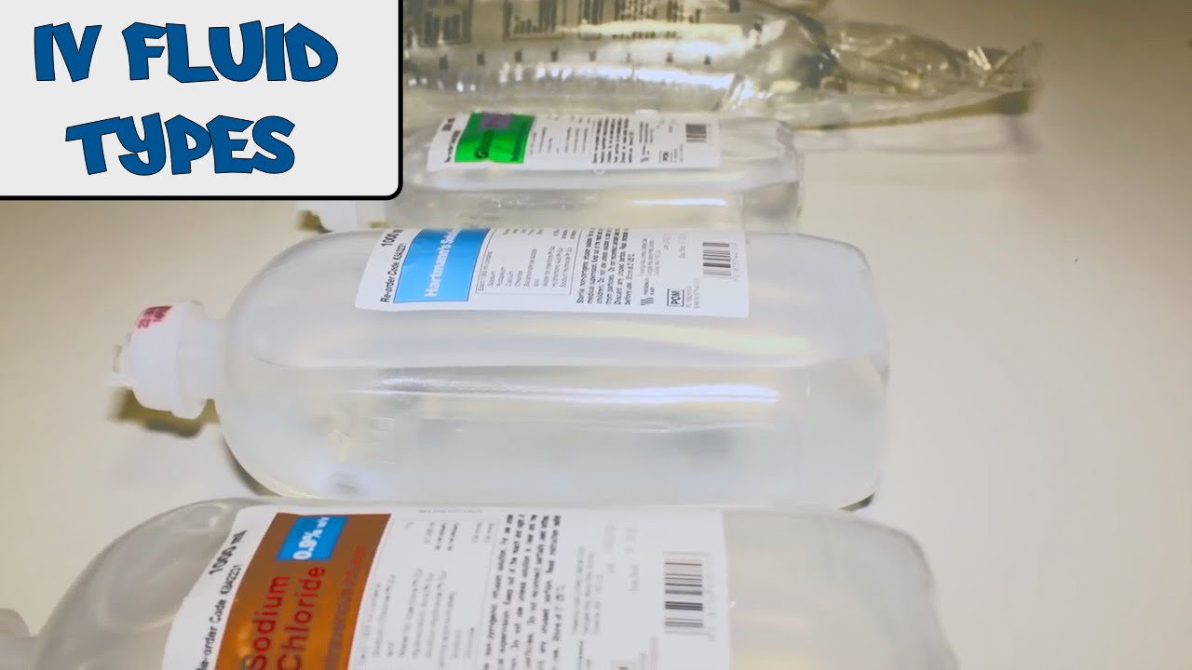
Type of intravenous fluid

Slide 10
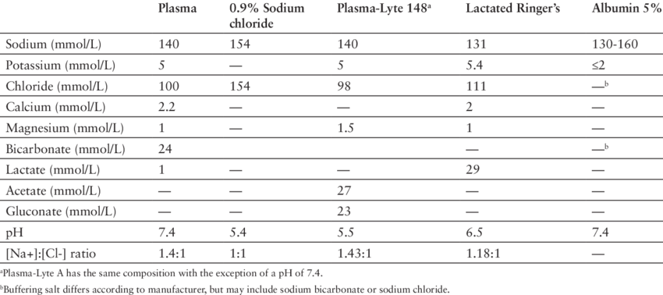

Slide 11
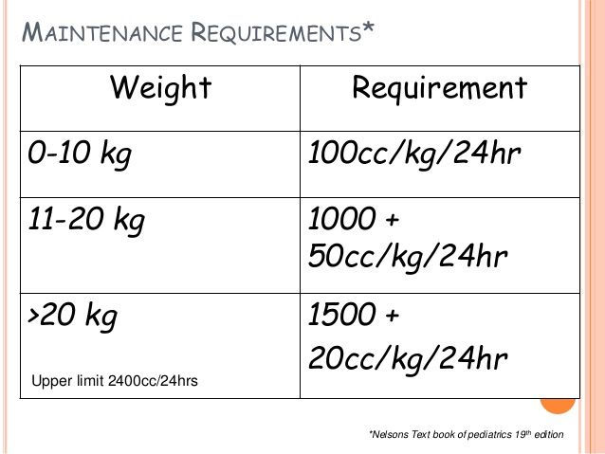
Maintanance requirements

Slide 12
First 10 kg | 100 mL/kg/day | 4ml/kg/hr
Second 10 kg | 50ml/kg/day | 2ml/kg/hr
Every kg thereafter | 20ml/kg/day | 1ml/kg/hr
Table 2. Holliday-Segar Method for Calculating Maintenance Fluid Requirements in Children
Holliday-Segar Method Holliday-Segar Estimate

Slide 13
Normally serum Na concentration is approximately 140 meq/l and serum K concentration is approximately 4 meq/l
Maintenance solution replaces normal losses
Maintenance solution does not have an electrolyte concentration equal to serum because the electrolyte composition of urine and stool is not equal to that of serum
Maintenance fluids commonly provided a 5% dextrose solution
Dextrose provides some energy and prevents hypoglycemia

Slide 14
Electrolyte Maintenance
Sodium and chloride − 2 to 3 mEq/100 mL of water per day
Potassium − 1 to 2 mEq/100 mL of water per day In children with normal serum potassium levels and renal function
potassium chloride is usually added to maintenance fluids at a concentration of 10 mEq/L for small children with weights <10 kg, and for larger children with weights ≥10 kg, a concentration of 10 to 20 mEq/L is provided.

Slide 15
Choice of IVF.
Normal saline (154mEq/L).
Usually after calculating electrolyte and fluid requirements child receive 5% D5 in forth or third saline .
HOW????

Slide 16
Case 1.
10 months old.
Current weight is 8 kg.
Refuse oral feeding..
…. Calculate his IVF maintenance …
Answer.

Slide 17
Maintenance fluid 100*8=800 cc
Maintenance NA 3*8=24 meq
Main……K 2*8=16 meq
type of fluid is 0.18 % glucose saline
Rate of fluid replacement is 800/24=33cc/hr

Slide 18
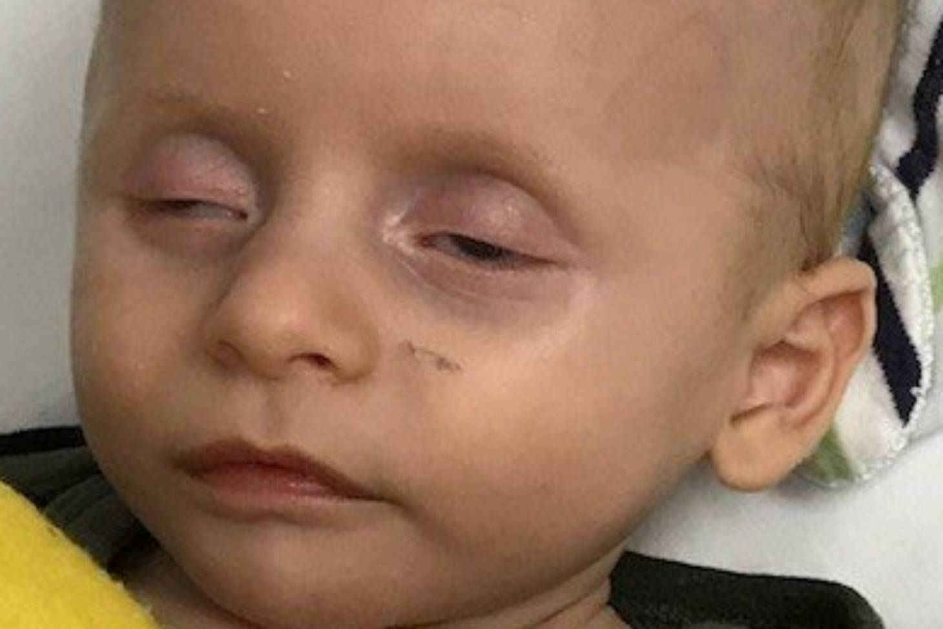
Dehydration.

Slide 19
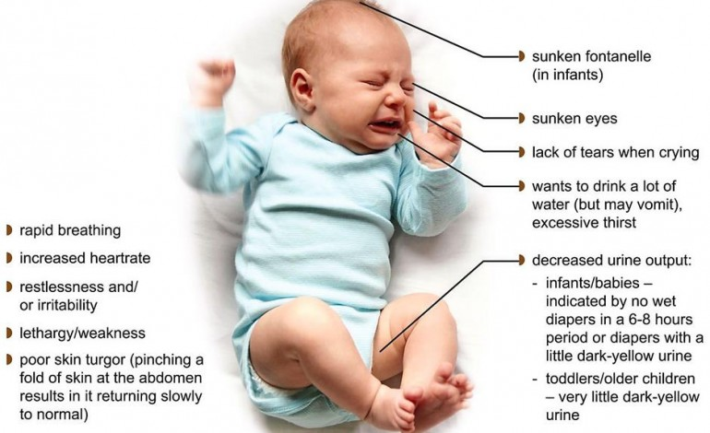

Slide 20
Dehydration: Isonatremic, Hyponatremic, and
Hypernatremic Recognition and Management

Slide 21
Dehydration is significant depletion of body water and electrolytes.
Symptoms and signs include thirst, lethargy, dry mucosa, decreased urine output.
tachycardia, hypotension, and shock occure later.
Diagnosis is based on history and physical examination.
Treatment is with oral or IV replacement of fluid and electrolytes.

Slide 22
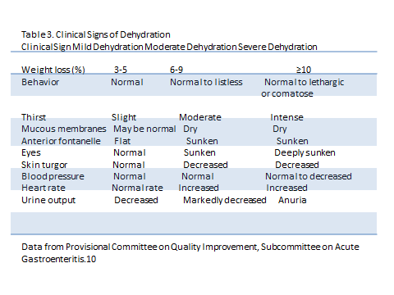

Slide 23
Etiology
Increased fluid loss, the most common source of increased fluid loss is the gastrointestinal tract—from vomiting, diarrhea, or both (eg, gastroenteritis)
Decreased fluid intake
Both

Slide 24
Signs and symptomes
Thirst
Dry mucus membrane
Lethargy
…and….
depend on severity and degree of dehydration.

Slide 25
Approach to dehydration
Act fast
Assess the degree of dehydration
Restore intravascular volume and tissue perfusion
Give IV fluid bolus.. Isotonic solution like NS
20 ml /Kg over 20 minutes
Repeat and re assess…

Slide 26
Calculation of fluid deficit
Deficit is the percentage of dehydration multiplied by the weight.
For the next 24 hours.
How..???

Slide 27
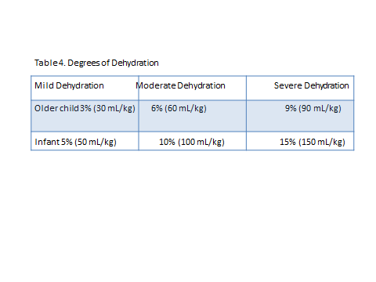

Slide 28
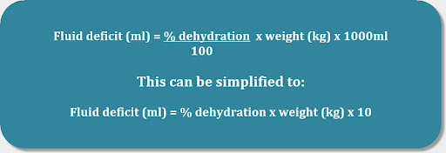

Slide 29
Case 2
12 kg
Sever dehydration 10%
Serum NA is 138meq/l
Calculate…
First….
Maintanance fluid then deficit
Total volume over the next 24 hours.

Slide 30
Restore iv volum
Give 20 cc/kg iv over 20 min of isotonic solution
Re asses
Re peat
Re asses..
Calculate fluid requerment over 24 hours
Substract the bolluses
Replace the ongoing losses.

Slide 31
Ex of ongoing loss..
diarrhea
Each liter of diarrhea contain …55meq NA
…25 meq K
…15 meq HCO3

Slide 32
Monitoring and follow up..
Vital signs..
Intake and output
Sign of dehydration
Sign of fluid overload.

Slide 33
HYPO NATREMIC DEHYDRATION
NA <135 meq/l
Correction of 12 meq in 24 hours
if na less than 125 meq with symptomes (seizure) give hypertonic saline 3% .
4 ml /kg increase NA 3 to 4 meq/l
Slow correction…

Slide 34
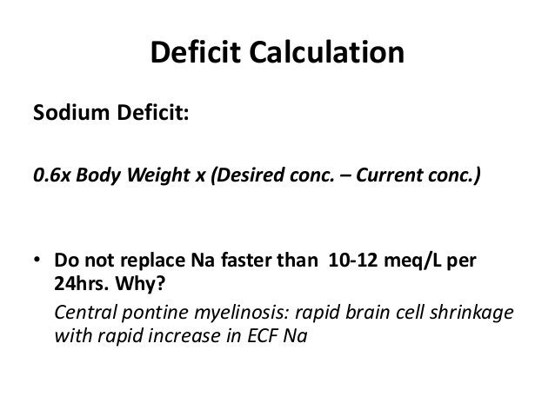
Hyponatremic dehydration..

Slide 35
HYPERNATREMIC DEHYDRATION
NA >145 meq/l
Use D5% half NS in a rate of 1.25 to 1.5 times maintenance.

Slide 36
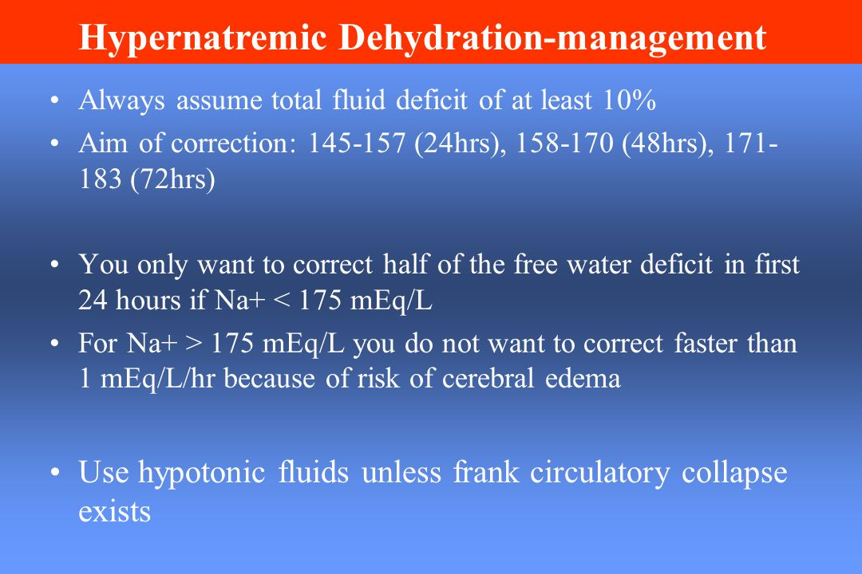

Slide 37
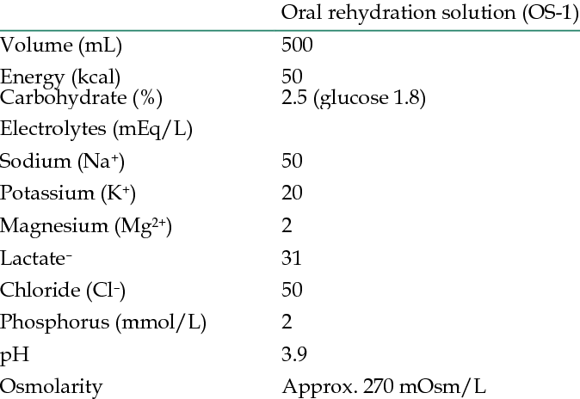
Oral rehydration

Slide 38
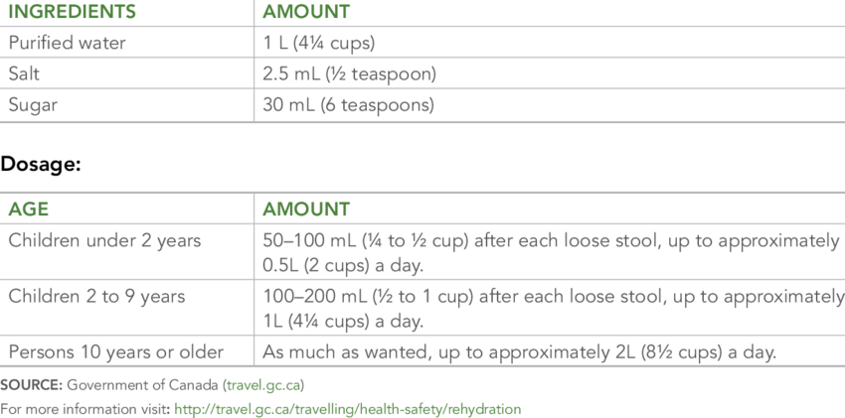

Slide 39
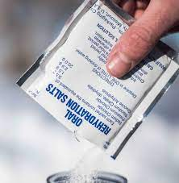

Slide 40
Questions???
Good luck.

