Slide 1
Pediatric neoplasms
Ala’a Almaaiteh, MD

Slide 2
Pediatric neoplasms
Include malignant tumors “cancers” and nonmalignant tumors
Pediatric cancers are uncommon
Less than 1% of all newly diagnosed cancer cases in US
Differs from adult malignancies in prognosis and distribution by histology and tumor site
The most common pediatric malignancy is acute leukemia, with survival rate up to 90%

Slide 3
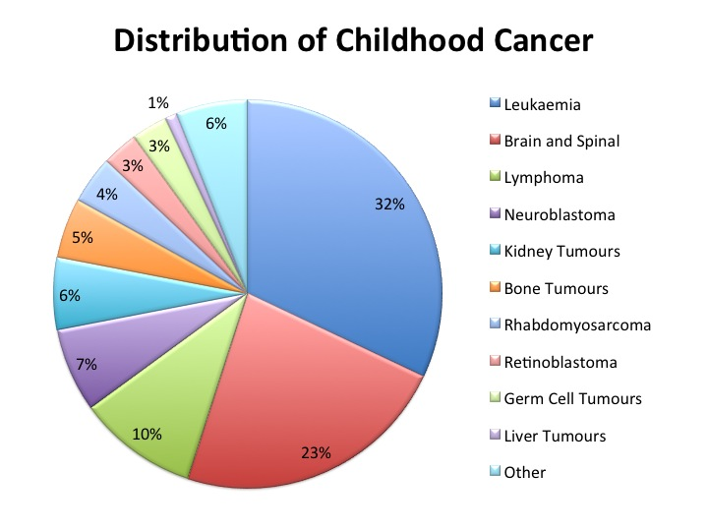

Slide 4
Leukemias

Slide 5
The leukemias
A group of malignant diseases in which genetic abnormalities in a hematopoietic cells give rise to an unregulated clonal proliferation of cells.
Accounts for 31% of pediatric malignancies
Acute lymphoblastic leukemia (ALL) accounts for 77% of cases
Acute myelogenous leukemia (AML) 11%
Chronic myelogenous leukemia (CML) 2-3%
Juvenile myelomonocytic leukemia 1-2%

Slide 6
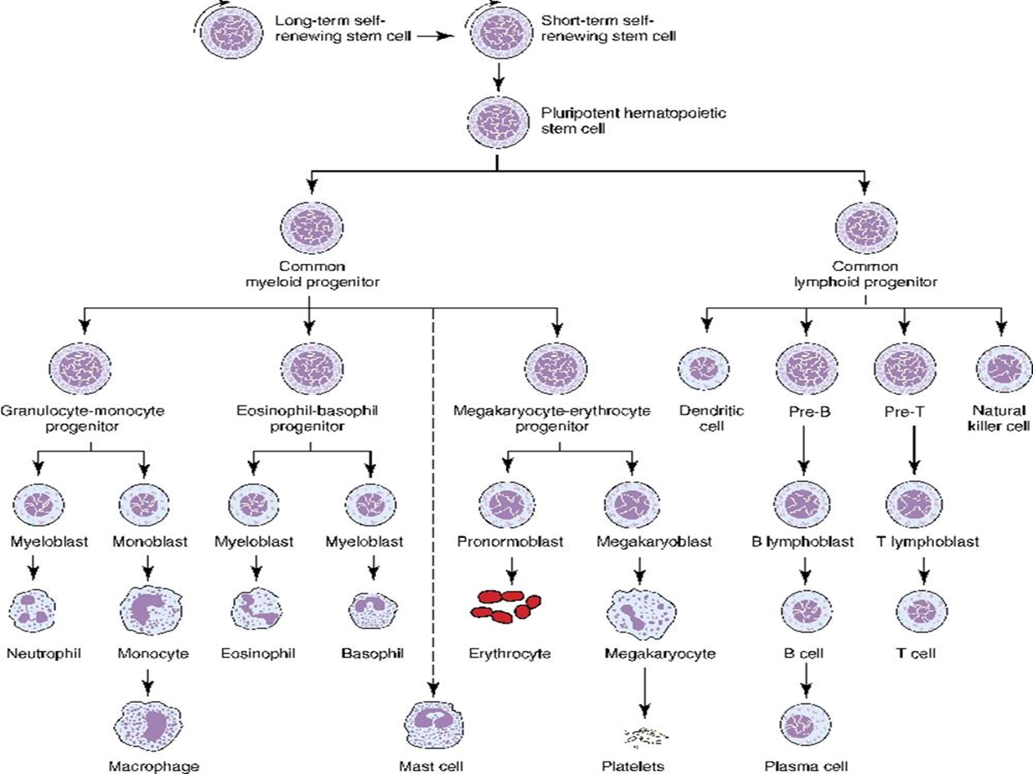

Slide 7
ALL
Incidence: 3-4/100,000
Peak age group 2-3 years
Male more than females
Etiology: unknown, several genetic and environmental factors: Chemical, Drugs, Ionizing Radiation.
More common with certain chromosomal abnormalities, e.g., down syndrome, bloom syndrome, ataxia-telangectesia, and fanconi anemia

Slide 8
Classification (immunophenotyping)
1.Pre-B ALL 85%
2.T-Cell ALL 15%
3.Mature B (Burkitt) ALL 1%
Many chromosomal abnormalities in most ALL cases are used as diagnostic and prognostic factors

Slide 9
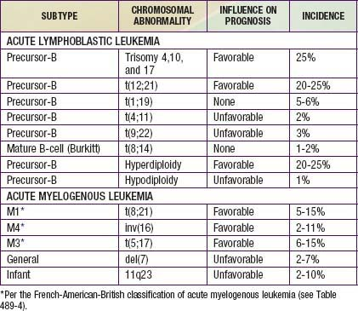

Slide 10
Good prognostic factors
1. Age : 1-10 year.
2.WBC: < 50,000
3.Chrom. Abnormalities: presence of TEL/AML1 gene. Philadelphia-negative, hyperdiploidy, absence of MLL rearrangement
4.Immunophenotype: B-cell ALL
5. No CNS involvement
6.Early Response to Chemotherapy

Slide 11
Clinical Manifestations
Initial symptoms are nonspecific and relatively brief:
  Anorexia, fatigue, malaise, and irritability
  low-grade fever
  Sever bone or, less often, joint pain, particularly in the lower extremities
  history of an upper respiratory tract infection in the preceding 1-2 mo
Later signs and symptoms of bone marrow failure
Organ infiltration can cause lymphadenopathy, hepatosplenomegaly, testicular enlargement, or central nervous system (CNS) involvement
Respiratory distress may be due to severe anemia or mediastinal node comparison of the airways.

Slide 12
Physical examination findings
pallor, listlessness
purpuric and petechial skin lesions, or mucous membrane
lymphadenopathy, splenomegaly, or, less commonly, hepatomegaly.
In patients with bone pain, there may be exquisite tenderness over the bone
CNS involvement: papilledema
Testicular mass: rare
Respiratory distress: in T-cell with large anterior mediastinal mass

Slide 13
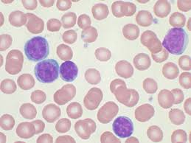
Diagnosis
CBC: most patients have sever anemia and thrombocytopenia. High WBC (not in all cases)
Blood film: peripheral blasts
bone marrow aspiration and biopsy, flow cytometry, cytogenetics, and molecular studies.
LP and CSF examination for blasts
CXR: mediastinal mass
High lactate dehydrogenase (LDH)

Slide 14
Differential Diagnosis
aplastic anemia (congenital or acquired) and myelofibrosis
Failure of a single cell line eg.e, transient erythroblastopenia of childhood, ITP, and congenital or acquired neutropenia.
Infectious mononucleosis in patients with acute onset of fever and lymphadenopathy and from rheumatoid arthritis in patients with fever, bone pain but often no tenderness, and joint swelling.
(AML) and other malignant diseases that invade the bone marrow

Slide 15
Treatment
The single most important prognostic factor in ALL is the treatment
5 years survival rate > 80%
Without effective therapy, the disease is fatal.
Duration is 2.0—3.0 years
Treatment protocol according to risk stratification (low risk, intermediate vs high risk)
Several phases: Remission induction, consolidation and intensification, maintenance phase
Several chemotherapeutic agents are used in ALL treatment
  Corticosteroids, vincristine, methotrexate (IT and IV), daunomycin
  Mercaptopurine and oral methotreaxate oral

Slide 16
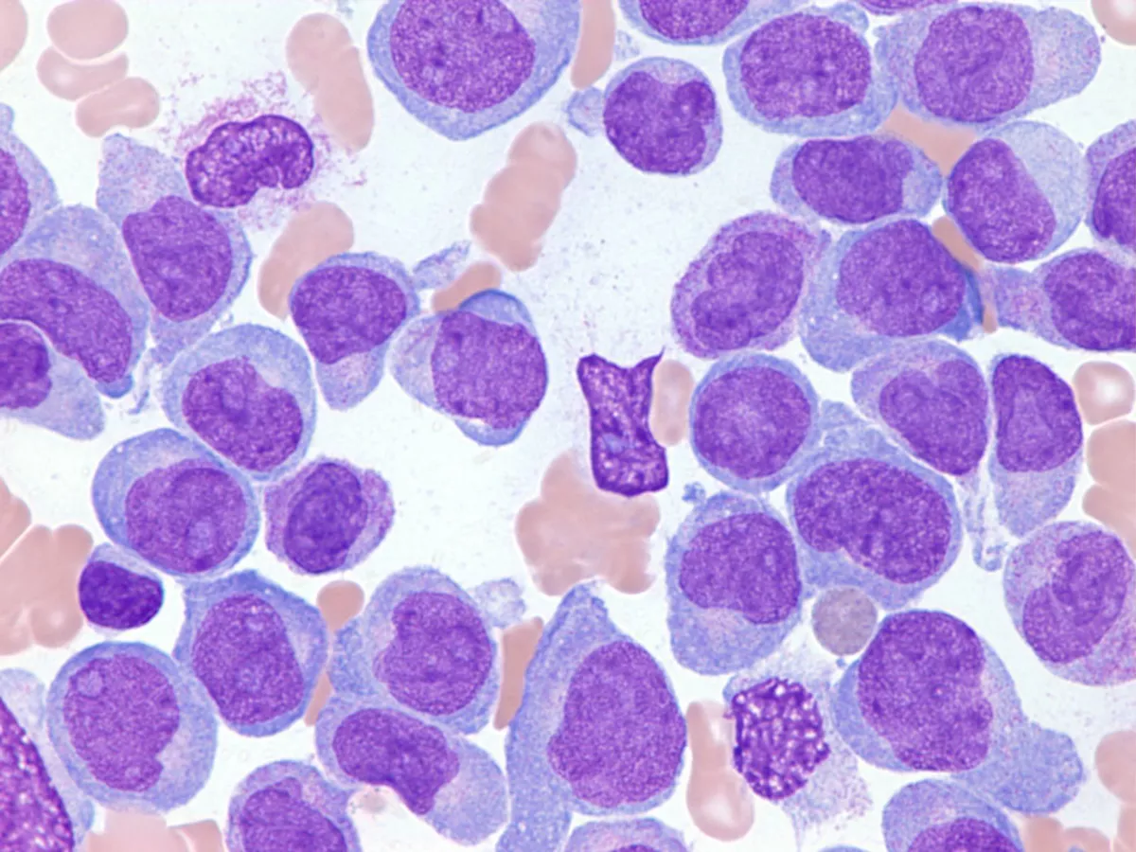
AML

Slide 17
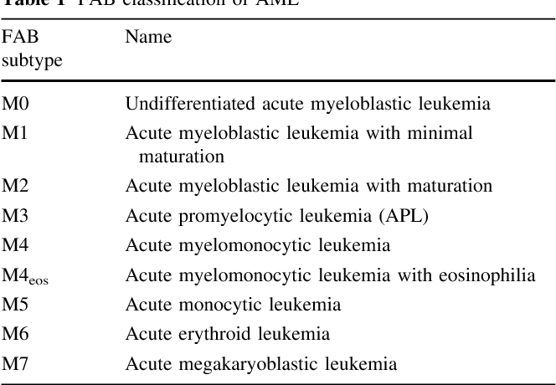
Acute Myelogenous Leukemia

Slide 18
Signs and symptoms are same as in ALL
High WBC count at presentation
M3 may present with DIC
M4 and M5 may present with gingival infiltration
M7 is most specific leukemia in Down syndrome
Carries worse prognosis than ALL
Treatment : Aggressive chemotherapy, Bone marrow transplant (for unfavorable prognosis)

Slide 19
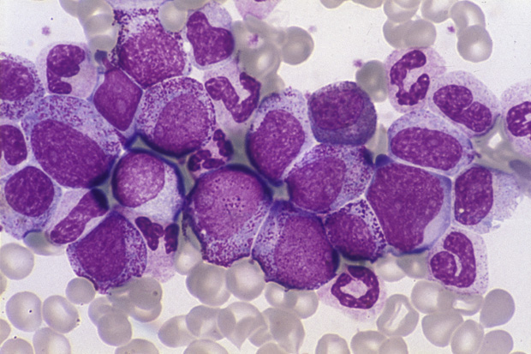
CML

Slide 20
Initial chronic phase in which malignant clone produces high WBC. Mild anemia and thrombocytosis
Splenomegaly
chronic phase lasts 3-4 years and ends by “Blast crisis” which mimic ALL
95% of CML cases have positive Philadelphia chromosome “t(9;22)” resulting in a BCR-ABL fusion protein
Treatment:
  hydroxyurea
  Imatinib: specifically inhibts BCR-ABL production
  BMT

Slide 21
Lymphoma

Slide 22
Most common cancer in adolescents
Two major types:
  Hodgkin disease
  Non-Hodgkin lymphoma (NHL)
Unknown etiology, EBV plays causal role in both conditions
Hodgkin disease peaks in the adolescent/young adult. NHL increases with age.
NHL in childhood are diﬀuse, highly malignant
NHL has three histologic subtypes
NHL has association with immunodeﬁciency

Slide 23
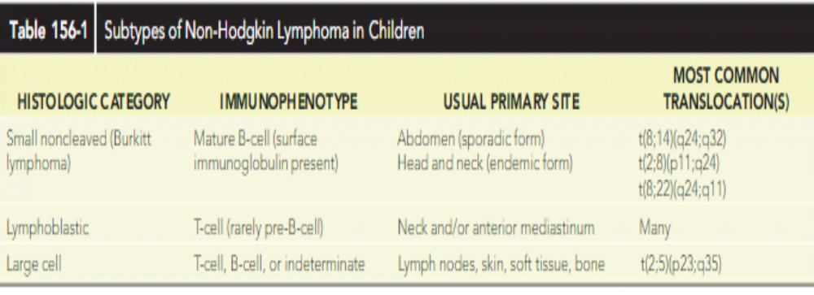

Slide 24
Clinical manifestation
painless, ﬁrm lymphadenopathy usually the supraclavicular and cervical nodes
Mediastinal lymphadenopathy producing cough or shortness of breath
B symptoms:
  Fever >38° C for 3 consecutive days
  drenching night sweats
  unintentional weight loss of 10% or more within 6 months
Burkitt lymphoma may present with abdominal mass or jaw mass

Slide 25
Diagnosis
Diagnosis is established by tissue biopsy
Pathologic hallmark of Hodgkin disease is the identiﬁcation of Reed-Sternberg cells.
Chest x-ray assesses for a mediastinal mass
CT scan for staging
PET scan
Bone marrow aspiration
CBC and blood chemistry

Slide 26
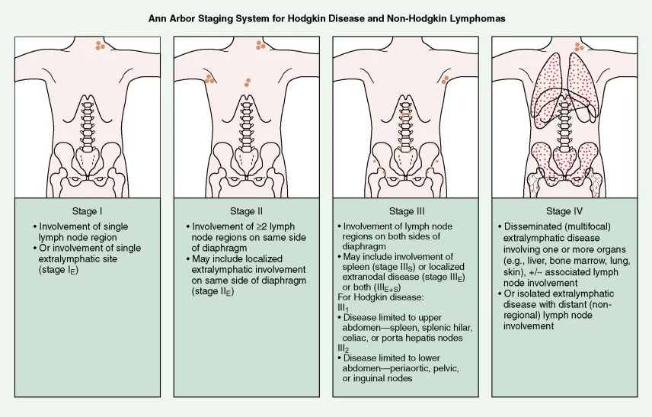

Slide 27
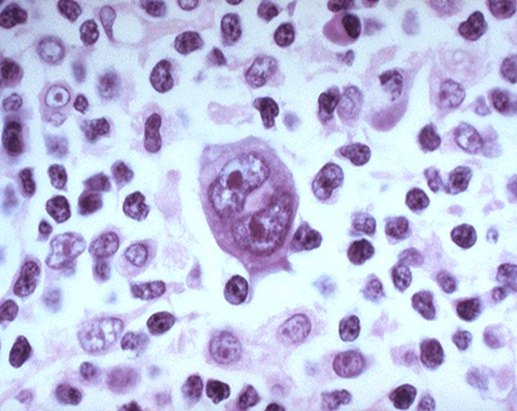
Reed-Sternberg (RS) cell
resembling an "owl's eye" appearance

Slide 28
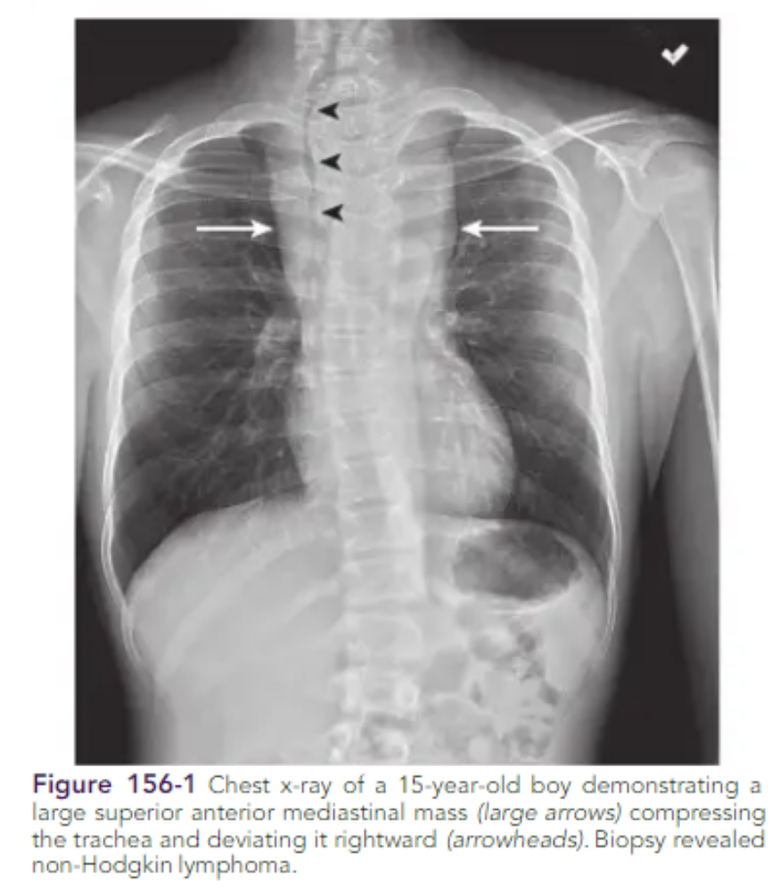
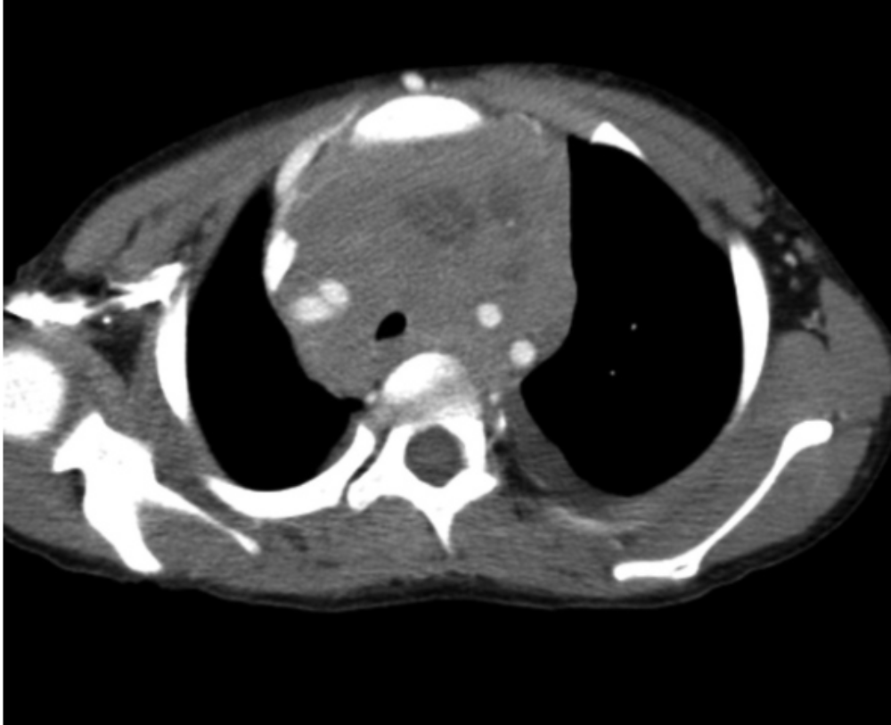
Mediastinal mass

Slide 29
diﬀerential diagnosis
leukemia, rhabdomyosarcoma, nasopharyngeal carcinoma, germ cell tumors, and thymomas.
Nonmalignant diagnoses include infectious mononucleosis (EBV infection), branchial cleft and thyroglossal duct cysts, cat scratch disease (Bartonella henselae),
bacterial or viral lymphadenitis
mycobacterial infection, toxoplasmosis
Patients with acute abdominal pain from Burkitt lymphoma may be misdiagnosed as having appendicitis

Slide 30
Treatment
For Hodgkin disease: a combination of chemotherapy with or without low-dose radiation therapy.
Chemotherapy usually consists of some combination of cyclophosphamide, vincristine, procarbazine, doxorubicin, bleomycin, vinblastine, prednisone, and etoposide.
More aggressive chemotherapy is used to treat NHL: cyclophosphamide, moderate- to high-dose methotrexate, cytarabine, doxorubicin, ifosfamide, and etoposide.
The prognosis is generally excellent. There is an approximately 90% 5-year overall survival rate,

Slide 31
Central Nervous System Tumors

Slide 32
Central Nervous System Tumors
CNS tumors are the most common solid tumors in children
Most central nervous system (CNS) tumors in children are primary tumors: low-grade astrocytomas or embryonic neoplasms (medulloblastoma, ependymoma, germ cell tumor).
Incidence is approximately 33 cases per 1 million children under 15 years of age.
The incidence peaks before age 10 years
Most CNS tumors etiology is unknown
certain inherited syndromes increase risk of CNS tumors including NF (types 1 and 2), Li-Fraumeni syndrome, and von Hippel-Lindau syndrome,

Slide 33
Clinical manifestations
increased intracranial pressure: lethargy, headache, and vomiting, (particularly in the morning on awakening), sixth cranial nerve palsy
Irritability, anorexia, poor school performance, and loss of developmental milestones
Cranial nerve deficits
Increase in head circumference may occur before sutures closure
Seizures, focal weakness or sensory changes
Pituitary involvement produces neuroendocrine effects (galactorrhea with prolactinoma, excessive growth with growth hormone secretory tumors, precocious puberty).
Cerebellar tumors are associated with ataxia and diminished coordination.

Slide 34
Laboratory/Imaging Studies
Magnetic resonance imaging (MRI) brain and spine is currently the examination of choice
CSF histologic testing is essential to determine the presence of metastatic disease
LP is contraindicated in presence of increased ICP

Slide 35
Differential Diagnosis
The differential diagnosis of a CNS :
  malignant tumor,
  benign tumor,
  AV malformation, aneurysm,
  brain abscess,
  intracranial hemorrhage,
  pseudotumor cerebri,
  vasculitis,
  metastatic tumor

Slide 36
Treatment
depends on the tumor type, location, size, and associated symptoms.
High-dose dexamethasone often is administered immediately to reduce tumor-associated edema
radiation therapy often is combined with chemotherapy
Surgical complete excision, or maximal debulking
The 5-year overall survival rate associated with all childhood CNS tumors is approximately 50% to 60%

Slide 37
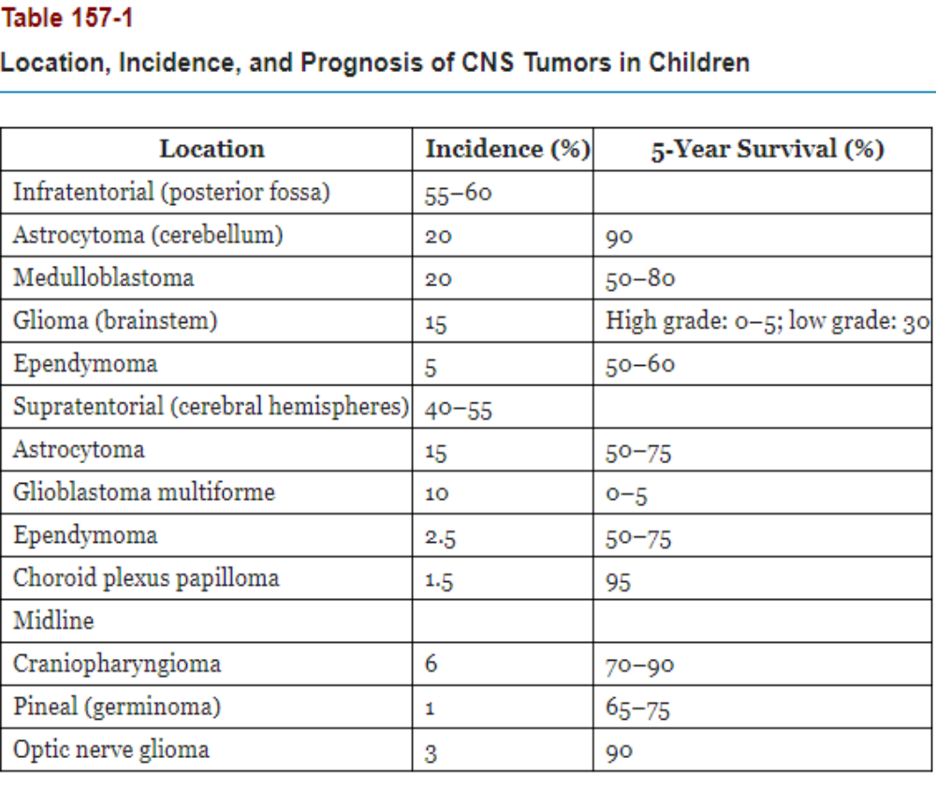

Slide 38
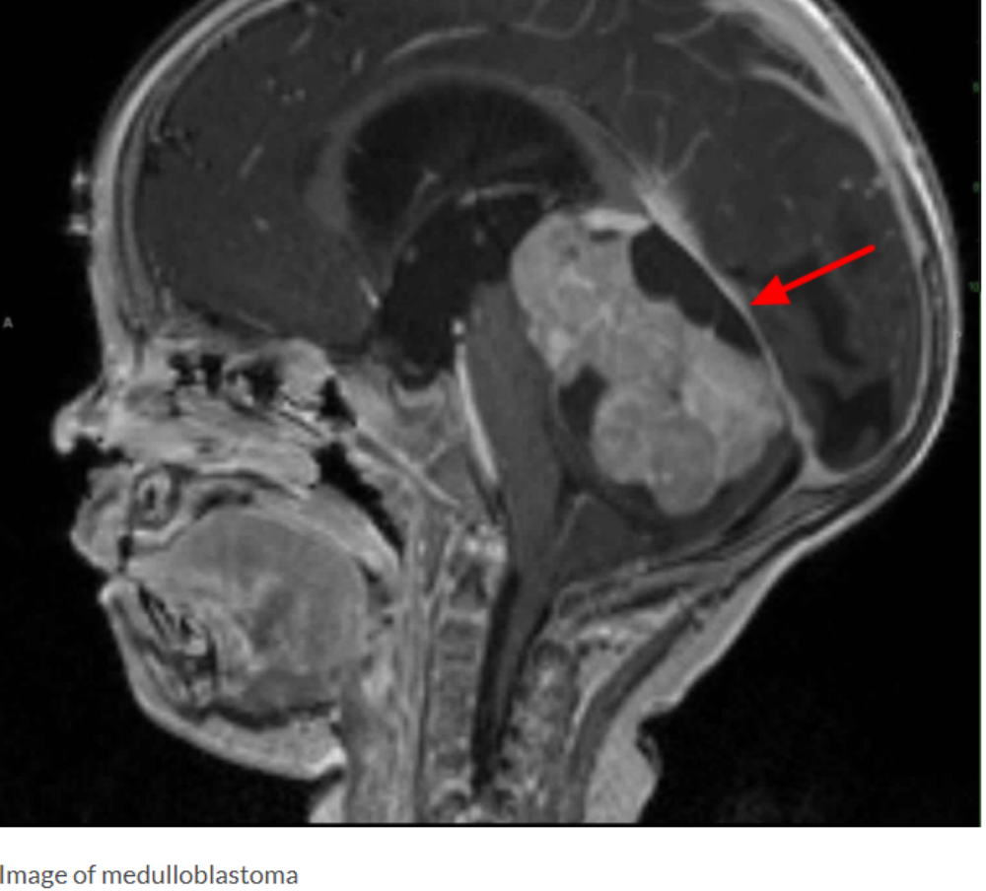
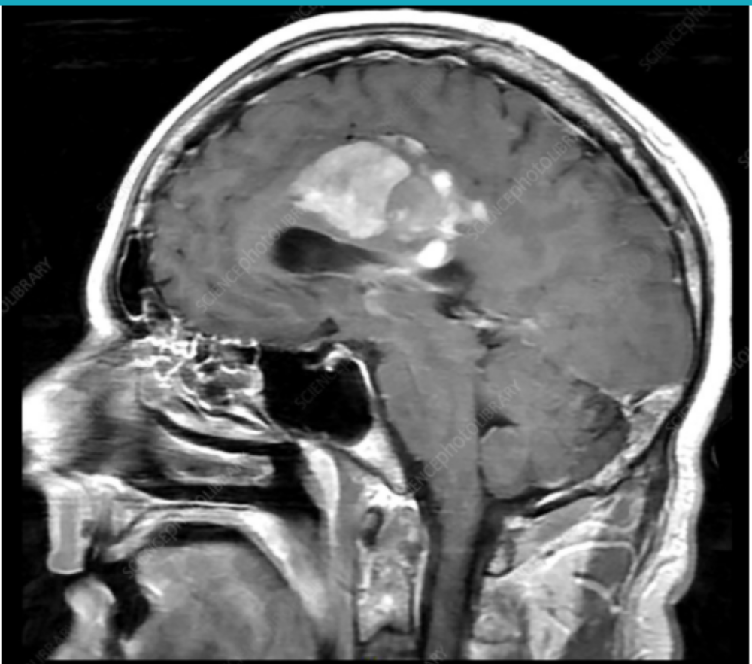


Slide 39
Neuroblastoma

Slide 40
Neuroblastoma
The most common extracranial solid tumor of childhood and the most common malignancy in infancy.
derived from neural crest cells that form the adrenal medulla and the sympathetic nervous system
Etiology unknown
The median age at diagnosis is 20 months

Slide 41
Clinical Manifestations
The most common presentation is abdominal pain or mass
45% of tumors arise in the adrenal gland, and 25% arise in the retroperitoneal sympathetic ganglia.
Metastatic disease: ill and have systemic complaints, such as fever, weight loss, and pain
spinal cord compression
Horner syndrome
several paraneoplastic syndromes, including secretory diarrhea, profuse sweating, and opsomyoclonus
mets to multiple organs, including the liver, bone, bone marrow, and lymph nodes
Periorbital ecchymoses is a sign of orbital bone involvement.

Slide 42
Laboratory/Imaging Studies
CBC
X-ray: Calcification within abdominal
urinary catecholamines: About 90% of neuroblastomas produce catecholamines (Vanillylmandelic acid; Homovanillic acid)
Definitive diagnosis of neuroblastoma requires tissue biopsy
A computed tomography (CT) scan of the chest, abdomen, and pelvis;
Metaiodobenzylguanidine “MIBG” scan;
bilateral bone marrow aspiration and biopsies;

Slide 43
Differential Diagnosis
Wilms tumor
Leukemia: if there is bone marrow mets.
Child abuse: in presence of peri-orbital ecchymosis
Treatment:
Chemotherapy +/- surgical resection +/- radiotherapy

Slide 44
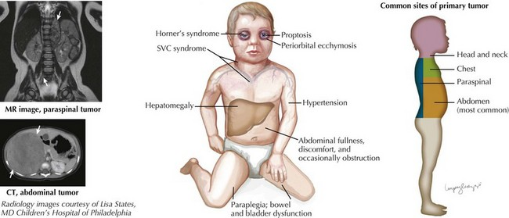

Slide 45
Wilms Tumor

Slide 46
Wilms Tumor
the most common malignant renal tumor of childhood
The mean age at diagnosis is 3 to 3.5 years of age
Congenital anomalies are associated with Wilms tumor: sporadic aniridia, Beckwith-Wiedemann syndrome, and genitourinary abnormalities.
Most common presentation is abdominal mass that is discovered by the parents
Other associated symptoms: abdominal pain, fever, hypertension, and hematuria.
Treatment: neoadjuvant chemotherapy followed by nephrectomy and then adjuvant chemotherapy

Slide 47
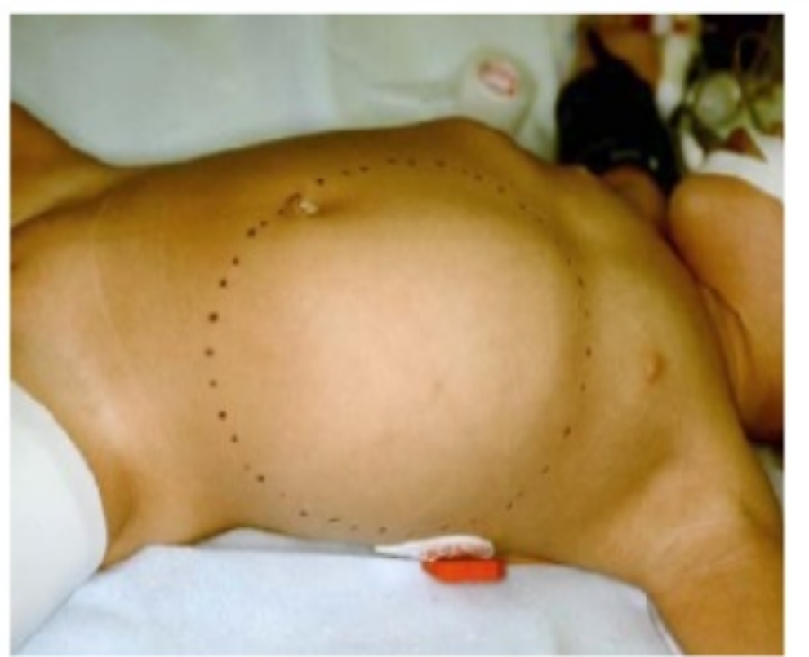
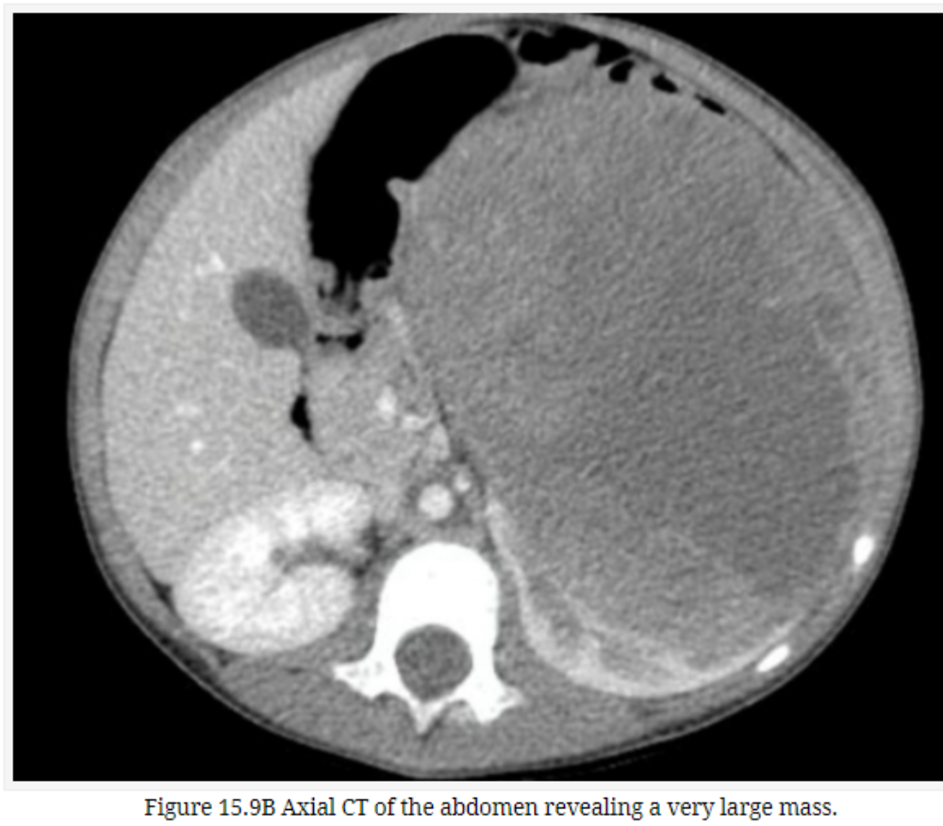
Wilms tumor

Slide 48
Sarcomas

Slide 49
Sarcomas
Two types: soft tissue sarcomas and bone cancers.
Rhabdomyosarcoma, the most common soft tissue sarcoma in children
The most common malignant bone cancers in children are osteosarcoma and Ewing sarcoma.
Osteosarcoma often is located at the epiphysis or metaphysis
Ewing sarcoma is located at the diaphysis, the femur and pelvis are the most common sites.

Slide 50
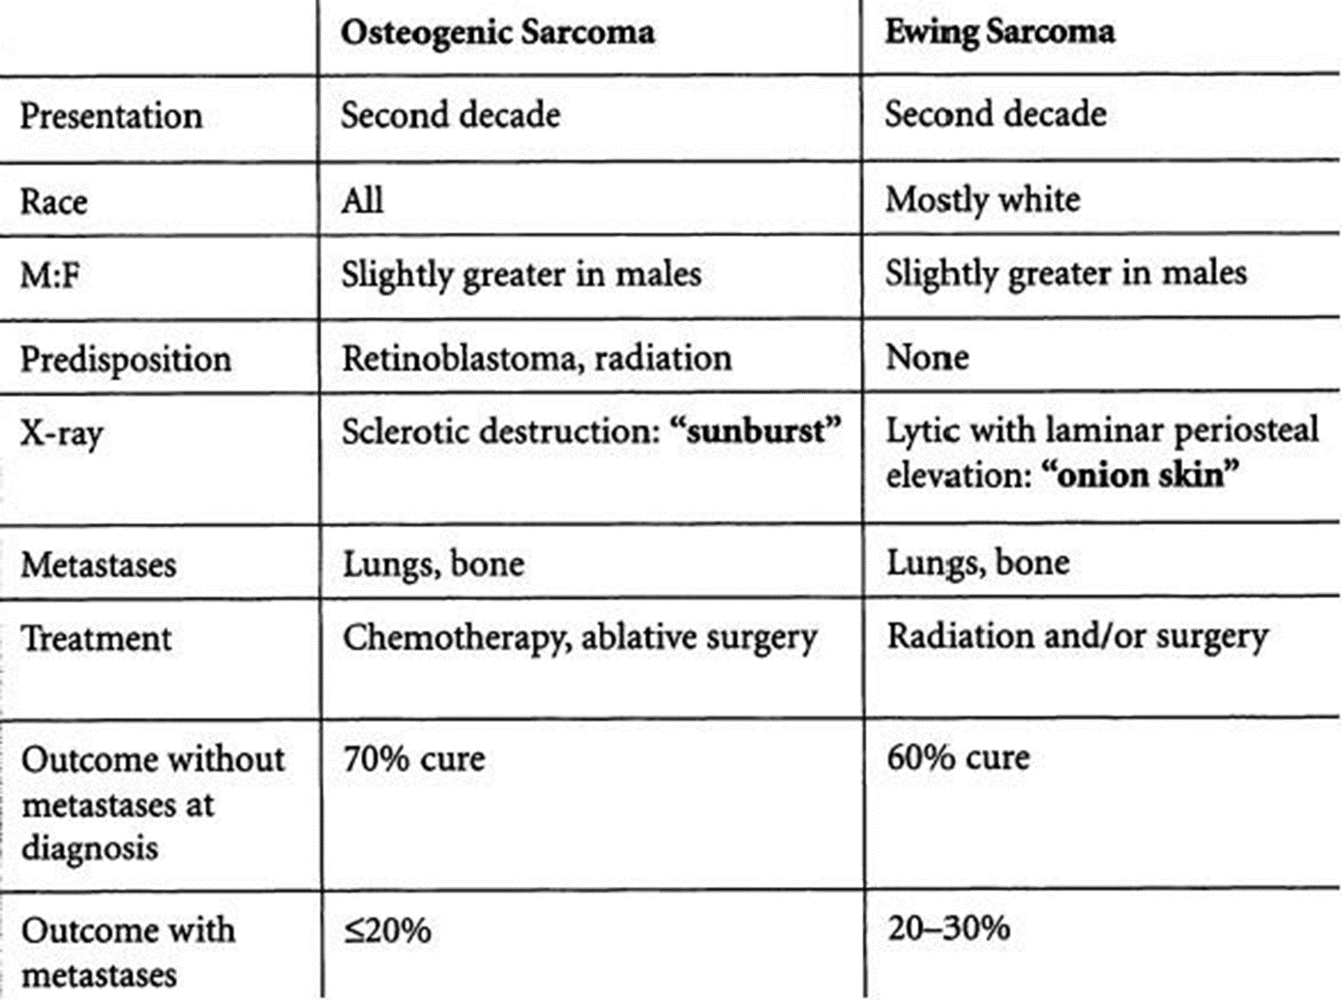

Slide 51
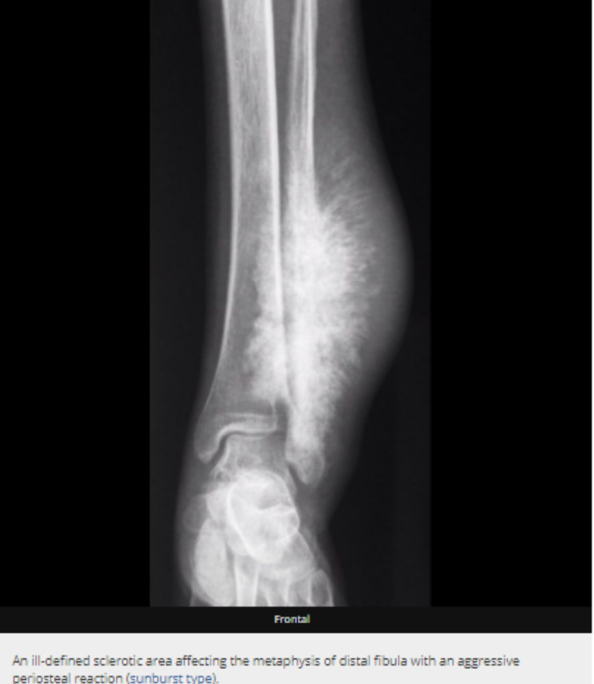
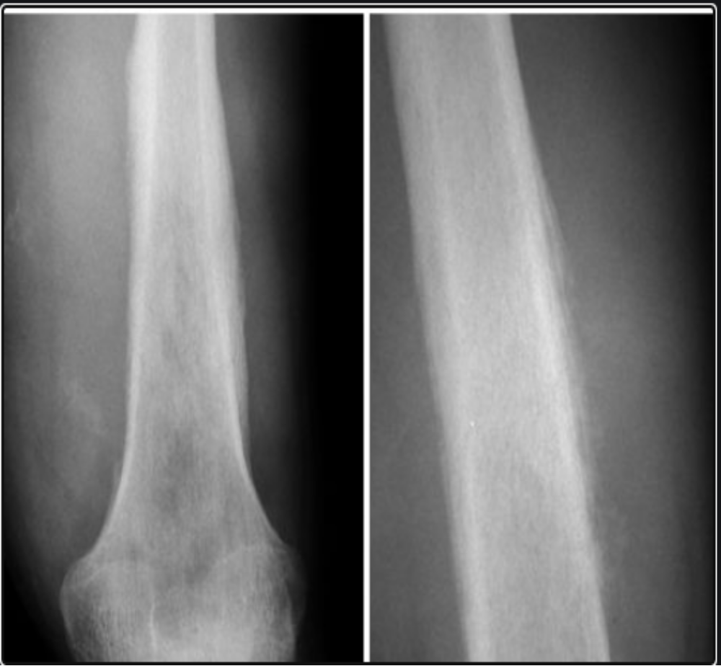
Ewing sarcoma onion skin

Slide 52
Oncologic emergency

Slide 53
Tumor lysis syndrome (TLS)
Sudden massive lysis of tumor cells leading to release their contents into the bloodstream occur spontaneously or after initiation of chemotherapy
metabolic disorders: hyperkalemia, hyperphosphatemia, hypocalcemia, and hyperuricemia leading to end-organ damage.
Can lead to acute kidney injury (AKI), fatal arrhythmias, and even death.
30% of patients need hemodyalisis
Morality rate 15%

Slide 54
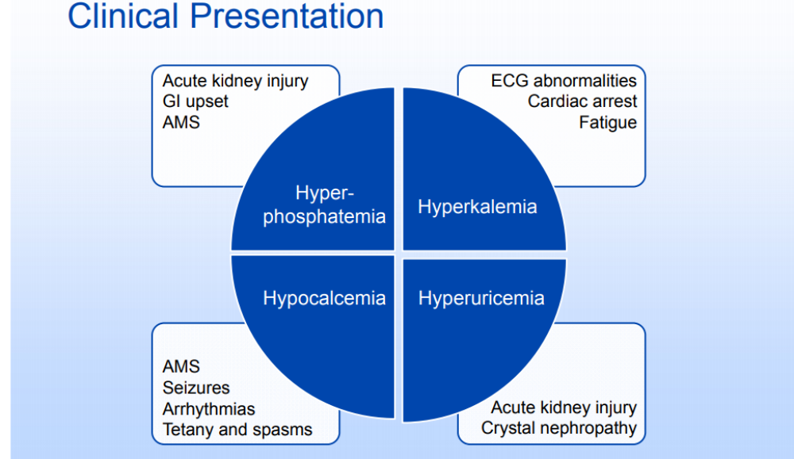

Slide 55
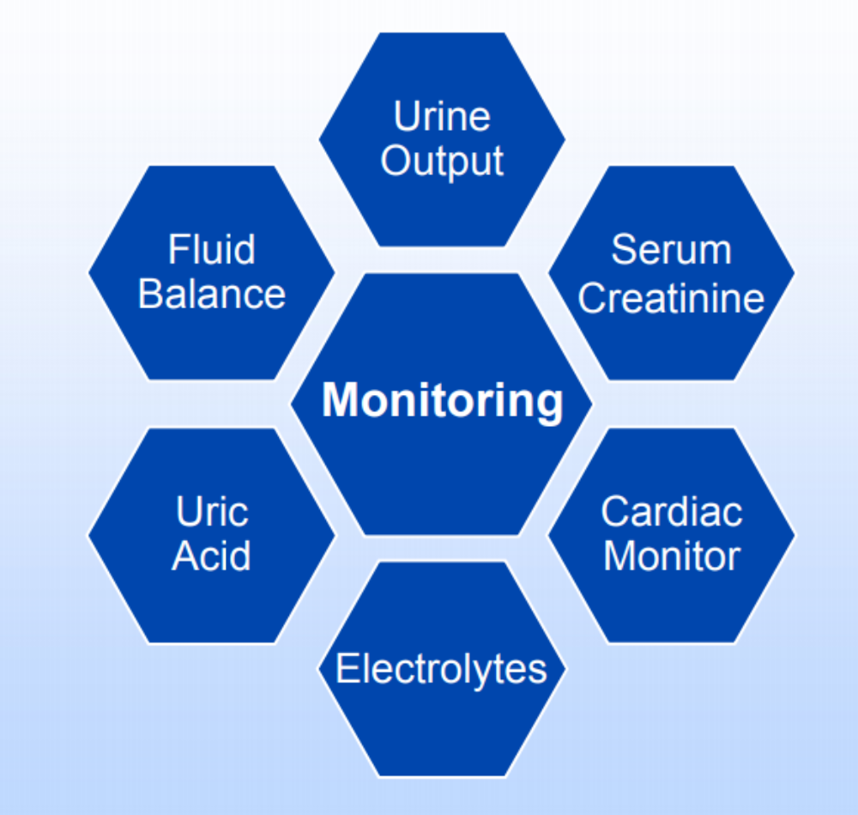
TLS treatment
Aggressive hydration plus diuretics
Medications:
  Allopurinol: blocks uric acid production
  OR Rasburicase: in sever cases, high cost
Dialysis
Monitoring

Slide 56
Thank you

