Slide 1
Hemostasis and bleeding disorders
Ala’a Almaaiteh. MD

Slide 2
Hemostasis
The dynamic process of coagulation as it occurs in areas of vascular injury.
The main components : platelets, vascular wall, procoagulant and anticoagulant proteins, and fibrinolytic system.
Hemostasis stages:
  vascular spasm, or vasoconstriction, a brief and intense contraction of blood vessels;
  formation of a platelet plug; stops bleeding within 3-7 minutes
  blood clotting or coagulation, which reinforces the platelet plug with fibrin mesh that acts as a glue to hold the clot together. Once blood flow has ceased, tissue repair can begin.

Slide 3
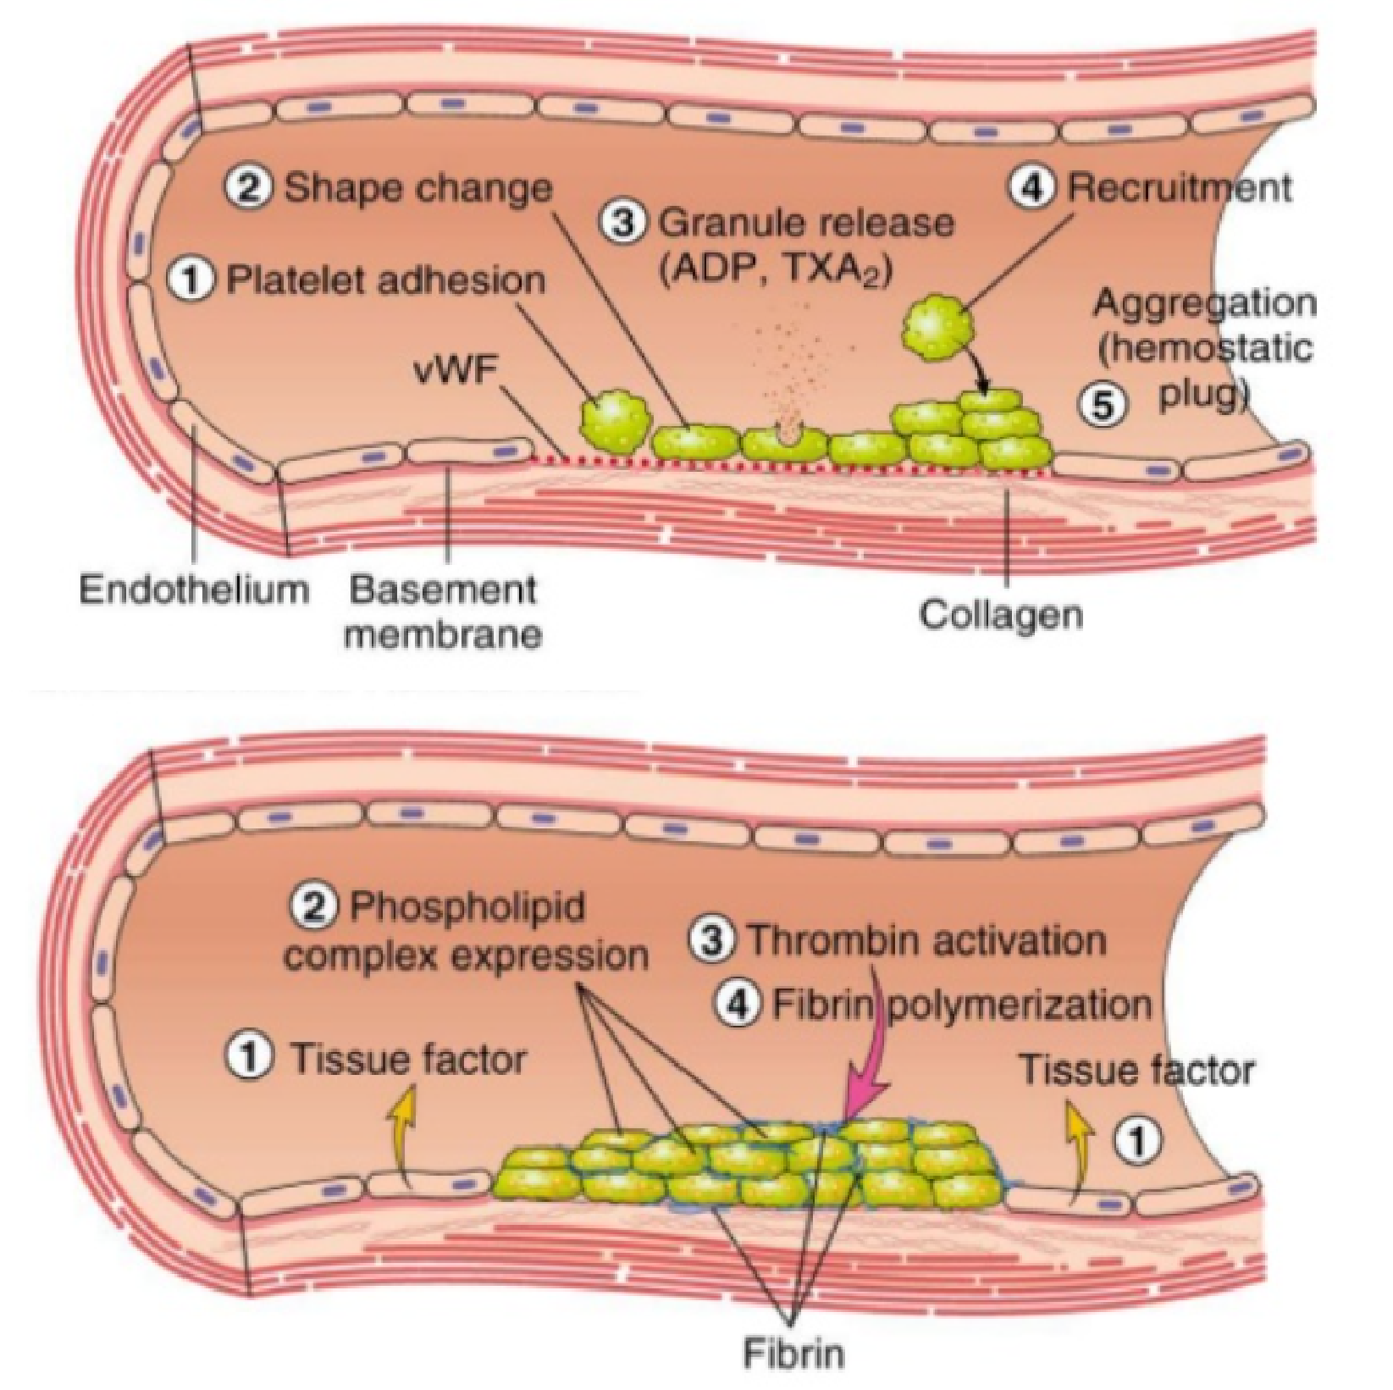
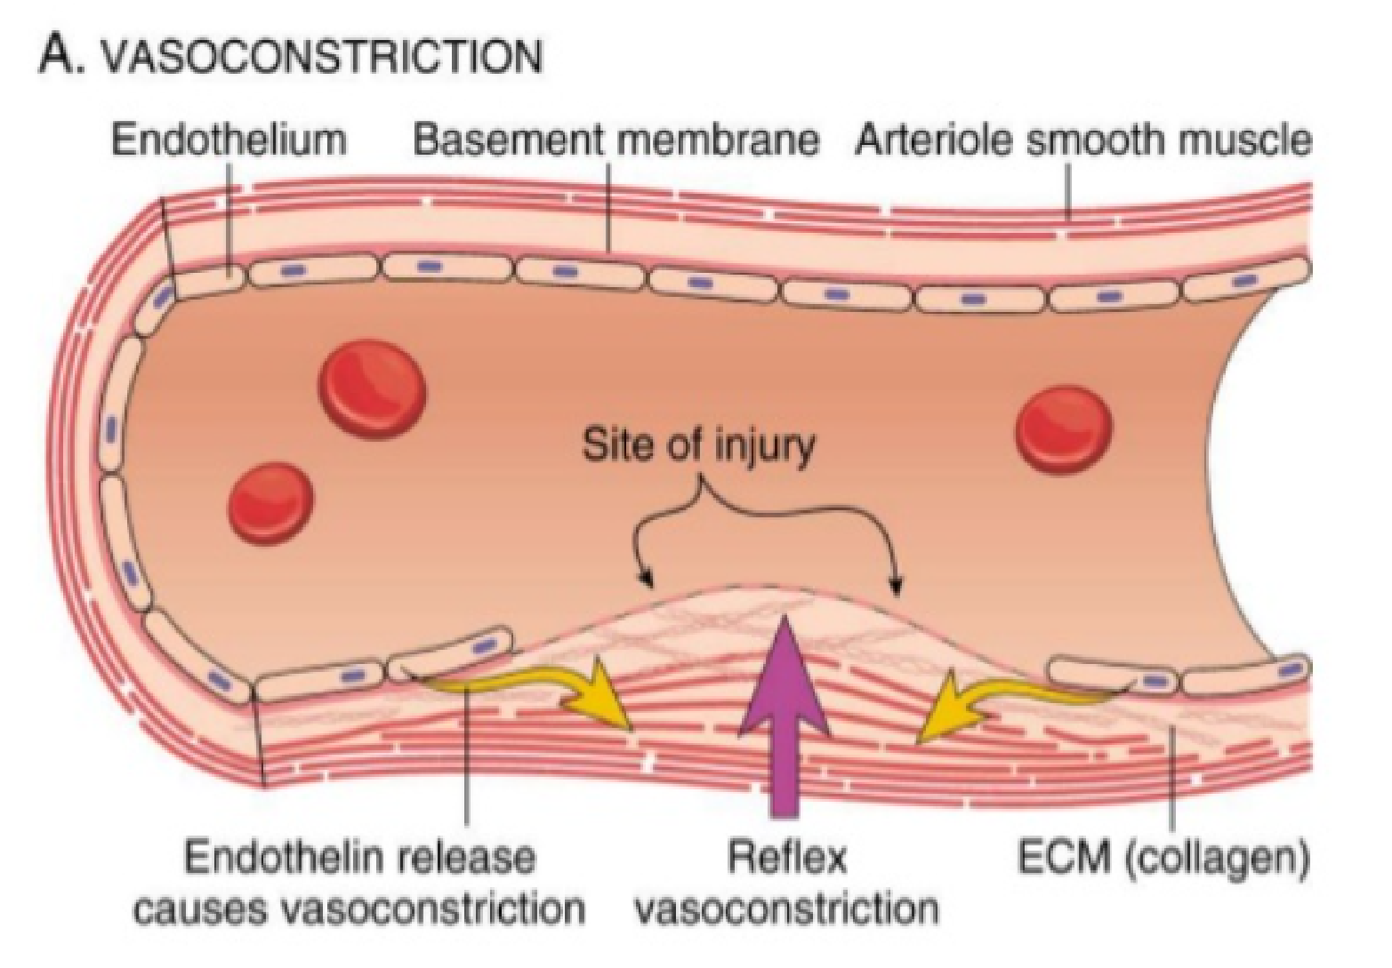
Hemostasis stages

Slide 4
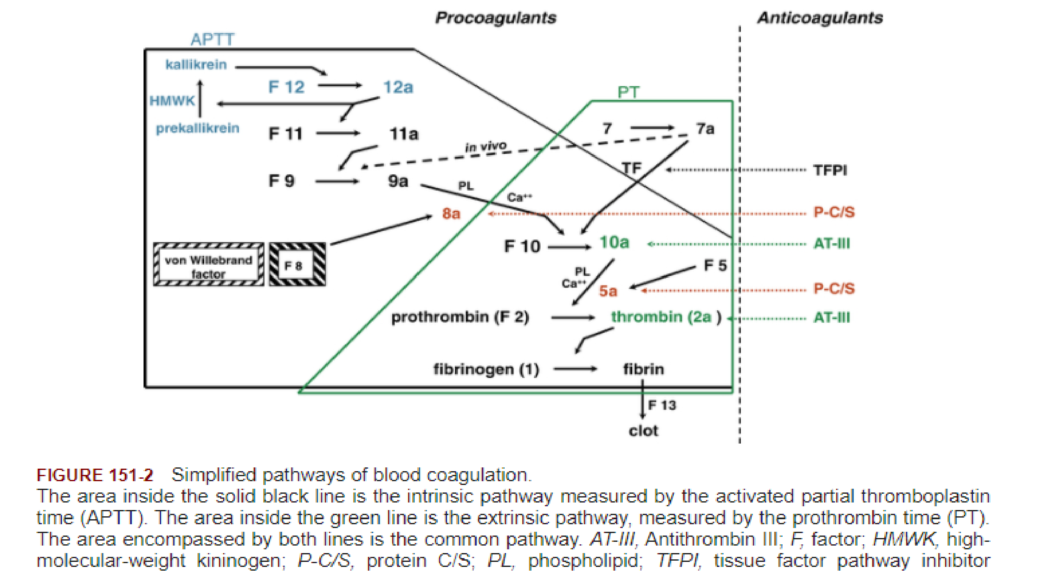

Slide 5
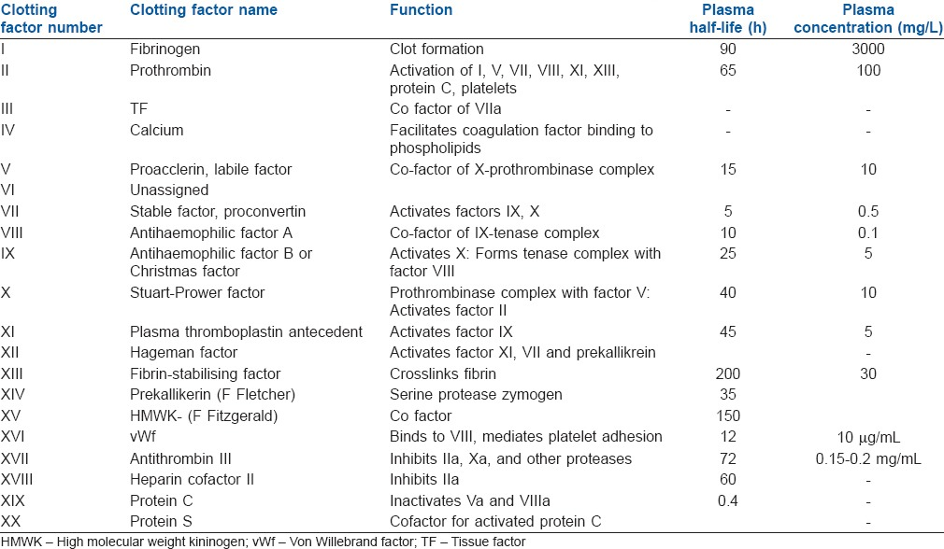

Slide 6
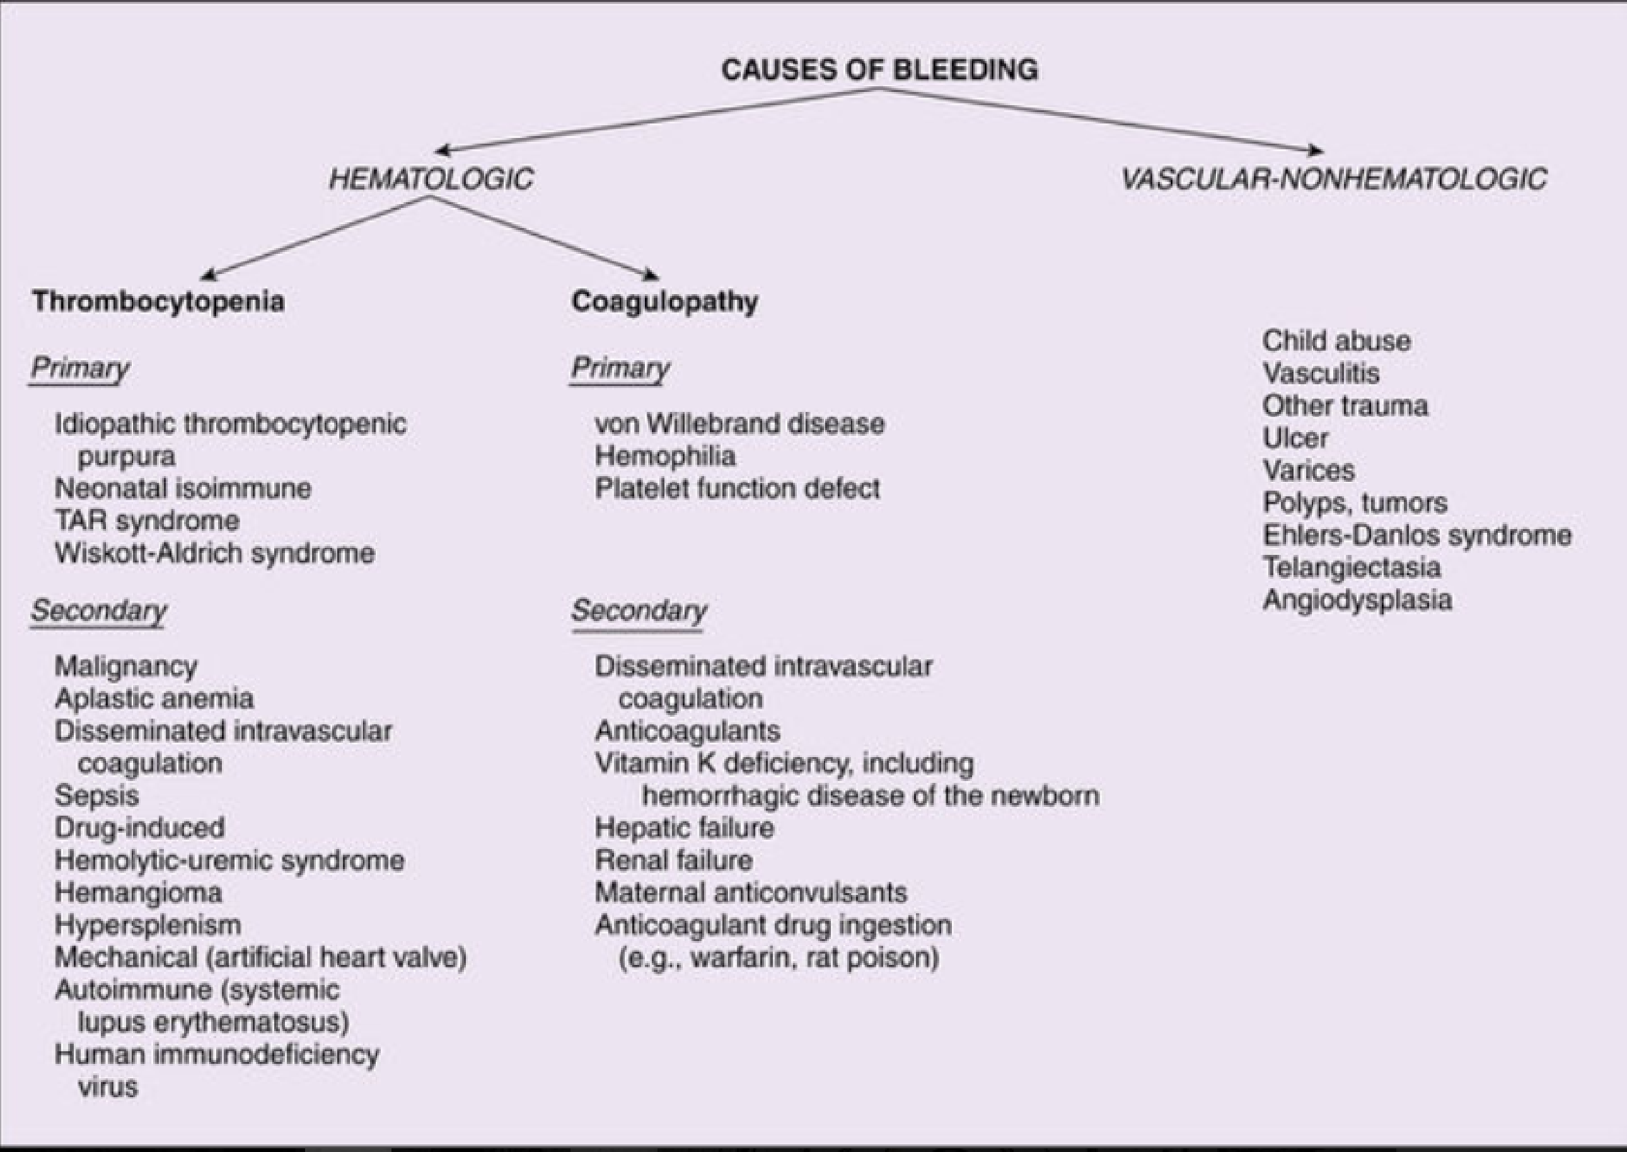

Slide 7
Hemostatic disorders
Clinical history inquiry should include:
  A detailed family history of bleeding and thrombotic disorders
  Age at onset of bleeding indicates whether the problem is congenital or acquired
  The sites of bleeding (mucocutaneous or deep) and degree of trauma (spontaneous or significant)
  Medication history
physical examination:
  Presence of superficial bleeding (skin or mucous membrane), or deeper bleeding ( muscle, joints or internal organs)
  Petechia: non-blanching lesion <2 mm. Purpura is a group of adjoining petechiae, ecchymoses (bruises) are isolated lesions larger than petechiae, and hematomas are raised, palpable ecchymoses.
  manifestations of an underlying disease, lymphadenopathy, hepatosplenomegaly.
  Manifestations of thrombosis or arterial clot

Slide 8
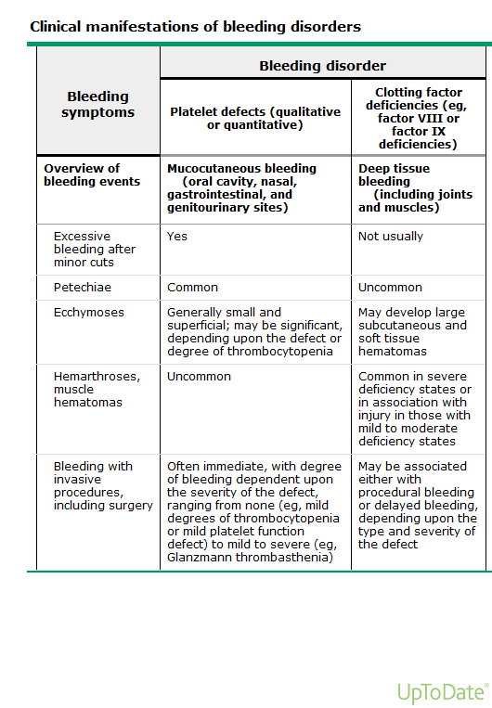

Slide 9
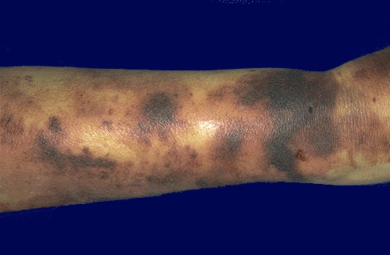
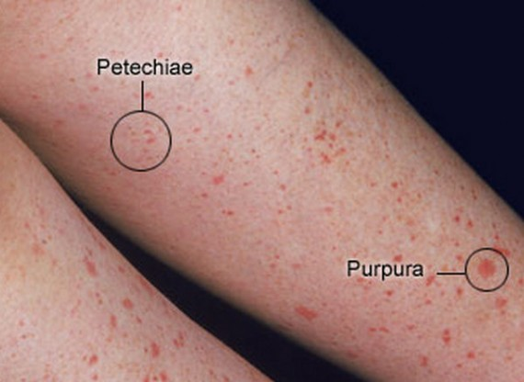
Non-blanching rashes
Ecchymoses, petechiae and purpura

Slide 10
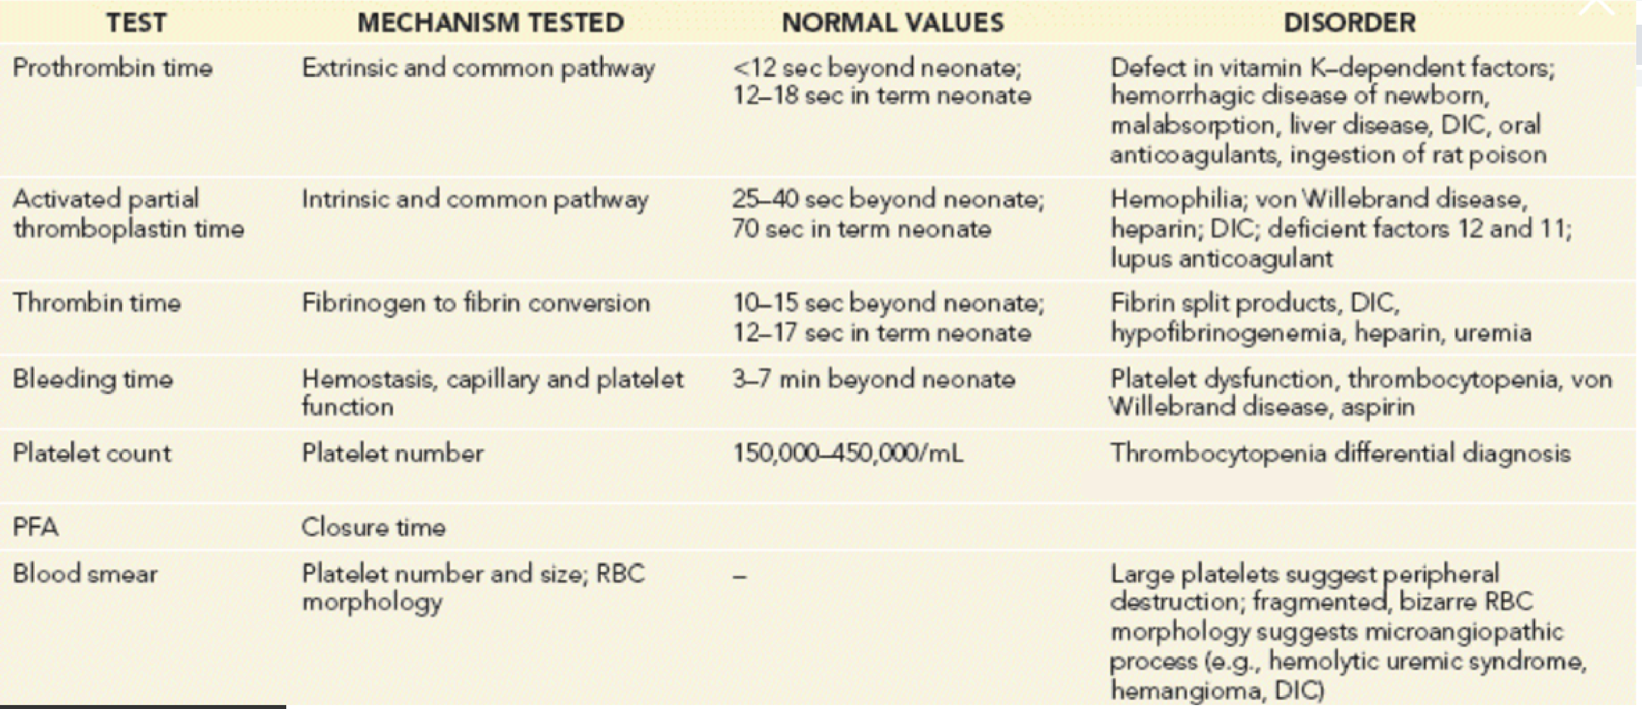
Initial laboratory tests

Slide 11
Differential diagnosis
Decrease production
quantitative
Increase consumption
Platelets abnormalities
sequestration
qualitative
Bleeding disorders
Inherited deficiency
Factor abnormalities
acquired

Slide 12
Disorders of platelets
Thrombocytopenia: platelets less than 150,000/mm³
Mucocutaneous bleeding is the hallmark of platelet disorders
platelet counts less than 20,000/mm³ carries risk for spontaneous bleeding
Etiology:
  1- decreased production on either a congenital or an acquired
  2- sequestration of the platelets within an enlarged spleen or other organ,
  3- increased destruction of normally synthesized platelets on either an immune or a nonimmune basis

Slide 13
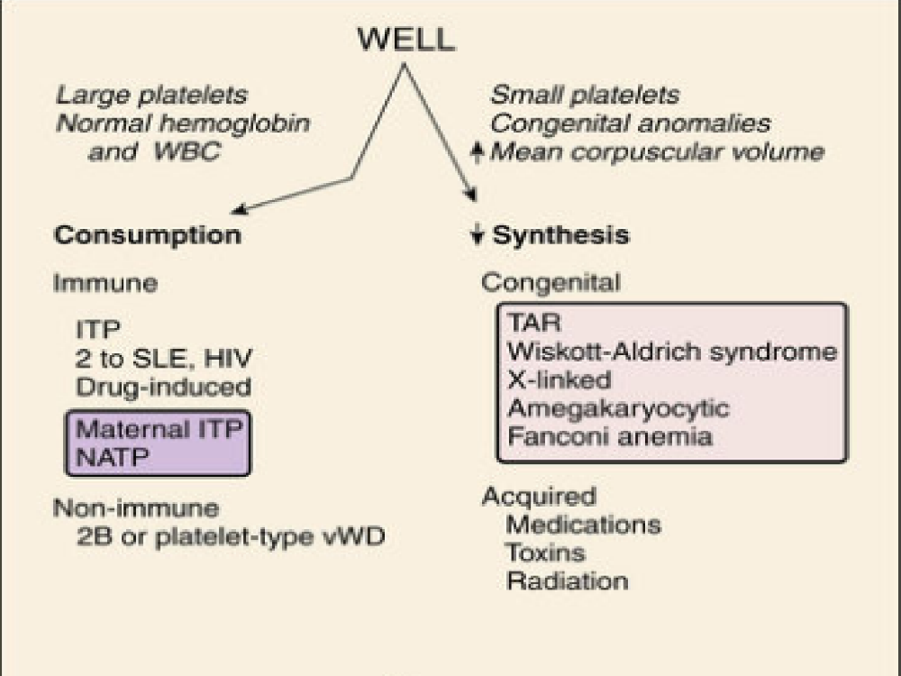
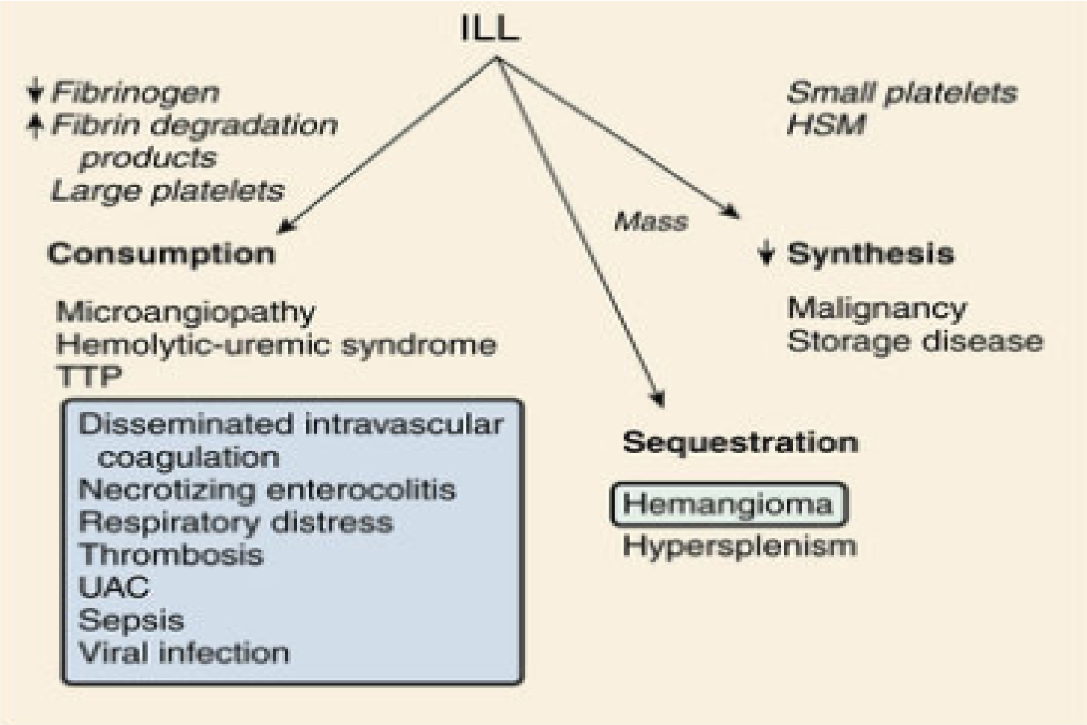
Differential diagnosis of childhood thrombocytopenic syndromes

Slide 14
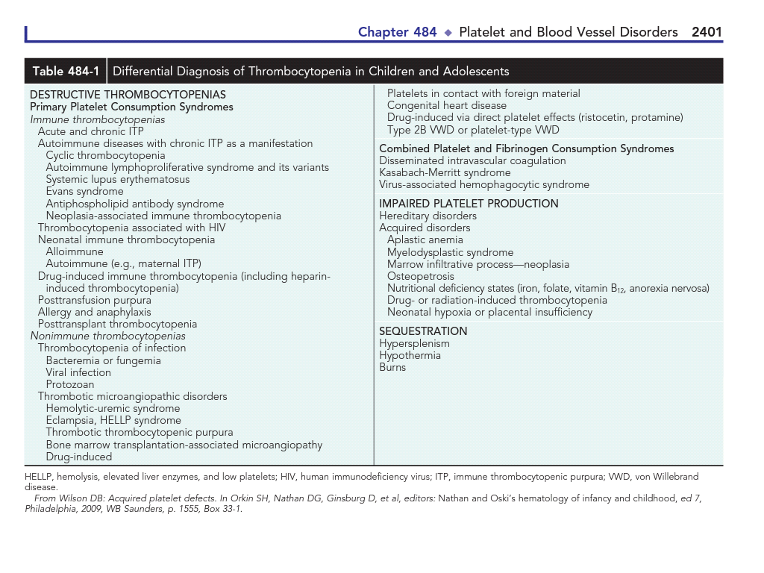

Slide 15
Autoimmune thrombocytopenic purpura of childhood (childhood ITP)
The most common cause of acute onset of thrombocytopenia in otherwise healthy child
Incidence in Males=females
Peak incidence between 1 – 4 years of age
Follows acute viral infection
  Most common viruses have been described in association with ITP, including Epstein-Barr virus and HIV .
  Epstein-Barr virus-related ITP is usually of short duration and follows the course of infectious mononucleosis.
  HIV-associated ITP is usually chronic ( lasts more than 6 months).
abrupt onset of petechiae, purpura, and epistaxis. Other physical exam findings are normal
normal red blood cell (RBC) and white blood cell (WBC) counts.

Slide 16
ITP
usually 1 to 4 weeks after an acute viral infection (commonest cause)
antibody (IgG or IgM) that binds to the platelet membrane.
splenic destruction of antibody-coated platelets leading to sever thrombocytopenia < 10.000 platelets/mm3
Diagnosis is based on clinical presentation and the platelet count.
bone marrow examination is not necessary, unless indicated.

Slide 17
Treatment
Therapy is seldom indicated for platelet counts greater than 20,000/mm³
Therapy for moderate and severe clinical bleeding with severe thrombocytopenia (platelet count <10,000/mm3 ):
  prednisone , 2 to 4 mg/kg/24 hours for 2 weeks
  IVIG, 1 g/kg/24 hours for 1 to 2 days
  Splenectomy is indicated in acute ITP only for life-threatening bleeding.
Repeated treatments with IVIG, IV anti-D, or high-dose pulse steroids are effective in delaying the need for splenectomy
Platelet transfusion in ITP is usually contraindicated unless life-threatening bleeding is present

Slide 18
prognosis
Intracranial bleeding, occurs in fewer than 1% of patients with ITP
Therapy does not affect the long-term outcome of ITP
Approximately 80% of children have a spontaneous resolution within 6 months after diagnosis.
Chronic ITP : lasts >6 months, Secondary causes of chronic ITP, especially SLE and HIV infection
Splenectomy induces a remission in 70% to 80% of childhood chronic ITP cases.

Slide 19
Other disorders associated with low platelets
Wiskott-Aldrich syndrome
  X-linked disorder characterized by hypogammaglobinemia, eczema, and thrombocytopenia
  Plateles are small
  Hematopoietic stem cell transplantation cures the immunodeficiency and thrombocytopenia
Thrombotic microangiopathy
  thrombocytopenia, anemia secondary to intravascular RBC destruction
Disseminated intravascular coagulation (DIC )
  wide-ranging hemostatic disorder with activation and clearance of platelets
thrombotic thrombocytopenic purpura
  platelet consumption, precipitated by a congenital or acquired deficiency of a metalloproteinase that cleaves von Willebrand factor.

Slide 20
Platelets function disorders
Congenital :
  Glanzmann thrombasthenia .
  Bernard-Soulier syndrome .
Acquired :
  systemic illnesses, e.g., liver disease, kidney disease (uremia).
  drugs, e.g., acetylsalicylic acid (aspirin).
  Other nonsteroidal antiinflammatory drugs, valproic acid, and high-dose penicillin.

Slide 21
Bernard-Soulier syndrome
a severe congenital platelet function disorder, is caused by absence or severe deficiency of the VWF receptor (GPIb complex) on the platelet membrane.
characterized by thrombocytopenia, with giant platelets and markedly prolonged bleeding time (>20 min) .
inherited as an autosomal recessive disorder.

Slide 22
Glanzmann thrombasthenia
Is a congenital disorder associated with severe platelet dysfunction (aggregation dysfunction) that yields prolonged bleeding time and a normal platelet count.
Platelets have normal size and morphologic features on the peripheral blood smear.
Is inherited in an autosomal recessive manner.
For both Bernard-Soulier syndrome and Glanzmann thrombasthenia, the diagnosis is confirmed by flow cytometric analysis of the patient’s platelet glycoproteins

Slide 23
Hereditary Clotting Factor Deficiencies (Bleeding Disorders)
Factor 8 and factor 9 deficiencies (Hemophilias) are the most common severe inherited bleeding disorders.
von Willebrand disease is the most common congenital bleeding disorder.
Procoagulant proteins:
  Deficiency contact factors (prekallikrein, kininogen, and factor 12) cause a prolonged activated partial thromboplastin time (APTT) but are not associated with a predisposition to bleeding.

Slide 24
Hemophilia
Hemophilia A (factor 8 deficiency) occurs in 1 in 5000 males.
Hemophilia B (factor 9 deficiency), also called Christmas disease, occurs in approximately 1 in 25,000
Clinically the two disorders are indistinguishable
The severity of the disorder is determined by the degree of clotting factor deficiency:
  Severe hemophilia: less than 1% factor 8 or factor 9
  Moderate hemophilia: 1% to 5% factor 8 or factor
  Mild hemophilia: >5% factor 8 or factor 9

Slide 25
Clinical features
Neither factor VIII nor factor IX crosses the placenta; bleeding symptoms may be present from birth or may occur in the fetus.
Only 2% of neonates with hemophilia sustain intracranial hemorrhages .
30% of male infants with hemophilia bleed with circumcision.
Obvious symptoms such as easy bruising, intramuscular hematomas, and hemarthroses begin when the child begins to cruise.
The hallmark of hemophilic bleeding is hemarthroses which may be induced by minor trauma or occur spontaneously .
spontaneous bleeding in sever hemophilia < 1 %
Life-threatening bleeding in the patient with hemophilia is caused by bleeding into vital structures (central nervous system, upper airway

Slide 26
labs
prolonged aPTT.
Results of the other screening tests of the hemostatic mechanism (platelet count, bleeding time, prothrombin time, and thrombin time) are normal.
The specific assay for factors VIII and IX will confirm the diagnosis of hemophilia.

Slide 27
Treatment
Early, appropriate replacement therapy is the hallmark of excellent hemophilia care
Prophylactic therapy starting in infancy has greatly diminished the likelihood of chronic arthropathy in children with hemophilia.
Recombinant factor VIII (FVIII) or recombinant factor IX (FIX)
Desmopressin acetate increase factor 8 level in patient with mild or moderate hemophilia A.

Slide 28
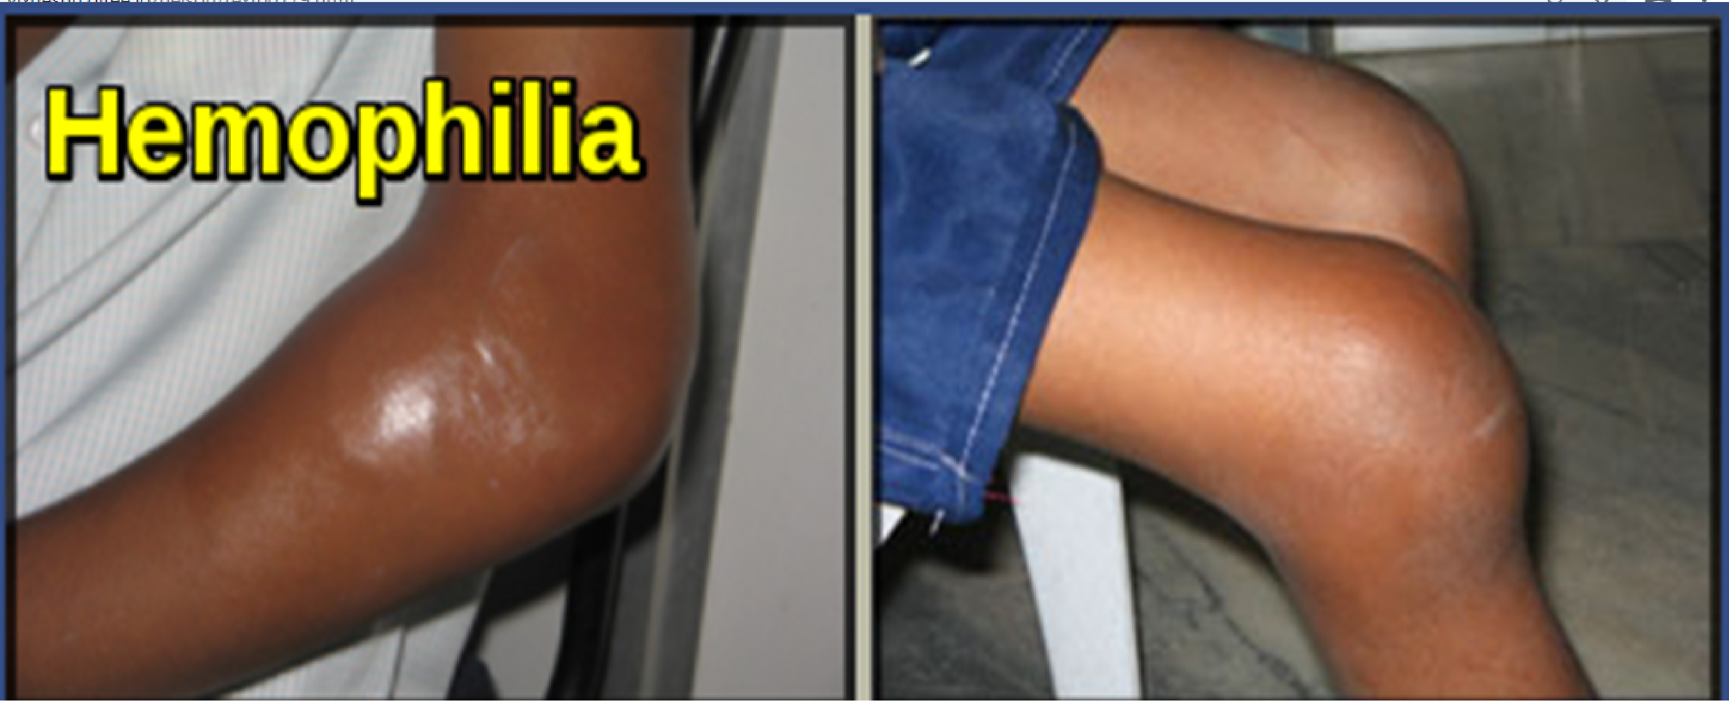

Slide 29
complications
Long-term complications of hemophilia A and B include :
Chronic arthropathy, development of an inhibitor to either factor VIII or factor IX,
Risk of transfusion-transmitted infectious diseases ( not with recombinant factors)

Slide 30
Von Willebrand Disease
von Willebrand disease (VWD) is the most common inherited bleeding disorder, with an estimated prevalence cited at 1 : 100 to 1 : 10,000 .
VWF has several functions in coagulation. First, VWF serves to tether platelets to injured subendothelium via binding sites for platelets and for collagen. Second, VWF serves as a carrier protein for factor VIII (FVIII),

Slide 31
VWD typically presents with mucosal bleeding, similar to that seen with other platelet defects.
Epistaxis, easy bruising, and menorrhagia in women are common complaints.
Symptoms, however, are variable, and do not necessarily correlate well with VWF levels.
Surgical bleeding, particularly with dental extractions or adenotonsillectomy, is another common presentation.
Severe type 3 VWD may present with joint bleeds.
Most patients will have a family history of bleeding. Women are more likely to be diagnosed with VWD because of the potential for symptoms with menorrhagia.

Slide 32
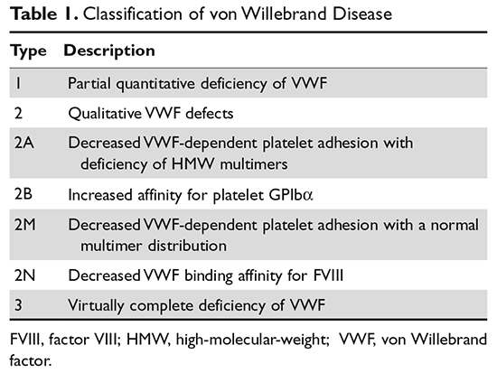
CLASSIFICATION

Slide 33
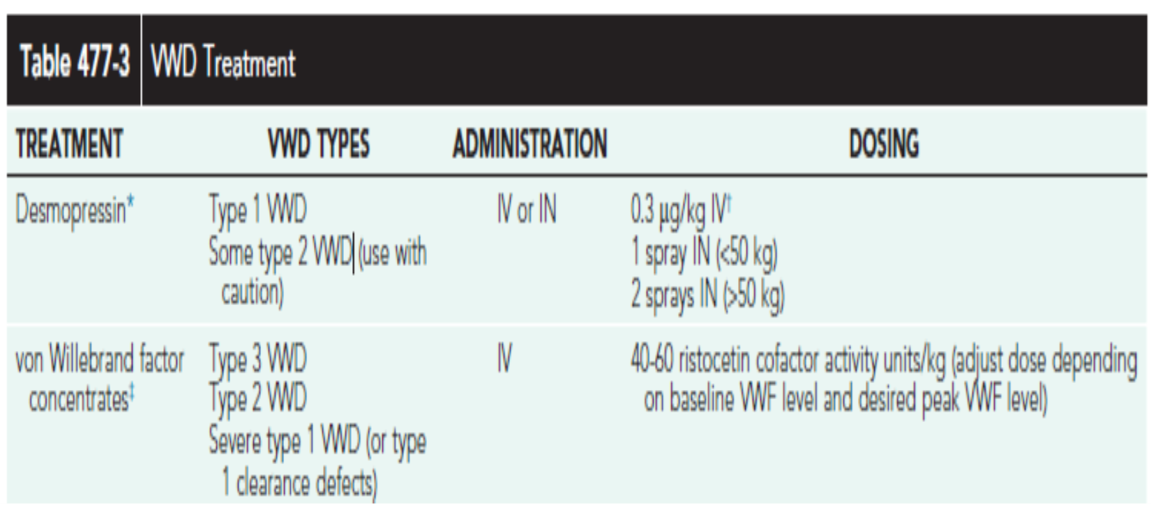
treatment

Slide 34
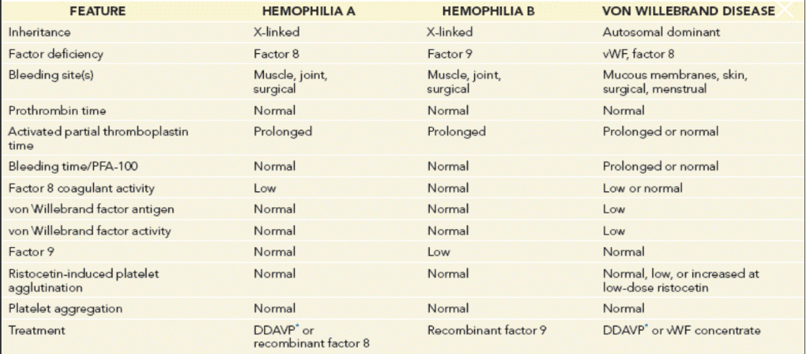

Slide 35
Thank you

