Slide 1
Anemia
Alaa Almaaiteh, MD

Slide 2
Definition
Reduction in hemoglobin, hematocrit, or number of red blood cells (two standard deviations below the mean for age and sex for the normal population)

Slide 3
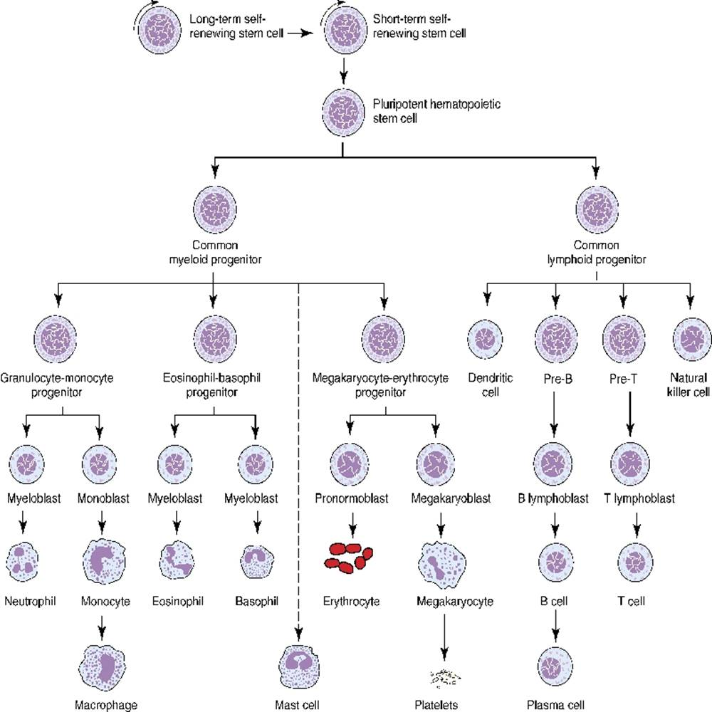

Slide 4
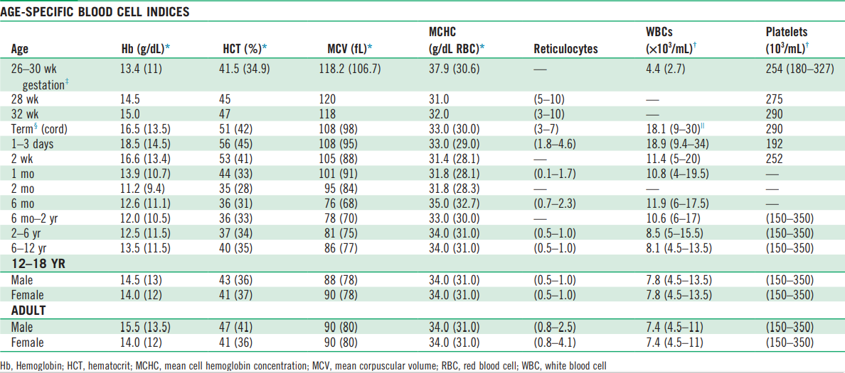

Slide 5
Evaluation of anemic patient
Detailed history
Physical examination
Essential laboratory tests

Slide 6
History
Age: e.g., IDA rare before age of 6 months. Anemia resulting from congenital disorder of hemoglobin usually detected at 3 to 6 months.
Gender: consider X-linked disorders ( G6PD, pyruvate kinase deficiency)
Race and Ethnicity
Neonatal history: e.g. hyperbilirubinemia, prematurity.

Slide 7
Diet: Pica, e.g., sources of iron, folic acid, B12, Vit E.
Drugs: oxidant-induces hemolytic anemia, phenytoin- induced megaloblastic anemia.
Infections: parvovirus, hemolytic anemia. Infections from recent travels
Diarrhea and malabsorption

Slide 8
Family history:
    hemoglobinopathies, jaundice, gall stones, splenectomy, bleeding disorder.
History of possible hemolytic crisis or blood loss.
Menstrual history in all females.

Slide 9
Physical examination
Pallor ( tongue, nail beds, palms, or palmer creases), fatigue, irritability
Sever acute anemia: compensatory mechanisms; tachycardia, heart murmur, lethargy, or pallor. signs of acute heart failure.
Sever chronic anemia associated with paucity of symptoms

Slide 10
Skin:
  Hyperpigmentation ( Fanconi’s anemia)
  Jaundice
  Petechiae, purpura
  Cavernous hemangioma
Face and mouth:
  frontal bossing, prominence of maxillary and malar bones
  Glossitis (B12 and iron deficiency), angular stomatitis (IDA)

Slide 11
Skeletal abnormalities:
  triphalangeal thumb ( red cell aplasia), absent thumb/radius ( Fanconi’s anemia), spoon nails (IDA), short stature.
Splenomegally: hemolytic anemias, malignancies, infections.

Slide 12
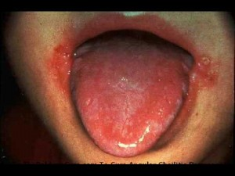
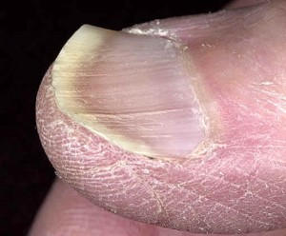
Iron deficiency anemia:
Glossitis, angular stomatitis , spoon nails

Slide 13
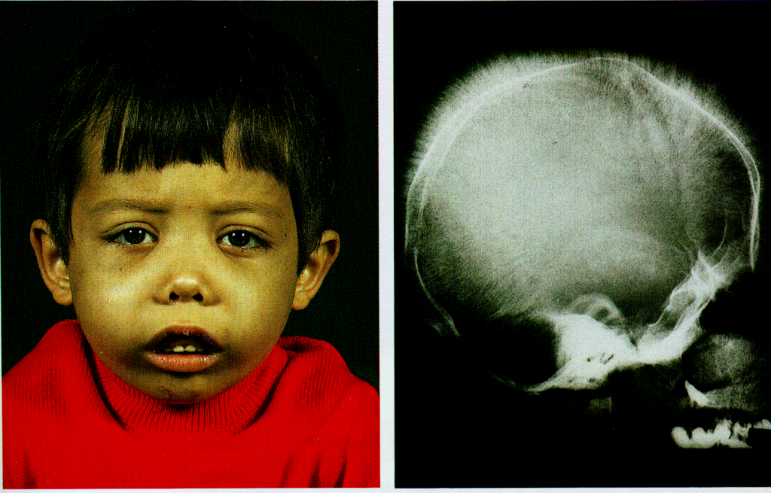
Thalassemic facies and ‘hair on end’ Appearance

Slide 14
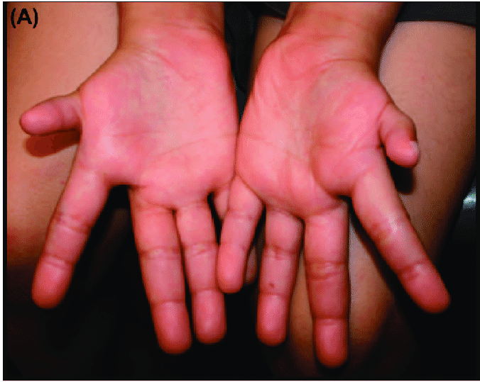
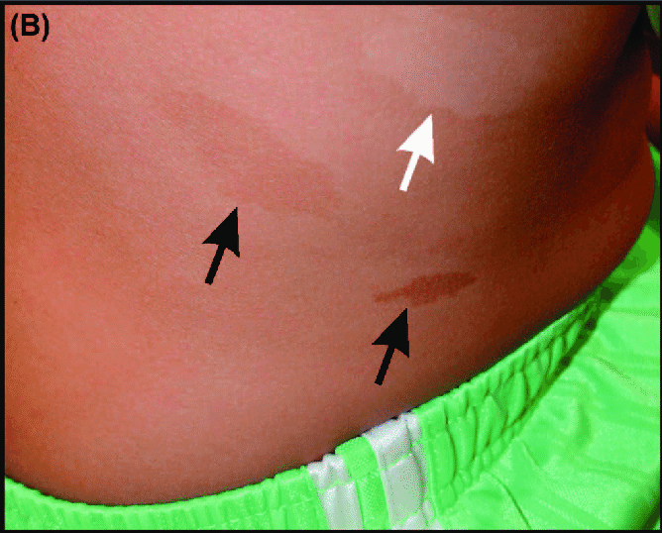
Fanconi’s anemia:
(A) Hypoplastic thumbs in an 11-year-old. (B) Hypopigmented (white arrow) and hyperpigmented (black arrows) skin lesions

Slide 15
Initial laboratory test
Complete blood count
Reticulocytes count
Blood film
Disease-specific tests based on initial evaluation

Slide 16
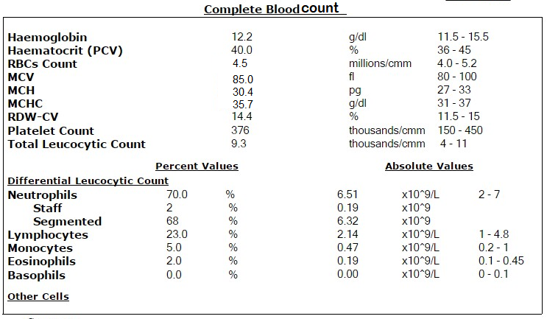

Slide 17
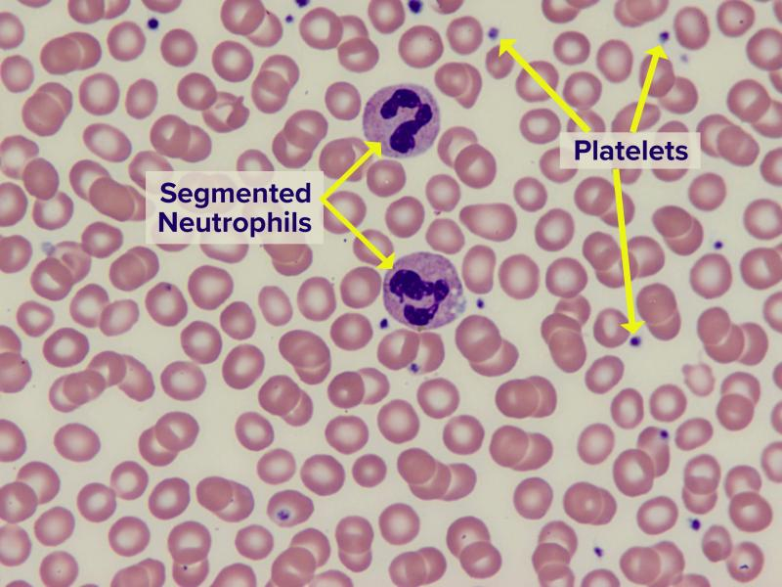
Normal blood smear with red blood cells (majority of cells shown), white blood cells (segmented neutrophils) and platelets (small purple dots)

Slide 18
Classifications of Anemias
Physiologic :
  Disorders of effective red cell production
  rapid erythrocytes destruction or loss
Red cell size; MCV:
  macrocytic anemias
  microcytic anemias
  normocytic anemias

Slide 19
Anemia classification by RBC size
CBC
Low MCV
Normal MCV
Increased MCV
Iron deficiency anemia ( IDA)
Thalassemia
Sidroblastic anemia
Lead poisoning
Anemia of chronic disease
Autoimmune hemolytic anemia (AIHA)
Sickle cell anemia
Hereditary Spherocytosis
G6PD deficiency & Enzymopathies
Acute blood loss
Leukmias, lymphomas.
Transient erythroblastopenia of childhood (TEC),
Fanconi Anemia
Aplastic anemia and other bone marrow failure syndromes
Trisomy 21
Hypothyroidism
B12/Folate Deficiency
pure red cell aplasia , Diamond-Blackfan anemia (DBA)

Slide 20
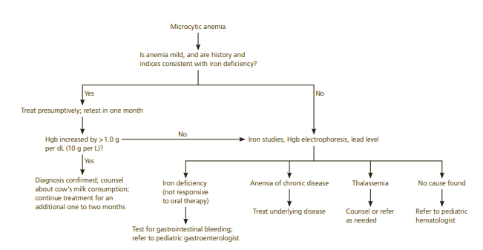

Slide 21
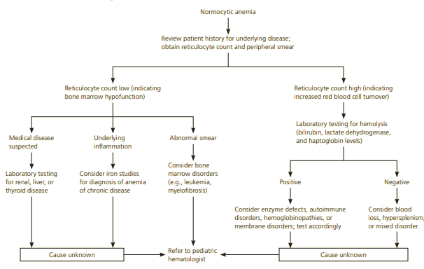

Slide 22
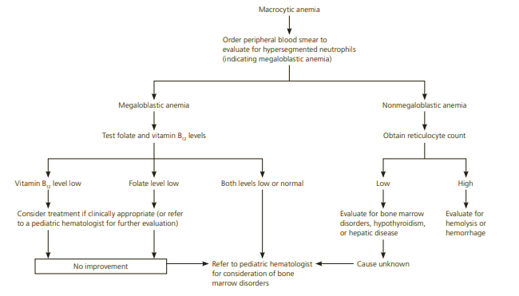

Slide 23
Macrocytic anemia
Megaloblastic anemia:
  B12 , folate deficiency
Non-megaloblastic anemia:
  Fanconi anemia
  Diamond-Blackfan anemia (DBA)
  Aplastic anemia
  Pearson syndrome
  Chronic liver disease

Slide 24
Megaloblastic anemia
Megaloblasts in bone marrow
High MCV
Peripheral blood shows hypersegmented neutrophils
Causes: Folic acid and vitamin B12 deficiency
Both vitamins are required for DNA synthesis and red cell maturation

Slide 25
Folate deficiency
Causes:
  Malnutrition, malabsorption, goat’s milk consumption
  Antimetabolite (e.g., methotrexate), phenytoin, trimethoprim/sulfa
Clinical manifestation:
  glossitis, symptoms of anemia (weakness, pallor, shortness of breath), and GI problems (weight loss and infertility)
Treatment:
  diet modification, treat underlying cause, folate therapy.

Slide 26
Vitamin B12 (Cobalamin) Deficiency
Causes:
  Pernicious anemia, ileal resection,
  strict vegetarian,
  congenital intrinsic factor or transcobalamin deficiency
Main manifestations
  same as those for folate but may be a more serious presentation with peripheral neuropathy, degeneration of the spinal cord, or demyelination of white matter of brain.
Treatment:
  diet modification, treat underlying cause, B12 therapy.

Slide 27
Fanconi anemia
inherited bone marrow failure
Autosomal recessive.
Many patients eventually develop acute myelogenous leukemia at an early age.

Slide 28
Fanconi anemia
Presents with:
  Pancytopenia: develops between 4 and 12 years of age
  Short stature
  Absence of or malformation in hands and arms, for example the absence of a thumb or the presence of polydactyly
  Single kidney or of a horseshoe kidney
  Café-au-lait spots

Slide 29
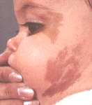

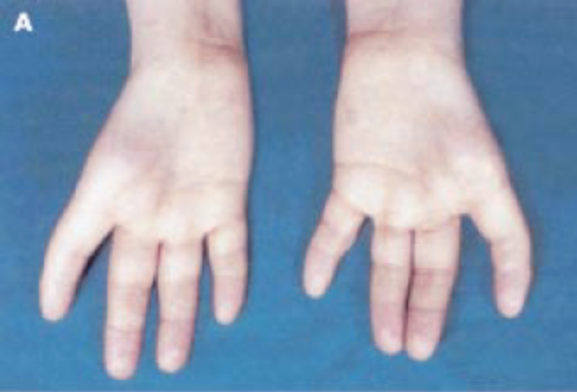
Fanconi anemia

Slide 30
Fanconi anemia
Diagnosis: positive chromosome-breaking effect to diepoxybutane (DEB) or mitomycin C (MMC) tests
Treatments include:
  Bone marrow transplant.
  Hematopoietic (blood-stimulating) growth factors are used to stimulate WBC production.
  Androgens: stimulate the production of RBCs and platelets.
  Future: gene therapy
Genetic counseling

Slide 31
Diamond-Blackfan anemia (DBA)
  Bone Marrow Failure
  Autosomal dominant, May be sporadic or inherited
  Congenital Anomalies mainly involve cranio-orofacial, upper extremity, genitourinary, cardiac
  Cancer Predisposition

Slide 32
DBA
Treatment:
  Prednisone: 2 mg/kg for up to 8-12 weeks before declaring failure
  chronic red cell transfusions. Chelation therapy for Iron overload
  HSCT for transfusion dependent patients
Outcome:
  Remission of anemia ~ 20% by age
  cancer predisposition: e.g., AML/ MDS, osteosarcoma.

Slide 33
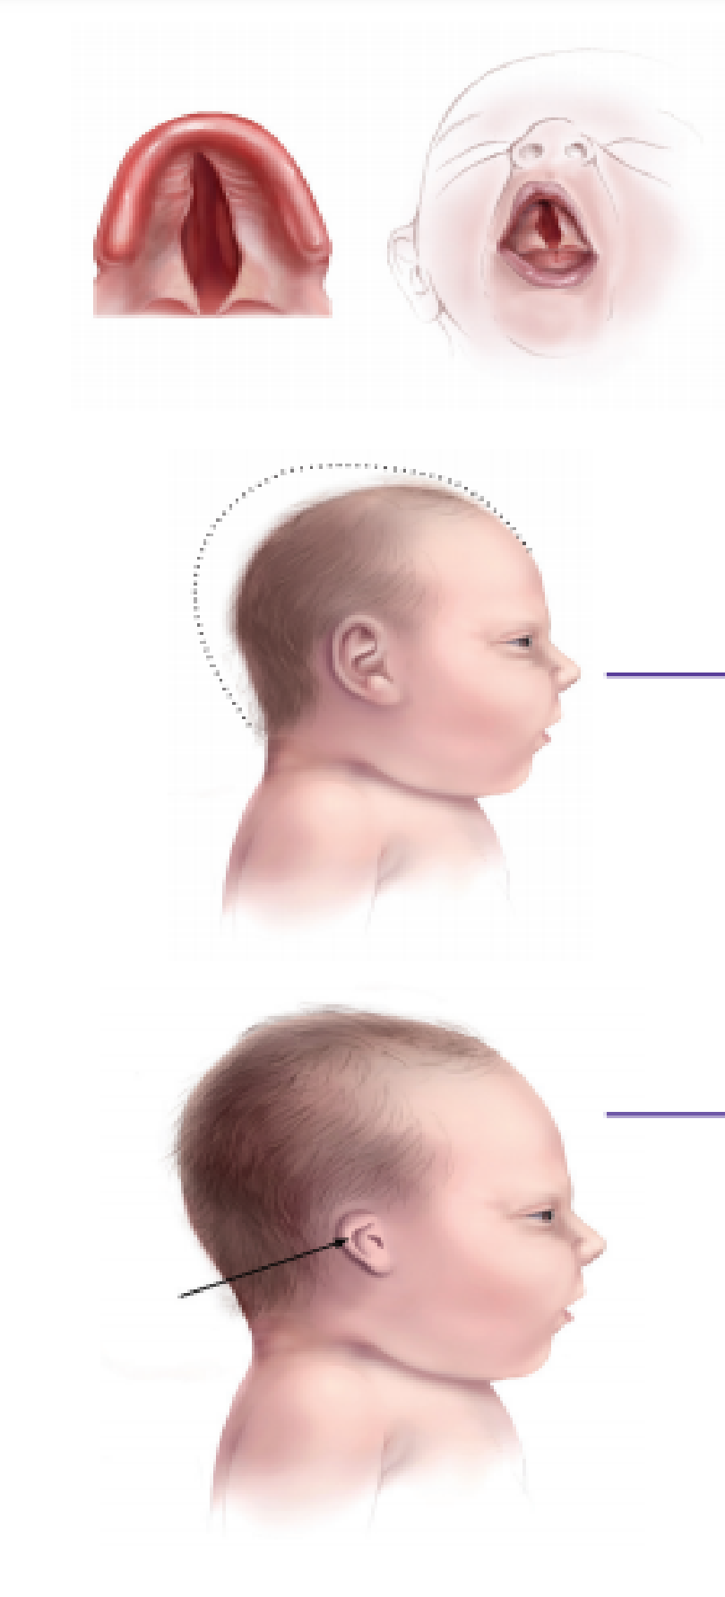
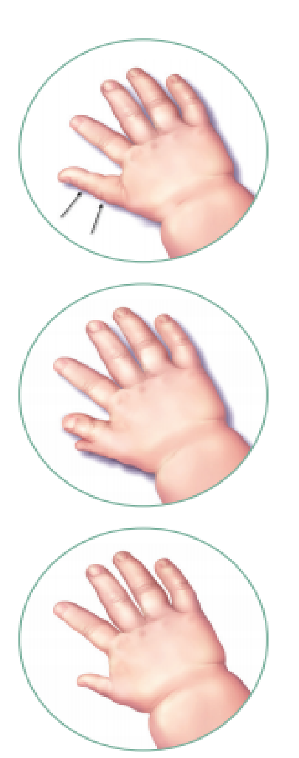
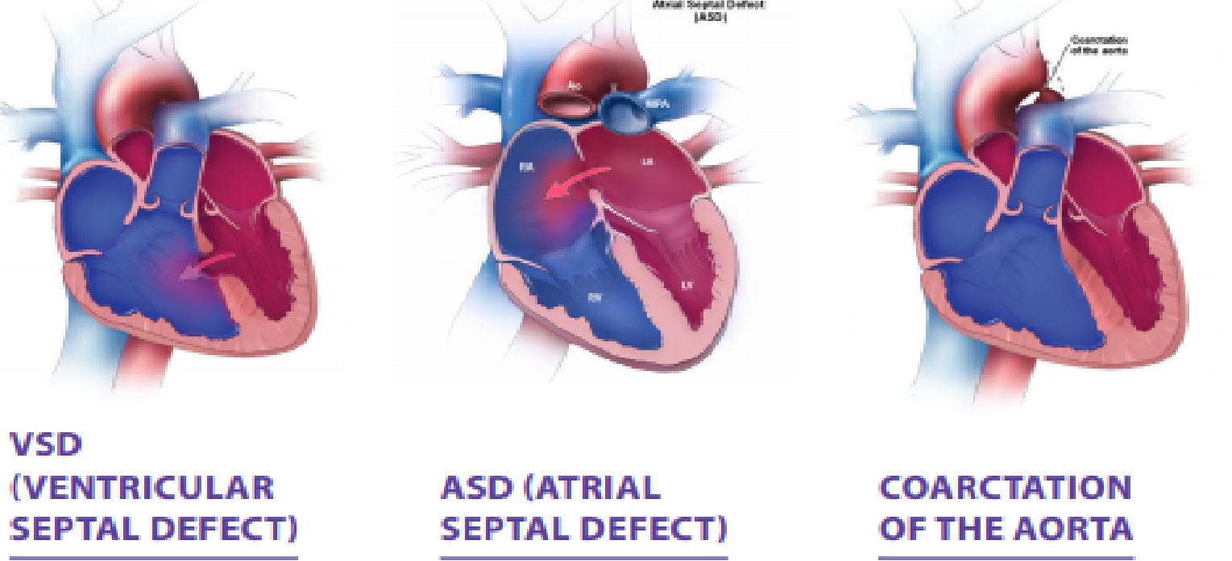
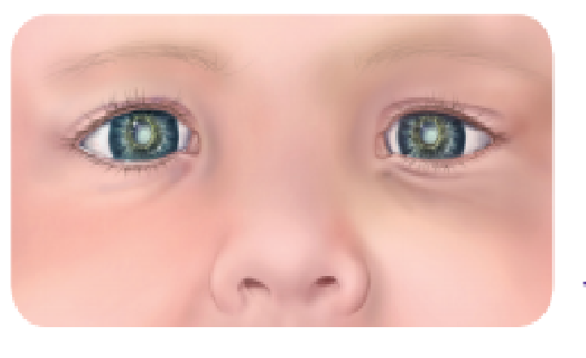
DBA
Cleft palate
Microcephaly
small ears
Ptosis
congenital cataract
Strabismus
short webbed neck
Single kidney, horseshoe kidney

Slide 34
Pearson Syndrome
Refractory sideroblastic anemia by 6 months of age
Exocrine pancreatic dysfunction (fat malabsorption)
Associated usually mild neutropenia, thrombocytopenia
Bone Marrow: Vacuolated precursors/ringed sideroblasts
Death usually as a consequence of acidosis, sepsis, liver or renal failure related to tubular dysfunction
Median survival 3 years
Genetics: Mitochondrial DNA deletion. Pathognomonic, maternal inheritance

Slide 35
Acquired aplastic anemia
2 of 3 peripheral blood criteria:
  - ANC < 500/ml
  - Platelets < 20,000/ml
  - Reticulocytes < 1% corrected (ARC < 40,000/ul)
1 of 2 bone marrow criteria:
  - < 25% cellularity on biopsy
  - 25 – 50% with < 30% hematopoietic cells

Slide 36
Causes of acquired aplastic anemia
Idiopathic (70%)
Radiation
Drugs/Chemicals
      Cytotoxic agents, benzene
      Idiosyncratic: chloramphenicol, anti-epileptic, anti-inflammatory, and psychotropic medications
Viruses:
      EBV, CMV, sero-negative hepatitis, HHV6, HIV, parvovirus
Immunologic disorders: GvHD. Preleukemia, MDS, thymoma
Malnutrition
Paroxysmal nocturnal hemoglobinuria

Slide 37
Transient erythroblastopenia of childhood (TEC)
Most common acquired red cell aplasia in previously healthy children
Age: 6 months and 3 years of age
Neutropenia 10%, Thrombocytosis 50 % of cases.
Typically self limited within 1-2 mo – close supportive care
Transfusion if necessary:
  Hgb<5 with reticulocytopenia
Follow to resolution

Slide 38
Microcytic anemias

Slide 39
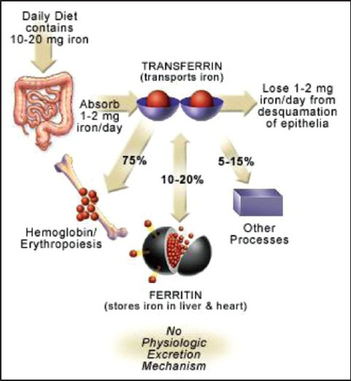
Iron Deficiency Anemia
Most common cause of anemia
Iron is essential for DNA synthesis

Slide 40
Etiology
Excessive Cow’s Milk Intake
    Chronic low grade hemorrhagic enteropathy
    Low iron content
    Poor bioavailability of iron (50% in BM, 5-10% cow’s milk)
    Prevention of eating iron-rich foods
impaired absorption ( e.g. celiac disease)
Vegan/Poor Meat Intake
Growth spurts
Blood Loss
    Menorrhagia
    GI (celiac, IBD), Parasite/Worm (#1 cause of GI blood loss worldwide)

Slide 41
Clinical manifestations
Neurocognitive effects ( Apathy, irritability, poor concentration)
Pica: compulsive consumption of nonnutritive substances
Anorexia, poor weight gain
Epithelial changes: angular stomatitis, glossitis, finger nails koilonychias or spooning. dry skin, thin hair.

Slide 42
Diagnostic laboratory tests
CBC:
    low hb , normal WBCs, normal or high paltelets. Low MCV and MCH. High RDW. Low reticulocytes
Blood Film:
    hypochromic microcytic RBC, anisopoikilocytosis ( variable sizes and shapes)
Iron metabolism tests:
    low ferritin, Low serum iron, low transferrin saturation, high total iron-binding capacity,

Slide 43
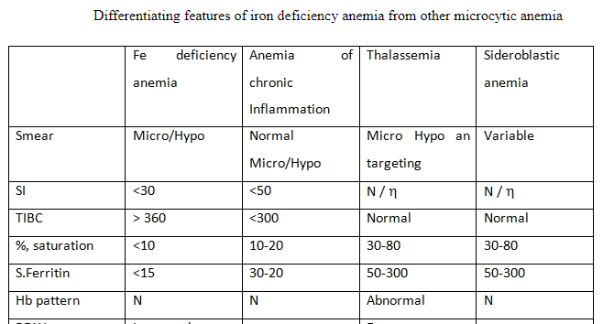

Slide 44
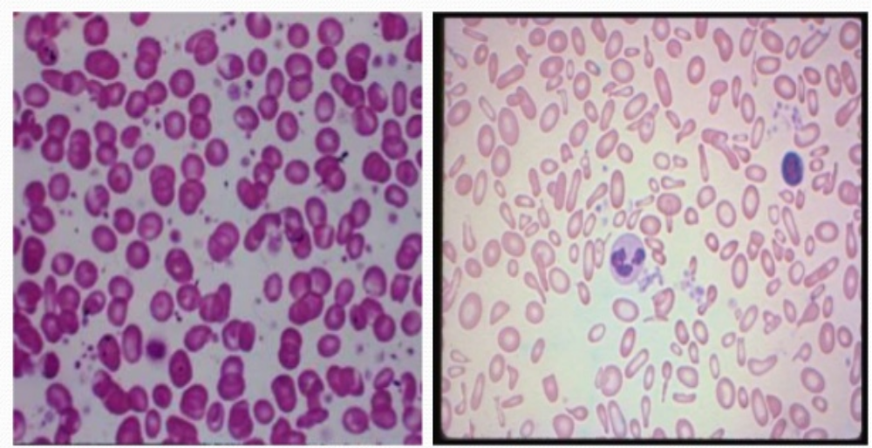
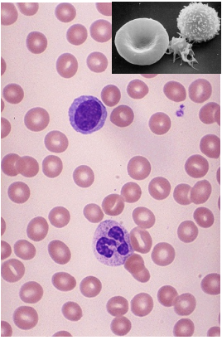
Normal blood film
IDA
Hypochromic microcytic, anisopokilocytosis

Slide 45
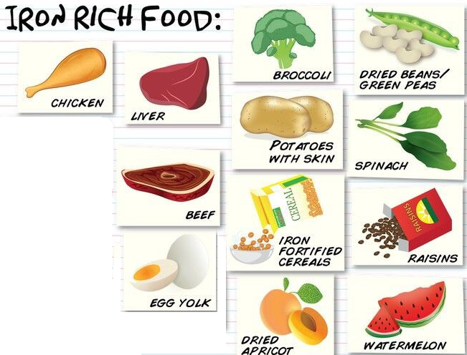
Treatment
Decrease milk intake
Promote iron rich foods
Control/evaluate for blood loss
Elemental iron 4-6 mg/kg per day (divided once or BID) orally
IV iron if malabsorption suspected

Slide 46
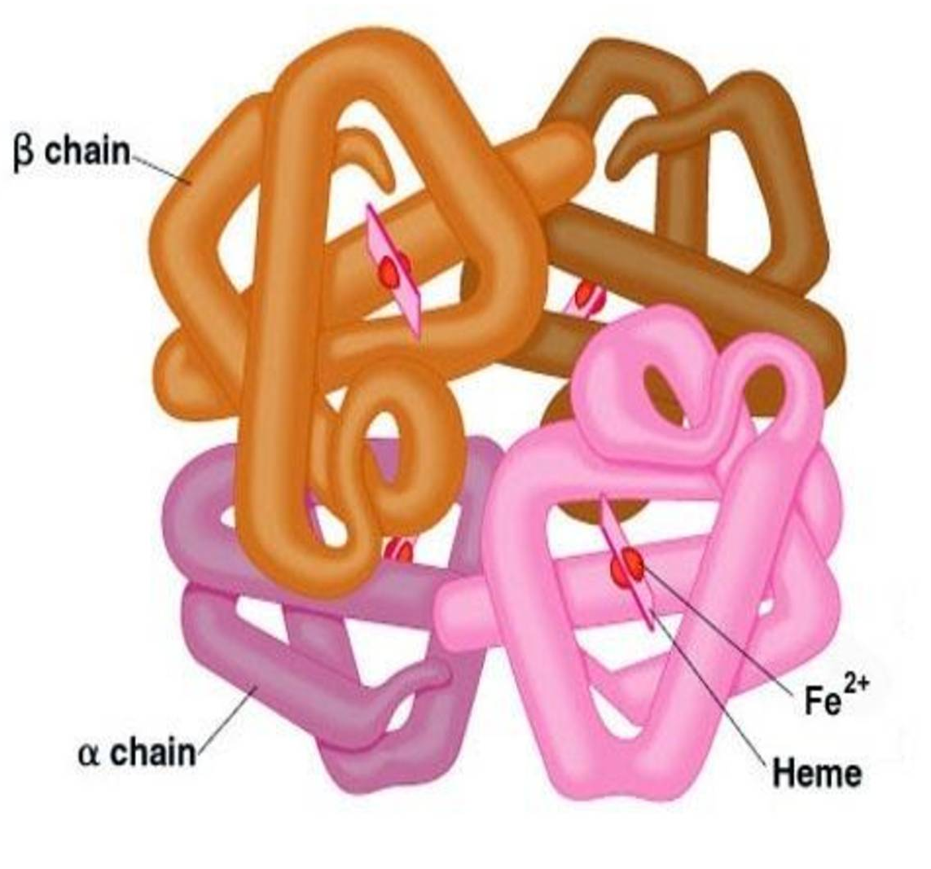
Hemoglobinopathies

Slide 47
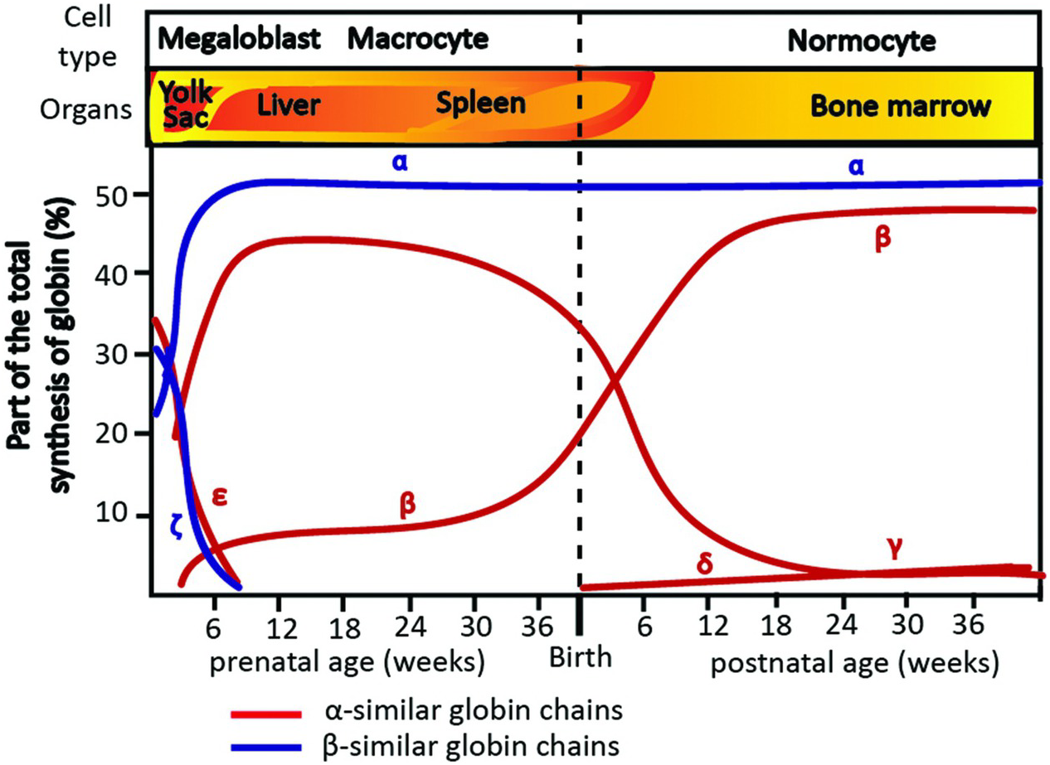
Expression of globin genes during prenatal and postnatal development in humans.

Slide 48
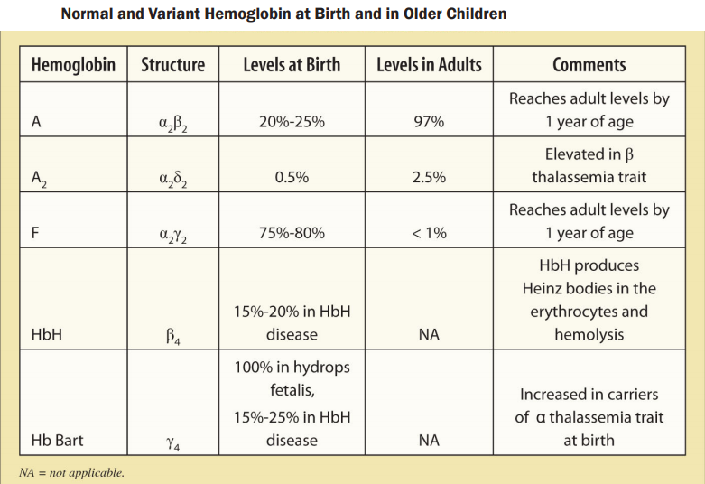

Slide 49
Thalassemia
A group of hemoglobin disorders in which the production of normal hemoglobin is partially or completely suppressed as a result of defected synthesis of one or more globin chains
Inherited as autosomal recessive
Hypochromic microcytic anemia as a result of ineffective erythropoiesis and increased hemolysis
High incidence in Asia, Africa, Mideast, and Mediterranean countries

Slide 50
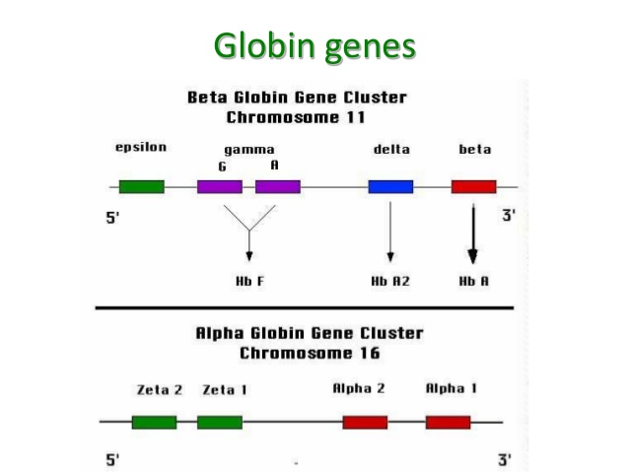

Slide 51
“silent” carrier (1 gene deletion)
Trait (Two genes deletion)
hemoglobin H disease (3 genes deletion)
alpha thalassemia major/ hemoglobin Bart’s/ hydrops fetalis. (4 genes deletions)
alpha
thalassemia
Trait
Intermedia
Major (coolys anemia)
beta

Slide 52
Alpha thalassemia
Alpha globin genes are coded on chromosome 16 (Two genes on each chromosome)
The majority result from gene deletions
  One deletion: Silent carrier; no clinical significance
  Two deletions: α Thalassemia trait; mild hypochromic microcytic anemia
  Three deletions: Hgb H; variable severity, but less severe than Beta Thalassemia Major
  Four deletions: Bart’s Hgb; Hydrops Fetalis; In Utero or early neonatal death

Slide 53
Beta thalassemia
Beta globin genes are coded on chromosome 11 (one gene on each chromosome)
Point mutations result in most of Beta-Thalassemias
  Thalassemia minor (trait) ß+: Affected individuals have only one affected ß gene. Anemia is either not present or very mild
  Thalassemia intermedia ß+: both ß genes , anemia is relatively mild-moderate with no or rare transfusion requirement
  Thalassemia major ß0: both ß genes are affected, anemia is sever. Patients are transfusion dependent.

Slide 54
Beta thalassemia (major and intermedia) sequelae
Hyperplastic expanded bone marrow and bone abnormalities
Iron overload /hemochromatosis (mainly from recurrent blood transfusions)
    Liver fibrosis/cirrhosis
    Endocrine disturbances (e.g., DM, hypothyroidism, hypogonadism, hyperparathyroidism, etc)
    Cardiac hemochromatosis, arrhythmias, and failure
    Skin hyperpigmentation
Hypersplenism:
    Low RBC, WBC, and platelets

Slide 55
Clinical features
Presention at about 2-4 months of age (after HbF toHbA switch)
Sever anemia
Progressive pallor and jaundice
Hepatosplenomegally
Failure to thrive, gross motor delay, short stature
Cardiomyopathy, heart failure
Recurrent infections

Slide 56
Skeletal changes: prominence of malar eminence, frontal
bossing, depression of bridge of the nose, exposure of
upper central teeth
primary amenorrhea, delayed puberty in males
Diabetes mellitus
Leg ulcers, gallstones
Skin bronzing
If untreated, 80% of patients die in the first decade of life

Slide 57
Laboratory findings
Hematological:
    Anemia: hypochromic microcytic.
    Mentzer index ( MCV/RBC) < 13 ( not disgnostic)
    Reticulocytosis
    Leukopenia and thrombocytopenia
    Blood smear: Target cells, nucleated RBCs, extreme anisocytosis
    Hemoglobin electrophoresis ( diagnostic): HbF raised; HbA2 increased
    Megaloblastic bone marrow (due to folate deficiency)
Biochemistry
    High bilirubin.
    Evidence of liver dysfunction
    Evidence of endocrine abnormalities
    Elevated ferritin and transferrin levels

Slide 58
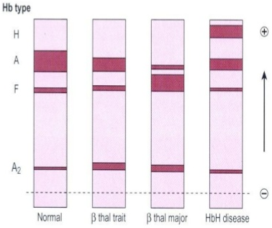
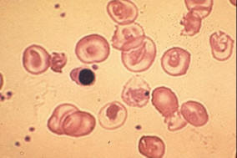
Hgb Electrophoresis
target cells and nucleated RBC

Slide 59
Treatment
Blood transfusion every 4-6 weeks, to keep Hgb> 10g\dl to suppresses ineffective erythropoiesis
Iron chelating therapy: maintain serum ferritin close to 1000 ng/ml
Splenectomy: deferred as long as possible, at least till age 5-6 years
Bone marrow transplant : curative
Hydroxyurea?: enhance HbF production
Gene therapy: future ??

Slide 60
Supportive therapy
Diet modification: restrict iron-rich food intake. Drink more tea
Folic acid
Hormonal therapy
Treatment of congestive heart failure
Psychological support
Genetic counselling

Slide 61
Anemia of chronic disease
Anemia of inflammation
Causes:
  infections, e.g., Osteomyelitis, Tuberculosis
  Malignancies
  autoimmunity, and graft-versus-host disease, Familial Mediterranean Fever, Ulcerative Colitis, Crohn’s Disease, SLE, RA
  chronic kidney disease.
It is typically a mild to moderate normocytic, normochromic, hypo proliferative anemia associated with a decreased serum iron and low transferrin saturation

Slide 62
Normocytic anemias and Hemolytic anemias

Slide 63
Enzyme defects
Pyruvate Kinase deficiency:
defective red cell glycolysis
Red cell rigid, deformed and metabolically and physically vulnerable
Autosomal –recessive inheritance
Nonspherocytic hemolytic anemia
Variable severity: moderate severe anemia
Neonatal jaundice, splenomegaly, heosiderosis
Splenomegaly, Gallstones, hemosiderosis, bone changes
Treatment: folic acid supplementation, transfusions, splenectomy

Slide 64
Enzyme defects
Glucose-6-Phosphate Dehydrogenase deficiency (G6PD):
Also known as Favism, is the most common enzymopathy
X-linked recessive
G6PD is particularly important for the survival of red blood cells and their ability to respond to oxidative stress
There are many different variants and Mediterranean variant is the most common mutation in the world

Slide 65
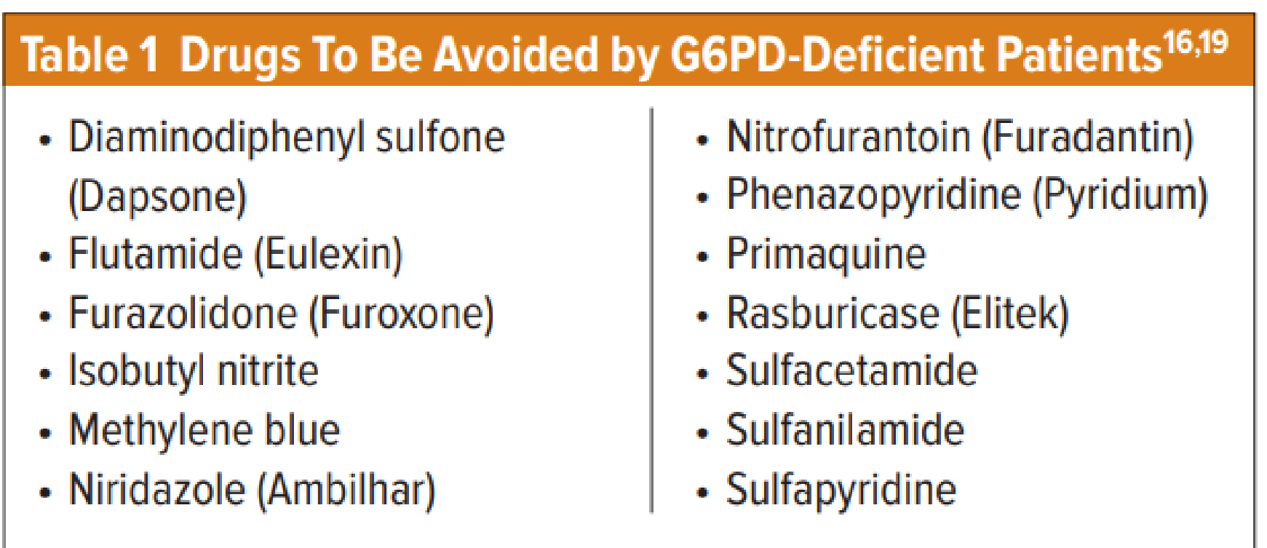
Most deficient people do not show any symptoms until following exposure to oxidative drugs, infections, or some foods e.g. Fava beans.

Slide 66

G6PD
Clinical features:
Neonatal jaundice is the earliest indication of G6PD deficiency.
The most common presenting symptom is fatigue as a result of the decreased red blood cell count.
Acute hemolysis may also lead to back or abdominal pain, shortness of breath, dizziness, headache, cold extremities, pallor, and chest pain.
If hemolysis is severe enough, jaundice and hemoglobinuria (dark urine) may occur.
Treatment: avoidance of oxidative stressors, Blood transfusion, Folic acid.

Slide 67
Hereditary spherocytosis
Autosomal-dominant inheritance (75%), sporadic–25%
Membrane instability due to dysfunction or deficiency of a red cell skeletal protein: ankyrin (75-90%) and/or spectrin (50%)
Mild- moderate microcytic anemia
Reticulocytosis. Blood film: microspherocytes, hyperdense cells , polychromasia
Direct antiglobulin test (DAT) negative
Increased osmotic fragility

Slide 68
Hereditary spherocytosis
Anemia and jaundice- severity depends on rate of hemolysis, degree of compensation of anemia by reticulocytosis, and ability of liver to conjugate and excrete indirect hyperbilirubinemia
Splenomegally
Neonatal hyperbilirubinemia

Slide 69
HS- Complications
Hemolytic crisis – with pronounced jaundice due to accelerated hemolysis ( may be precipitated by infection)
Erythroblastopenic crisis – dramatic fall in Hb level and reticulocyte count, usually associated with parvovirus B19 infection
Folate deficiency caused by increased red cell turnover, may lead to superimposed megaloblastic anemia
Gallstones in 50% of untreated patients, incidence increases with age
Rarely hemochromatosis

Slide 70
HS- Treatment
Folic acid supplement 1mg/day
Leukocyte-depleted packed red cell transfusion for severe erythroblastopenic crisis
Splenectomy and cholecystectomy for moderate to severe cases

Slide 71
Sickle cell disease
Autosomal recessive disorder
Arises from a mutation substituting thymine for adenine in the sixth codon of the beta-chain gene, which results in production of abnormal hemoglobin
The disorder typically affects Africans and people of Mediterranean ancestry
Common sickle cell syndromes:
  Sickle Cell Trait (HbS gene)
  Sickle Cell Anemia (HbS/HbS): the most common type
  Hgb SC Disease
  Sickle Beta-Thalassemia

Slide 72
Sickle cell disease
Clinical manifestations do not appear until after ~ 6 months
By 5 yeras of age, most children with sickle cell anemia have complete functional asplenia.
With low oxygen levels, the shape of red cells becomes distorted. They appear elongated and sickle shaped
Red blood cells become very fragile, short lived, and can occlude blood vessels
The sickling phenomena is exacerbated by hypoxia, acidosis, fever, hypothermia, and dehydration
Diagnosis by Hgb electrophoresis

Slide 73
Clinical features
Hematology:
  Mild to sever anemia ( MCV low or normal)
  Reticulocytosis
  Neutrophilia and thrombocytosis are often present
  ESR low despite inflammation
  Blood film : sickle cells, target cells , Howell-jolly bodies, nucleated RBCs

Slide 74
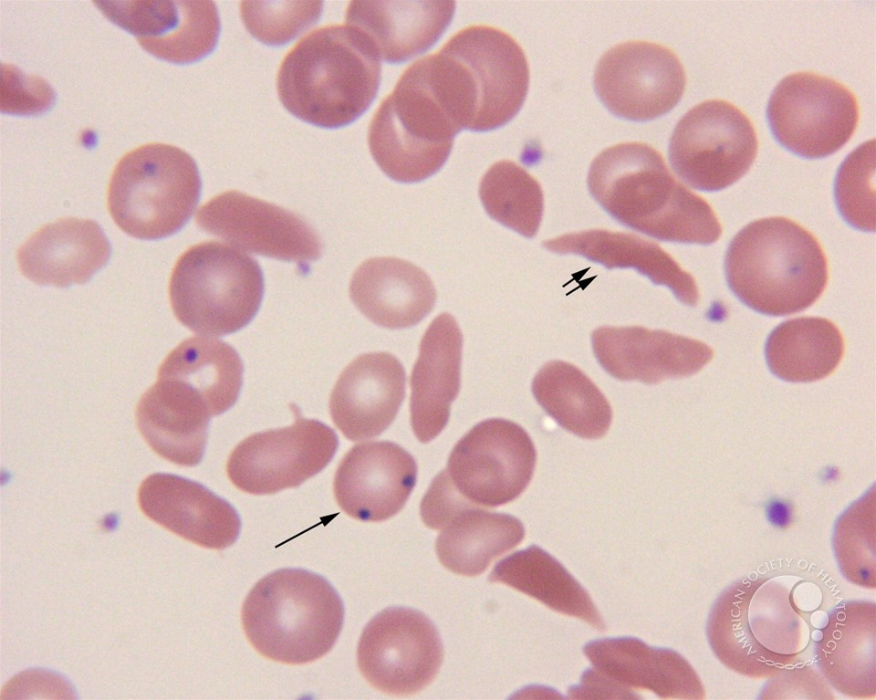
Crescent-shaped sickle cells are noted (double arrow). Several RBCs with Howell-Jolly bodies are also present (single arrow)

Slide 75
Acute complications (crises)
Vaso-occlusive pain crisis:
  Microvascular occlusion
  Mimic osteomyelitis,
  Sites: hands/feet (dactylitis), long bones, spine, pelvis, and abdomen ( mesenteric infarction)
  Treatment: analgesia, hydration, oxygen
Overt stroke
  Treatment: exchange transfusion and supportive therapy
Priapism:
  Sustained, painful erection of the penis, may last > 3 h.
  Analgesia , hydration, pseudonephrine
  Urological consultation for episodes lasting > 4 h.

Slide 76
4. Acute chest syndrome (ACS)
  Development of new pulmonary infiltrate accompanied with fever, chest pain, hypoxia, and shortness of breath.
  Most common cause of death in sickle patients
  ACS is caused by infections, infarctions, and/or fat embolism, and iatrogenically by overhydration.
  Treatment:
    chest imaging, infections workup. ICU admission.
    Pain management, iv fluids , broad spectrum antibiotics plus atypical bacteria coverage
    Oxygen if hypoxemic, mechanical ventilation if needed
    Simple and/ or exchange transfusions.

Slide 77
5. Splenic sequestrations
  Between 5 and 24 months, pooling of large amount of blood in the spleen
  Hypovolemic shock
  Treatment: cardiovascular support. Blood transfusion, and pain management
Transient pure red cell aplasia
  Spontaneous termination at around 10 days
  Human parvovirus B19

Slide 78
Chronic complications
Silent stroke
Pulmonary hypertension
cardiac failure
Pulmonary fibrosis
Renal failure
Chronic liver disease
Bone abnormalities, vascular necrosis of the femoral head, leg ulcers
Retinopathy, sensorineural hearing loss
Functional hyposplenism

Slide 79
Fever and sickle cell anemia
Due to functional hyposplenism patients are at high risk to develop overwhelming sepsis.
Encapsulated organism, gram negative enteric organisms, and salmonella.
Febrile sickle cell patient is a medical emergency.
early administration broad spectrum antibiotic is crucial

Slide 80
Management
Patient education (e.g., good hydration) and psychological support
Oral analgesia
Penicillin pophylaxis, vaccinations
Hydroxyurea for induction of fetal Hgb
Hematopoitic stem cell transplantation: curative

Slide 81
Extracorpuscular hemolytic anemias

Slide 82
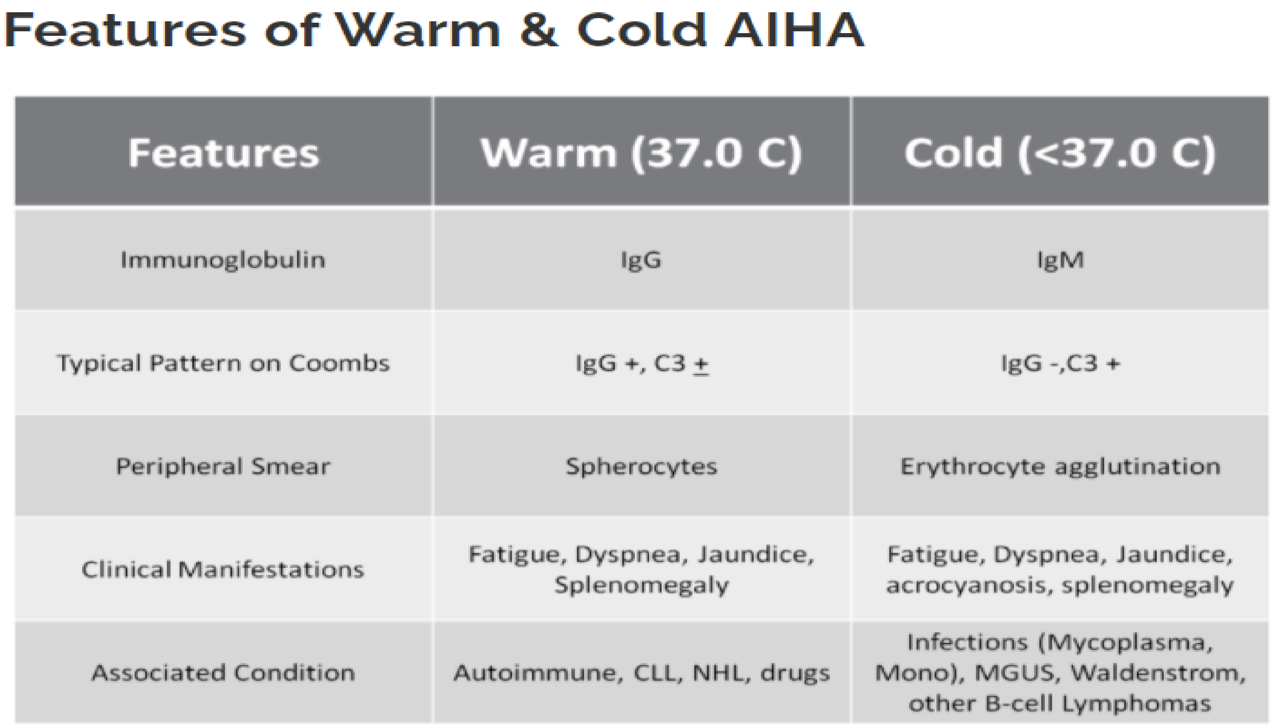
Autoimmune hemolytic anemia

Slide 83
Nonimmune hemolytic anemia
Microangiopathic hemolytic anemia caused by renal, cardiac, liver disease, infections. Like hemolytic uremic syndrome

Slide 84
Physiologic Anemia of infancy
At one week postnatal all RBC indices begin declining to a minimum value reached at about 2 months of age.
  decreased RBC production
  plasma dilution associated with increasing blood volume
  shorter life span on neonatal RBCs (50-70 days)
  more fragile RBCs
  switch from HbF to HbA
    HbF decreases about 3% per week
    at 6 mo. HbF represents only 2% of total Hb
    switch to HbA provides for greater unloading of oxygen to tissues d/t lower oxygen affinity of HbA relative to HbF.
  seldom produces symptoms
  not altered by nutritional supplements

Slide 85
Thank You

