Slide 1
Cystic Fibrosis
Muna Kilani,MD

Slide 2
Among the most common life shortening genetic illnesses, median survival is 47years
Chronic, progressive obstructive lung disease.
Associated with pancreatic insufficiency, liver disease, CF related diabetes.
There is no currently no cure for CF

Slide 3
Epidemiology
30,000 cases in North America.
Incidence 1:3200 in whites, 1:15000 in people of African decent.
Incidence of CF in Jordan???

Slide 4
Pathogenesis
The disease is caused by a genetic mutation on chromosome 7q31.2, which codes for the cystic fibrosis transmembrane conductance regulator (CFTR) protein.
CFTR is an apical epithelial chloride channel.
1900 mutations have been identified, all categorized into 6 distinct classes.

Slide 5
Class 1: Lack of protein production
Class 2: Defect in protein trafficking with degradation in endoplasmic reticulum
Class 3:Defective regulation of CFTR
Class 4: Reduced chloride transport through the apical membrane
Class 5: Splicing defect with reduced production of CFTR
Class 6: Decreased CFTR stability

Slide 6
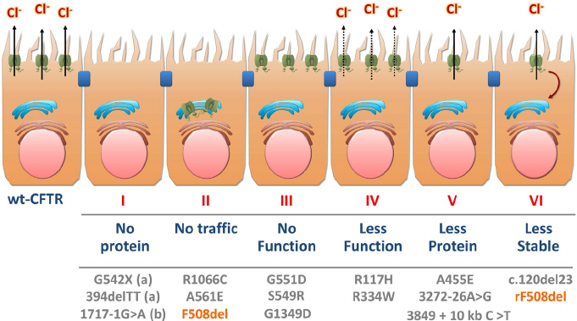

Slide 7
Most common mutation delta 508, it is a class 2 mutation, 70% have one gene, 50% have 2 genes.
G551D is a class 3 mutation, that is targeted by Ivacaftor.

Slide 8
2 mutations are needed for the disease
Classes 1-3 are associated with early onset of disease, and pancreatic insufficiency
Classes 4-5, are associated with later onset lung disease, and pancreatic sufficiency.

Slide 9
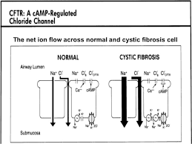

Slide 10
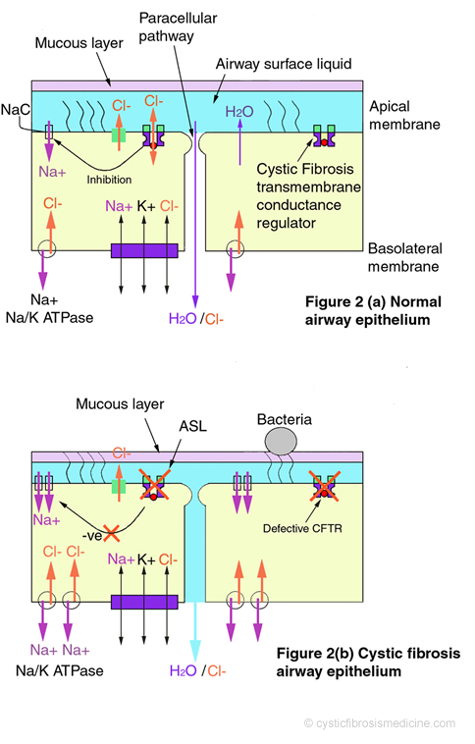

Slide 11
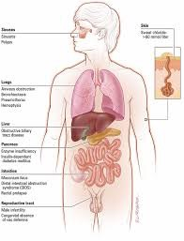

Slide 12
Pathophysiology
Lungs: Mucus plugging==inflammation, chronic infection, small airway obstruction, bronchiectasis
Exocrine pancreas, intestines and liver: vicid secretions==Pancreatic insufficiency, intestinal obstruction,cholestasis.
Other systems: Pansinusitis, nasal polyps and infertility, increased salt excretion in the sweat.

Slide 13
Diagnosis
Cyctic Fibrosis Foundation diagnostic criteria:
  The presence of 1 or more phenotypic symptoms of CF like, recurrent sinopulmonary disease, nutritional of gastrointestinal symptoms, or absence of vas deference.
  OR
  Positive family history of CF in a sibling
  OR
  Positive newborn screen,
    with evidence of chloride transport abnormalitis
      Abnormal sweat test on 2 separate occasions
      Abnormal nasal epithelial cell potential
      The presence of 2 known CF causing mutations on genetic testing

Slide 14
The gold standard for diagnosis of CF remains the pilocarpine iontophoresis sweat test developed by Gibson and Cooke in 1959 .
nterpretationofSweat Chloride Concentration
Group Interpretation
Infants age 0–6 months
Sweat chloride concentration (mEq/L)
0–29 CF is unlikely
30–59 Intermediate
60 Indicative of CF
Infants age >6 months, children, and adults
Sweat chloride concentration (mEq/L)
0–39 CF is unlikely
40–59 Intermediate
60 Indicative of CF

Slide 15
Diagnosis
False positive sweat Cl:
  Eczema, Ectodermal dysplasia, malnutrition, congenital adrenal hyperplasia, Adrenal insufficiency, hypothyroidism.
False negative sweat Cl:
  Dilution, edema, inadequate sweat.

Slide 16
Diagnosis
Abnormal nasal potential difference measurement. (Absence of voltage after pilocarpine administration).
Fecal elastase to measure exocrine pancreatic junction.
Genetic testing:
  usually look for 30-96 mutations.
  Complete sequencing of the CFTR gene is available for atypical cases
  List of clinical manifestations associated with the individual CFTR mutations are available on www.cftr2.org

Slide 17
Diagnosis
Newborn screening was implemented in all states in 2010
Newborn screening was associated with improved nutritional status, and lung function at age 6.
It has 90% sensitivity but low specificity.
Immunoreactive trypsinogen is measured in the newborns blood.
  a positive test needs referral to a pulmonologist , and the performance of a sweat test.
  False negative newborn screening can happen especially in infants with meconium ileus.

Slide 18
Clinical Manifestations
  Recurrent sinopulmonary infection
  Stetorrhea
  Failure to thrive.( The triad of symptoms)

Slide 19
Clinical Manifestions by age
Hyperechoic bowel of fetal US, is suggestive of CF
Delayed meconium passage, meconium plugging and meconium ileus, are present in 15-20% of infants with CF.
  Due to high protein in meconium
  inspissation of meconium is bowel leading to intestinal obstruction…usually needs surgical removal
Rectal prolapse
  Seen in patients 6m—3years
  Due to malnutrition, elimination of large stools

Slide 20
Clinical Manifestions
Less frequent manifestations in infancy
  Salt depletion sydrome, results in hyponatremic, hypokalemic, hypochloremic metablolic alkalosis.
  Prologed neonatal jaundice from intrahepatic biliary stasis, and extra hepatic biliary obstruction.
  Edema and hypoprotinemia from malabsorbtion
  Hemorrhagic disease of the newborn from Vit K deficiency.

Slide 21
Clinical Manifestations
    In older children, adolescents and adults.
      Recurrent lung infection
      Poorly controlled asthma
      Bronchiectasis
      Recurrent sinusitis and nasal polyps
      Hemoptysis, pneumothorax
      Respiratory failure

Slide 22
Clinical Manifestations
Malabsorption
DIOS…Distal Intestinal obstruction syndrome
Rectal prolapse
Liver disease
Infertility absent vas deference

Slide 23
Management
The aim of management is to
  Maintain optimal lung function
    Antibiotics
    Lung clearance
    Anti inflammatory medications
  Maintain optimal nutritional status

Slide 24
Management
In the US cystic fibrosis care is provided at CF foundation accredited centers with a multi disciplinary team approach.
Cystic Fibrosis Foundation’s Pulmonary Clinical Practice Guidelines Committee developed recommendations that were based on a systematic review of the literature and assessment of the available evidence based on an established grading scale. These guidelines were updated in 2013

Slide 25
Management
Chronic airway infection
  surveillance cultures; pseudomonas, staph aureus, atypical mycobacterial infections, fungal infections
  First evidence of pseudomona colonization is usually treated with inhaled tobramycin
  Patients with chronic pseudomonas infection, can benefit from inhaled antibiotics every other month
  Acute exacerbations are treated with IV antibiotics usually double coverage for pseudomonas and depending on the sensitivities obtained by sputum culture.

Slide 26
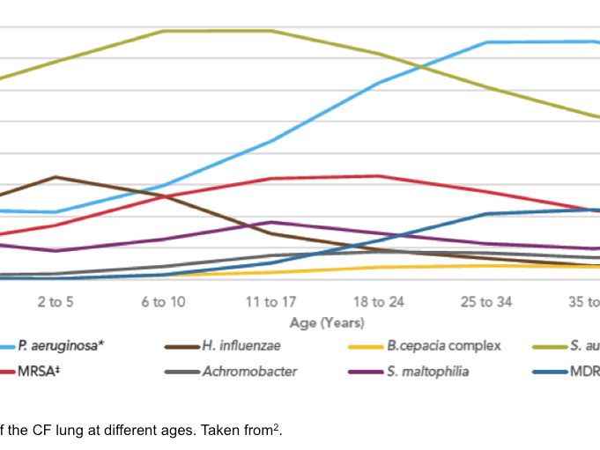

Slide 27
Management
Airway clearance
  Percussion, postural drainage, active cycle breathing, positive expiratory pressure, high frequency chest wall oscillation.
  Usually combined with mucus alternating agents like DNase, and hypertonic saline
  Usually done twice daily and increased frequency with acute infections.

Slide 28
Management
Chronic airway infammation
  Ibuprofen: high doses (blood levels of 50-100microgm/ml) have been associated with decrease neutrophil migration and decreased inflammation
  Azithromycin: used 3 times/week, improves lung function and lessens exacerbations
  Sterids: Should not be used routinly

Slide 29
Management
Pancreatic enzyme replacement therapy
  Pancreatic enzymes must be taken with every meal and snack
  The dose is 2000-2500u/kg of lipase/meal
  Too high of a dose causes fibrosing colonopathy
Fat soluble vitamines replacement therapy
  AKED vitamines

Slide 30
Management
Management of the compilcations
  Pulmonary exacerbation: worsening cough, shortness of breath, fatigue or weight loss, decrease in lung functions
  Treament is with antibiotics, oral,IV or inhaled depending on culture results and sensitivities.

Slide 31
Management
  Hemoptysis 9% of patients:
    usually from bronchial arteries, in advance disease
    treatment is antibiotics for mild to moderate, 5-250ml
    Bronchial artery embolization or lung resection for sever bleeding
  Pneumothorax in 3.4% of patients
    If small to moderate management depends on degree of respiratory compromise
    If large a chest tube needs to be inserted
    if large and recurrent, chemical or surgical pleurodesis

Slide 32
Management
Chronic rhinosinusitis and nasal polyps
  Medical therapy with inhaled steroids, saline rinses
  surgery, functional endoscopic sinus surgery.
DIOS
  Vicid fecal matter obstructing distal intestines, risk factors include fat malabsorption secondary to insufficient enzyme replacement, dehydration, a history of meconium ileum
  Treatment is hydration, and osmotic laxatives, in cases of complete obstruction gastrografin enema

Slide 33
Management
CF liver disease
  Patient get biliary fibrosis that leads to biliary cirrhosis and liver cirrhosis
  Hepatomegaly, abnormal liver functions and abnormal liver US and and an abnormal liver biopsy
  Treatment is ursodeoxycholic acid

Slide 34
Management
Cystic Fibrosis Related Diabetes Mellitus
  CFRD has been associated with decreased body mass index, lung functions and mortality
  Early control improves outcome and mortality
  Microvascular complications of DM can happen
  Incidence increase 5% per year after 10 years of age, and 10% per year after 20 years of age
  Recommended to perform a glucose tolerace test yearly after 1 year of age, HA1C is not recommended as in underestimates the glycemic load
  Treatment is with Insulin, oral hypoglycemic agents are not recommended
  Caloric restriction is not recommended, intake of carbohydrates is not discouraged.

Slide 35
Management
Disease-Modifying Therapies
  Ivacaftor is an oral pharmacologic potentiator
  Activates defective CFTR in patients with class 3 mutation G511D
  Approved for patients with at least one G511D mutation

Slide 36
Management
CFTR modulator therapies
Ivacaftor
Ivacaftor and lumacaftor (Orkambi)
Ivacaftor, Tezacaftor, Elexacaftor (TriKafta)

Slide 37
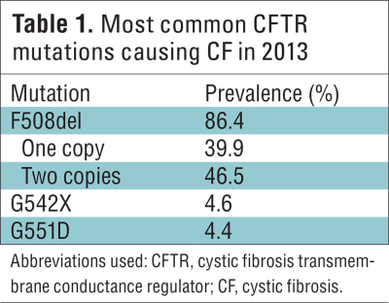

Slide 38
Management
  Lung transplantation
    5 year survival about 70%

Slide 39
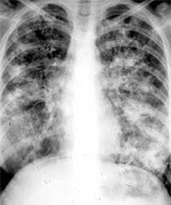

Slide 40
Non-CF Bronchiectasis

Slide 41
Incidence unknown and varies between 4/100.000 (children) – 52/100.000 (adults)
It is still an important cause of chronic suppurative lung disease in low-income countries
Decline in prevalence since 1950’s in high-income countries

Slide 42
Definition: dilatation of the airways, supported by radiological and clinical evidence
Pathophysiology:
  ▪ Infection
  ▪ Inflammation ▪ Tissue damage

Slide 43
Etilogy
Idiopathic 17-40%
▪ Aetiology depends on region: primary immunodeficiency/
infections

Slide 44
Al Subie et al. J Paediatr Child 2012.

Slide 46
Symptoms
Chronic cough > 8 weeks
Asthma not responding to treatment
Pneumonia with incomplete resolution or recurrent pneumonia
Hemoptysis
Persistent lung crackles on exam

Slide 47
Investigations
Imaging
HRCT gold standard, sensitivity 97% ,MRI ?
Differential diagnosis Sweat test, screening for PCD
  CRP, WBC, Immunological screening
  • IgG, IgA, IgM, specific antibodies, HIV, IgE, aspergillus IgE, aspergillus allergy skin test, response to vaccinations
  • Lymphocytes subsets, proliferation tests, NK cells
  • Phagocyte function, complement levels.

Slide 48
Treatment
Treatment of the etiology if possible
Antibiotics, inhaled and oral
Chest physiotherapy
Azithromycin

Slide 49
Thank you!

