Slide 1
Respiratory Tract Infections
Muna Kilani, MD

Slide 2
Common Cold (Coryza)
Nasal discharge
Cough
Fever
Less than 1 week duration
Rhinovirus, corona virus, RSV

Slide 3
Pharyngitis
Sore throat, fever, cough
Pharynx is inflamed, lymph nodes enlarged.
Usually viral etiology, adenovirus, rhinovirus,
In older children group A beta hemolytic streptococcus.

Slide 4
Tonsillitis
A form of pharyngitis, with involvement of the tonsils.
Common pathogens are group A hemolytic streptococcus
Viruses like Ebstein Barr virus ( infectious mononucleosis)
If bacterial infection diagnosed treatment in penicillin or erythromycin if patient allergic
Treatment does not prevent post streptococcal nephritis.

Slide 5
Streptoccocal Pharyngitis
Streptococcal tonsillitis characterized by erythema and swelling of the tonsils, exudate, petechia on the palate, tender anterior cervical lymph nodes
Can be associated with sandpaper rash.
Diagnosed with Rapid Antigen Detection Test, and throat culture, sensitivity 63-96, specificity 90-100%

Slide 6
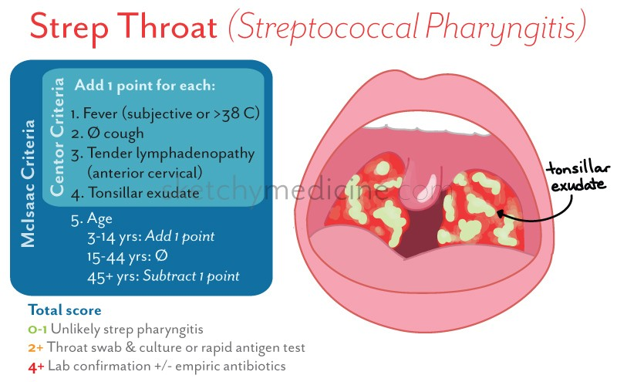

Slide 7
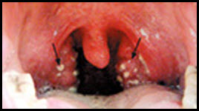
Tonsillar exudate

Slide 8
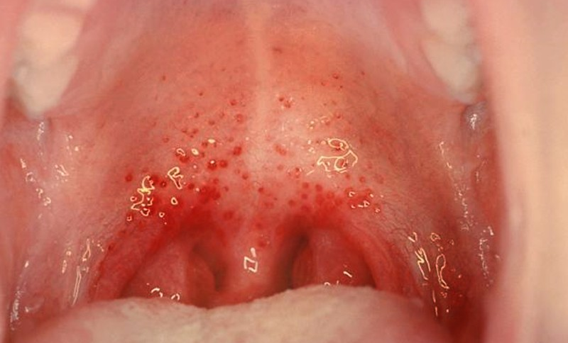
Palatal petichiae

Slide 9
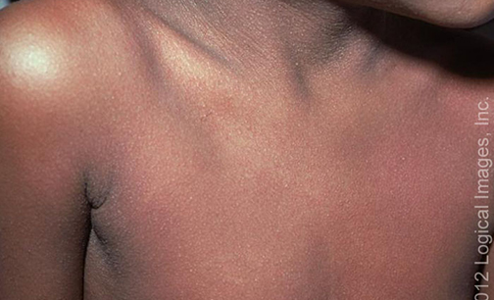
Sand paper rash

Slide 10
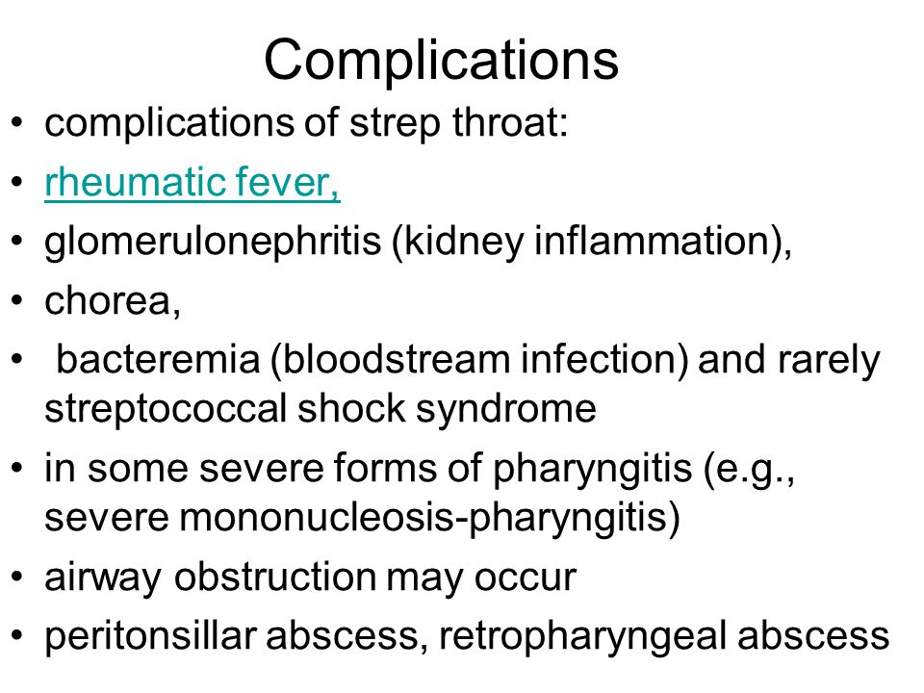

Slide 11
Sinusitis
Infection of the sinuses
Maxillary, Ethmoidal, Spenoidal, Frontal
Pathophysiology: Swelling --- inflammation---infection.
Predisposing factors: Cyctic Fibrosis, allergic rhinitis, immunodeficiencies , structural abnormalities

Slide 12
Sinusitis
Headache
Fever
Nasal discharge
Cough: night time and early morning cough

Slide 13
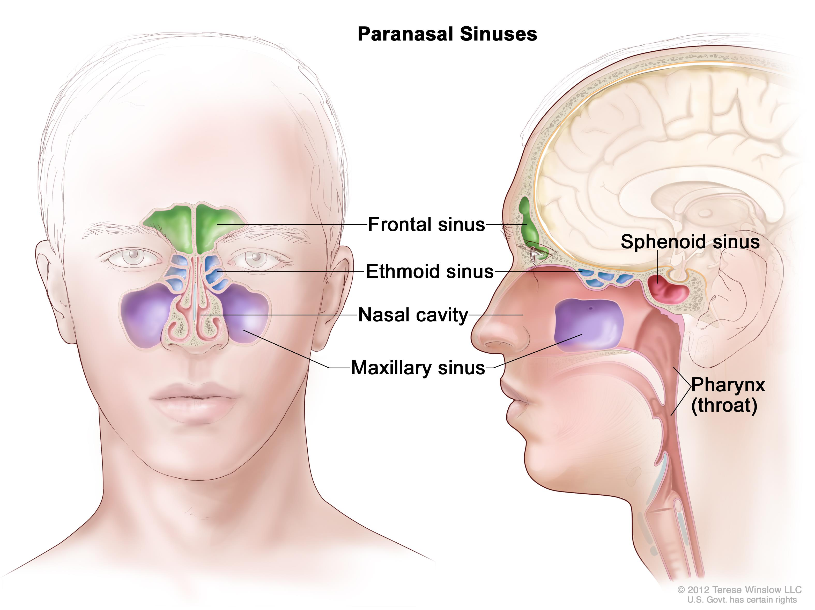

Slide 14
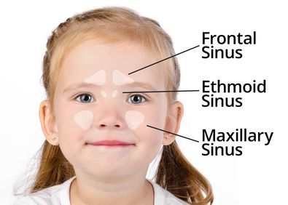

Slide 15
Sinusitis
Diagnostic criteria AAP guidelines 2014
URI Symptoms of 10 days duration
Or worsening URI symptoms after initial improvement
Or Sever onset of purulent to discharge and high grade fever of 3 days duration
No imaging necessary
Organisms, streptococcus pneumonia, staph aureus, non typable Hemophilus influenza, moraxella catarralis
Physical findings: nasal discharge, post nasal drip, facial tenderness

Slide 16
The ethomoid and maxillary sinuses form in the 3rd to 4th gestational month.
The sphenoid sinuses are pneumatized by 5 years of age
The frontal sinuses do not appear until the 7th to 8th year of life and are not completely developed until adolescense

Slide 18
Croup
Laryngotracheobronchitis
Mostly viral
Parainfluenza is the most common organism, but also RSV, Rhinovirus, influenza
Pathophysiology: swelling of the subglottic space secondary to the viral infection

Slide 19
Croup
age 6m-3 years most common, can happen up to 6 years
Preceded by upper respiratory tract
Harsh barking cough, worse at night
Stridor, non toxic looking
Management: keep child comfortable, management according to severity

Slide 20
Croup
Moderate/Severe: Stridor at rest AND
  Moderate intercostal retratctions
  Tachypnea
  Agitation/restlessness/tired appearing
Mild only harsh cough

Slide 21
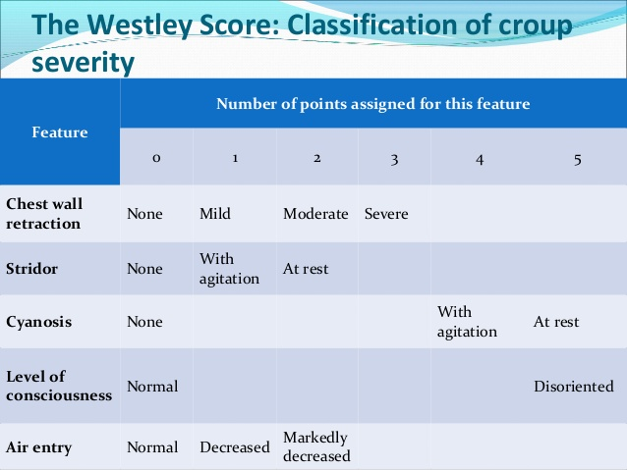

Slide 22
Croup
Mild------ Steroids
  Dexamethazone 0.5mg/kg IM
Moderate/Severe
  Dexamethazone 0.5mg/kg IM
  Racemic epinephrine

Slide 23
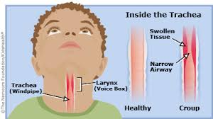

Slide 24
Epiglottitis
Infection of the Epiglottiis, potentially life threatening
Most common organism is Hemophilus influenza, now streptococcus and other species.
Most common age 2-6years
Sudden onset of symptoms, high fever, anxious
Patient toxic looking, drooling, tripod position, leaning forward
Do not examine. if sever obstruction send to OR for intubation
Incidence decreases significantly after Hib vaccination
IV antibiotics after airway has been secured

Slide 25
Treatment
Antibiotics, according to organism

Slide 26
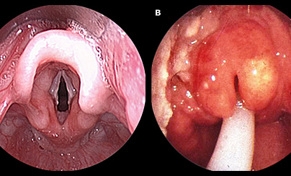

Slide 27
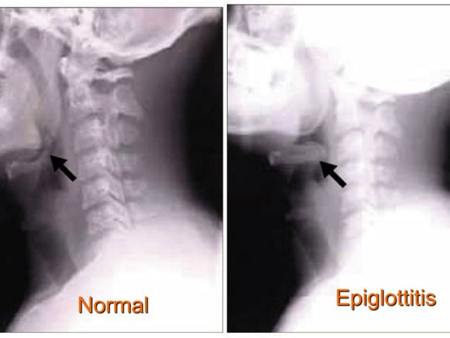

Slide 28
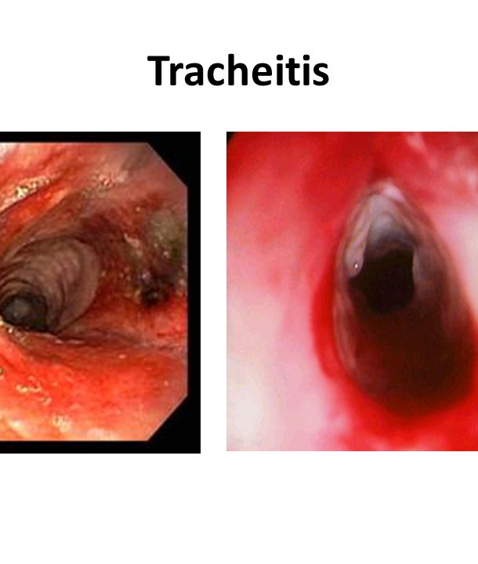
Tracheitis
Most likely bacterial in origin
Staph aureus most common organism
Sick, toxic looking patient
Stridor
Treatment : Admiission, I V antibiotics.

Slide 29
Bronchiolitis
Very common, 3% of all US infants are hospitalized with bronchiolitis
Respiratory Syncytial Virus is main pathogen, but also metapneumvirus, rhinovirus
Up until 2-3 years of age
Pathophysiology: viral infection of the lower respiratory tract, with inflammatiion, edema, swelling, increased mucus secretion leading to airway obstruction

Slide 30
Bronchiolitis
Signs and symptoms
  Nasal discharge, cough, fever, shortness of breath, cyanosis, apnea in infants( apnea may preceed respiratory symptoms)
  Chest exam wheezing, crackles, retractions, cyanosis
Infection has a seasonal pattern, depending on the patients location, in the northern US it is Nov to April

Slide 31
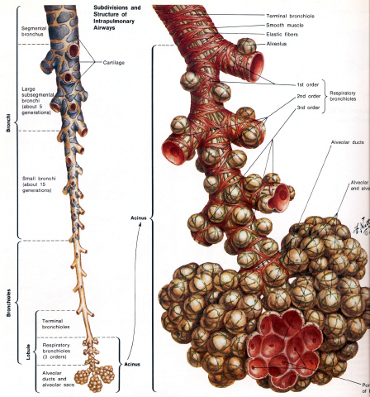

Slide 32
Bronchiolitis
Diagnosis
  Viral swab: not indicated for uncomplicated cases. ( rapid immunofluorecent, or PCR)
  CBC and electrolytes normal
  CXR : Hyperinflation, perihilar infiltrates, atelectasis.....but not always routinely indicated

Slide 33
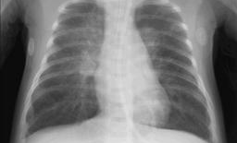

Slide 34
Broncholitis
Clinical course for RSV bronchilolitis is worsening first 48-72h, then a plateau for 2-3 days followed by improvement, symptoms can last 3 weeks
High risk patients are premature babies, babies with congenital heart disease, Cystic fibrosis or chronic lung disease
About 25-50% of patients with Bronchiolitis develop recurrent wheezing

Slide 35
Bronchiolitis
Treatment
    Supportive
    Oxygen, cpap, intubation
    IV fluid if unable to take PO or too tachypnic ( respiratory rate above 60b/min)
    Superinfection with bacteria is very rare in RSV bronchiolitis.
    Bronchodilators Albuterol and epinephrine may help, no place for scheduled treatments
    Steroids are not recommended in previously healthy children
    Hypertonic saline not routinely recommended

Slide 36
Bronchiolitis
Prophylaxis
  Palivisumab, monoclononal RSV antibody, has decreased admission by 50% in high risk infants, given as monthly infections

Slide 37
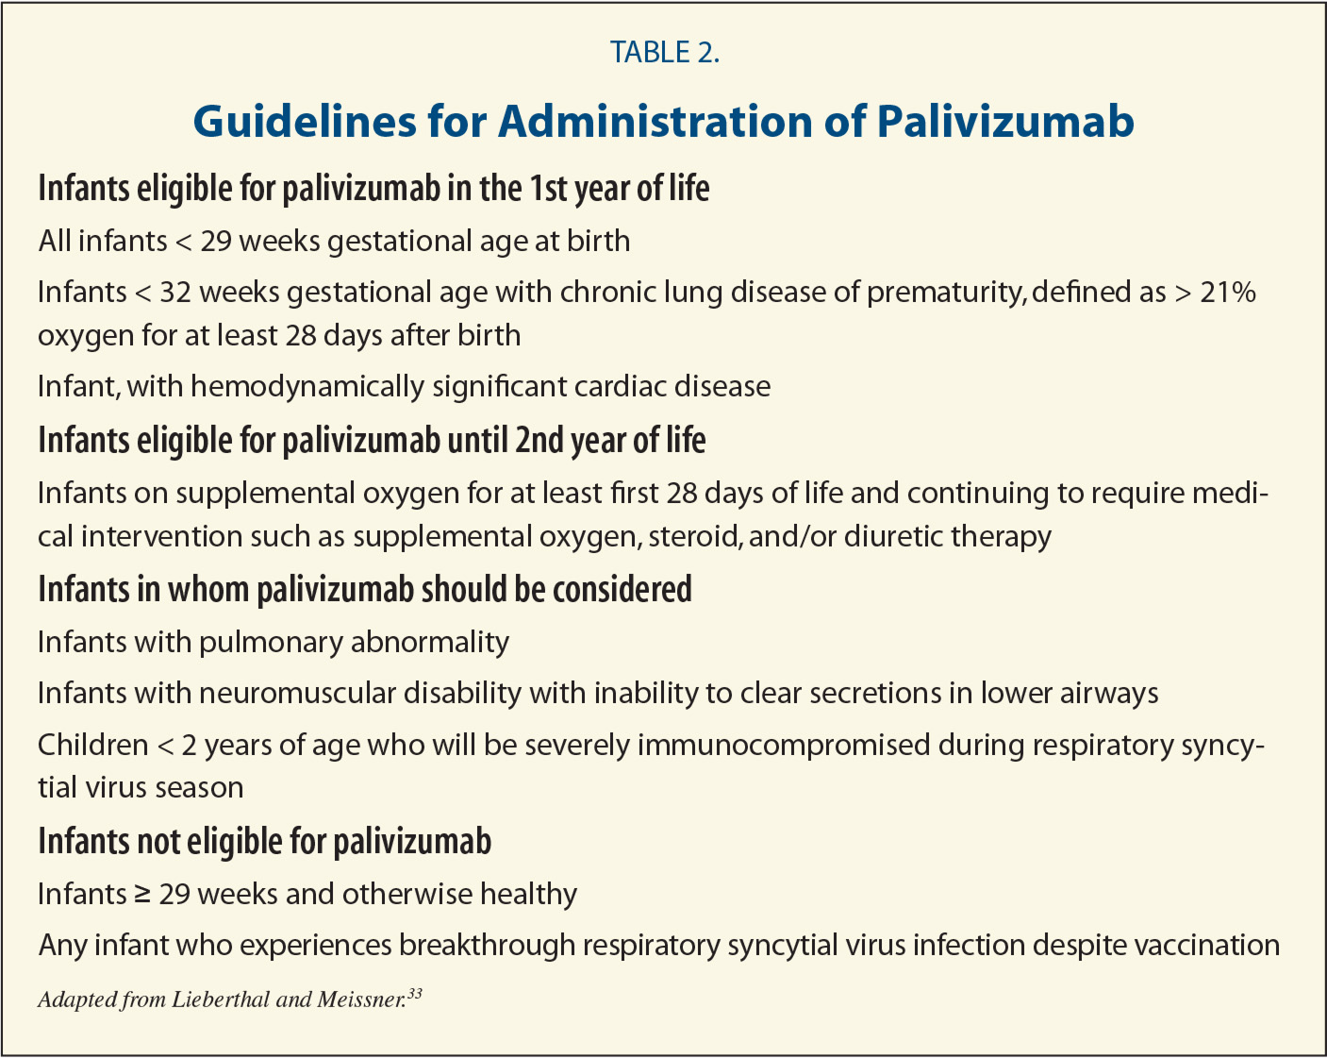

Slide 38
Pneumonia

Slide 39
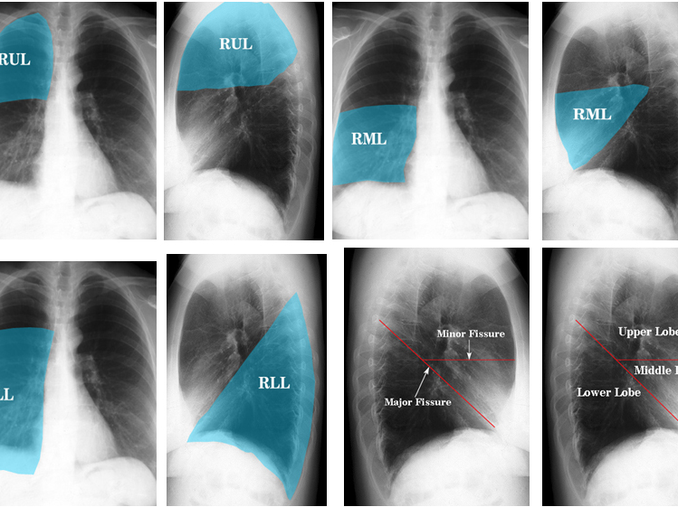

Slide 40
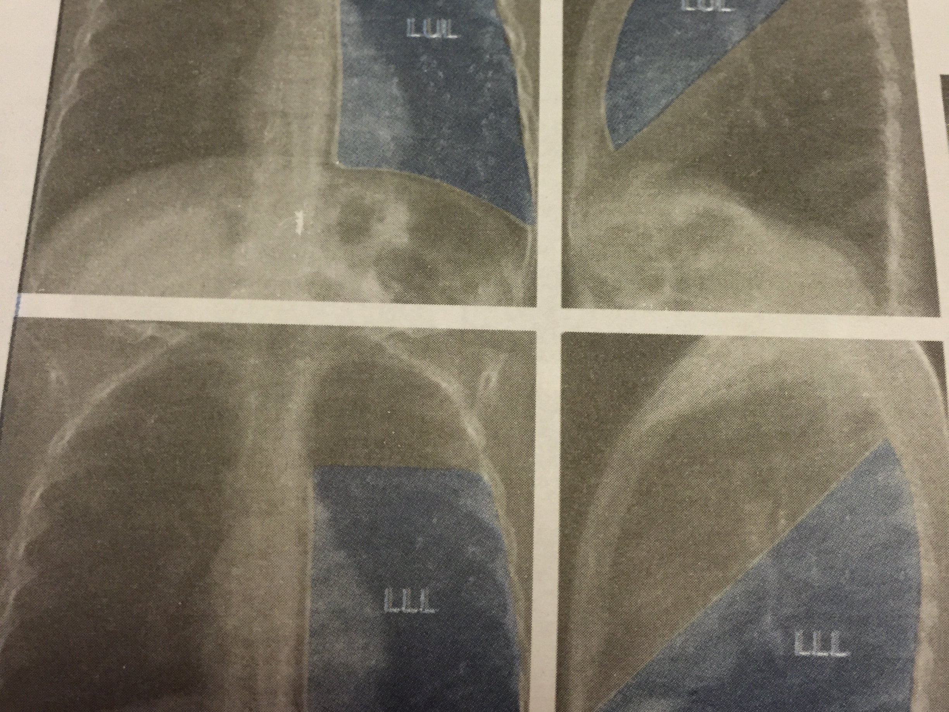

Slide 41
Pneumonia
Etiology varies by community, in one study 60% were bacterial, 45% viral
Lobar pneumonia, bronchopneumonia and interstitial pneumonia

Slide 42
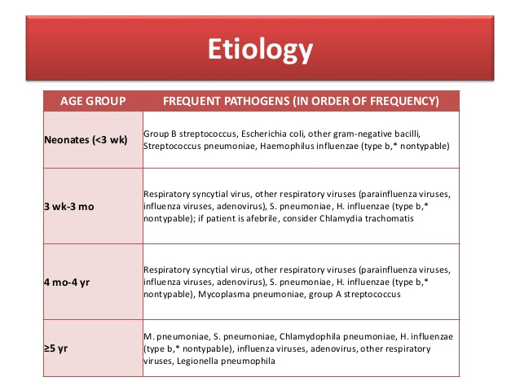

Slide 43
Pneumonia
Clinical features
  Cough, fever, shortness of breath
  Tachypnea and retractions, grunting
  Decreases air entry or crackles over affected lobe, or may have normal breath sounds

Slide 44
Pneumonia
Diagnosis
  Diagnosis in mainly clinical
  CBC may show elevated WBC's, left side shift.
  Atypical lymphocytes may be seen in viral infections
  Blood culture only in hospitalized patients
  CRP elevated in sever disease

Slide 45
Pneumonia
CXR PA and lateral
Lobar infiltrate more likely bacterial
Perihilar scattered infiltrates with hyperinflation and adenopathy most likely viral

Slide 46
Pneumonia
Treatment
  Oxygen
  IV fluids if unable to do PO feeds
  Antibiotics vary by age, severity
  Newborns ampicillin gentamicin or cefotaxime
  Older children, ampicillin or ampicillin clavulanic acid, in sever cases third generation cephalosporins
  If older than 5 and mycoplasma suspected macrolides can be used
  Always check latest infectious disease guidelines
  If patient is toxic looking add vancomycin
IDSA 2011

Slide 47
Diagnosis and Treatment of Adults with Community-acquired Pneumonia
An Official Clinical Practice Guideline of the American Thoracic Society and Infectious Diseases Society of America
Joshua P. Metlay*, Grant W. Waterer*, Ann C. Long, Antonio Anzueto, Jan Brozek, Kristina Crothers, Laura A. Cooley, Nathan C. Dean, Michael J. Fine, Scott A. Flanders, Marie R. Griffin, Mark L. Metersky, Daniel M. Musher,
Marcos I. Restrepo, and Cynthia G. Whitney; on behalf of the American Thoracic Society and Infectious Diseases Society of America
THIS OFFICIAL CLINICAL PRACTICE GUIDELINE WAS APPROVED BY THE AMERICAN THORACIC SOCIETY MAY 2019 AND THE INFECTIOUS DISEASES SOCIETY OF AMERICA AUGUST 2019

Slide 51
Pneumonia
Influenza pneumonia
  Zanamivir (neuraminidaze inhibitors)
  Second line is oseltamivir plus rimanitidine

Slide 52
Pneumonia
Complication
Necrosis
Abscess formation
Pneumatocele
Effusions parapneumonic
Empyema
Sepsis and toxic shock syndrome

Slide 53
Pertussis

Slide 54
Bordetella pertussis or parapertussis
Signs and symptoms
  3 stages
    Catarrhal (URI like symptoms)
    Paroxysmal ( paroxysms of intense cough)
    Convalescent ( Chronic cough)

Slide 55
It is estimated that the incidence is 50 million cases a year
In infants < 3 month mortality is 3%
Maternal immunity is not transferred to infants

Slide 56
Pertussis
Diagnosis
  PCR nasophayngeal swab
  Culture of nasophyngeal swab
  CDC recommends both test for cough >3 weeks
  WBC >10,000 lymphocytes
  PCR and culture can be negative after the first few weeks of symptoms

Slide 57
Pertussis
Prevention
  DTaP at 2,4,6 and 15-18 month and at 4-6 years of age
  Tdap recommended for children 7-10y as as single dose at 11-18 year, and for adults and pregnant women

Slide 58
Pertussis
  Complications
  Pneumonia 13% from B pertussis or seconday infection
  Hypoxic encephalopathy 1%
  Otitis media
  Hernia
  Seizures
  Cerebral hemorrage

Slide 59
Pertussis
Management
  Antibiotics to hasten irradiation of organism and prevent spread
  Erythromycin, clarithromycin, azithromycin

