Slide 1
Septic work up
Dr. Dhikra Nabil

Slide 2
Blood
Urine
Cerebrospinal fluid
Chest X-Ray
?? stool, pus….

Slide 3
Blood
CBC
CRP
Blood culture

Slide 4
CBC
-WBC: count (leukocytosis vs. Leukopenia )plus differentials
-Platelets
-Hb

Slide 5
Urine
Ways of collecting the samples

Slide 6
Suprapubic
Foley’s catheter
Mid stream clean catch
Urine bag

Slide 7
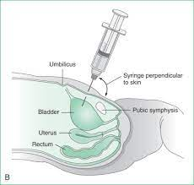
suprapubic

Slide 8
Urine
Urine analysis (UA)
Urine culture (Ucx) (2 days)

Slide 9
Urine analysis
PH
WCC
RCC
Protein
Glucose
Specific gravity
Crystals, casts, epithelial cells
Visible microbes

Slide 10
Cerebrospinal fluid
CSF
Lumber puncture

Slide 11
Indications
-Diagnostic
Infections
Malignancies
-Therapeutic
Relieve pressure
Inject medications (antibiotics,chemotherapy,anethesia…)

Slide 12
Contraindications
Increase intracranial pressure
Skin lesions or deformity at site of puncture
Cardiorespiratory instability
Coagulopathy(absolute)
Thrombocytopenia (relative contraindication)

Slide 13
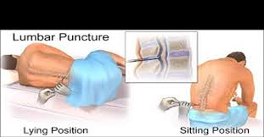
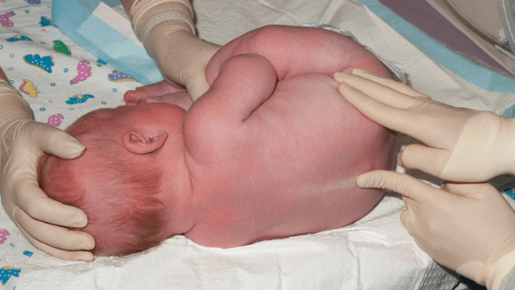
POSITION

Slide 14
Conditions
Sterile technique

Slide 15
Examine first
Pressure
Color
Turbidity

Slide 16
Samples
Cytology
Biochemistry
Microbiology
Serology
Others

Slide 17
Cytology
-WCC (count ,Diffx)
Do correction of WCC if needed
-RCC ,if positive…
Traumatic
Infection
Malignancy
hemorrhage

Slide 18
Biochemistry
Protein
Glucose

Slide 19
Microbiology
Gram stain
Culture( 2 days)
Latex test (capsulated microorganisms)

Slide 20
Serology
Herpes simplex PCR
Enterovirus PCR

