Slide 1
Introduction to Emergencies
Dr. Dhikra Nabil

Slide 2
Hyperkalemia

Slide 3
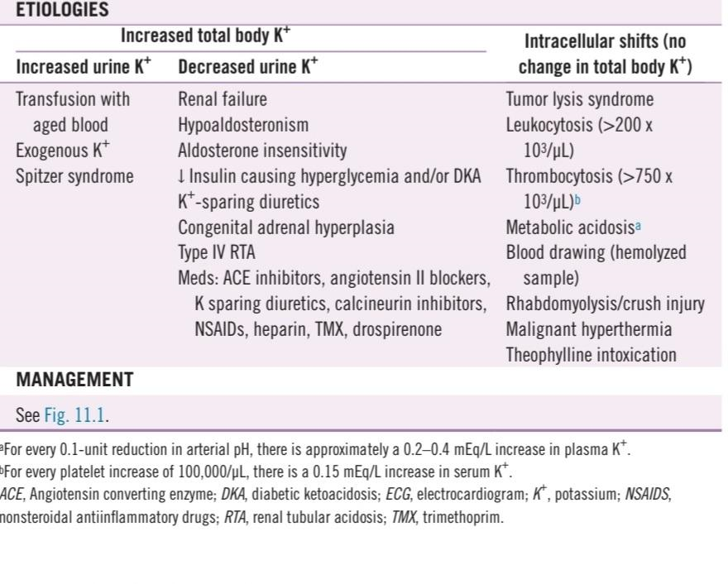
Etiologies

Slide 4
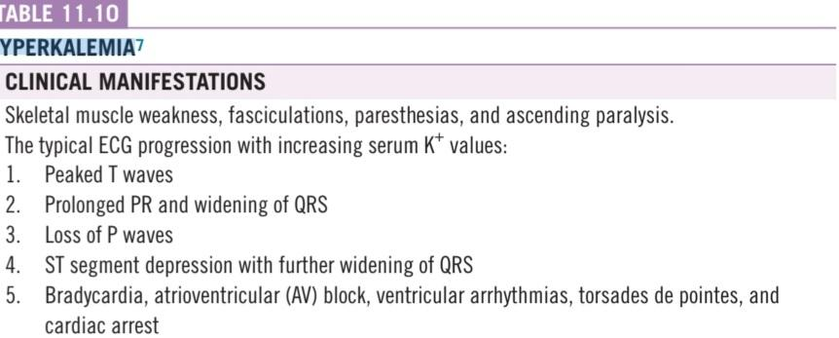
Clinical manifestations

Slide 5
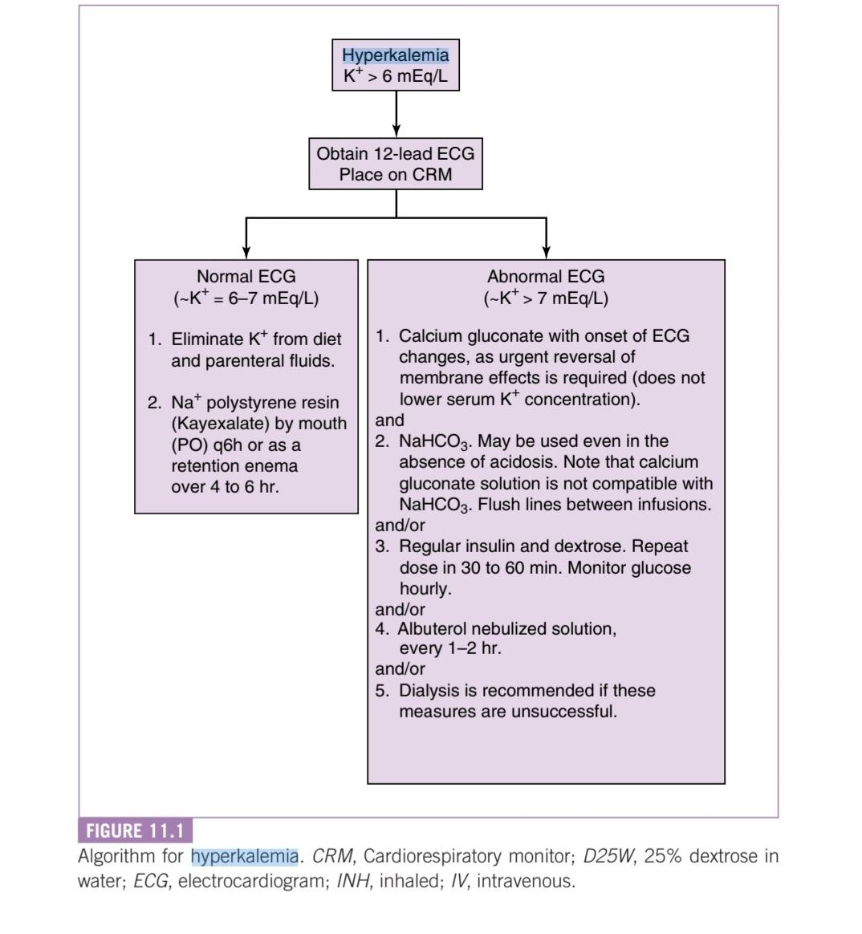

Slide 6
Diabetic KetoAcidosis
DKA

Slide 7
Diabetic KetoAcidosis
Hyperglycemia
Ketonemia, ketonurea
Wide anion gap metabolic acidosis

Slide 8
4 lines for the management
1-Fluid…
2-Insulin
3-Electrolytes and labs
4-Neurological monitoring

Slide 9
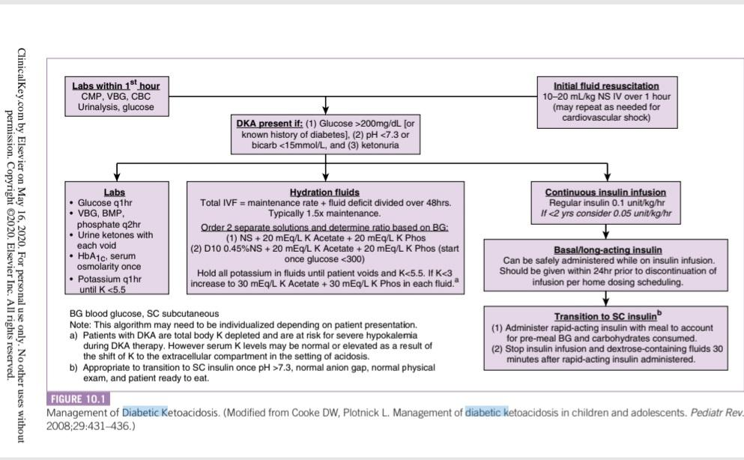

Slide 10
After being out of DKA
Change into SC insulin
Start meals
Transfer to the pediatric ward
Monitor glucose level
Counsel
Follow up

Slide 11
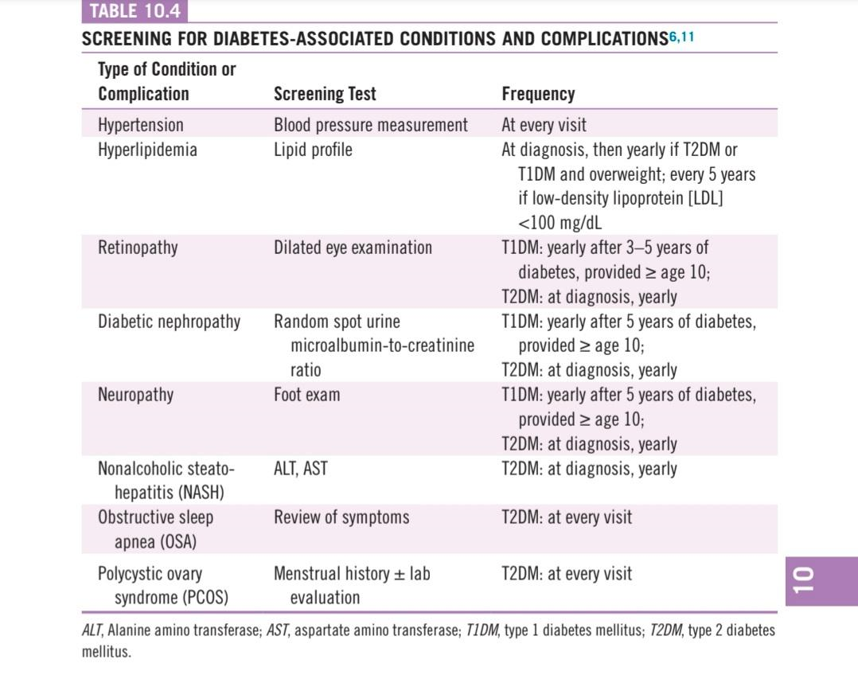

Slide 12
Anaphylactic shock

Slide 13
Anaphylaxis
cardiovascular
Skin and cutaneous
Respiratory
Gastroenterology

Slide 14
Management
-ABCs
-Epinephrine
-Albuterol
-Histamine-1 receptor antagonist
-Corticosteroids discharge with good counseling and Epi-Pen/Epi-Pen junior
-For hypotension….

Slide 15
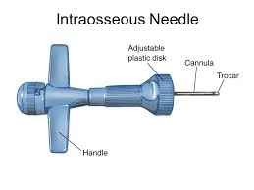
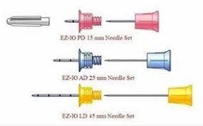
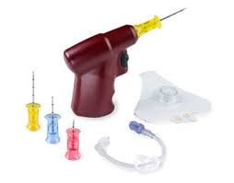
intraosseous needle

Slide 16
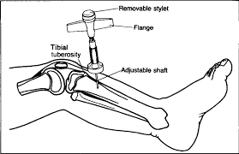
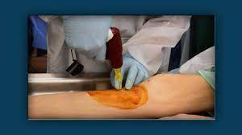
Intraosseous

