Slide 1
Management of Tachyarrhythmia
Jwana qosous
Buthaina alhawarat
Majd Zeidan

Slide 2
Table of Contents
ECG basics and approach
Signs and Symptoms
Initial diagnostic approach
Initial treatment decisions
Types of tachyarrhythmia
Treatment options for each type
Summary and recommendations

Slide 3
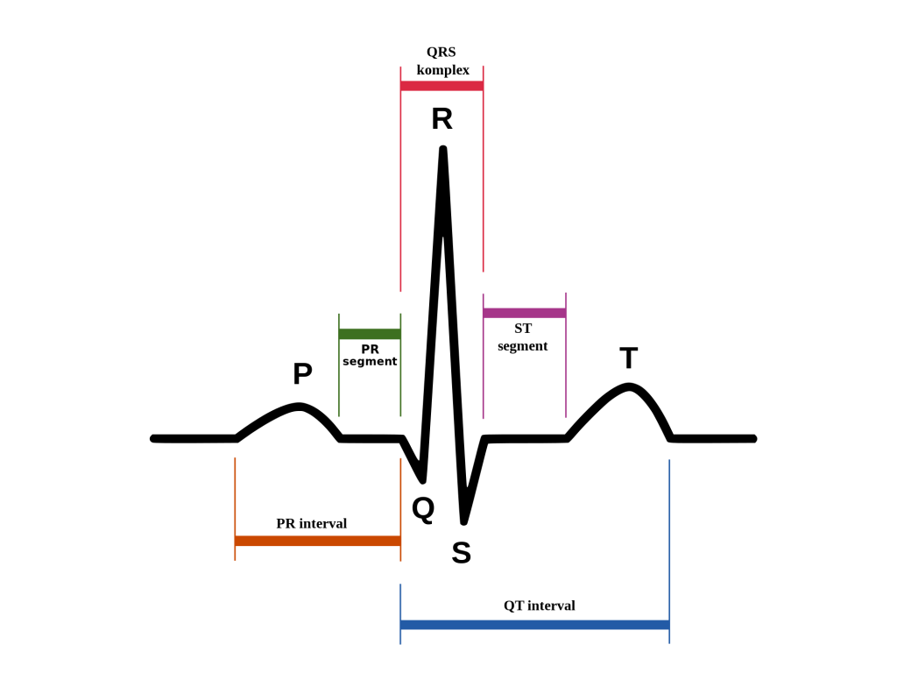
P wave: Atrial depolarization
PR interval: time for impulse to travel from SA node to myocardium
QRS: Ventricular depolarization
ST segment: isoelectric period before repolarization
T wave: Ventricular repolarization

Slide 4
Step 1: Find the p waves
Present? Sinus Rhythm
P wave originates in sinus node, so P is upright in leads II, III, avF

Slide 5
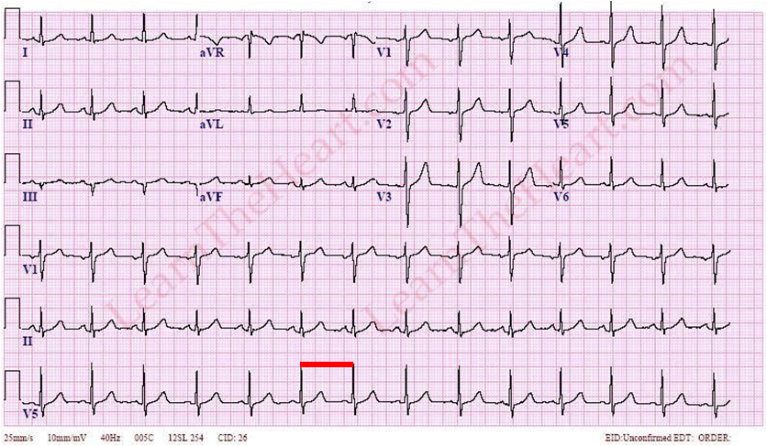
Step 2: Rate?
300/number of big squares between R waves
normal
bradycardic
tachycardic

Slide 6
Step 3: Regular or Irregular?
(R-R intervals)
To sum up so far:
p present, regular rhythm: sinus rhythm
p present, irregular rhythm: sinus rhythm with PACs / Multifocal atrial tachycardia/ Sinus with AV block.
No p wave, irregular rhythm: Atrial Fibrillation (irregularly irregular) / Atrial flutter with variable block
No P wave, regular rhythm: SVTs / Ventricular tachycardia

Slide 7
Step 4: Wide or Narrow QRS?
Narrow QRS (<120ms <3 small boxes): HIS-Purkinje system works, No BBB, and the arrhythmia originates above ventricles.
Wide QRS: (slower spread of ventricular depolarization)
BBB / Ventricular tachycardia

Slide 8
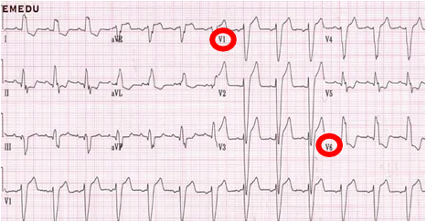

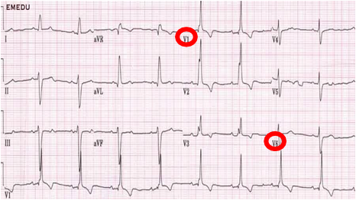

QRS morphology

Slide 9
Step 5: Check the intervals
PR (normal <210ms, 5 small boxes, 1 big)
prolonged: AV block
shortens: sympathetic tone
QT (normal <½ R-R interval)
prolonged: low calcium/ antiarrhythmic drugs
shortens: high calcium

Slide 10
Step 6: ST segment
T wave: 1. inverted 2.peaked 3. flat/ U waves
ST depression
ST elevation

Slide 11
Introduction
Tachyarrhythmia, defined as abnormal heart rhythms with a ventricular rate of 100 or more beats per minute.

Slide 12
Signs and Symptoms
Signs and symptoms related to the tachyarrhythmia may include shock, hypotension, heart failure, shortness of breath, chest pain, acute myocardial infarction, palpitations, and/or decreased level of consciousness.

Slide 13
Initial diagnostic approach
In anyone who presents with a symptomatic tachyarrhythmia, a 12-lead electrocardiogram (ECG) should be obtained while a brief initial assessment of the patient's overall status is performed.
If the patient is hemodynamically unstable, it may be preferable to obtain only a rhythm strip prior to urgent cardioversion and not wait for a 12-lead ECG.

Slide 14
Initial diagnostic approach
Is the patient clinically (or hemodynamically) unstable?
Determining whether a patient's symptoms are related to the tachycardia depends upon several factors, including age and the presence of underlying cardiac disease.

Slide 15
Hemodynamically unstable
Hemodynamically unstable and not sinus rhythm – If the rhythm is not sinus tachycardia, or if there is any doubt that the rhythm is sinus tachycardia, urgent conversion to sinus rhythm is recommended.

Slide 16
Hemodynamically stable
Hemodynamically stable – If the patient is not experiencing hemodynamic instability, a nonemergent approach to the diagnosis of the patient's rhythm can be undertaken. A close examination of the 12-lead ECG should permit the correct identification of the arrhythmia in 80% of cases.

Slide 17
Is the QRS complex narrow or wide? Regular or irregular?
Most treatment decisions are made based on the width, morphology, and regularity of the QRS complex.
Narrow QRS complex tachyarrhythmias have a QRS complex <120 milliseconds in duration.
Wide QRS complex tachyarrhythmias have a QRS complex ≥120 milliseconds in duration.

Slide 18
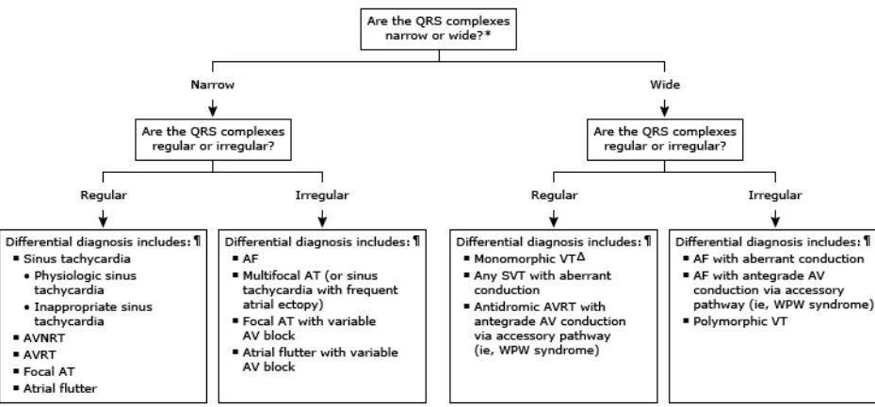
Types of Tachyarrhythmia

Slide 19
Regular Narrow QRS

Slide 20
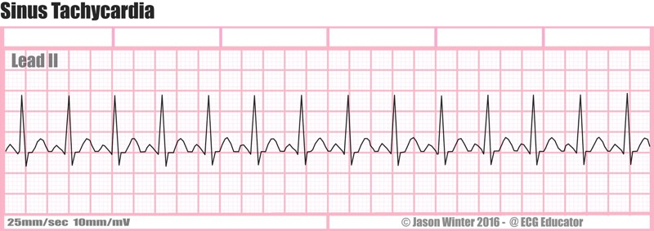
Sinus tachycardia

Slide 21
Sinus tachycardia
Sinus rate >100bpm
The most common tachycardia. If clinically significant cardiac symptoms are present, management should be focused on the underlying disorder and on treating any contributing cause of the rapid heart rate (eg, coronary ischemia, pulmonary embolism, respiratory or cardiac failure, hypovolemia, anemia, hyperthyroidism, fever, pain, or anxiety).
In patients with sinus tachycardia and certain forms of heart disease, such as coronary disease or aortic stenosis, treatment may need to be directed at the heart rate itself.
In such cases, cautious use of an intravenous beta blocker is appropriate.

Slide 22
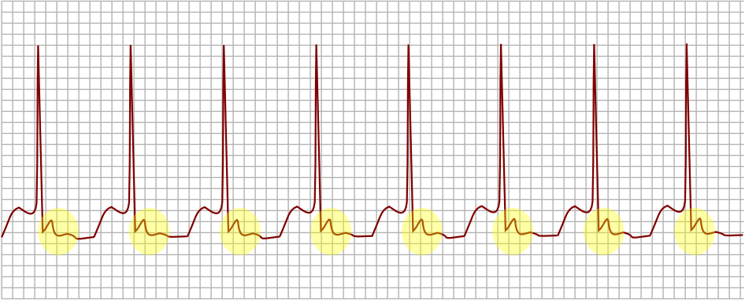
Atrioventricular nodal reentrant tachycardia (AVNRT)

Slide 23
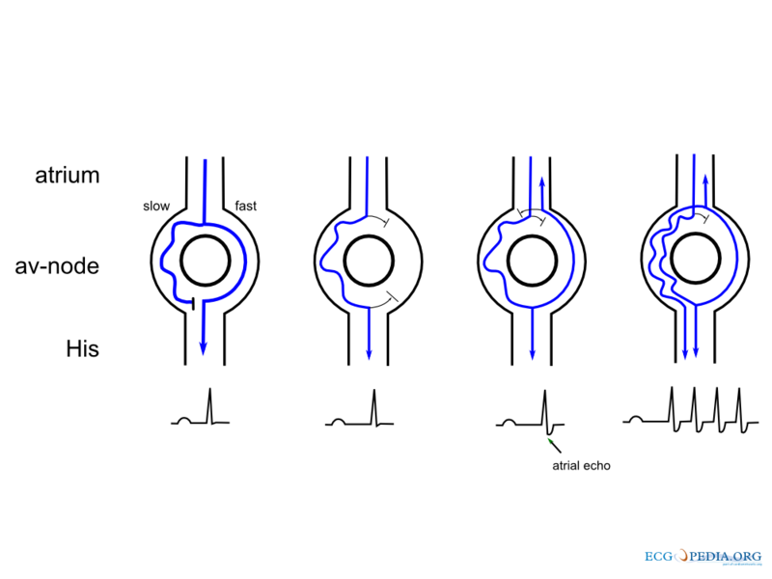
Atrioventricular nodal reentrant tachycardia (AVNRT)
The most common type of supraventricular tachycardia. (60-70%)
ECG: no P wave is seen (buried in QRS) or seen at the end of the QRS (very short R-P interval)

Slide 24
For patients with AVNRT who are hemodynamically unstable related to their arrhythmia, we recommend immediate DC cardioversion.
For patients with AVNRT associated with severe symptoms due to the tachycardia (eg, angina, hypotension, heart failure, or mental status changes) in whom intravenous access is available, we suggest an initial attempt at termination with adenosine rather than cardioversion. If adenosine cannot be administered or is ineffective, patients should undergo immediate DC cardioversion.
For patients with AVNRT that is not associated with severe symptoms or hemodynamic collapse, including patients without symptoms, we suggest the following sequential approach to acute termination:
1- Vagal maneuvers (Valsalva maneuver or carotid sinus massage)
2- IV adenosine
3- IV calcium channel blocker or an IV beta blocker
Long-term management: Radiofrequency ablation

Slide 25
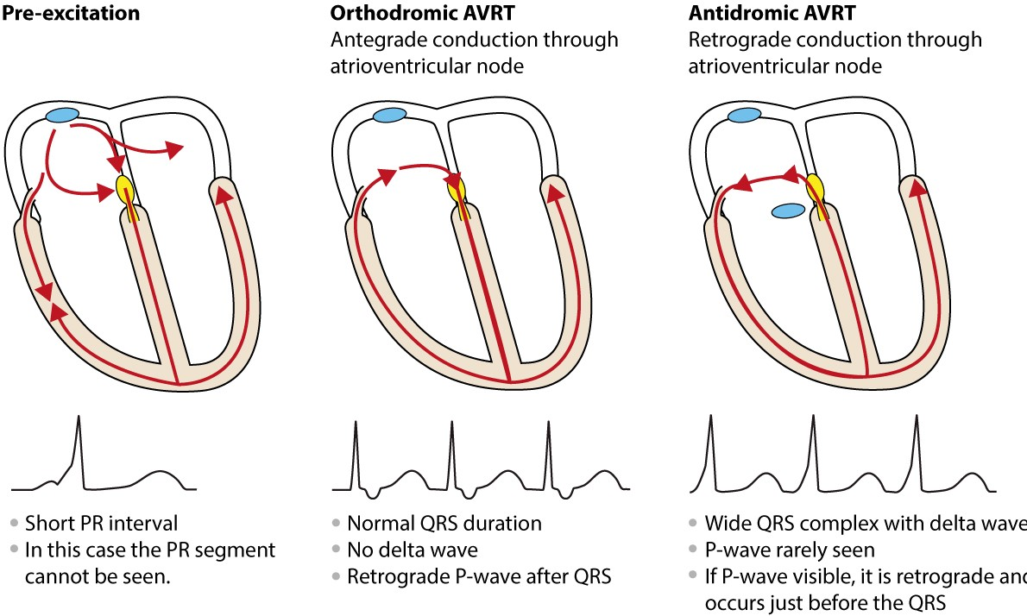
Atrioventricular reentrant tachycardia (AVRT)

Slide 26
Atrioventricular reentrant tachycardia (AVRT)
AVRT may result in either a narrow QRS complex tachycardia or a wide QRS complex tachycardia depending on the direction of conduction across the accessory pathway, which is “The bundle of kent” that bypass the AV node.
Bypass consequence:
1- Asymptomatic with ECG changes (delta wave): WPW pattern
2- Regular Tachycardia and palpitations: WPW syndrome
Either orthodromic or antidromic AVRT
3- Atrial Fibrillation (irregularly irregular wide QRS tachycardia)

Slide 27
Treatment of accessory pathway
1- ASX patients: nothing
2- WPW syndrome who are hemodynamically stable, : vagal maneuvers, adenosine, calcium channel blockers (same as SVTs)
3- A-Fib in WPW: NEVER use digoxin, verapamil, or BBs (increase RP in AV node hence enhance conduction down the accessory pathway, precipitate V-Fib)
use IV procainamide, ibutilide or amiodarone
if unstable: immediate DC cardioversion
definitive treatment: Radiofrequency ablation

Slide 28
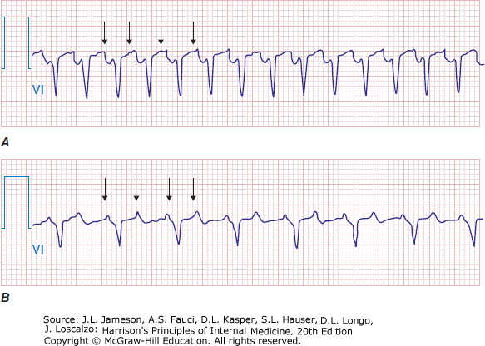
Focal Atrial tachycardia

Slide 29
Focal Atrial tachycardia
Arises from a localized area in the atria (Crista terminalis,pulmonary veins ostium of coronary sinus or atrial septum).
These are usually paroxysmal and self-limited.
Key diagnostic test : EKG
Changes seen on EKG:regular atrial tachycardia with P-wave different morphology
Clinical picture;
There is a wide range of symptoms that a patient with atrial tachycardia can present with, as it can be either an asymptomatic presentation ( HR<100 bpm ) or often patients present with dyspnea,fatigue & palpitations ( HR>100 bpm ).

Slide 30
Atrial Fibrillation
A.Fib is amongst the most common sustained arrhythmia.
It results in an IRREGULARLY IRREGULAR pattern of EKG.
Mechanism: small segments/foci of depolarization will occur all over the atria and will be conducted as waves towards AV node, some of these will depolarize it and generate a QRS complex , others will not as they reach AVN while its in refractory period , this will lead to a chaotic irregular pattern of QRS complexes.

Slide 31
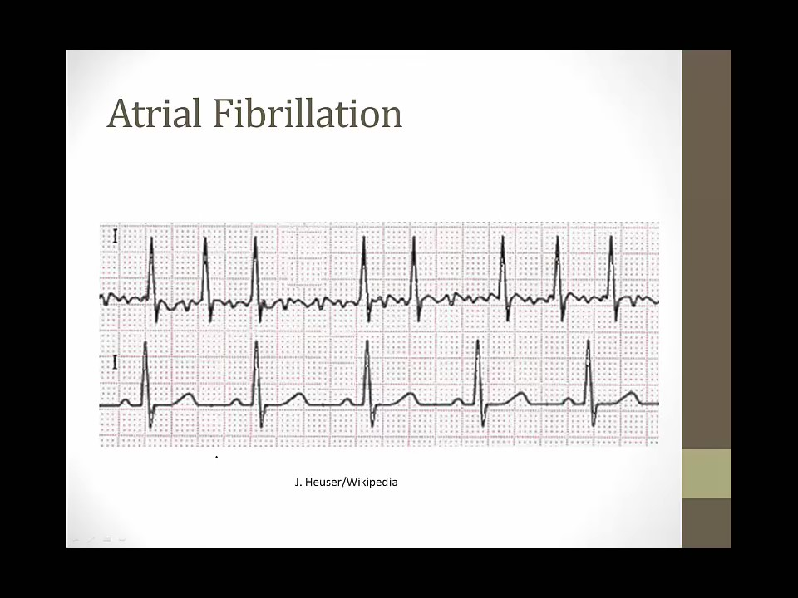

Slide 32
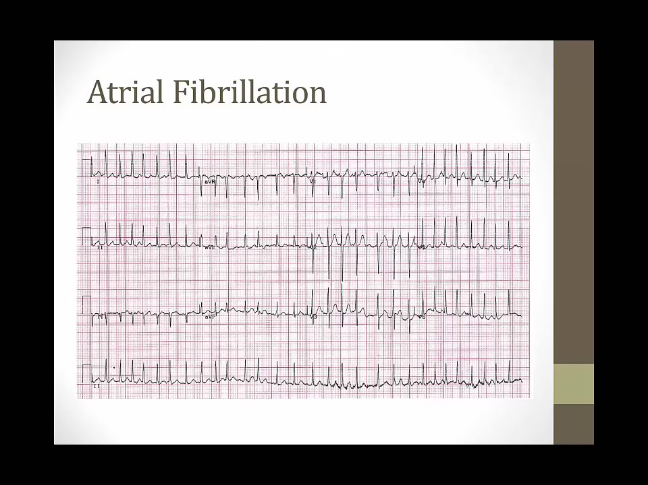

Slide 33
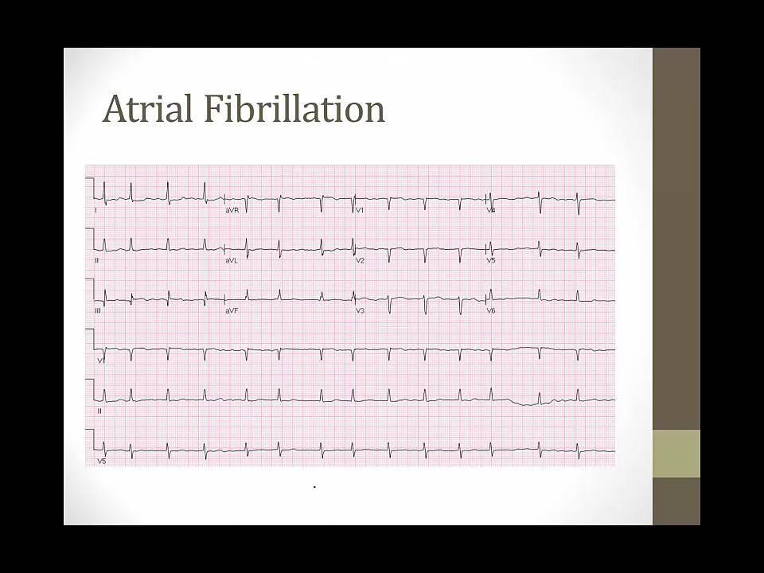

Slide 34
Terminology
There are fiour main types of Atrial Fibrillation – first diagnosed, paroxysmal, persistent, and permanent:1,2
First diagnosed: Not diagnosed previously, irrespective of duration or presence of AF-related symptoms
Paroxysmal AF: Also known as intermittent AF characterized as sporadic episodes. Self-terminating, in most cases within 48 hours, but could last up to 7 days.
Persistent AF: Lasts longer than 7 days and unlikely to resolve without treatment
Permanent: Can not be reverted to normal sinus rhythm despite treatment

Slide 35
Risk Factors
Age ( incidence increases with increasing age).
More common in females.
Associations: Hypertension and coronary artery disease, valvular diseases & heart failure ( so perform an echocardiogram )
Thyrotoxicosis is also a cause for Afib. (TFT)
Triggers: Infection , Binge drinking , Infections ( pneumonia) .

Slide 36
You have 3 modalities for the treatment of Afib:
1. Rate control (control of ventricular response)
2.Rhythm control (restoration and maintenance of sinus rhythm)
3.Anticoagulation
**Rate control is the common strategy for asymptomatic or minimally symptomatic patients and is often the only modality of treatment in some patients, while rhythm control is often selected for significantly symptomatic and younger patients.
Management of Atrial fibrillation

Slide 37
Rate Control
Strict control of heart rate; our goal is a heart rate around 80 bpm at rest and 110 bpm during a 6-minute walk
Agents used;
beta-blockers (atenolol, metoprolol) or calcium channel blockers (verapamil, diltiazem) for rate control at rest and with exercise. Digoxin can have a synergistic effect (By increasing parasympathetic tone to the heart) for rate control when combined with these medications.
Postoperative AFib
For patients undergoing cardiac surgery, give an oral beta-blocker to prevent postoperative Afib (unless contraindicated). For those who develop postoperative Afib, achieve rate control with AV nodal blocking drugs (beta-blockers, calcium channel blockers, or digoxin). Routine postoperative amiodarone is not indicated for the prevention of atrial fibrillation

Slide 38
Rhythm control ( To restore sinus rhythm)
DC cardioversion (Synchronus) is the most effective method to restore sinus rhythm. Chemical cardioversion rates of success are lower and depend on the antiarrhythmic drug used and clinical scenario. ( Drug toxicity )
Emergent/Urgent DC cardioversion is recommended for patients with hemodynamic instability (angina pectoris, MI, shock, or pulmonary edema), ongoing myocardial ischemia, symptomatic hypotension, angina or heart failure, and WPW syndrome with rapid ventricular rate.
Antiarrythmic drugs are also used ( Before and after DC cardioversion ) or alone in case cardioversion was not performed ( Class 1 ; Flecainide , propafenone or Class 3 ; Amiodarone , sotalol or dofetilide )

Slide 39
Important points regarding DC cardioversion:
• With slow Afib, consider inserting a temporary pacemaker before DC cardioversion because the patient could have sinus nodal disease and may have asystole after cardioversion.
•There is a risk of stroke when performing chemical/electrical cardioversion, so there are some precautions that should be followed according to clinical hx;
If it has been > 48 hours since the onset of Afib (or you are unsure of the onset/duration) and the patient is stable, you must achieve adequate anticoagulation x3 weeks before you attempt cardioversion. As an alternative to preceding anticoagulation, it is reasonable to perform Transesophageal echocardiogram, and if there is no identifiable thrombus, perform a cardioversion.
If it has been< 48 hours since the onset of Afib, cardiovert most patients without any preceding anticoagulation.

Slide 40
When attempting pharmacological cardioversion, use is based on duration of symptoms.
• For A-fib> 7 days:
o I st line: dofetilide
o 2nd line: amiodarone or ibutilide
• For A-fib< 7 days:
o 1st line: dofetilide, flecainide, ibutilide, or propafenone (previously, dronedarone*)
o 2nd line: amiodarone (Exception: If< 48 hours and poor cardiac function, amiodarone is 1st line.)
**as with DC cardioversion when Afib has been present >48hrs or unknown.you must rule out atrial thrombus or at least 3 weeks of anticoagulant prior to performing one.

Slide 41
anticoagulation
Antithrombotic therapy to prevent thromboembolism is recommended for all patients with Afib (irrespective of rate or rhythm control strategy), except for those with lone Afib (age < 60 years without heart disease and without risk factors) or contraindications.
For patients with non-valvular A-fib (without rheumatic heart disease associated mitral stenosis or prosthetic valves), the CHADS2/ CHADS-VASC scoring system is often used for risk stratification , as we use either warfarin/aspirin accordingly.

Slide 42
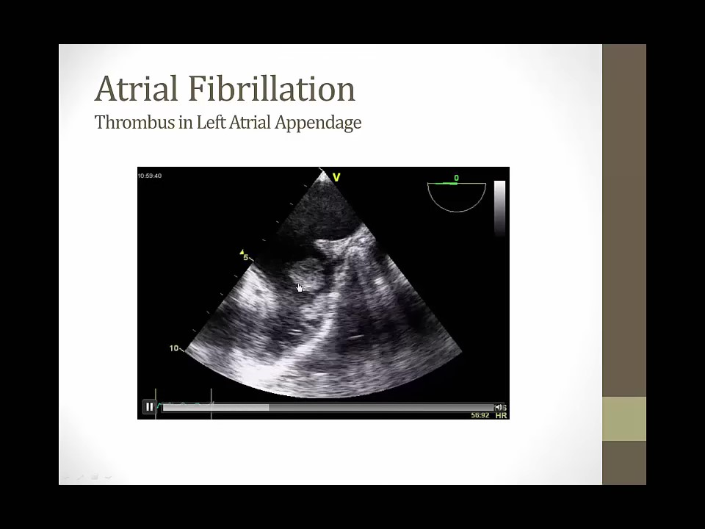

Slide 43
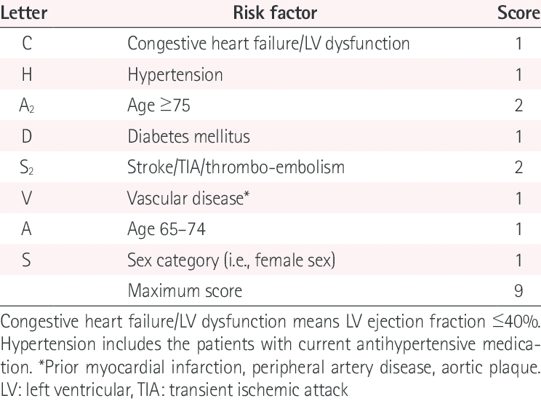

Slide 44
Radiofrequency ablation of the AV node with subsequent permanent pacing is a treatment for patients with refractory Afib and for those who cannot tolerate the meds needed for rate or rhythm control. This strategy provides definitive rate control but does not cure the underlying atrial fibrillation-hence, patients still require anticoagulation.
In many patients, A-fib originates as abnormal impulses arising in the pulmonary veins. Radiofrequency ablation, or isolation of the pulmonary veins, is becoming increasingly popular in treating recurrent, drug refractory, symptomatic A-fib, although it is not yet established as I st line therapy

Slide 45
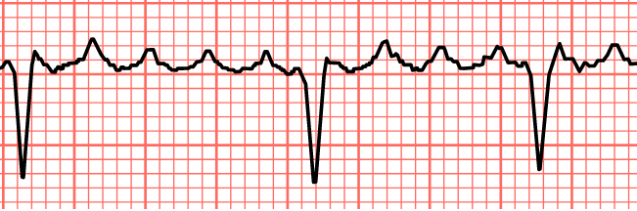
Atrial flutter

Slide 46
Atrial flutter
Patient presents with a regular narrow complex tachycardia (atrial rate of 300bpm) with a 2:1 AV block, ventricular response of approximately 150 beats per minute.
if the AV block >3:1, the cause is medications or advanced AV conduction disease.
ECG: flutter waves may be symmetrical, resembling p-waves, or maybe asymmetrical with a "sawtooth" appearance, rising gradually and falling abruptly or vice versa

Slide 47
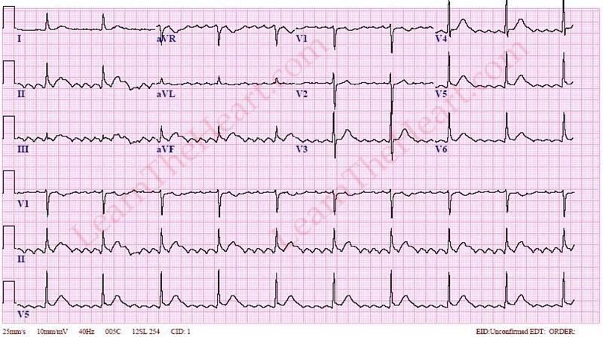

Slide 48
As with atrial fibrillation, the early steps in the management of atrial flutter involve an assessment of the need for cardioversion, ventricular rate slowing therapy, and anticoagulation therapy. Our initial approach to the management of patients with atrial flutter is the same as our approach for atrial fibrillation.

Slide 49
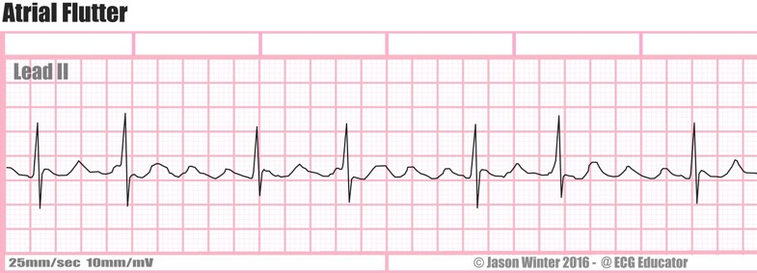
Atrial flutter with variable AV block

Slide 50
Atrial flutter with variable AV block
Our initial approach to the management of patients with atrial flutter is the same as our approach for atrial fibrillation.
With new onset atrial flutter assess the need for
  cardioversion
  ventricular rate slowing therapy
  antithrombotic therapy.
Another modality of treatment is by surgery; Atrial fibrillation ablation ( has relatively high success rates)

Slide 51
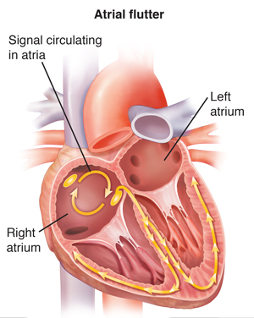

Slide 52
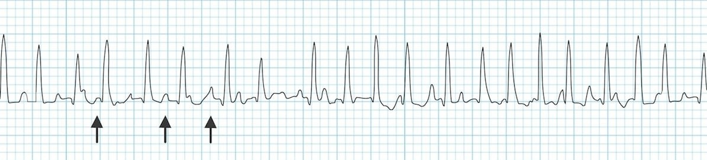
Multifocal atrial tachycardia

Slide 53
Multifocal atrial tachycardia
Multifocal atrial tachycardia (MAT) is mainly diagnosed by ECG criteria of atrial rate > 100 beats/ minute with P waves of at least 3 distinct morphologies. MAT is usually seen in patients with pulmonary disease and may be a result of theophylline use. MAT can also be caused by very low K+ and Mg+2.
Medical therapy for MAT is indicated only if MAT causes a sustained rapid ventricular response that causes or worsens myocardial ischemia, heart failure, peripheral perfusion, or oxygenation.

Slide 54
Multifocal atrial tachycardia
Options for medical therapy for patients with symptomatic MAT requiring ventricular rate control include non-dihydropyridine calcium channel blockers and beta blockers.
  For patients without heart failure or bronchospasm, start treating with beta blocker, usually metoprolol, before calcium channel blockers.
  Conversely, for patients with severe bronchospasm, start with non-dihydropyridine calcium channel blocker, usually verapamil. Beta blockers may be used cautiously in patients with stable heart failure.
Rate control therapy is typically unsuccessful, without treating the underlying disorder.

Slide 55
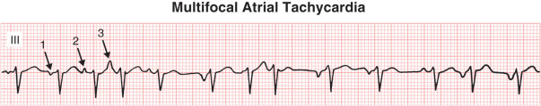

Slide 56
Regular wide QRS

Slide 57
The most concerning potential cause of a wide QRS complex tachycardia is VT, so it should be assumed to be VT until proven otherwise.
Immediate assessment of patient stability takes precedence over any further diagnostic evaluation.
A patient who is unresponsive or pulseless should be treated according to standard advance cardiac life support (ACLS) algorithms.
In a patient who is unstable but conscious, immediate synchronized cardioversion with appropriate sedation when possible is recommended.
In a stable patient, a focused diagnostic evaluation may proceed to determine the etiology of the arrhythmia and guide specific therapy.

Slide 58
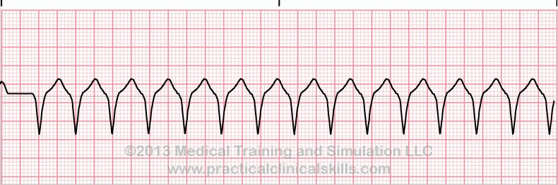
Ventricular tachycardia

Slide 59
Ventricular tachycardia (VT) is defined as 3 or more sequential QRS complexes of ventricular origin at a rate of 100 bpm or faster.
Based on duration and association with symptoms, VT can be defined as nonsustained (asymptomatic with duration of less than 30 seconds) or sustained (symptomatic or duration of more than 30 seconds).
VT can be monomorphic (regular in rate and appearance ) and is associated with structural heart diseases and polymorphic.
** Idiopathic VT occurs in otherwise structurally normal hearts and has much better prognosis. The most common idiopathic VT is right ventricular outflow tract (RVOT) VT.

Slide 60
Ventricular tachycardia
For sustained monomorphic VT, do the following:
• Stable: Give IV amiodarone.
• Hemodynamically compromised: Shock.
• Unstable and refractory to electrical cardioversion: Give IV amiodarone/procainamide.
• VT specifically with acute MI: Most use amiodarone first. IV lidocaine can be useful.
Do not use CCBs for wide-complex tachycardias. (fear of hemodynamic collapse, hypotension and cardiac arrest )
ideally all patient with sustained VT should undergo placement of ICD ,unless EF is normal (then consider amiodarone)

Slide 61
RVOT VT can be terminated acutely with adenosine.
beta-blockers/calcium channel blockers (CCBs) can be used for long-term management.
Patients with NSVT without structural heart disease have good prognosis, and they do not require further management.

Slide 62
Supraventricular tachycardia with aberrant conduction
The narrow complex supraventricular tachycardia (SVT) rhythms may present with a wide complex in the setting of aberrant conduction and it can be misdiagnosed as VT .
This is common in patients with bundle branch block who experience SVT.
In stable patients with a WCT that is known to be an SVT, initial management is similar to that of an SVT with a narrow QRS complex. A continuous rhythm strip should be obtained during any intervention that is intended to slow or terminate the arrhythmia.

Slide 63
Antidromic AVRT

Slide 64
Antidromic AVRT
For patients with acute symptomatic antidromic AVRT who are hemodynamically stable, our approach is as follows:
We treat with intravenous procainamide in an effort to terminate the tachycardia or, if the tachycardia persists, slow the ventricular response. This is because it is often difficult to correctly determine that the rhythm is due to antidromic AVRT and not ventricular tachycardia.
If the rhythm is definitely known to be antidromic AVRT, then adenosine, verapamil, or IV beta blockers may be considered, but monitoring should be continued to ensure that there is no rapid ventricular rate if atrial fibrillation (AF) subsequently develops after SVT termination.

Slide 65
Irregular wide QRS

Slide 66
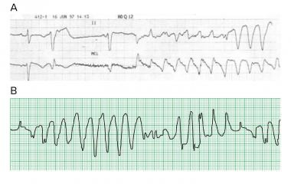
Polymorphic ventricular tachycardia

Slide 67
Polymorphic ventricular tachycardia
Polymorphic ventricular tachycardia (VT) is defined as an unstable rhythm with a continuously varying QRS complex morphology in any recorded electrocardiographic (ECG) lead. Polymorphic VT is generally a rapid and hemodynamically unstable rhythm, and urgent defibrillation is usually necessary.
In addition to immediate defibrillation, further therapy is intended to treat underlying disorders and to prevent recurrences. The specific approach depends upon whether or not the QT interval on the baseline ECG is prolonged. Polymorphic VT that occurs in the setting of QT prolongation in sinus rhythm is considered as a distinct arrhythmia, called torsades de pointes.
Prompt defibrillation is indicated in patients with hemodynamically unstable torsades de pointes.

Slide 68
Polymorphic ventricular tachycardia
In the conscious patient with recurrent episodes of torsades de pointes:
Intravenous magnesium sulfate (initial dose of 1 to 2 grams IV over 15 minutes, may be followed by an infusion) is first-line therapy, as it is highly effective for both treatment and prevention of recurrence .
Temporary transvenous overdrive pacing (atrial or ventricular) at about 100 beats per minute is generally reserved for patients who do not respond to intravenous magnesium.
In those with congenital long QT syndrome, beta blockers may be used to reduce the frequency of premature ventricular contractions and shorten the QT interval.
For patients with polymorphic VT triggered by pauses or bradycardia, isoproterenol (initial dose 0.05 to 0.1 mcg/kg per minute in children and
2 mcg/minute in adults, then titrated to achieve a heart rate of 100 beats per minute) can be used as a temporizing measure to achieve a heart rate of 100 beats per minute prior to pacing.

Slide 69
Polymorphic ventricular tachycardia
For patients with polymorphic VT and a normal baseline QT interval, the most likely cause is myocardial ischemia. Treatments may include:
1- Prompt defibrillation in the hemodynamically unstable patient. 2- Beta-blockers if blood pressure tolerates. Metoprolol 5 mg
intravenously every five minutes, to a total of 15 mg, may be given.
IV amiodarone may prevent a recurrent episode.
Urgent coronary angiography and possible revascularization. 5- Short-term mechanical circulatory support.
6- Magnesium is less likely to be effective for polymorphic VT if the baseline QT interval is normal.
If the polymorphic VT is due to catecholaminergic polymorphic ventricular tachycardia (CPVT), beta blockers should be used. If it is due to Brugada syndrome - rare but serious condition that affects the way electrical signals pass through the heart - , isoproterenol should be initiated.

Slide 70
Summary and Recommendations
For hemodynamically unstable patients, urgent cardioversion should be performed.
Further treatment recommendations regarding the acute management of tachyarrhythmias were presented throughout this topic.

Slide 71
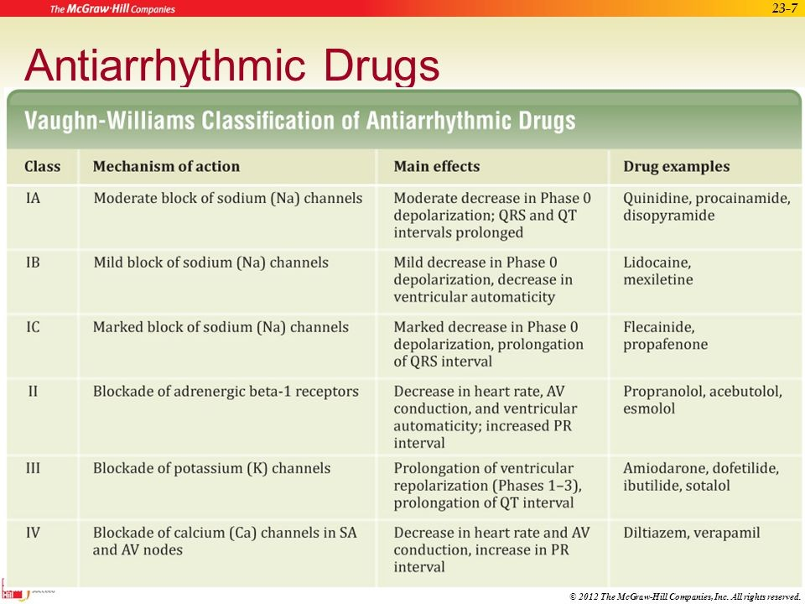

Slide 72
Thank you!

