Slide 1
Management of bradyarrhythmia
Fatima Mohammad Abdallah
Niveen Saleh
Raghad darwish

Slide 2
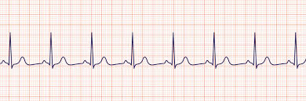
Normal sinus rythem
Notes:
NSR is the characteristic rhythm of the healthy human heart. NSR is considered to be present in adults if the heart rate is between 60 and 100 beats per minute, the P wave vector on the electrocardiogram (ECG) is normal, and the rate is regular .
The normal sinus P wave demonstrates right followed by left atrial depolarization giving rise to an upright P wave in leads I, II and a negative P wave in lead aVR.

Slide 3
Definition
Bradys(slow)-Kardia(heart) is the resting heart rate less than 60 bpm although it is seldom symptomatic until the rate drops below 50 bpm.
Relative bradycardia is used to explain a heart rate that,although not actually below 60 bpm is considered too low for the patient medical condition. For example 70 bpm for septic patient
Symptomatic bradycardia only exists when the 3 criteria are present;
Slow heart rate
The patient has symptoms
The symptoms are due to slow heart rate

Slide 4
signs and symptoms
Symptoms
Chest discomfort
SOB
Decreased LOC
Weakness and fatigue
Lightheadedness and dizziness
Presyncope and syncope
Signs
Hypotension-orthostatic hypotension
Pulmonary congestion on xray and auscultation
Features of CHF
Features of pulmonary edema

Slide 5
Bradycardias are either due to SA node dysfunction of AV node block, to sum up
SA node dysfunction; Sick sinus syndrome, inappropriate sinus bradycardia, SA exit block, sinus pause/arrest, tachycardia-bradycardia syndrome
AV block; 1st degree, 2nd degree, 3rd degree, high grade AV block

Slide 6
Sick sinus syndrome
inability of the heart's natural pacemaker (sinus node) to create a heart rate that's appropriate for the body's needs. It causes irregular heart rhythms (arrhythmias)
In sick sinus syndrome, the electrical signals are abnormally paced. Your heartbeat can be too fast, too slow, interrupted by long pauses — or an alternating combination of these rhythm problems.
Notes:
he sinus node creates a steady pace of electrical impulses. The pace changes depending on your activity, emotions, rest and other factors

Slide 7
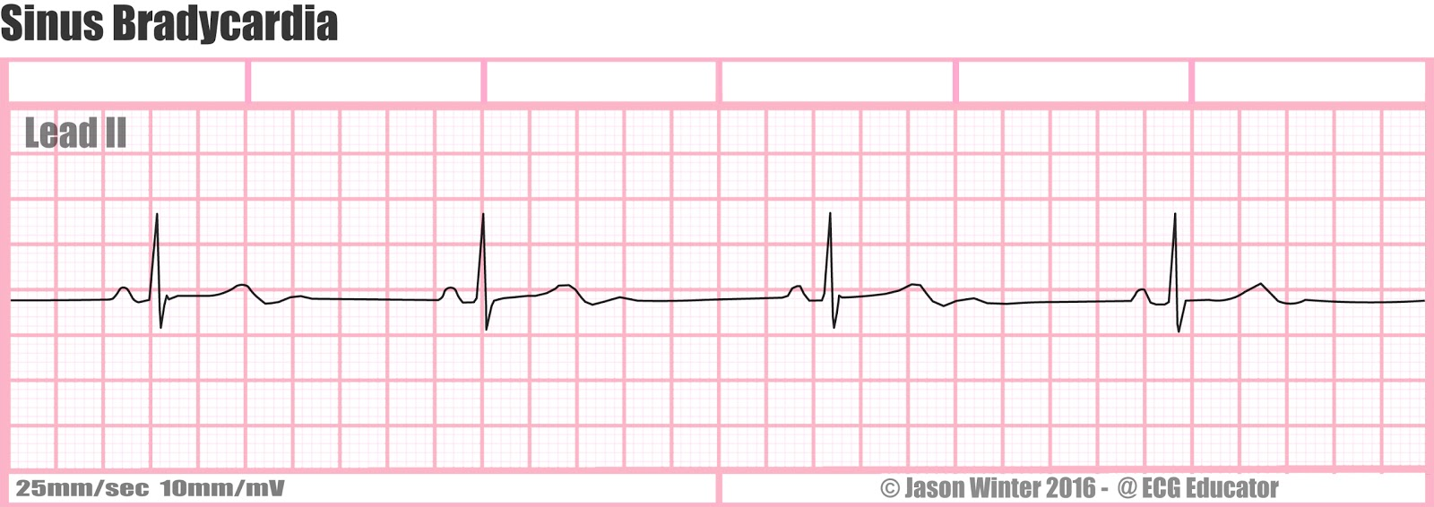
Inappropriate sinus bradycardia
HR<60 doesn’t increase appropriately with exercise.
Usually defined as failure to attain 80% of MAHR on exercise testing
MAHR=220-age
E.g. failure to reach 120 bpm in 70 year old patient
Notes:
Treating underlying conditions
Adjusting medications
Pacemaker

Slide 8
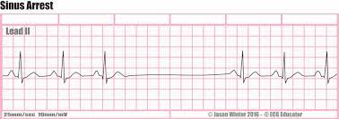
Sinus pause/Arrest
Absence of a sinus beat for >= 3 seconds while AWAKE, transient absence of P wave and may last up to several minutes.
SA node fails to discharge so there is no atrial activity-doesn’t fire
Notes:
may arise from hyperkalemia; excessive vagal tone; ischemic, inflammatory, or infiltrative or fibrotic disease of the SA node; sleep apnea; certain drugs (eg, digitalis).

Slide 9
SA exit block
Sinus node still firing
Impulse fails to conduct beyond the SA node
Degrees;
1st degree
2nd degree (1 and 2)
3rd degree

Slide 10
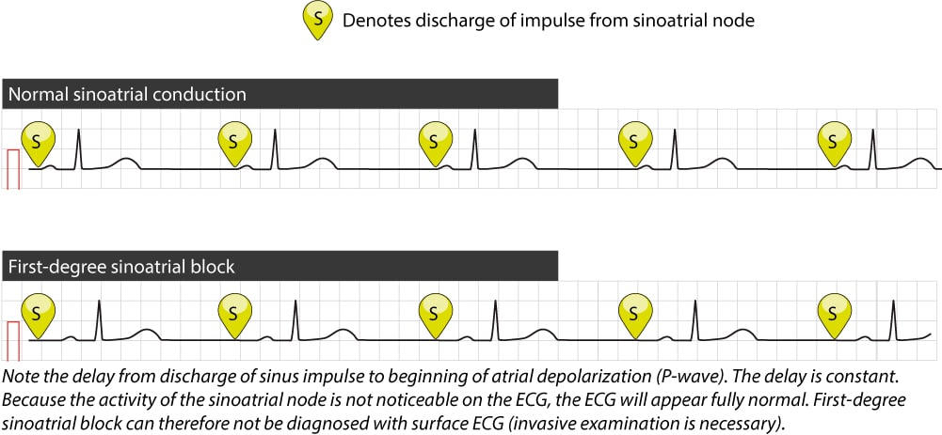
1st degree SA exit block
Delay in conduction of sinus impulse
Not evident in a surface ECG because there is still 1:1 conduction and SA node discharge isn’t recorded
Diagnosed with EPS

Slide 11
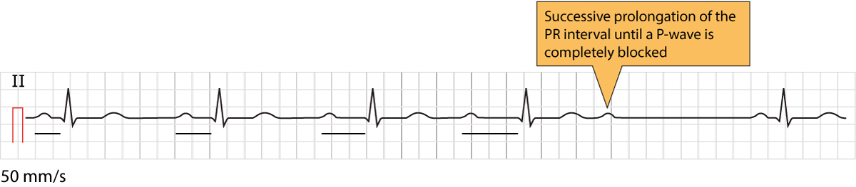
2nd degree SA exit block
Type 1; Wenkebach; the PR interval progressively lengthens and P-P interval progressively shortens prior to the pause and the duration of the pause is less than 2 P-P cycles

Slide 12
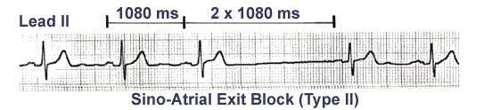
2nd degree SA exit block
Type 2; no change in PR interval prior to the pause
The pause is double the preceding PP interval

Slide 13
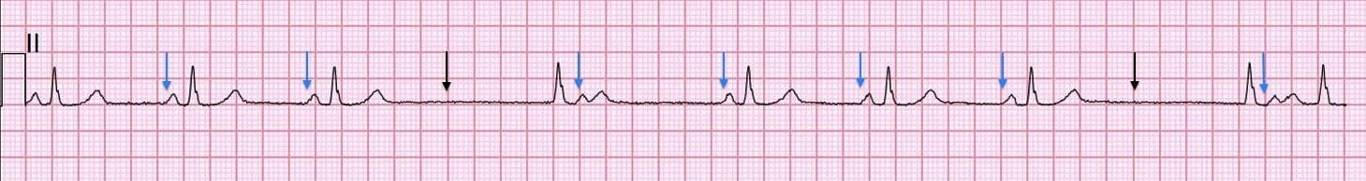
The preceding P-P interval is 1.05 seconds and the dropped is double the value 2.1 seconds

Slide 14
3rd degree SA exit node
Complete absence of P waves
Difficult to diagnose without sinus node electrograms because it is very similar to sinus arrest
Require EPS

Slide 15
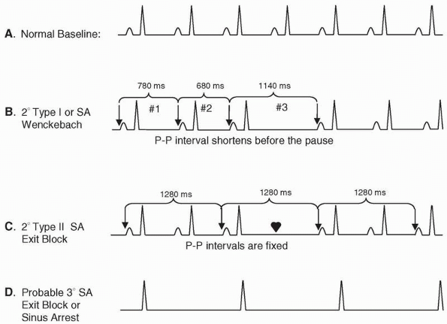

Slide 16
Case
58 year female pt came with chest pain of 1 hr duration
No hx of SOB, sweating,palpitation,syncope or leg swelling
Not a known DM/HTN
Pulse 80 bpm
Bp 120/80
CVS & RS normal

Slide 17
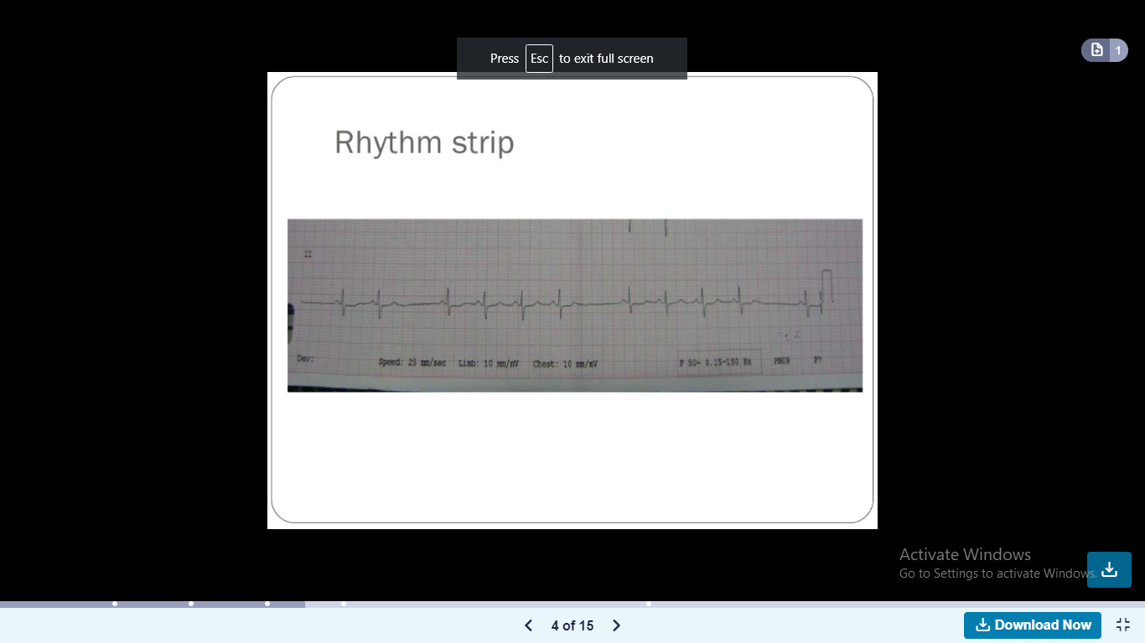

Slide 18
In this ECG; Sinus rythem with absence P-QRS-T every 5th wave
P QRS T morphology normal
PP interval before the drop is 0.68 and it is twice the number1.36 in the dropped one without progressively lengthen in PR or shorten the PP interval
2nd degree type 2 SA exit block

Slide 19
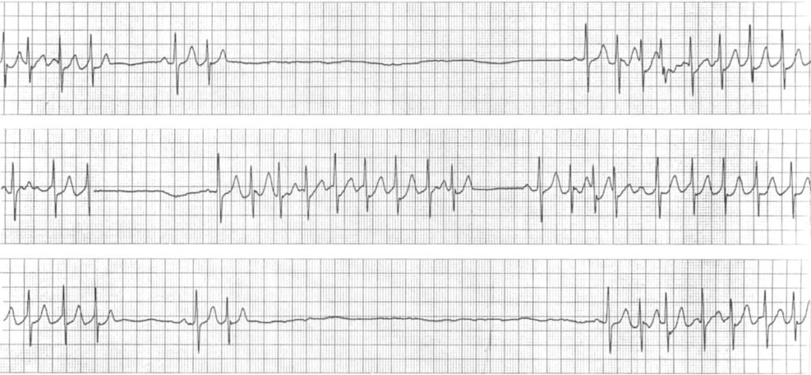
Bradycardia tachycardia syndrome
Bradycardia/ (long) sinus pause up to 6 seconds interspersed with atrial arrythmias ( Afib,Atach)
Sinus arrest manifests after termination of atrial arrythmia either spontan or after DCCV
Notes:
Direct current cardioversion

Slide 20
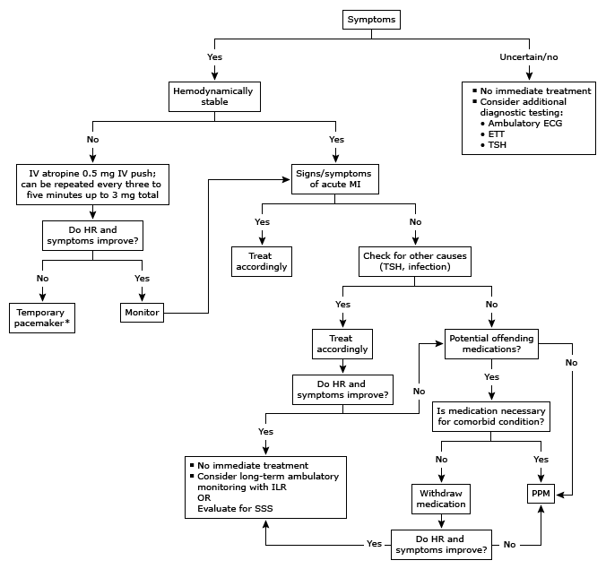
treatment

Slide 21
Treatment-continue..
The treatment of choice for chronic, symptomatic bradycardia is the placement of a cardiac pacemaker.
Antiarrhythmic drugs may prevent paroxysmal tachyarrhythmia after pacemaker insertion.
Theophylline and hydralazine are options to increase heart rate in healthy, younger patients who have bradycardia without syncope.

Slide 22
Atrioventricular block

Slide 23
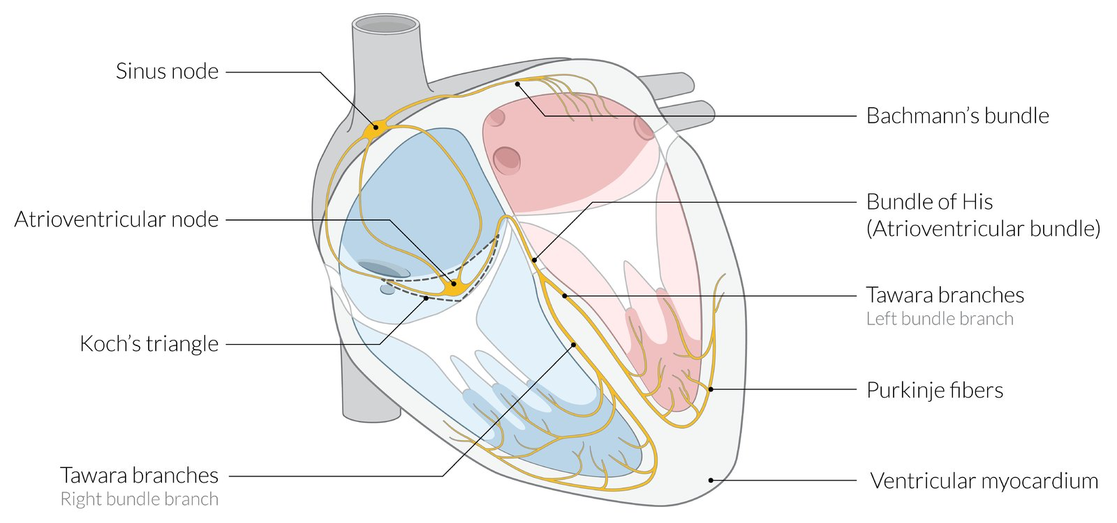

Slide 24
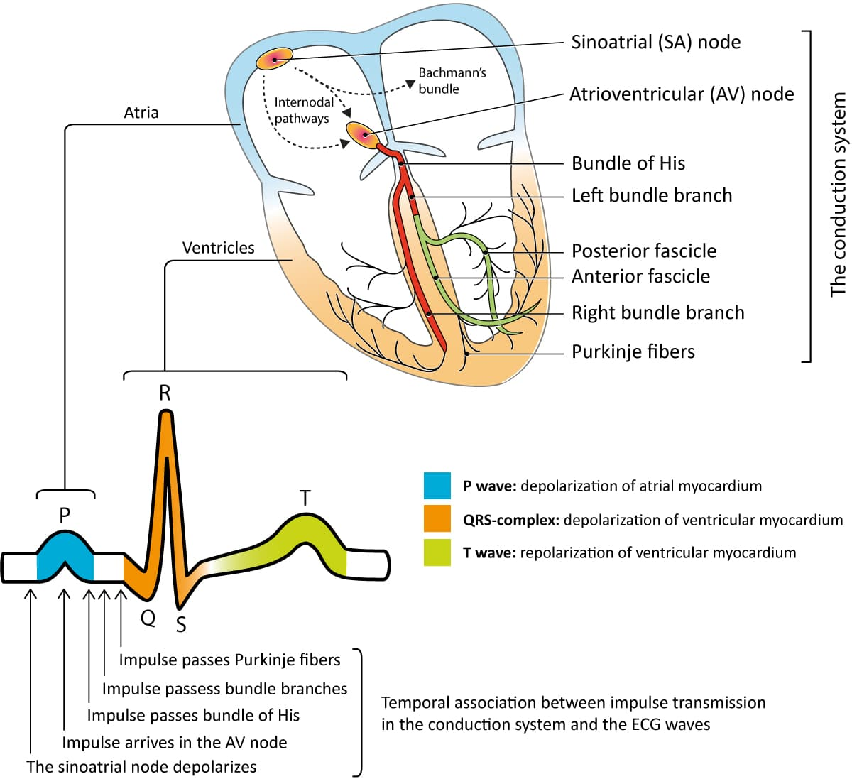

Slide 25
What do we mean by atrioventricular block ?
Transient or permanent

Slide 26
Is it always pathological ?

Slide 28
Atrioventricular block may be partial or complete:
First-degree and second-degree blocks are partial.
Third degree blocks are complete.

Slide 29
Clinical features:
Asymptomatic (common): especially with first-degree and Mobitz type I blocks
Clinical features of end-organ hypoperfusion (due to bradycardia) may be present, including:
Fatigue
Exercise intolerance
Dyspnea
Dizziness
Syncope

Slide 30
Irregular rhythms (e.g., Mobitz I): palpitations
Loss of atrioventricular synchrony (e.g., extreme 1° AV block or 3° AV block) :
Feeling of pulsations in the neck or chest
Cannon A waves
Symptoms of heart failure
Significant pauses of asystole
Stokes-Adams attacks
Sudden losses of consciousness that may occur with brief prodromal symptoms, e.g., dizziness, or without any warning, usually lasting a few seconds
Attacks are caused by ventricular asystole, most commonly due to third-degree heart block, especially idiopathic paroxysmal AV block.
Cardiac arrest

Slide 31
Atrioventricular block degree

Slide 32
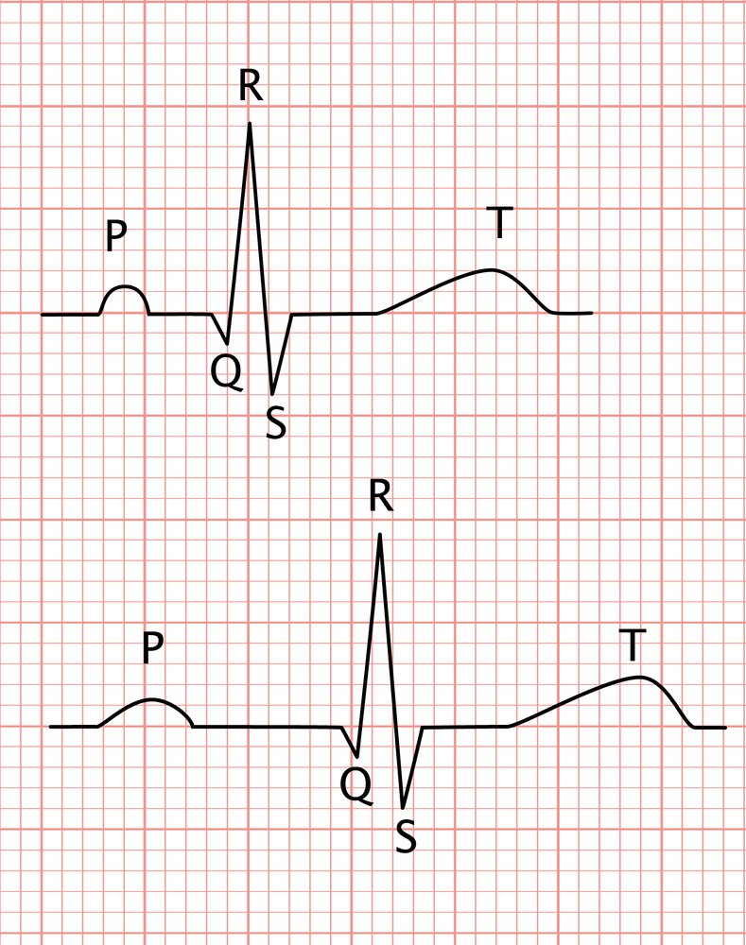
First-degree AV block:

Slide 33
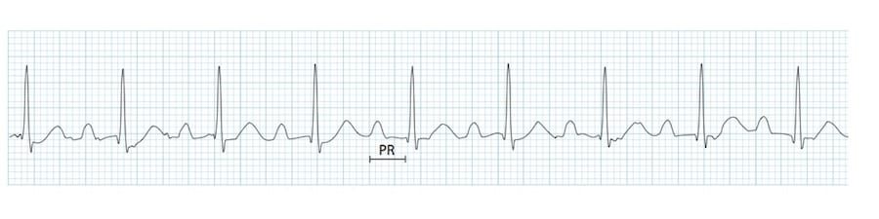
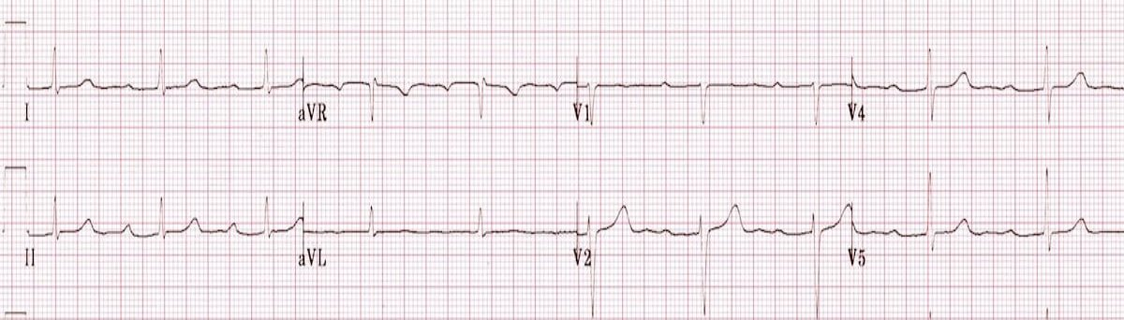

Slide 34
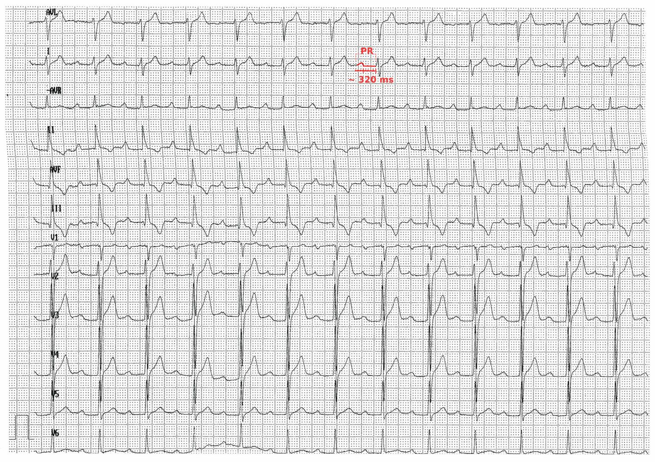

Slide 35
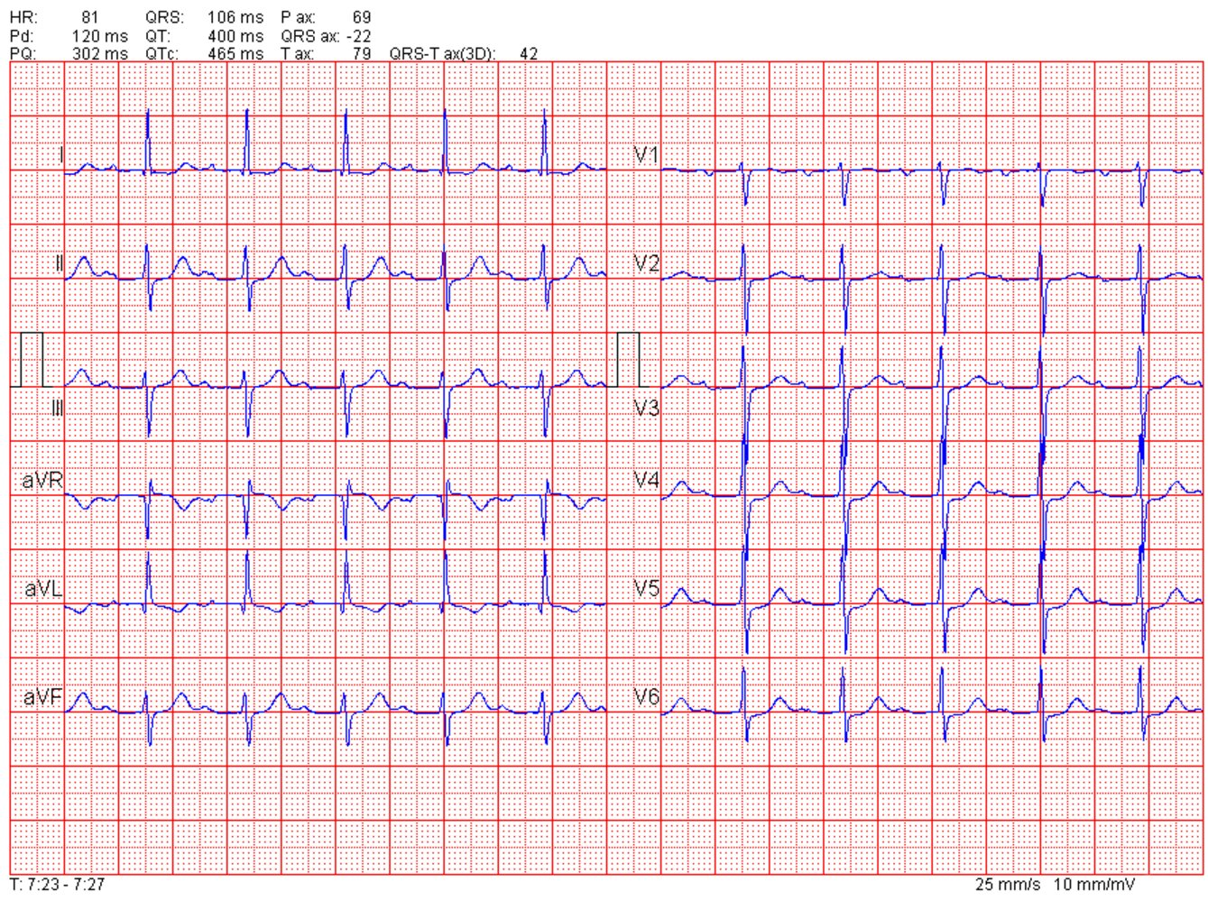

Slide 36
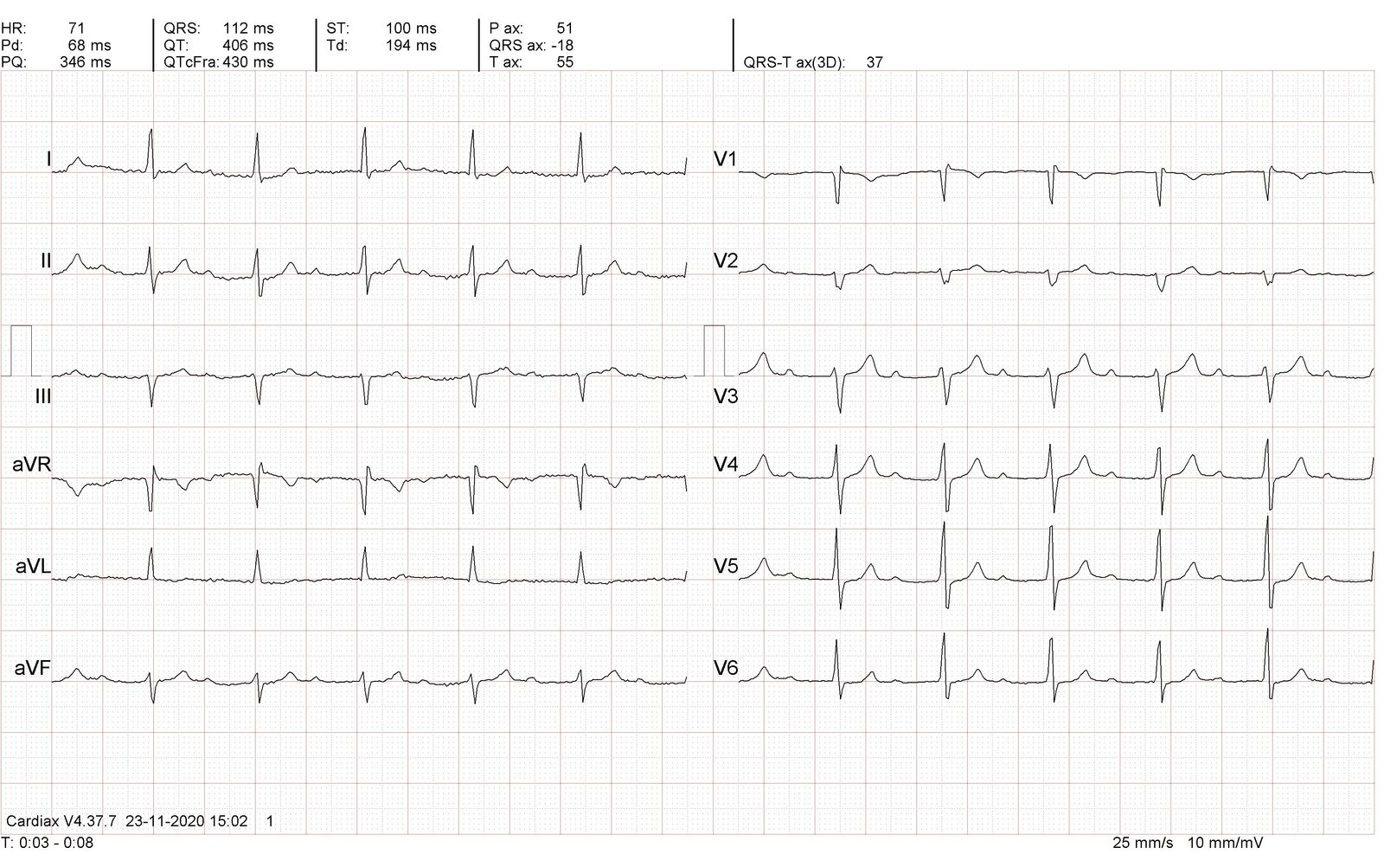

Slide 37
Pacemaker syndrome and pseudo-pacemaker syndrome
Pacemaker syndrome is a phenomenon in which a patient feels symptomatically worse after pacemaker placement and presents with progressively worsening symptoms of congestive heart failure (CHF). This is mainly due to the loss of atrioventricular synchrony whereby the pathway is reversed and now has a ventricular origin.
It describes the uncomfortable awareness of one's heart beat due to atrial contraction against a closed mitral valve or when atrial contraction occurs shortly after ventricular systole with incomplete atrial filling.
Pseudo-pacemaker syndrome refers to a similar constellation of symptoms that can occur with first degree AV block and other heart rhythms that have AV dissociation

Slide 38
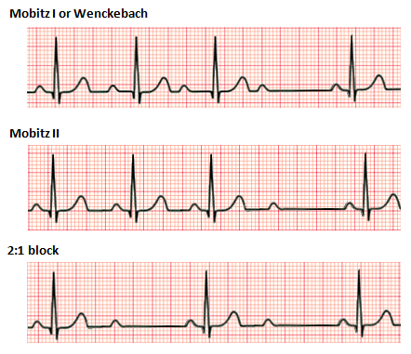
Second degree heart block:

Slide 39
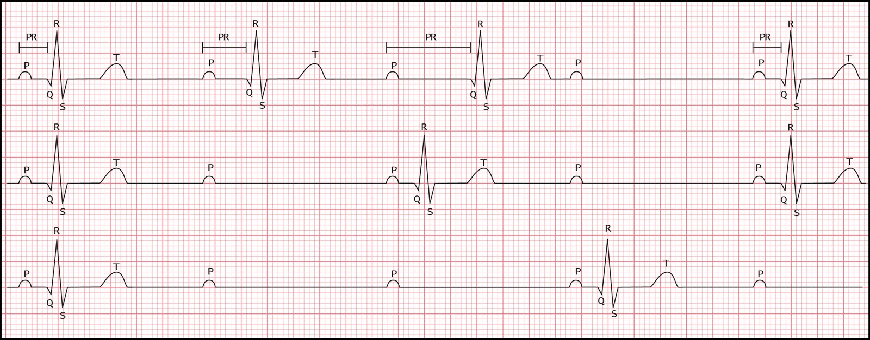
Second degree AV block :
Notes:
2:1 AV block
Every second impulse from the atria is not conducted to the ventricles.
Regular rhythm
Narrow QRS complexes (< 0.12 s)

Slide 40
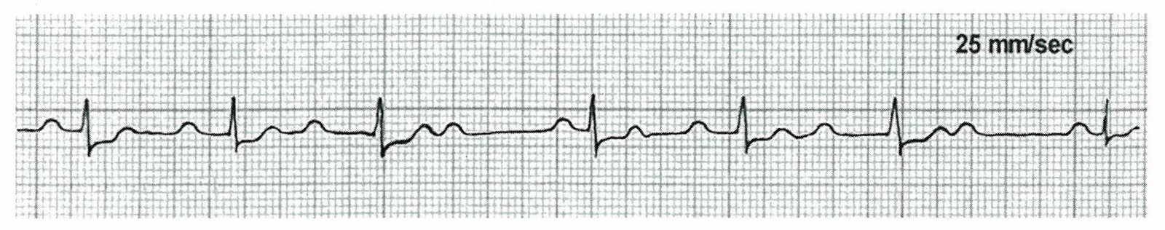
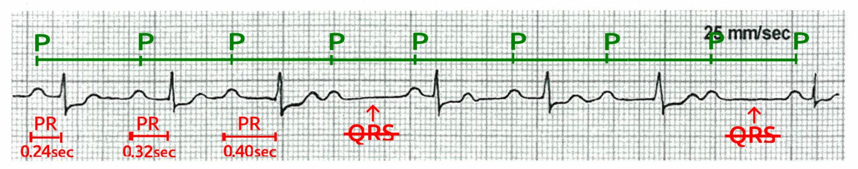
Mobitz I
Notes:
Progressive lengthening of the PR interval until a beat is dropped, i.e., a normal P wave is not followed by a QRS complex
Regularly irregular rhythm
Narrow QRS complexes (< 0.12 s)

Slide 41
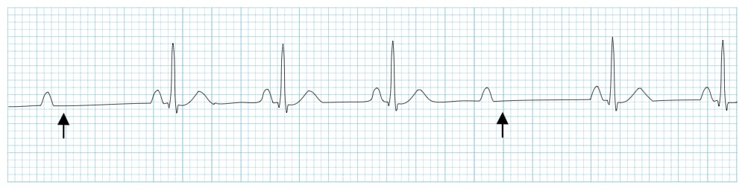
Mobitz II

Slide 42
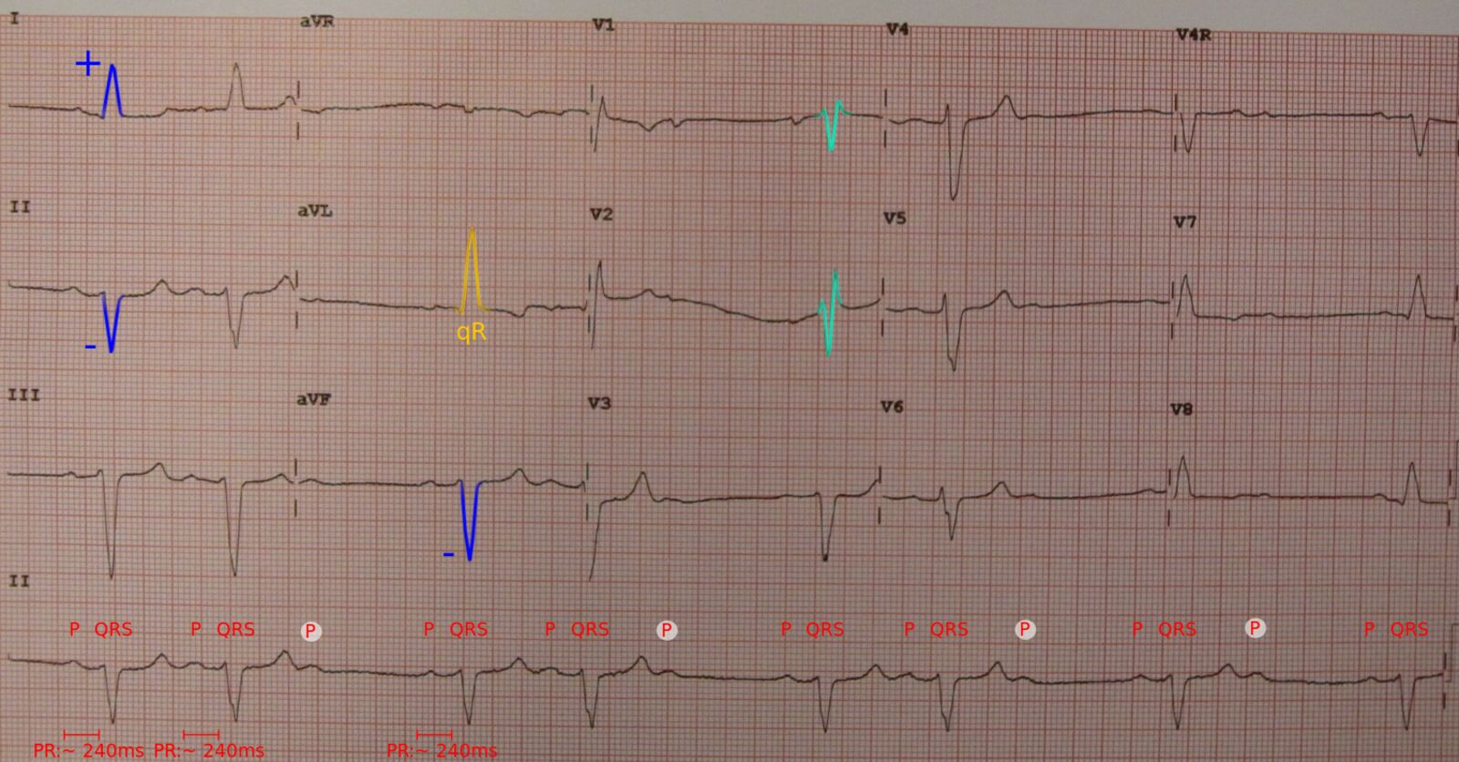
Mobitz II
Notes:
Single or intermittently dropped beats (nonconducted P waves), often at a regular conduction interval (e.g., 3:2, 4:3, 5:4)
The PR interval in conducted beats is constant.
Regularly irregular rhythm
Wide QRS complexes (> 0.12 s)

Slide 43
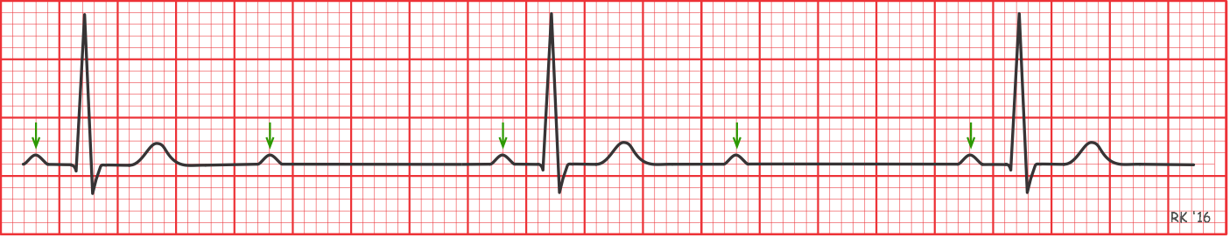
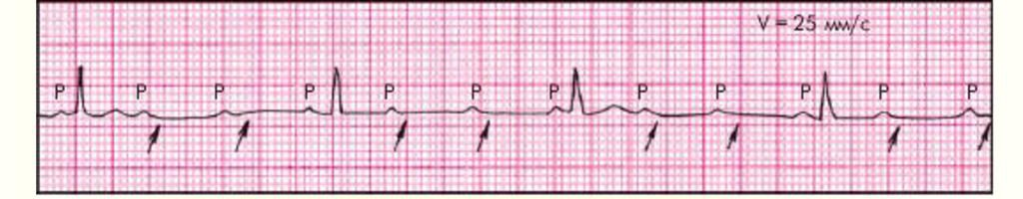
2:1 block
High-grade AV block :
P:QRS ratio of 3:1 or higher, producing an extremely slow ventricular rate.

Slide 44
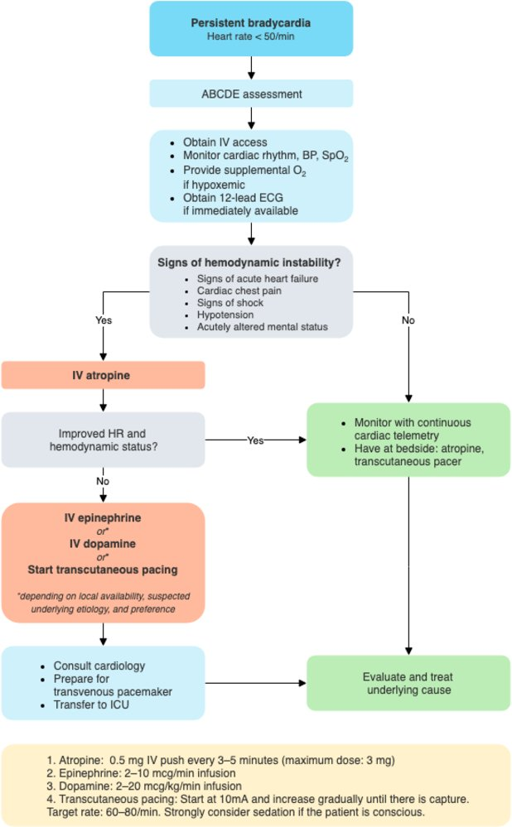
Emergency management of bradycardia

Slide 45
Types of AV blocks :
High risk *:
Low risk
Mobitz II
2:1 second degree heart block caused by infranodal block
Third degree heart block
First degree block
Mobitz I
2:1 block due to AV block
*: higher risk of developing sudden cardiac arrest

Slide 46
Management :
All patients
Obtain 12-lead ECG immediately (with or without rhythm strip) to ascertain the type of AV block.
Evaluate for signs of unstable bradycardia and apply transcutaneous pacing pads if required.
Asymptomatic:
No treatment is required
Pacemaker is not recommended in the management of first degree AV block.
investigate as an outpatient unless hemodynamically unstable

Slide 47
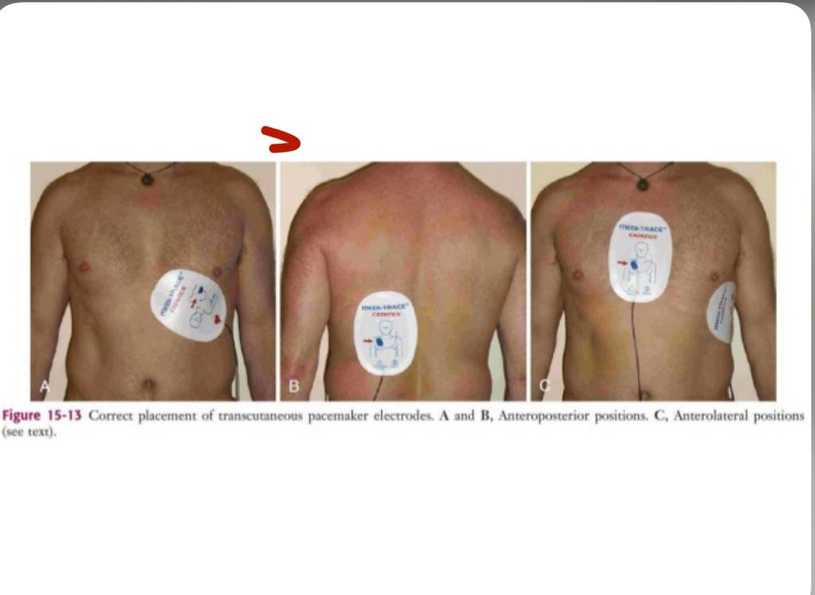

Slide 48
Stable-patient low-risk AV block:
. Identify and treat the underlying cause (e.g., structural heart disease, digoxin toxicity).
Check serum electrolytes and provide electrolyte repletion as needed.
Screen for and treat acute coronary syndrome in patients with atherosclerotic risk factors (e.g., serial ECG, troponin, aspirin).
Further diagnostics and specific management according to suspected etiology of AV block

Slide 49
Identify medications that can impair AV conduction.
Beta-blockers
Non-dihydropyridine calcium channel blockers
Digoxin
Others: clonidine, amiodarone, adenosine, flecainide, class IB antiarrhythmics, and some antidepressants.
Consider measuring drug levels: e.g. digoxin level

Slide 50
Management of low-risk AV block:
Hemodynamically stable patients
Consider assessment for pacemaker indications in patients with low-risk AV blocks.
Ambulatory Holter ECG in symptomatic patients to ensure the arrhythmia correlates with symptoms
Carotid sinus massage, exercise ECG, or EPS to assess level of the AV block

Slide 51
Cont,
Plan permanent pacemaker placement (with or without defibrillator) in patients with:
High-risk AV block (Mobitz II, high-grade AV block, 3° AV block)
Low-risk AV block and:
Symptoms that correlate with the block
Neuromuscular disease
Infranodal block

Slide 52
Hemodynamically unstable patients
Consider atropine with or without beta agonists.
Begin temporary cardiac pacing.
Plan permanent pacemaker placement (with or without defibrillator) if cause is nonreversible.

Slide 53
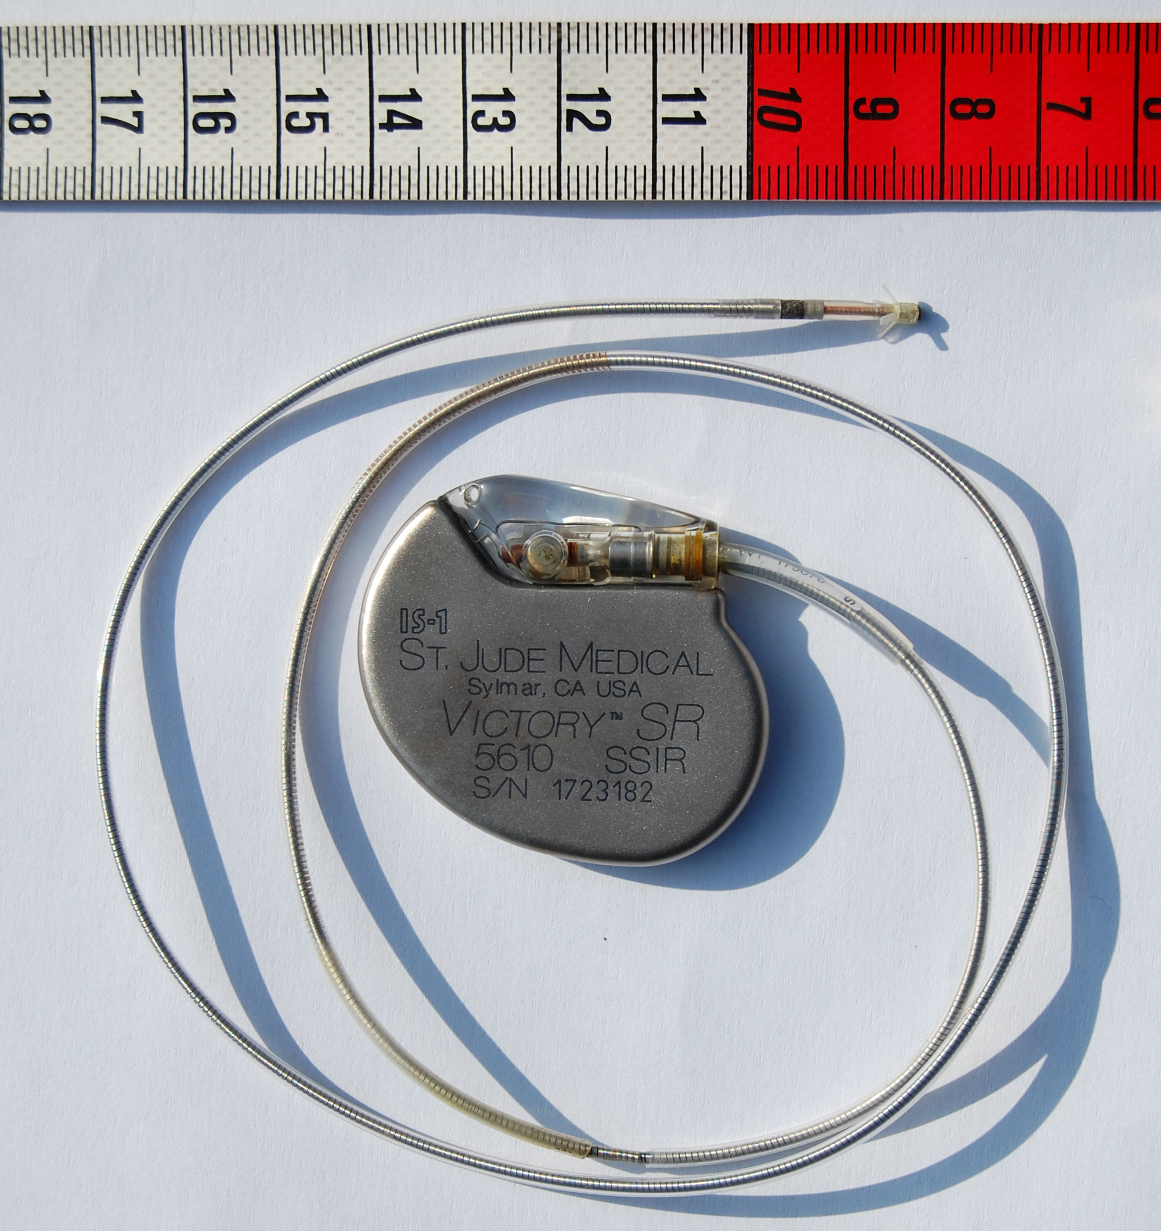

Slide 54
3rd Degree AV block
Complete heart block or complete AV dissociation .
Impulse is completely blocked between the atria and the ventricles .
Atrial conduction is normal but no beats are conducted to the ventricles .
The atrial and the ventricular rhythms are absolutely independent of one another .

Slide 55
Epidemiology
Although AV blocks are fairly common, third-degree AV block is relatively rare.The incidence in the general population appears to be low, approximately 0.02% to 0.04%.
the incidence increases with a study of patients in the Veterans Health Administration, demonstrating an incidence of 1.1% in those with diabetes mellitus and 0.6% in those with hypertension.

Slide 56
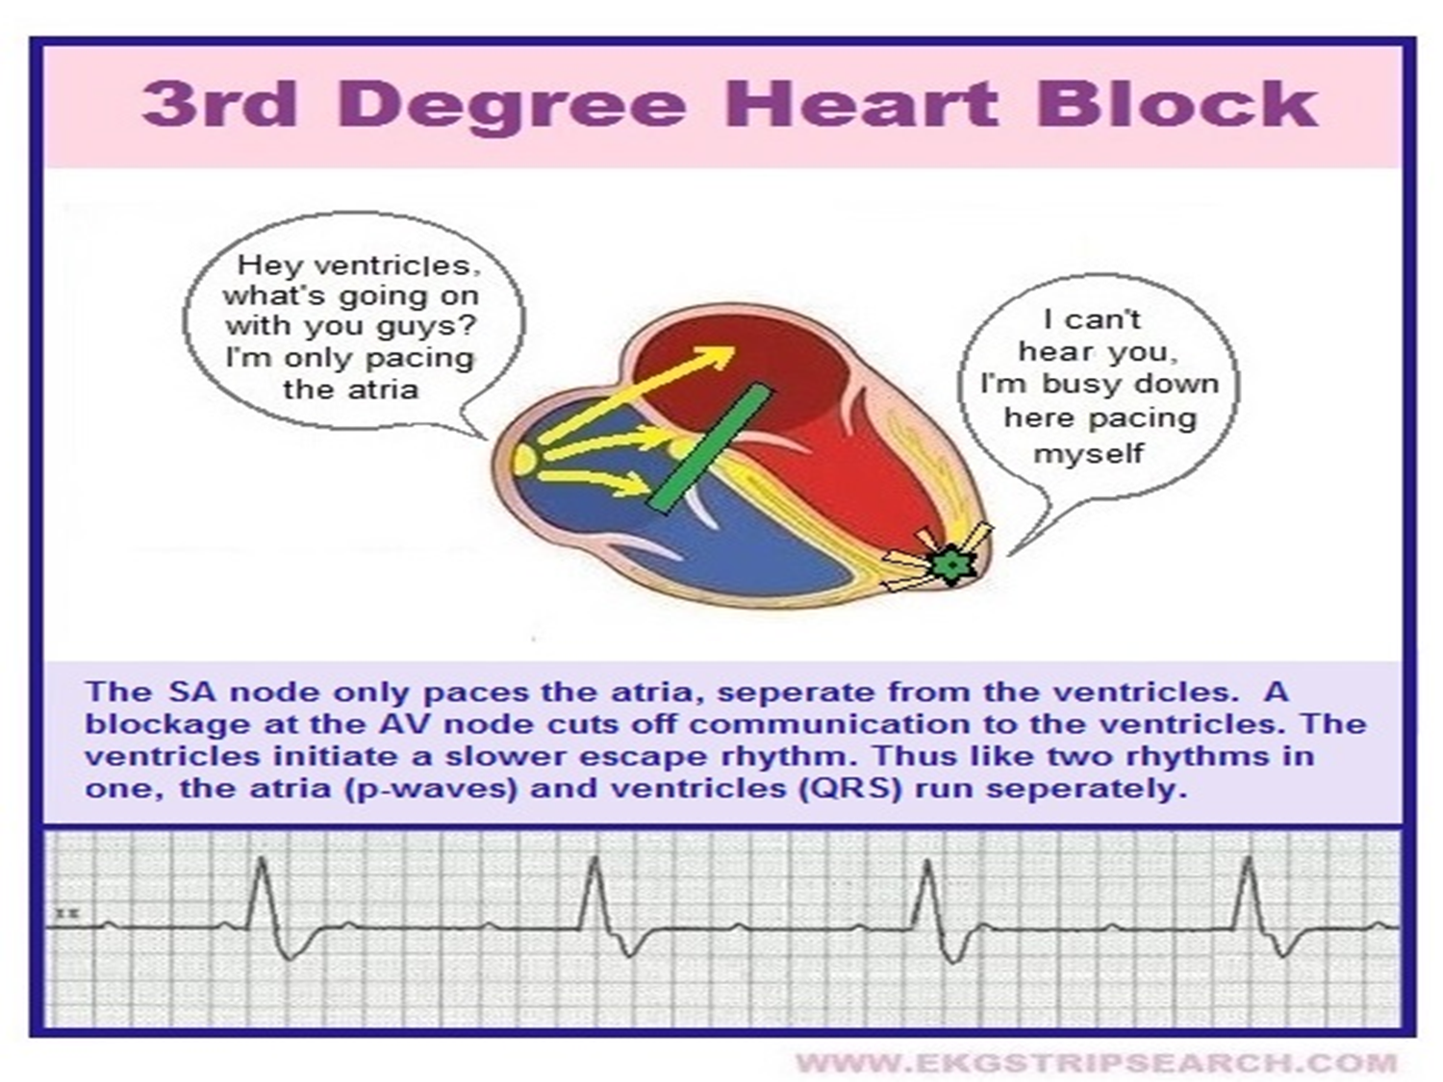

Slide 57
Causes :
Idiopathic / conduction tissue fibrosis
Congenital
Ischemic heart disease
Associated with Aortic valve calcification
Cardiac surgery & trauma
Digoxin intoxication

Slide 58
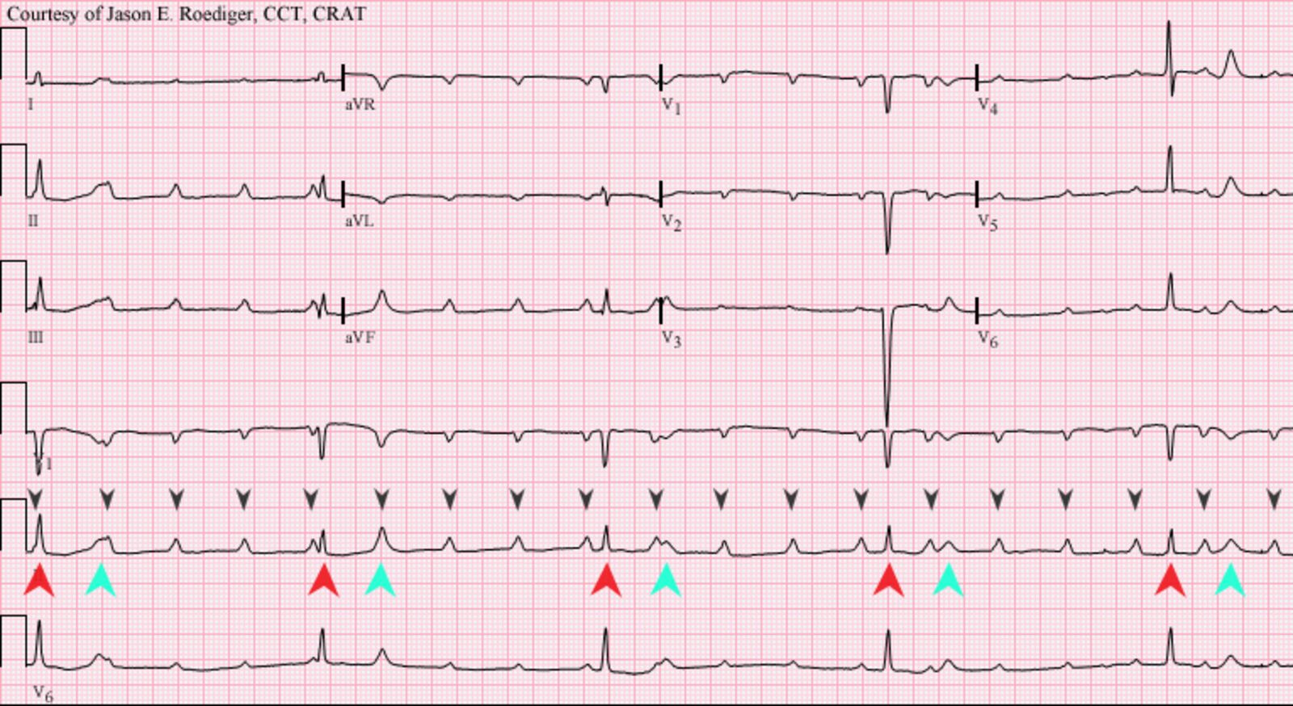

Slide 59
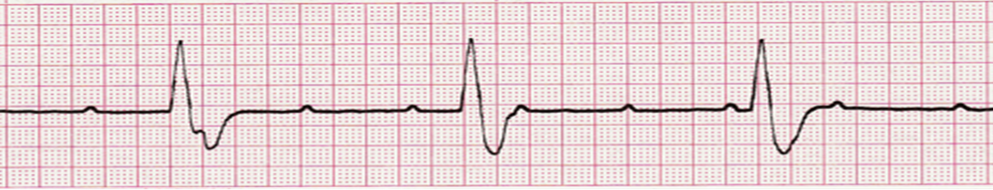

Slide 60
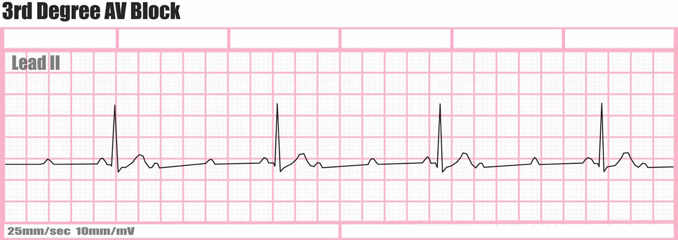

Slide 61
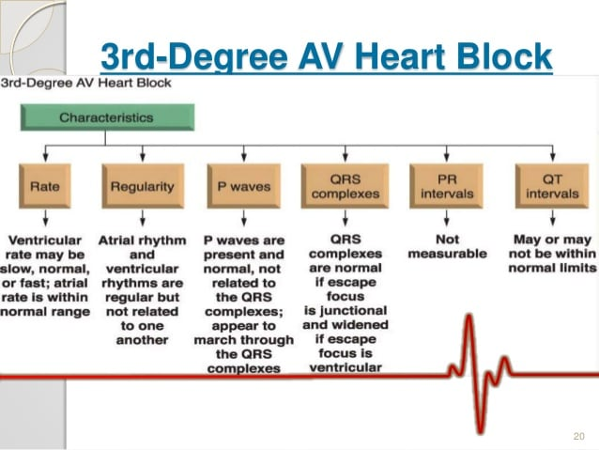

Slide 62
The level of block
In third degree (complete) AV block, the escape rhythm that controls the ventricles can occur at any level below that of the conduction block and the morphology of the QRS complex can help to determine the location where this is occurring .
the ventricles activate through an escape rhythm that can be mediated by either the AV node (junctional escape), or by ventricular myocytes themselves (ventricular escape rhythm).

Slide 63
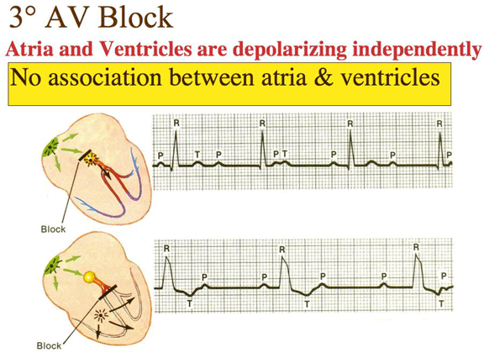

Slide 64
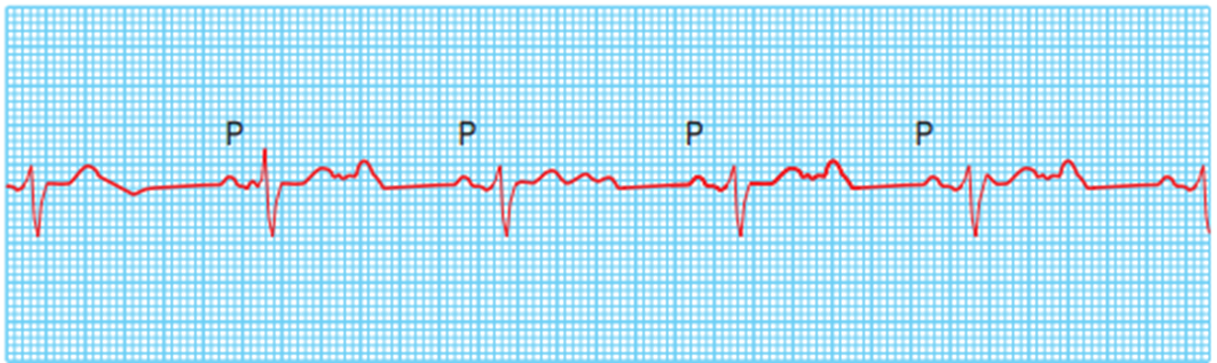
Junctional escape rhythm
A rhythm generated at the level of the AV node
Heart rate 40–60/minute
Narrow QRS complexes

Slide 65
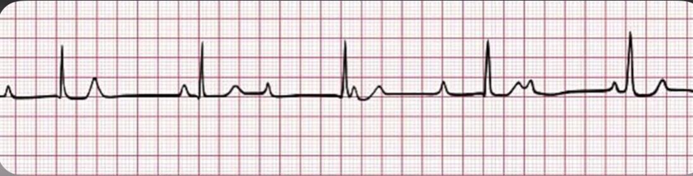

Slide 66
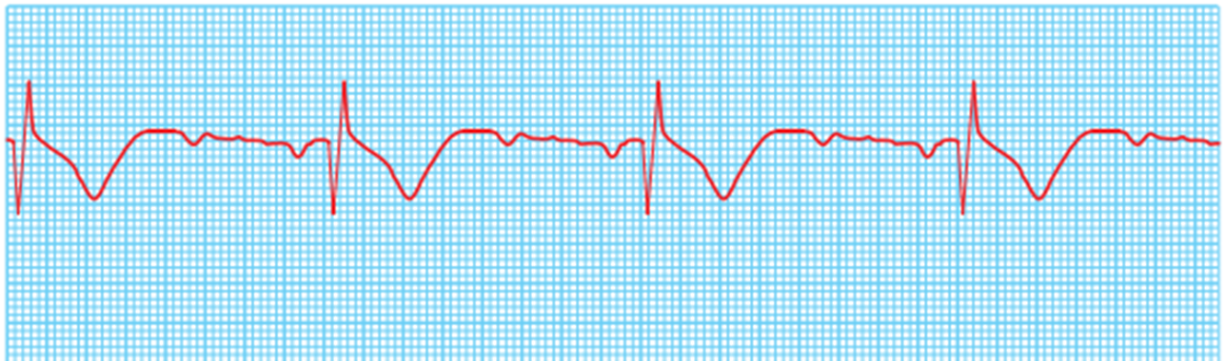
Ventricular escape rhythm
A rhythm generated at the level of the bundle of His
Heart rate 20–40/minute
Wide QRS complexes

Slide 67
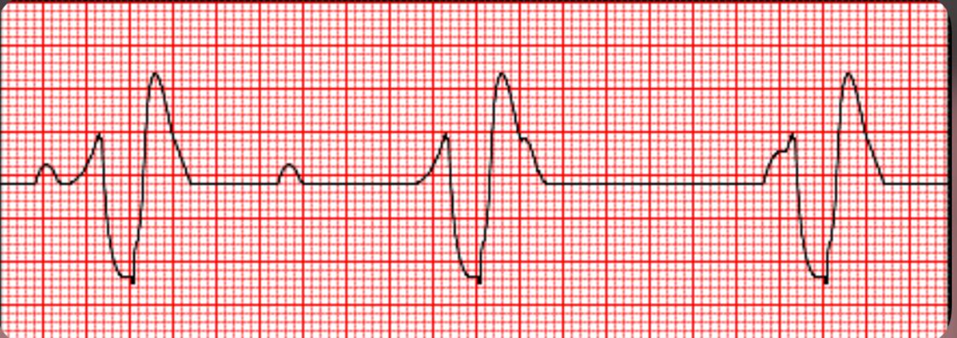

Slide 68
The patient's status at the time of presentation can vary depending upon the concurrent disease and the rate of the escape rhythm.

Slide 69
Patients with third-degree blocks can have varying clinical presentations. Rarely, patients are asymptomatic. Usually, they may present with:
generalized fatigue,
tiredness,
chest pain,
shortness of breath,
presyncope, or syncope.

Slide 70
patients might also present with features consistent with decompensated heart failure, respiratory distress, and hypoprofusion such as diaphoresis, tachypnea, altered mental status, retraction, cool skin, and decreased capillary refill.
The presence of any new murmurs should be noted as a strong association exists between complete AV block and cardiomyopathies, mitral calcification, aortic calcification, or endocarditis. If there is coexistent heart failure evidenced by S gallop.

Slide 71

Attention should be paid to any signs of infection or skin rashes, such as rheumatic fever, Lyme disease, and endocarditis, which cause heart blocks.

Slide 72
Management :
1-The initial management of bradycardic patients that are symptomatic usually begins with the use of intravenous atropine as per the advanced cardiac life support recommendations.
2- dopamine
3-epinephrine
Often patients in third-degree heart block will require pacing. Transcutaneous pacing is more rapid, although both electrical and mechanical capture must be assured.

Slide 73
Stable patients :
Identification and treatment of any reversible causes.
Acute myocardial infarction should be treated with temporary pacing and revascularization.
Medication-induced should be observed while the offending agents are withdrawn
Hyperkalemia
Hypothyroidism

Slide 75
Idiopathic paroxysmal AV block
A subtype of third-degree AV block that can affect patients with otherwise normal AV conduction.
Recurrent episodes may lead to Stokes-Adams attacks
.

Slide 76
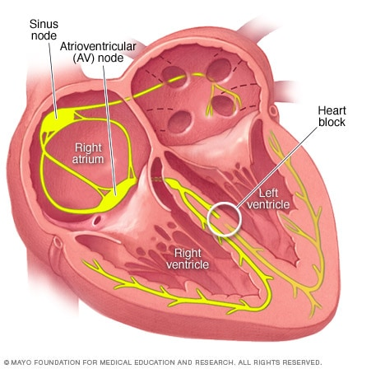
Bundle branch block

Slide 77
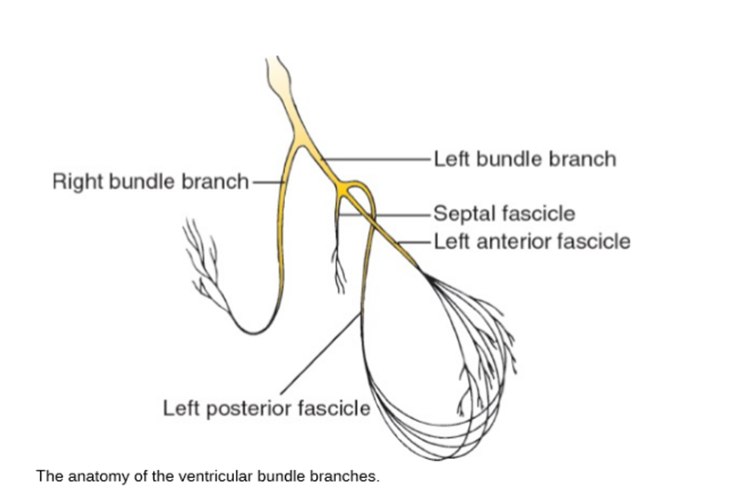

Slide 78
impulses, or electrical signals, travel through both the left and right chambers of your heart to make it pump. But if the pathway is blocked, the impulses may move slower than normal or irregularly. This is called a bundle branch block.
There are two types:
Right bundle branch block (RBBB)
Left bundle branch block (LBBB)

Slide 79
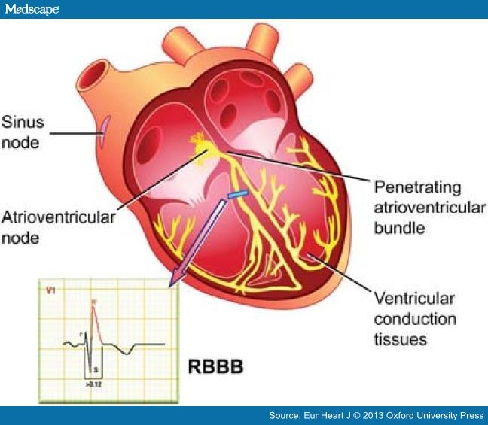
Right Bundle Branch Block
This is the most common type.

Slide 80
Causes :
Pulmonary embolism (a blood clot in the lungs)
Heart attack
Congenital heart defect (problems you were born with, like a hole in the wall between the upper chambers of the heart)
High blood pressure in the arteries
Infection of the heart muscle (myocarditis)
Idiopathic

Slide 81
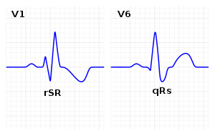
There is late activation of the right ventricle , seen in deep S wave in lead I & V6 and as a tall R wave in V1

Slide 82
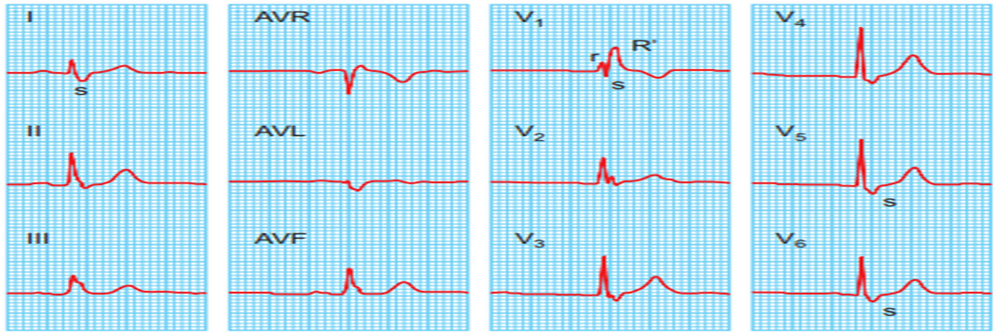

Slide 83
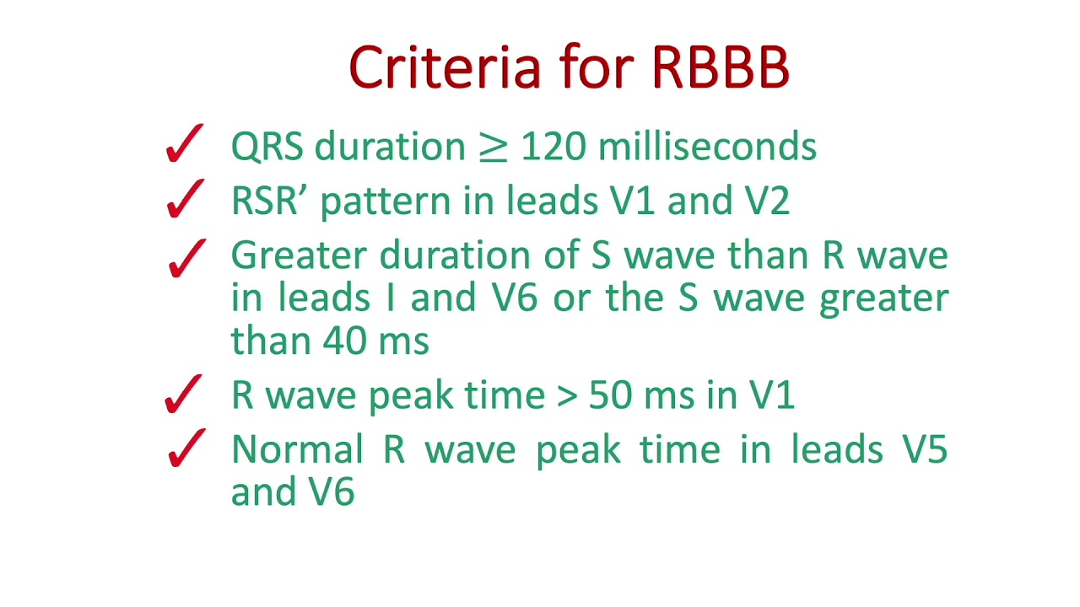

Slide 84
Right bundle branch block is usually asymptomatic and is typically found incidentally on ECG. The ECG finding itself does not cause any signs or symptoms. On physical examination, the patient may have a split second heart sound.

Slide 85
Left bundle branch block

Slide 86
Causes :
Many of them are the same as RBBB and can include:
Left ventricular outflow obstruction
Aortic stenosis
Hypertension
Heart attack
High blood pressure
Infection of the heart muscle (myocarditis)
Thick, stiff, or weak heart muscle (cardiomyopathy)
Coronary artery disease

Slide 87
In LBBB there may be reversed splitting of the second heart sound

Slide 88
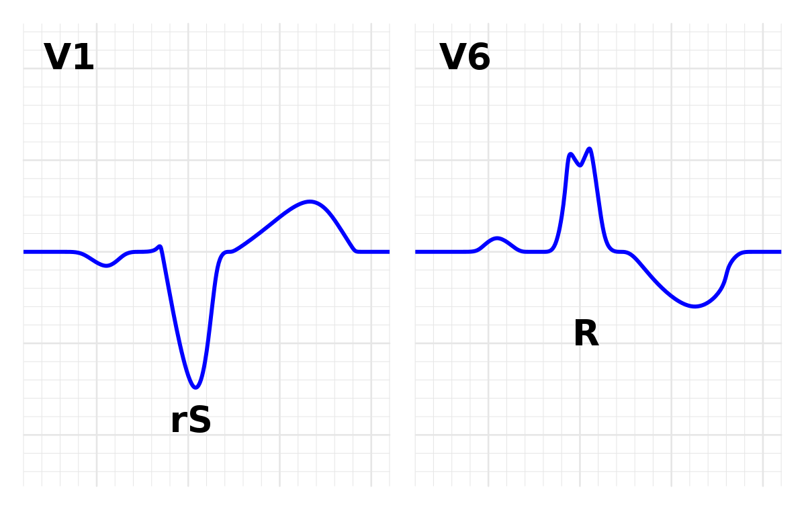
Produce a deep S in V1 and tall late R in lead I and V6

Slide 89
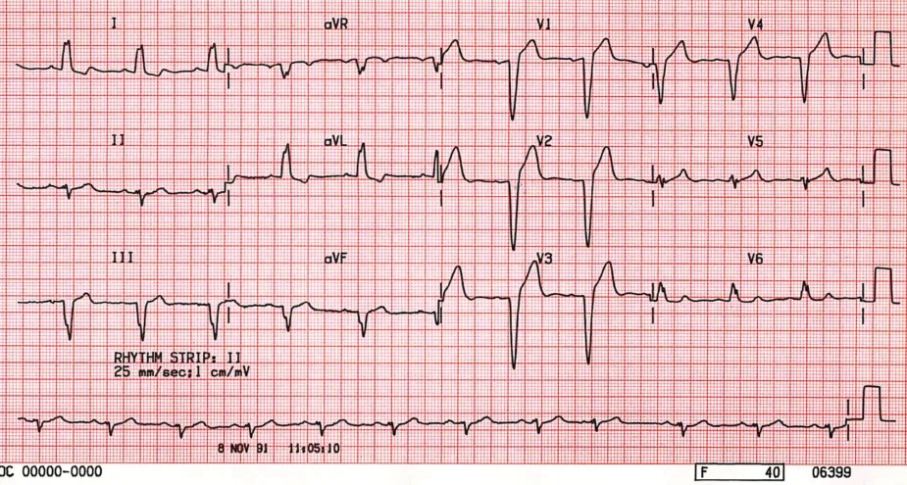

Slide 90
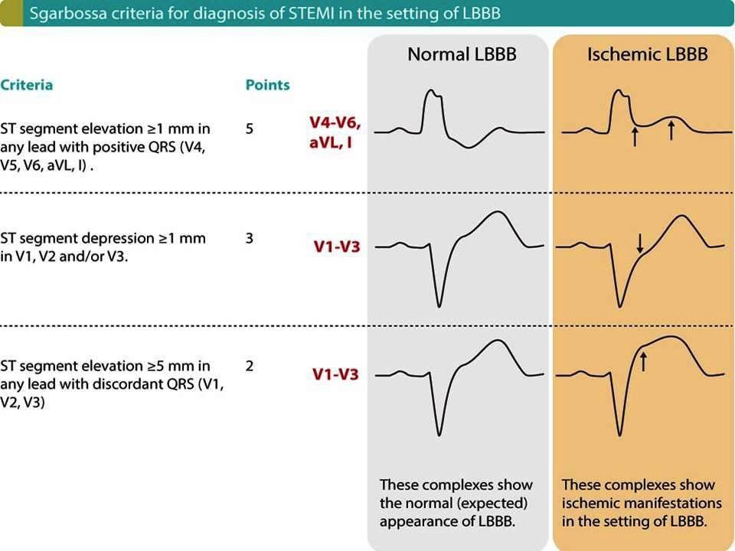

Slide 91
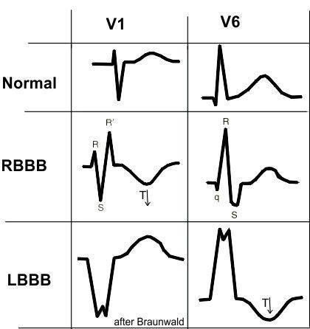

Slide 92
Management :
if the patient doesn't already have heart disease, heart disease symptoms, or other electrical blocks, he may not need treatment. But we will look into treatment options if he had:
Heart attack of heart failure
Fainting or dizzying spells
Chest pain

Slide 93
Hemiblock
when there is block in one of the divisions of the left bundle, either anterior division or posterior division, this will produce a swing in the electrical axis of the heart.
Anterior hemiblock : cause left axis deviation
Posterior hemiblock : cause right axis deviation

Slide 94


Slide 95


Slide 96


Slide 97


Slide 98


Slide 99
Bifascicular block is often associated with structural heart disease (50-80%) and extensive fibrosis of the conducting system. There is a risk of progression to complete heart block with additional damage to the third remaining fascicle.
Syncope or presyncope in the context of a bifascicular block is an indication for admission and monitoring. If other causes of syncope are not identified on work-up, pacemaker insertion is recommended.

Slide 100


Slide 101


Slide 102
A trifascicular block is a precursor to complete heart block. While a trifascicular block itself does not require any treatment, high doses of AV blocking agents likely should be avoided. Some series report a 50% lifetime need for a permanent pacemaker in the setting of a trifascicular block.

Slide 103
Thank you

