Slide 1
Jaundice
Done by:
  Mahmoud Barbarawi
  Yazan Khalaileh
  Faris Ayasra

Slide 2
History
Patient profile.
Chief complaint and duration.

Slide 3
Case Study
Mr. Fadi is a 36-year-old unemployed engineer, lives in Amman, divorced, who presents with yellow discoloration of his eyes which he noticed two days ago while washing his face. Mr. Fadi came to your clinic to discuss his situation.
Chief complaint: Yellow discoloration of his eyes for 2 days.

Slide 4
History cont.
History of presenting illness (HOPI). (for jaundice)
  Onset (when and who noticed the change).
  Course (progression).
  Associated symptoms(start with open questions): abdominal pain, fever (w/o chills), weight loss, itching (pruritis), steatorrhea, signs of anemia, bleeding tendency, fatigue, appetite, GI disturbances, vomiting and nausea.
  Colour of stools (normal or pale) and urine (normal or dark)..
  Relieving and exacerbating factors (start with open questions)(fasting, mild diseases)

Slide 5
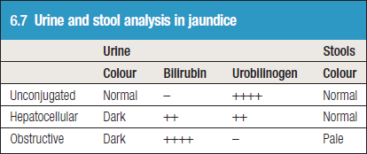

Slide 6
At first, he thought the color was due to the lighting in his bathroom, but this morning, when going outside, he thought his hands “looked yellow.”
Mr. Fadi further admits to feeling "sick and tired" for the past 2 -3 weeks. He noticed his urine is dark, but when asked about his stool it was not pale. He has lost his appetite and feels weak. During this time, he has been frequently nauseated and ate very little food. Last night he developed a fever and "shook all over with a chill." This morning he awoke after a restless night with pain and a sensation of fullness in the right upper abdomen. He also vomited twice. The emesis was non-bloody. He has not had diarrhea. He has no back or shoulder pain. He thinks he lost 10 kg during the last 3 months. He denies having joint pain or skin rash.

Slide 7
History cont.
Past medical/ surgical history.
  Does patient have any chronic illnesses? (HTN, DM, autoimmune, sickle cell anemia, malignancy)
  Liver diseases (hepatitis, malignancy)
  Pancreatic or biliary diseases/procedures (gallstones, MRCP, ERCP)
  If yes, what are they? Since when? Controlled?
  Did the patient have similar attacks/episodes?
  Previous admissions to the hospital.
  Previous surgeries(biliary, hepatic, pancreatic, other)(what, when, why, outcomes, complications).
  Previous blood transfusion.

Slide 8
Mr. Fadi is a chronic alcoholic who has been hospitalized on several occasions for alcohol related problems, including a psychiatric admission. Although he was considered a gifted, young engineer with a bright future. Since graduation from engineering school, he has had many alcohol related work problems and lost his position at a prestigious firm three weeks ago. Since that time, he has consumed approximately one fifth of vodka every day or so.

Slide 9
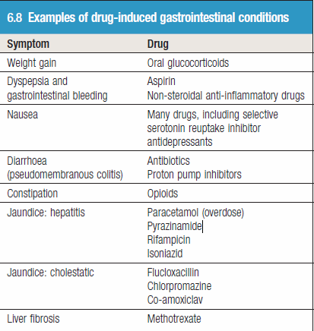
History cont.
Drug History:

Slide 10
History cont.
Family history:
  Jaundice.
  Malignancy.
  Diseases of liver.
  Hereditary spherocytosis.
  Gilbert syndrome.
  Contacted jaundiced patients (e.g. Hep. A)

Slide 11
History cont.
Social History
  alcohol intake.
  occupation.
  smoking.
  travel history.
  vaccinations.
  use of illicit or intravenous drugs. (sharing needle)
  sexual history.
  tattoos.

Slide 12
He states he does not use IV drugs. He takes Paracetamol for frequent headaches but takes no other medications. He smokes one pack of cigarettes per day. He can't remember if he had a blood transfusion. Last year he went to Egypt.

Slide 13
History cont.
Systemic review:
  CVS & RS:
    Cough.
    Sore throat/ pharyngitis.
    Shortness of breath.
    Chest pain.
  CNS & MSS:
    Headache.
    Myalgia.
    Photophobia.
    Paresthesia.
    Tetany
    Bone pain/ osteomalacia.

Slide 14
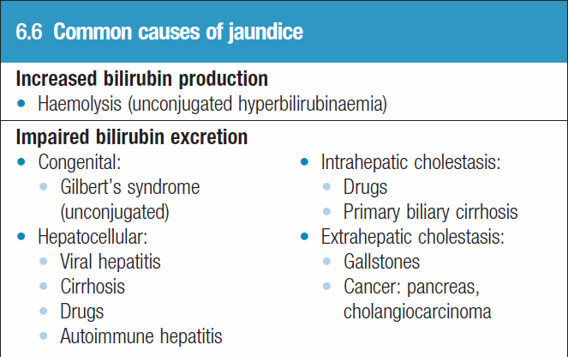
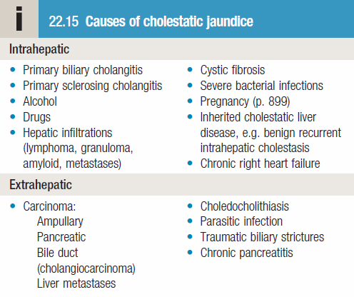
Causes of jaundice

Slide 15
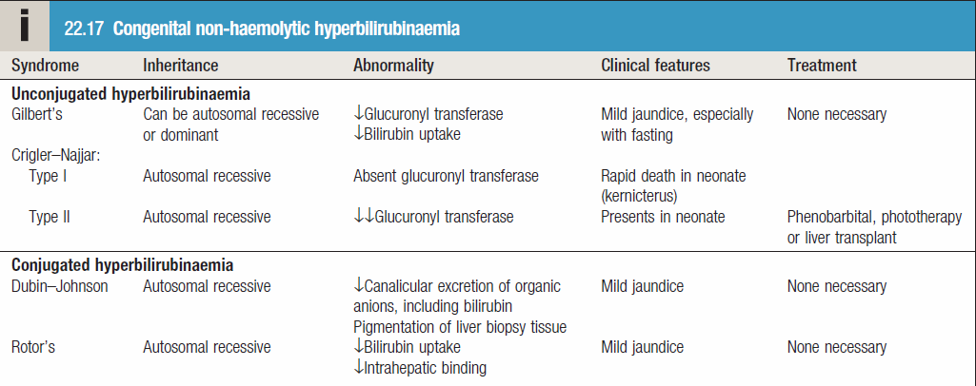
Cont.

Slide 16
Differential Diagnosis
Top differential diagnosis for our patient:
  Alcoholic hepatitis.
  Viral hepatitis.
  Drug induced hepatitis.
  Choledocholithiasis/ascending cholangitis.
  Acute pancreatitis

Slide 17
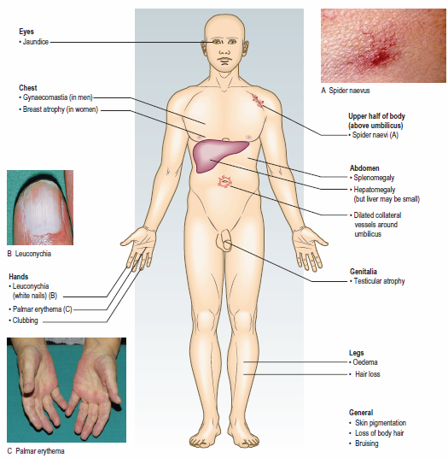
Physical Examination
General examination:
Note the patient’s demeanour and general appearance.
Are they in pain, cachectic, thin, well nourished or obese?
Note whether obesity is truncal or generalised. Look for abdominal striae or loose skin folds.
Inspect the patient’s hands for clubbing, koilonychia (spoon-shaped nails) and signs of chronic liver disease, including leuconychia (white nails) and palmar erythema.
Inspect the mouth, throat and tongue.
Ask the patient to look down and retract the upper eyelid to expose the sclera; look to see if it is yellow in natural light.
Examine the cervical, axillary and inguinal lymph nodes.
Check for vital signs.

Slide 18
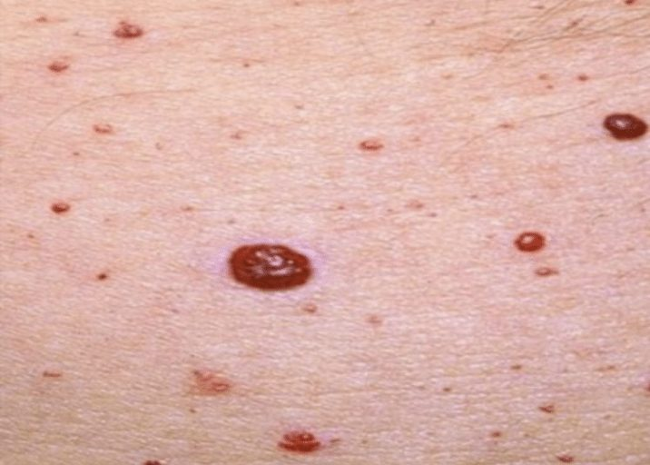
Inspection (GI examination)
Look at the teeth, tongue and buccal mucosa; check for mouth ulcers.
Note any smell, including alcohol, fetor hepaticus, uraemia, melaena or ketones.
Expose the abdomen from the xiphisternum to the symphysis pubis, leaving the chest and legs covered.
Check skin; in older patients, seborrhoeic warts, ranging from pink to brown or black, and haemangiomas (Campbell de Morgan spots) are common and normal,
but note any striae, bruising or scratch marks.
Check for visible veins; abnormally prominent veins on the abdominal
wall suggest portal hypertension or vena cava obstruction.
Check for abdominal swelling; diffuse abdominal swelling could be due
to ascites or intestinal obstruction.
Abdominal scars and stomas.

Slide 19
Palpation (examination sequence)
Begin with light superficial palpation away from any site of pain.
• Palpate each region in turn, and then repeat with deeper palpation.
• Test abdominal muscle tone using light, dipping finger movements.
• Describe any mass. Describe its site, size, surface, shape and consistency, and note whether it moves on respiration. Is the mass fixed or mobile?
• To determine if a mass is superficial and in the abdominal wall rather than within the abdominal cavity, ask the patient to tense their abdominal muscles by lifting their head. An abdominal wall mass will still be palpable,
whereas an intra-abdominal mass will not.
• Decide whether the mass is an enlarged abdominal organ or separate from the solid organs.
Ensure your hands are warm and clean.
If the bed is low, kneel beside it but avoid touching the floor to prevent infection.
Ask the patient to show you where any pain is and to report any tenderness during palpation.
Ask the patient to place their arms by their sides to help relax the abdominal wall.
Use your right hand, keeping it flat and in contact with the abdominal wall.
Observe the patient’s face throughout for any sign of discomfort.

Slide 20
Palpation cont.
Abnormal Findings:
  Tenderness.
  Palpable mass.
  Enlarged organs.(Examine the liver, gallbladder, spleen and kidneys in turn during deep inspiration)
If you feel a liver edge, describe:
  size
  surface: smooth or irregular
  edge: smooth or irregular; define the medial border
  consistency: soft or hard
  tenderness
  pulsatility.

Slide 21
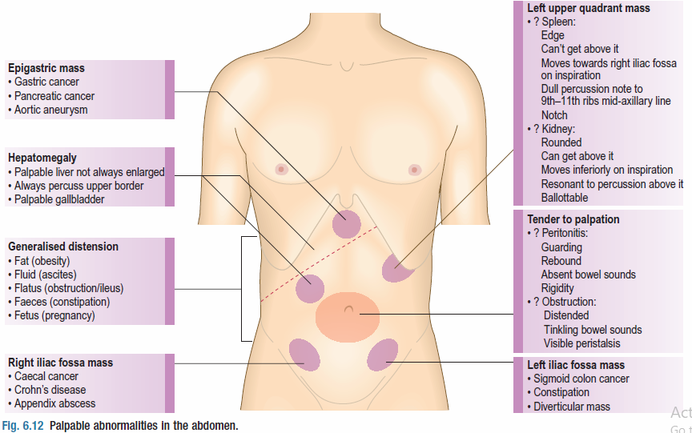
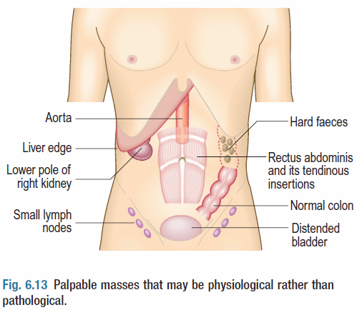

Slide 22
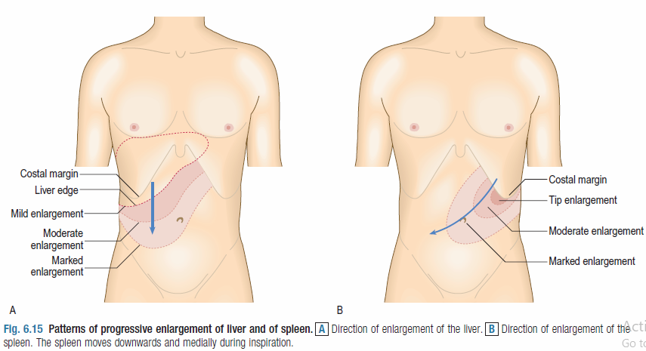
Percussion (examination sequence)
Ask the patient to hold their breath in full expiration.
Percuss downwards from the right fifth intercostal space in the mid-clavicular line, listening for dullness indicating the upper border of the liver.
Measure the distance in centimetres below the costal margin in the mid-clavicular line or from the upper border of dullness to the palpable liver edge.

Slide 23
Percussion cont.
Shifting dullness.
Fluid thrill.
Abnormal findings:
  Ascites.
  Splenomegaly.

Slide 24
Auscultation
With the patient supine, place your stethoscope diaphragm to the right of the umbilicus and do not move it.
Listen for up to 2 minutes before concluding that bowel sounds are absent.
Listen above the umbilicus over the aorta for arterial bruits.
Now listen 2–3 cm above and lateral to the umbilicus for bruits from renal artery stenosis.
Listen over the liver for bruits.
Test for a succussion splash; this sounds like a half-filled water bottle being shaken. Explain the procedure to the patient, then shake their abdomen by rocking their pelvis using both hands.

Slide 25
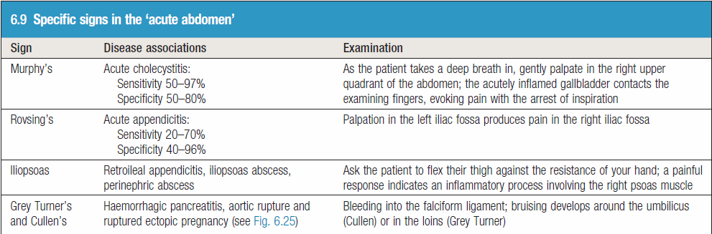
DON’T FORGET.
Complete with rectal and hernia examination.

Slide 26
Return to the case…
The patient is alert but exhausted looking. He is skinny and shows prominent cheek bones. His clothing is untidy, and his hair is uncombed. He appears much older than his stated age.
Vital signs: Blood pressure in right arm 104/60 mmHg, Heart Rate 110/minute and regular, Respiratory Rate 18/minute, Temperature 38.90 C.

Slide 27
HEENT:
  Bilateral, deep conjunctival icterus.
EXTREMITIES:
  Bilateral tremors of hands; bilateral palmar erythema.
SKIN:
  Icteric; spider nevi noted on shoulders.
ABDOMEN:
  The abdomen is round and slightly tympanitic. The liver is palpable beneath the costal margin (9 cm.) and tender. The liver span is 20 cm. There is no rebound tenderness, shifting dullness or splenomegaly. Normal bowel sounds.
CHEST:
  Prominent ribs. Lungs are clear to percussion and auscultation.
CARDIOVASCULAR:
  Soft S1 and S2. No murmurs or extra cardiac sounds.

Slide 28
Investigations
Serum bilirubin.
Complete blood cell (CBC) count to screen for hemolysis.
Serum aminotransferases (aspartate aminotransferase [AST], alanine aminotransferase [ALT])
Alkaline phosphatase (ALP)/GGT.
Serum protein (albumin) – chronic liver disease.
PT to exclude cirrhosis.
Urinalysis.
Stool analysis.
Viral markers.
Blood alcohol or acetaminophen levels upon admission (may be useful in certain cases).
Antimitochondrial antibody when considering primary biliary cholangitis.
Antinuclear antibodies (ANAs), smooth-muscle antibodies, and other serologic studies when considering autoimmune hepatitis.
Iron and genetic studies when considering hemochromatosis.
Copper studies when considering Wilson disease.
Alpha-1 antitrypsin fractionation and other studies when considering hereditary liver diseases.
Serum amylase/lipase to exclude pancreatitis.

Slide 29
Imaging studies
Ultrasonography.
Computed tomography (CT) scanning.
Magnetic resonance imaging (MRI).
Endoscopic retrograde cholangiopancreatography (ERCP).
Percutaneous transhepatic cholangiography (PTC or PTHC).

Slide 30
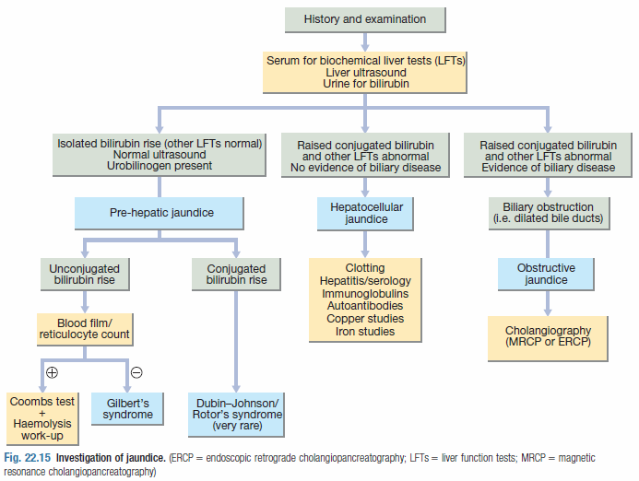

Slide 31
Patient’s lab results
Complete blood cell count
  White blood cell count: 17,000 cells/mm3 with modest shift to left
  Hemoglobin 11.1 g/dL; Hematocrit 35%
  Platelets 120,000/mm3
  MCV 110/micro m3
2. Chemistries
  Aspartate aminotransferase (AST) 150 U/L
  Alanine aminotransferase (ALT) 60 U/L
  Total Bilirubin 22 mg/dL
  Alkaline phosphatase 400 U/L
3. Prothrombin time 13.2 seconds
4. During hospitalization WBC rose to 42,000/mm3; total bilirubin rose to 32 mg/dL

Slide 32
Lab results may show:
  Anemia
  Macrocytosis
  Leukocytosis
  Bilirubin
  Liver enzymes
  Alkaline phosphatase
  Worsening WBC count and bilirubin in 3 days.
Transaminases are elevated but not very high. ALT > AST. Probably mild hepatocellular injury.
The total bilirubin is high.

Slide 33
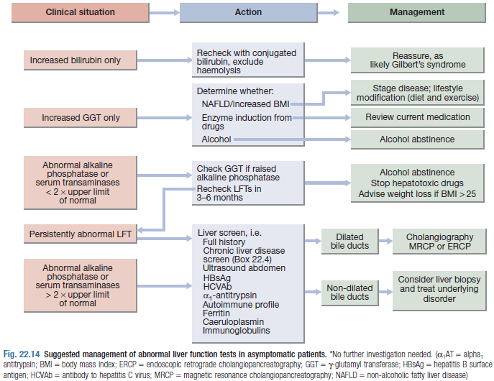

Slide 34
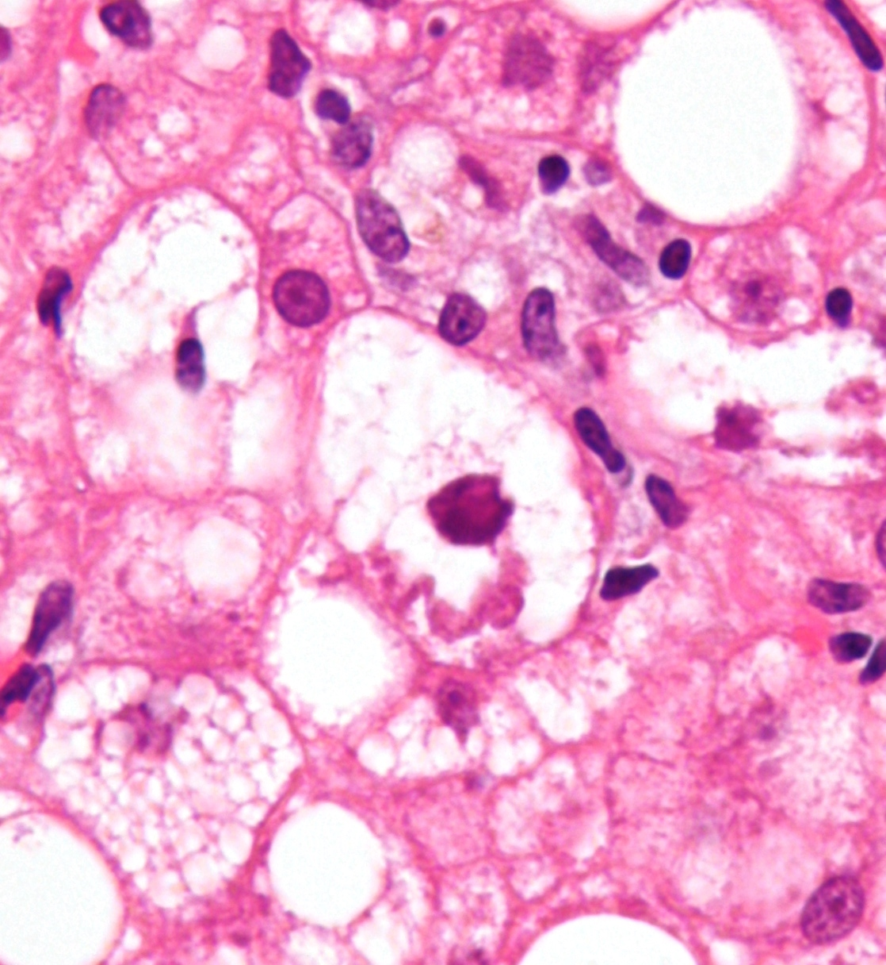
Biopsy
Scattered, small foci of liver cell necrosis.
Mallory bodies (intracellular accumulation of cytokeratin).
Scattered foci of neutrophils
Steatosis.
Cholestasis.
Possible fibrosis since alcoholism has been chronic.

Slide 35
Why not viral?
Viral hepatitis is unlikely, especially if we assume patient is not an IV drug user.
AST is greater than ALT.
Transaminases are low for hepatitis.
Increased wbc is not typical for viral hepatitis, especially level of 42,000/mm3.

Slide 36
Diagnosis
Alcoholic hepatitis.
Infection must be ruled out in view of the fever, chills, and leukocytosis.
Why?
  Recent and past history of alcoholism.
  Nausea, vomiting and RUQ pain.
  Hepatomegaly, spider nevi, palmar erythema.
  Cholestatic picture: AST greater than ALT. AST/ALT ratio >1
  Leukocytosis.
  Biopsy.

Slide 37
An advice to the patient regarding the use of Paracetamol.
Acetaminophen (Paracetamol) in therapeutic doses can be and is reported to be toxic in patients with liver disease due to increased P-450 enzyme activity.
Acetaminophen should be used cautiously or probably not at all in these patients, and they should be properly instructed about the potential toxicity of therapeutic doses of Acetaminophen.

Slide 38
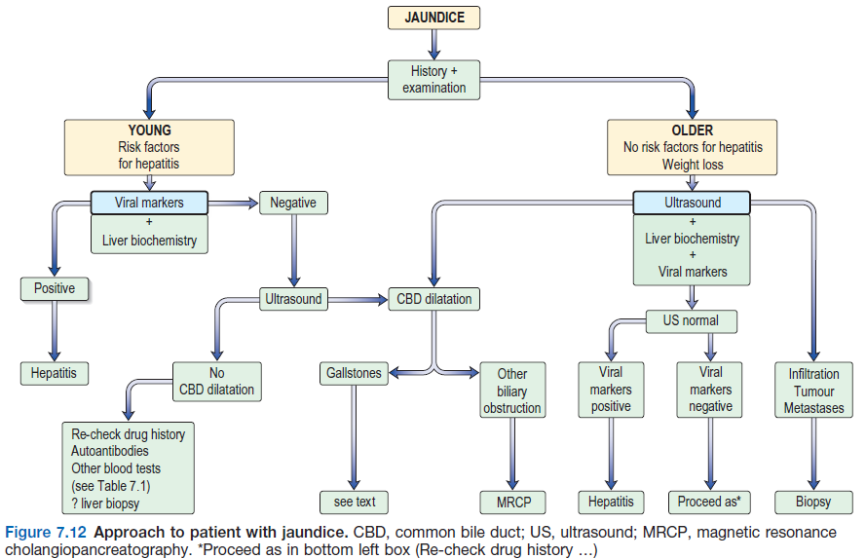

Slide 39
References
Harrison's Principles of Internal Medicine. 14th Edition. McGraw-Hill.
Cecil Essentials of Medicine.
Davidson's Principles and Practice of Medicine - 23rd Edition (859-862p).
Kumar and Clark's Clinical Medicine - 9th Edition.
Macleod's Clinical Examination 14th Edition.
Medscape, 2020.

