Slide 1

Diabetic Ketoacidosis (DKA)
Yazan Omar Alawneh
Acute Complications of DM
SARA ALNAFISI
NOUF ALNAFISI

Slide 2
Topics to cover:
1) Diabetic ketoacidosis (DKA)
2) Hyperosmolar Hyperglycemic Non-ketotic Syndrome (HHNS)
3) Hypoglycemia

Slide 3
Diabetic Ketoacidosis (DKA)
Yazan Omar Alawneh
Diabetic Ketoacidosis
(DKA)

Slide 4
Diabetic Ketoacidosis
DKA is an acute life-threatening medical emergency that can occur in both DM type 1 and type 2, but mostly in type 1.
Secondary to insulin deficiency and glucagon excess.
Usually following:
- Undiagnosed DM.
- Interruption of insulin therapy.
- Stress or illness.
Notes:
A state of :
1• hyperketonaemia (≥ 3 mmol/L) and ketonuria (more than 2+ on standard urine sticks)
2• hyperglycaemia (blood glucose ≥ 11 mmol/L (~200 mg/dL))
3• metabolic acidosis (venous bicarbonate < 15 mmol/L and/or venous pH < 7.3).
Majority of cases could have been prevented:
- Earlier diagnosis.
- Better communication between patient and doctor.
- Better patient education.
Most common error of management is omission or reduction of insulin by the patient (25%).
Insulin may need adjusting up or down but never stopped.

Slide 5
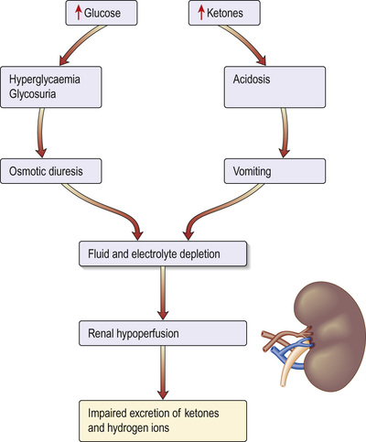
Pathogenesis
Ketoacidosis associated
with insulin deficiency.
Counter-regulatory
hormone excess and
fluid depletion.
Increased hepatic glucose
production.
Decreased tissue uptake of
glucose.

Slide 6

Lipolysis occurs.
Free fatty acids are
converted into ketones.
Excess ketones excreted
in urine and appear in the
breath.
Hyperventilation to
compensate for acidosis.

Slide 7
Clinical Features
Features of uncontrolled DM and acidosis:
-Dehydration
- Hyperventilation (Kussmaul breathing).
- Nausea and vomiting.
- Abdominal pain.
- Acetone fruity breath.
- Polydypsia, uria, and phagia.
- Altered mental state, and even coma (5%).
- Marked dehydration (orthostatic hypotension, tachycardia, dry skin).

Slide 8
Precipitating Factors
5 I’s:
- Infection
- Infarction, Ischemia
- Intercurrent illness
- Inappopriate withdrawal of insulin (Ignorance (poor control))
- Intoxication (alcohol)

Slide 9
Diagnostic criteria
Diabetic - Hyperglycemia:
- Blood glucose more than 250 mg/dL.
Ketonemia and/or ketonuria:
- Dipstick and blood centrifuging.
Acidosis:
- pH <7.3 or HCO3 <15 mEq/L.
- Increased anion gap.
- ABGs.
Notes:
D > Diabetic >250 (usually 500-800)
K > Ketones produced (ketonemia or ketouria
A > Acidosis: increased anion gap

Slide 10
Diagnosis
Features suggesting severe DKA:
- Pulse >100bpm or <60bpm.
- Systolic BP <90mmHg.
- Glasgow Coma Scale <12.
- O2 sat <92% on air.
- Blood ketones >6mmol/L.
- Bicarbonate <12mmol/L.
- pH <7.1.
- Hypokalemia on admission.
Notes:
Hyponatremia: serum sodium decreases 1.6 mEq/L for every 100mg/dL increase in glucose leve.

Slide 11
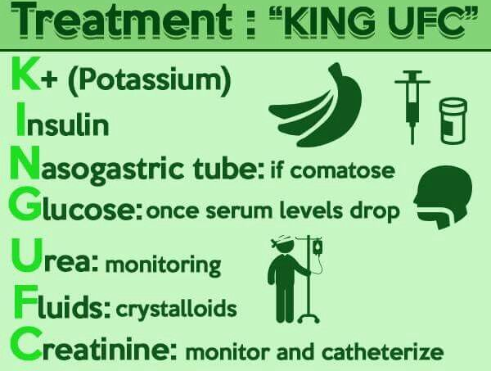

Slide 12
Replace fluid losses:
- With 0.9% saline. Average loss of water is 5-7L with a sodium loss of 500mmol.
- Change to 5% glucose once blood glucose reaches 250 mg/dL.
Replace electrolytes losses:
- Do not start insulin if K+ is less than 3.3.
- Add KCl coverage 20-30 mEq/L.
- Monitor urine output
Restore acid-base balance:
- Once fluids are replaced, the patient will compensate for the acidosis if the kidneys were intact.
- Bicarbonate is given only if pH is <6.9.

Slide 13
Insulin:
- Short acting insulin as IV infusion.
- Give 0.1 U/kg bolus then:
- 0.1U/kg/hour.
Find and treat the underlying cause (infection, MI, bleeding, etc.):
- CXR.
- Urine and blood cultures.
- ECG.
Give broad spectrum antibiotics if infection is suspected.
Notes:
Short-acting: regular, 30 min – 1 hour

Slide 14
Problems of Management
Cerebral edema: excessive rehydration and hypertonic fluids may cause it.
Hypoglycemia.
Hypokalemia from potassium loss in the urine.
Pulmonary edema from excessive fluid replacement.

Slide 15
Prognosis
IV glucose and insulin are continued until patient feels able to eat without vomiting.
Then changed into injection regimen.
Mortality of DKA is around 5% and increased in elderly.
Must advice patients as to how to avoid recurrence.

Slide 16
labs
Glucose > 250 mg/dl
Ph <7.3
Hco3 serum < 15
Serum ketones +ve positive
urine ketones positive +ve
beta hydroxybutyrate ELEVETED
Anion gab >12 (high)

Slide 17
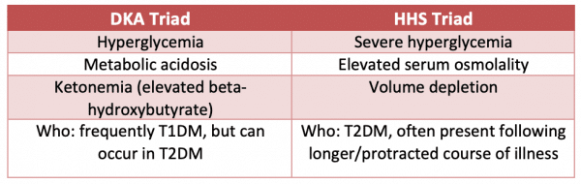
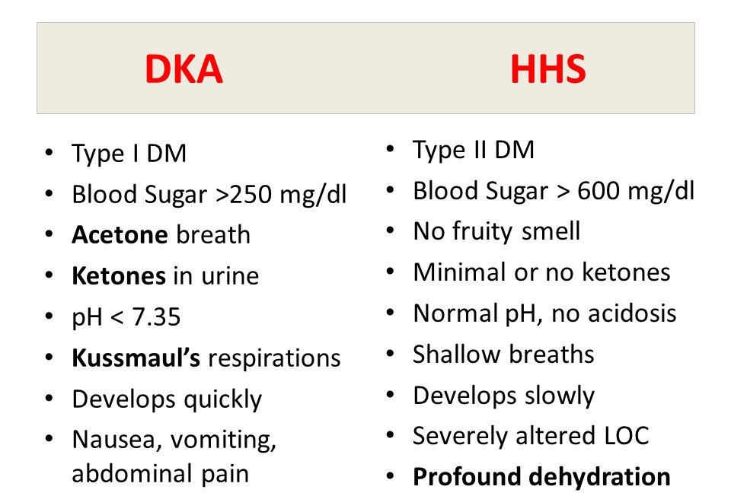

Slide 18
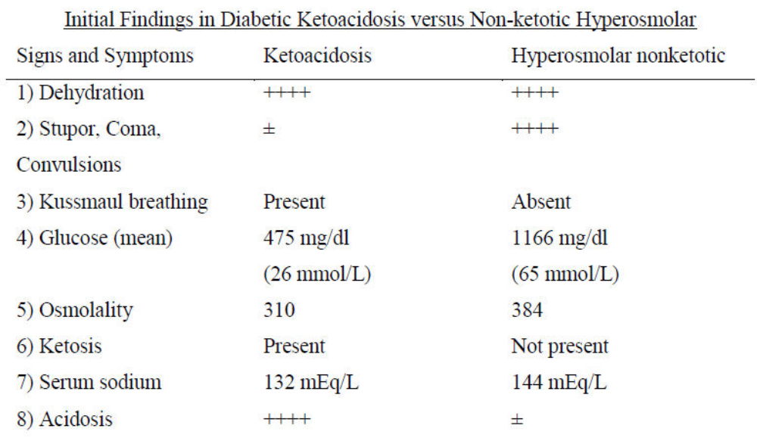
Notes:
Epidemiology:
DKA : seen in type 1, <65 yrs old, motality rate <1%
HHS : seen in type 2, >65 yrs old, motality rate 5-10%
HHNS has a higher mortality rate than DKA, but it is less common than DKA

Slide 19
Diabetic Ketoacidosis (DKA)
Yazan Omar Alawneh
Hyperosmolar
Hyperglycemic Nonketotic Syndrome (HHNS)

Slide 20
Hyperosmolar Hyperglycemic Nonketotic Syndrome
Severe hyperglycemia without significant ketosis.
Typically seen in type 2 DM, in the elderly.
Usually caused by:
- Ingestion of glucose-rich fluids.
- medications (thiazide, steroids).
- illness (infection, MI).

Slide 21
H
H
N
S
Hyperosmolarity: Serum osmolarity >320
Hyperglycemia: Glucose > 900
No Ketosis: No Acidosis (pH >7.3 / HCO3 >15)
Severe Dehydration: CNS (lethargy, confusion)

Slide 22
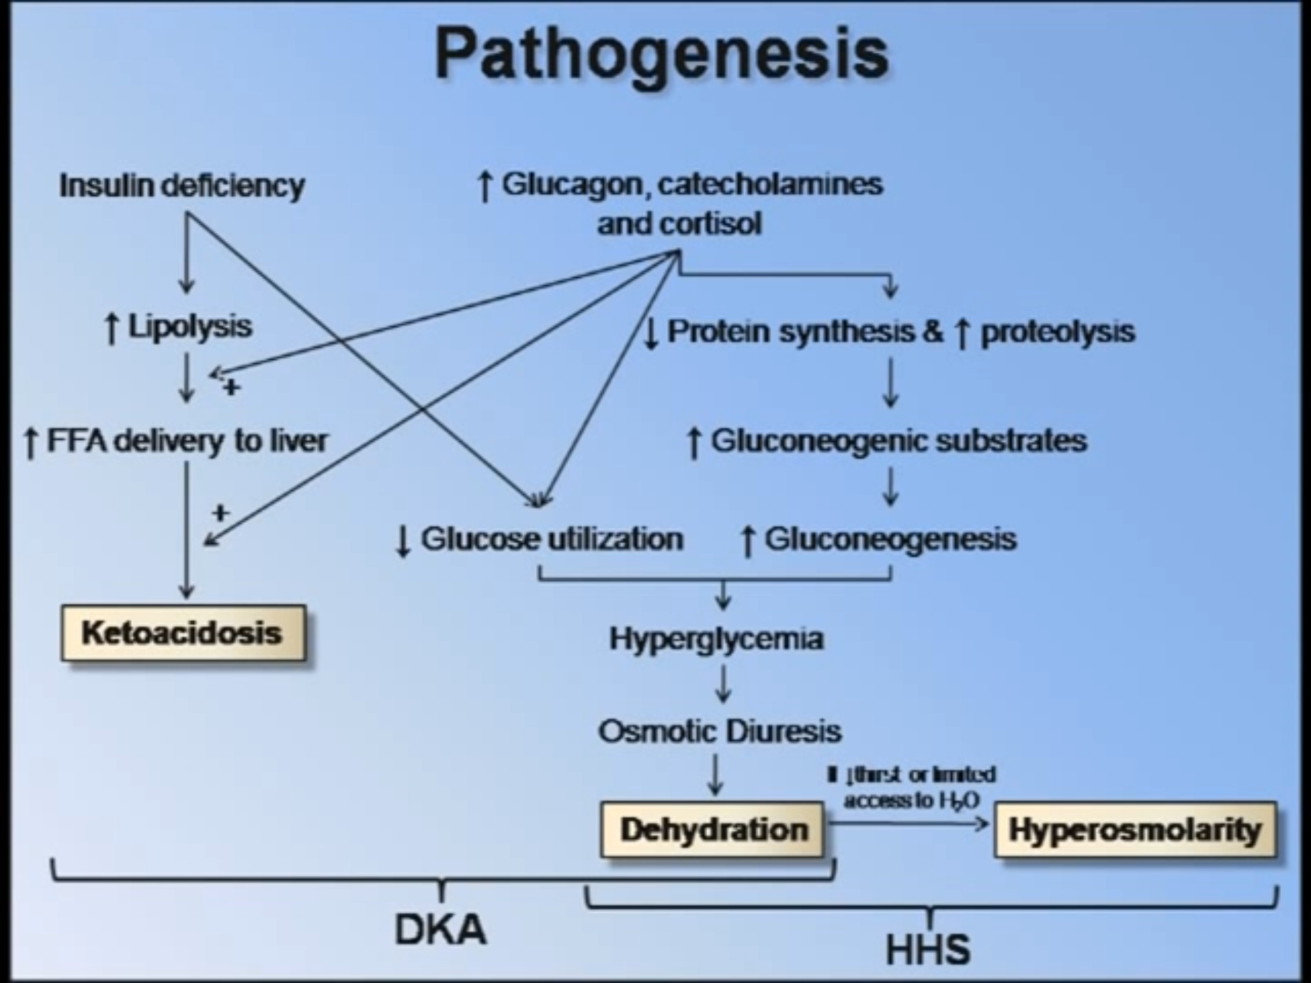
Notes:
As with DKA ,Hyperglycemia → an osmotic diuresis→ dehydration ( with loss of water, sodium, potassium and other electrolytes )
Hyperglycemia usually develops over a longer period (a few days to weeks), causing more profound hyperglycaemia and dehydration

Slide 23
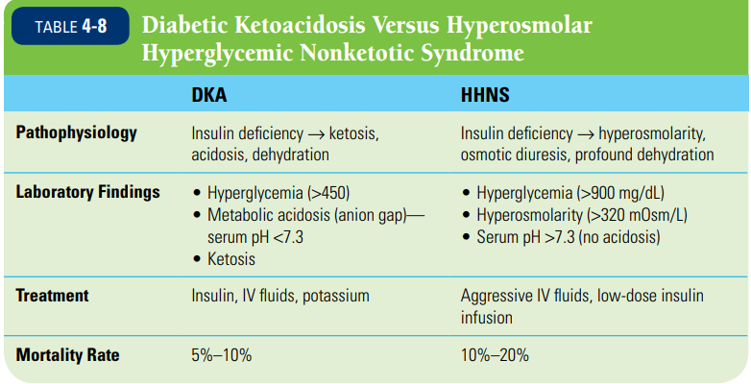

Slide 24
Clinical Features
Thirst, polyuria
Signs of extreme dehydration and volume depletion (hypotension and tachycardia)
CNS findings and focal neurologic signs are common (seizures, Impairment of the LOC – 2ry to hyperosmolarity).
Lethargy and confusion may develop, leading to convulsions and coma
Evidence of underlying illness (pneumonia, UTI).

Slide 25
Diagnosis
Hyperglycemia (typically higher than DKA) >600mg/dL. (frequently >900mg/dL)
Hyperosmolarity (2(Na⁺ + K⁺) + glucose + urea) >320mOsm/L.
Serum pH >7.3. (no acidosis)
Serum HCO3 >15mEq/L.
BUN is usually elevated, Pre-renal azotemia is common

Slide 26
Management
The main goals in HHNS treatment are:
- To vigorously rehydrate the patient while maintaining electrolyte hemostasis.
- To correct hyperglycemia.
- To treat underlying diseases.
- To monitor and assist cardiovascular, renal, and CNS function.
Very rapid lowering of blood glucose can lead to cerebral edema in children (as in DKA)

Slide 27
A. Fluid replacement:
- most important (normal saline): 1 L in the first hour, another liter in the next 2 hours. Most patients respond well. Switch to half normal saline once the patient stabilizes(( Aim for positive fluid balance of 3–6 L by 12 hrs, and replacement of remaining estimated loss over next 12 hrs ))
- Glucose levels are lowered as the patient is rehydrated (but the patient still requires insulin).
- When glucose levels reach 250 mg/dL, add 5% glucose (D51/2NS) as in DKA.

Slide 28
B. Insulin: An initial bolus of 5 to 10 units IV, followed by a continuous low-dose infusion ( 0.05 U/kg/hr = 2 to 4 units/hr)
- Reduce blood glucose by no more than 5 mmol/L/hr
- Treat coexisting conditions
- Give prophylactic anticoagulation
- Assume high risk of foot ulceration

Slide 29
Prognosis
Higher mortality rate than DKA (20-30%);
HHNS: not an absolute indication for subsequent insulin therapy like DKA.
Survivors may do well on diet and oral agents.
Poor prognostic signs include:
hypothermia
hypotension (systolic blood pressure < 90 mmHg),
tachy- or bradycardia
severe hypernatraemia (sodium160 mmol/L)
serum osmolality > 360 mOsm/kg
the presence of other serious comorbidities.

Slide 30
Complications
Thromboembolic events (cerebral and MI, mesenteric thrombosis, pulmonary embolism, and disseminated intravascular coagulation),
Cerebral edema
Adult respiratory distress syndrome
Rhabdomyolysis.

Slide 31
Diabetic Ketoacidosis (DKA)
Yazan Omar Alawneh
Hypoglycemia

Slide 32
Hypoglycaemia
Blood glucose < 3.5 mmol/L (63 mg/dL)
            Hypoglycemia in diabetes result In most circumstances from:
insulin therapy
less frequently from use of oral insulin such as sulphonylurea drugs, and rarely with other anti-diabetic drugs.

Slide 33
Hypoglycemia can be a frequent occurrence in the lives of people with type 1 diabetes especially in those receiving intensive therapy, Less commonly, hypoglycemia may also affect patients with type 2 diabetes who take a sulfonylurea oral meglitinide or who use insulin
Classifications:
- Severe hypoglycemia
- Documented symptomatic hypoglycemia
- Asymptomatic hypoglycemia
- Probable symptomatic hypoglycemia
- Pseudohypoglycemia

Slide 34
Counter-regulatory response to hypoglycemia
1. endogenous insulin release from pancreatic β cells is suppressed (first line of defense)
2. release of glucagon from pancreatic α cells is increased
3. the autonomic nervous system is activated, with release of catecholamines (epinephrine) both systemically and within the tissues.
In addition, stress hormones, such as cortisol and growth hormone, are increased in the blood.
These actions :-
1. reduce whole-body glucose uptake
2. increase hepatic glucose production maintaining a glucose supply to the brain

Slide 35
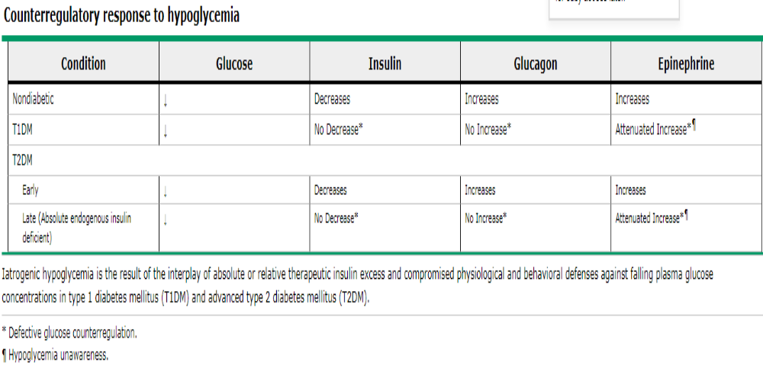

Slide 36
People with type 1 diabetes cannot regulate insulin once it is injected subcutaneously, and so it continues to act, despite developing hypoglycaemia.
In addition, within 5 years of diagnosis, most patients will have lost their ability to release glucagon specifically during hypoglycaemia. This is thought to result mainly from loss of α-cell regulation by β cells.
These two primary defects mean that hypoglycaemia occurs much more frequently in people with type 1 and longer duration type 2 diabetes.

Slide 37
Causes of hypoglycaemia
• Missed, delayed or inadequate meal
• Unexpected or unusual exercise
• Alcohol
• Errors in oral anti-diabetic agent(s) or insulin dose/schedule/
administration
• Poorly designed insulin regimen
• Lipohypertrophy at injection sites causing variable insulin
absorption
• Gastroparesis due to autonomic neuropathy causing variable carbohydrate absorption
• Malabsorption, e.g. coeliac disease
• Unrecognised other endocrine disorder, e.g. Addison’s disease

Slide 38
Risk factors for severe hypoglycaemia
• Strict glycaemic control
• Impaired awareness of hypoglycaemia
• Age (very young and elderly)
• Long duration of diabetes
• Sleep
• C-peptide negativity (indicating complete insulin deficiency)
• History of previous severe hypoglycaemia
• Renal impairment
• Genetic, e.g. angiotensin-converting enzyme (ACE) genotype

Slide 39
Symptoms
Hypoglycemic symptoms may be
adrenergic due to sympathetic neural activation and epinephrine release
neuroglycopenic, resulting from direct effects of hypoglycemia on the central nervous system.
The severity of the neuroglycopenic symptoms increases with the severity of hypoglycemia

Slide 40
Most common Sx of hypoglycaemia
A . Autonomic
• Sweating • Trembling
• Pounding heart • Hunger
• Anxiety
B. Neuroglycopenic
• Confusion • Drowsiness
• Speech difficulty • Inability to concentrate
• Incoordination • Irritability, anger may even have seizure or enter a coma.
C. Non-specific
• Nausea • Tiredness • Headache

Slide 41
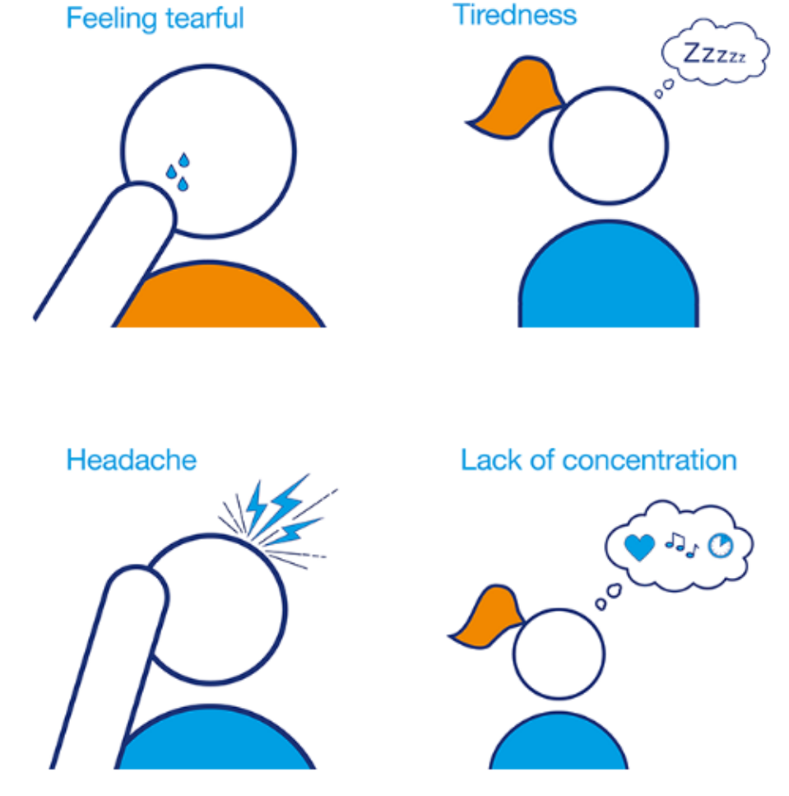
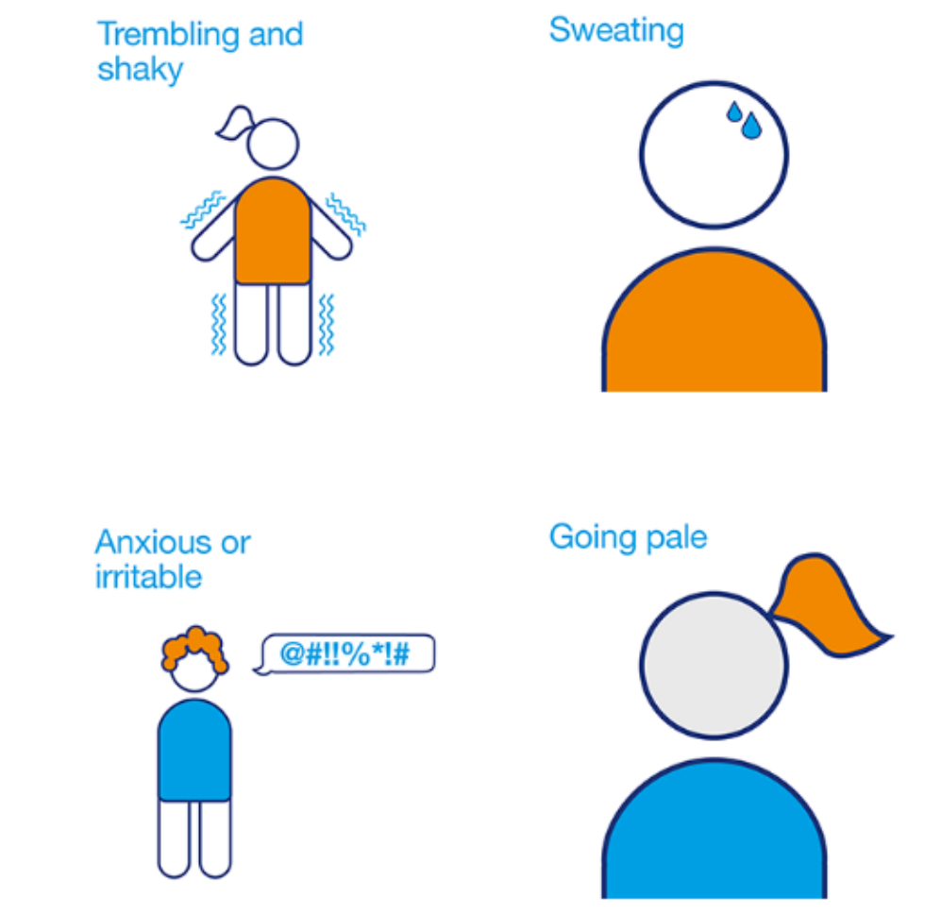
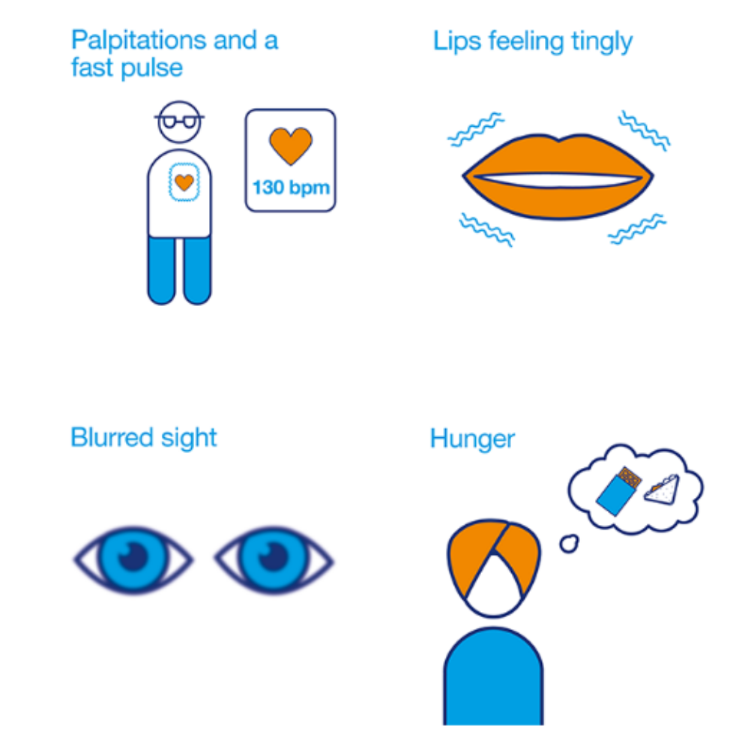

Slide 42
Hypoglycemic Unawareness
In diabetic patients, if severe neuropathy is present, the autonomic response (epinephrine) to hypoglycemia is not activated. This leads to neuroglycopenic symptoms.
This is more commonly seen in children with long duration of diabetes, and increases the risk of severe and/or recurrent hypoglycemia.
Prevention of hypoglycemia for a few weeks can restore hypoglycemia awareness..

Slide 43
Treatment of hypoglycaemia
Depends on its severity and on whether the patient is conscious and able to swallow
Mild (self-treated)
• Oral fast-acting carbohydrate (10–15 g) is taken as glucose drink or tablets or confectionery
• This should be followed with a snack containing complex carbohydrate

Slide 44
Severe (external help required)
• If patient is semiconscious or unconscious, parenteral treatment is required:
IV 75 mL 20% dextrose (= 15 g; give 0.2 g/kg in children)
Or IM glucagon (1 mg; 0.5 mg in children)
• If patient is conscious and able to swallow:
Give oral refined glucose as drink or sweets (= 25 g)
Or Apply glucose gel or jam or honey to buccal mucosa

Slide 45


