Slide 1
Antibiotic & Prophylaxis
Othman Badran
Saif AL-Sa’di
Ghaith Al-hadidi

Slide 2
Classification according to mechanism
Cell wall inhibitors:
Penicillin
Cephalosporins
Carbapenems
Vancomycin

Slide 3
Cell wall inhibitors
A:Penicillins
Mechanism:
Binds to transpeptidase which interferes with cross-linkage of peptidoglycan cell wall
Antibacterial spectrum:
The antibacterial spectrum of penicillins is determined by their ability to cross the bacterial peptidoglycan cell wall to reach the penicillin binding proteins in the periplasmic space.

Slide 4
Cont.
Natural penicillins (Penicillin G and Penicillin V):
Penicillin G:
Gram + cocci
Gram – cocci
Gram positive bacilli
Spirochetes
Penicillin V:Same spectrum as Penicillin G but it is not used to treat bacteremia .

Slide 5
Cont.
Antistreptococcal penicillins(Methicillin):
Used in penicillinase producing staphylococci.Ex:Methicillin sensitive staph.aureus
Extended spectrum penicillins (Ampicillin and amoxicillin):
They have an antibacterial spectrum similar to that of penicillin G, except that they are more effective against gram negative bacilli.

Slide 6
Cont.
Antipseudomonas penicillin (Piperacillin and ticarcillin):
They are called antipseudomonas penicillins due to their activity against pseudomonas aeruginosa.
They are effective against many gram negative bacilli but not against klebsiella because of its constitutive penicillinase.

Slide 7
Cont.
Resistance:
Resistance to penicillin occurs due to:
Beta lactamase activity
Decreased permability of the drug
Altered penicillin binding protein

Slide 8
Cont.
Pharmacokinetics
The route of administration is determined by:
1-The stability of the drug to gastric acid
2-The severity of infection

Slide 9
Cont.
Route of administration:
Penicillin V,amoxicillin,and dicloxacillin are available as oral preparations only.
Others are effective as oral,IV or IM routes.

Slide 10
Cont.
Absorption:
Most drugs are incompletely absorbed orally and reach the intestine in sufficient amounts to affect the intestinal flora.
Must be administered on an empty stomach.

Slide 11
Distribution
The B-lactam antibiotics distribute well throughout the body.
All cross the placental barrier but no teratogenic effects have been shown.
Penetration into bone or CSF in insufficient for therapy unless inflamed.
Penicillin amounts in prostate are insufficient to be effective against infections.

Slide 12
Metabolism
Host metabolism of B-lactam antibiotics is usually insignificant,but some metabolism of penicillin G may occur in patients with impaired renal function.
Excretion:
All excreted renally except nafcillin and oxacillin(metabolized in the liver).
They are also excreted in breast milk.

Slide 13
Adverse effects
Hypersensitivity
Diarrhea
Nephritis
Neurotoxicity
Hematologic toxicities

Slide 14
Cephalosporins
Cephalosporins have the same mode of action as penicillins,and are affected by the same resistance mechanisms.
They are more resistant than penicillins to certain b-lactamases.

Slide 15
Antibacterial spectrum
Cephalosporins have been classified into first, second, third, and fourth generation based on:
Bacterial suspectability patterns
Resistance to B-lactamases.
However,commercially available penicillins are ineffective against MRSA,L.monocytogenes,C.difficile and the enterococci.

Slide 16
Cont.
First generation
Cover MSSA, Proteus mirabilis, E.coli, and K.pneumonia.
Second generation
Greater activity against three additional gram-negative organisms:H.influenza, Enterobacter aerogenes, and some Neisseria species,whereas activity against gram-positive organisms is weaker.

Slide 17
Cont.
Antimicrobial coverage of cephamycins and ceftoxitin also includes anaerobes.
Third generation
Less potent than first generation cephalosporins against MSSA.
Potent against gram negative bacterias mentioned above as well as Serratia marcescens.
Ceftazidime is effective against P.aeruginosa.

Slide 18
Cont.
Fourth generation(Cefepime)
Effective against:
Streptococci and staphylococci
Aerobic gram negative organisms

Slide 19
Pharmacokinetics
Administration:
Many cephalosporins must be administered IV or IM due to their poor oral absorption. Exceptions are:
First generation: Cephalexin, Cefadroxil
Second generation: Cefuroxime
Third generation: Cefdinir, cefixime, ceftibuten

Slide 20
Cont.
Distribution:
All cephalosporins distribute very well in body fluids.However,adequate therapeutic levels in CSF are achieved with only a few cephalosporins. For example:
Ceftriaxone and cefotaxime are effective to treat neonatal and child hood meningitis cause by H.influenza.
Cefazolin is used as a single dose porphylaxis prior to surgery.And due to its ability to penetrate the bone, it is effective for most orthopedic surgeries.
All cephalosporins cross the placenta.

Slide 21
Cont.
Elimination
Cephalosporins are excreted renally except ceftriaxone.(It is excreted through the bile into the feces).

Slide 22
Adverse effects
Cephalosporins are well tolerated,however patients who has:
Allergic reactions
Steven-Johnson syndrome
Or toxic epidermal necrolysis to penicillins should not receive cephalosporins.
The highest allergic cross sensitivity is between penicillin and first generation cephalosporins.

Slide 23
Carbapenems
They are synthetic beta lactams.
Drugs of this group are:
Imipenem
Meropenem
Doripenem
Ertapenem

Slide 24
Antibacterial spectrum
Imipenem,meropenem and doripenem is active against Beta-lactamase producing gram positive and gram negative organisms,anaerobes and P.aeruginosa.
Ertapenem lacks coverage against P.aeruginosa, Enterococcus species, and Acinetobacter species.

Slide 25
Pharmacokinetics
Imipenem and meropenem are administered IV and excreted by glomerular filtration
Metabolism of imipenem in the proximal tubule produces an inactive metabolite that is nephrotoxic. Compounding it with cilastatin protects it and prevents the formation of this toxic metabolite.

Slide 26
Cont.
Ertapenem can be administed IM or IV once daily.
Adverse effects:
Nausea,vomiting and diarrhea
Eosinophilia and neutopenia (less common than other beta lactams)
High levels of imipenem may provoke seizures

Slide 27
Vancomycin
It is a tricyclic glycopeptide that is important to treat methicillin-resistant S.epidermis and MRSA infections,as well as enterococcal infections.
Usage:
B-lactam resistant gram positive organisms
Gram positive infections in people who have serious allergy to beta-lactams
Vancomycin is not absorbed orally,so the use of oral formulation is limited to the treatment of pseudomembraneous collitis.
Vacomycin can cause red man syndrome when rapidly infused.(Tachycardia,angioedema,flushing and generalized pruritis).

Slide 28
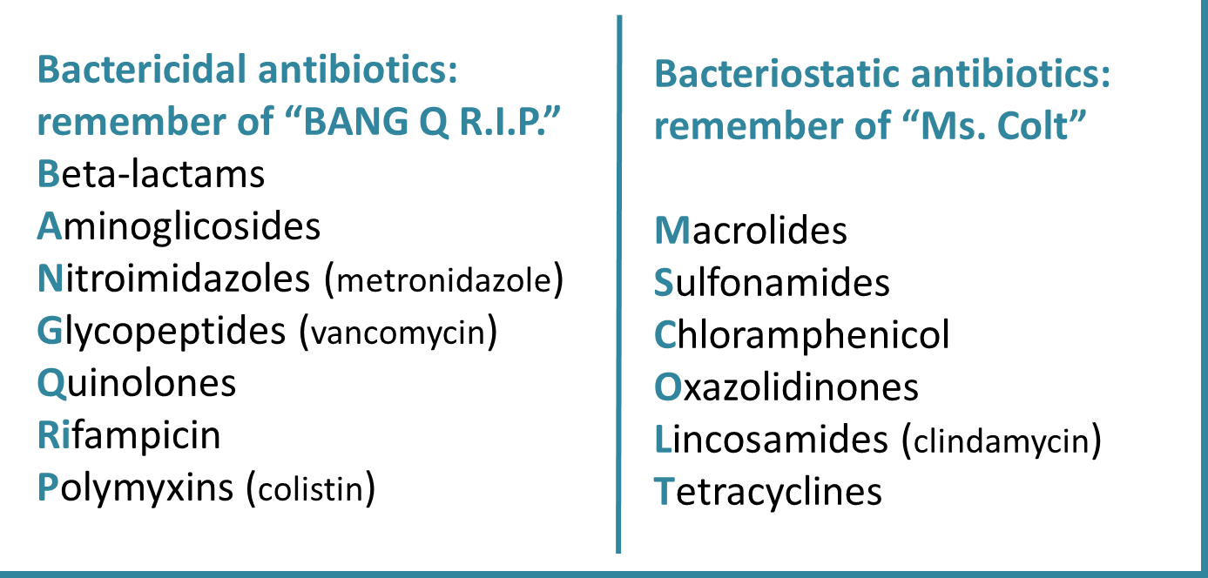
Bacteriostatic versus bactericidal drugs:

Slide 29
PROTEINS SYNTHESIS
Transcription
Translation
Protein Synthesis
Inhibitors
a substance that stops or slows the growth or proliferation of cells by disrupting the processes that lead directly to the generation of new proteins

Slide 30
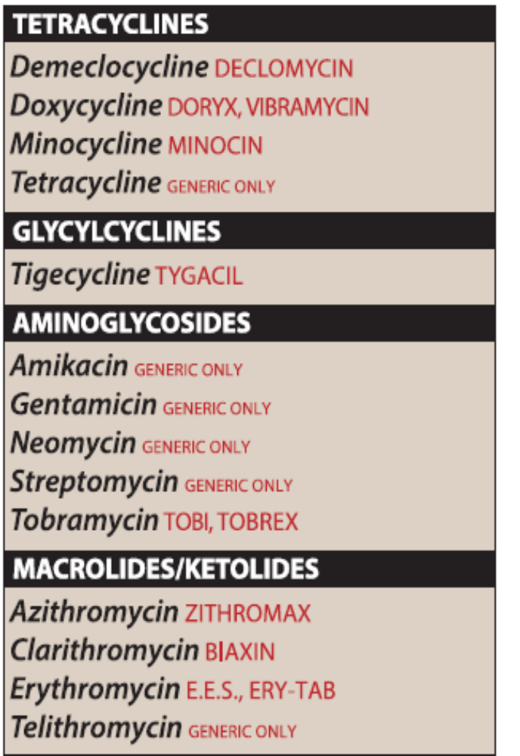
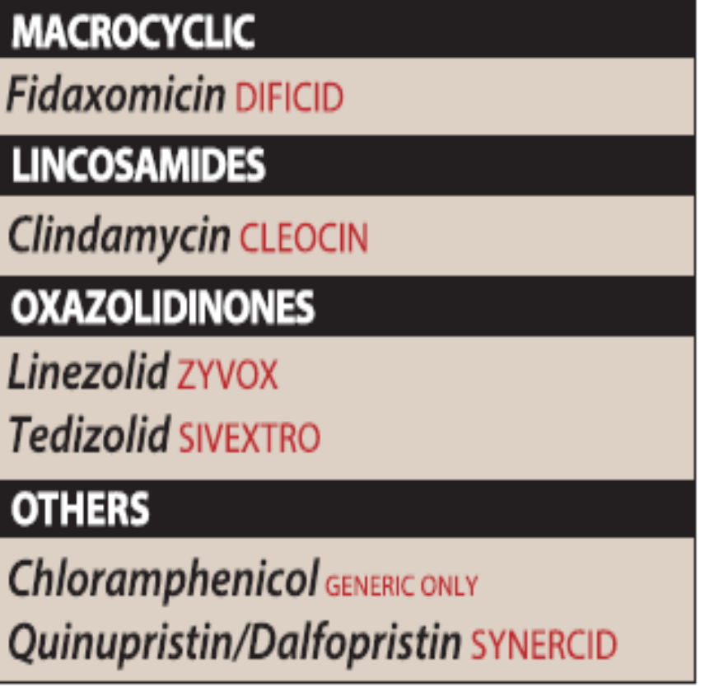

Slide 31
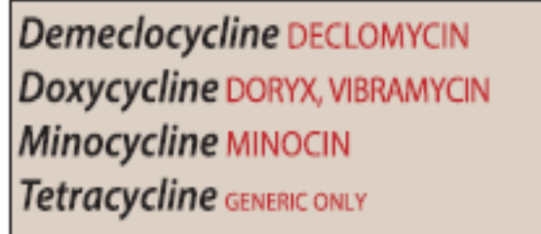
:Tetracyclines
:MECHANISM
Bacteriostatic; bind to 30S and prevent attachment of aminoacyl-tRNA;
--------------------------
limited CNS penetration.
Do not take tetracyclines with milk (Ca2+), antacids (Ca2+ or Mg2+), or iron-containing preparations because divalent cations inhibit drugs’ absorption in the gut.
CLINICAL USE:
Borrelia burgdorferi, M pneumoniae. Drugs’ ability to accumulate intracellularly makes them very effective against Rickettsia and Chlamydia. Also used to treat acne
ADVERSE EFFECTS:
GI distress, discoloration of teeth and inhibition of bone growth in children, photosensitivity. Hepatotoxicity—may occur in pregnant women Contraindicated in pregnancy.

Slide 32
Glycylcyclines
derivatives of tetracycline
it is very broad-spectrum with activity against gram positive organisms (including VRE, MRSA),
anaerobes, and gram-negative rods
Tigecycline is indicated for complicated skin and soft
tissue infections and intraabdominal infections.
Nausea and vomiting are its main side effects

Slide 33
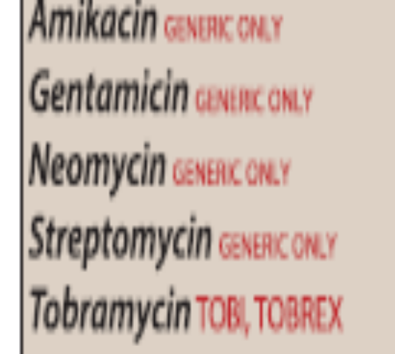
Aminoglycosides
Aminoglycosides are used for the treatment of serious infections due to aerobic gram-negative bacilli; however, their clinical utility is limited due to serious toxicities.
Mechanism of action

Slide 34
Antimicrobial coverage
• Treat gram-negative aerobes, such as E. coli, Pseudomonas, Acinetobacter, or
Klebsiella
• Sometimes used in combination with ampicillin for complicated UTIs, meningitis, or other serious infections .
aminoglycosides are often combined with a B-lactam antibiotic to employ a
synergistic effect, particularly in the treatment of Enterococcus faecalis and
Enterococcus faecium infective endocarditis.
•
No activity against anaerobes

Slide 35
Elimination
Most are given parenterally.
• Adverse reactions:
• Ototoxicity—may cause irreversible hearing loss, especially if infused too quickly. Baseline and follow-up hearing tests are required for patients on aminoglycosides
long term
• Nephrotoxicity—may cause renal insufficiency or acute tubular necrosis Aminoglycoside toxicity is dose-related, so be sure to adjust dose for renal dysfunction
Neuromuscular paralysis
Allergic reactions Contact dermatitis is a common reaction to
topically applied neomycin
Check peak and trough levels to avoid drug toxicities
Contrindication

Slide 36
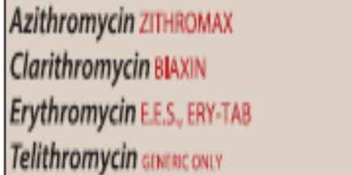
Macrolides
Mechanism of action•
Antimicrobial coverage :
Good at treating intracellular pathogens, such as Mycoplasma, Chlamydia, and Legionella
• Erythromycin and clarithromycin have activity against staphylococci and Streptococci
Clarithromycin is the treatment of choice for Mycoplasma pneumonia (“walkingpneumonia”) and Legionella spp.
• Erythromycin is also appropriate as an alternative to penicillin G if there is a penicillin allergy (e.g., treatment of chlamydia in pregnancy, to avoid tetracycline)
• Due to adverse events and frequent dosing, erythromycin is being used less often as an antibiotic. It is still regularly used as a GI stimulant however
• Clarithromycin is one of the drugs used in therapy for eradication of Helicobacter pylori
• Azithromycin and clarithromycin have activity against H. influenzae
• Azithromycin also treats Moraxella catarrhalis

Slide 37
Adverse effect :
• GI side effects are the most common and include epigastric pain, nausea, and
vomiting (particularly with erythromycin)
• Cholestasis
• Prolongation of QT interval, especially with erythromycin
Ototoxicity
Containdication
Drug interaction digoxin
hepatic dysfunction
fidaxomicin

Slide 38
Chloramphenicol
MECHANISM:
Blocks peptidyltransferase at 50S ribosomal subunit. Bacteriostatic.
CLINICAL USE:
Meningitis (Haemophilus influenzae, Neisseria meningitidis, Streptococcus pneumoniae) and Rocky Mountain spotted fever (Rickettsia rickettsii). Limited use owing to toxicities but often still used in developing countries because of low cost

Slide 39
ADVERSE EFFECTS:
Anemia (dose dependent), aplastic anemia (dose independent), gray baby syndrome (in premature infants because they lack liver UDP-glucuronyl transferase).

Slide 40
Clindamycin
MECHANISM
Blocks peptide transfer (translocation) at 50S ribosomal subunit. Bacteriostatic.
CLINICAL USE
Anaerobic infections (eg, Bacteroides spp., Clostridium perfringens) in aspiration pneumonia, lung abscesses, and oral infections. Also effective against invasive group A streptococcal infection.
ADVERSE EFFECTS
Pseudomembranous colitis (C difficile overgrowth), fever, diarrhea.

Slide 41
Linezolid
MECHANISM
Inhibit protein synthesis by binding to 50S subunit and preventing formation of the initiation complex.
CLINICAL USE
Gram ⊕ species including MRSA and VRE.
ADVERSE EFFECTS
Bone marrow suppression (especially thrombocytopenia), peripheral neuropathy, serotonin syndrome.

Slide 42
streptogramins
Quinupristin and dalfopristin are streptogramins which are administrated as combination iv antibiotics
This compound has narrow spectrum against certain aerobic , gram positive organism – specifically vancomycin resistant E.faecium and MRSA and is used when these organisms are resistant to ,or pateints are intolerant to , other agents
It is rarely used , given availability of newer agents

Slide 43
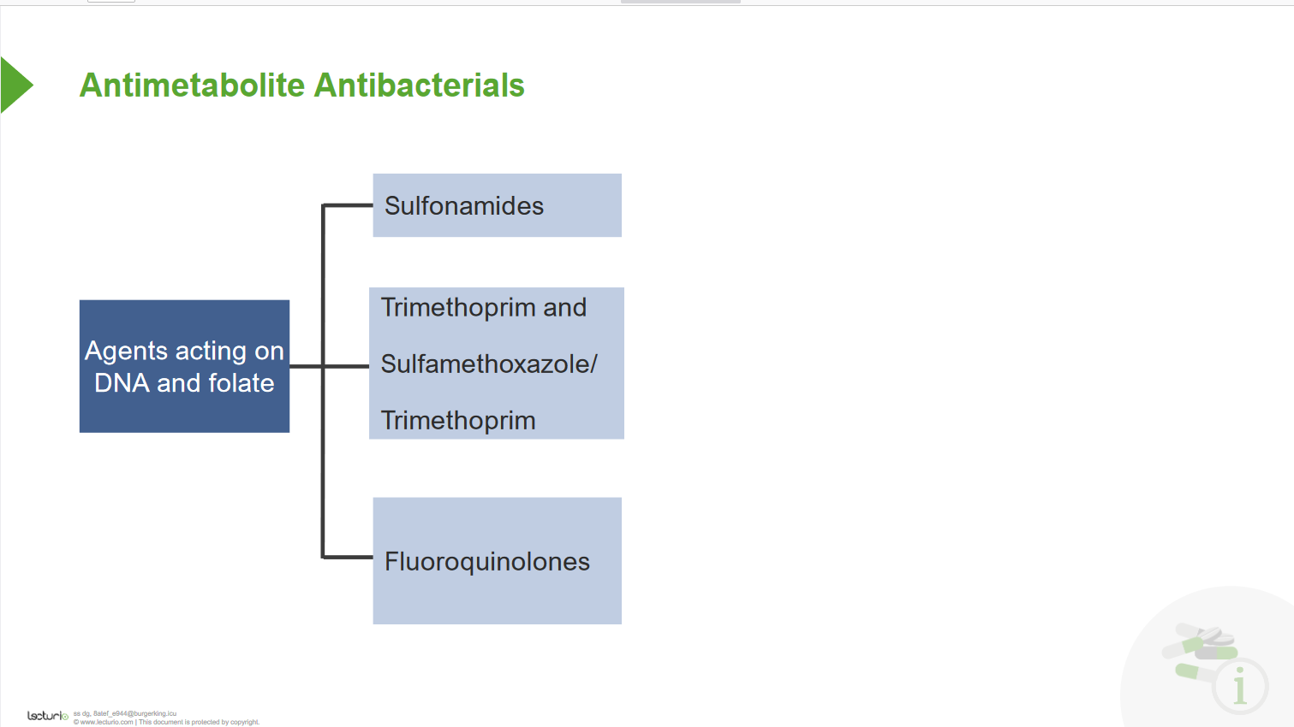

Slide 44
Inhibition of nucleic synthesis
Quinolones are chemotherapeutic bactericidal drugs.
The majority of quinolones in clinical use are fluoroquinolones
First and second generation quinolones are largely active against Gram-negative bacteria, whereas third and fourth generation quinolones have increased activity against Gram-positive and anaerobic bacteria

Slide 45
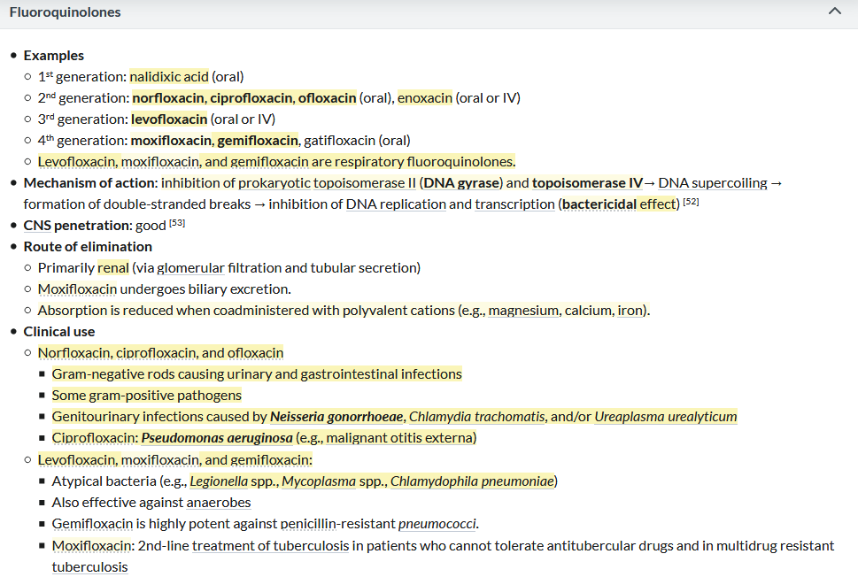

Slide 46
Medical uses
Fluoroquinolones are often used for genitourinary infections and are widely used in the treatment of hospital-acquired infections associated with urinary catheters. In community-acquired infections, they are recommended only when risk factors for multidrug resistance are present or after other antibiotic regimens have failed. However, for serious acute cases of pyelonephritis or bacterial prostatitis where the person may need to be hospitalised, fluoroquinolones are recommended as first-line therapy.^{[4]}
Due to people with sickle-cell disease being at increased risk for developing osteomyelitis from the Salmonella, fluoroquinolones are the "drugs of choice" due to their ability to enter bone tissue without chelating it, as tetracyclines are known to do.
Fluoroquinolones are featured prominently in guidelines for the treatment of hospital-acquired pneumonia
Fluoroquinolones have varying specificity for cytochrome P450, so may have interactions with drugs cleared by those enzymes

Slide 47
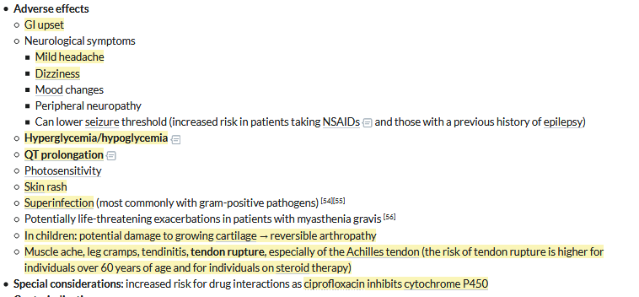

Slide 48
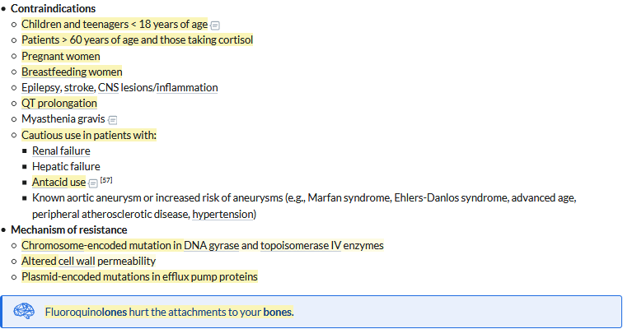
Contraindications

Slide 49
bacterial resistances
Resistance to quinolones can evolve rapidly, even during a course of treatment. Numerous pathogens, including Escherichia coli, commonly exhibit resistance.^{[55]} Widespread veterinary usage of quinolones, in particular in Europe, has been implicated
Three mechanisms of resistance are known.^{[60]} Some types of efflux pumps can act to decrease intracellular quinolone concentration.^{[61]} In gram-negative bacteria, plasmid-mediated resistance genes produce proteins that can bind to DNA gyrase, protecting it from the action of quinolones. Finally, mutations at key sites in DNA gyrase or topoisomerase IV can decrease their binding affinity to quinolones, decreasing the drugs' effectiveness.

Slide 50
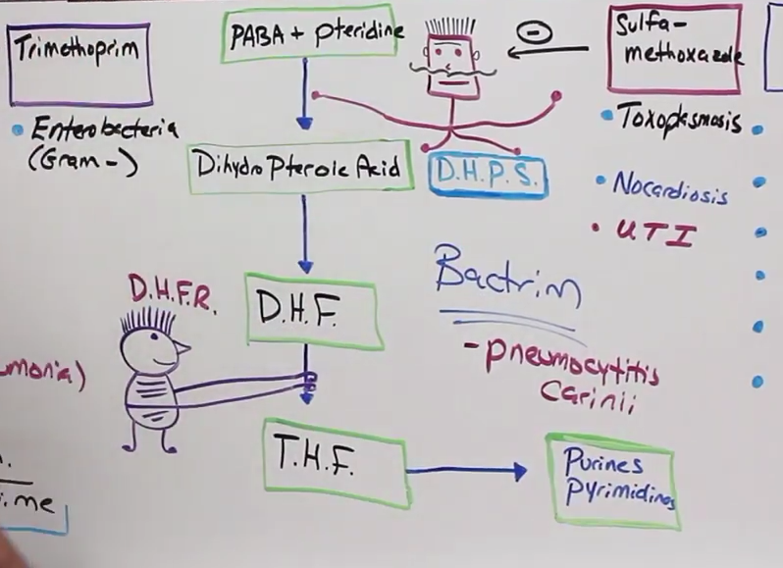
Folic acid inhibitors

Slide 51
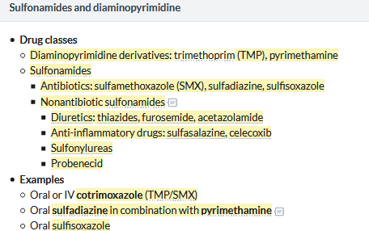

Slide 52
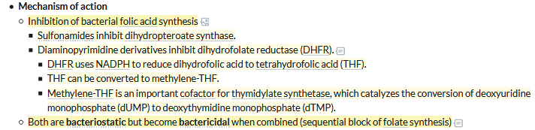

Slide 53
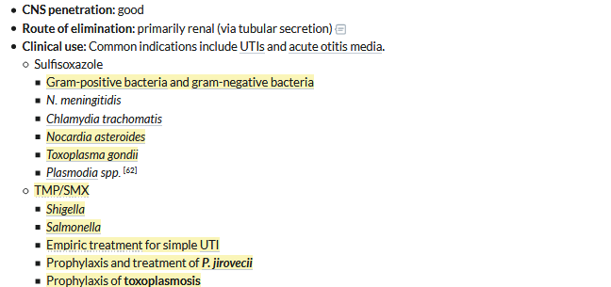

Slide 54
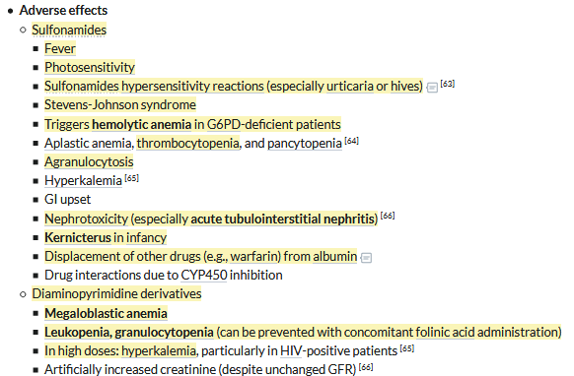

Slide 55
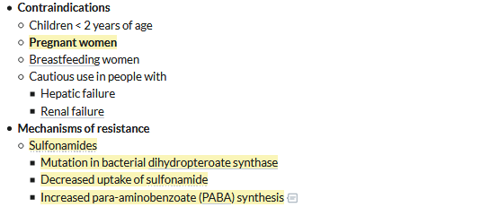

Slide 56
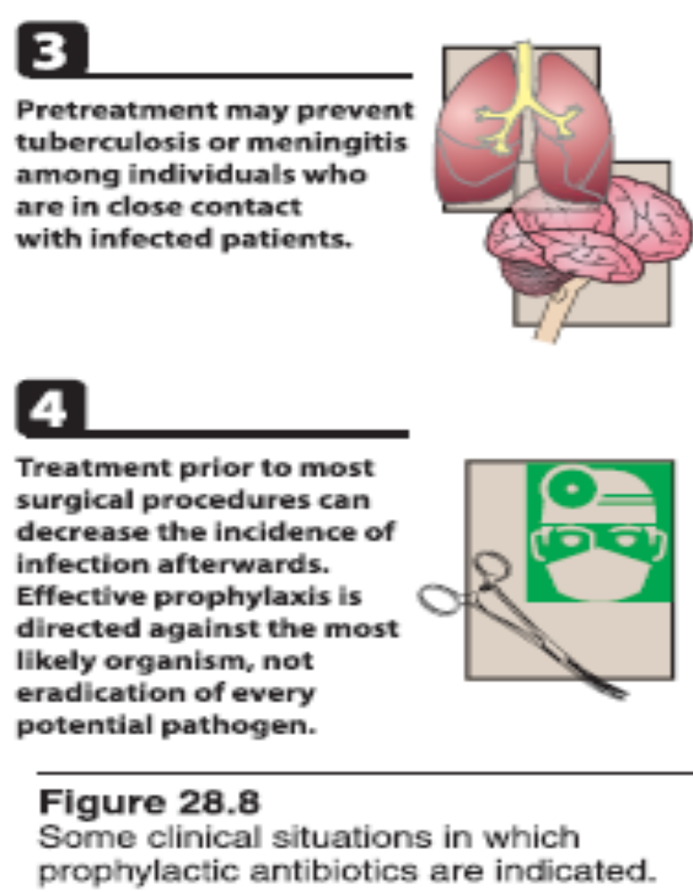
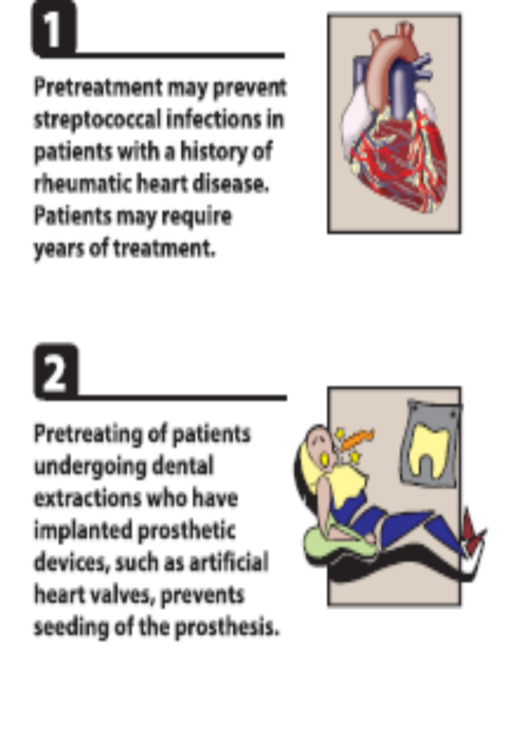
Prophylaxis:

Slide 57
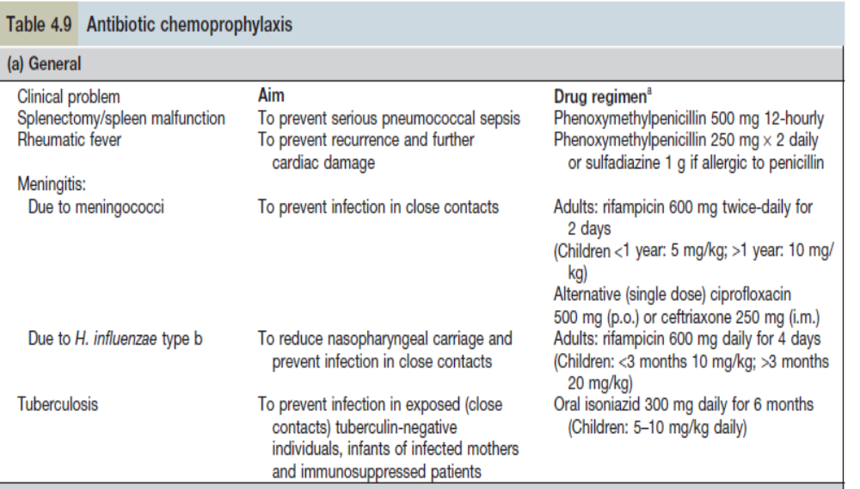

Slide 58
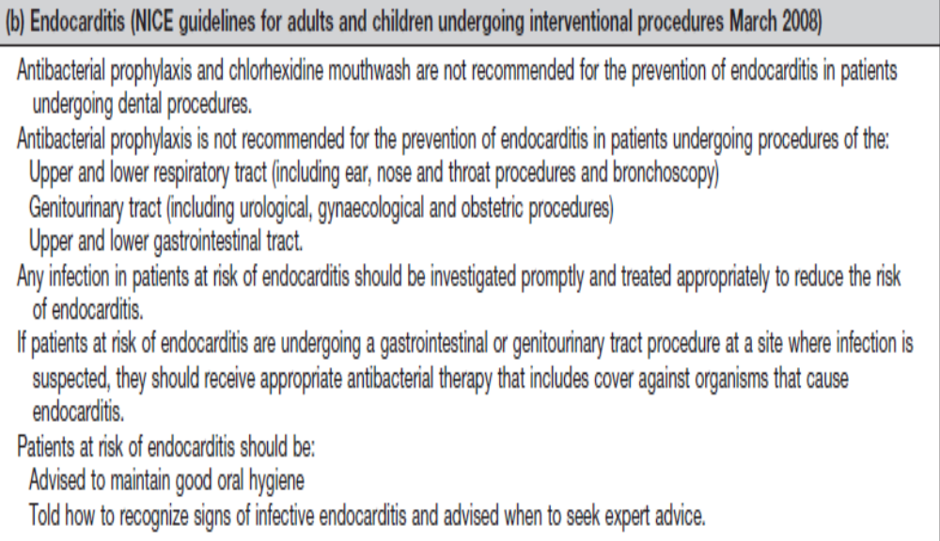

Slide 59
References
Kumar and clarks clinical medicine -8th Edition
Medscape ,2020
Step up to medicine ,5th Edition
Lippincott pharmacology 7th Edition

