Slide 1
Non- diabetic
Endocrine Emergencies
Louy Alsurkhi
Loulwa Alothman
Rand Dawoud

Slide 2
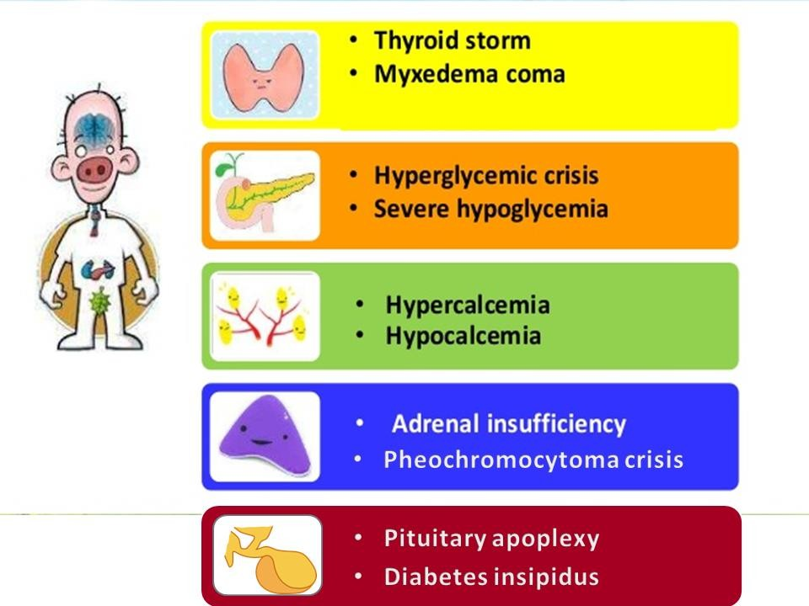

Slide 3
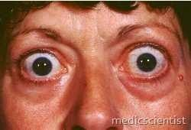
Thyroid Storm

Slide 4
Acute life threatening exacerbation of the manifestations of hyperthyroidism
Patient with Graves disease OR is previously undiagnosed

Slide 5
Precipitating factors
Surgery
Trauma
Withdrawal of antithyroid drugs
Severe infection
DKA
CVI
Cardiac failure
radioiodine
Drug reaction
Iodinated contrast medium

Slide 6
Clinical picture
Hyperpyrexia ( >40 ⁰C ), Sweating
Cardiac symptoms:
Tachycardia with or without AF
GI symptoms: Nausea, vomiting and diarrhea
CNS symptoms: Psychosis, delirium, seizures or coma
+ symptoms and signs of hyperthyroidism

Slide 7
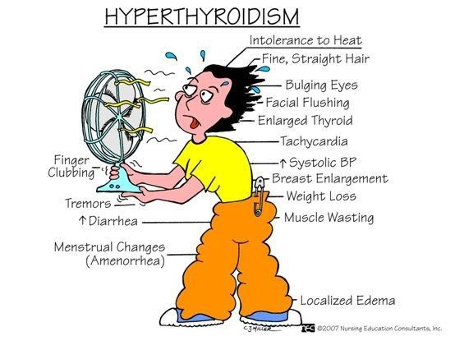

Slide 8
Diagnosis
Free T4, free T3 elevated
TSH suppressed
Note that findings are not different than that of hyperthyroidism, but the difference is in the setting

Slide 9
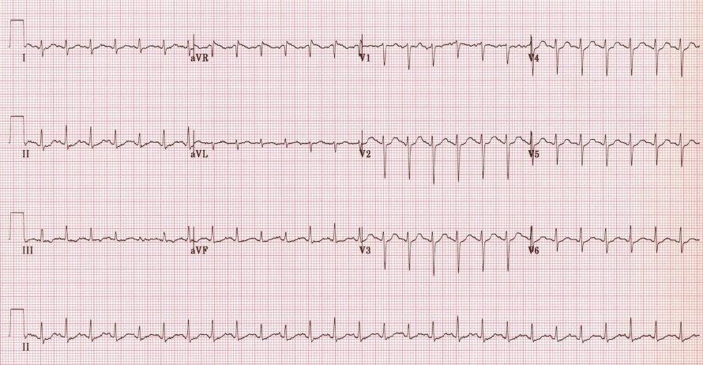

Slide 10
Management of Thyroid Storm
Supportive care
Fluids, containing Glucose and thiamine
Oxygen
Cooling, acetaminophens
Avoid Aspirin (can displace thyroid hormones from binding proteins)
Phenobarbital
Digoxin

Slide 11
Treatment of Thyroid Storm
⇓ Sympathetic
outflow
Triangle
of Treatment
⇓Production and release of thyroid hormone
⇓Peripheral conversion (T4 → T3)

Slide 12
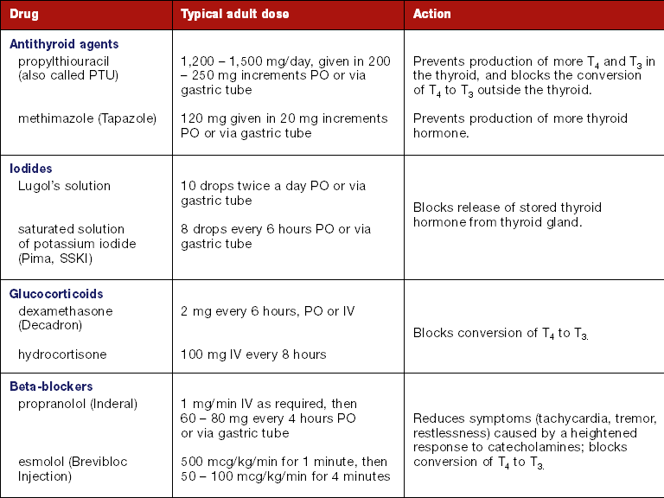
Management of Thyroid Storm (2)

Slide 13
Prognosis
◆ Mortality dropped since the 1920’s from 100% to 20 – 30%
◆ Mortality most frequently associated with serious underlying medical conditions

Slide 14
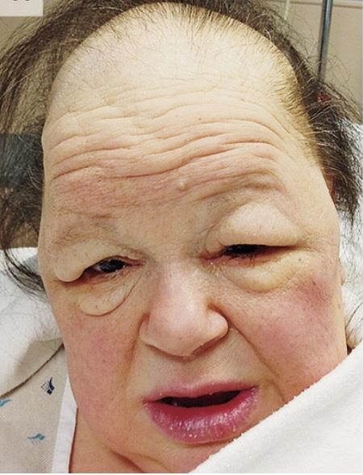
Myxedema Coma

Slide 15
Myxedema Coma
End stage of untreated or insufficiently treated hypothyroidism

Slide 16
Precipitating Events
CVI
trauma
Infection
UTI
Pneumonia
MI
Cold exposure
Administration of sedative, narcotic or potent diuretics

Slide 17
Clinical picture:
Elderly obese female has a history of
Hypothyroidism
Previous thyroid surgery
Radioiodine therapy
Depressed state of consciousness, seizures, COMA
Profound hypothermia (24-32.2 C)
Respiratory depression with CO2 retention
+ Signs and symptoms of Hypothyroidism

Slide 18
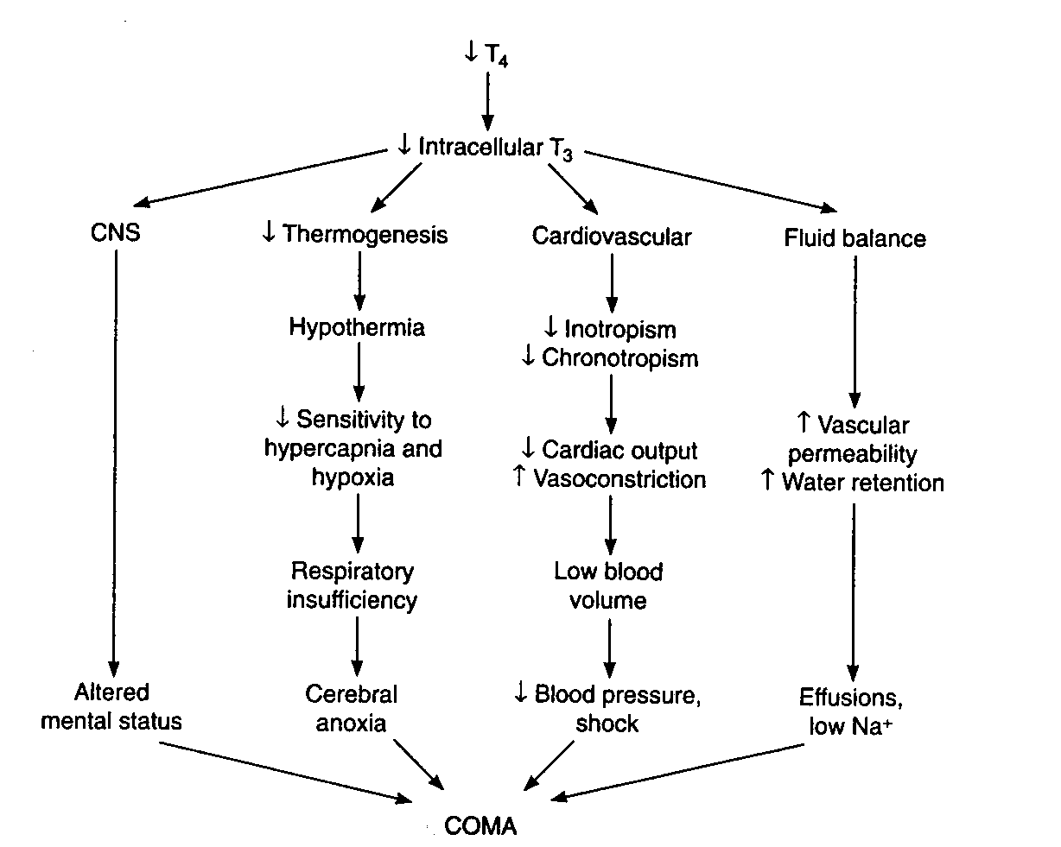
Pathogenesis of Myxedema

Slide 19
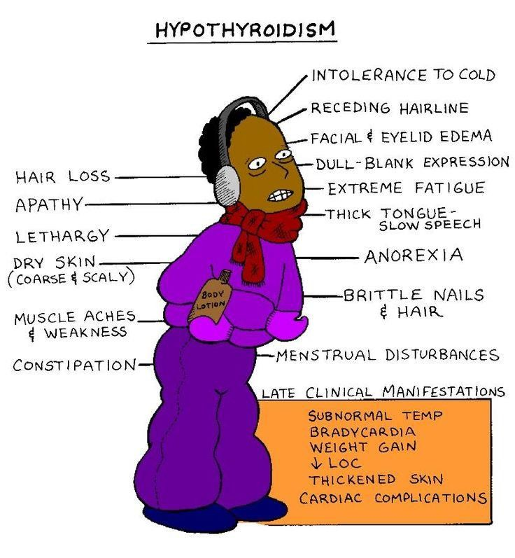
Physical Findings

Slide 20
Lab Tests
Free T4 low and TSH high
If the T4 is low and TSH low normal consider pituitary hypothyroidism
Blood gasses
Electrolytes and creatinine

Slide 21
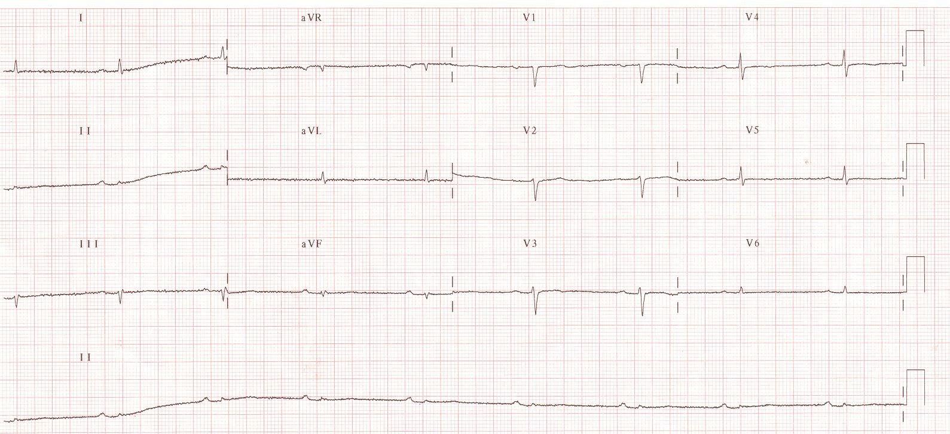
ECG in Patient with Myxedema Coma

Slide 22
Management of Myxedema
Supportive care:
Body temperature support
  Warming
Respiratory support
  Intubation may be needed
Cardiovascular support
  Fall in blood pressure is ominous
Avoid fluid overload
Avoid sedation

Slide 23
Management of Myxedema
Parenteral thyroxine (levothyroxine)
Loading dose of 300 – 400 μg Then 50-100 μg daily
Glucocorticoids
Controversial but necessary in hypopituitarism or multiple endocrine failure
Dose: Hydrocortisone 40 – 100 mg 6 hly for 1 week, then taper

Slide 24
Prognosis of Myxedema
Mortality is ~50% , even with treatment!

Slide 25
Acute Hypocalcaemia

Slide 26
Causes of Acute Hypocalcaemia
Hypoparathyroidism :
Destruction of parathyroids (most commonly surgical – parathyroid resection or accidental)
Acute hypomagnesaemia: result in decrease PTH secretion
Reduced 1,25(OH)vit D
Chronic renal insufficiency
Acute systemic illness
Drugs: ketoconazole, doxorubicin, cytarabine

Slide 27
Causes of Acute Hypocalcaemia
Increased uptake of Ca in bone
Osteoblastic metastases
Hungry bone syndrome
Complexing of Ca from the circulation
↑ albumin binding in alkalosis
Acute pancreatitis with formation of Ca soaps
Transfusion related citrate complexing

Slide 28
Clinical Picture of Acute Hypocalcaemia
Symptoms:
asymptomatic
Increase neuromuscular irritabilty
(Tingling and numbness especially perioral, fingers and toes)
Muscle cramps
Tetanic contractions (may include laryngospasm)
Seizures
Signs:
Hyperreflexia
Chvostek sign
Trousseau sign
Hypotension
Bradycardia
Prolonged QT interval

Slide 29
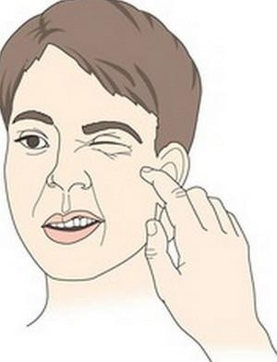
Chvostek sign
tapping facial nerve leads to contraction (twitching) of facial muscle

Slide 30
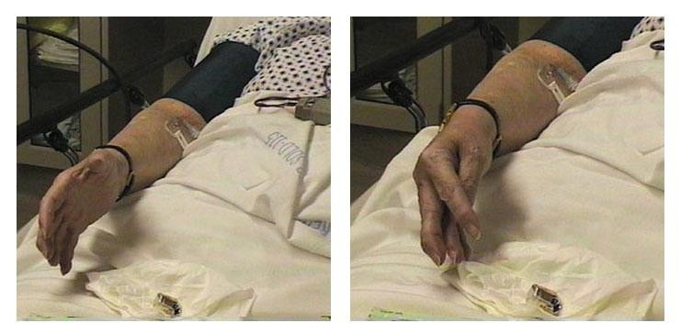
Trousseau sign
inflate BP cuff to a pressure higher than the pt systolic BP for 3 min (occludes blood flow in forearm). This elicts carpal spasm

Slide 31
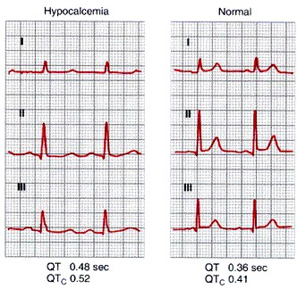
ECG in Hypocalcemia

Slide 32
Biochemical Workup
Ca⁺⁺
Total Ca⁺⁺, Albumin and Ionized
Phosphate
Magnesium
Plasma PTH
ECG
25(OH)D₃ and 1,25 (OH)D₃
Serum Amylase and Lipase

Slide 33
Treatment of Hypocalcemia
First correct low Mg⁺⁺
Calcium gluconate 10 ml of 10% solution IV Over 5 – 10 min and repeat as necessary in cases with frank generalized tetany
Slower continuous infusion of Calcium gluconate in less acute cases

Slide 34
Acute Hypercalcaemia

Slide 35
Most Common Causes :
Endocrine:
Hyperparathyroidism
PTHrp by solid tumors
Neoplastic:
Ca with bone metastases
Myeloma
Drugs:
  Thiazide
  Lithium
Granulomatous:
  Sarcoidosis
  Tuberculosis

Slide 36
Clinical Features
Dehydration
Bone pain
Confusion
Anorexia
Constipation
History of polyuria and polydipsia
(Renal stones, Painful bones, Groans and psychiatric overtones)

Slide 37
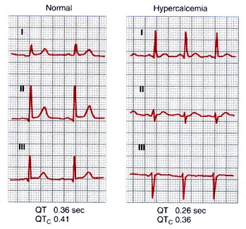
ECG Hypercalcemia
shortened Q – T interval

Slide 38
Workup
Plasma Calcium (corrected for albumin)
Phosphate, Magnesium
U and E’s
LFT’s
PTH
24 hr urine Calcium
ECG

Slide 39
Treatment of Hypercalcaemia
Volume repletion and diureses (1st step)
NaCl 0.9% 4 L in first 24 h
Loop diuretics ( furosemide has calciuretic effects)
Bisphosphonates IV (Pamidronate)
Corticosteroids (prednisone 30 – 60 mg daily):
are the drugs of choice if granulomatous disease or vit A or D intoxication is the cause

Slide 40
Primary adrenal insufficieny
DEFINITION
disorder that involves the loss of adrenal gland function leading to the deficiency of aldosterone (mineralocorticoid) and cortisol
it can either be acute or chronic depending on the etiology

Slide 41
Primary adrenal insufficieny
CAUSES
autoimmune adrenalitis (Addison disease)
most common cause in the industrialized world
infectious adrenalitis
e.g., tuberculosis
most common cause worldwide
hemorrhagic infarction
Waterhouse-Friderichsen syndrome associated with meningococcemia
anticoagulant/heparin therapy
metastatic disease
from lung, breast or melanoma cancers
iatrogenic
e.g., bilateral adrenalectomy

Slide 42
Primary adrenal insufficieny
CLINCAL FEATURES
lack of cortisol
GI symptoms e.g., nausea, vomiting, abdominal pain, anorexia
mental symptoms e.g., confusion, psychosis, lethargy
hypoglycemia (cortisol is a gluconeogenic hormone)
hyperpigmentation (↓ cortisol stimulates ACTH&MSH secretion)
low aldosterone
hyponatremia
hypovolemia
hypotension
hyperkalemia
shock

Slide 43
Primary adrenal insufficieny
DIAGNOSIS
serum cortisol concentration
low serum cortisol
plasma ACTH concentration
high plasma ACTH concentration
ACTH stimulation test
low response to ACTH stimulation

Slide 44
ADRENAL CRISIS
an acute and severely symptomatic stage of adrenal insufficieny that can inlucde:
severe hypotension
cardiovascular collapse
abdominal pain (can mimic an acute abdomen)
acute renal failure
death
any stress (e.g., trauma, infection, surgery, acute glucocorticoid withdrawal) can precipitate an adrenal crisis

Slide 45
ADRENAL CRISIS
TREATMENT
IV fluids
volume replacement as patients are hypovolemic
1-3L of 0.9% saline
OR
5% dextrose in 0.9% saline within the first 12-24 hours
glucocorticoid replacement
e.g., dexamethasone/hydrocortisone
give initial bolus then maintanence dose of 50 mg every 8 hours

Slide 46
pheochromocytoma
non-malignant tumor of the adrenal medulla that secretes catecholamines
symptoms are episodic
5 P’s
  Pressure (↑ BP)
  Pain (headache)
  Perspiration
  Palpitations (tachycardia)
  Pallor
TREATMENT
surgical tumor resection
α blockade (phenoxybenzamine) for 10-14 days prior to surgery → control BP
β blockade for 2-3 days prior to surgery → ↓ tachycardia

Slide 47
Pituitary apoplexy
DEFINITION
hemorrhage or infarction of pituitary gland
often in the setting of an existing pituitary adenoma
SYMPTOMS
sudden-onset severe headache
visual disturbance e.g., bilateral hemianopia, diplopia
altered mental status
IMAGING
intrasellar mass with hemorrhage on CT
TREATMENT
corticosteroids 4 mg b.d
transsphenoidal pituitary decompression

Slide 48
Thank you

