Slide 1
MANAGEMENT OF ACUTE DECOMPENSATED HF
Aya Hassan
Roa’a Ghanem

Slide 2
HEART FAILURE
It is a clinical syndrome that can result from any structural or functional cardiac disorder that impairs the ability of the heart to function as a pump and meet the body demands under normal physiologic conditions .
The incidence increases with age.
The prognosis of heart failure has improved in the last 10 years, but the mortality is still high

Slide 3
Types of HF
1
According to the affected side (Left vs Right)
11
According to the cardiac cycle (Systolic vs Diastolic)
111
According to the cardiac output (High vs Low)

Slide 4
According to the cardiac cycle
Systolic HF (HFrEF)
Diastolic HF (HFpEF)

Slide 5
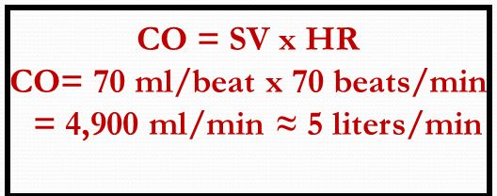
Definitions:
Cardiac Output ( CO ) : Amount of blood the heart pumps per minute ( L/min ) .
Stroke Volume ( SV ) : Amount of blood that heart pumps with each beat .
Heart rate ( HR ) : Number of beats per minute .

Slide 6
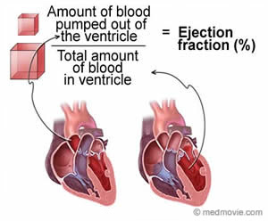

Slide 7
Ejection fraction
One of the measurements used by physicians to assess how well a patient's heart is functioning .
An ejection fraction is a percentage of the blood within the chamber that is pumped out with every heartbeat .
EF = SV / EDV
Normal EF = 55 to 70 %

Slide 8
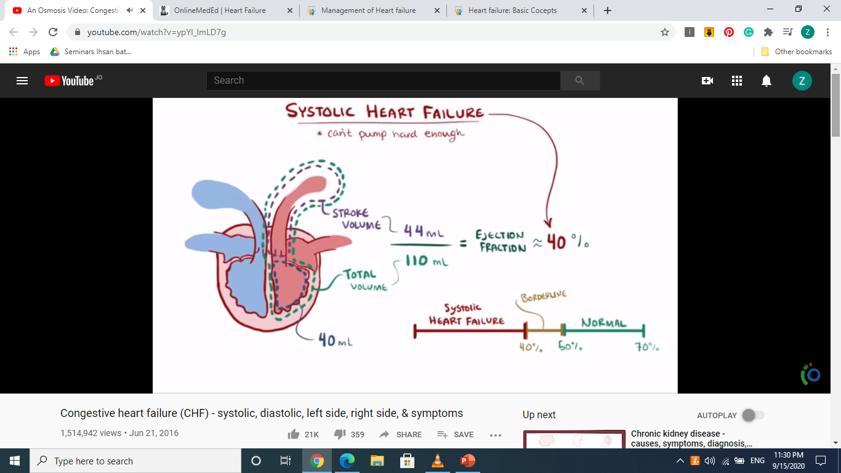

Slide 9
Systolic failure
Hallmark: decrease in left ventricular ejection fraction ( less than 40 %)
Due to :
1 . Ischemic heart disease ( e.g. MI )
2 . Increased afterload ( e.g. Hypertension )
3 . Cardiomyopathy
4 . Mechanical abnormalities ( e.g. valve disease )

Slide 10
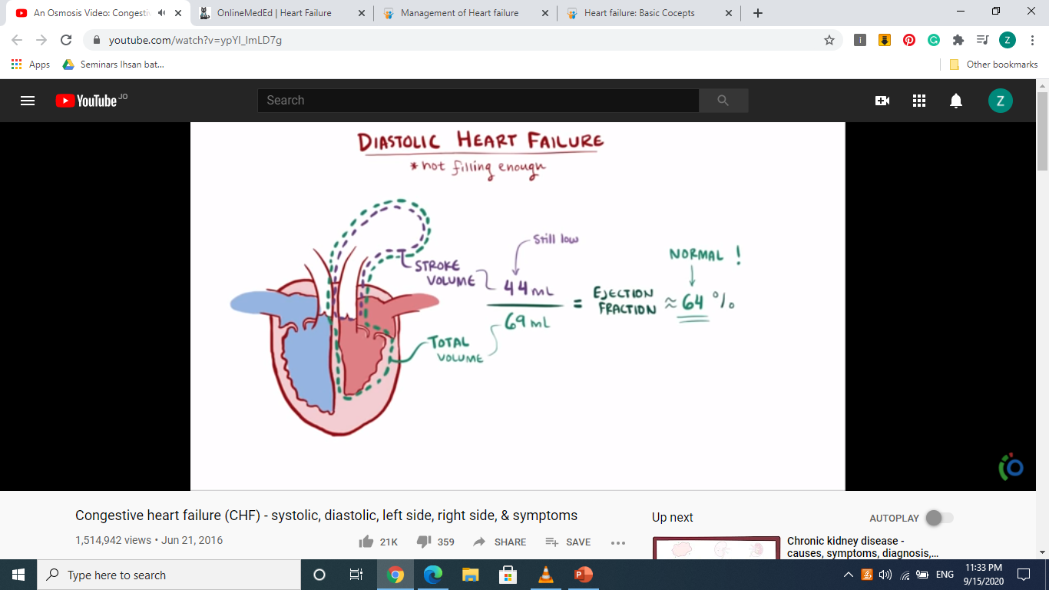

Slide 11
Diastolic failure
Impaired ability of ventricles to relax and fill during diastole → Decrease stroke volume and CO .
Normal ejection fraction .
Causes :
1 . Myocardial Hypertrophy
2 . Valvular disease
3 . Restrictive cardiomyopathy .

Slide 12
According to the affected side
Left-sided heart failure
There is a reduction in left ventricular output and an increase in left atrial and pulmonary venous pressure. As a result, blood builds up in the pulmonary circulation leading to pulmonary congestion or edema.
Causes: - Ischemic Heart Disease (e.g. atherosclerosis)
- Long standing HTN
- Dilated Cardiomyopathy
- Valvular Disease (e.g. aortic stenosis)

Slide 13
Right-sided heart failure:
Here the right ventricle of the heart is too weak to pump enough blood to the lungs. This causes blood to build up in the systemic circulation. The increased pressure inside the veins can push fluid out of the veins into surrounding tissue leading to edema.
Causes: - Left-sided HF
- COPD (cor pulmonale)
- PE
- Chronic Pulmonary HTN
- Left-to-right shunt (ASD,VSD..)

Slide 14
Biventricular heart failure.
In biventricular heart failure, both sides of the heart are affected. This can cause the same symptoms as both left-sided and right-sided heart failure.
Causes: - Dilated Cardiomyopathy
- Ischemic Heart Disease
- RHF failure developing from advanced LHF

Slide 15
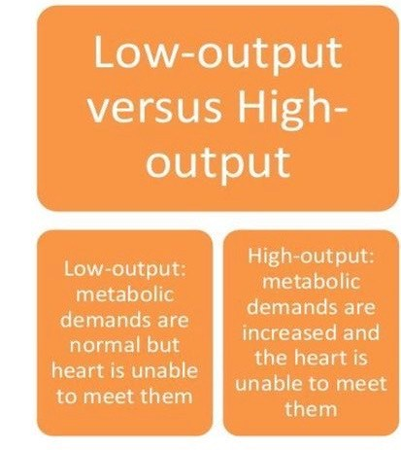

Slide 16
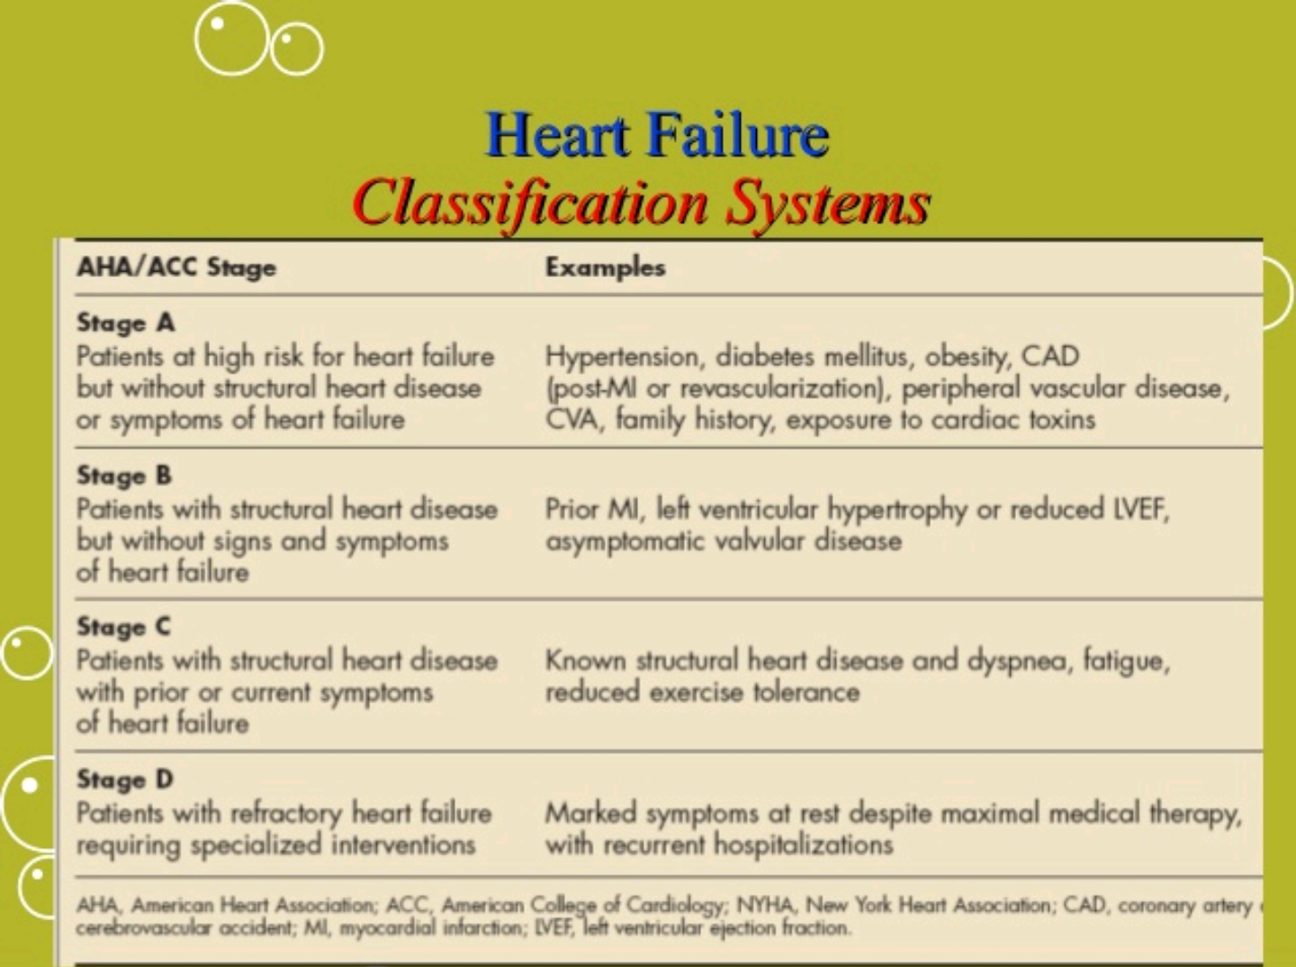

Slide 17
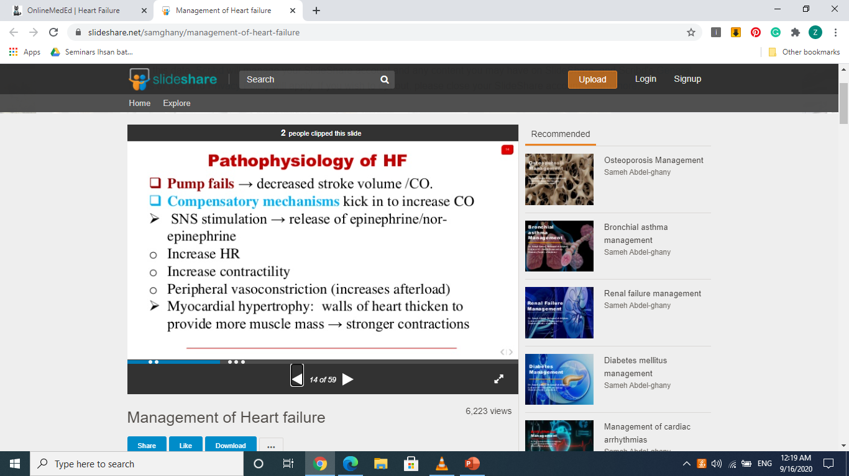
Compensation

Slide 18
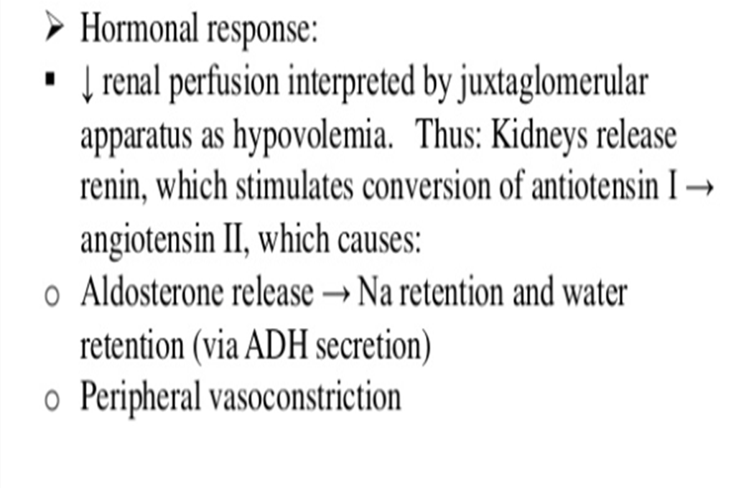

Slide 19
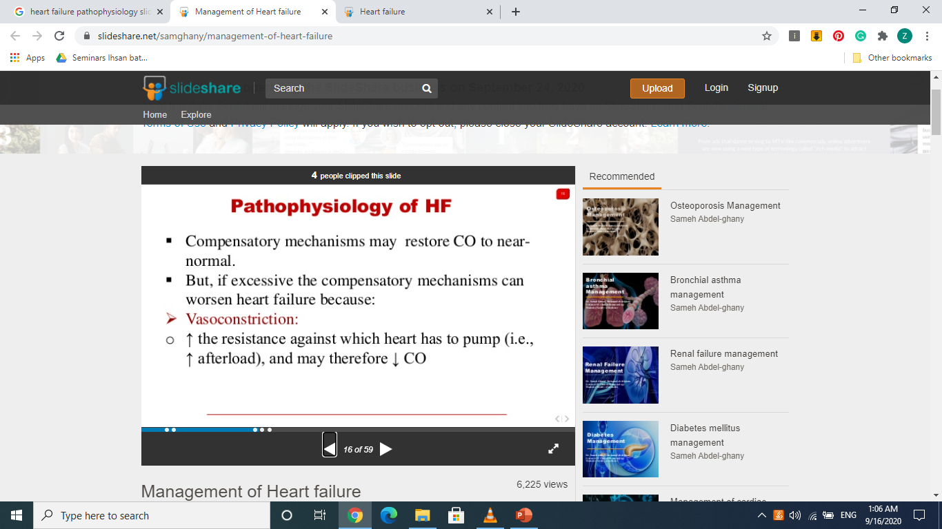
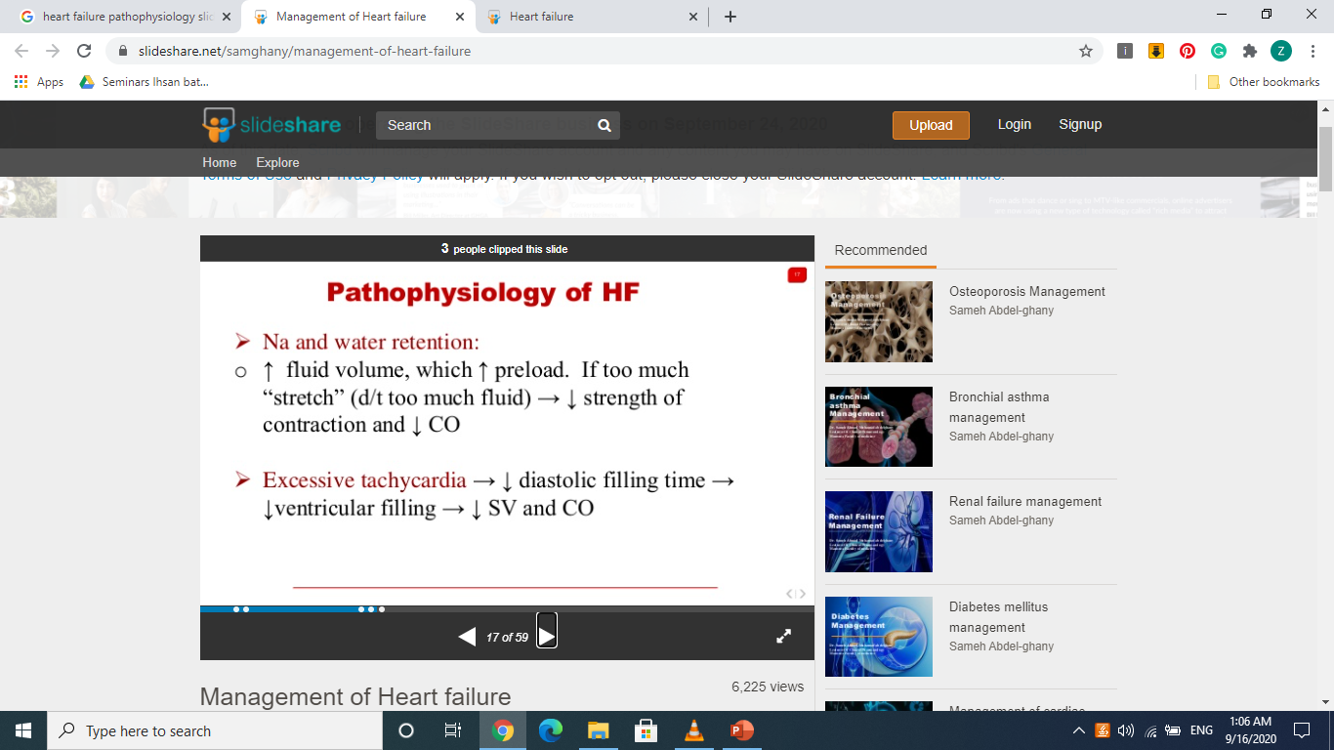

Slide 20
Clinical presentation

Slide 21
Left heart failure
Clinical features :
Symptoms are fatigue, dyspnoea, orthopnoea and paroxysmal nocturnal dyspnea
→ signs are cardiomegaly (with displaced apex), left vevtricular 3rd or 4th Heart sounds ,functional mitral regurgitation.
crackles at lung basis and pulmonary oedema
( congestion)

Slide 22
Right heart failure
Clinical features :
→ Symptoms : fatigue, dyspnoea, anorexia and nausea.
→ Physical signs :-
Raised jugular venous pressure
Hepatomegaly
Hepatojugular reflux
Pitting lower limb oedema
Ascitis
Right ventricular enlargment
Functional tricuspid regurgitation
Right ventricular third heart sound

Slide 23
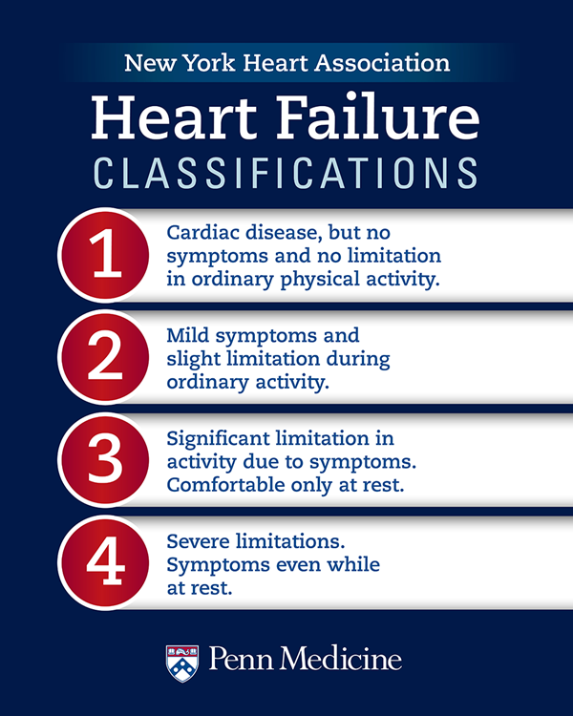
NYHA classification

Slide 24
Determining prognosis in HF
Low ejection fraction
Low sodium
CKD
Anemia
Elevated troponin
Elevated brain natriuretic peptide (BNP)
Persistance sinus tachycardia
NYHA class 3 or 4
High norepinephrine and catecholamine levels

Slide 25
Investigations

Slide 26
Blood tests
CBC (anemia)
Cardiac enzymes (to r/o MI)
Urea and electrolytes
Imaging
Chest xray
Echocardiogram

Slide 27
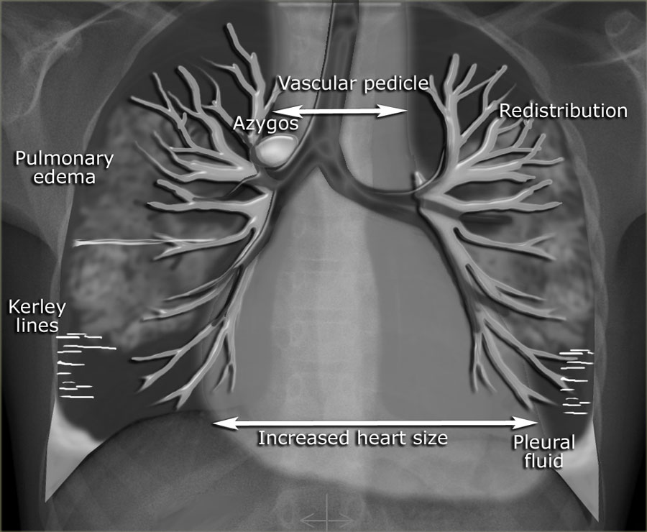
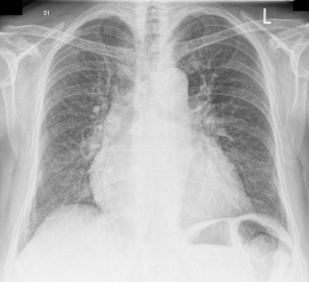
Chest x-ray
cardiomegaly
kerley B lines
pulmonary congestion, pleural effusion

Slide 28
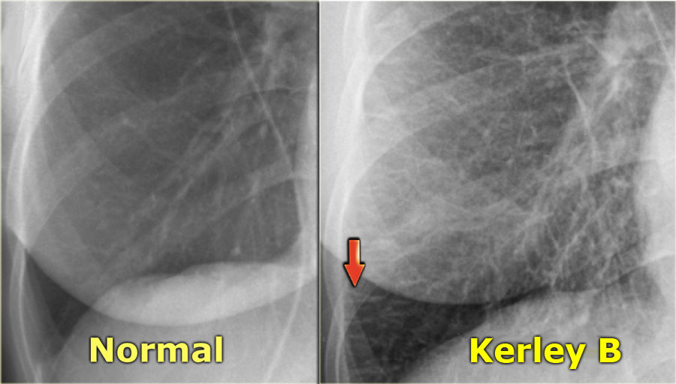

Slide 29
Echocardiogram
-initial test of choice
-determine whether systolic or diastolic dysfunction predominates.
-determine the cause (pericardial,myocardial,valvular….)
-estimate EF.

Slide 30
-ECG→
-non-specifec
-show chamber enlargment
-evidence of present or recent MI
-Plasma BNP or proBNP
-BNP>100 pg/ml or NTproBNP>300 pg/ml indicates heart failure

Slide 31
Cardiac catheterization
-can provide valuable quantitive informations regarding diastolic or systolic dysfunction.
-can clarify the cause of CHF

Slide 32
Investigations
Blood tests : full blood count, liver biochemistry,
urea and electrolytes, cardiac enzymes, thyroid function test
Chest X-ray : large heart , pulmonary congestion, upper lobe diversion, Kerley B line,..etc
ECG
Echocardiography
Cardiac catheterization

Slide 33
Management of Heart Failure

Slide 34
General principles
Therapy is aimed at 2 goals:
Symptomatic relief
Prevention of adverse cardiac remodeling, and prolonging survival.
- Therapy is classified as :
Life-style modifications
Pharmacologic therapy
Implanted cardiac devices
Coronary revascularization
Ventricular assist devices
Cardiac transplantation

Slide 35
Life-style modifications
Sodium restriction :
Patients with heart failure should aim for salt intake < 6 g/day.
Fluid restriction :
Consider fluid restriction (1.5-2 L/day) for patients with advanced heart failure, particularly in patients with hyponatremia, to reduce congestive symptoms.

Slide 36
Pharmacologic Therapy
Principles:
RAAS blockers and Adrenergic beta blockers form the cornerstone of pharmacotherapy and lead to:
Attenuation of decline and improvement in cardiac structure and function with consequent reduction in symptoms
Improvement in QOL
Decreased burden of hospitalizations
Decline in mortality from both pump failure and arrhythmic deaths

Slide 37
Types HF Presentation
Distinctive phenotypes of presentation with diverse management targets, these include:
Chronic heart failure with reduced ejection fraction (HFrEF)
Chronic heart failure with preserved ejection fraction (HFpEF)
Acute decompensated heart failure (ADHF)
Advanced heart failure or end-stage (refractory) heart failure

Slide 38
A- Chronic heart failure with reduced ejection fraction (HFrEF)
- Pharmacotherapy:
ACE inhibitors : Standard initial HF therapy that reduces mortality in pts with symptomatic HF, delays the onset of HF in pts with asymptomatic LV dysfunction, and lowers mortality when begun soon after acute MI.
ACE inhibitors are the basis of therapy and recommended for all patients with HF (especially HFrEF), irrespective of blood pressure status.
ACE inhibitors through vasodilation reduce preload and afterload, thereby reducing right atrial, pulmonary arterial, and pulmonary capillary wedge pressures.
All ACE inhibitors have been studied and are considered equal in terms of HF treatment.
Angiotensin receptor blockers (ARBs) may be substituted if pt is intolerant of ACE inhibitor (e.g., because of cough or angioedema).

Slide 39
Add diuretics as needed in patients with evidence of fluid retention: Loop diuretics (e.g., furosemide is most used) are most potent and, unlike thiazides, remain effective when GFR <25 mL/min. Combine loop diuretic with thiazide for augmented effect.
Beta blockers (bisoprolol, carvedilol, or sustained-release metoprolol succinate) reduce cardiovascular mortality and sudden cardiac death, reduce hospitalization for heart failure, and may reduce all-cause mortality.
Start patients on beta blockers after stabilization of symptoms with diuretic and ACE inhibitor therapy when blood pressure is normal or high.
Beta blockers are contraindicated in cardiogenic shock and severe active asthma.

Slide 40
Hydralazine plus isosorbide dinitrate (vasodilators) may be used when ACE inhibitors and ARBs are not tolerated or contraindicated (e.g., renal failure). When a combination of hydralazine and isosorbide is used, there is a reduction in death and a decrease in hospitalizations.
Aldosterone antagonist (eplerenone or spironolactone) for NYHA class II-IV patients with serum creatinine ≤ 2.5 mg/dL (221 mcmol/L) in men or ≤ 2 mg/dL (177 mcmol/L) in women and potassium < 5 mEq/dL (5 mmol/L). Monitor for hyperkalemia and impaired renal function.

Slide 41
Angiotensin receptor-neprilysin inhibitor (ARNI) (not an ACE inhibitor or ARB): for patients with CHF and reduced ejection fraction (HFrEF) who are mildly/moderately symptomatic.
sacubitril inhibits the degradation of natriuretic peptide. Neprilysin is a neutral endopeptidase that degrades several vasoactive peptides, including natriuretic peptides (ANP, BNP) and bradykinin.
Inhibition of neprilysin increases levels of these substances, which then counteract the effects of neurohormonal activation such as vasoconstriction and sodium retention. They block the RAAS system and lead to natriuresis and decrease cardiac hypertrophy and fibrosis.

Slide 42
Valsartan/sacubitril has been shown to lower risk for the composite endpoint of cardiovascular death or heart failure hospitalization compared with enalapril in patients with HFrEF.
Do not administer valsartan/sacubitril concurrently with an ACE inhibitor or within 36 hrs of the last dose of an ACE inhibitor, due to angioedema risk. Also, avoid in those with a history of angioedema.
Ivabradine (negative chronotropic agent): consider in patients in sinus rhythm, ejection fraction ≤ 35%, persisting heart rate ≥ 70 beats/minute, and persisting symptoms (New York Heart Association [NYHA] class II-IV) despite treatment with standard therapy.

Slide 43
The addition of inotropic agents to patients with severe HF improves symptoms and quality of life and reduces hospitalizations but does not improve survival. The most used inotropic agent is digitalis
Digitalis will increase both the force and the velocity of the myocardial contraction. It will also promote a more complete emptying of the ventricles.
Digitalis should only be added after all drugs that reduce mortality have been tried. Then it can be used for the treatment of systolic HF, atrial fibrillation/flutter, and paroxysmal atrial tachycardia/SVT.
The serum potassium should be carefully monitored in all patients taking digitalis. hypokalemia increases digitalis toxicity.
Digoxin is contraindicated in hypertrophic cardiomyopathy and in pts with AV conduction blocks.

Slide 44
Medical Devices for Systolic Dysfunction
The automatic implantable cardioverter/defibrillator (AICD)
Biventricular pacemaker

Slide 45
Drugs that lower Mortality
All these drugs and devices lower mortality in HFrEF:
ACE inhibitors/ARBs
Beta blockers
Spironolactone
Hydralazine plus isosorbide dinitrate
Valsartan/sacubitril (Entresto)
Ivabradine
AICD
Biventricular pacing
Digitalis and diuretics do not reduce mortality but help in management.

Slide 46
B- Chronic heart failure with preserved ejection fraction (HFpEF)
Patients with diastolic HF (thick ventricles, preserved EF) do not benefit from inotropic agents, since their cardiac contractility is normal. ACE inhibitors are less useful than in systolic HF.
Diuretics must be used cautiously, since limited preload (filling) is a hallmark of the disease.

Slide 47
Preferred management for HF with preserved systolic function includes the following:
Diuresis as needed for volume overload
BP control (CCBs, BBs, or ACE inhibitors/ARB)
Exercise program and cardiac rehabilitation
Beta blockers are now used less often but may be added for rate control of atrial fibrillation or if patient has concurrent CAD.
Beta blockers and ACE inhibitors may be of benefit in blunting neurohormonal activation but have not been shown to lower mortality in this population.

Slide 48
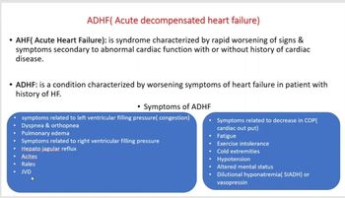

Slide 49
C- Acute decompensated heart failure (ADHF)
The first principle of management of these patients is to identify and tackle known precipitants of decompensation.
Identification and management of medication nonadherence and use of prescribed medicines such as nonsteroidal anti-inflammatory drugs, cold and flu preparations with cardiac stimulants, and herbal preparations, including licorice and herbal forms of ephedrine, are required.
Active infection and overt or covert pulmonary thromboembolism
Arrhythmias
Ischemia
Anemia
Thyrotoxicosis

Slide 50
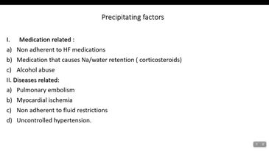

Slide 51
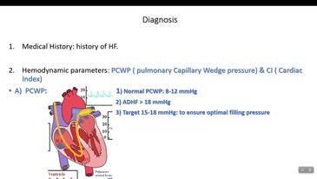

Slide 52
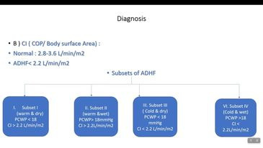

Slide 53
Administer oxygen in patients with capillary oxygen saturation < 90% or partial pressure of oxygen in arterial blood (PaO2) < 60 mm Hg.
Administer IV loop diuretics (such as furosemide) to treat symptoms of fluid overload. low-dose dopamine infusion may be considered in addition to loop diuretic.
Measure serum electrolytes, urea nitrogen, and creatinine during titration of heart failure medications (including diuretics and renin-angiotensin-aldosterone system inhibitors)
Use invasive hemodynamic monitoring with pulmonary artery catheter to guide therapy in patients with suspected heart failure in whom fluid status cannot be determined from clinical assessment

Slide 54
- For patients that have significant dyspnea despite supplemental oxygen and aggressive diuresis:
Consider vasodilators (IV nitroglycerin, nitroprusside, or nesiritide) as adjunct to diuretics to relieve dyspnea in absence of symptomatic hypotension.
Consider noninvasive positive pressure ventilation.
Consider cautious use of IV opiates (for example, morphine sulfate ) in particularly distressed, anxious, or restless patients to relieve symptoms and improve breathlessness.
- For patients with borderline or low blood pressure with documented severe systolic dysfunction
Consider short-term, continuous IV inotropic support (such as dopamine, dobutamine, or milrinone)

Slide 55
Ventilatory support:
- Consider noninvasive ventilation in patients with respiratory distress (respiratory rate > 25 breaths/minute, transcutaneous oxygen saturation < 90%) and start as early as possible to improve breathlessness and reduce rate of mechanical endotracheal intubation
Use with caution in hypotensive patients as it may reduce blood pressure
- Intubation recommended if unable to noninvasively manage respiratory failure leading to:
Hypoxemia (partial pressure of oxygen in arterial blood < 60 mm Hg)
Hypercapnia (partial pressure of carbon dioxide in arterial blood > 50 mm Hg)
Acidosis (pH < 7.35)

Slide 56
Pulmonary Edema
Acute heart failure with pulmonary edema is a medical emergency that should be treated urgently. The patient should initially be kept rested, with continuous monitoring of cardiac rhythm, BP and pulse oximetry.
Intravenous opiates can be of value in distressed patients but must be used sparingly, as they may cause respiratory depression and exacerbation of hypoxemia and hypercapnia.

Slide 57
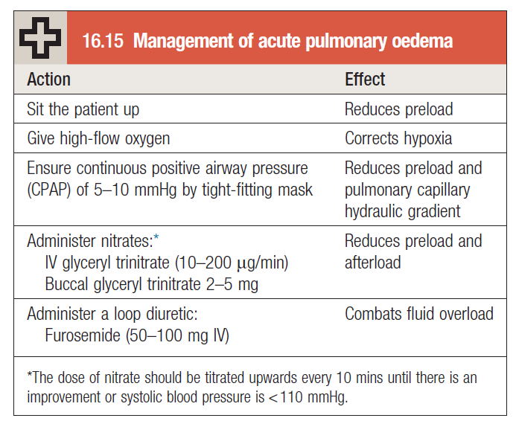
The key elements of the management of pulmonary edema:

Slide 58
Thank you

