Slide 1
NEW DRUGS
IN MEDICINE

Slide 2

Drugs used in hyperlipidemia:
HMG-CoA Reductase Inhibitors (statins)
Niacin (vit B3)
Bile Acid sequestrants (cholestyramine)
Fibrates (fenofibrate)
Cholesterol absorption inhibitors (Ezetimibe)
Omega 3 fatty acids
PCSK9 inhibitors

Slide 3
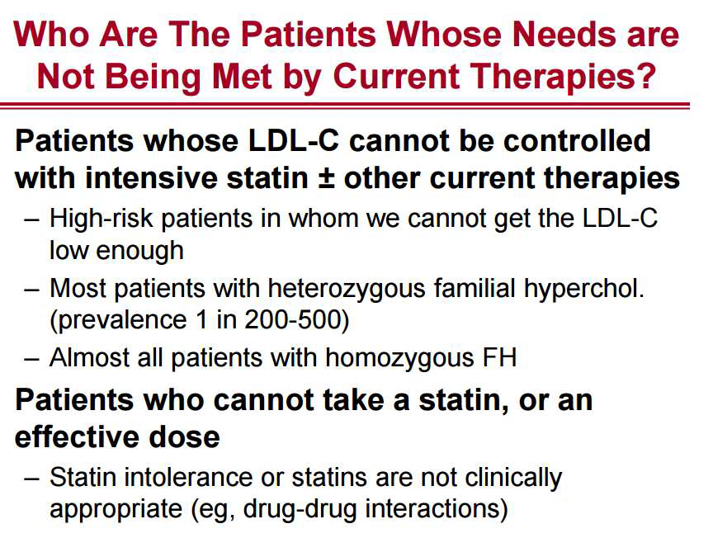
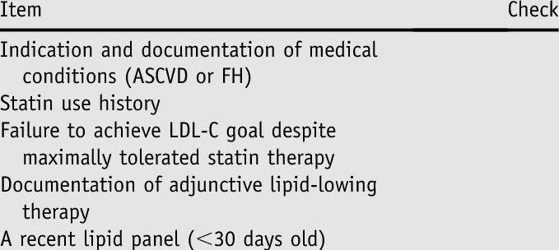

Slide 4

PCSK9: Proprotein convertase subtilisin/kexin type 9
An enzyme, is predominantly produced in the liver.
Normally, low-density lipoprotein receptors (LDL-R) in hepatocytes bind to LDL particles and remove them from circulation.
PCSK9 bind to the LDL-R and promote their degradation.
By blocking PCSK9, there will be increase in availability of LDL-R to remove LDL-C from the circulation

Slide 5
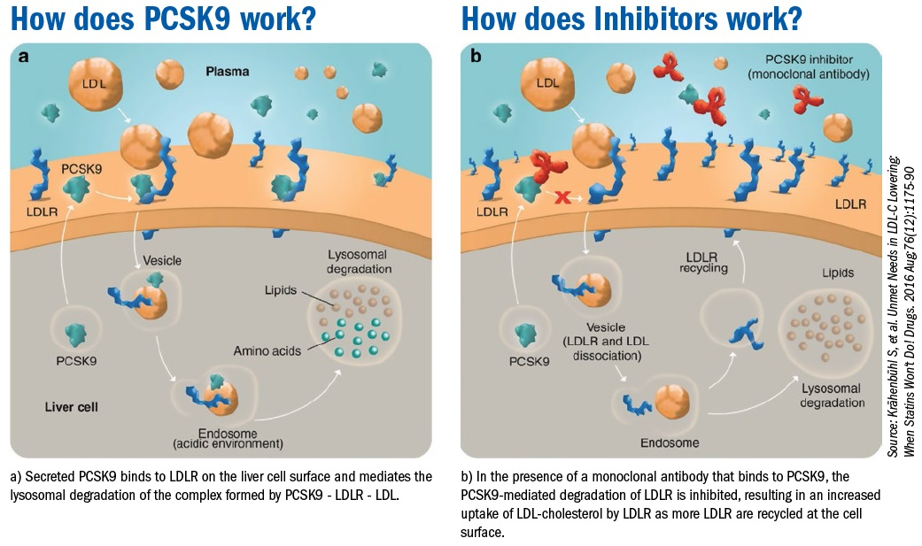

Slide 6
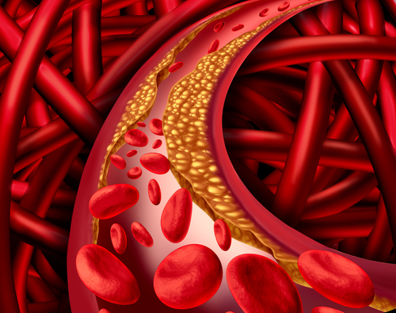
Other mechanisms, besides LDL-C lowering, by which PCSK9 antibodies might improve cardiovascular outcomes have been postulated.
These include a reduction in inflammation and oxidative stress within atherosclerotic plaques and inhibition of prothrombotic pathways.

Slide 7
PCSK9 inhibitor benefits:
A reduction in LDL-C (70%)
A reduction in lipoprotein(a) levels by (18 to 36) %
Reduction triglyceride levels by (12 to 31) %
increase in HDL-C by (5 to 9) %
A decrease in present atheroma volume
Reduction in cardiovascular event (50%)

Slide 8
PCSK9 inhibitor :
Evolocumab And Alirocumab
The onset of inactivation of PCSK9 enzyme occurs within four to eight hours following the first subcutaneous injection of PCSK9 monoclonal antibodies
Rote of administration: Subcutaneous. It can be injected in the upper arm or leg or in the abdomen.
They have already been approved for use in primary hyperlipidemia, homozygous FH, statin intolerance, to achieve LDL-C goals and prevention of cardiovascular event( decrease risk of MI and stroke).
High cost of therapy remains an issue. (600-700$)
Notes:
evolocumab and alirocumab: Monoclonal antibody

Slide 9

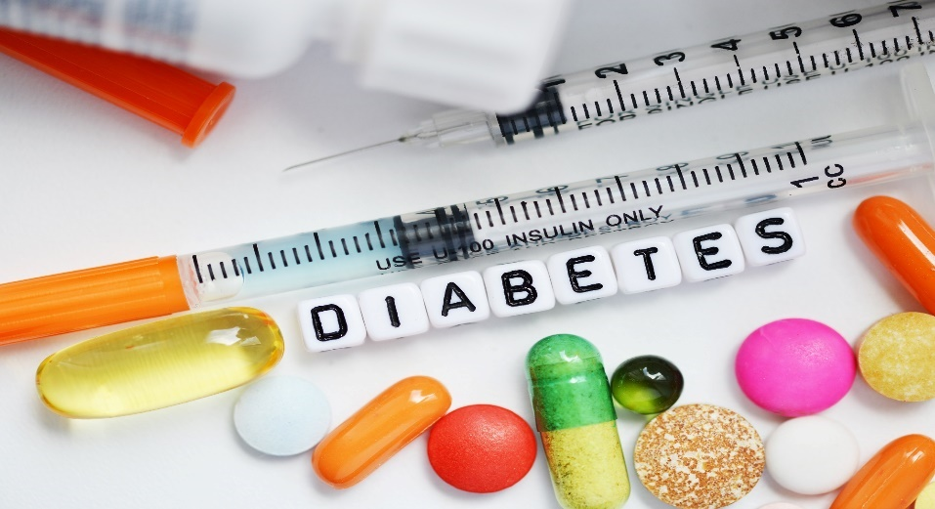
Sodium-glucose co-transporter 2
(SGLT2) inhibitors
Current treatments for type 2 diabetes have centered on increasing insulin availability (either through direct insulin administration or through agents that promote insulin secretion), improving sensitivity to insulin, delaying the delivery and absorption of carbohydrate from the gastrointestinal tract, or increasing urinary glucose excretion.
Sodium-glucose co-transporter 2 (SGLT2) inhibitors reduce blood glucose by increasing urinary glucose excretion.

Slide 10
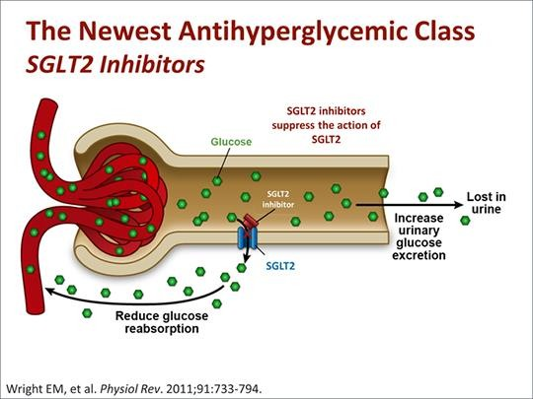
The SGLT2 protein responsible of reabsorption of the filtered glucose in tubular lumen of kidney (mainly at PCT).
SGLT2 inhibitors block these proteins which means less glucose gets reabsorbed back into the blood and gets passed out of the body via the urine
IT decreases absorption of sodium, causes osmotic diuresis. May reduces systolic blood pressure and weight.
Should be avoided in patient with renal dysfunction

Slide 11
SGLT2 inhibitors may play a role in the following settings:
◆ Empagliflozin: decreasing the risk of cardiovascular death in adult with type 2DM and CVD
As a third-line agent in patients with inadequate glycemic control on two oral agents (eg, metformin and sulfonylurea) if for some reason combination metformin and insulin is not a therapeutic option
As a third-line agent in patients not adequately controlled on metformin and insulin therapy, in whom glucagon-like peptide-1 receptor agonists are contraindicated and increasing insulin dosing would lead to weight gain
As a second agent in patients with inadequate control on metformin who are unwilling or unable to consider injection therapy and in whom weight gain is a significant issue

Slide 12
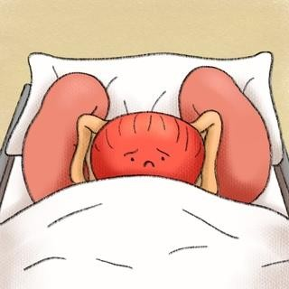
Adverse Effects
Vulvovaginal candidal infections
Hypotension and dehydration
Acute kidney injury
Urinary tract infections
Euglycemic diabetic ketoacidosis
Increased risk of lower extremity amputation and bone fractures have also been reported

Slide 13
Choice of Therapy
When a decision has been made to use an SGLT2 inhibitor, available options are:
Canagliflozin Dapagliflozin
Empagliflozin Ertugliflozin
Often choice of agent is dictated by cost and insurer formulary preference, as the published trials have not revealed any substantial differences with regard to A1C lowering, weight reduction, or risk for mycotic infections.

Slide 14
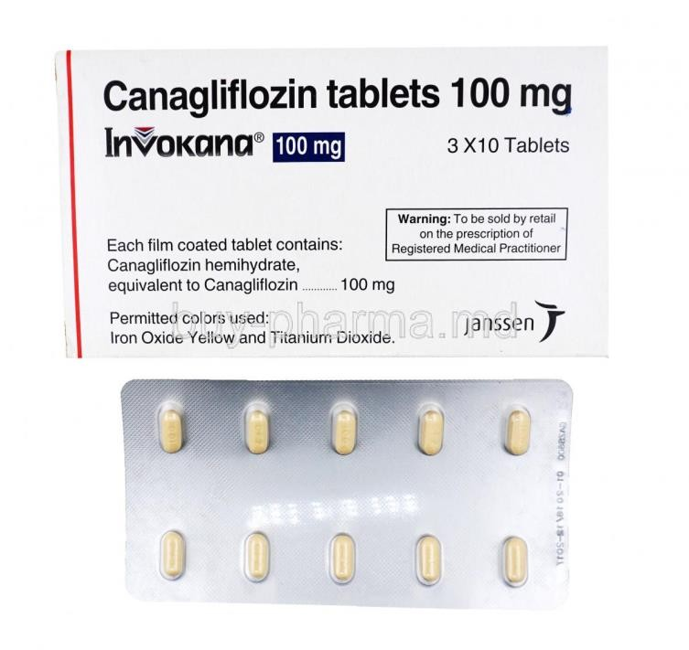
Canagliflozin
It should be taken orally before the first meal of the day
The initial dose is 100 mg once daily
Canaglifozin is contraindicated in:
Type 1 diabetes
Diabetic ketoacidosis
Severe renal impairment (estimated glomerular filtration rate <30 mL/min/1.73 m2), end-stage renal disease
Patients on dialysis
Canagliflozin (300 mg) reduced A1C to a slightly greater extent than Dapagliflozin (10 mg) or Empagliflozin (25 mg)
there was an increase in the risk of lower limb amputations and fractures.

Slide 15
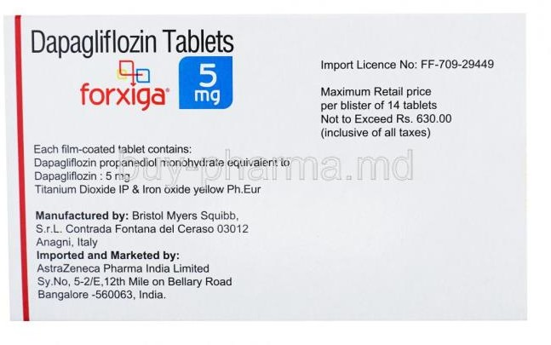
Dapagliflozin
10 mg once daily can be taken any time of day with or without food.
It is not recommended for use in patients with GFR<60 mL/min or in patients with active bladder cancer.
For patients with severely reduced liver function, a starting dose of 5 mg is recommended.

Slide 16
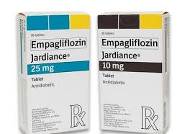
Empagliflozin
A prior history of myocardial infarction or stroke might favor choosing Empagliflozin
It should be taken orally once daily in the morning with or without food
Should not be initiated in patients with GFR <45 mL/min.
should be discontinued In patients who are taking Empagliflozin and have a persistent fall in GFR below 45 mL/min
May be used in patients with hepatic impairment.

Slide 17
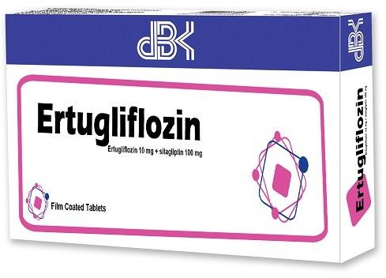
Ertugliflozin
It should be taken once daily in the morning with or without food.
Contraindicated in patients with an GFR <30 mL/min and is not recommended in patients with GFR of 30 to <60 mL/min
In patients taking ertugliflozin who have a persistent fall in eGFR below 60 mL/min, it should be discontinued

Slide 18
Monitoring
In addition to glycemic indices (A1C, fasting blood sugar), renal function and volume status (blood pressure) should be monitored during SGLT2 treatment.
Renal function:
eGFR >60 mL/min – We measure serum creatinine after three months and, if stable, then annually or as clinically indicated.
eGFR between 45 and 60 mL/min (canagliflozin and empagliflozin)
We measure serum creatinine every three months or as clinically indicated

Slide 19
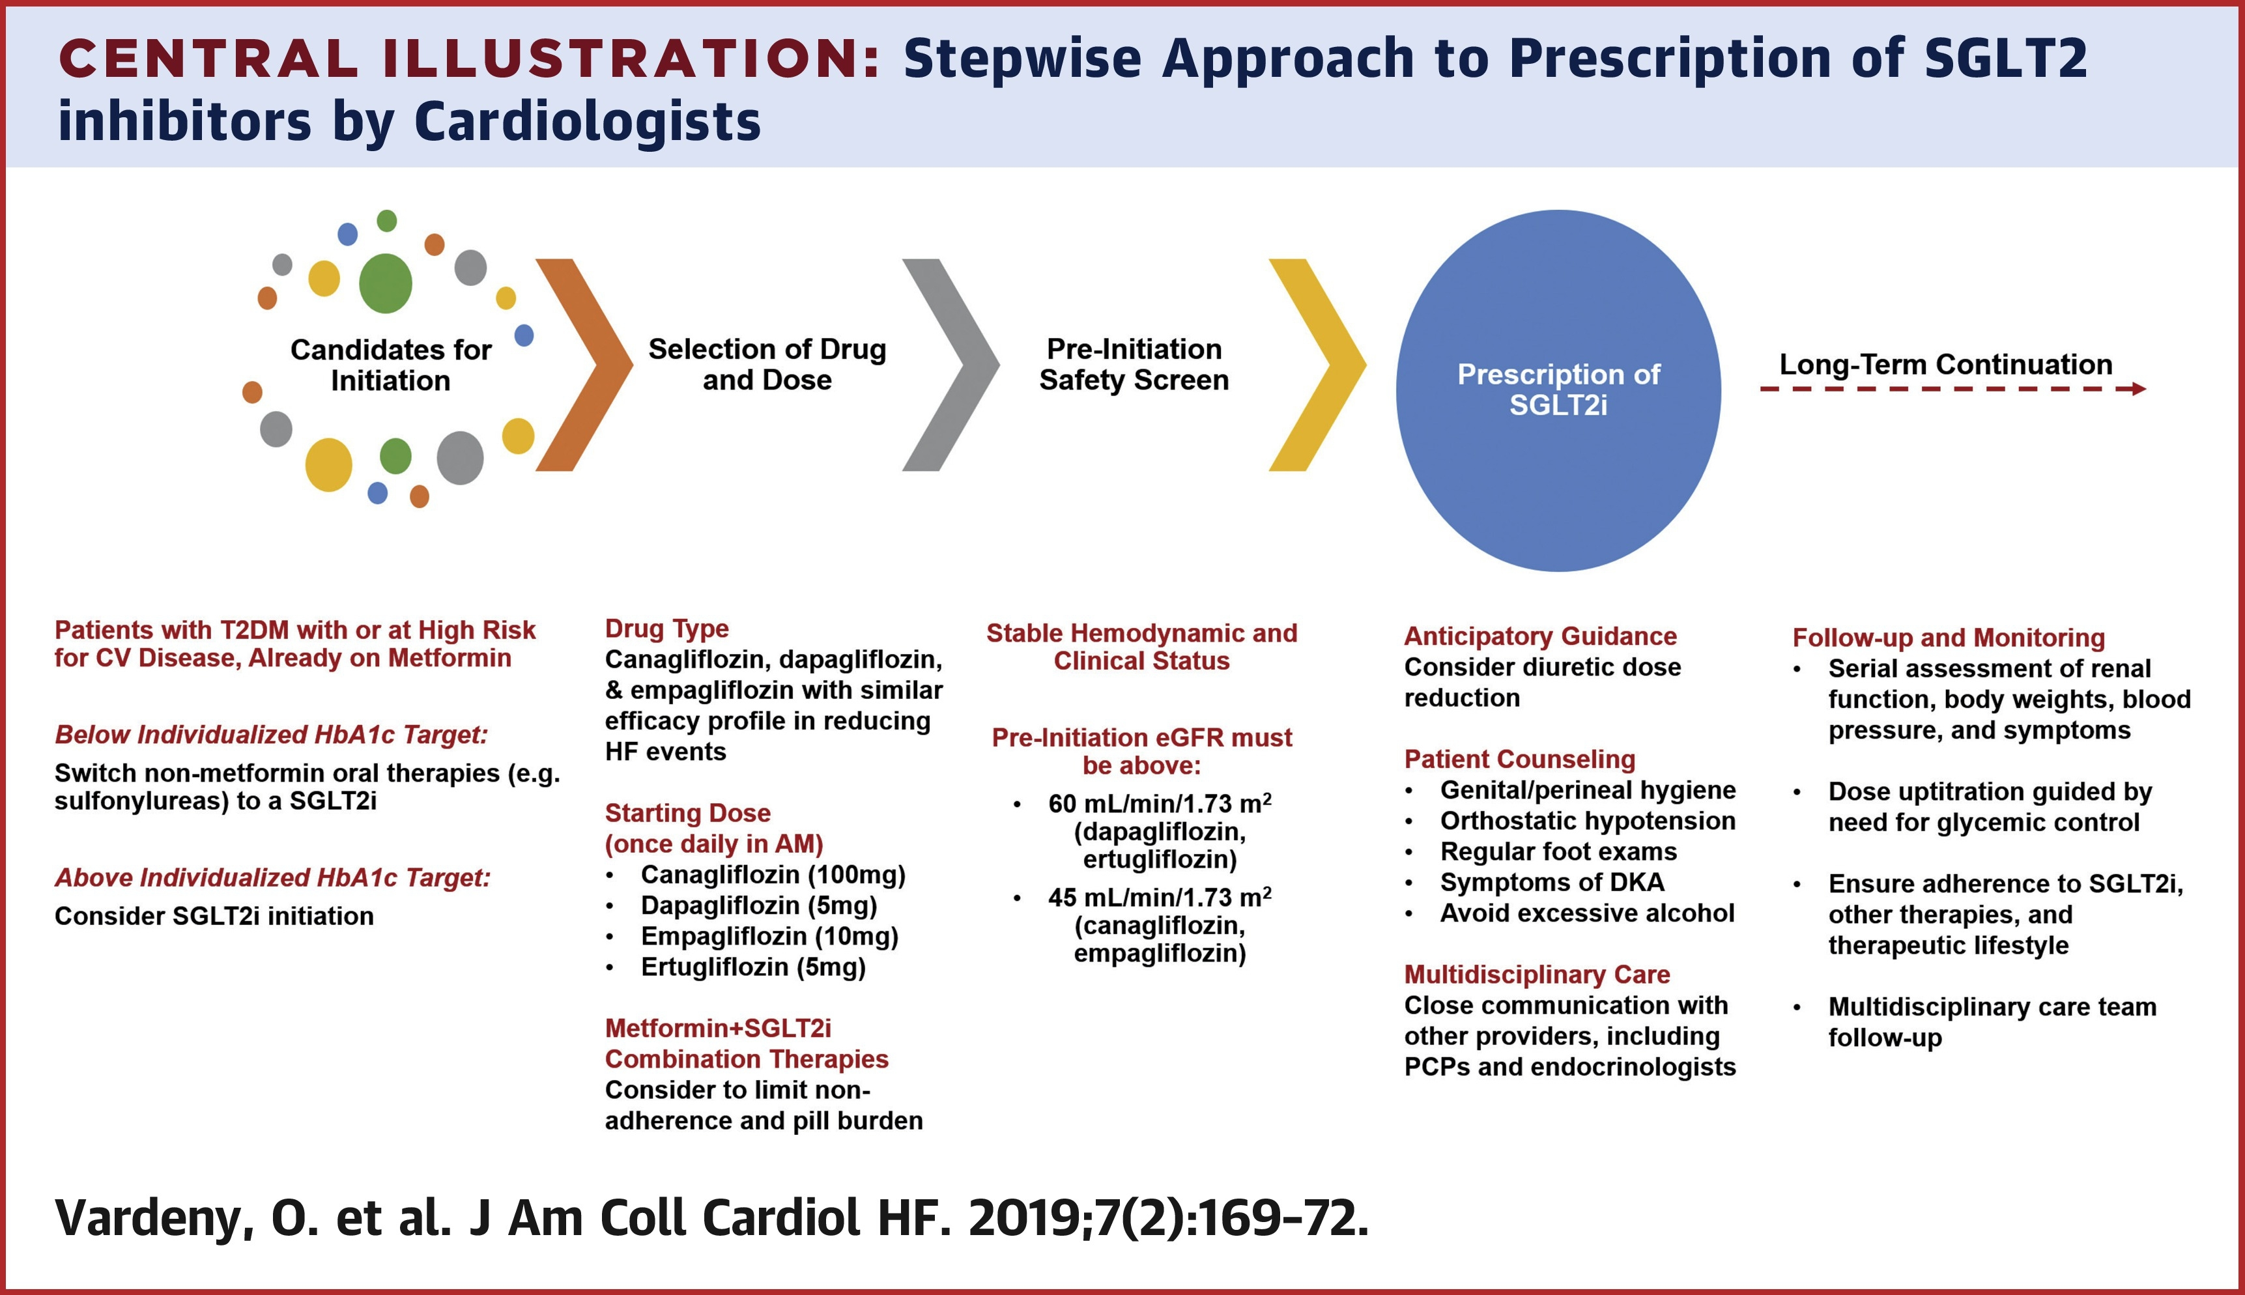

Slide 20
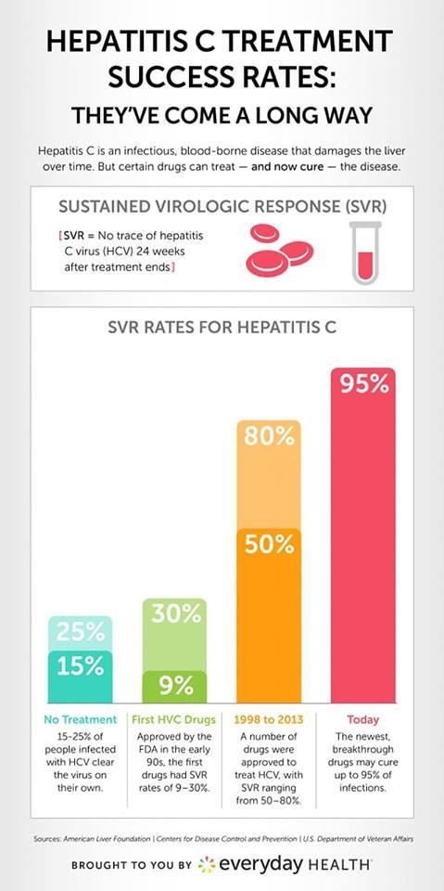
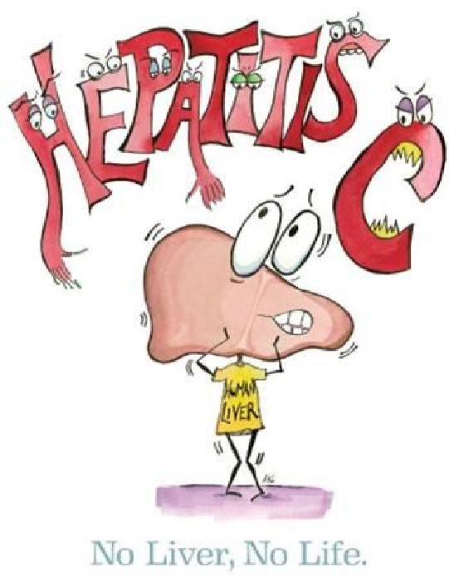
New Medications for Hepatitis C

Slide 21
In the past the treatment for chronic hepatitis C virus (HCV) infection regardless of genotype was a combination therapy with injectable interferon-alfa and ribavirin.

Slide 22
New generation of drug was found known as Direct-acting Antiviral agents (DDAs) that target specific steps in HCV life cycle include:
1-NS3/4A protease inhibitors
2-NS5A inhibitors
3-NS5B RNA-dependent RNA polymerase inhibitors

Slide 23
NS3/4A PROTEASE INHIBITORS
◆ They are inhibitors of the NS3/4A serine protease, an enzyme involved in post-translational processing and replication of HCV
◆ Protease inhibitors disrupt HCV by blocking the NS3 catalytic site or the NS3/NS4A interaction

Slide 24
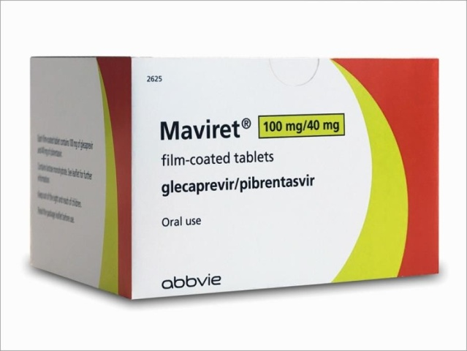
Glecaprevir & Grazoprevir are potent, pangenotypic protease inhibitor, which is only available in combination with the NS5A inhibitor pibrentasvir and elbasvir, respectively.
Paritaprevir: is an HCV protease inhibitor that is given with low dose ritonavir (a protease inhibitor that does not have anti-HCV activity) for a pharmacologic boosting effect, and are available as a fixed-dose combination with Ombitasvir (an NS5A inhibitor) and usually given with the non-nucleoside NS5B inhibitor Dasabuvir.

Slide 25
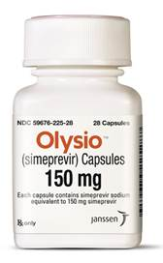
Simeprevir was the first available second-generation protease inhibitor.
It is used in combination with peginterferon and ribavirin for chronic genotype 1 infection.
In general, simeprevir is well tolerated. Patients should be cautioned about this risk and instructed to use sun protective measures and limit sun exposure. If a severe rash or photosensitivity reaction occurs, simeprevir should be discontinued.
Itching, Upset stomach, Muscle pain, Diarrhea, Dizziness, Headache and Feeling tired or weakness

Slide 26

NS5A INHIBITORS
- The NS5A protein plays a role in both viral replication and the assembly of the hepatitis C virus. The exact mechanism of action of HCV NS5A inhibitors is unclear.
- As a class, agents that inhibit NS5A are generally quite potent and are effective across all genotypes, but they have a low barrier to resistance and variable toxicity profiles.
- NS5A inhibitors have been shown to significantly reduce HCV RNA levels and enhance sustained virologic response when given in conjunction with peginterferon and ribavirin.

Slide 27
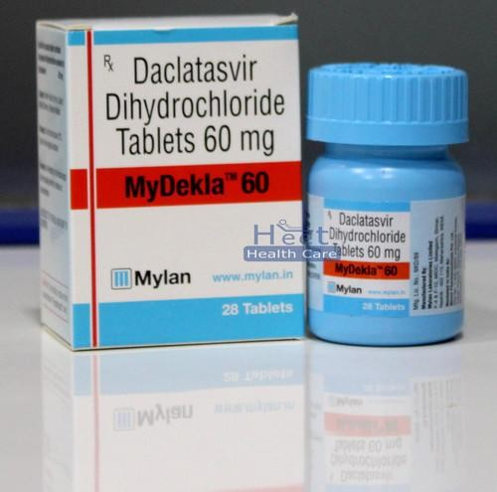
Daclatasvir
- It’s a NS5A inhibitor that is used mainly in combination with sofosbuvir.
Administration and pharmacology: given as a 60 mg oral dose once daily with or without food. Daclatasvir is only used in combination with other DAA agents.
No dose adjustments are required for renal or hepatic impairment.
Adverse effects –headache, fatigue, and nausea were the most commonly reported adverse effects . These were mild to moderate in severity.
Drug interactions: is primarily metabolized through CYP3A metabolism Coadministration of daclatasvir is thus not recommended with rifampin, phenytoin, carbamazepine

Slide 28
◆ Elbasvir: only available as a fixed-dose combination with the protease inhibitor grazoprevir.
◆ Ledipasvir: available as part of a fixed-dose combination with sofosbuvir .
◆ Ombitasvir: is only available as a fixed-dose combination with the protease inhibitors paritaprevir and ritonavir, which is usually given in combination with the non-nucleotide NS5B inhibitor dasabuvir.
◆ Pibrentasvir: is only available as a fixed-dose combination with the protease inhibitor glecaprevir.
◆ Velpatasvir: is only available as a fixed-dose combination with the NS5B
inhibitor sofosbuvir.

Slide 29
NS5B RNA-dependent RNA polymerase inhibitors
There are two classes:
A-nucleoside/nucleotide analogues (NPIs)
B-non-nucleoside analogues (NNPIs)

Slide 30
Nucleoside/nucleotide analogues (NPIs)
Nucleoside polymerase inhibitors (NPIs) have moderate to high efficacy across all six genotypes and have a very high barrier to resistance

Slide 31
Sofosbuvir
◆ - the only agent in this class, high potency across all six genotypes, a very high barrier to resistance
◆ - 400 mg orally once daily with or without food
◆ - It should not be used without other antiviral agents, and the dose of sofosbuvir should not be decreased.
◆ - Renal clearance is the major form of elimination, and pharmacokinetic studies with sofosbuvir suggested that no dose adjustment is required for patients with mild or moderate renal insufficiency
◆ - Sofosbuvir is well tolerated
◆ - Drug Interaction: Coadministration of sofosbuvir and amiodarone

Slide 32
Non-nucleoside polymerase inhibitors (NNPIs)
◆ As a class, NNPIs are less potent, and more genotype specific
(all NNPIs in clinical development have been optimized for genotype 1), have a low to moderate barrier to resistance, and have variable toxicity profiles.
◆ - this class of drug has been studied primarily as an adjunct to more potent compounds with higher barriers to resistance.
◆ - Dasabuvir is administered and packaged with ombitasvir- paritaprevir-ritonavir.

Slide 33
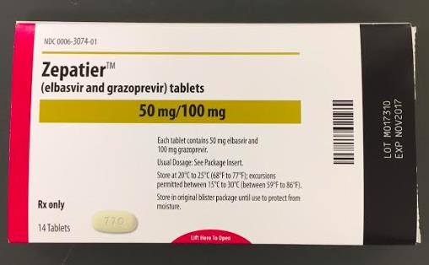
Fixed-Dose Combinations
Elbasvir-grazoprevir (50mg, 100mg respectively)
Glecaprevir-pibrentasvir (100mg, 40mg respectively)
Ombitasvir-Paritaprevir-Ritonavir (12.5mg, 75mg, 50gm respectively) (With or without dasabuvir)
for HCV Genotype 1.
These regimens are contraindicated in patients withChild-Pugh class B or C cirrhosis.
Ledipasvir-sofosbuvir (90mg, 400mg respectively)
Sofosbuvir-velpatasvir (400mg, 100mg respectively)
Sofosbuvir-Velpatasvir-Voxilaprevir (400,mg, 100mg, 100mg respectively)

Slide 34
novel oral anticoagulants (NOACs)

Slide 35
New anticoagulants :
Direct factor Xa inhibitor.
Direct thrombin inhibitor.
Notes:
All anticoagulant have risk of thrombosis after discontinuation.

Slide 36
Direct factor Xa inhibitor:
Direct factor Xa inhibitors prevent factor Xa from cleaving prothrombin to thrombin.
There are no parenteral direct factor Xa inhibitors in clinical use.
Several oral agents are available, including rivaroxaban, apixaban, edoxaban, and betrixaban.
Metabolized in the kidney (25 to 35 percent) and liver,
Severe hepatic impairment could result in accumulation of these agents.
However, direct factor Xa inhibitors do not appear to cause hepatotoxicity.
A reversal agent for the direct factor Xa inhibitors → andexanet alfa.
Notes:
Otamixaban was developed as an intravenous factor Xa inhibitor, but development was discontinued due to an increased risk of bleeding compared with unfractionated heparin in patients with acute coronary syndromes.

Slide 37
Rivaroxaban
Used in :
  Nonvalvular atrial fibrillation.
  prevention and treatment of venous thromboembolic (VTE).
  Heparin-induced thrombocytopenia (Off-Label).
Rivaroxaban crosses the placenta → Bleeding may occur in the fetus.
Rivaroxaban is present in breast milk →Use of alternative anticoagulants is preferred

Slide 38
Rivaroxaban is generally given at a fixed dose without monitoring, (15-20)mg tablets taken with food.
The drug should not be used in individuals with a creatinine clearance <15 mL/minute, as well as in those with significant hepatic impairment .
Monitoring is best done by measuring anti-factor Xa activity.
Premature discontinuation of any oral anticoagulant, increases the risk of thrombotic events
Notes:
In case of bleeding

Slide 39
Apixaban:
Deep vein thrombosis.
Nonvalvular atrial fibrillation.
Pulmonary embolism.
Apixaban crosses the placenta → Bleeding may occur in the fetus.
Apixaban is present in breast milk →Use of alternative anticoagulants is preferred

Slide 40
Edoxaban:
Not recommended in patients with prosthetic heart valves or significant rheumatic heart disease.

Slide 41
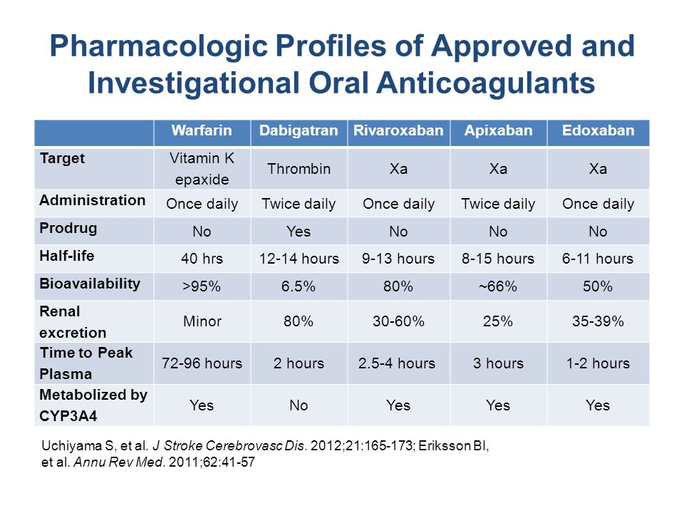

Slide 42
2. Direct thrombin inhibitor
Inactivate circulating and clot-bound thrombin (factor IIa)
Parenteral direct thrombin inhibitors:
    Percutaneous coronary intervention (PCI).
    Heparin-induced thrombocytopenia (HIT).
Oral direct thrombin inhibitor:
    Dabigatran

Slide 43
Dabigatran:
Used in:
  DVT and Pulmonary embolism (treatment and prophylaxis).
  Nonvalvular atrial fibrillation.
dabigatran capsules should only be dispensed and stored in the original bottle (with desiccant) or blister package in which they came, due to the potential for product breakdown from moisture and resulting loss of potency.
There does not appear to be an increased risk of serious liver injury.
As with all anticoagulants Dabigatran increase risk of bleeding, however the antidote → idarucizumab.

Slide 44
Settings in which a heparin or vitamin K antagonist may be preferable:
Prosthetic heart valves.
Pregnancy.
Renal impairment.
Severe liver disease.
Gastrointestinal disease.
Compliance and Cost.
Notes:
Compliance : The lack of routine monitoring and short half-lives of these agents make it more difficult to determine if a patient is taking them appropriately.

Slide 45
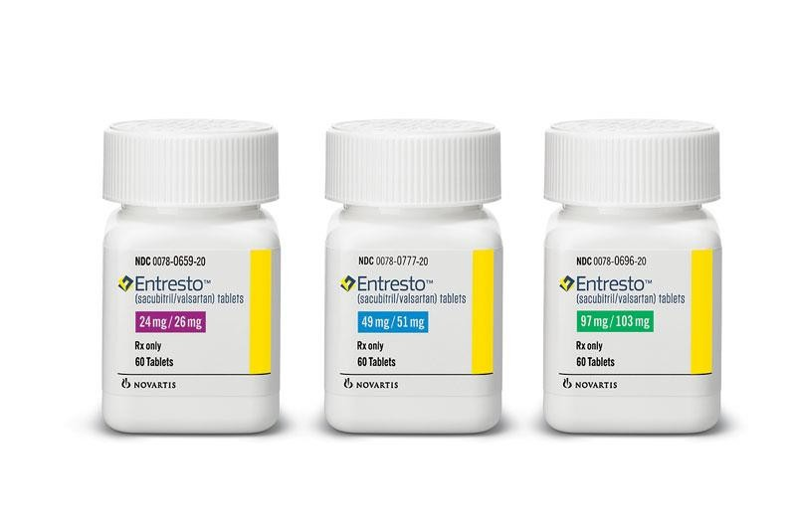
Sacubitril and valsartan

Slide 46
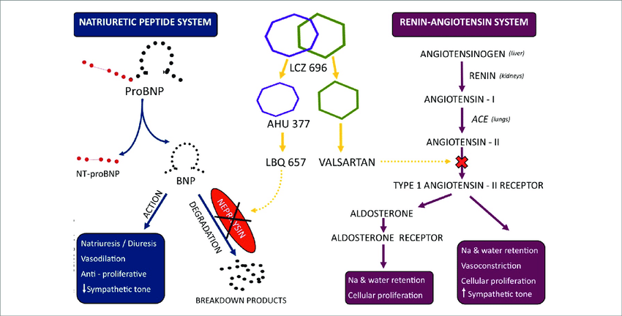
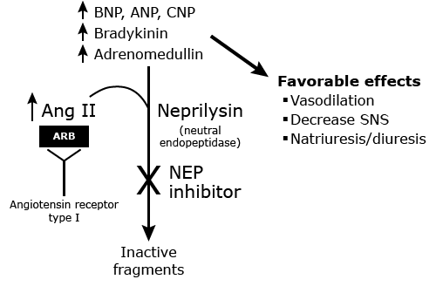

Slide 47
Brand Names: US Entresto
◆ Brand Names: Canada Entresto
◆ Pharmacologic Category Angiotensin II Receptor Blocker; Neprilysin Inhibitor
Use
◆ Heart failure: Reduce the risk of cardiovascular death and hospitalization for heart failure in patients with chronic heart failure (NYHA Class II-IV) and reduced ejection fraction; usually administered in conjunction with other heart failure therapies, in place of an angiotensin-converting enzyme (ACE) inhibitor or other angiotensin II receptor blocker (ARB)
◆ Note: According to the ACC/AHA/HFSA heart failure guidelines, in patients with chronic symptomatic heart failure with reduced ejection fraction (HFrEF) NYHA Class II or III who tolerate an ACE inhibitor or ARB, replacement with sacubitril/valsartan is recommended

Slide 48
◆ — Blockade of the renin-angiotensin-aldosterone system is a key component of treatment of patients with heart failure with reduced ejection fraction (HFrEF, also known as systolic HF or HF due to systolic dysfunction) .
Augmentation of beneficial counter-regulatory systems such as natriuretic peptides is an additional strategy to treat HF . Inhibition of neprilysin raises levels of several endogenous vasoactive peptides, including natriuretic peptides, bradykinin, and adrenomedullin. The combination of neprilysin inhibitor plus angiotensin II receptor blocker (ARB) therapy is used as an alternative to angiotensin converting enzyme (ACE) inhibitor (or single agent ARB) therapy

Slide 49
The following recommendations for use of sacubitril-valsartan
◆ For patients with new diagnosis of NYHA class II to IV HFrEF (left ventricular ejection fraction [LVEF] ≤40 percent), we suggest use of an ACE inhibitor (or single agent ARB) rather than sacubitril-valsartan as a component of initial medical therapy.
◆ Some experts have suggested use of sacubitril-valsartan as a component of initial therapy for HFrEF, but we feel that at this time there is insufficient clinical experience to recommend its use as initial therapy.

Slide 50
Criteria for patient selection
◆ are an elevated natriuretic peptide level defined as a brain natriuretic
peptide [BNP] level ≥150 pg/mL or NT-proBNP ≥600 pg/mL;
◆ or if the patient was been hospitalized for HF within the previous 12 months, a BNP ≥100 pg/mL or an NT-proBNP ≥400 pg/mL),
◆ a systolic blood pressure ≥100 mmHg, an estimated glomerular filtration rate
≥30 mL/min/1.73 m², and tolerance of ACE inhibitor or ARB therapy in doses
equivalent to at least enalapril 10 mg twice daily for ≥4 weeks.
◆ Patients should have no history of angioedema.

Slide 51
Initial evaluation for contraindications
◆ In patients with hypersensitivity to any component.
◆ In patients with a history of angioedema (whether resulting from
angiotensin converting enzyme [ACE] inhibition or not).
◆ In patients who are pregnant given risk of fetal toxicity including fetal death.
Monitoring Parameters Baseline and periodic serum potassium, renal function, BP.
2013 ACCF/AHA Heart Failure guideline recommendations: Within 1 to 2 weeks after initiation of an ARB, reassess blood pressure (including postural blood pressure changes), renal function, and serum potassium; follow closely after dose changes.

Slide 52
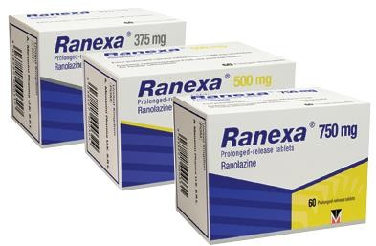
RANOLAZINE
Brand Names: US Ranexa
Pharmacologic Category Antianginal Agent; Cardiovascular Agent

Slide 53
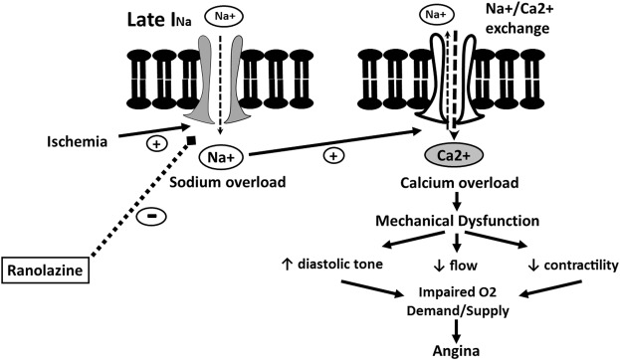
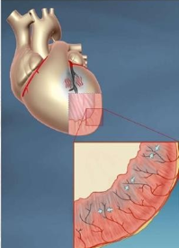

Slide 54
use
Chronic angina: Treatment of chronic angina
Note: ranolazine may be useful when prescribed as a substitute for beta blockers for relief of symptoms if initial treatment with beta blockers leads to unacceptable side effects, is less effective, or if initial treatment with beta- blockers is contraindicated. May also be used in combination with beta- blockers, for relief of symptoms when initial treatment with beta-blockers is not successful .
Off-label Use: Ventricular tachycardia

Slide 55
INTRODUCTION/ treatment of chronic angina:
Medical therapy to prevent Ml and death:
Anti platelet therapy: aspirin ( clopidogrel if aspirin is contraindicated)
High-dose statin
Beta-blockers (if left ventricular ejection fraction [LVEF] < 40% or prior MI)
ACE inhibitors (ifLVEF < 40%, DM, HTN, or CKD)
◆ Medical therapy for relief of symptoms:
◆ Beta-blockers as initial therapy.
◆ Prescribe calcium channel blockers or long-acting nitrates when beta- blockers cannot be used, or in combination with beta-blockers when beta- blockers are not sufficient.
◆ Ranolazine in combination with maximally tolerated beta-blockers.

Slide 56
Mechanism of Action
◆ Ranolazine exerts antianginal and anti-ischemic effects without changing hemodynamic parameters (heart rate or blood pressure). At therapeutic levels, ranolazine inhibits the late phase of the inward sodium channel (late I_{Na}) in ischemic cardiac myocytes during cardiac repolarization reducing intracellular sodium concentrations and thereby reducing calcium influx via Na⁺-Ca²⁺ exchange. Decreased intracellular calcium reduces ventricular tension and myocardial oxygen consumption. It is thought that ranolazine produces myocardial relaxation and reduces anginal symptoms through this mechanism although this is uncertain. At higher concentrations, ranolazine inhibits the rapid delayed rectifier potassium current (I_{Kr}) thus prolonging the ventricular action potential duration and subsequent prolongation of the QT interval.

Slide 57
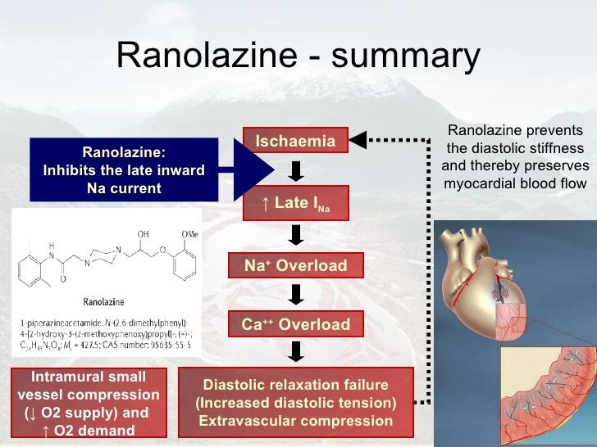

Slide 58
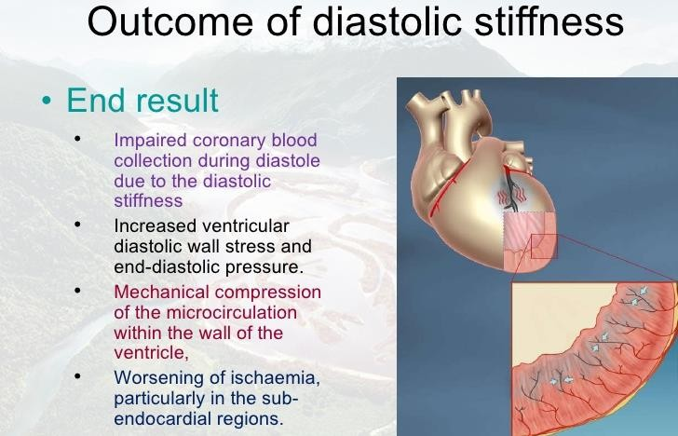

Slide 59
Adverse Reactions >0.5% to 10%:
◆ Cardiovascular: Bradycardia (≤4%), hypotension (≤4%), orthostatic hypotension (≤4%), palpitation (≤4%), peripheral edema (≤4%), prolonged QT interval on ECG (>500 msec: ≤1%)
◆ Central nervous system: Dizziness (6%; may be dose-related), headache (≤6%), confusion (≤4%), syncope (≤4%), vertigo (≤4%)
◆ Dermatologic: Hyperhidrosis (≤4%)
◆ Gastrointestinal: Constipation (5%), abdominal pain (≤4%), anorexia (≤4%), dyspepsia (≤4%), nausea (≤4%; dose-related), vomiting (≤4%), xerostomia (≤4%)
◆ Genitourinary: Hematuria (≤4%)
◆ Neuromuscular: Weakness (≤4%)
◆ Ophthalmic: Blurred vision (≤4%)
◆ Otic: Tinnitus (≤4%)
◆ Respiratory: Dyspnea (≤4%)
Ranolazine also inhibits pathways involved in the metabolism of digoxin and simvastatin, and dose reduction may be required.

Slide 60
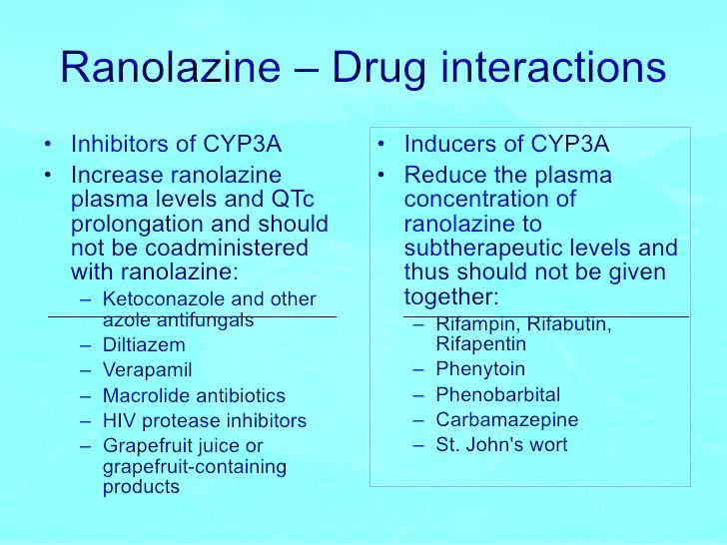

Slide 61
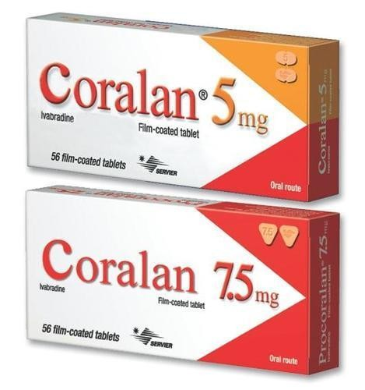
ivabradine

Slide 62
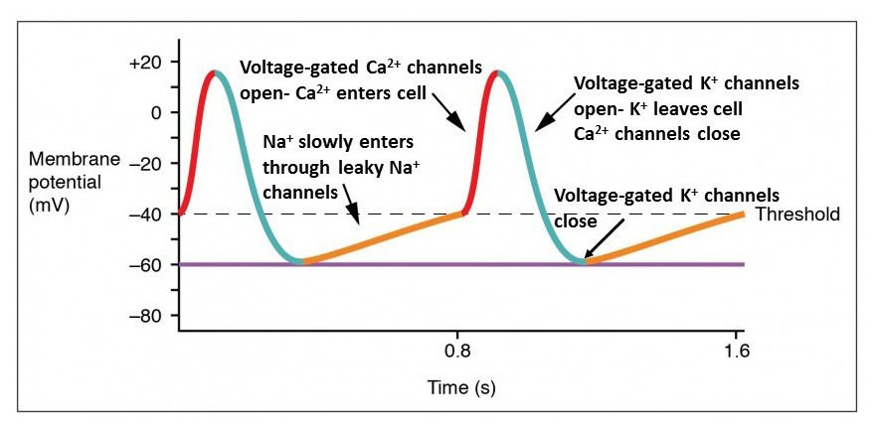

Slide 63
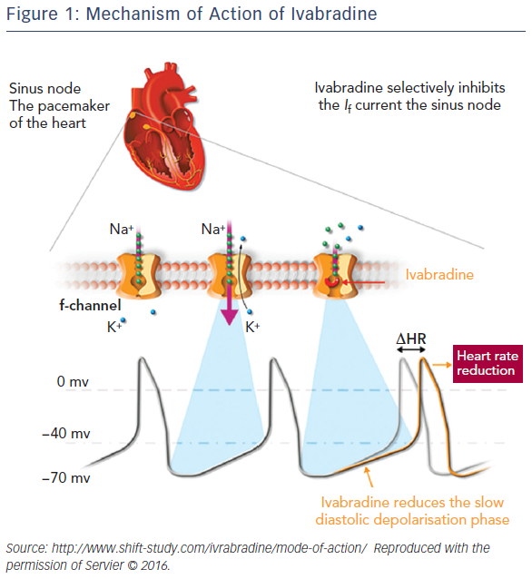

Slide 64
◆ Brand Names: US Corlanor
◆ Brand Names: Canada Lancora
◆ Pharmacologic Category Cardiovascular Agent, Miscellaneous
USE
◆ Heart failure: To reduce the risk of hospitalization for worsening heart failure in patients with
stable, symptomatic (NYHA class II to III according to the ACC/AHA/HFSA heart failure guidelines [Yancy 2016]) chronic heart failure with left ventricular ejection fraction ≤35%,
who are in sinus rhythm with resting heart rate ≥70 beats per minute (bpm) and either are on maximally tolerated doses of beta blockers or have a contraindication to beta-blocker use.
Use: Off-Label Inappropriate sinus tachycardia; Stable angina

Slide 65
mechanism of Action
Selective and specific inhibition of the hyperpolarization-activated cyclic nucleotide-gated (HCN) channels (f-channels) within the sinoatrial (SA) node of cardiac tissue resulting in disruption of If ion current flow prolonging diastolic depolarization, slowing firing in the SA node, and ultimately reducing heart rate. Has not demonstrated effects on myocardial contractility or relaxation, ventricular repolarization, or conduction apart from the sinus node effects. Partial inhibition of the retinal I_{h} current (similar to the cardiac I_{f} current) may explain visual disturbances (eg, phosphenes) (Nawarskas 2015).

Slide 66
Adverse Reactions 1% to 10%:
Cardiovascular: Bradycardia (6% to 10%), hypertension (9%), atrial fibrillation (5% to 8%)
Central nervous system: Phosphene (3%)
Frequency not defined: Cardiovascular: Heart block, sinoatrial arrest
Notes:
The pulmonary venous myocardium, which is an important source of AF initiation and maintenance, demonstrates an If current which is affected by ivabradine. This raises the possibility that ivabradine treatment may affect AF risk.

Slide 67
Contraindications
Acute decompensated heart failure;
blood pressure <90/50 mm Hg;
◆ sick sinus syndrome
◆ or third-degree AV block;
resting heart rate <60 bpm prior to treatment;
◆ severe hepatic impairment;
pacemaker dependence (heart rate maintained exclusively by the pacemaker).

Slide 68

Warnings/Precautions
Atrial fibrillation: increases the risk of atrial fibrillation; monitor cardiac rhythm. Discontinue if atrial fibrillation develops.
Avoid concurrent use with verapamil and diltiazem.
Visual function: Phosphenes – luminous phenomena (described as transient enhanced brightness in a limited area of the visual field, halos, image decomposition, colored bright lights, or multiple images) may occur with use. Onset is generally within the first 2 months of therapy and is reported to be of mild to moderate intensity; most cases resolve during or after treatment discontinuation.

Slide 69
Monitoring Parameters
Heart rate (prior to initiation, prior to increasing dose, or after decreasing dose); monitor heart rate more closely if receiving other negative chronotropes (eg, amiodarone, beta-blockers, digoxin)
blood pressure
cardiac rhythm (assessing for atrial fibrillation)

