Slide 1
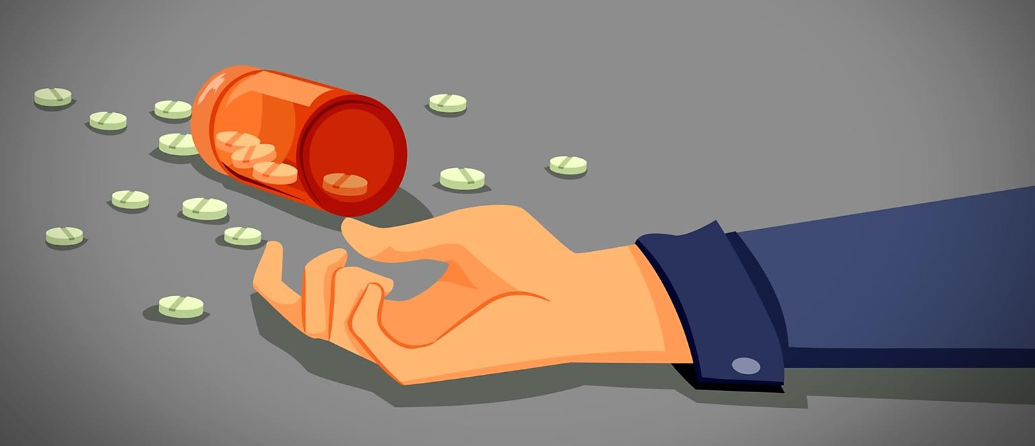
DRUG POISONING & OVERDOSE
Under supervision : Dr.Mohammad Althnaybat
Presented by Mohammad Sanwar

Slide 2
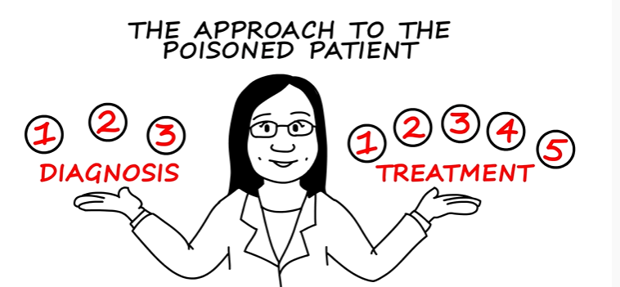

Slide 3
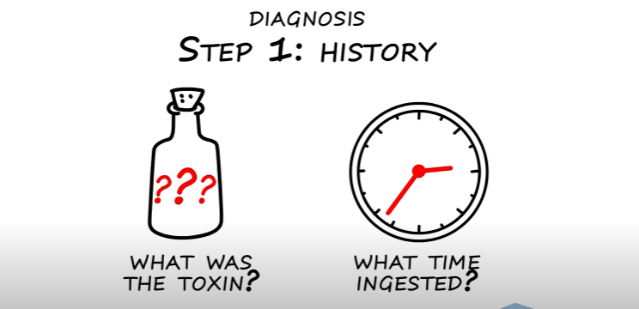
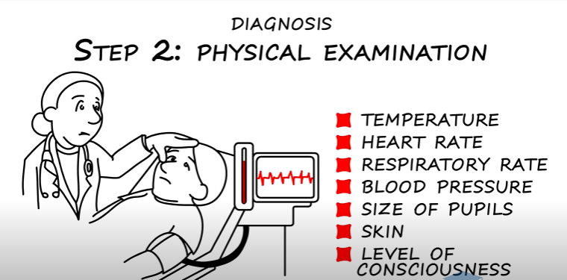

Slide 4
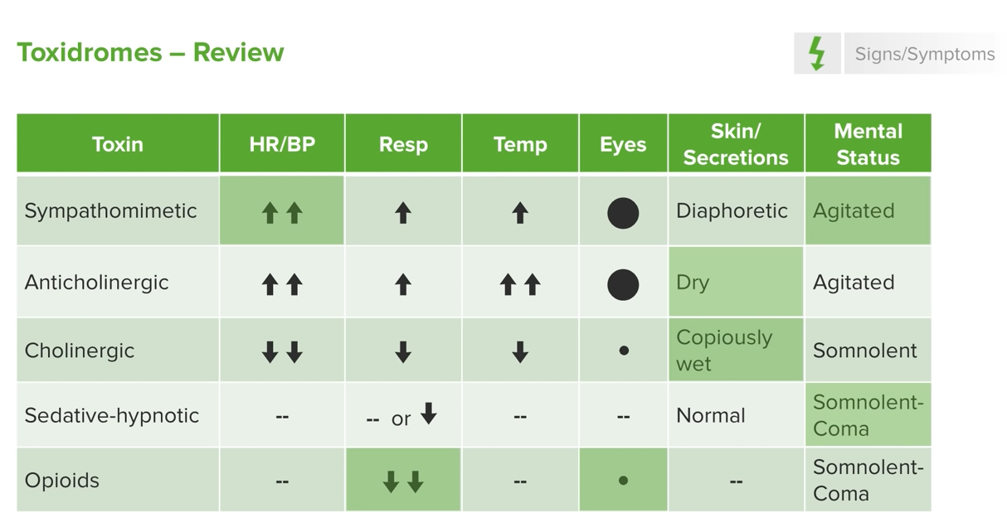

Slide 5
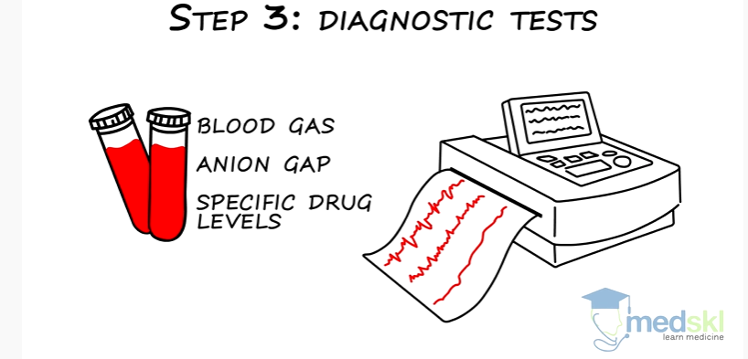

Slide 6
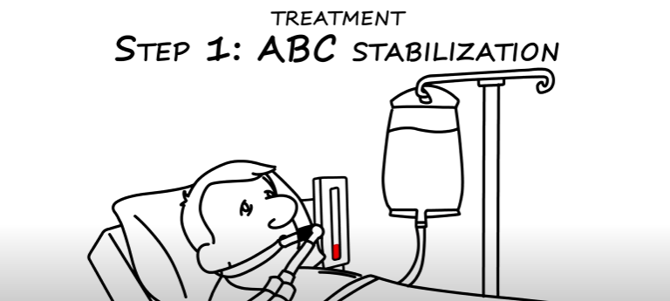
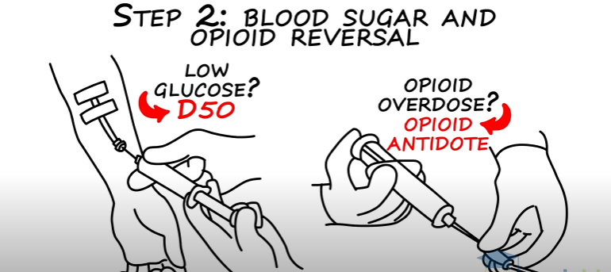

Slide 7
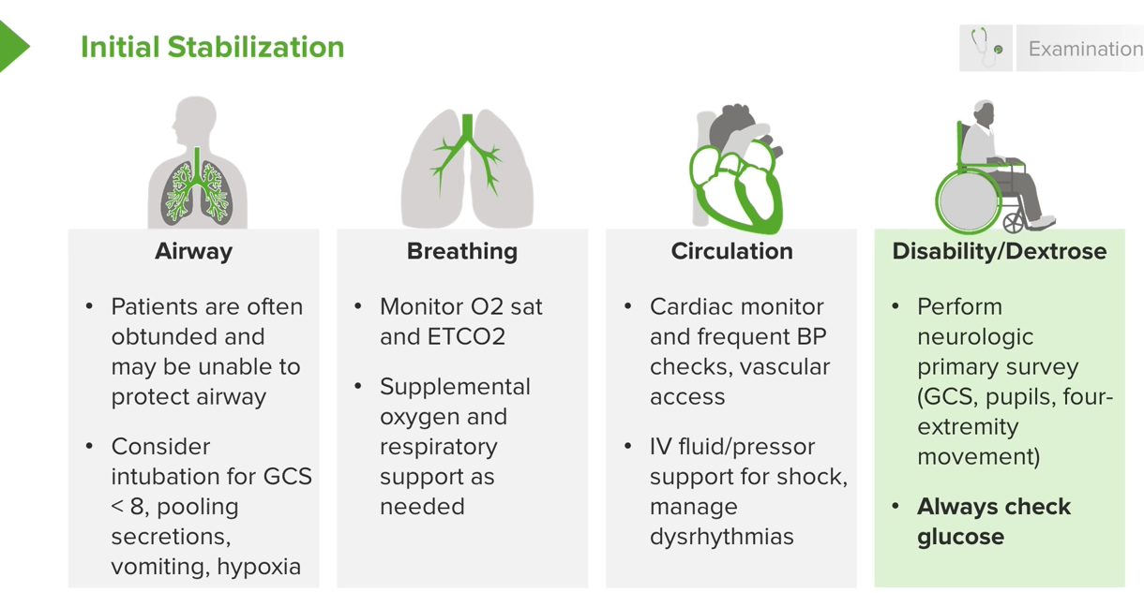

Slide 8
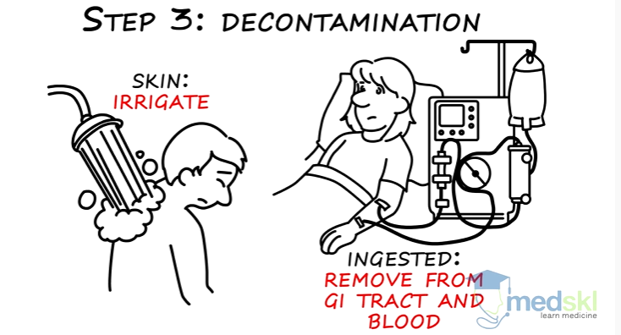
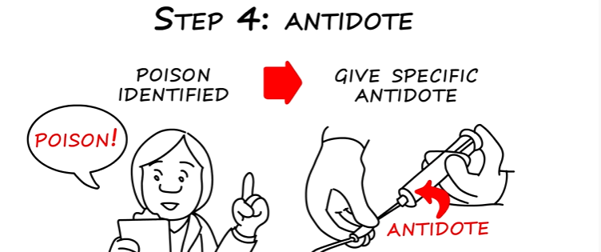

Slide 9
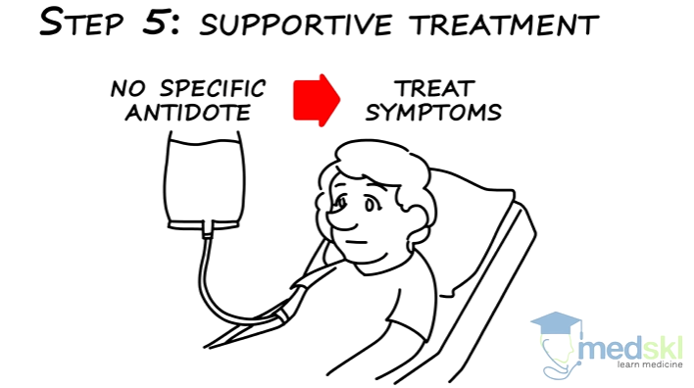

Slide 10
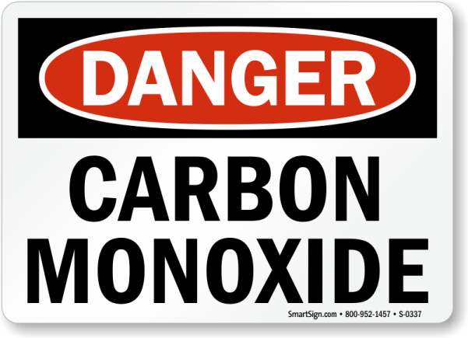
binds to hemoglobin, myoglobin, mitochondrial cytochrome oxidase →decreased oxygen delivery to the tissues.
For hemoglobin, CO has 250 times greater affinity than that for oxygen.
Labs : ↑HbCO (arterial or venous)
CT and MRI >> cerebral edema.
Chest X-ray: Ground-glass appearance , Peribronchial cuffing.

Slide 11
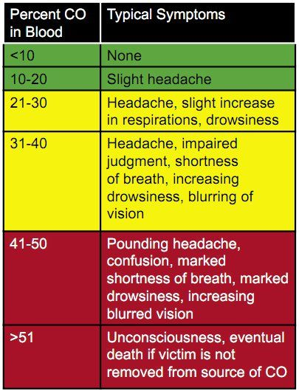

Slide 12
management
1- decontamination
2- CPR (if unconscious)
3- High-flow 100% FiO₂ or hyperbaric oxygen continued until HbCO levels have normalized.
4- Admission (if there are any cardiac abnormalities)
5- Screen for any other victims

Slide 13
Under supervision : Dr.Mohammad Althnaybat
Presented by Mu’ath Abdeen

Slide 14
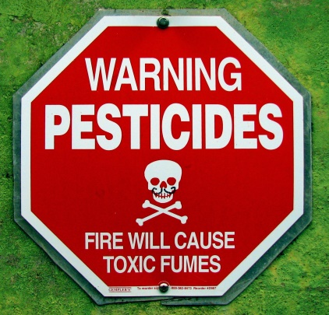
2 main types:
1- Organophosphates (Ops) :eg: Parathion , malathion .
2- Carbamates ( CMs) :eg: Aldicarb
Both present identically.
Organophosphates are more toxic than carbamates; they bind irreversibly to acetylcholinesterase, whereas the carbamate binding is reversible.
This is reflected by a decrease in the level of RBC (not plasma!) acetylcholinesterase for several months after organophosphate poisoning, while it returns to normal within hours after carbamate poisoning.

Slide 15
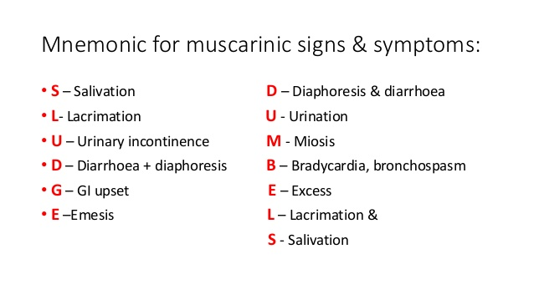
Symptoms
excessive cholinergic activity
→ severe secretions and stimulation of smooth muscle.
inhibit nerve transmission in skeletal muscle; this affects respiratory muscles and causes respiratory failure (THE MOST COMMON CAUSE OF DEATH) .

Slide 16
management
The route of the poison into the body is dermal absorption (especially organophosphates), so decontaminate by removing clothes and showering with soap.
For moderate-to-severe symptoms, give atropine ( 1-2 mg IV, repeat q 5 min pm).
Additionally, for organophosphates only (not carbamate), give 2-protopam (2-PAM) IV

Slide 17
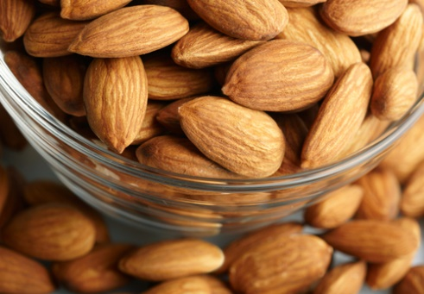
Cyanide poisoning
CLUES:
Patient's breath has an almond odor,
lab draw shows bright red venous blood.
Symptoms: patients very quickly develop headache, tachycardia, and tachypnea. This may quickly progress to coma and various cardiac arrhythmias.
Diagnosis is clinical, after excluding other causes of lactic acidosis and carbon monoxide poisoning.
Consider in fire patients or who received sodium nitroprusside or amygdalin
Labs : significant lactic acidosis.

Slide 18
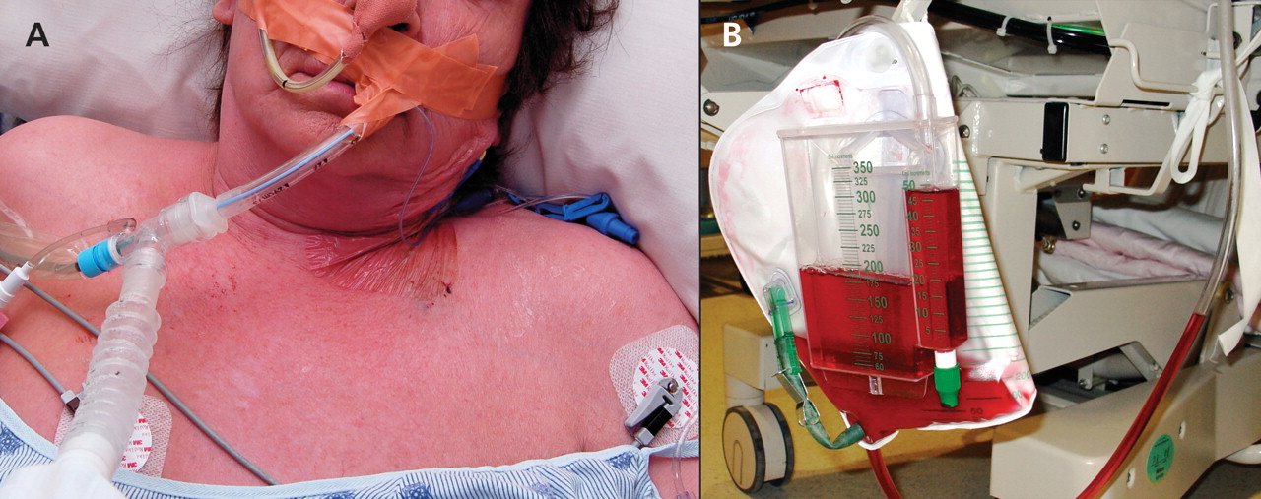
management
Goal is to induce methemoglobinemia because cyanide preferentially binds methemoglobin and produces a less toxic reaction.
the 3-step cyanide antidote package :
• Step 1: Hold amyl nitrite under the patient's nose for 30 sec.
• Step 2: Administer 3% sodium nitrite IV.
• Step 3: Administer sodium thiosulfate IV

Slide 19
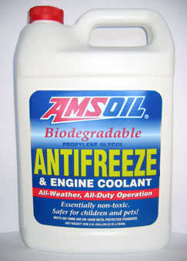
Ethylene glycol (antifreeze):
Alcohol dehydrogenase breaks down ethylene glycol to its very toxic metabolites, especially oxalate.
calcium oxalate crystals in the urine and hypocalcemia (oxalate chelates calcium).
Treat with fomepizole, bicarbonate for the acidosis, calcium pm, and immediate dialysis.

Slide 20

DRUG OVERDOSE AND ITS MANAGEMENT

Slide 21

General information
Opiates: Most common cause of drug overdose death
Investigations to do :
1. Toxicological: Blood and urine drug screens
2. Non-toxicological: ECG, radiology
Ways to manage and increase elimination:
Multiple-dose activated charcoal
Urine alkalization
Hemodialysis/ Hemodialfiltration

Slide 22
1) Analgesics
Salicylates :
Salicylates metabolites accumulate in liver → hepatic failure and metabolic acidosis
The classic presentation: tachypnea and a mixed acid-base disorder (HAGMA + respiratory alkalosis) and a history of having taken over-the-counter pain medicine,tinnitus, bleeding

Slide 23


Management:
The antidotes are Sodium bicarbonate , Activated charcoal
If Mild: parenteral fluid and electrolyte (Potassium) replacement only.
Hemodialysis is the treatment of choice for severely poisoned patients (plasma salicylate concentration >700 mg/L)

Slide 24
Acetaminophen:
90% of this drug is metabolized in the liver , overdoses lead to formation of toxic metabolite NAPQ resulting in hepatotoxicity .
only after 4 hrs level rise in plasma and 24-48 hours that liver toxicity ensues.
It is standard to check acetaminophen levels regardless of the presentation(sx need 24 hr to appear )because untreated toxicity is potentially fatal..
The severity of paracetamol poisoning is dose related.
patients usually remain asymptomatic for the first 24 hours or at the most develop anorexia, nausea and vomiting.
Liver damage is not usually detectable by routine liver function tests until at least 18 hours after ingestion of the drug.

Slide 25

Management
N-acetylcysteine is a very effective antidote
Activated charcoal

Slide 26
Under supervision : Dr.Mohammad Althnaybat
Presented by Seif Al-Dahabrh

Slide 27
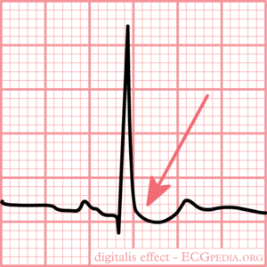
Digoxin Toxicity
Digitalis (digoxin)
Toxicity is more common with renal failure ? Why?
The most common precipitating cause of digitalis toxicity is …….?
Hypokalemia >>>>Digoxin toxicity
Digoxin toxicity >>>>Hyperkalemia
Toxicity presentation:
GI symptoms (abdominal pain, nausea, vomiting, diarrhea) IS THE MOST COMMON
Anorexia, fatigue
Visual changes (diplopia, blindness, photophobia) YELLOW HALOS AROUND OBJECT
CNS symptoms (confusion, weakness, hallucinations )
Bradycardia, any type of cardiac arrhythmia but atrial tachycardia with variable AV block is the most common digoxin toxic arrythmia
Hyperkalemia (due to inhibition of the Na+-K+-ATPase)
Diagnostic ? The most accurate test is digoxin level but the best initial tests are potassium level and a ECG
ECG?
Treatment :
Control potassium and give Digoxin-specific antibody
Antidote: Anti-digoxin Fab fragments

Slide 29
Iron Poisoning
It commonly occurs in children of pregnant women taking pre-natal vitamins because children often
confuse brightly colored iron pills for candy.
When ingested in large amounts, elemental iron is corrosive to the gastrointestinal mucosa, causing abdominal pain, nausea, vomiting, diarrhea, and hematemesis within 30 minutes to 6 hours of ingestion.
▪ Patients are at risk of gastric scarring and pyloric stenosis within weeks of ingestion.
The mechanism of iron poisoning is free radical production and lipid peroxidation, which impairs various cell processes, leading to systemic manifestations.

Slide 30
Severely affected patients develop hypotensive shock and anion-gap metabolic acidosis from poor perfusion and accumulation of lactic acid. These patients may become tachypneic and develop respiratory alkalosis to compensate for the acidosis.
Other dangerous complications include liver necrosis, coagulopathy, seizures, and death.
The diagnosis is confirmed by measuring serum iron levels. Iron is radiopaque, and visualization of gastric tablets on abdominal x-ray further supports the diagnosis.
Treatment depends on the severity of the poisoning. Whole-bowel irrigation is sometimes instituted, but other methods of decontamination (activated charcoal, syrup of ipecac, gastric lavage) are not routinely recommended. Chelation therapy with intravenous deferoxamine which binds ferric iron, allowing urinary excretion

Slide 31
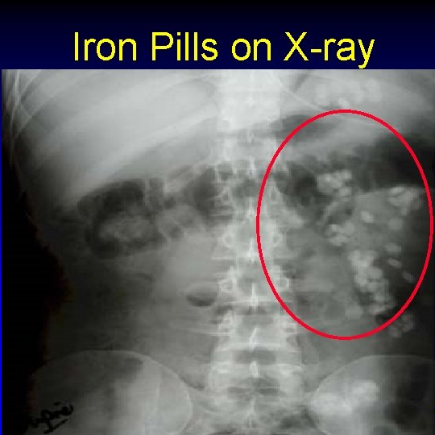

Slide 32
Cocaine
A strong CNS stimulant.
Sympathetic activation :
Dilated pupil ,Increased energy , alertness, euphoria, Hallucination tactile( bugs crawling on my skin ), Fever ,Anxiety Paranoia , chronic use may lead to perforated nasal septum due to vasoconstriction and resulting ischemic necrosis .
CNS :Seizures and stroke are also common with cocaine; consider it in patients with Ist time seizure.
CVS: Tachycardia Increase BP
Cardiotoxicity can occur no matter what the route of use.
rhythm disturbances (including V fib/tach)
chest pain is common complaint
( increase demand Decrease supply ( coronary vasoconstriction 》angina.
(Suspect use in a young patient presenting with MI.)

Slide 33
Management
Benzodiazipines are 1st line mx
Calcium channel blockers.

Slide 34
Amphetamines
Indirect Sympathomimetic increases the release of epinephrine, norepinephrine, serotonin, and dopamine
Consider toxicity in the sweaty, severely agitated or psychotic patient with tachycardia, tachypnea and hypertension
euphoria, extrovert behavior, a lack of desire to eat or sleep, tremor, dilated pupils, tachycardia and hypertension.

Slide 35
Management
Acute treatment of the severely agitated patient is with IV benzodiazepines first and
Then anti psychotics, such as haloperidol, if needed

Slide 36
Antidepressants: MAOIs
Features after overdose may be delayed for 12–24 hours
Presentation:
excitement, restlessness, hyperpyrexia, hyperreflexia, convulsions, opisthotonos, rhabdomyolysis and coma. Sinus tachycardia and either hypo- or hypertension have also been observed
Management:
- Treatment is supportive.
- Diazepam 》 control of convulsions and marked excitement
- Dantrolene
- Plasma expansion
- α-adrenoceptor blocker such as chlorpromazine

Slide 37
Antidepressants: Tricyclics
Tricyclic antidepressants: Amitriptyline
Tri-C’s: Convulsions, Coma, Cardiotoxicity (arrhythmia due to Na+ channel inhibition);
Toxicity presentation:
CNS symptoms (mental status changes, seizures)
Respiratory depression
Cardiovascular symptoms (tachycardia, hypotension, prolonged QT, arrhythmias) ECG will often show a wide QRS interval
Anticholinergic symptoms (dry mouth, blurred vision, dilated pupils, urinary retention, flushing, hyperthermia)
Metabolic acidosis and cardio respiratory depression are observed in severe

Slide 38
Antidotes:
O2
IV fluids
IV NaHCO3 for arrhythmias
Benzodiazepines for seizures
Decontamination with activated charcoal if ingestion was within 2 hours

Slide 39
Benzodiazepines:
Benzodiazepines are commonly taken in overdose but rarely produce severe poisoning except in the elderly or those with chronic respiratory disease.
Clinical features:
Toxicity presentation:
Slurred speech
Unsteady gait
Drowsiness
Respiratory depression (When vital sign derangements or respiratory depression are seen , co-ingestion with other sedative-hypnotic should be suspected)
Nausea, vomiting, Seizures can also be present.

Slide 40
Management:
Antidote: Flumazenil (competitive antagonist of benzodiazepine)
IV atropine → given for bradycardia and heart block. The initial dose can be repeated every 3–5 minutes

Slide 41
Opioids
Toxicity presentation:
CNS symptoms (euphoria, drowsiness, slurred speech, seizures, pinpoint pupils)
GI symptoms (nausea, vomiting, constipation)
Respiratory depression
Antidote: Naloxone

Slide 42
Lithium:
Lithium toxicity is usually the result of therapeutic overdose .
Narrow therapeutic index
Renal excretion .RF for toxicity : renal insufficiency , volume depletion
Management : Hemodyalysis

Slide 43
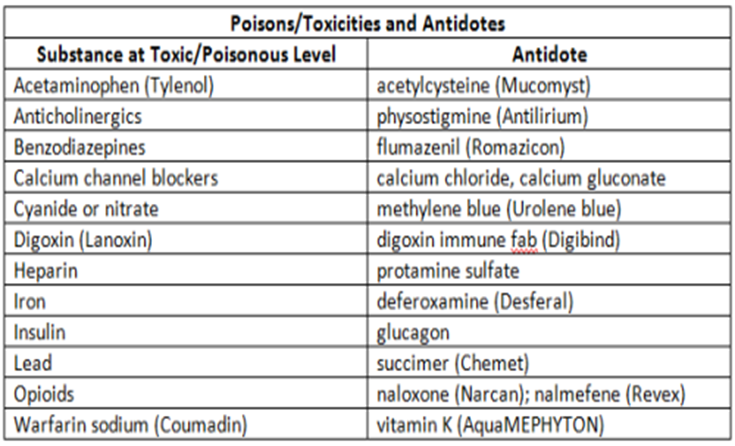
Antidotes:

