Slide 1
Dialysis and Renal Replacement Therapy
Presented by:
Reem hamad
Salsabeel abuasab
Rahaf alnajjar

Slide 2
Kidney Functions
Homeostasis: through its excretory function to get rid of endogenous metabolic substances :e.g. urea and creatinine or exogenous , e.g. drugs.
It regulates water and electrolytes concentration (sodium, potassium, chloride, calcium, phosphorus, magnesium, sulfate).
Acid Base balance.
Blood pressure control (via aldosterone)
Part of the endocrine system: produces erythropoietin, calcitriol, renin.

Slide 3
Renal Replacement Therapy
replaces the normal blood- filtering function of the kidneys. It is used when the kidneys are not working well as in renal failure, acute kidney injury and chronic kidney disease.

Slide 4
Dialysis is the artificial mechanism by which the fluid and toxic solutes are moved from the circulation when the kidneys cannot do so sufficiently.
Dialysis is an imperfect treatment to replace kidney function because it does not correct the compromised endocrine functions of the kidney.
Dialysis treatment replace some of these functions through diffusion (waste removal) and ultrafiltration (fluid removal).

Slide 5
The two major methods of dialyzing a patient are:
1-Hemodialysis.
2-Peritoneal dialysis.

Slide 6
Settings in which dialysis is considered:
CKD—CKD = Stage 5 = GFR <15
Asymptomatic patients with eGFR 5 to 15 mL/min/1.73 m² – closely follow such but do not initiate dialysis in the absence of signs or symptoms.
Patients with eGFR 5 to 15 mL/min/1.73 m² with signs or symptoms that could be due to ESKD: We initiate dialysis for those patients whose signs and symptoms are refractory to medical therapy (refractory hyperkalemia, Refractory fluid overload, refractory metabolic acidosis, uremic pericarditis or pleuritis, Uremic encephalopathy ).
Patients with eGFR <5 mL/min/1.73 m^{2 :} We initiate dialysis for most patients regardless of the absence or presence of ESKD-related signs or symptoms.

Slide 7
B. AKI—dialysis is often required as a temporary measure until the patient’s renal function improves.
Indications for KRT in patients with AKI generally include:
● Refractory fluid overload
● Refractory hyperkalemia
● Signs of uremia, such as pericarditis, encephalopathy, or an otherwise unexplained decline in mental status
● Severe metabolic acidosis (pH <7.1)
C. Overdose of medications or ingestions of substances cleared by the kidneys— methanol , ethylene glycol, lithium, aspirin, salicylic acid, magnesium containing laxatives.

Slide 8
How does hemodialysis work?

Slide 9
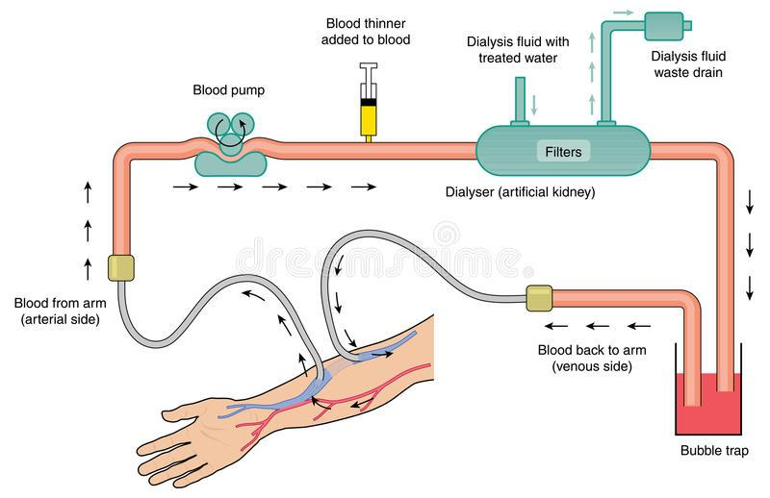

Slide 10
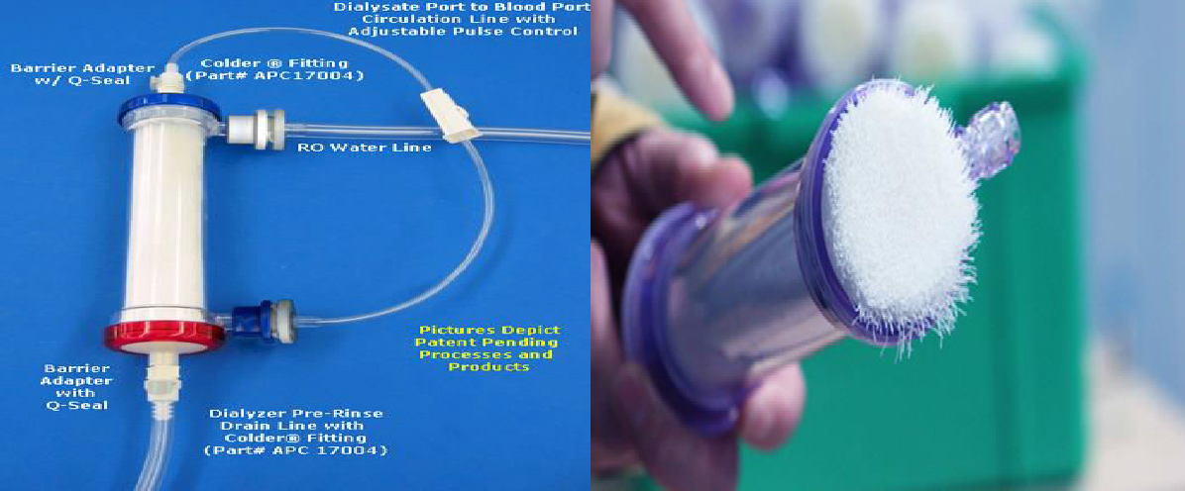

Slide 11
hemodialysis apparatus
The apparatus used to conduct hemodialysis consists of the following components:
Dialyzer
Dialysis solution (dialysate)
Tubing for transport of blood and dialysis solution
Machine to power and mechanically monitor the procedure

Slide 12
Dialyzers are composed of a polyurethane capsule or shell within which hollow fibers or parallel membrane plates are suspended in dialysate. The fibers or plates function as a semipermeable membrane across which blood and dialysate flow in opposite directions.
Blood flows by one side of a semi-permeable membrane and a dialysate, or special dialysis fluid, flows by the opposite side.
By crossing this membrane, solutes and water move between a patient's intravascular compartment and the dialysis fluid contained within the dialyzer. Smaller solutes and fluid pass through the membrane, but the membrane blocks the passage of larger substances (for example, red blood cells, large proteins).

Slide 13
Dialysate
Highly purified water
Sodium
Potassium
Calcium
Magnesium
Chloride
Bicarbonate
Dextrose

Slide 14
Dialysis tubing consists of synthetic tubing designated as the "arterial" line, which carries blood from the arteriovenous access to the dialyzer, where blood and dialysate interface at the membrane, and the "venous" line, which carries dialyzed blood back to the patient.
the dialysis machine must include a blood pump to move blood between patient and the dialyzer, a delivery system to transport dialysis solution, and monitoring devices.

Slide 15
Hemodialysis Process
The patient’s blood is pumped by an artificial pump outside of the body through the dialyzer, which typically consists of fine capillary networks of semipermeable membranes.
The dialysate flows on the outside of these networks,
and fluid and solutes diffuse across the membrane.
The patient’s blood must be heparinized to prevent clotting in the dialyzer.

Slide 16
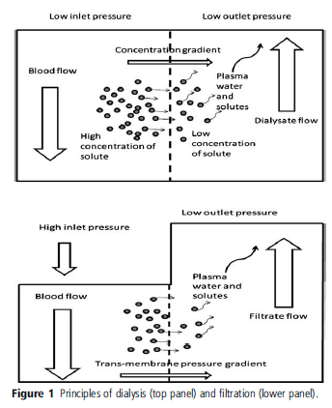
Principles of dialysis
Dialysis = diffusion = passive movement of solutes across a semi- permeable membrane down concentration gradient.
Good for small molecules
(Ultra)filtration = convection = solute + fluid removal across semi-permeable membrane down a pressure gradient (solvent drag)
Better for removal of fluid and medium-size molecules such as H2O, glucose, urea, AA.

Slide 17
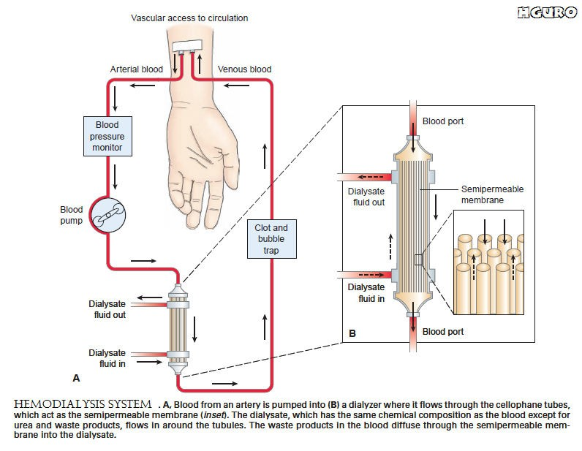

Slide 18
2. Frequency: Most hemodialysis patients require 3 to 5 hours of dialysis 3 days per week.
3. Access: Hemodialysis catheters usually have two main lumens attached to two ports (blue and red colored). he red port identifies the "arterial" lumen that draws blood from the body, and the blue port identifies the "venous" lumen for return of blood from the dialysis machine to the patient

Slide 19
Access
Hemodialysis catheters usually have two main lumens attached to two ports (blue and red colored). he red port identifies the "arterial" lumen that draws blood from the body, and the blue port identifies the "venous" lumen for return of blood from the dialysis machine to the patient
Types of access:
Temporary: central venous catheter
Permanent: AV access

Slide 20
Central venous catheter
Non-tunneled central line is a type of short-term IV catheter. A non-tunneled central line may be placed most often in the subclavian or internal jugular vein or femoral vein for temporary access.
Tunneled central line: is a thin flexible hollow tube (catheter) that is tunneled under the skin before entering a large vein. It is most commonly placed in the neck into the internal jugular vein and extends down to a larger vein just above the heart (cavoatrial junction).

Slide 21
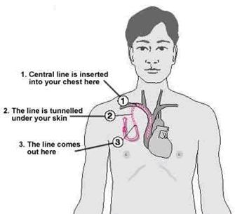
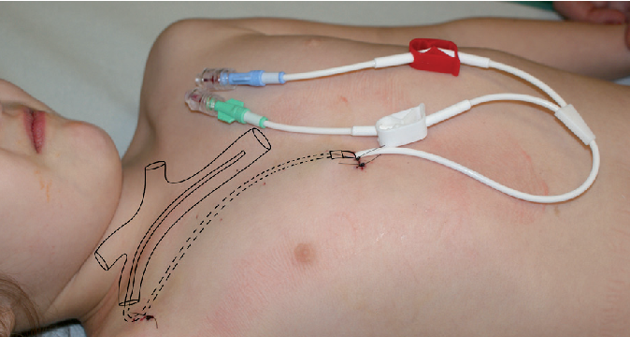

Slide 22
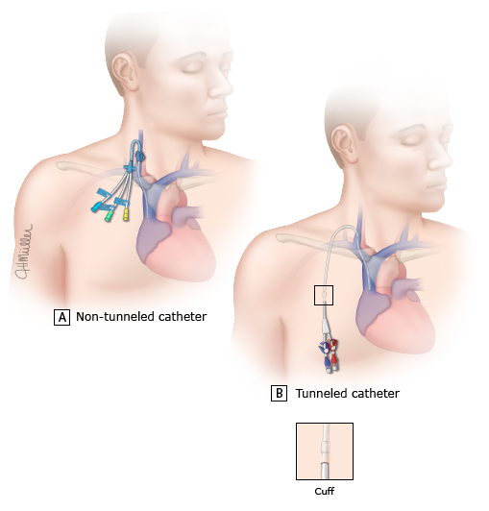
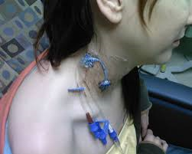

Slide 23
AV access
Arteriovenous fistula
AV Grafts

Slide 24
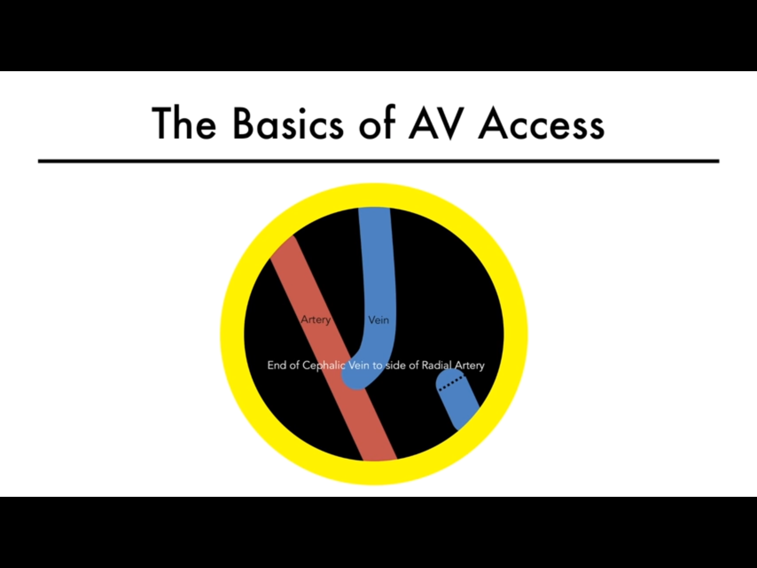

Slide 25
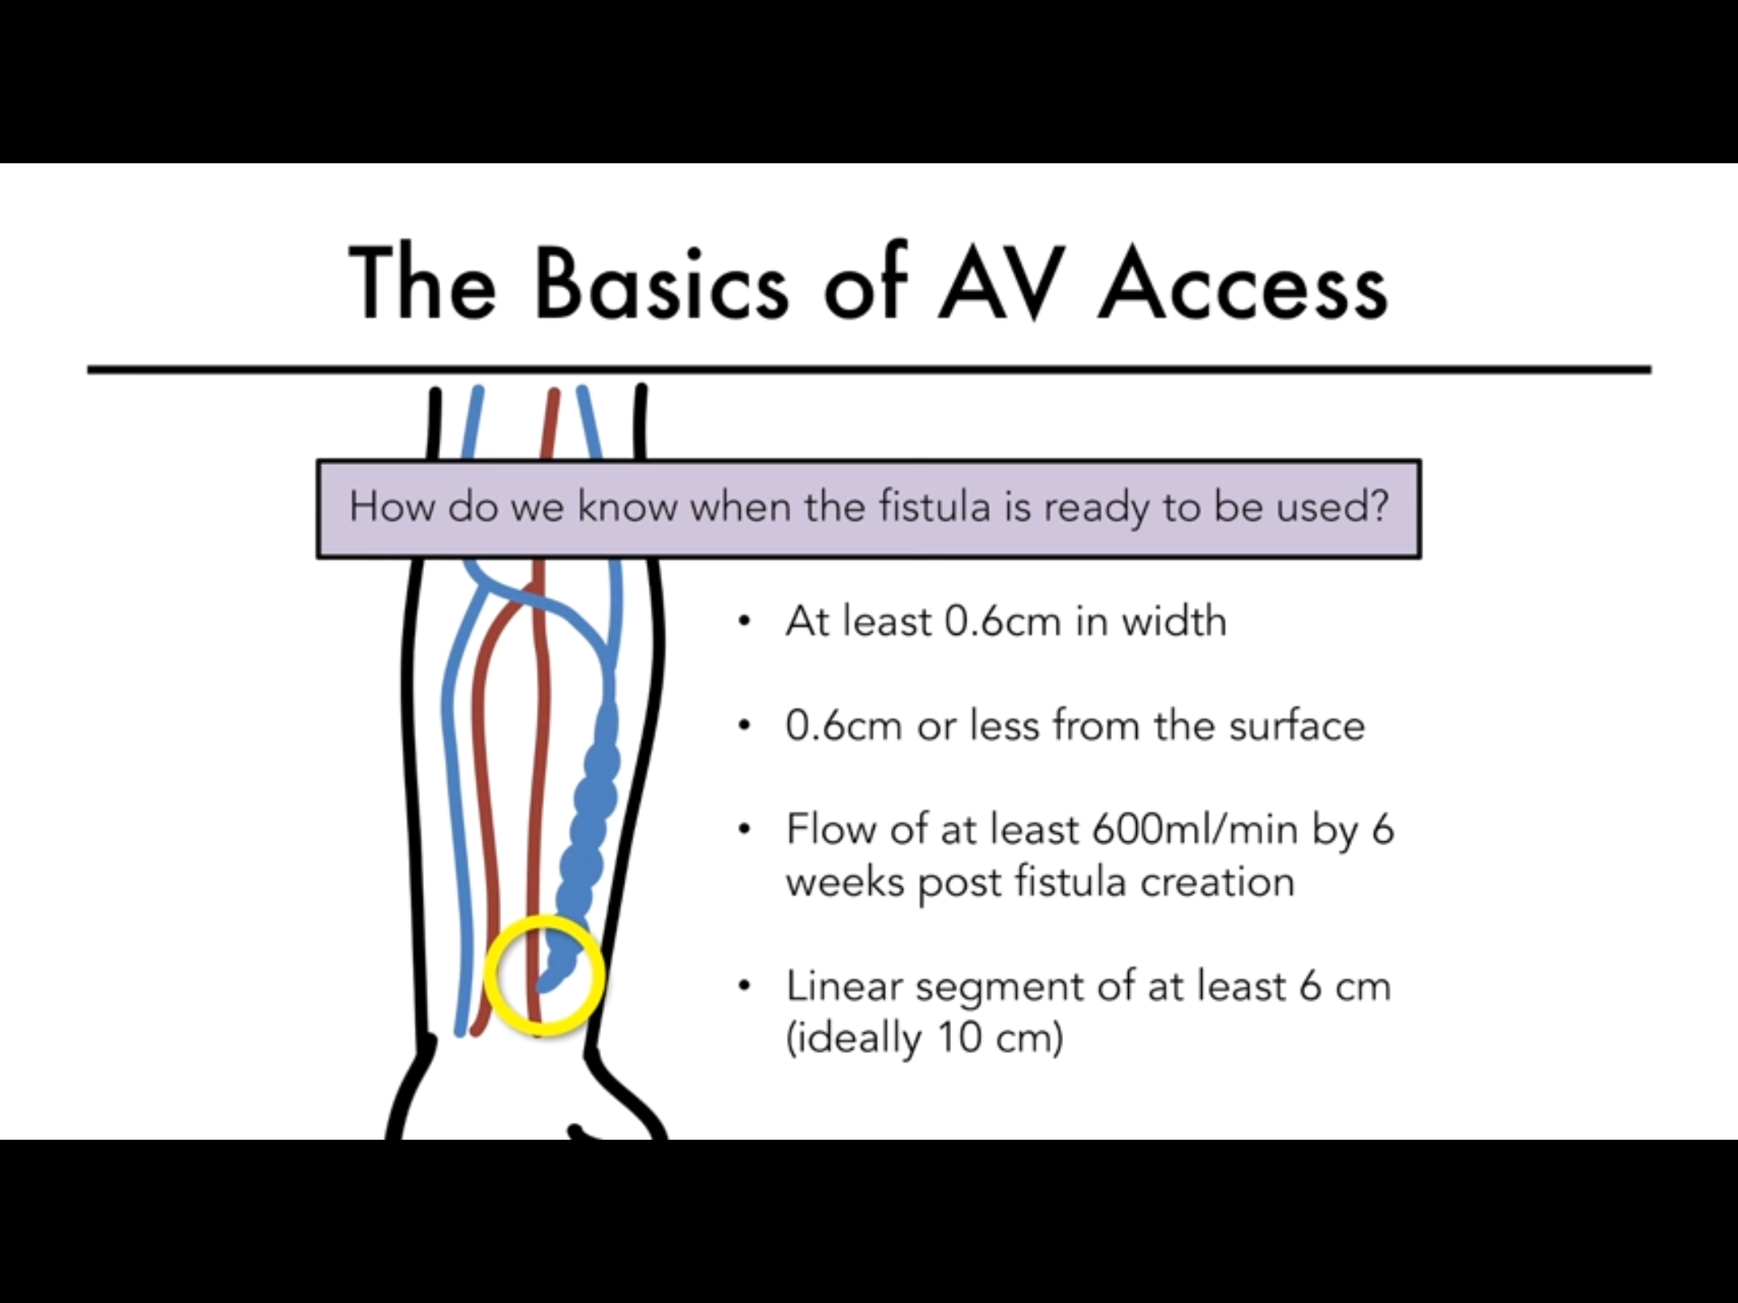

Slide 26
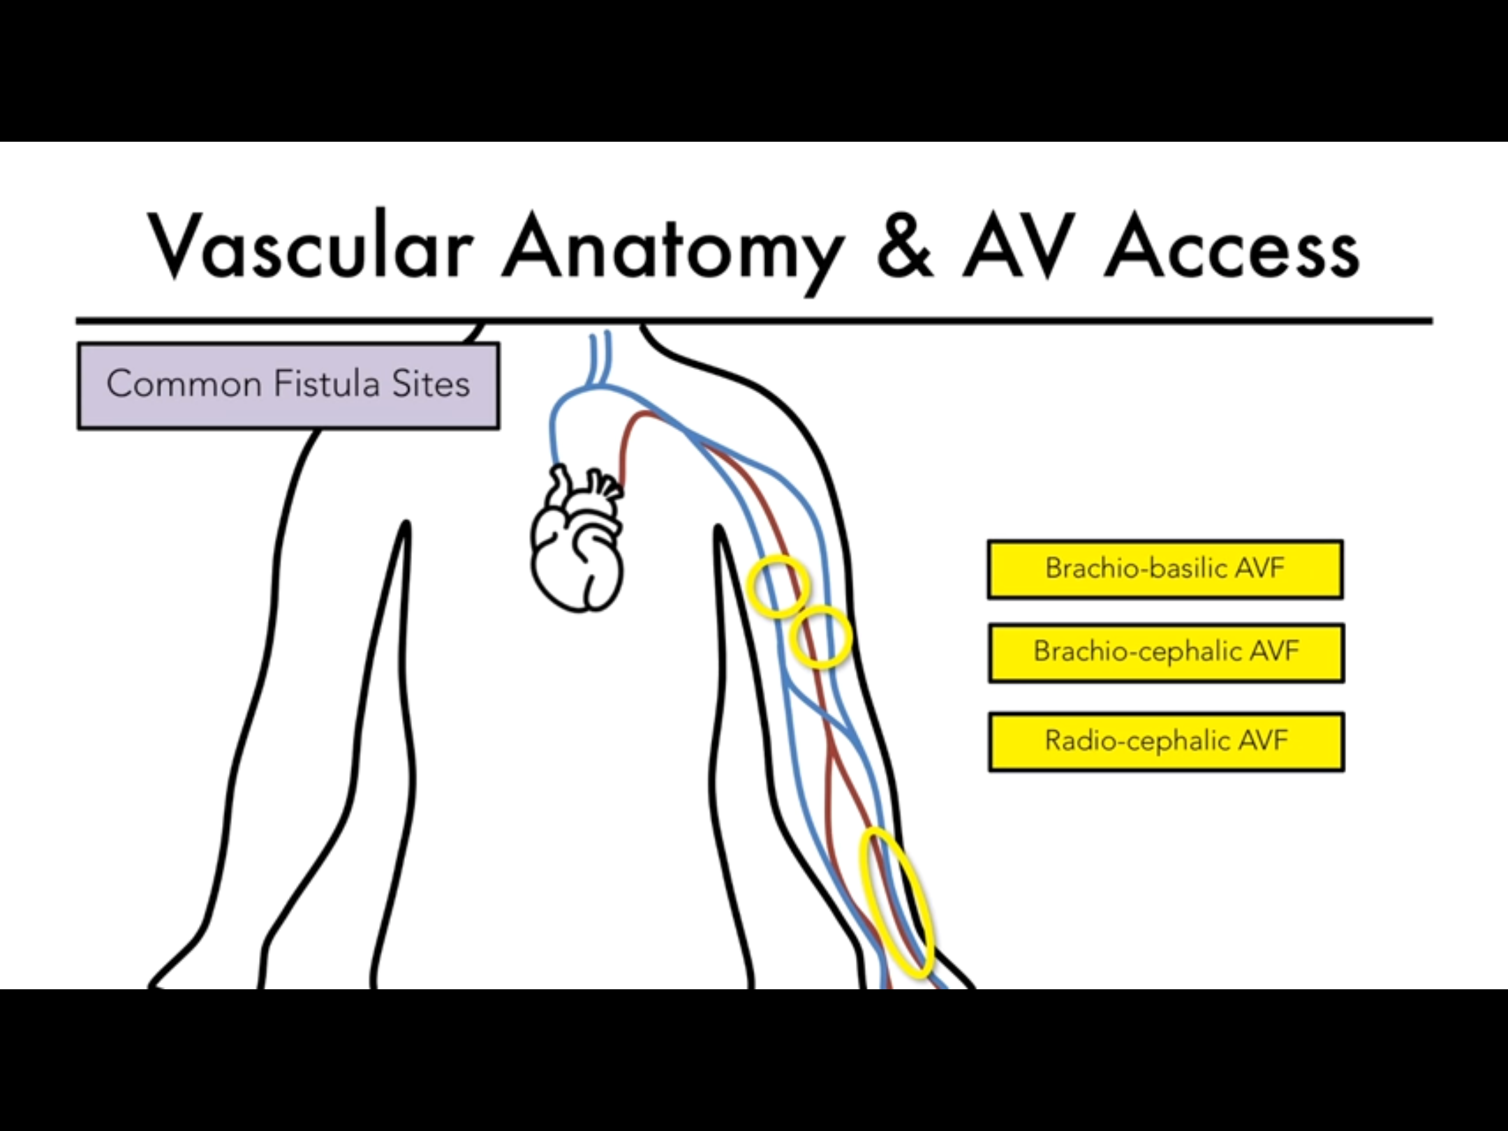

Slide 27
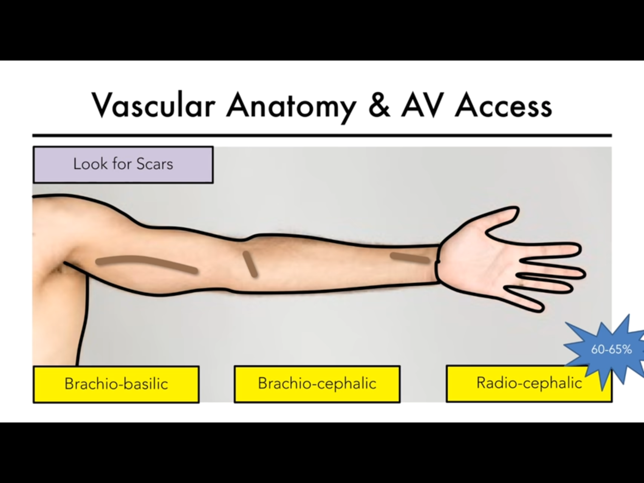

Slide 28
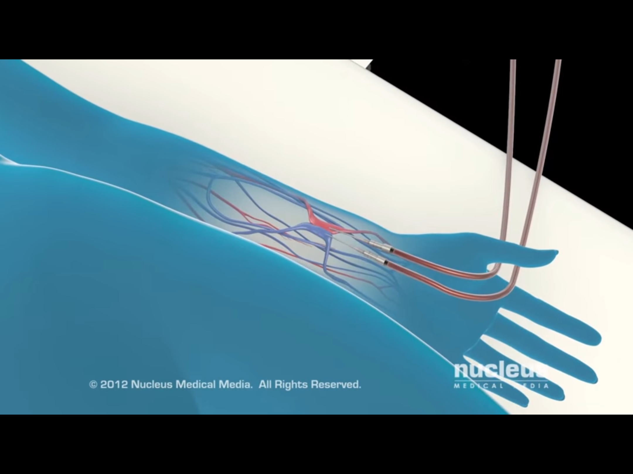

Slide 29
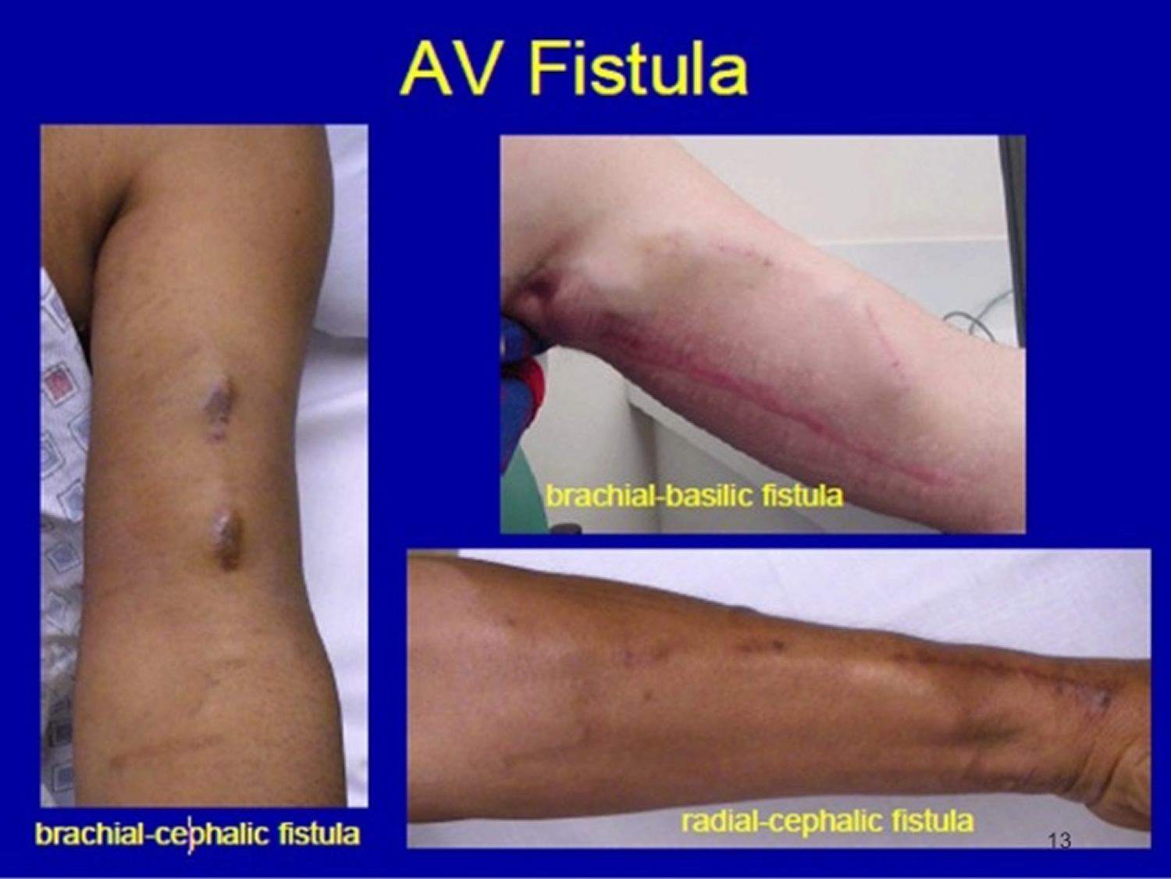

Slide 30
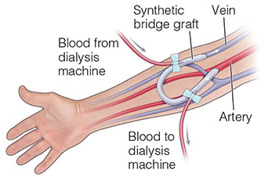

Slide 31
Complications
The most common complications of AV fistulas and AV grafts include:
Thrombosis.
infection.
access-related hand ischemia (vascular steal syndrome).
aneurysmal dilation
venous hypertension.
Seroma.
heart failure.
local bleeding.

Slide 32
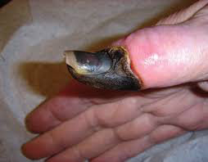
Distal hypoperfusion ischemic syndrome (DHIS)

Slide 33
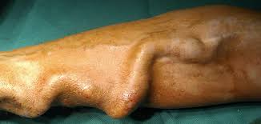

Slide 34
Complications
Complications associated with hemodialysis.
  Hypotension—may result in myocardial ischemia, fatigue, and so on.
  “First-use syndrome”—chest pain, back pain, and rarely, anaphylaxis may occur immediately after a patient uses a new dialysis machine
  Complications associated with anticoagulation—hemorrhage, hematoma, etc.
  Infection of vascular access site—may lead to sepsis

Slide 35
The Adequacy of hemodialysis
Definition :
The adequacy of hemodialysis refers to how well toxins and waste products are removed from the patient's blood.
Two methods are generally used to assess dialysis adequacy, URR and Kt/V:
1- URR stands for urea reduction ratio.
2- KT/V (also known as single-pool Kt/V)

Slide 36
URR
Example:
If the initial, or predialysis, urea level was 50 mg/dL
And the postdialysis urea level was 15 mg/dL, the amount of urea removed was 35 mg/dL.
50 mg/dL - 15 mg/dL = 35 mg/dL
The amount of urea removed (35 mg/dL) is expressed as a percentage of the predialysis urea level (50 mg/dL).
35/50 = 70/100 = 70%
*** some experts recommend a minimum URR of 65 percent.

Slide 37
single-pool Kt/V
represents the number of times the entire body’s urea distribution volume (close to the volume of total body water) gets cleared of urea in the dialysis treatment.
K represents dialyzer clearance
T duration of dialysis
V urea distribution volume

Slide 38
single-pool Kt/V
Example: If the dialyzer's clearance is 300 mL/min and a dialysis session lasts for 180 minutes (3 hours), Kt will be 300 mL/min multiplied by 180 minutes. The result comes to 54,000 mL, or 54 liters.
Kt = 300 mL/min multiplied by 180 minutes
Kt = 54,000 mL = 54 liters
The body is about 60 percent water by weight. If a patient weighs 70 kilograms (kg), or 154 pounds (lbs), V will be 42 liters.
V = 70 kg multiplied by .60 = 42 liters
So the ratio—K multiplied by t to V, or Kt/V—compares the amount of fluid that passes through the dialyzer with the amount of fluid in the patient's body. The Kt/V for this patient would be 1.3.
Kt/V = 54/42 = 1.3
***These guidelines recommend a target single-pool Kt/V of 1.2 to 1.4 per session

Slide 39
Dialysis Disequilibrium Syndrome (DDS)
is characterized by neurological symptoms caused by rapid removal of urea during hemodialysis. It develops primarily from an osmotic gradient that develops between the brain and the plasma as a result of rapid hemodialysis.

Slide 40
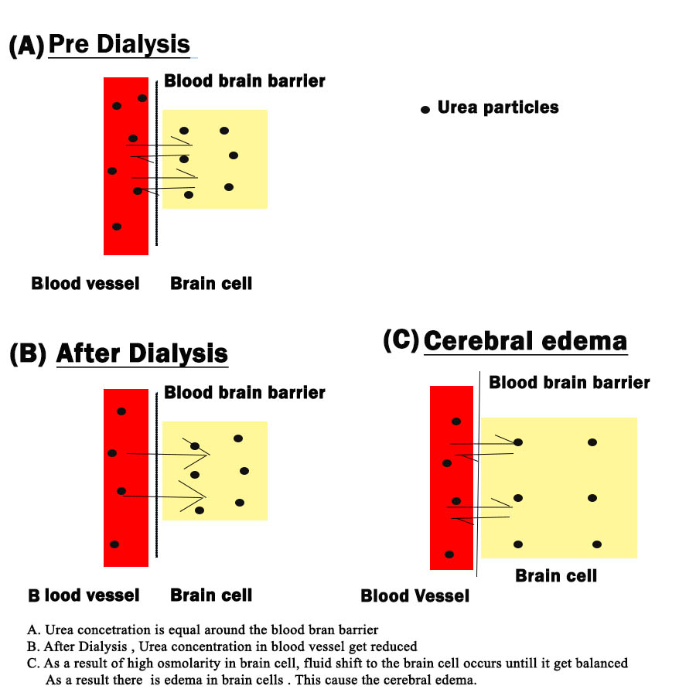

Slide 41
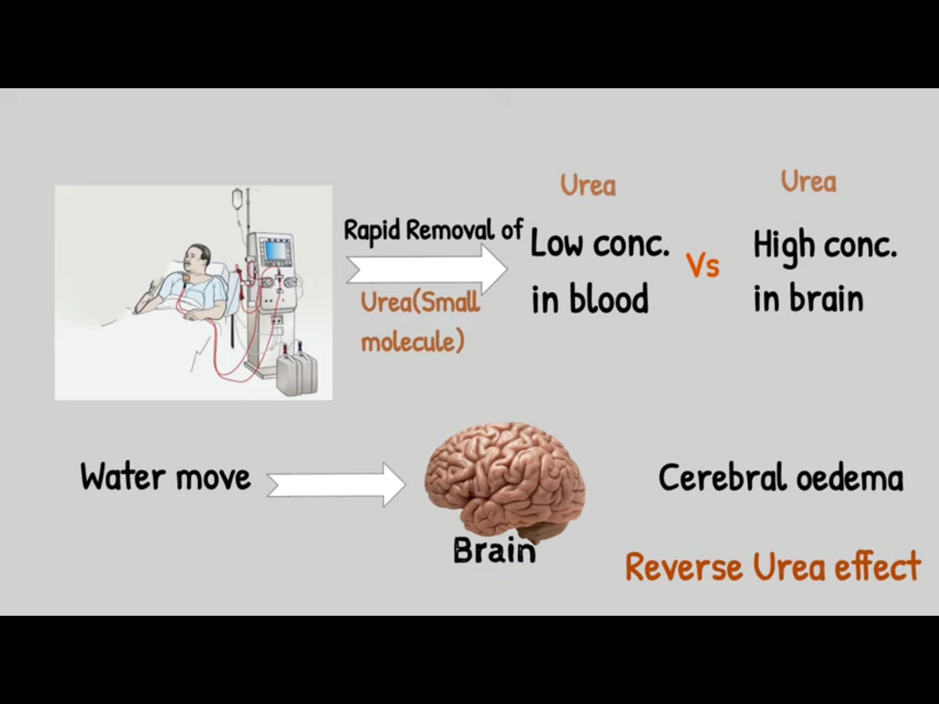

Slide 42
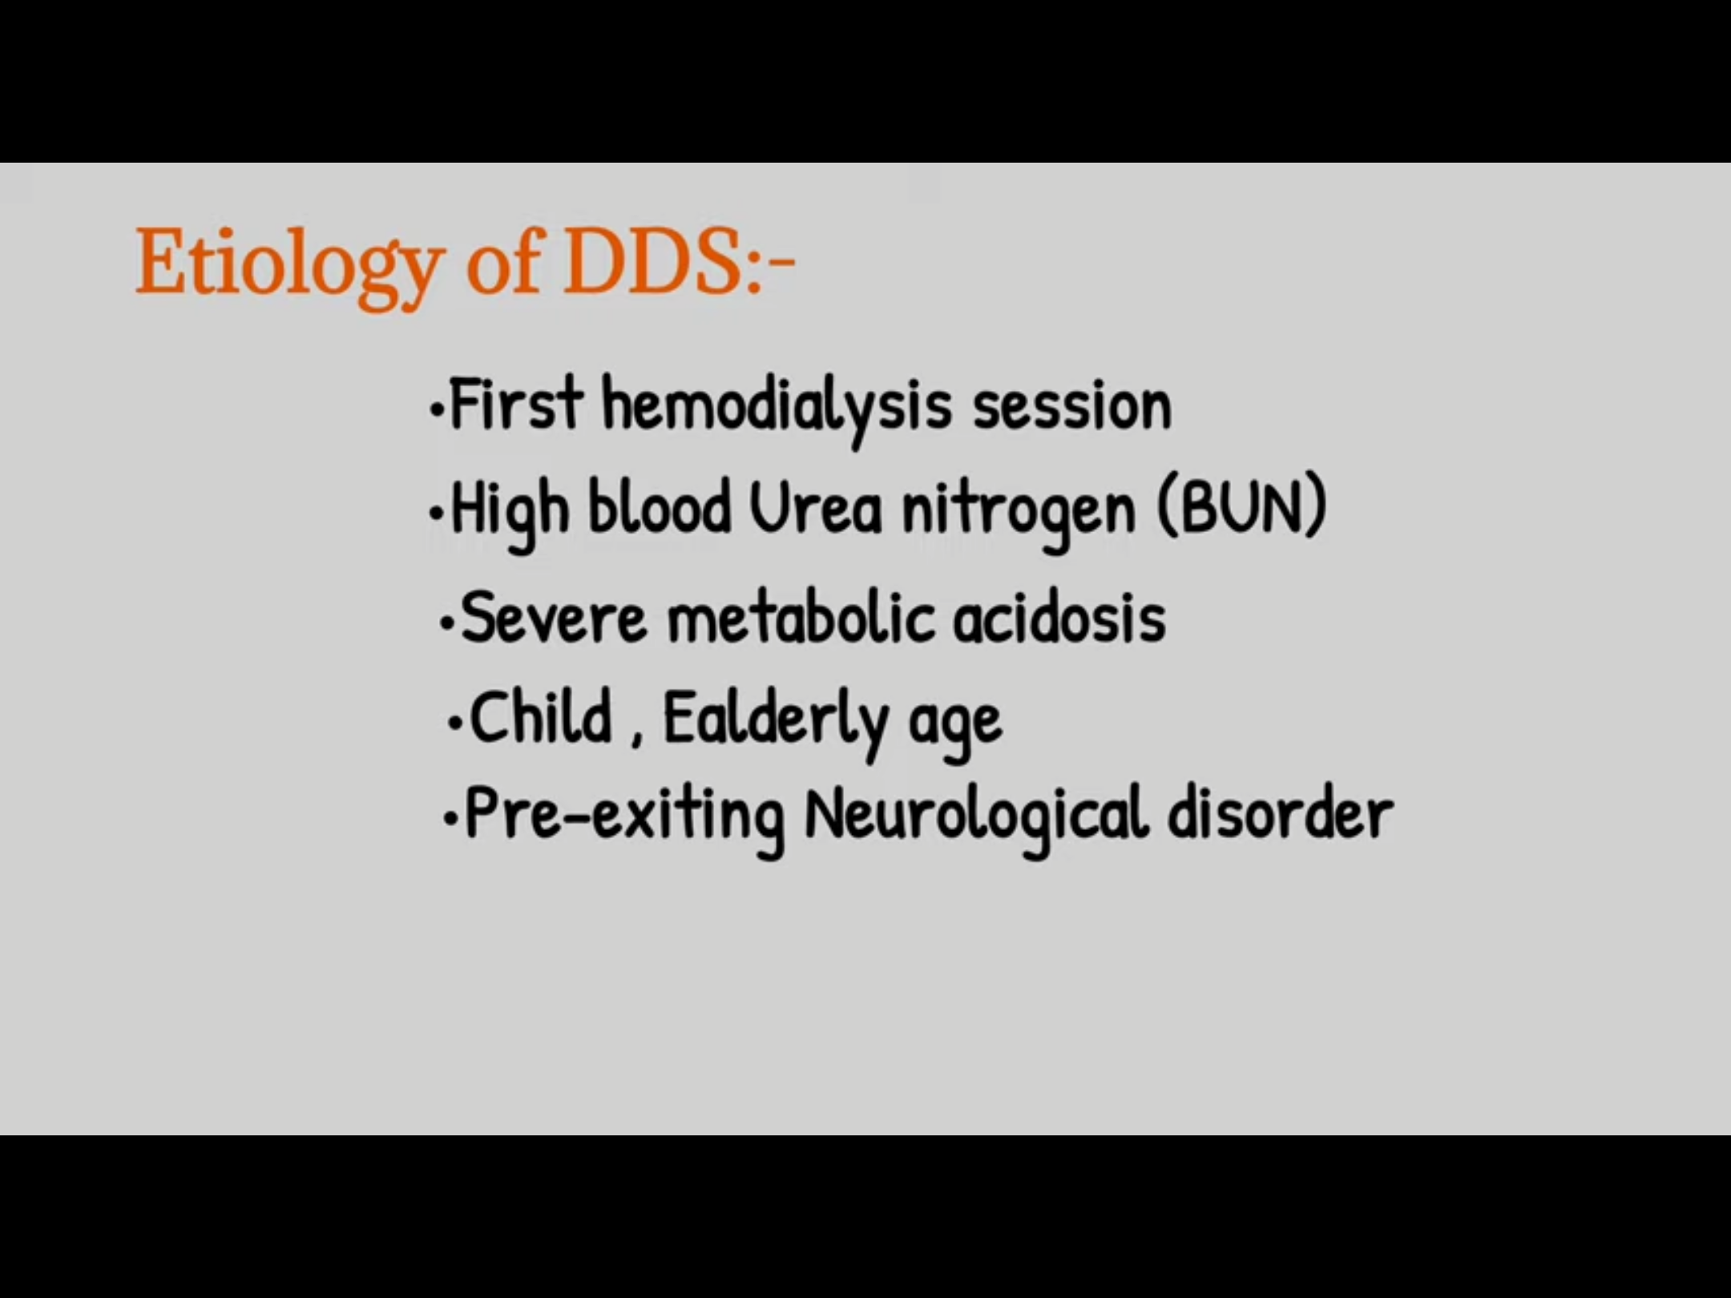

Slide 43
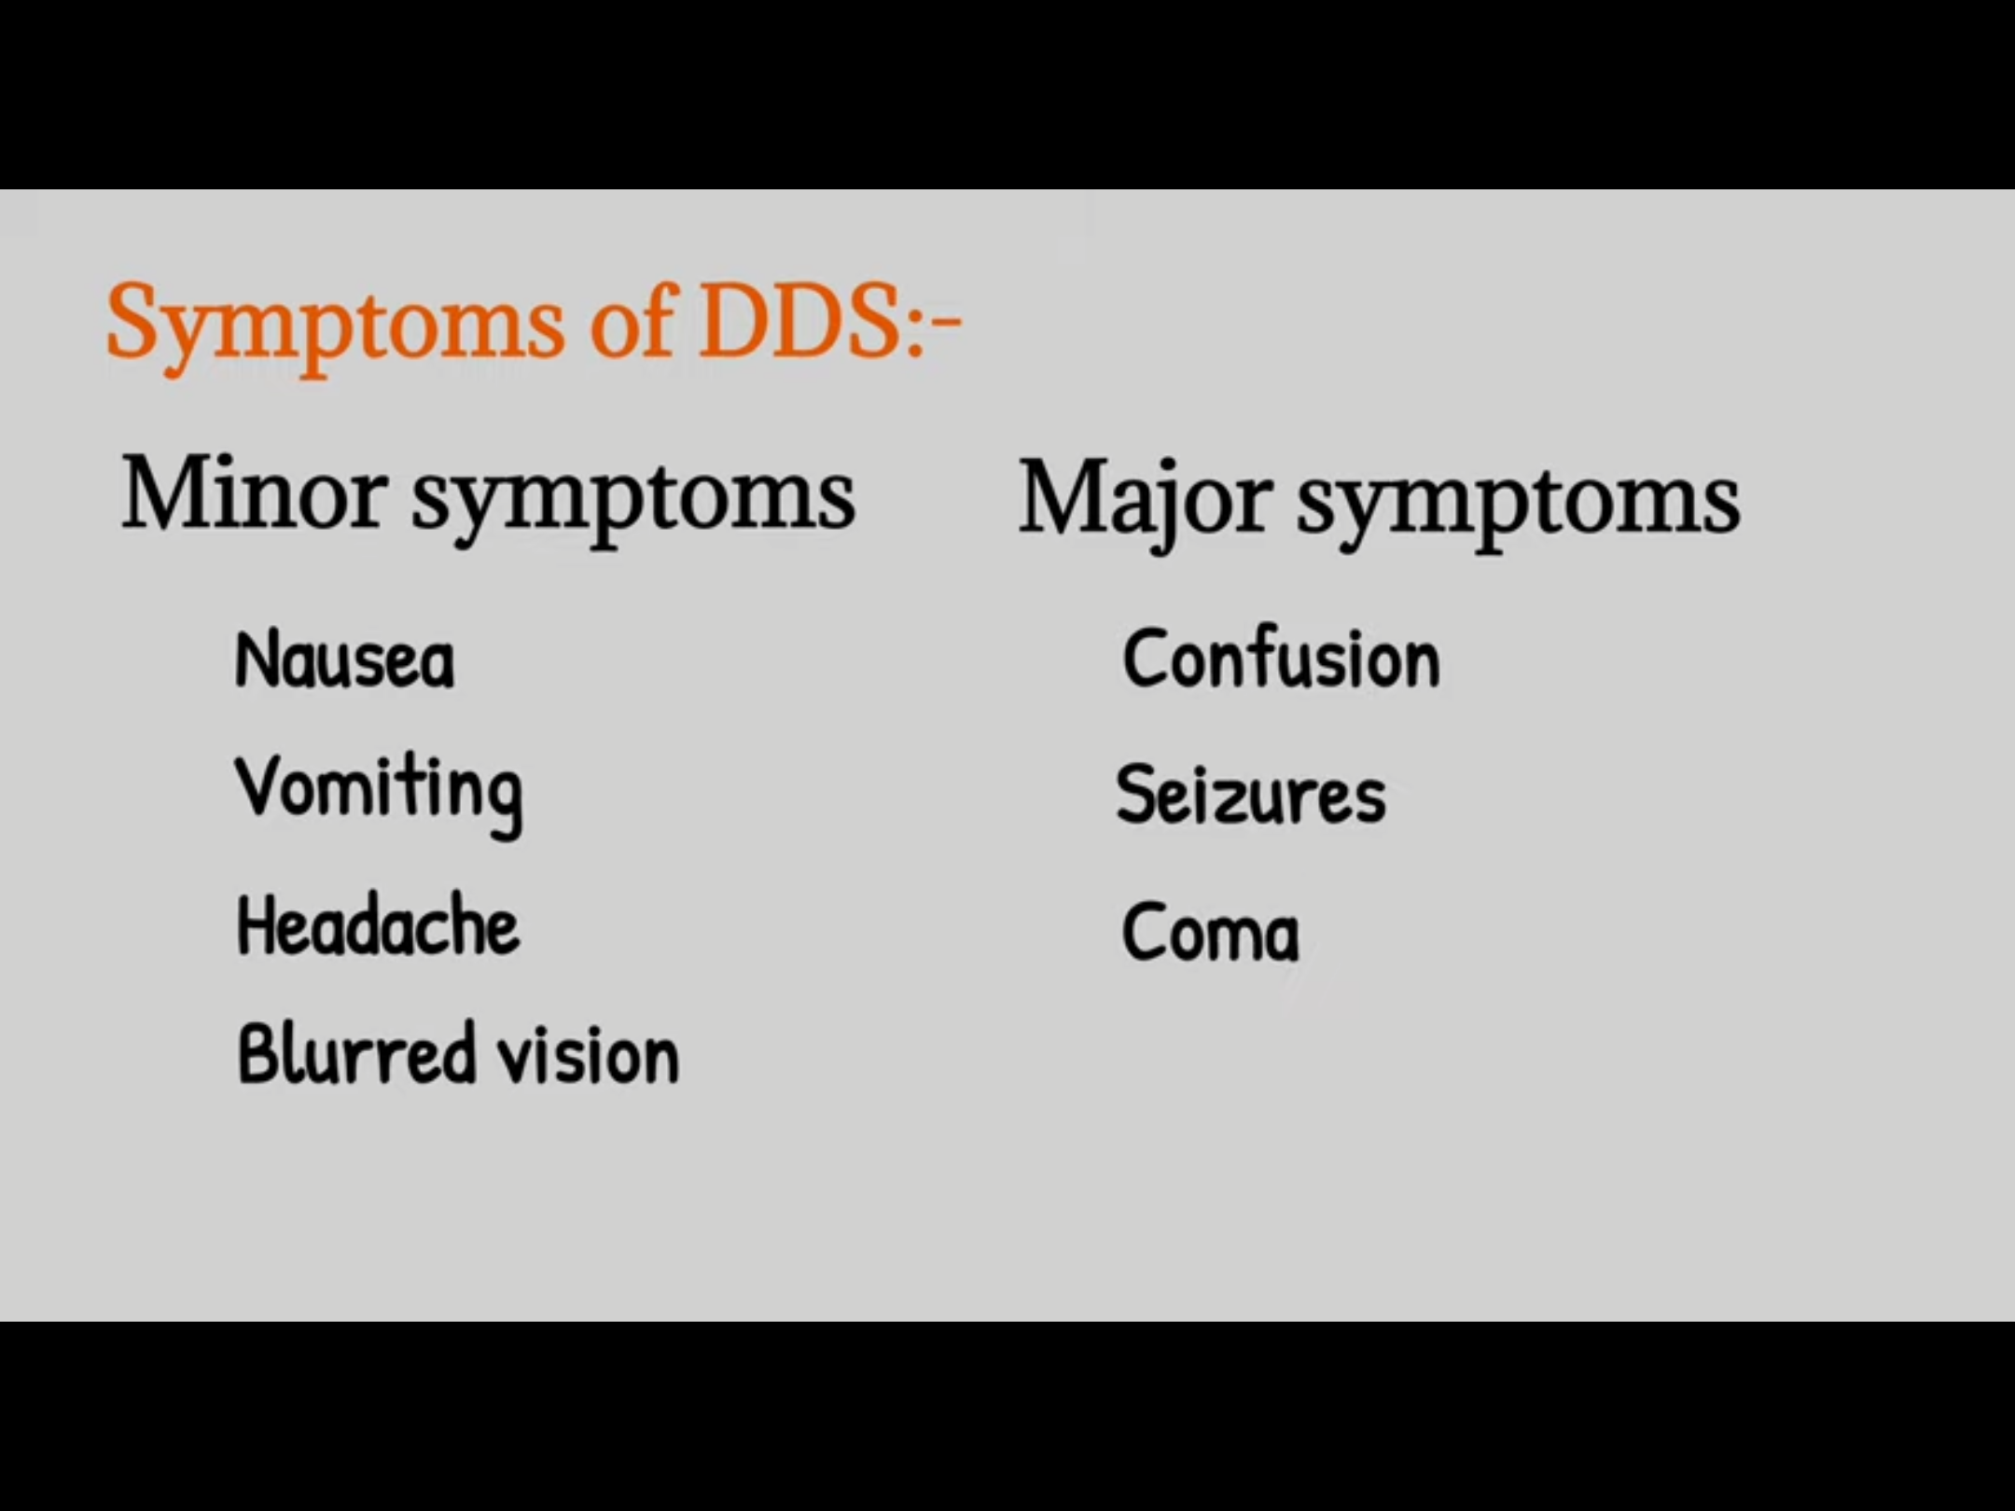

Slide 44
Supplementation
Calcitriol.
Erythropoietin.
Iron.
Phosphorus binders.
B-complex vitamens and folic acid.
Vitamin E.

Slide 45
Peritoneal dialysis
is a type of dialysis which uses the peritoneum in a person's abdomen as the membrane through which fluid and dissolved substances are exchanged with the blood

Slide 46
Hemodialysis vs Peritoneal dialysis
Hemodialysis
Peritoneal dialysis
Medium:
  Blood to dialysate
  Qb, blood flow: 300-400 ml/min
  D,dialysate flow: 400-800 mi/min
Selective semipermeable filter (dialysis filter)
Vascular access (AVF,AVG.CVC)
Medium
  Capillary to peritoneal space
  Dialysate equilibrium 2-3L over 2-6 hr**
Selective semi-permeable filter (peritoneal membrane)
Peritoneal access (Tenkhoff catheter)
***dialysate fluid is drained and replaced every hour in Assisted peritoneal dialysis, but only once every 4 to 8 hours in CAPD.

Slide 47
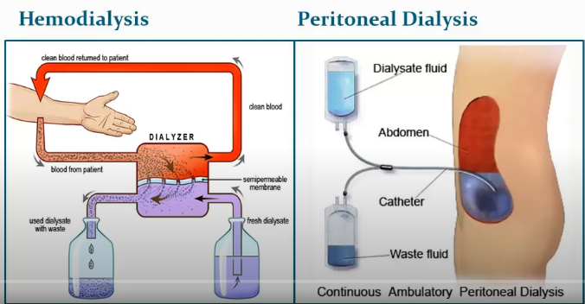

Slide 48
→Peritoneal cavity: reservoir for dialysate, 100ml but can expand up to 2.5-3 L
→Peritoneum semipermeable membrane across which excess body fluid and solutes are removed
→Tenkhoff catheter: Polyurethane or silicone made.
→Dialysate :hyperosmolar solution( %1.5-2.5% or 4.5% dextrose) sodium chloride, lactate or bicarbonate.
→Dwell: the total volume of dialysate
→Peritoneal capillaries: Fluid, Urea, Creatinine and Potassium

Slide 49





hookup
infusion
Diffusion (fresh)
Diffusion (waste)
drainage

Slide 50
Basic mechanisms in peritoneal dialysis
Solutes removal
Fluid removal
“Clearance”
Diffusive clearance
Solvent drag
“Ultrafiltration”
Osmosis
Convective clearance

Slide 51
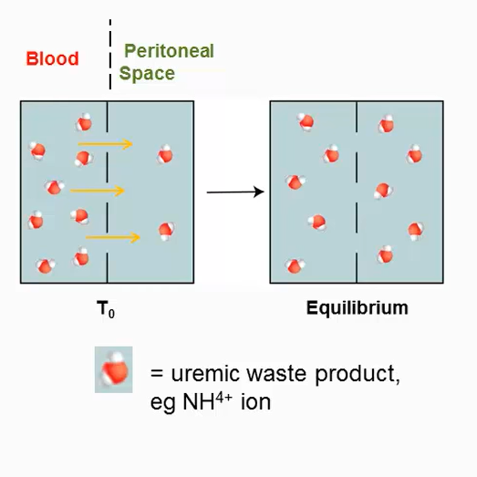

Slide 52
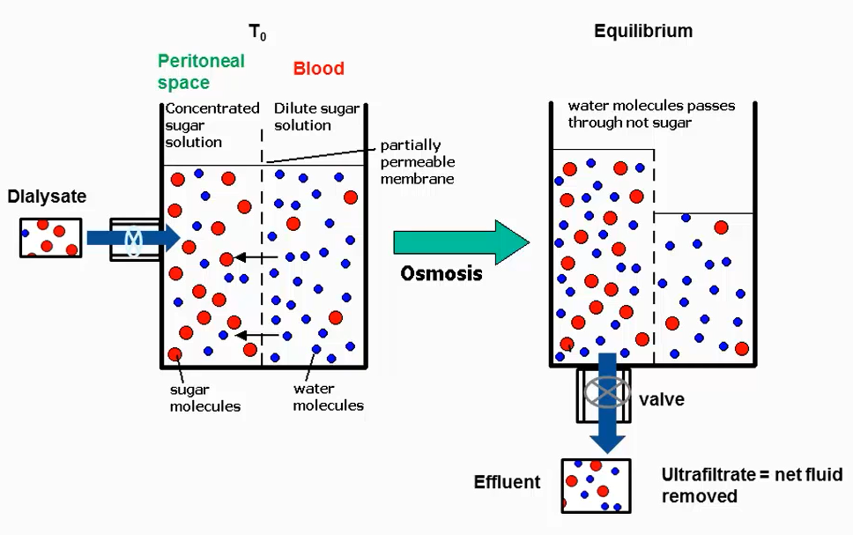

Slide 53
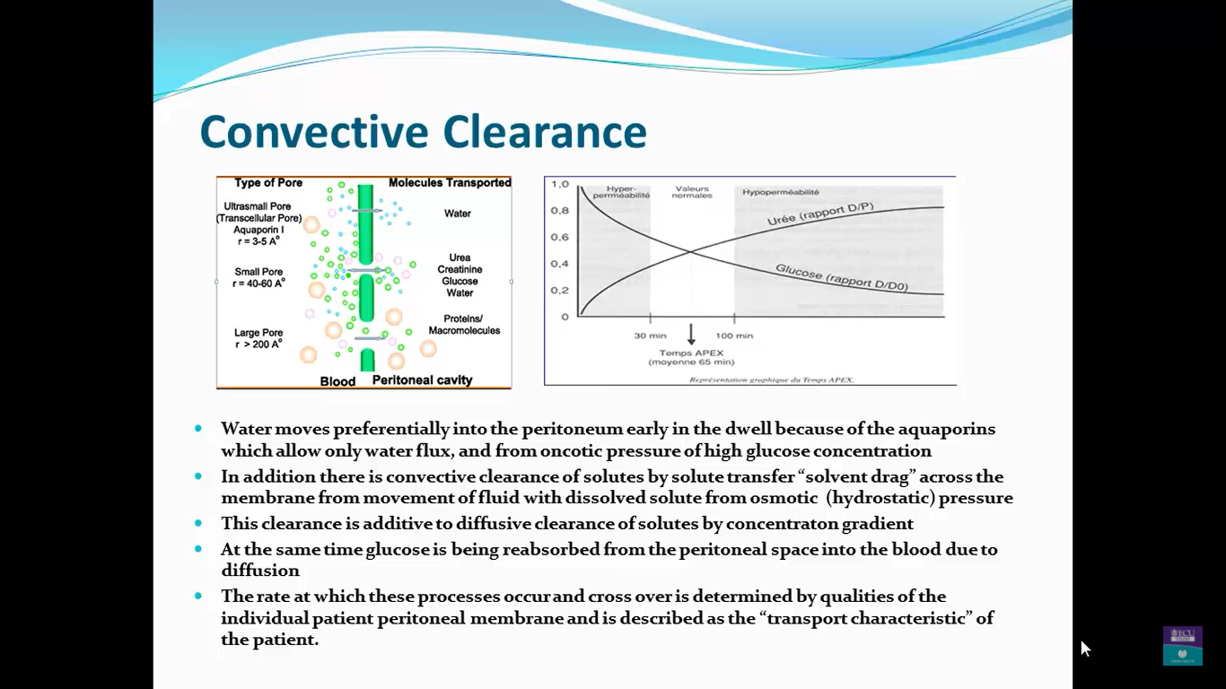

Slide 54
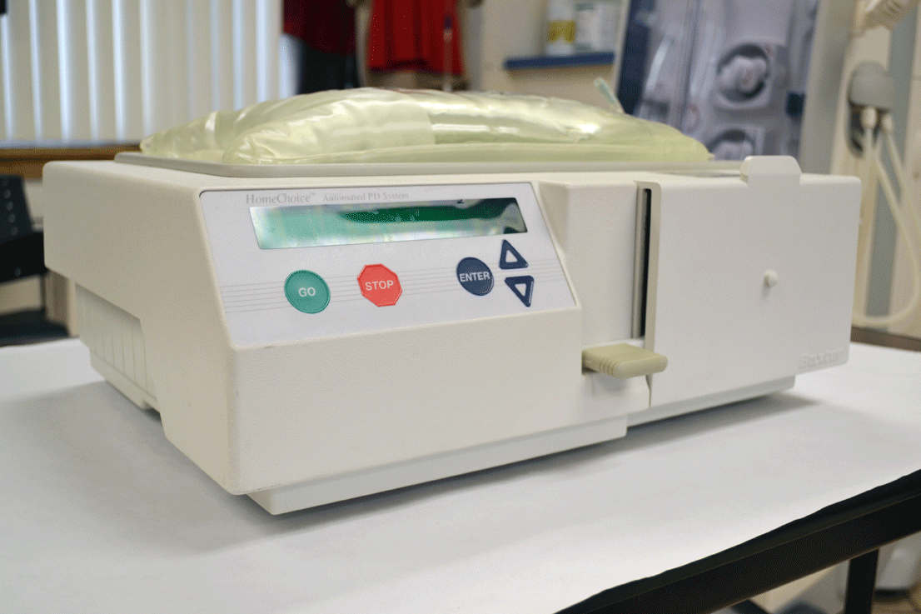
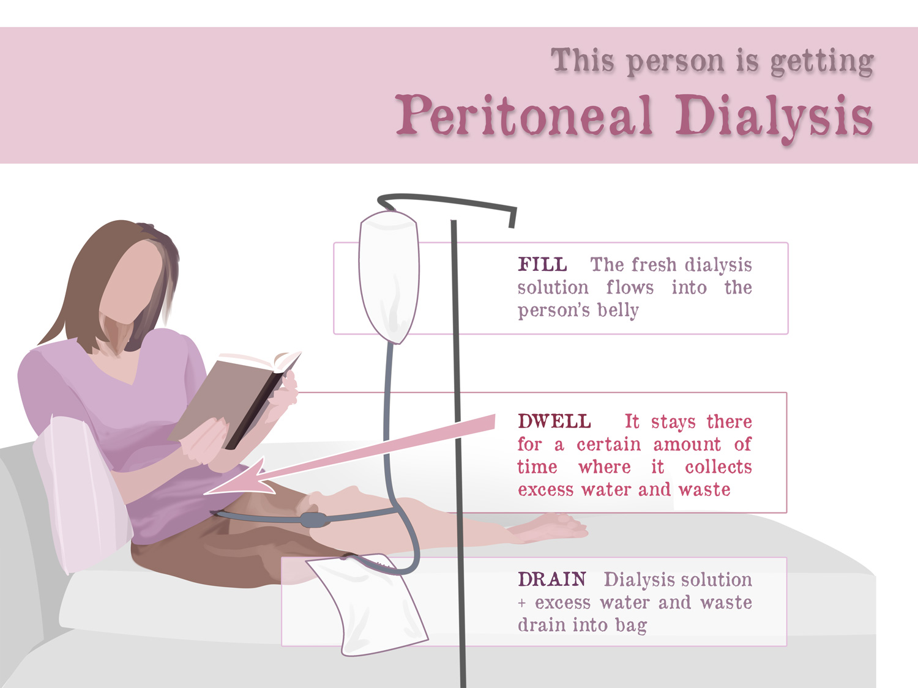
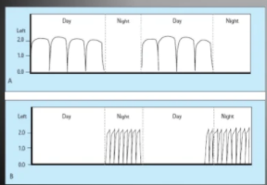
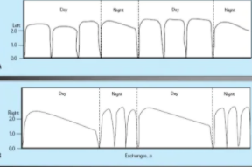
Types of peritoneal dialysis
Continuous
Intermittent
DAPD
Daytime ambulatory PD
NPD
Nightly PD
CAPD
Continuous ambulatory PD
CCPD
Continous cyclical PD

Slide 55
PD complications
1. Peritonitis:
→accompanied by fever and abdominal pain
→can be treated with intraperitoneal antibiotics
→cloudy peritoneal fluid is key sign.
2.Abdominal/inguinal hernia:
→↑ risk due to ↑intra-abdominal pressures.
3. Hyperglycemia—especially with diabetic patients.
  4.Protein malnutrition.

Slide 56
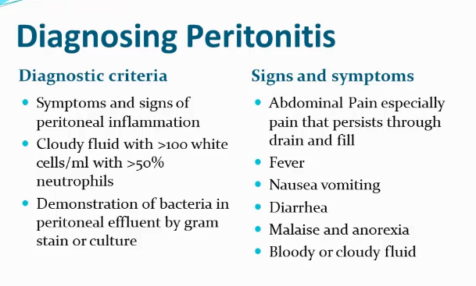

Slide 57
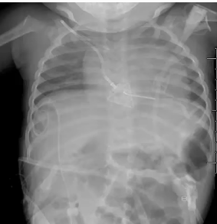
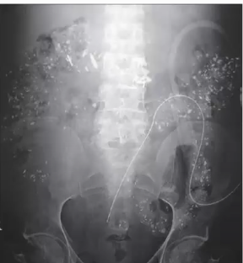

Slide 58
Hemodialysis | Peritoneal dialysis
More efficient with higher flow rates and efficient dialyzers shorten the period of time required for dialysis. | More convenient; The patient can perform dialysis on his or her own.
initiated more quickly using temporary vascular access in the emergent setting. | It mimics the physiology of normal kidney function more closely
It is less similar to the physiology of natural kidney function | The patients must be highly motivated to self-administer it.
Hypotension due to rapid removal of intravascular volume leading to rapid fluid shifts from the extravascular space into cells. | Cosmetic—there is increased abdominal girth due to dialysate fluid.
Requires vascular access.
dialysis does not replicate the kidney’s synthetic functions, therefore still prone to erythropoietin and vitamin D deficiency, with their associated complications.

Slide 59
When to choose PD?
1. PD continues to be the preferred dialysis modality for infants and young children
2. Patients with severe hemodynamic instability on hemodialysis
3. Patients with difficult vascular access
4. Patient’s preference

Slide 60
Contraindications
1. The one absolute contraindication to chronic PD is an unsuitable peritoneum due to the presence of extensive adhesions, fibrosis, or malignancy.
2. Abdominal hernias
3. Presence of colostomy, ileostomy, nephrostomy, or ileal conduit
4. Recurrent chronic backache with preexisting disc disease
5. Severe psychological and social problems
6. Severe diverticular disease of the colon
7. Severe neurologic disease, movement disorder, or severe arthritis preventing self care. (caregivers can be trained to perform the peritoneal dialysis)
8. Severe chronic obstructive pulmonary disease
9. Malnutrition

Slide 61
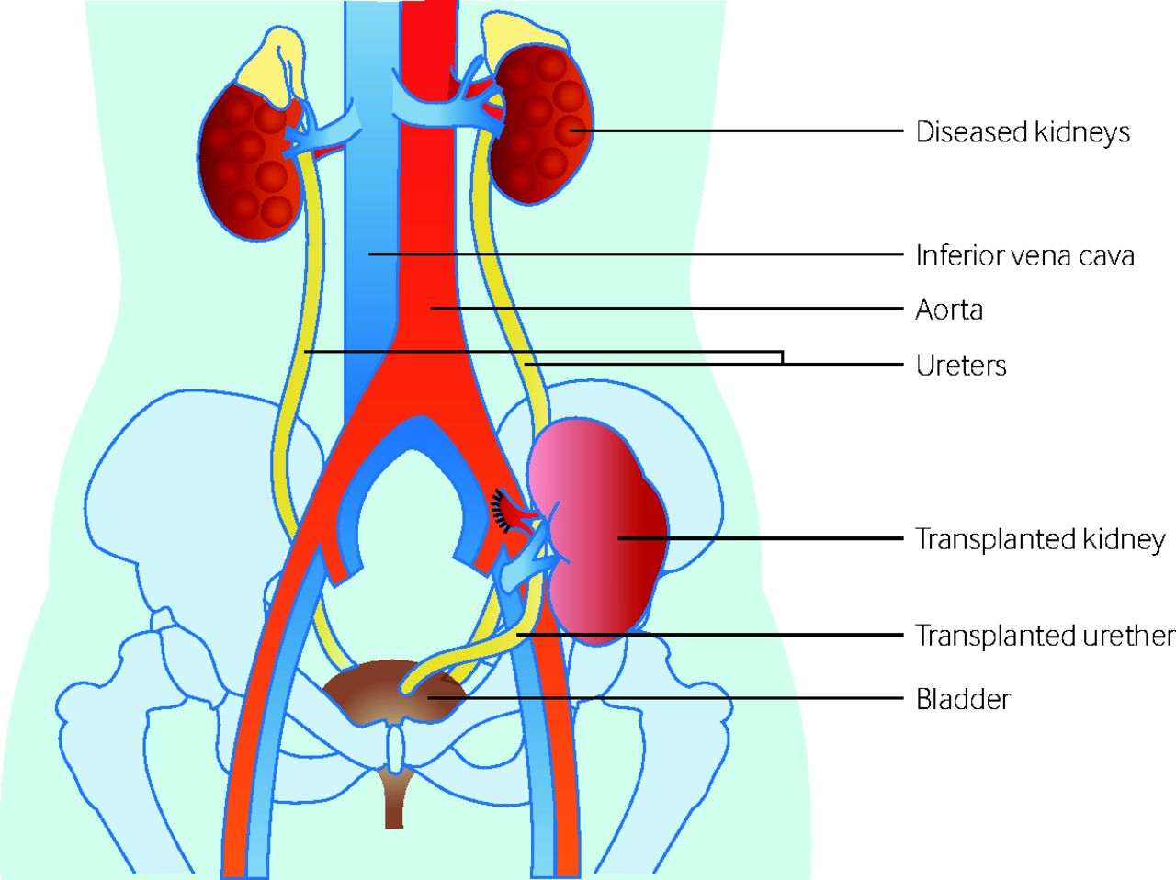
Kidney transplantation

Slide 62
Renal Transplantation
The most cost-effective modality of renal transplantation, with a longer life and better QoL.
Can restore normal kidney function and correct all the metabolic abnormalities of CKD.
Early transplantation (“ pre-emptive or within 1 year of dialysis initiation) yields best results.
Refer for transplant evaluation when eGFR=/< 20 ml/mn/1.73 m2.
Living donor kidney outcomes are superior to deceased donor kidney outcomes

Slide 63
Deceased Donor kidneys Transplant:
Standard Criteria Donors (SCD):
→ <50 yr + do not meet any of the criteria below that are assigned to Expanded Criteria Donors.
Expanded Criteria Donors (ECD):
>60 or 50-59 + at least 2 following criteria:
history of high blood pressure, the donor passed away from a CVA (stroke) or had a creatinine higher than the normal laboratory value (1.5 mg/dl)
Donation after Cardiac Death (DCD):
Double Kidney Transplants (Duals): Using both kidneys of expanded criteria to achieve better results.
Donors with High-Risk Social Behavior: individuals with history high-risk behavior for sexually transmitted disease, drug use, or were incarcerated. All of these donors are tested for transmissible disease at the time of organ recovery.

Slide 64
Living Donor Kidney Transplant
A procedure during which a kidney is removed from a healthy donor and surgically placed in an individual with kidney failure.
The living donor often is usually a relative, but living donor kidneys can also come from strangers.
the most important Advantage over deceased kidney transplant is higher success rate.

Slide 65
Transplant Rejection
Compatibility of ABO blood group between donor and recipient.
The degree of matching for major histocompatibility antigens, influences the incidence of rejection.
Long-term immunosuppression is required with cautions to their side effects
Immunosuppression agents like; Prednisolone, ciclosporin or tacrolimus, and azathioprine.

Slide 66
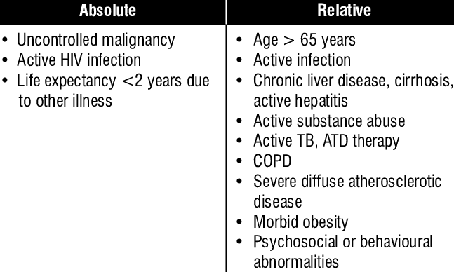
Contraindications

Slide 67
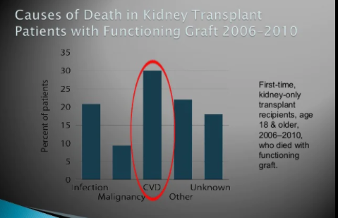
After kidney transplantation
Most common cause of transplant loss is death with a functional transplant due to
  Heart disease
  Infections
    Urinary tract infection (UTI) is the most common
    infection after kidney transplantation, which is
    associated with mortality, morbidity, graft
    rejection, and graft loss.
  Malignancies:
    4-100x compared to general population
    SCREENING IS THE KEY

Slide 68
THANK YOU
Questions?

