Slide 1
MICROCYTIC AND MACROCYTIC ANEMIAS
Done by: Mohammad Saleh
Mosab Abu Shqeer
Hamza Alhamdan

Slide 2
Definition
A decrease in hemoglobin ( Hb) , hematocrit ( Hct ) , or RBC count.
Measurement | Men | Women
Hemoglobin (g/dL) | > 13.5 (13.6 to 16.9) | >12 (11.9 to 14.8)
Hematocrit (%) | ~45 (40 to 50) | ~40 35 to 43
RBC count (× 10⁶/microL) | ~5 (4.2 to 5.7) | ~4.5 (3.8 to 5.0)

Slide 3
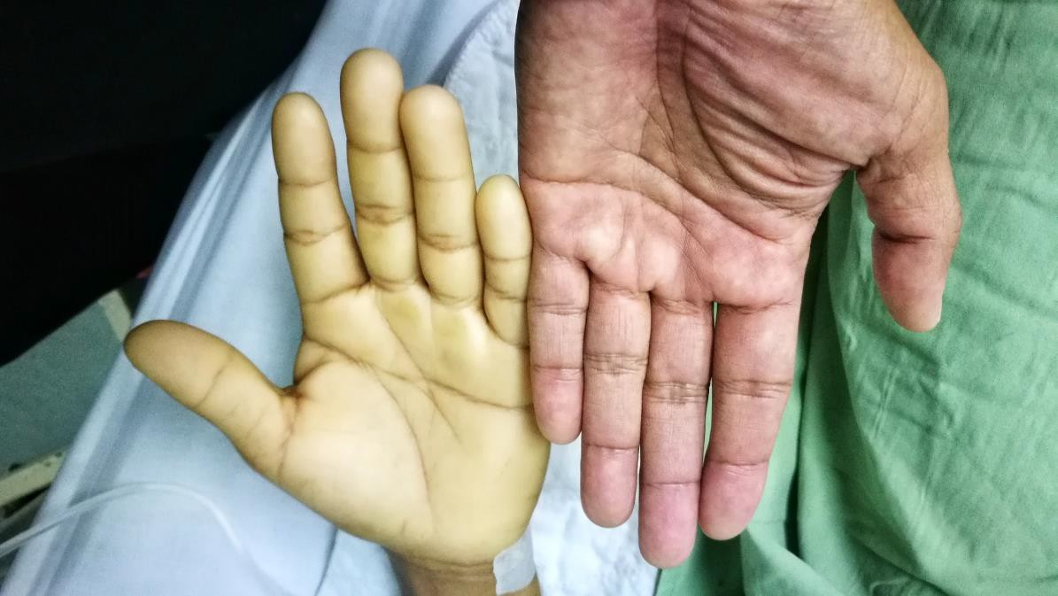
Anemia
Clinical Features
Vary based on degree of anemia
Can be asymptomatic
Weakness
Fatigue
Dyspnea
Palpitation
Headache
Dizziness
Pallor - unhealthy pale appearance
  Skin of palms and face
  Also nails and conjunctivae
Pallor versus Normal Palm
Shutterstock

Slide 4
Clinical Features
History:
symptoms of anemia: fatigue, weakness, dyspnea, decreased exercise tolerance, palpitations, headache, dizziness, tinnitus, syncope.
acute vs. chronic, bleeding, diet, alcohol, family history.
menstrual history: menorrhagia, menometrorrhagia, dysfunctional uterine bleeding
rule out pancytopenia (recurrent infection, mucosal bleeding/easy bruising)

Slide 5
Physical examination:
pallor in mucous membranes, palm and conjunctiva
jaundice.
cardiac: tachycardia, hypotension.
Nail changes ( koilonychias )
glossitis.

Slide 6
Classifications of Anemias
Etiologic :
  Disorders of effective red cell production
  rapid erythrocytes destruction or loss
Morphologic :
  macrocytic anemias
  microcytic anemias
  normocytic anemias

Slide 7
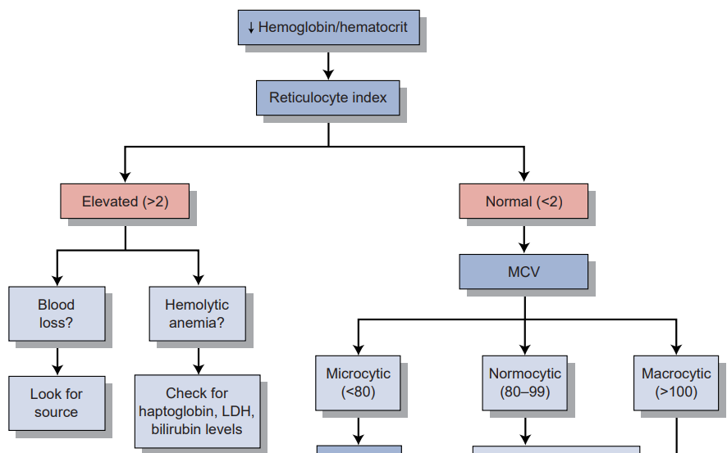
Approach to anemia

Slide 8
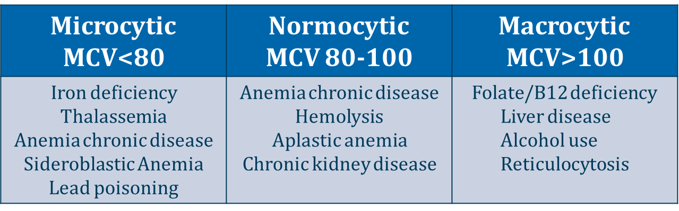

Slide 9
Microcytic Anemia

Slide 10
Iron Deficiency Anemia:
- Most common cause of anemia worldwide
Iron is essential for the production of hemoglobin, and a deficiency leads to impaired erythropoiesis and iron deficiency anemia (IDA).
Causes:
Chronic blood loss (most common) from either the gastrointestinal (especially PUD, malignancies) or genitourinary tracts (e.g., menorrhagia)
Pregnancy (increased iron requirements)
Malabsorption (e.g., celiac disease or gastric bypass surgery)
Lack of dietary iron

Slide 11
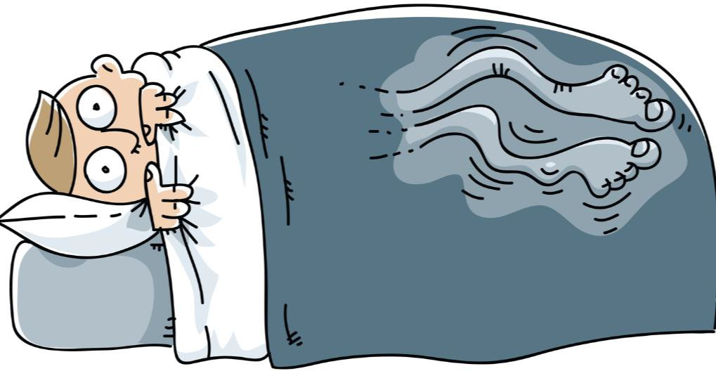
Clinical features
Fatigue, pallor, dyspnea
Pica
  Craving for non-food substances
  Clay or dirt (geophagia)
  Ice (pagophagia)
Restless legs syndrome
Koilonychia ( spoon shaped nails )
Restless Leg Syndrome

Slide 12
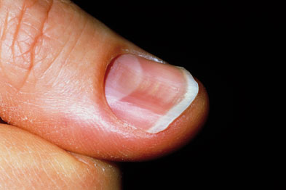
koilonychia

Slide 13
Iron Metabolism
Iron always bound to a protein
Transport protein: transferrin
  Transported in blood via transferrin
  ↑ transferrin when iron stores are low
Storage protein: ferritin
  Stored intracellularly as ferritin
  Stored in macrophages of liver and bone

Slide 14
Iron Measurements
Test | Interpretation
Serum iron | Iron level
Total Iron Binding Capacity | Amount of transferrin in serum
Serum ferritin | Amount of storage iron
% saturation | Amount of transferrin bound to Fe

Slide 15
Iron Deficiency
↑ Iron Loss
↓ Iron Intake
Loss > Intake
Test | Fe Deficiency
Serum iron | ↓
TIBC | ↑
Serum ferritin | ↓
% saturation | ↓↓
↓ Ferritin
(storage form)
↑ Transferrin
(TIBC)
Response to low iron stores Body seeking more iron
↓ Serum iron
↓ % Sat
(Iron/TIBC)
↓ Iron
↑ TIBC

Slide 16
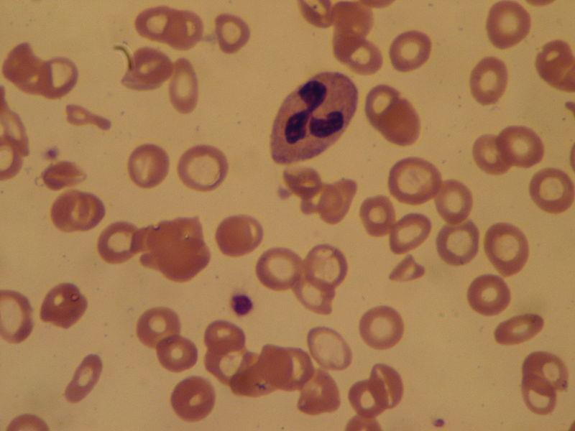
Iron Deficiency Anemia
Microcytic, hypochromic anemia
  ↓ RBC/Hgb/Hct
  Low MCV (small cells)
  Hypochromic (low hemoglobin)
Low reticulocyte count (↓ Hgb)
Roberto J. Galindo

Slide 17
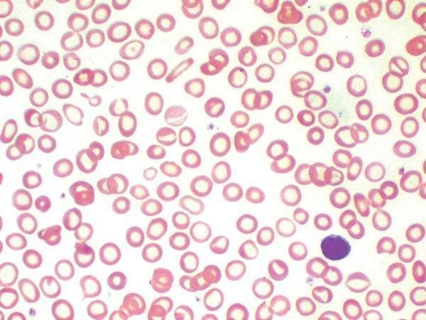
Blood smear: iron deficiency anemia

Slide 18
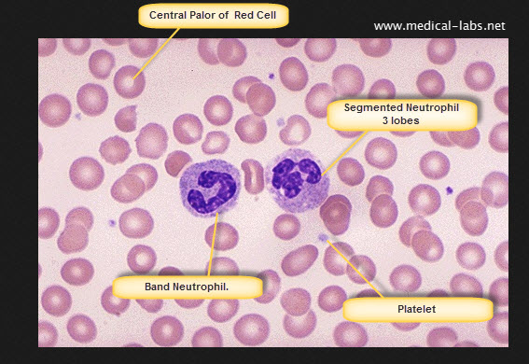
Normal red blood cell – peripheral blood smear

Slide 19
Red Cell Distribution Width
RDW
Spectrum of RBC size
Often increased in iron deficiency
Normal RDW makes iron deficiency unlikely ➔ consider thalassemia
Iron Deficiency Anemia
Normal
Number of cells
RBC Size

Slide 20
Diagnosis
1. Peripheral blood smear:
Red cells are microcytic (MCV < 80 mm3) hypochromic (decreased MCHC), with a low reticulocyte count.
High RDW.
2. Iron studies:
Decreased serum ferritin—most reliable test available
Increased TIBC/transferrin levels
Decreased serum iron
Low saturation
3. Bone marrow biopsy—the gold standard, but rarely performed.
4. If GI bleeding is suspected—stool analysis ( for occult blood ) or colonoscopy

Slide 21

Treatment
Oral iron replacement (ferrous sulfate)
  Gastrointestinal side effects very common
  Constipation, diarrhea, epigastric pain, nausea/vomiting
  Black, green or tarry stools
Parenteral iron replacement (Iron dextran can be administered IV or IM)
  Used when GI side effects prohibit oral replacement
  Or patients with malabsorption
  Pregnancy (more rapid repletion of iron)
Blood transfusion is not recommended unless anemia is severe, or the patient has cardiopulmonary disease
Public Domain

Slide 22
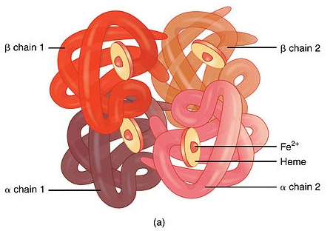
Hemoglobin development
Normal hemoglobin is a tetramer with 2 α- and 2 β-globin chains.
These tetramers are covalently linked to heme, a complex of ferrous iron and protoporphyrin.
A normal Hb electrophoresis pattern would be HbA (α2β2) > 97.5%, HbA2 < 2.5%.

Slide 23
Thalassemias
Inherited disorders characterized by inadequate production of either the α- or β-globin chain of hemoglobin
leading to decreased production of hemoglobin tetramers
Wide range of manifestation

Slide 24
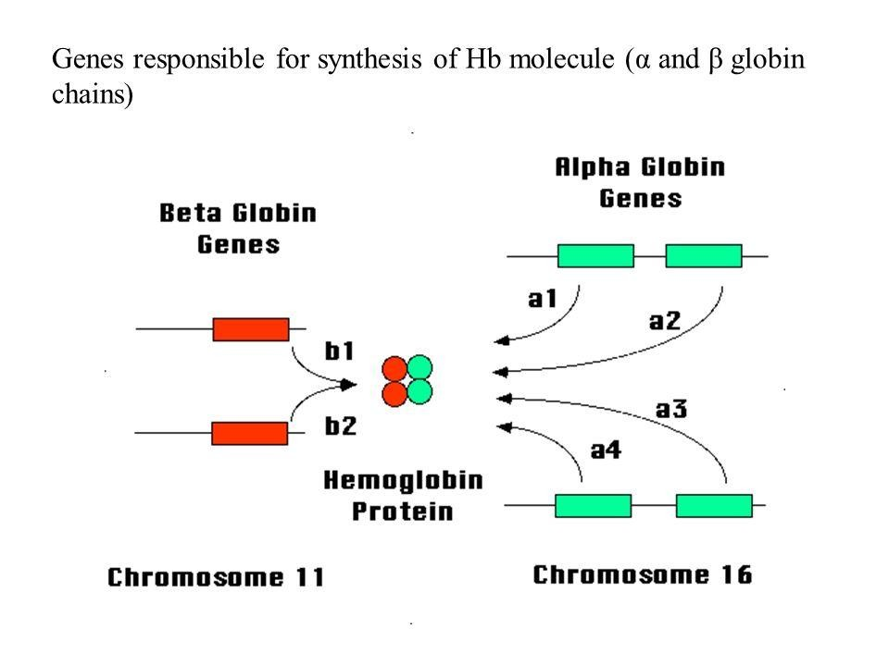

Slide 25
They are classified according to the chain that is deficient:
1-β thalassemia.
2-α thalassemia.

Slide 26
β-Thalassemias
Autosomal recessive.
Mutation in β-globin gene on chromosome 11.
β-chain production is deficient, but the synthesis of α-chains is unaffected.
It is most often found in people of Mediterranean, Middle Eastern, and Indian ancestry.

Slide 27
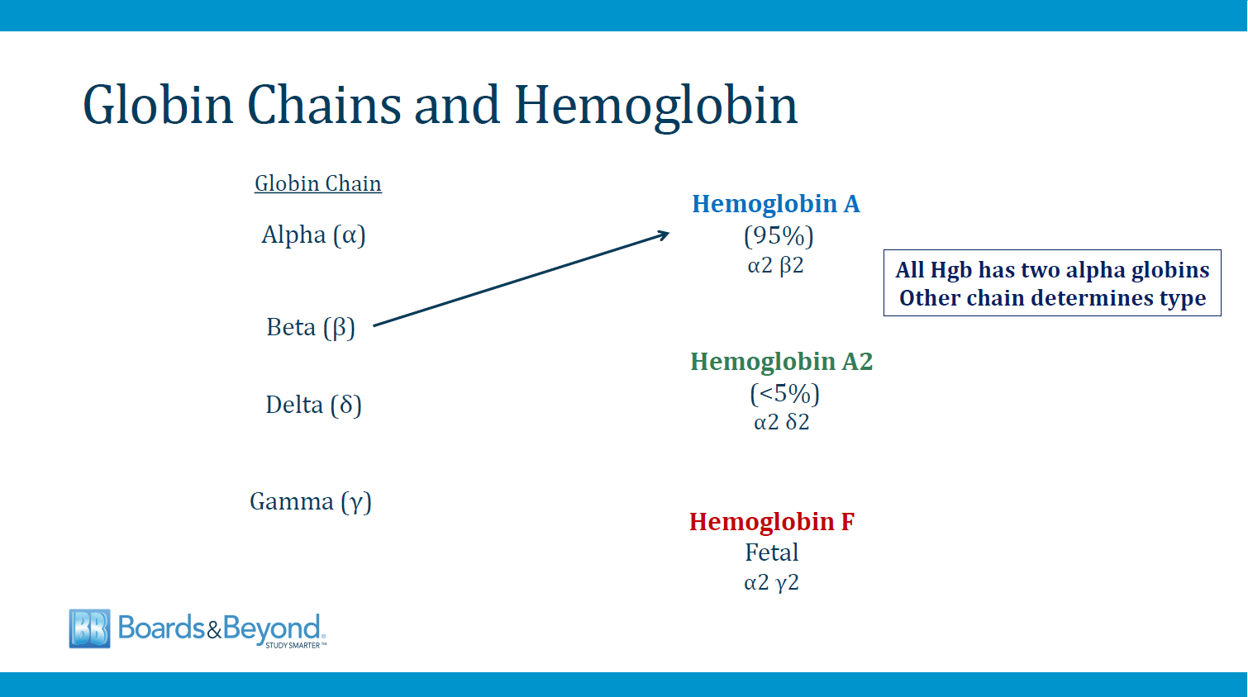

Slide 28
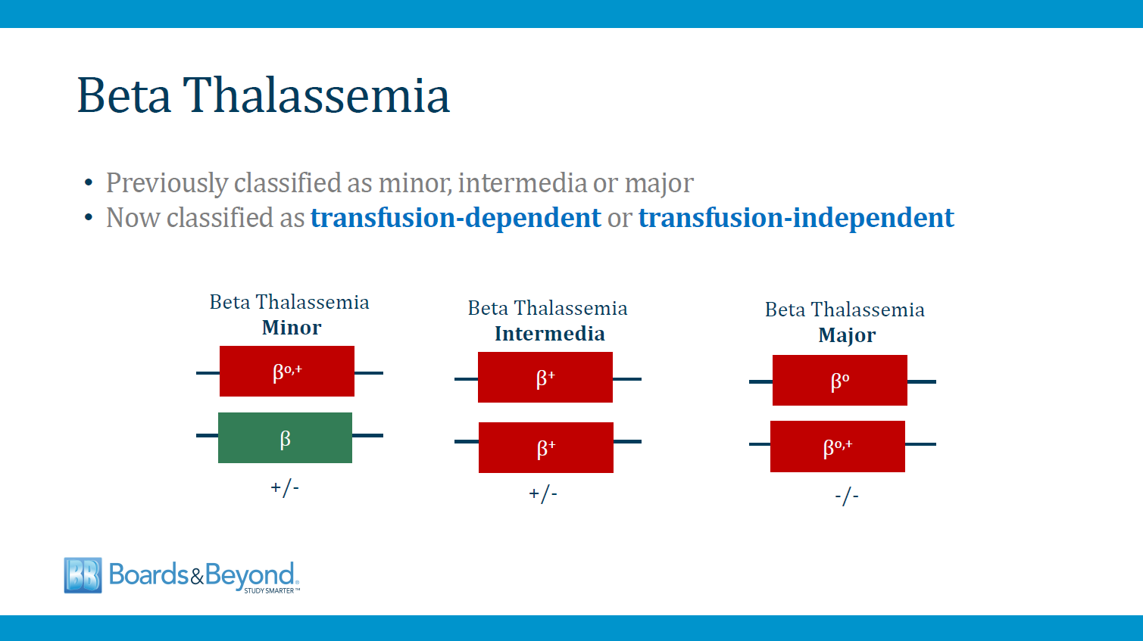
βo= no function; β+= some function

Slide 29
1. Thalassemia minor (heterozygous β-chain thalassemia)
Clinical features: patients are usually asymptomatic.
Diagnosis:
hemoglobin electrophoresis: HbA2 (> 3.5%)
Peripheral blood smear: A mild microcytic, hypochromic anemia
Treatment: usually not necessary (Patients are not transfusion dependent.)

Slide 30
2. Thalassemia intermedia
Usually involves both β-globin genes
Severity of anemia is intermediate
Patients usually are not transfusion dependent
* May require episodic transfusions with stress
* Especially during infection or pregnancy

Slide 31
3. Thalassemia major (Cooley anemia; homozygous β-chain thalassemia)
Clinical features:
Severe anemia (microcytic hypochromic).
Massive hepatosplenomegaly.
Expansion of marrow space—can cause distortion of bones.
Growth retardation and failure to thrive.
If untreated (with blood transfusions), death occurs within the first few years of life secondary to progressive CHF.
Skull x-ray may show “crew-cut” appearance.

Slide 32
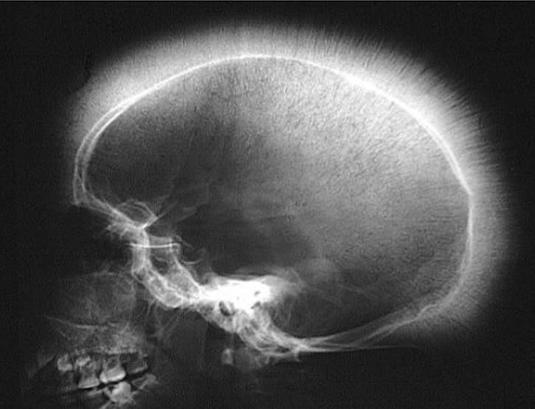
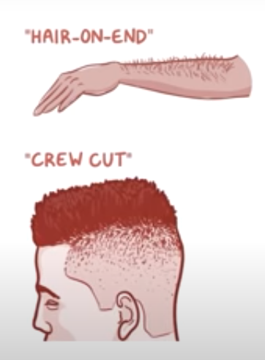
“crew-cut”/”Hair-on-end” appearance

Slide 33
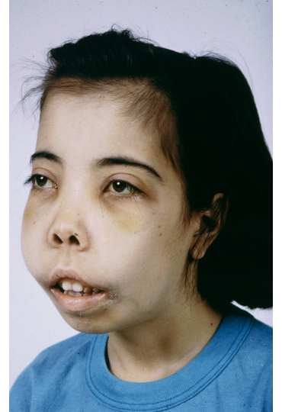
frontal bossing
maxillary hypertrophy
depression of nasal bridge
malocclusion of teeth
Thalassemic/chipmunk face

Slide 34
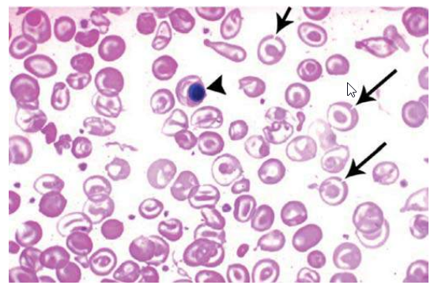
Diagnosis:
Hemoglobin electrophoresis:
Hb F and Hb A2 are elevated
Peripheral blood smear:
1. microcytic hypochromic anemia
2. target cells may be seen
Iron studies:
Serum Ferritin: Normal/high
Serum Iron: Normal/high
TIBC: Normal
Blood smear: thalassemia. Target cells (arrows) and circulating nucleated red blood cells (arrowhead).

Slide 35
Treatment
“Transfusion dependent”.
frequent PRBC transfusions are required to sustain life.
Splenectomy
Bone marrow transplantation
Iron overload sometimes develops in patients with transfusion-dependent thalassemia, and if untreated this can lead to CHF (symptoms of hemochromatosis). Therefore, these patients are often treated with chelating agents that eliminate excess iron:
Deferoxamine (IV).
Deferiprone (Oral).

Slide 36
Alpha Thalassemia

Slide 37
Alpha Thalassemia
* There is an α-globin gene deletions ,which lead to decrease in α-globin synthesis . which are a component of all types of hemoglobins .
* Chromosome 16 contains 2 copies of the a-gene at 2 different loci on each of the 2 genes. There are, therefore, 4 a-genes in normal individuals. The clinical manifestations correlate with the number of a-genes that are affected: the more loci affected, the worse the symptoms.
* This type is seen in African, Mediterranean, and Southeast Asian populations .

Slide 38
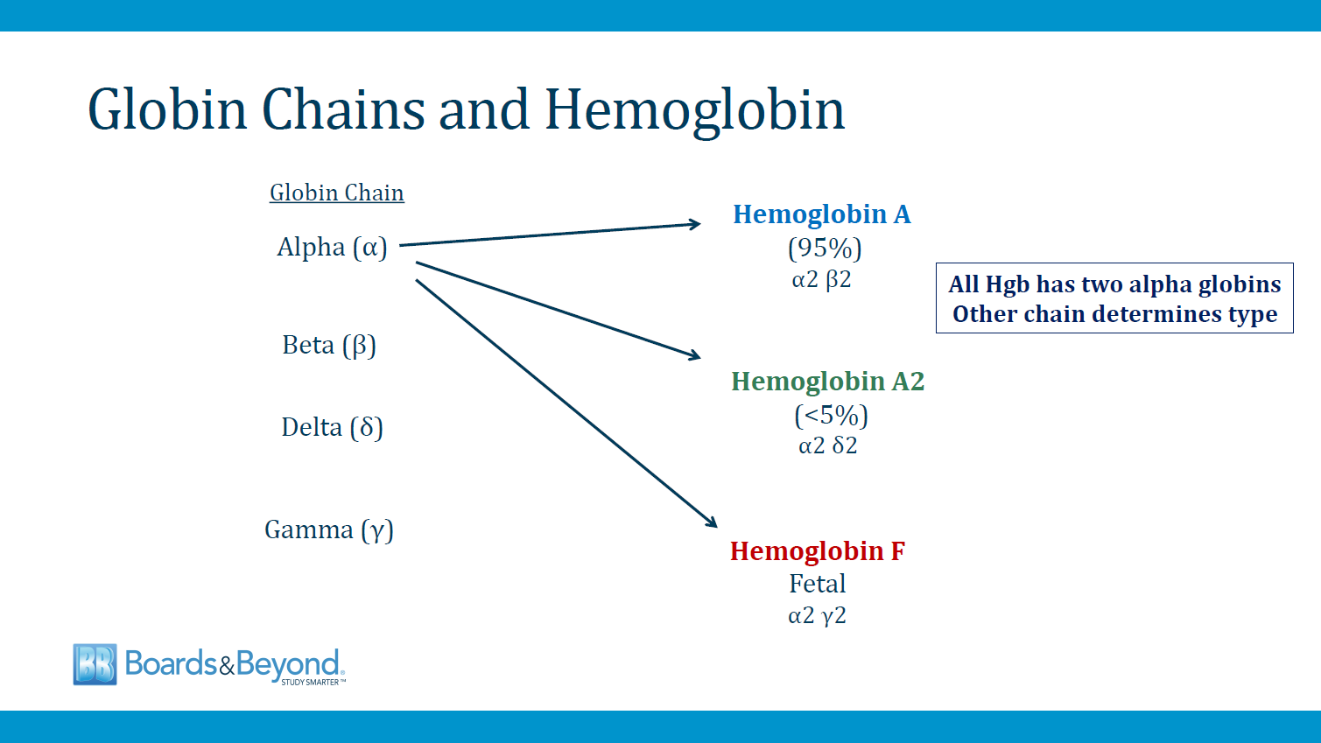

Slide 39
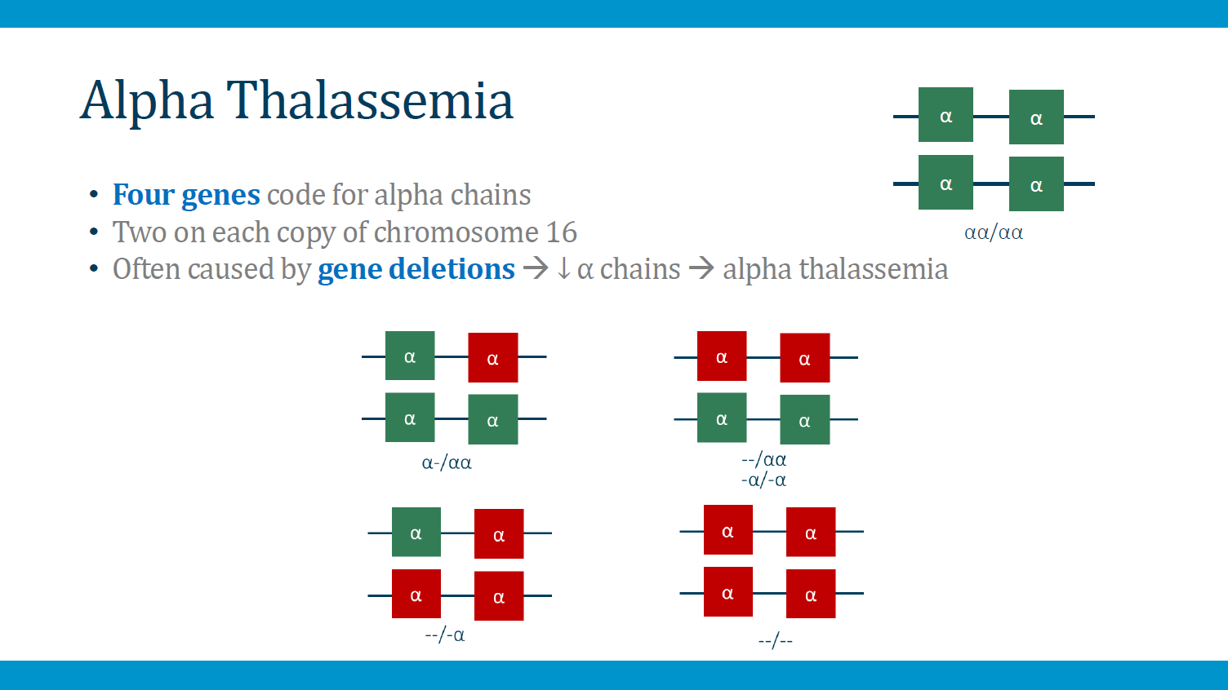

Slide 40
Alpha thalassemia types:
Silent carriers—mutation/deletion of only one α-locus
Asymptomatic
Normal hemoglobin and hematocrit level
No treatment necessary
α-Thalassemia trait (or minor)—mutation/deletion of two α-loci
Characterized by mild microcytic hypochromic anemia
Common in African-American patients
No treatment necessary

Slide 41
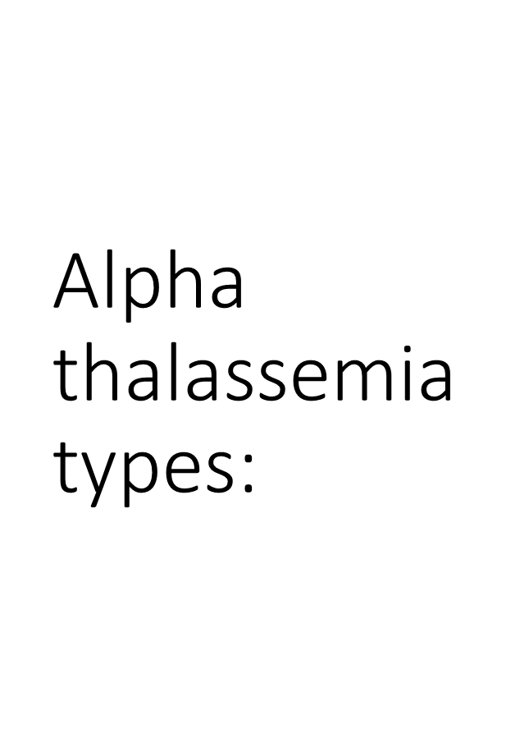
Hb H disease—mutation/deletion of three α-loci
Significant microcytic, hypochromic anemia
Hemoglobin electrophoresis shows Hb H
Treatment is often the same as for patients with β-thalassemia major. Splenectomy is sometimes helpful.
Mutation/deletion of all four α-loci
Hemolytic anemia, splenomegaly
4 tetramers (Hb Bart's) form and have such high oxygen affinity that they do not deliver any oxygen to the tissues, causing death in utero (hydrops fetalis).

Slide 42
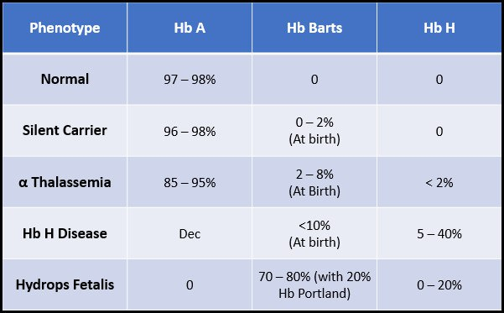
Diagnosis:
Peripheral blood smear ---micocytic hypochromic RBCs
Hemoglobin electrophoresis

Slide 43
SIDROBLASTIC ANEMIA
Type of microcytic anemias that occur due to defective in protoporphyrin synthesis
Hemoglobin = hem + globin
Hem = ferretin + protoporphorin , so any decrease in protoporphorin will lead to decrease heme thus will decrease hemoglobin which will cause microcytic anemia .
Mainly it’s an abnormality in RBC iron metabolism

Slide 44
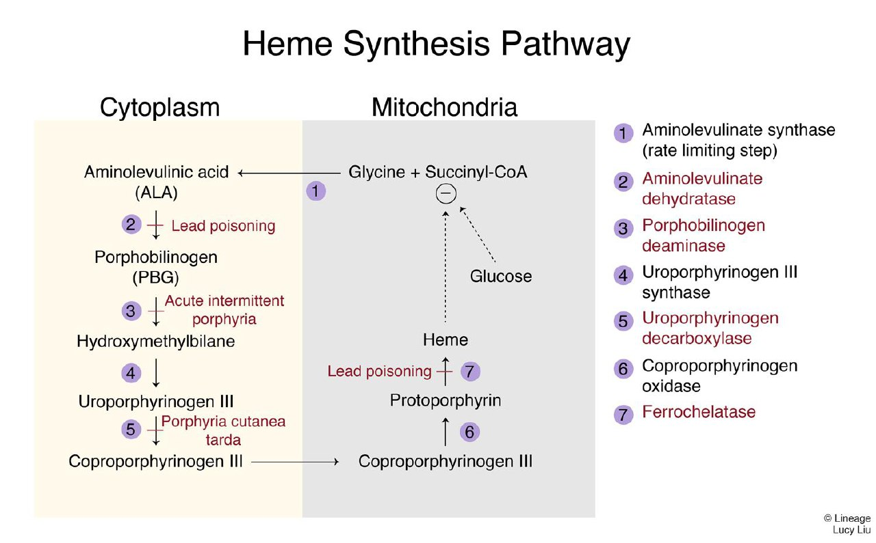

Slide 45
Cont.
It can be divided into :
Congenital : mainly due to ALAS defect ( the rate limiting step enzyme )
Acquired (reversible) :
Exposure to lead which denature the enzyme ( inhibit ALAD and FERROCHELATASE)
Alcohol ( toxic to the mitochondria, hence it will damage the production of protoporphorin)
Vitamin B6 deficiency ( cofactor and a rate limiting step for ALAS to function properly)
Drugs ( isoniazid , chloramphenicol )
Neoplastic disease (Myelodysplastic syndromes).

Slide 46
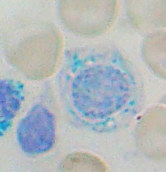
Clinical features : general signs and symptoms of anemia.
Lab findings:
Iron studies : High iron, normal/low TIBC, high ferritin.
Bone marrow biopsy : Ringed sideroblasts (with iron-laden, Prussian blue–stained mitochondria .
Peripheral blood smear: Basophilic stippling of RBCs.
Treatment :
Remove the offending agent .
Pyridoxine (B6, cofactor for δ-ALA synthase)

Slide 47
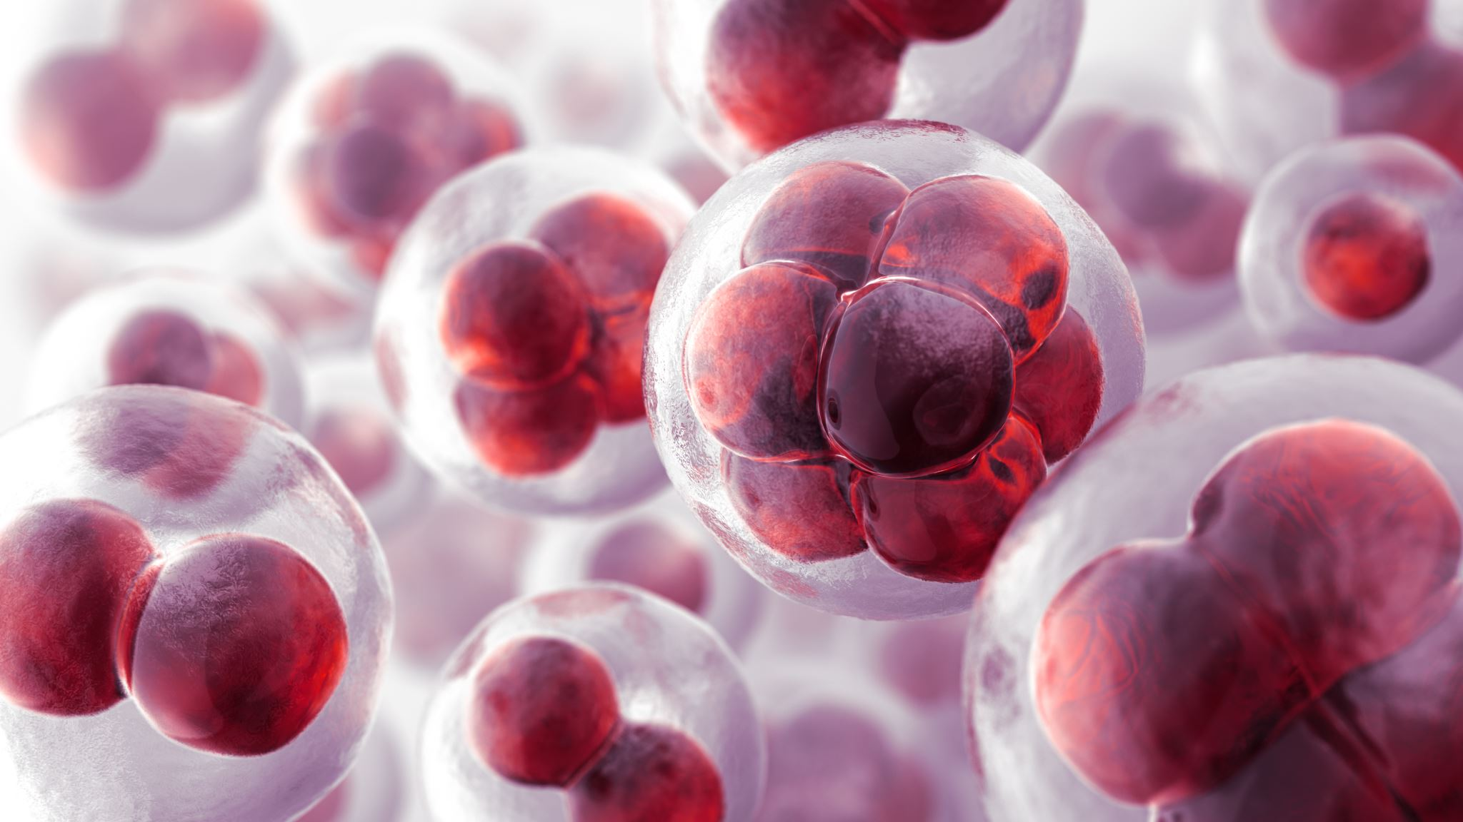
Macrocytic Anemia

Slide 48
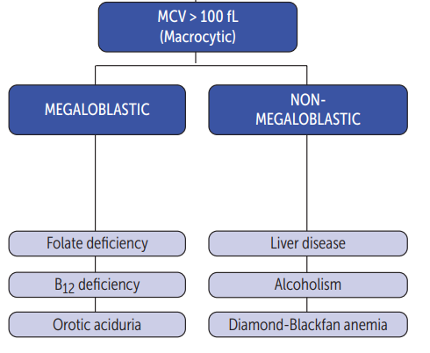

Slide 49
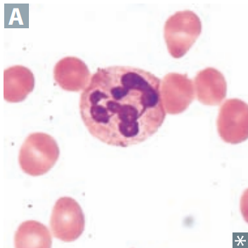
Megaloblastic anemia
Impaired DNA synthesis ---maturation of nucleus of precursor cells in bone marrow delayed relative to maturation of cytoplasm.
They are often the result of deficiencies of B12 and/or folate but may also result from drugs that impair DNA metabolism.
Findings :
Macrocytic RBC
Hypesegmented neutrophil
Glossitis
Pancytopenia

Slide 50
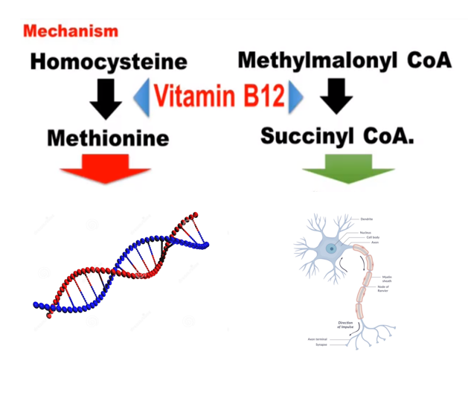
1) Vitamin B12 (cobalamin) deficiency
Vitamin B12 stores in the liver are plentiful, and can sustain an individual for 3 or more years.
The main dietary sources of vitamin B12 are meat and fish.
Vitamin B12 is bound to intrinsic factor (produced by gastric parietal cells), so it can be absorbed by the terminal ileum.

Slide 51
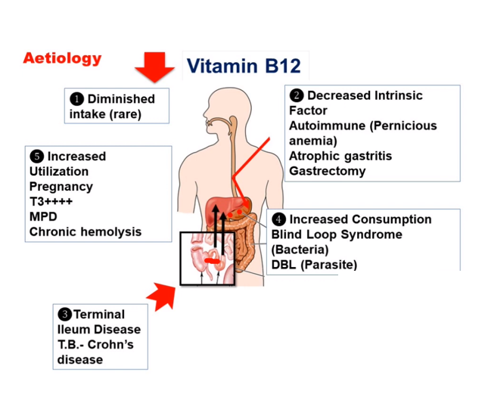

Slide 52
Clinical features
Anemia
1. A variety of nonspecific complaints—headache, fatigue, poor
concentration, diarrhea, nausea, vague abdominal discomfort
2. Pallor—best noted in the conjunctiva
3. Hypotension and tachycardia
Sore tongue (stomatitis and glossitis)
Neuropathy (can distinguish between vitamin B12 deficiency and folate deficiency)

Slide 53
Cont.
Neuropathy
Demyelination in posterior columns, in lateral corticospinal tracts and spinocerebellar tracts—leads to a loss of position/vibratory sensation in lower extremities, ataxia, and upper motor neuron signs (increased deep tendon reflexes, spasticity, weakness, Babinski sign).
Can lead to urinary and fecal incontinence, impotence .
Can lead to dementia—Investigate in the
workup for dementia .

Slide 54
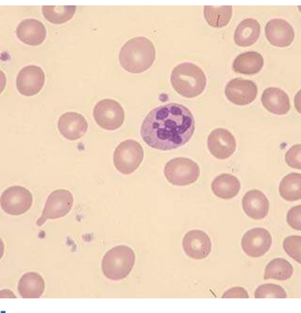
Diagnosis:
1. Peripheral blood smear.
a. Megaloblastic anemia—macrocytic RBCs (MCV >100).
b. Hypersegmented neutrophils .
2. Serum vitamin B12 level is low (<200 pg/mL).
3. Serum methylmalonic acid and homocysteine levels—these are elevated in vitamin B12 deficiency and are useful if the vitamin B12 level is borderline.
4. Antibodies against intrinsic factor can help in the diagnosis of pernicious anemia.

Slide 55
Treatment
Teart with daily injections for 1 week , followed by weekly injections for 1 month , and then monthly injections for life.
Severely anemic patients can develop hypokalemia with treatment , so monitor k levels in these patients .

Slide 56
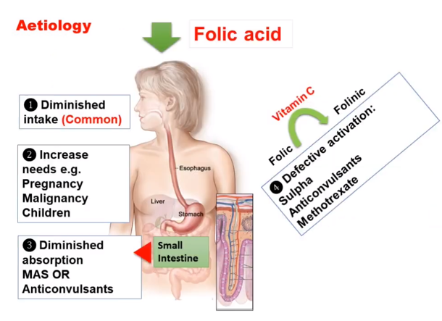
2) Folic acid deficiency
Folic acid stores are limited. Inadequate intake of folate over a 3-month period can lead to deficiency.
Green vegetables are the main source of folate. Overcooking of vegetables can remove folate.
Clinical features: Similar to those of vitamin b12 deficiency except there is no neurological symptoms .
Treatment: Treat with daily oral folic replacement.

Slide 57
 | Vit B12 deficiency | Folate deficiency
Neurological manifestations | yes | no
Homocysteine level | high | high
Methylmalonic acid | high | normal
Peripheral blood smear | Macrocytic RBCs, hypersegmented neutrophils

Slide 58
3) Orotic aciduria
Inability to convert orotic acid to UMP (de novo pyrimidine synthesis pathway) because of defect in UMP synthase.
Autosomal recessive ,presents in children as failure to thrive, developmental delay, and megaloblastic anemia refractory to folate and B12.
No hyperammonemia (vs ornithine transcarboxylase deficiency—orotic acid with hyperammonemia)
Orotic acid in urine.
Treatment: uridine monophosphate or uridine triacetate to bypass mutated enzyme.

Slide 59
Nonmegaloblastic anemia
Macrocytic anemia in which DNA synthesis is unimpaired.
Findings :
RBC macrocytosis without hypersegmented neutrophils.
Causes:
Chronic alcoholism, due to a direct toxic effect on the bone marrow.
Bone marrow disorders (e.g., myelodysplastic syndromes, lymphoma, myeloma, myelofibrosis, cancer) .
Liver disease
Cytotoxic drugs such as azathioprine, hydroxyurea, and 6-mercaptopurine .
Reverse transcriptase inhibitors, such as stavudine, lamivudine, and zidovudine, because these drugs interfere with DNA metabolism.
Diamond-blackfan anemia

Slide 60
Thank you

