Slide 1
Mini once exam
Orthopedics
B5,6,7,8

Slide 2
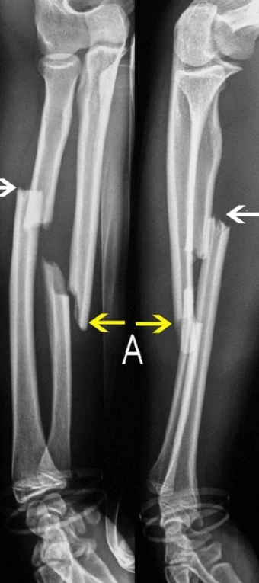
Q1. Describe the fractures
It was a transverse fracture of ulna and segmental fracture of radius (I couldn’t find the exact picture

Slide 3
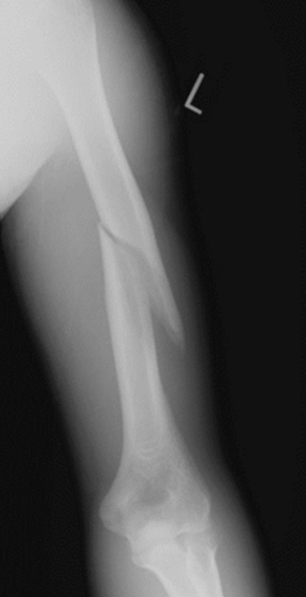
Q2.
A. What is the type of fracture
B.what is the feared complication
Spiral fractures of humerus shaft
Neurovascular injury –brachial artery and radial nerve

Slide 4
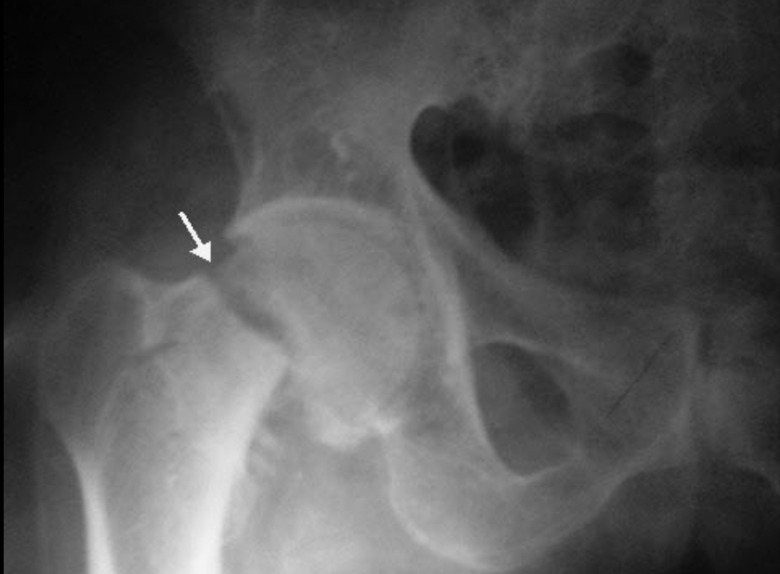
Q3.
A. Name the fracture b. Mention the most 2 feared complications
A. Femoral neck fracture
B. Avascular necrosis of head of femur
b. Non union of the fracture due to instability

Slide 5
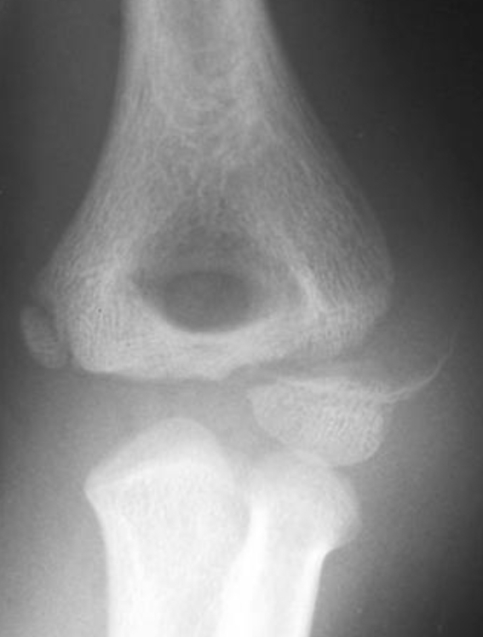
Q4. What is the deformity possibly will happen if this fracture didn’t unite
Cubits valgus

Slide 6
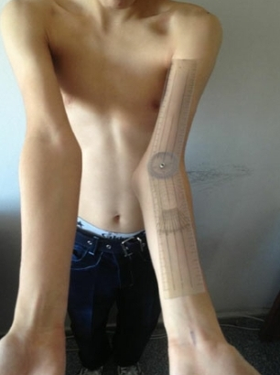
Q5. A.Name the deformity b. What is the main complication
A. Cubits valgus
Ulnar nerve damage

Slide 7
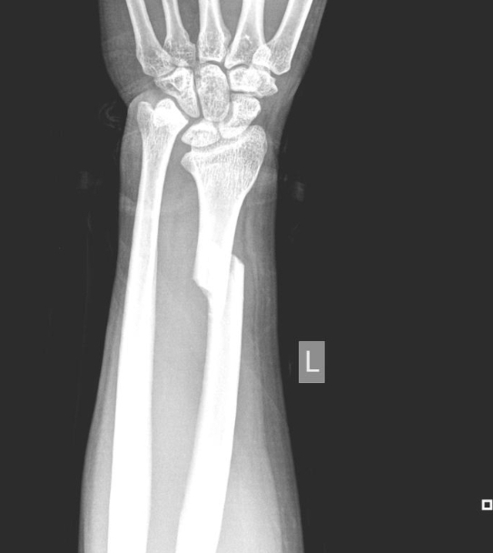
Q6. Name the fracture
Geleazi Fracture

Slide 8
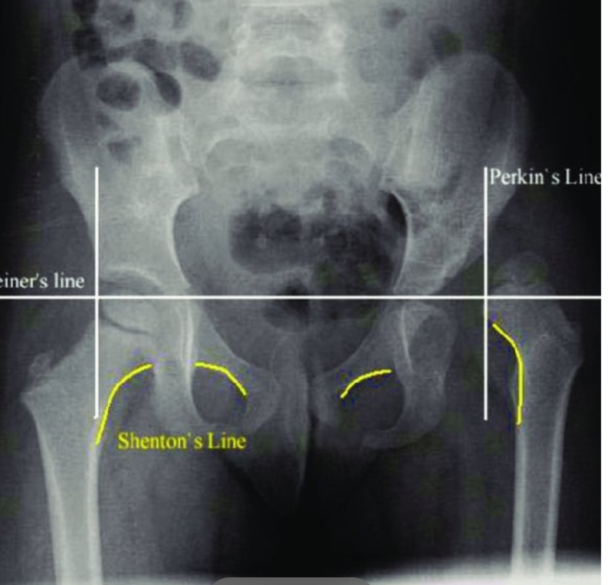

Q8. A. Name the line indicated by the arrow b. What are the deformity seen in right and left hip
Perkins line
Left is DDH right is normal

Slide 9
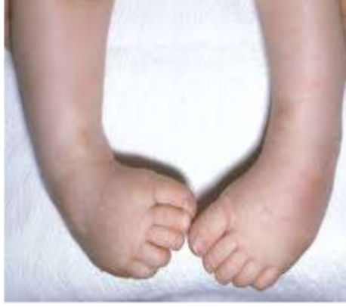
Q9. Name the deformity (without abbreviations)
Talipes Equinovarus

Slide 10
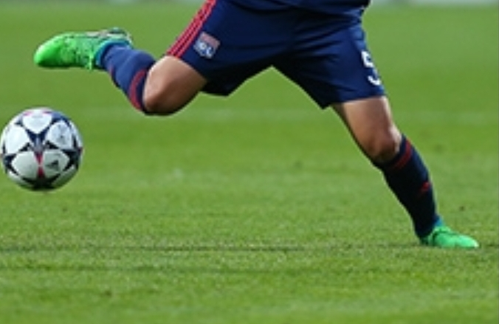
Q10. A. Mention the mechanism of injury, the force/s in it
B. What is the injured structure
A. Pivot injury :valgus and rotation of femur among tibia
B. ACL injury

Slide 11
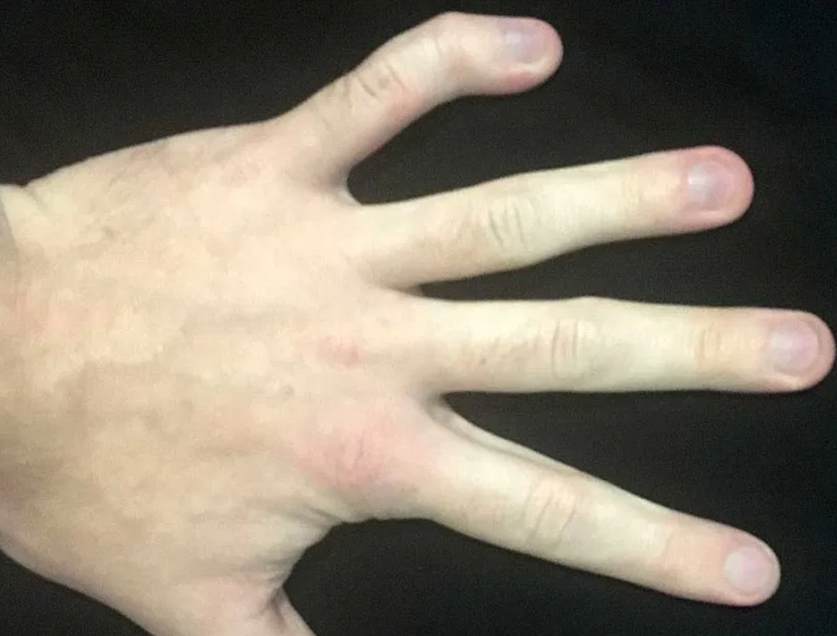
Q11. Name the deformity
Clinodactyly

Slide 12
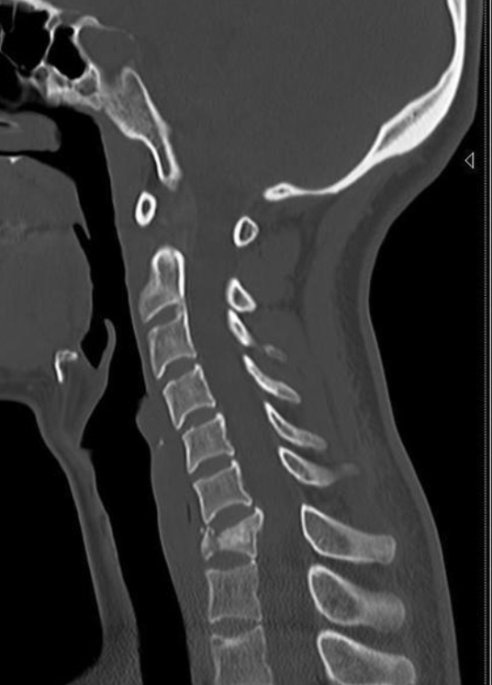
Q12. Name the fracture
answer :-not sure – could be tear drop or wedge fracture – the photos has the spine fractured too-

Slide 13
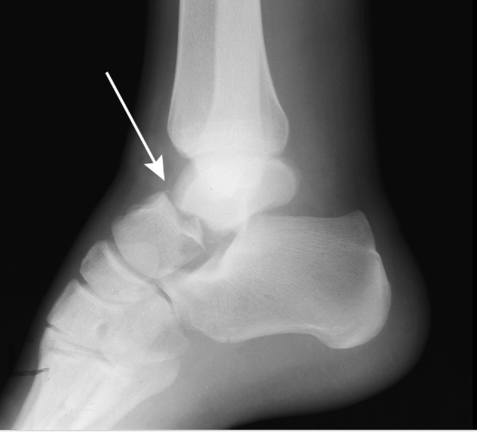
Q13. Name the bone
Talus

Slide 14
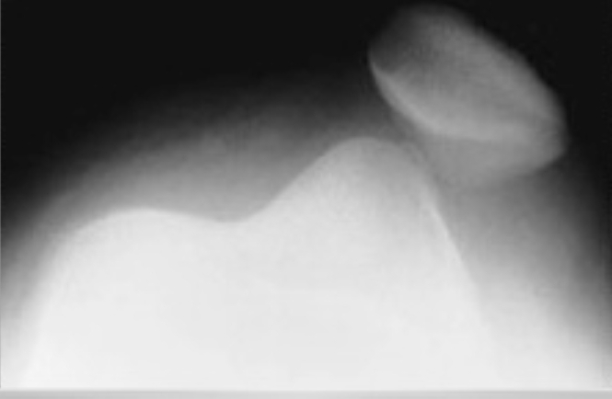
Q14. A. Name the problem b. What is the ligament injury associated with it
A. Lateral dislocation of the patella
Medial patellofemoral ligament

Slide 15
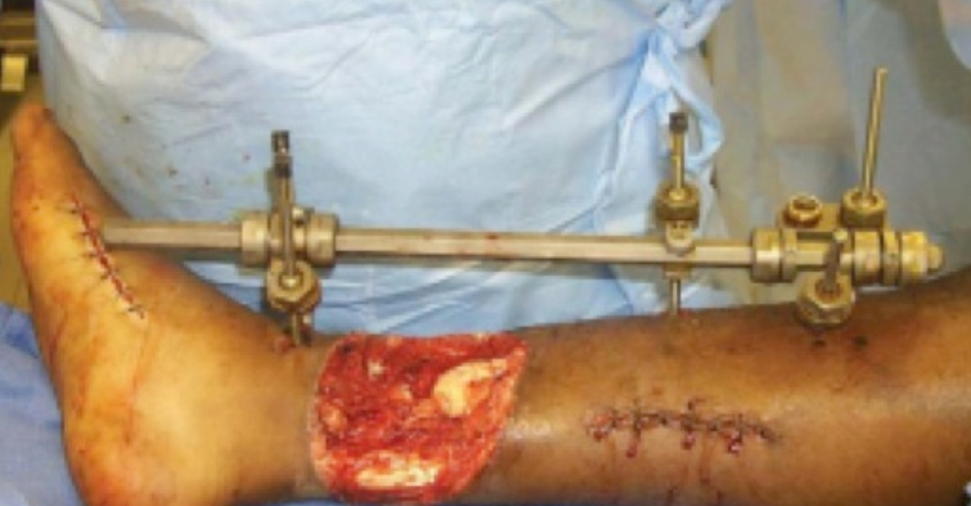
Q15. A.What stage this fracture in b. What is the most feared complication
A. Gestilio 3b – dr said peripheral pulses preserved –
B. Infection

Slide 16
. Q16 Describe the displacement of these fracture-couldn’t find the pic-

