Slide 1
BRUCELLOSIS
Marwan Shalabi, MD, FAAP.
Pediatric Infectious Diseases Consultant

Slide 2
ETIOLOGY
Brucella abortus (cattle)
B. melitensis (goat/sheep)
B. suis (swine)
B. canis (dog)
Aerobic, non–spore-forming, nonmotile, gram-negative coccobacillary bacteria
Fastidious

Slide 3
EPIDEMIOLOGY
Rare in industrialized countries
Prevalent in : in the Mediterranean basin, Arabian Gulf, Indian subcontinent, and parts of Mexico and Central and South America.
Unpasteurized milk from goats or camels may be used to feed children, thus leading to the development of brucellosis.

Slide 4
EPIDEMIOLOGY
Routes of infection :
  Cuts or abrasions
  Conjunctiva
  Inhalation of infectious aerosols
  or ingestion of contaminated meat or dairy products.
B. melitensis and B. suis tend to be more virulent than B. abortus or B. canis.
Zoonitic

Slide 5
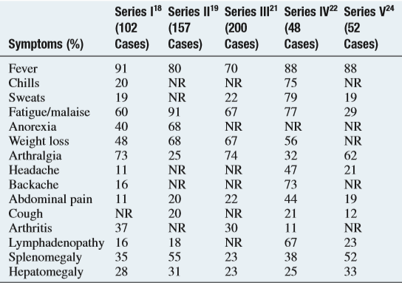
Clinical Findings in Childhood Brucellosis from Selected Seriesa

Slide 6
CLINICAL MANIFESTATIONS
nonspeciﬁc, beginning 2-4 wk after inoculation
  classic triad of fever, arthralgia/arthritis, and hepatosplenomegaly
  fever of unknown origin.
  abdominal pain, headache, diarrhea, rash, night sweats, weakness/fatigue, vomiting, cough, and pharyngitis

Slide 7
CLINICAL MANIFESTATIONS
Invasive infections: Meningitis, Bacteremia and SA/Osteomyelitis
Arthritis of the knees and hips in children and of the sacroiliac joint in adolescents and adults can be found.
Neonatal and congenital infections with these organisms have also been described.

Slide 8
DIAGNOSIS
CBC:thrombocytopenia, neutropenia, anemia, or pancytopenia.
history of exposure to animals or ingestion of unpasteurized dairy products may be more helpful.
A deﬁnitive diagnosis is established by recovering the organisms:
  Blood Culture. alert micro lab.
  Bone Marrow culture : alert micro lab.
  Bone marrow cultures may be superior to blood cultures

Slide 9
DIAGNOSIS
Serology
  Serum agglutination test (SAT)
    Measures total Ab ( IgM and IgG)
  False-positive results due to cross-reacting antibodies to other gram-negative organisms:
    Yersinia enterocolitica
    Francisella tularensis
    Vibrio cholerae

Slide 10
RECOMMENDED THERAPY FOR THE TREATMENT OF BRUCELLOSIS
< 8 years: | Rifampicin + TMP/SMX | Add IV Gentamycin for hospitalized patient
> 8 years: | Rifampicin + Doxycycline | Add IV Gentamycin for hospitalized patient

Slide 11
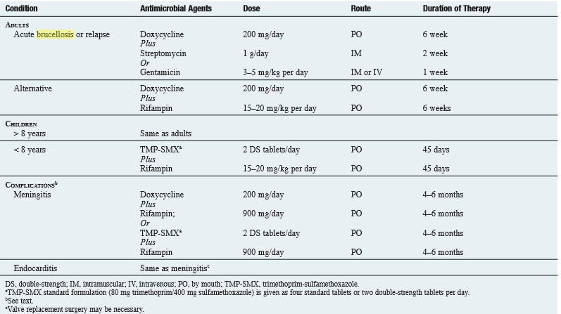
RECOMMENDED THERAPY FOR THE TREATMENT OF BRUCELLOSIS

Slide 12


