Slide 1
Hyperbilirubinemia
Dr. Salma Burayzat
Assistant Professor
Pediatric Gastroenterology, Hepatology and Nutrition

Slide 2
Hyperbilirubinemia
Definition
Types

Slide 3
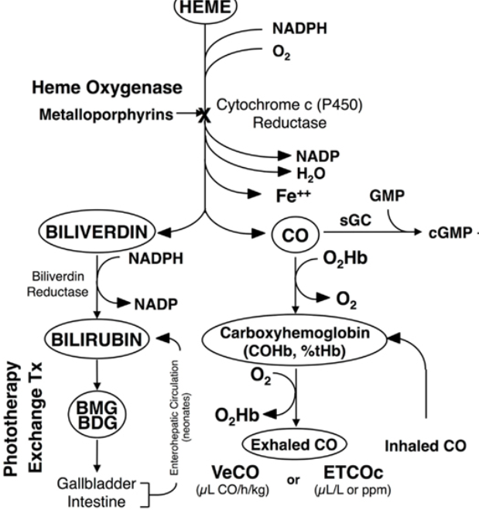

Slide 4
Inherited disorders of bilirubin conjugation

Slide 5
Crigler-Najjar syndrome type 1
Autosomal recessive
Glucuronyl transferase deficiency
Severe unconjugated hyperbilirubinemia develops in in the first 3 days of life
Kernicterus is almost universal complication
Stools are pale yellow.

Slide 6
Crigler-Najjar syndrome type 1
Diagnosis
  Decreased bilirubin concentration in the bile
  Measuring hepatic glucuronyl transferase activity in a liver biopsy
  DNA diagnosis
  Treatment
  Serum unconjugated bilirubin concentration should be kept to <20 mg/dL
  Exchange transfusions and phototherapy.
  liver transplantation cures the disease

Slide 7
Crigler-Najjar syndrome type II
  Autosomal recessive
  Partial deficiency of enzymes activity
  Development of kernicterus is unusual.
  Stool color is normal
  Significant response to phenobarbital in type 2

Slide 8
Gilbert syndrome
Common, affecting up to 5-10% of the white population
Decrease normal gene activity but only to ∼30%.
Usually presents after puberty
Total serum bilirubin concentrations fluctuate from 1 to 6 mg/dl, mainly unconjugated

Slide 9
Cholestasis

Slide 10
Cholestasis
The first step in evaluating a jaundiced infant is to measure the serum concentrations of both total and conjugated bilirubin.
An elevated conjugated bilirubin is an abnormal finding and requires additional evaluation

Slide 11
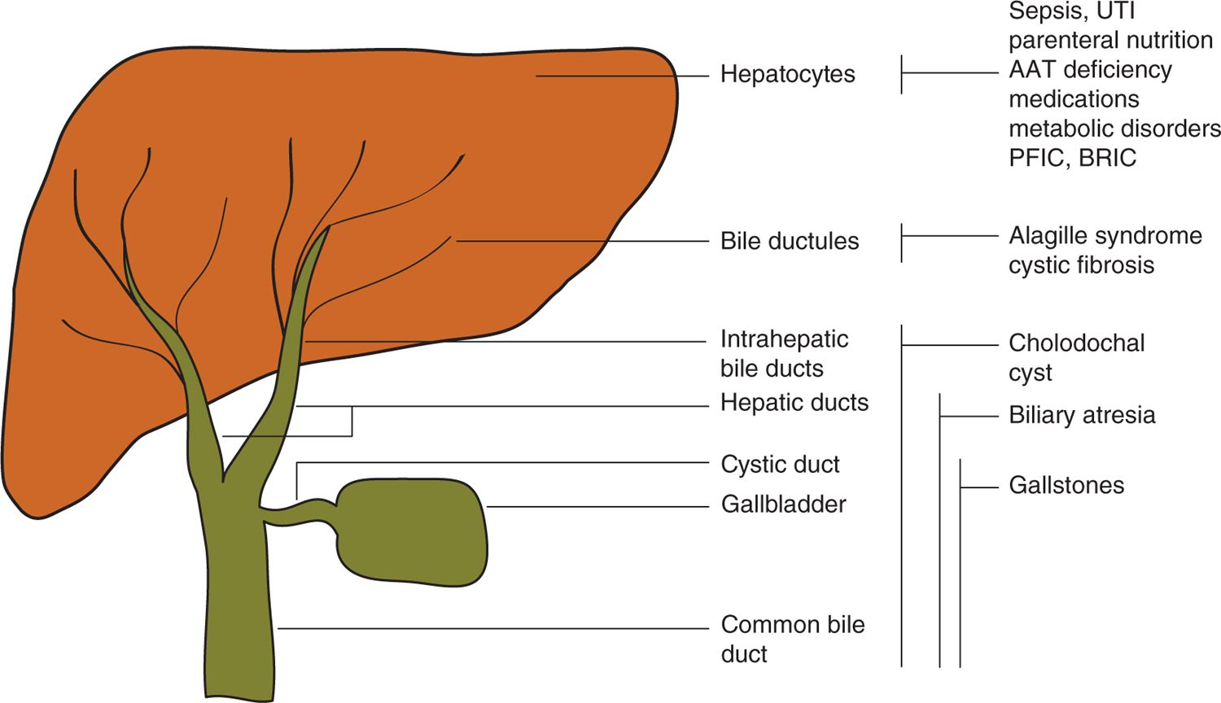
Cholestasis

Slide 12
Cholestasis-History
Vomiting
Stooling pattern
Stool color
Urine
Excessive bleeding
Consanguinity
Congenital infections
Prenatal ultrasonography and
Neonatal infection
Dietary history
Weight gain

Slide 13
Cholestasis-Physical examination
Assessment of general health
Measurement of vital signs
Growth parameters
Abnormal/ characteristic facial features
Cardiac examination
Abdominal examination
Inspection of the urine and stool
Bruising or petechial rash
Fundoscopic examination

Slide 14
Cholestasis-evaluation
Evaluation should be undertaken in a staged approach :
The initial step is rapid diagnosis and early initiation of therapy of treatable disorders
Additional testing is directed at the diagnosis of specific conditions

Slide 15
Cholestasis-Laboratory evaluation
Complete blood count with platelet count
Urinalysis & culture
Testing for reducing substances
Thyroid function tests
Blood cultures
Acid-base status
  Total and conjugated bilirubin
  Serum ALT, AST, & GGT
  Prothrombin and partial thromboplastin times
  Serum albumin and glucose concentrations.
  Blood ammonia concentration
Alpha-1 antitrypsin level
Screening for cystic fibrosis

Slide 16
Cholestasis-Radiological evaluation
Ultrasonography
Hepatobiliary scintigraphy
MRCP
Liver biopsy
Cholangiogram

Slide 17
Biliary Atresia
Biliary atresia (BA) is a progressive, idiopathic, fibro-obliterative disease of the extrahepatic biliary tree that presents with biliary obstruction exclusively in the neonatal period
BA is the most common indication for liver transplantation in children.
BA has 3 types……………
Pathogenesis is unknown

Slide 18
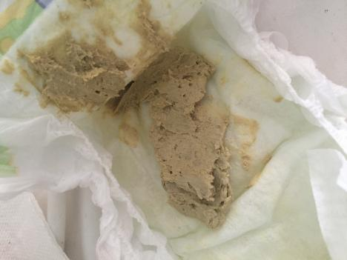
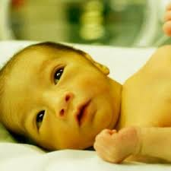
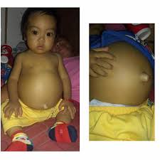
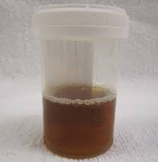
Biliary atresia
CLINICAL FEATURES

Slide 19
Biliary atresia
DIAGNOSIS
  Abdominal ultrasound: the gallbladder is usually either absent or irregular in shape
  Hepatobiliary scintigraphy: failure of tracer excretion suggests BA
  Liver biopsy

Slide 20
Biliary atresia
Management
Kasai procedure (hepatoportoenterostomy)

Slide 21
Alagille syndrome
Mutations in human Jagged1 gene (JAG1)
Autosomal dominant………………..
Arteriohepatic dysplasia is the most common syndrome with intrahepatic bile duct paucity.
Absence or marked reduction in the number of interlobular bile ducts in the portal triads

Slide 22
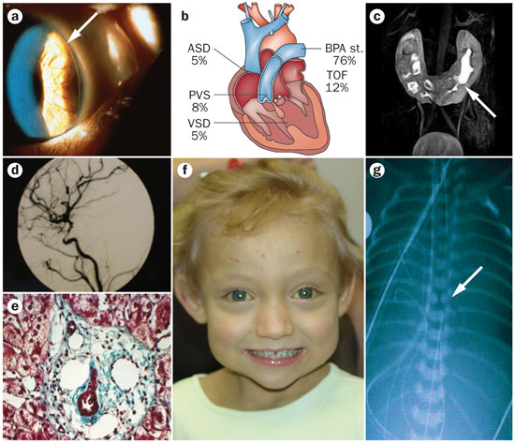
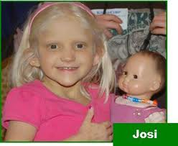
Alagille syndrome
Clinical manifestations

Slide 23
Alagille syndrome
The prognosis for prolonged survival is good, but patients are likely to have pruritus, xanthomas with markedly elevated serum cholesterol levels
Some cases require transplantation

Slide 24
Idiopathic neonatal hepatitis
Can occur in either sporadic or familial form
Neonate appears ill, failure to thrive
HIDA scan: failure of uptake
Liver biopsy: giant cell hepatitis
Treatment: supportive, majority recover

Slide 25
Progressive familial intrahepatic cholestasis (PFIC)
Defect in the canalicuar membrane transporters
PFIC type 1 (Byler disease) is a severe form of intrahepatic cholestasis.
PFIC type 2 (BSEP deficiency)
PFIC type 3 (MDR3 disease)
Affected patients present with steatorrhea, pruritus, vitamin D–deficient rickets, gradually developing cirrhosis

Slide 26
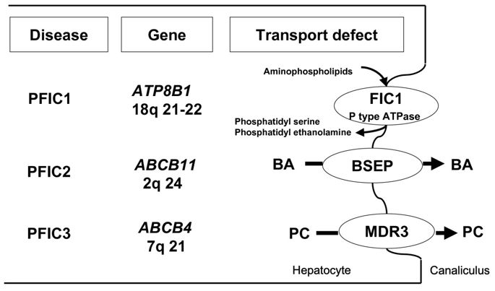
Progressive familial intrahepatic cholestasis (PFIC)

Slide 27
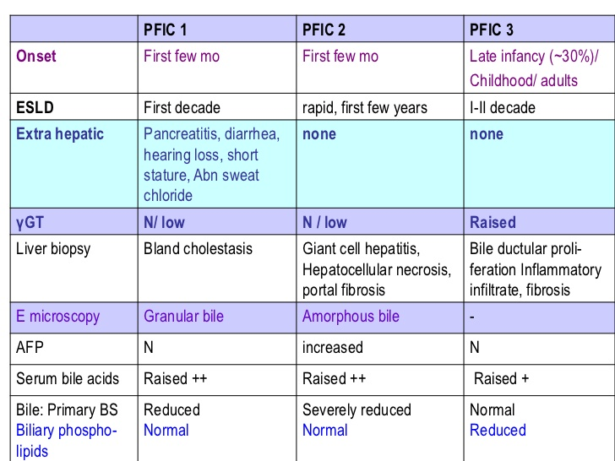
Progressive familial intrahepatic cholestasis (PFIC)

Slide 28
Zellweger (cerebrohepatorenal) syndrome
Autosomal recessive disorder marked by progressive degeneration of the liver and kidneys
The disease is usually fatal in 6-12 mo.
C/P: severe, generalized hypotonia and markedly impaired neurologic function with psychomotor retardation.
Patients have an abnormal head shape and unusual facial features, hepatomegaly, renal cortical cysts, calcifications of the patellas and greater trochanter, and ocular abnormalities.
Hepatic cells on ultrastructural examination show an absence of peroxisomes.

Slide 29
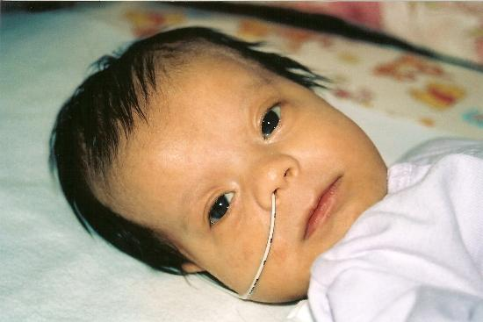
characteristic facial features such as a high forehead, underdeveloped eyebrow ridges, and wide-set eyes; and neurological abnormalities such as mental retardation and seizures

Slide 30
Aagenaes syndrome
Idiopathic familial intrahepatic cholestasis associated with lymphedema of the lower extremities.
Affected patients usually present with episodic cholestasis with elevation of serum aminotransferases, alkaline phosphatase, and bile acids.
Good prognosis, >50% have normal life span.
The locus for Aagenaes syndrome is on chromosome 15q.

Slide 31
Metabolic liver disease
When should we consider of metabolic liver disease?
Sick neonate not responding to usual treatment
Cholestasis , hepatomegaly
Seizure
Failure to thrive
Dysmorphic features
Metabolic acidosis
Persistent vomiting

Slide 32
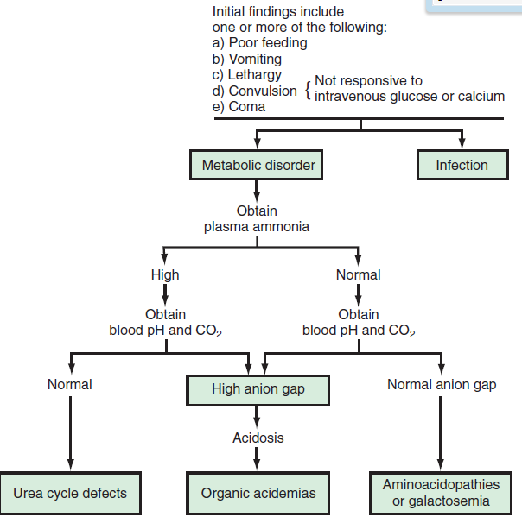

Slide 33
Galactosemia
Galactosemia is the most common metabolic cause of liver disease
deficiency of the galactose-1-phosphate uridyltransferase (GALT)
Manifestations
Symptoms of classic galactosemia occur in neonates within days of ingestion of lactose
These manifestations include poor feeding, vomiting, diarrhea, failure to thrive, hypoglycemia, jaundice, hepatomegaly, elevated transaminases, coagulopathy, ascites, liver failure, renal tubulopathy, lethargy, irritability, seizures, cataracts, and Escherichia coli neonatal sepsis.

Slide 34
Galactosemia
Diagnosis
The biochemical profile of galactosemia includes elevated galactose in plasma, galactose-1-phosphate in erythrocytes, and galactitol (reducing substances) in urine.
Diagnosis is confirmed by measuring GALT enzyme activity in erythrocytes and sequencing the GALT gene.
Management
Lactose-free formula should be started during the first 3 to 10 days of life

Slide 35
Tyrosinemia Type I
Tyrosinemia type I occurs due to deficiency of fumarylacetoacetate hydrolase
Manifestations
  Children with tyrosinemia type I can present during early infancy with vomiting, diarrhea, hepatomegaly, hypoglycemia, sepsis, liver failure with coagulopathy, ascites, jaundice, renal tubulopathy, and abnormal odor.

Slide 36
Tyrosinemia Type I
Diagnosis
  Elevated urine succinylacetone and tyrosine metabolites
  Elevated tyrosine and methionine in plasma.
  Serum a-fetoprotein is markedly elevated.
  Diagnosis can be confirmed by enzyme assay and molecular genetic testing for the FAH gene.
Management
  Nitisinone (NTBC) (1–2 mg/kg/d divided in 2 doses)
  Low tyrosine diet is also needed.

Slide 37
Hereditary Fructose Intolerance
It occurs due deficiency of fructose 1,6-biphosphate aldolase (aldolase B)
Manifestations
vomiting, hypoglycemia, jaundice, lethargy, irritability, seizures, coma, hepatomegaly, jaundice, elevated transaminases, coagulopathy, edema, ascites, liver failure, and renal tubulopathy.
Diagnosis
enzymatically by measuring the aldolase B activity in liver tissue and molecularly by sequencing the ALDOB gene.
Management
  Management is based on eliminating sucrose, fructose, and sorbitol from diet.

Slide 38
General management of cholestasis
High calories for growth
Medium chain TG
ADEK vitamins
Ursodeoxycholic acid
Specific management for specific diagnosis

