Slide 1
Chronic Kidney Disease (CKD) in Children
Dr Saiel Al Sarhan MD, PhD
Consultant & Assistant Professor of Pediatrics & Pediatric Nephrology.
Faculty of Medicine / Hashemite University
5th yr medical students 2020

Slide 2
Outlines
Definition
Pathogenesis
Stages
Etiology
Clinical presentation
Laboratory findings
Treatment
RRT

Slide 3
Definition
Kidney damage for ≥3 months, defined by structural or functional abnormalities of the kidney, with or without decreased GFR. OR:
GFR < 60 ml/min/1,73 m2 for > 3 months .
The Kidney Disease Outcomes Quality Initiative (KDOQI) working group of the National Kidney Foundation (NKF) defined chronic kidney disease as "evidence of structural or functional kidney abnormalities (abnormal urinalysis, imaging studies, or histology) that persist for at least 3 months, with or without a decreased glomerular filtration rate (GFR), as defined by a GFR of less than 60 ml/min /per 1.73 m².

Slide 4
A decade of efforts to define CKD !!
2002 2003 2004 2005 2006 2007 2008 2009 2010 2011 2012
K/DOQI CPG for CKD: Evaluation, classification & stratification. Am J Kidney Dis 2002; 39:S1
KDIGO ‘04 CC: Definition & classification of CKD. Kidney Int 2005;67:2089
KDIGO ‘06 CC: Definition & classification of CKD. Kidney Int 2007;72:247
KDIGO ‘09 CC: Definition & classification of CKD. Kidney Int 2010; 80:17
KDIGO CPG on CKD Kidney Int Suppl 2013; 3(1)

Slide 5
Criteria for CKD ( Present for >3 Months)
1. Markers of kidney damage (one or more)
- Albuminuria (albumin excretion rate [AER] ≥30 mg/24 hours;
- albumin-to-creatinine ratio [ACR] ≥30 mg/g [≥3 mg/mmol])-
- Urine sediment abnormalities
- Electrolyte and other abnormalities due to tubular disorders
- Abnormalities detected by histology
- Structural abnormalities detected by imaging
- History of kidney transplantation
2. Decreased glomerular filtration rate (GFR)GFR <60 ml/min/1.73 m² (GFR categories G3a–G5).

Slide 6
Prevalence
Globally, the prevalence of chronic kidney disease (CKD) stage II or lower in children is reported to be approximately 18.5-58.3 per million children
The frequency of chronic kidney disease increases with age and is much more common in adults than children.
Among children, chronic kidney disease is more common in children older than 6 years than in those younger than 6 years.
The percentages in the NAPRTCS cohort were 19% in children aged 0-1 years; 17% in those aged 6-12 years; 33% in children aged 2-5 years; and 31% in those older than 12 years.

Slide 7
Stages
The Kidney Disease Outcomes Quality Initiative (KDOQI) recommended the following classification of chronic renal disease by stage (2008-2009) :
Stage I disease is defined by a normal glomerular filtration rate (GFR) (> 90 mL/min per 1.73 m ²) and persistent albuminuria
Stage II disease is characterized by a GFR of 60-89 mL/min per 1.73 m ² and persistent albuminuria
Stage III disease is characterized by a GFR of 30-59 mL/min per 1.73 m ²
Stage IV disease is characterized by a GFR of 15-29 mL/min per 1.73 m ²
Stage V disease is characterized by a GFR of less than 15 mL/min per 1.73 m ²or end-stage renal disease (ESRD)

Slide 8
Categories - Stages
GFR Categories in CKD(ml/min/1.73 m²)
G1: ≥90 Normal or high
G2: 60–89 Mildly decreased
G3a: 45–59 Mildly to moderately decreased
G3b : 30–44 Moderately to severely decreased
G4: 15–29 Severely decreased
G5: <15 Kidney failure

Slide 9
. CKD stages were introduced to help define the progression of the disease and how to treat it.
• There are certain changes in the body or complications that happen more often at certain GFR levels regardless of CKD cause.

Slide 10
Schwartz equation for e-GFR
CrCl (ml/min/1.73m2)= [length (cm) x k] / Scr
k = 0.45 for infants 1 to 52 weeks old
k = 0.55 for children 1 to 13 years old
k = 0.55 for adolescent females 13-18 years old
k = 0.7 for adolescent males 13-18 years old

Slide 11
Pathogenesis
Hyperfiltration injury: possible final common pathway of glomerular destruction, independent of the underlying cause of renal injury
. As nephrons are lost, the remaining nephrons undergo an increase in glomerular blood flow
.This compensatory hyperfiltration temporarily preserves renal function, however it might cause damage to the surviving glomeruli by time
Proteinuria: direct toxic effect on tubular cells, recruitment of monocyte and macrophages : enhancement of glomerular sclerosis and tubulointerstitial fibrosis.
Hypertension: Arteriolar nephrosclerosis, increase hyperfiltration injury.
Hperphosphatemia: Deposition of calcium phosphate in the renal tissue and vessels
Hyperlipidemia: Glomerular dysfunction through oxidant-mediated injury

Slide 12
Causes of CKD in Children
Congenital abnormalities:
-Aplasia, Hypoplasia, Dysplasia
-Obstructive uropathy
- Reflux nephropathy
Herditary conditions:
- Polysystic kidney disease AR
- Hereditary nephritis
- Cystinosis
- Primary oxalosis
- Congenital NS
Glomerulonephritis
Multisystem diseases
- SLE
- HSP
-HUS
Miscellaneous
- Renal vascular disease
Renal tumors
Unknown causes

Slide 13
Clinical presentation
Depends on the severity of renal impairment and the underlying disorder
Pts in the early stage of CKD may be asymptomatic unless there are signs/symptoms from the underlying disease or systemic disease with renal involvement:
- Tubulointerstitial disorder.. reduce concentrating ability –Polyuria
- Lupus Neph. Or Wegener’s..fever, rash, arthralgia, pulmonary symptoms
- Poor growth : as the CKD progress
- Signs & symptoms of uremia (severe renal impairment) : vomiting, loss of appetite, weakness, fatigue, anorexia, pericarditis, neurocognitive dysfunction

Slide 14
Modes of presentation of CKD
Antenatal ultrasound scanning
Urinary tract infection
Enuresis, Polyuria-polydipsia
FTT
Short stature
Pallor & Lethargy
Proteinuria
Hypertension
Congestive heart failure
Seizures
Bony abnormalities from renal osteodystrophy
Failure to recover from acute renal failure

Slide 15
Manifestations & mechanisms (pathophysiology) of CKD
Accumulation of waste products: decrease in GFR
Acidosis: impaired bicarbonate reabsrption, decreased net acid excretion
Na retention: excessive renin production, oliguria
Na wasting: tubular damage
Urinary concentrating defect: tubular damage
Hyperkalemia: decreased GFR, excessive intake, metabolic acidosis
Renal osteodystrophy : see next slide
Growth retardation: see next slide
Bleeding tendency: defective PLT function
Anemia: see next slide
Infection: granulocyte defect, impaired cellular immune function, indwelling dialysis catheter
Neuro-manifestations: uremia, aluminum toxicity, hypertension
Hypertension: overload, rennin production
Hyperlipidemia: decreased plasma lipoprotein, lipase activity
Pericarditis, cardiomyopathy: uremia, overload, hypertension
Glucose intolerance: glucose tissue resistance

Slide 16
Pathogenic Factors of the Anemia of CKD
Decreased erythropoiesis
● Reduced availability of erythropoietin
● Inhibitor(s) of erythropoiesis*
● Bone marrow fibrosis*
Shortened red blood cell survival*
● Hemolysis due to extracorpuscular factor(s)
Excessive blood losses
Deficiency states
● Iron deficiency ● Folic acid deficiency
*These factors seem to be exacerbated by hyperparathyroidism

Slide 17
Mineral and Bone disorder
CKD leads to abnormal vitamin D, Ca, Phosphate, FGF23 and PTH metabolism.
. Decreased 25(OH)
. Decreased Ca intake
. Increased Fibroblast Growth Factor 23
. Increased Plasma phosphate
. Decreased 1a hydroxlation of 25(OH)D to the active form 1,25(OH)2D
. Decreased Ca absorption
. Increased PTH
Clinical manifestations
● Growth retardation
● Bone pain
● Myopathy
● Skeletal deformities
● Rickets signs in infants

Slide 18
Growth retardation in CKD ..Possible factors
Inadequate energy intake
Inappropriate protein intake
Disturbances in water and electrolytes balance
Renal osteodystrophy
Infections
Anemia
Corticosteroid therapy

Slide 19
Clinical evaluation
Hx of renal diseases or HTN
Growth Hx: poor linear growth
Polyuria, polydepsia, enuresis
Elevated BP
Recurrent uti’s
Antenatal diagnosed renal malformation
Unexplained anemia
Orthopedic or urological abnormalities
Seizures
Fluids and electrolytes disorders

Slide 20
Physical evaluation
Growth parameters
BP measurement
Assessment of pallor
Exam of extremities: Deformities (MBD), edema
Signs of hypervolemia: edema, rales, hepatic enlargement, cardiac gallop
Cardiac auscultation: friction rub, diminished heart sounds

Slide 21
Laboratory test
- CBC
- Biochemistry:
- Electrolytes
- KFT
- Protein & albumin
- Blood Ph & bicarbonate
- PTH
- Left hand & wrist x-ray
- CXR
- ECHO

Slide 22
Specific investigations - CKD
- Renal tract USS
- MCUG
- Radio-isotope scans: DMSA, MAG3, DTPA
- IVU
- C3, C4, ANA, ANCA, Anti-GBM antibodies
- Renal biopsy
- White cell cystine level
- Oxalate excretion

Slide 23
Management of CKD
Overall aims:
- Slowing progression of kidney dysfunction
- Prevention of biochemical and hematological derangements
- Maintaining normal growth and development
- Replacing absent or reduced kidney function

Slide 24
Management…..
-Fluids and electrolytes balance
- Anemia
- Hypertension
- Growth
- CKD mineral and bone disease
- Nutrition
- Immunizations
- Preparation for RRT

Slide 25
Slowing progression………
1. Optimum control of HTN
2. Control of proteinuria
3. Serum phosphorus within normal range
4. Serum ca-p within normal range
5. Prompt treatment of infections & dehydration
6. Correction of anemia
7. Minimization of regular use of NSAIDS
8. Control of hyperlipidemia

Slide 26
Fluids & electrolytes management
Sodium: as glomerular disease progress, stage4-5, salt restriction may become necessary, as well as in case of hypertension with edema and heart failure
- Heavy electrolytes losers are those with tubulopathies, cystinosis : supplements
- Infants on PD lose excessive Na and need supplements
- Remember … Salt depletion contributes to poor growth
Potassium:
restriction of oral intake,
medications, kayaxalate

Slide 27
Acidosis: Sodium bicarbonate is used to maintain the bicarbonate level above 22meq/l
Anemia: erythropoiesis stimulating agents are effective in improving the anemia of CKD:
- Erythropoietin , Darbepoitin
- Aim for Hb 10-12gr/dl
- Iron: iv or oral is required

Slide 28
Hypertension
- Hypertensive children due to fluid overload should follow restricted salt diet (2-3gr/day), and may be benefit from diuretic therapy
- Thiazide diuretic may be used in mild renal insufficiency, and loop diuretic as GFR falls significantly.
- ACE inhibitors are a good antihypertensive drug in proteinuric renal disease
- Ca channel blockers and B blockers may also be used

Slide 29
Renal osteodystrophy (mineral bone diseases)
Goal is to prevent bone deformity and to normalize growth velocity using both dietary and pharmacologic intervention
- Low phosphorous diet and low phosphorous formula in infants
- Phosphate binders: enhance fecal excretion;
- calcium carbonate
- non-calcium based binders
- Vitamin D supplementation

Slide 30
Growth
Growth retardation occurs in up to 50% of children with moderate –severe CKD (GFR< 50ml/min)
Dietary supplements orally or enterally
Gastrostomy ! Feeding
Salt supplementation
Correct acidosis, hyperparathyroidism
Give recombinant growth hormone (rhGH)

Slide 31
Nutrition
Ensuring adequate nutrition is one of the most important aspects of care of the child with CKD (Pediatric renal dietician involvement is crucial)
- Energy
- Protein
- Vitamins and minerals
(see guidelines for energy intake & protein requirements in patients with CKD)

Slide 32
Vaccination
Children with CKD should receive and complete all routine childhood vaccines
Exception: hold live vaccine if the patient is on steroids or other immunosuppressant… (GN!)
Administer live virus vaccines before kidney transplant
All CKD children should receive a yearly influenza vaccine

Slide 33
ESRF & RRT
ESRD represents the state in which a patient’s renal dysfunction has progressed to the point at which homeostasis and survival can no longer be sustained with native kidney function and maximal medical management.
At this point Renal Replacement therapy RRT(Dialysis or Transplantation) becomes necessary.

Slide 34
Treatment Options for Renal Replacement Therapy
ESRD
Comfort Care
Hemodialysis
Peritoneal Dialysis
Kidney Transplant
Notes:
There are essentially three options to a patient facing ESRD:
1- Dialysis
2- Transplantation, which has been clearly shown to be the best treatment option
3- or no renal replacement therapy leading to a certain death over time (an average of 10 to 90 days).
The relationship between the different renal replacement options is illustrated in this figure. Patients can start either PD or HD and switch to either modalities then receive a kidney transplant or they can also receive a pre-emptive kidney transplant.

Slide 35
Dialysis Options
Dialysis
Hemodialysis
Peritoneal Dialysis
In-Center HD (3 x week)
Home HD (short daily, nocturnal)
Manual (CAPD)
Cycler (CCPD)
Home
Notes:
They have to choose between hemodialysis and
peritoneal dialysis.
Hemodialysis can be done at home with a machine that is smaller than the traditional in-hospital/outpatient clinic machine.
Peritoneal dialysis can either be done with a cycler or manually

Slide 36
Dialysis
PERITONEAL DIALYSIS VERSUS HEMODIALYSIS
- There have not been any comparative studies of peritoneal dialysis (PD) and hemodialysis (HD) outcomes in children with end-stage renal disease (ESRD) to suggest superiority of one procedure versus the other.
- The choice of dialysis modality is most often based on patient and family preference, center philosophy, and availability of the desired modality
- Chronic peritoneal dialysis (CPD) is the most common dialysis treatment modality used to treat pediatric patients with end-stage renal disease (ESRD), particularly in children less than five years of age

Slide 37
Peritoneal dialysis
Principles:
Solute moves down the concentration gradient across the peritoneal membrane by diffusion and water by osmosis (ultrafiltration, UF)
Ultrafiltration causes movement of solutes by convection
The efficiency of PD is affected by:
- The peritoneal membrane
- The peritoneal microcirculation
- The dialysis compartment(type and volume of solution)

Slide 38
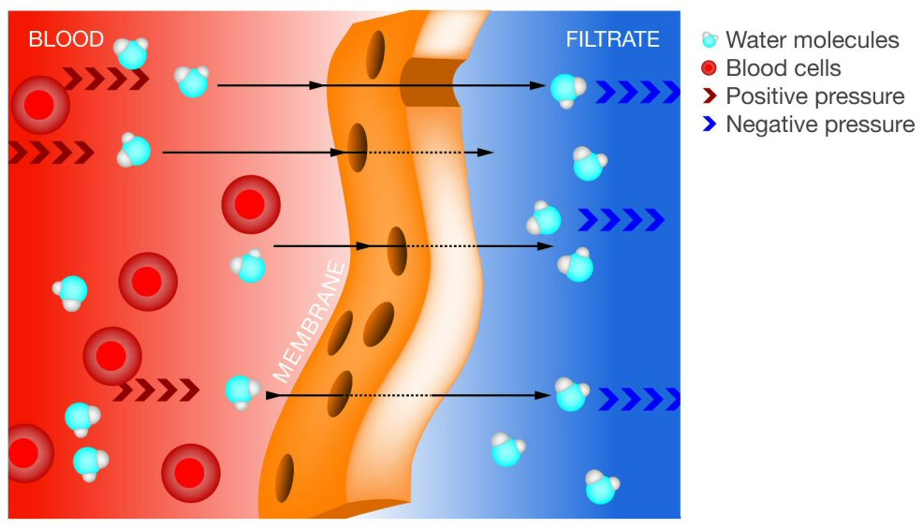
PD Treatment
Abdominal cavity is lined by a vascular peritoneal membrane which acts as a semi-permeable membrane
Diffusion of solutes (urea, creatinine, …) from blood into the dialysate contained in the abdominal cavity
Removal of excess water (ultrafiltration) due to osmotic gradient generated by glucose in dialysate

Slide 39
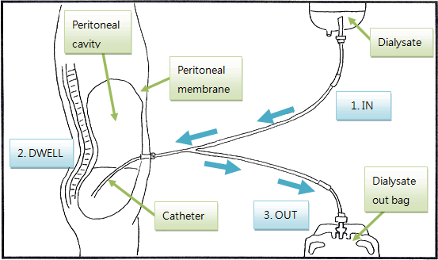
Principle of PD Treatment
Notes:
On the other hand, peritoneal dialysis is a continuous treatment, performed daily over several hours of the day, either manually or using a machine called a cycler. This cartoon describes the principle of PD. Dialysate is placed in the peritoneal cavity, left in place for 3 to 4 hours then drained out, and the cycle restarts.

Slide 40
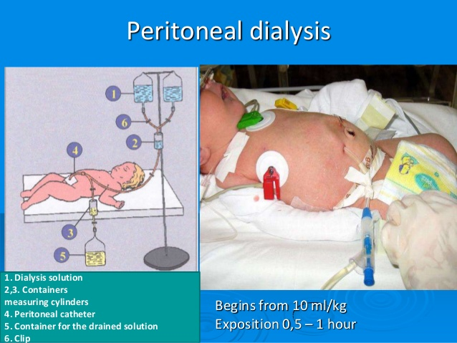

Slide 41
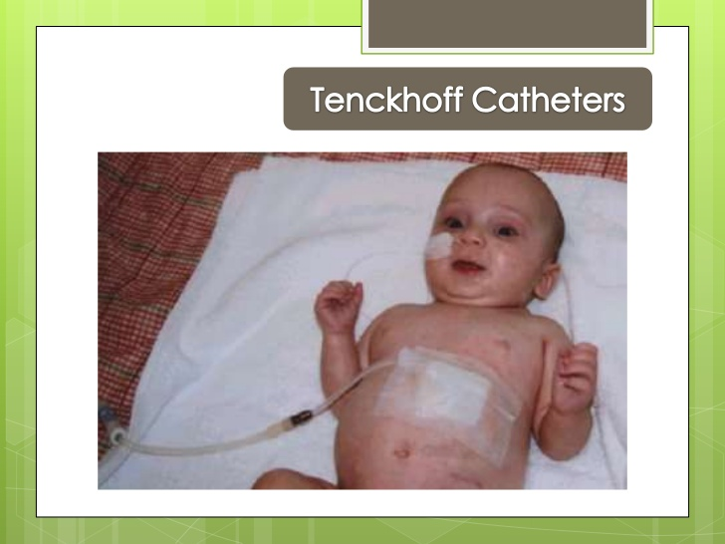

Slide 42
PD
Advantages
- Ability to perform PD at home
Technically easier than hemo.
Freedom to attend school and activities
Less restrictive diet
Less expensive than hemo.
Disadvantages
Catheter malfunction
Catheter related infections
Reduced appetite
Negative body image

Slide 43
Hemodialysis
(The machine, dialysate and Water)
Principles:
A semi-permeable membrane allows the passage of water and small molecular weight molecules
Solute transfer occurs by diffusion and convection
Water is removed by ultrafiltration

Slide 44
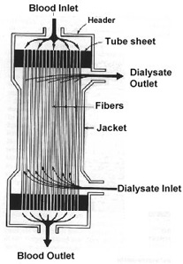
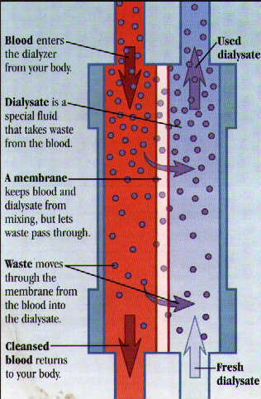
Hemodialysis Filter (Dialyzer)

Slide 45
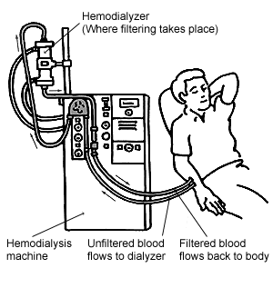
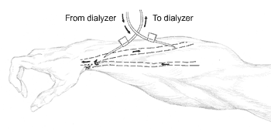
Principle of Hemodialysis
Vein
Artery
Notes:
Currently, patients on hemodialysis typically dialyze 3 to 4 hours, 3 times a week usually in an outpatient dialysis center. They need to have a permanent vascular access, optimally an AV fistula.

Slide 46
Kidney transplantation
The general principle is that transplantation should be the ultimate aim for the majority of children with CKD stage 5.

Slide 47
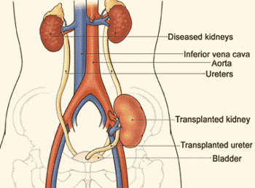
Kidney Transplantation
Iliac Fossa

Slide 48
Kidney Transplantation
- Kidney transplantation is the most cost-effective modality of renal replacement
- Transplanted patients have a longer life and better quality of life
- Early transplantation (before [pre-emptive] or within 1 year of dialysis initiation) yields the best results
- Living donor kidney outcomes are superior to deceased donor kidney outcomes
- Early transplantation is more likely to occur in patients that are referred early to nephrologists
- Refer for transplant evaluation when eGFR < 20 mL/min/1.73m²

Slide 49
Thank you
Questions ….. ??

Slide 50
Proteinuria (protein in urine)
Categories Category Protein excretion rate (mg/24 hours) Protein creatinine ratio (mg/G) Terms
A1 Less than 30 Less than 30 Normal to mildly increased
A2 30-300 30-300 Moderately increased
A3 Greater than 300 Greater than 300 Severely increased

