Slide 1
Malabsorption
Dr. Salma Burayzat
Pediatric gastroenterology, hepatology and nutrition

Slide 2
Q1. Mention six signes and symptoms of malabsorption
Q2. Name two screening tests for protein loosing enteropathy
Q3. Malabsorption of fat-soluble vitamins
  Vitamin A deficiency……………………………..
  Vitamin E deficiency leads to…………………………..
  Malabsorption of vitamin D leads to …………………………
  Malabsorption of vitamin K is associated with……………………….
Q4. Most common causes of malabsorption in children (name 5)

Slide 3
Malabsorption
The primary function of the small intestine is digestion and absorption of ingested nutrients. The term malabsorption refers to impairment in the absorption of one or more substances by the small intestine.

Slide 4
Malabsorption
Signs and Symptoms of Malabsorption
  Weight loss
  Failure to thrive
    Diarrhea
    –Loose and watery due to carbohydrate, bile acids, or fatty acids malabsorption
    –Bulky and foul-smelling due to fat malabsorption
    Abdominal pain
    Abdominal distention
    Anemia
    Increased flatulence
    Edema
    Osteomalacia
    Bleeding tendencies

Slide 5
Diagnostic Investigations
Initial Evaluation of Malabsorption
Detailed history
Complete physical examination
Serial growth and anthropometric measurements
Screening laboratory tests:
Blood:
  Complete blood count, complete metabolic panel, erythrocyte sedimentation rate, tissue transglutaminase immunoglobulin A (IgA) antibody, total IgA
Stool:
  Culture, ova and parasites, Clostridium difficile testing, occult blood, pH, reducing substances, fecal hydrolysis for detection of nonreducing carbohydrates, elastase, alpha-1- antitrypsin, stain for fat globules
Sweat chloride test

Slide 6
Diagnostic Investigations
Second-phase Evaluation
  72-hour quantitative fecal fat
  Breath hydrogen test
  Vitamins A, D, E, and B12; prothrombin time; folate, zinc, iron, ferritin
  Radiolabeled Tc albumin lymphatic scan
  Endoscopy with biopsy for histology and disaccharidase analysis
  Pancreatic enzyme analysis

Slide 7
Physiology and Pathophysiology of Digestion and Absorption
Carbohydrates

Slide 8
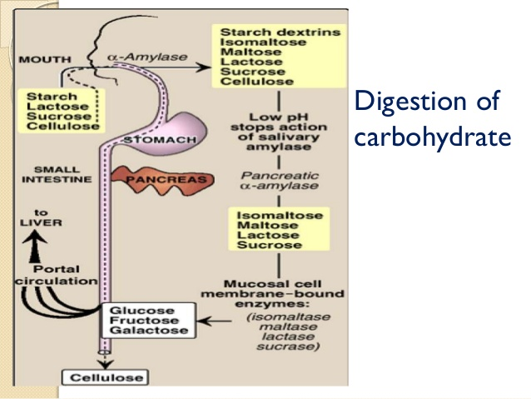

Slide 9
Carbohydrates
In malabsorption, maldigested oligosaccharides and unabsorbed monosaccharides are emptied into the colon
  Osmotic effect
  Gases
  Acids
  Unabsorbed reducing sugars
  The hydrogen breath test

Slide 10
Carbohydrates
Carbohydrate malabsorption may be due to:
  Mucosal damage
    Brush border enzyme deficiencies can follow injury to the small intestinal mucosa caused by disorders such as
      infectious gastroenteritis
      gluten-induced enteropathy
      cow milk protein sensitivity
  Short bowel syndrome
  Congenital intestinal transport or enzyme deficiencies
  Excessive ingestion of juices
  “Adult-onset” lactase deficiency.
  Sucrase-isomaltase deficiency
  Glucose-galactose malabsorption

Slide 11
Physiology and Pathophysiology of Digestion and Absorption
Proteins

Slide 12
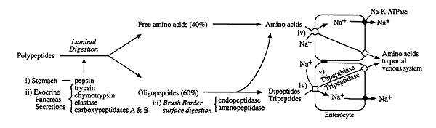
Proteins

Slide 13
Proteins
Protein malabsorption leads to failure to thrive, hypoproteinemia, and edema; and can be seen in:
  Pancreatic insufficiency
  enterocyte deficiency
  impaired AA or peptide transport by the enterocyte.
A fecal elastase test is a good screening test for……………………..
Measuring fecal clearance of alpha-1-antitrypsin in………..
Other features of protein deficiency include
  recurrent or severe infections
  muscle atrophy
  Weakness
  hair loss
  irritability

Slide 14
Physiology and Pathophysiology of Digestion and Absorption
Lipids

Slide 15
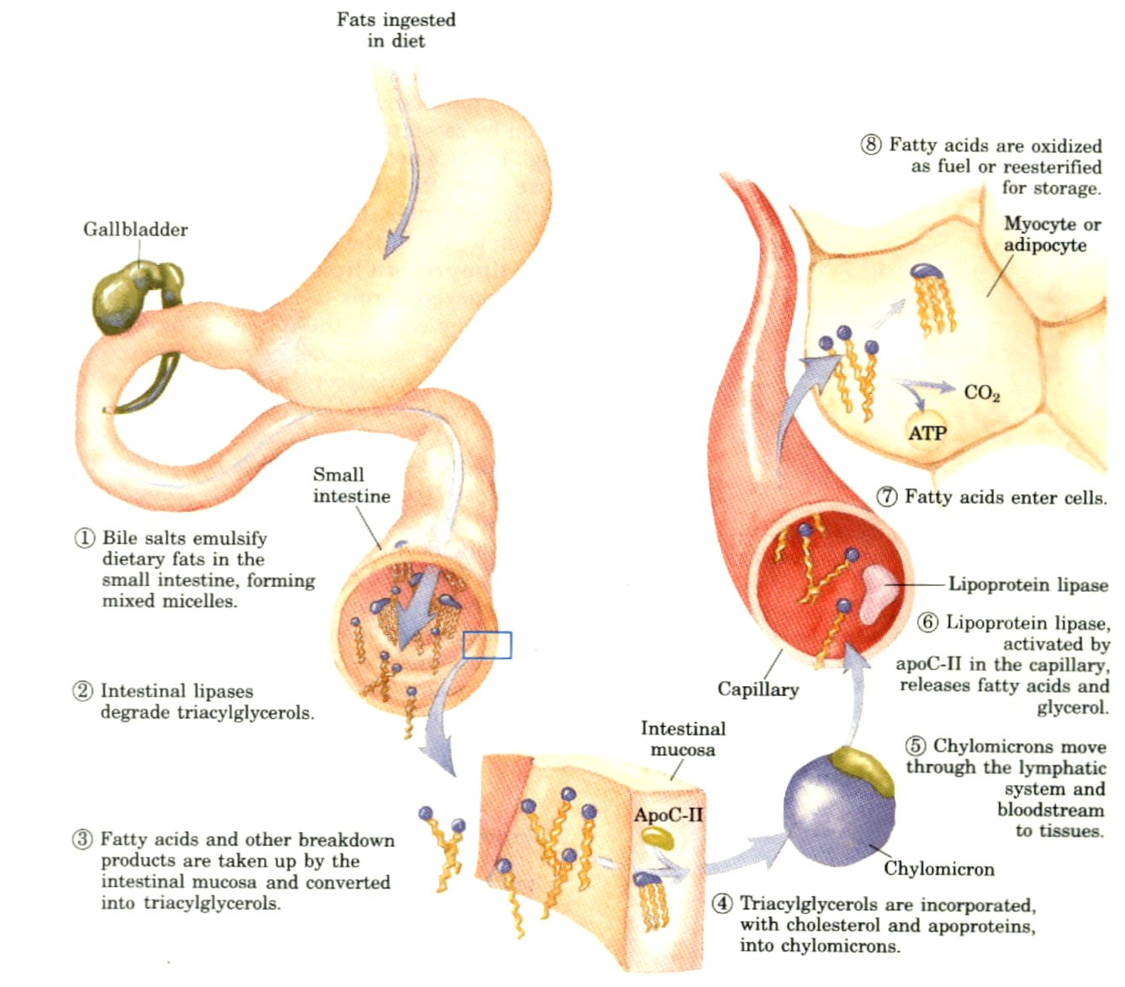
Lipids

Slide 16
Lipids
Fat maldigestion or malabsorption results in a variety of manifestations due not only to malassimilation but also to
  weight loss and malnutrition
  fat-soluble vitamin (A, D, E, and K) deficiency
  Diarrhea
  Steatorrhea
  Increase risk for oxaluria and calcium oxalate kidney stones.
Fat malabsorption occurs in:
Pancreatic insufficiency
  Congenital, such as in cystic fibrosis and Shwachman-Diamond syndrome
  Acquired, as in chronic pancreatitis.
In diseases that impair bile production or excretion
Abetalipoproteinemia…………………

Slide 17
Physiology and Pathophysiology of Digestion and Absorption
Vitamins and Minerals

Slide 18
Vitamins and Minerals
malabsorption of fat-soluble vitamins
  Vitamin A deficiency……………………………..
  Vitamin E deficiency leads to…………………………..
  Malabsorption of vitamin D leads to …………………………
  Malabsorption of vitamin K is associated with ………………….
vitamin B12 deficiency.
  lack of intrinsic factor
  Ileal resection or inflammation
  pancreatic insufficiency
if severe, vit B12 deficiency can lead to……………….........
Zinc malabsorption………………………………..

Slide 19
Specific Disorders Leading to Malabsorption
Pancreatic Insufficiency

Slide 20
Pancreatic Insufficiency
Pancreatic Causes of Malabsorption
  Cystic fibrosis
  Shwachman-Diamond syndrome
  Johanson-Blizzard syndrome
  Pearson syndrome
  Chronic pancreatitis
  Trypsinogen deficiency
  Amylase deficiency
  Lipase deficiency

Slide 21
Specific Disorders Leading to Malabsorption
Defects in Bile Acid Micellar Solubilization

Slide 22
Defects in Bile Acid Micellar Solubilization
Moderate steatorrhea can occur in any hepatobiliary disorder leading to bile acid deficiency, which can result from impaired hepatic synthesis or impaired bile flow.
Conditions Leading to Bile Acid Deficiency
  Chronic cholestasis
  Bile acid pool depletion
  Ileal resection
  Bile acid deconjugation by bacteria

Slide 23
Specific Disorders Leading to Malabsorption
Intestinal Brush Border Disorders

Slide 24
Intestinal Brush Border Disorders
Brush Border Disorders
  Congenital Causes
  Microvillus inclusion disease
  Tufting disease
  Primary lactase deficiency
  Sucrase-isomaltase deficiency
  Glucose/galactose malabsorption
Reduced Mucosal Surface Area
  Short bowel syndrome
  Ileal resection (such as necrotizing enterocolitis or Crohn disease)
Inflammatory Causes
  Celiac disease
  Crohn disease
  Postinfectious diarrhea
  Allergic enteropathy
  Autoimmune enteropathy

Slide 25
Clinical Cases

Slide 26
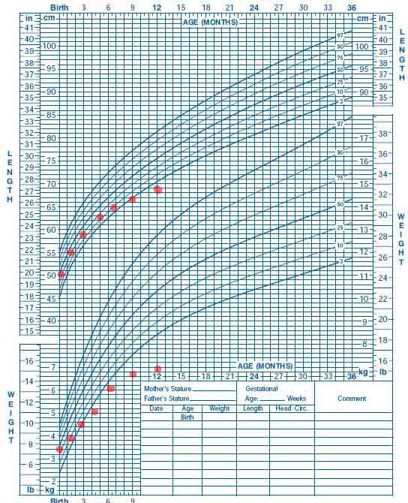
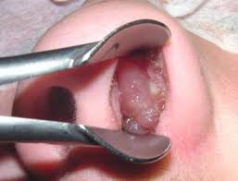
1.5 year old presented with

Slide 27
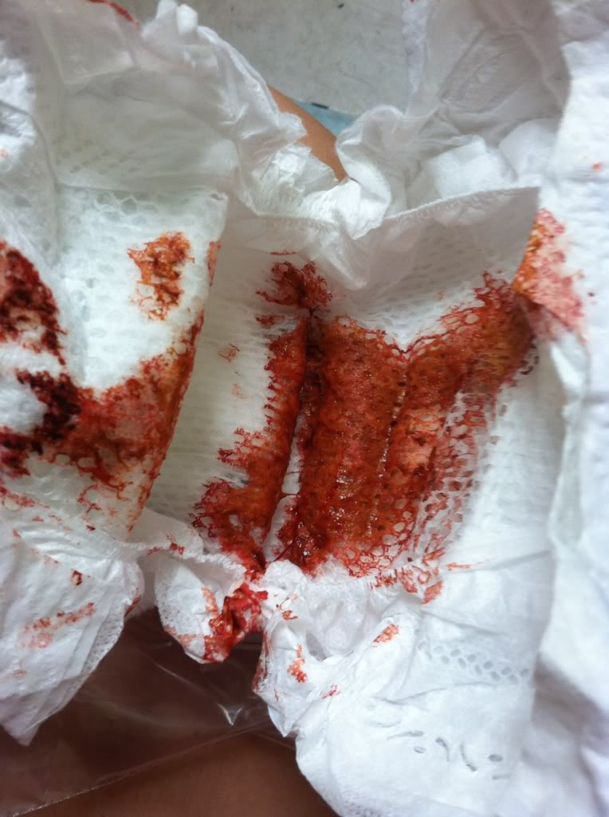

8 months old boy presented with

Slide 28
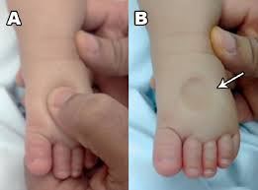
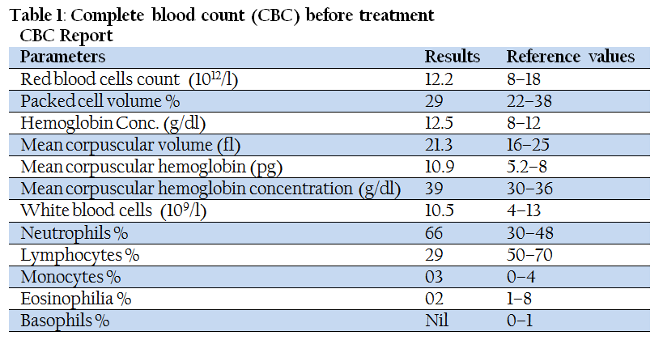
4 month presented with

Slide 29
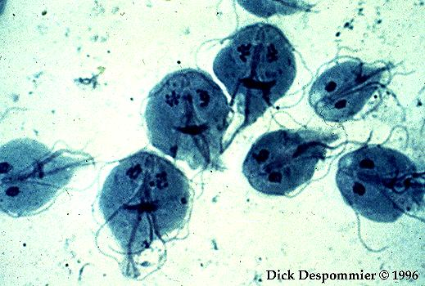
A 4 year old girl presented with diarrhea for 20 days; stool cx showed this parasite that lives in swimming pools

Slide 30
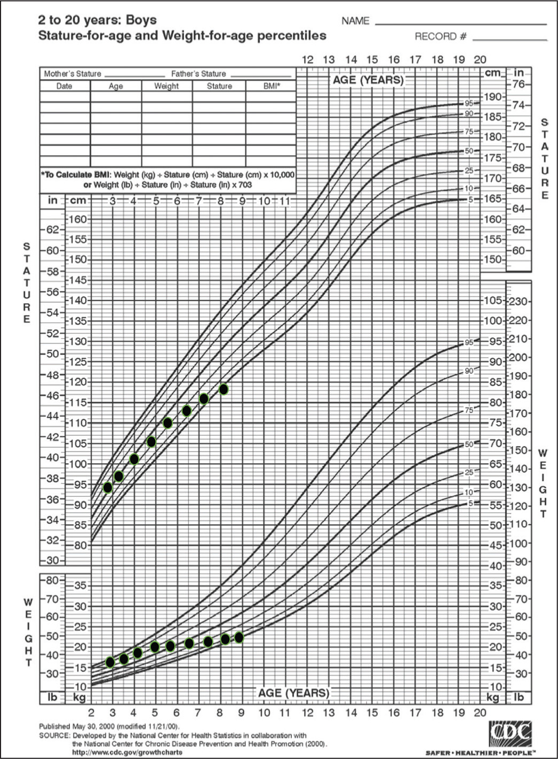
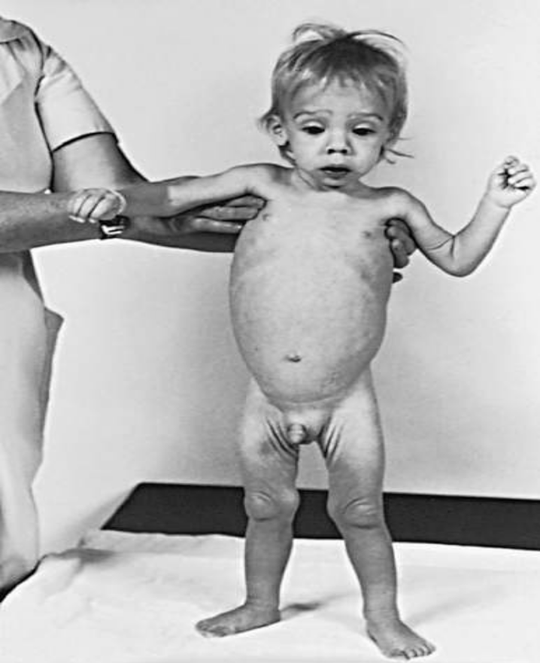
48 months old child with failure to thrive, chronic diarrhea, severe rickets and iron deficiency anemia

Slide 31
Celiac disease
Celiac disease is an immune-mediated enteropathy caused by permanent sensitivity to gluten in genetically susceptible individuals.
Its prevalence is estimated to be 1 in 300 to 1 in 80 children.
Gluten protein is derived from a group of cereal grains that includes wheat, rye, and barley. Pure oats are not considered an offending agent.

Slide 32
Risk groups of CD
First-degree relatives
Dermatitis herpetiformis
Unexplained iron-deficiency anemia
Autoimmune thyroiditis
Type 1 diabetes
Dental enamel hypoplasia
Autoimmune liver disease
Short stature
Delayed puberty
Down, Williams, and Turner syndromes
Irritable bowel syndrome
Sjögren syndrome
Epilepsy (poorly controlled) with occipital calcifications
Selective immunoglobulin A deficiency
Autoimmune endocrinopathies
Addison disease
Aphthous stomatitis
Ataxia
Alopecia
Polyneuropathy

Slide 33
Clinical manifestations in C.D
Gastrointestinal tract (Atrophy of the small bowel mucosa /Malabsorption)
    Diarrhea
    Distended abdomen
    Vomiting
    Anorexia
    Weight loss
    Failure to thrive
    Rectal prolapse
    Aphthous stomatitis
    Intussusception
Endocrinologic (Malnutrition, Calcium/vitamin D malabsorption)
  Short stature
  Pubertas tarda
  Secondary hyperparathyroidism
Dermatologic (Autoimmunity)
  Dermatitis herpetiformis
  Alopecia areata
  Erythema nodosum

Slide 34
Clinical manifestations in C.D
Hematologic (Iron malabsorption)
  Anemia
Skeletal (Calcium/vitamin D malabsorption)
  Rickets
  Osteoporosis
  Enamel hypoplasia of the teeth
Respiratory
  Idiopathic pulmonary hemosiderosis
Muscular (Malnutrition)
  Atrophy
Neurologic (Thiamine/vitamin B12 deficiency)
  Peripheral neuropathy
  Epilepsy
  Irritability
  Cerebral calcifications
  Cerebellar ataxia

Slide 35
Clinical spectrum of CD
SYMPTOMATIC
  With symptoms mentioned above.
SILENT
  No apparent symptoms in spite of histologic evidence of villous atrophy In most cases identified by serologic screening in at-risk groups
LATENT
  Subjects who have a normal histology, but at some other time, before or after, have shown a gluten-dependent enteropathy
POTENTIAL
  Subjects with positive celiac disease serology but without evidence of altered jejunal histology It might or might not be symptomatic

Slide 36
Diagnosis of CD
The diagnosis of celiac disease is based on a combination of symptoms, antibodies, HLA, and duodenal histology.
The initial approach to symptomatic patients is to test for anti-TG2 IgA antibodies and in addition for total IgA in serum to exclude IgA deficiency.
If IgA anti-TG2 antibodies are negative and serum total IgA is normal for age celiac disease is unlikely to be the cause of the symptoms.
  Patients with positive anti-TG2 antibody levels <10 × upper limits of normal should undergo upper endoscopy with multiple biopsies.
  In patients with positive anti-TG2 antibody levels at or >10 × upper limits of normal, blood should be drawn for HLA and EMA testing. If the patient is positive for EMA antibodies and positive for DQ2 or DQ8 HLA testing, the diagnosis of celiac disease is confirmed

Slide 37
Other causes of flat mucosa
Autoimmune enteropathy
Tropical sprue
Giardiasis
HIV enteropathy
Bacterial overgrowth
Crohn disease
Eosinophilic gastroenteritis
Cow’s milk enteropathy
Soy protein enteropathy
Primary immunodeficiency
Graft-versus-host disease
Chemotherapy and radiation
Protein energy malnutrition
Tuberculosis
Lymphoma
Nongluten food intolerances

Slide 38
Management
The only treatment for celiac disease is lifelong strict adherence to a gluten-free diet. This requires a wheat-, barley-, and rye-free diet.
It is recommended that children with celiac disease be monitored with periodic visits for assessment of symptoms, growth, physical examination, and adherence to the gluten-free diet.
Periodic measurements of TG2 antibody levels to document reductionin antibody titers can be helpful as indirect evidence of adherence to a gluten-free diet

Slide 39
1.5 year old presented with

Slide 40
Cystic Fibrosis CF
Cystic fibrosis (CF) is a major cause of pancreatic exocrine failure in children.
Autosomal recessive disorder caused by a mutation in the CFTR gene on chromosome 7.
Commonest mutation is Delta F508
Up to 90% of patients with CF have loss of exocrine pancreatic function as well as inadequate digestion and absorption of fats and proteins.

Slide 41
CF
Even though pulmonary disease is the major cause of morbidity and mortality, most patients (85%) have pancreatic insufficiency
Clinical signs of pancreatic insufficiency develop when less than 10% of normal pancreatic enzyme activity is present in the duodenum.
Patients usually present before 6 months of age with
  failure to thrive.
  hypoalbuminemia,
  edema
  anemia.

Slide 42
Complications of CF
GASTROINTESTINAL
  Meconium ileus, meconium plug (neonate)
  Meconium peritonitis (neonate)
  Distal intestinal obstruction syndrome (non-neonatal obstruction)
  Rectal prolapse
  Intussusception
  Volvulus
  Fibrosing colonopathy (strictures)
  Appendicitis
  Intestinal atresia
  Pancreatitis
  Biliary cirrhosis (portal hypertension: esophageal varices, hypersplenism)
  Hepatic steatosis
  Gastroesophageal reflux
  Cholelithiasis
  Inguinal hernia
  Growth failure (malabsorption)
  Vitamin deficiency states (vitamins A, K, E, D)
  Insulin deficiency, symptomatic hyperglycemia, diabetes
  Malignancy (rare)

Slide 43
Complications of CF
RESPIRATORY
  Bronchiectasis, bronchitis, bronchiolitis, pneumonia
  Atelectasis
  Hemoptysis
  Pneumothorax
  Nasal polyps
  Sinusitis
  Reactive airway disease
  Cor pulmonale
  Respiratory failure
  Mucoid impaction of the bronchi
  Allergic bronchopulmonary aspergillosis
OTHER
  Infertility
  Hypochloremic hypokalemic metabolic alkalosis
  Delayed puberty
  Edema-hypoproteinemia
  Dehydration–heat exhaustion
  Hypertrophic osteoarthropathy-arthritis
  Clubbing
  Amyloidosis
  Diabetes mellitus
  Aquagenic palmoplantar keratoderma (skin wrinkling)

Slide 44
Diagnosis of CF
Presence of typical clinical features (respiratory, gastrointestinal, or genitourinary)
or
A history of CF in a sibling
or
A positive newborn screening test
plus
Laboratory evidence for CFTR dysfunction:
  Two elevated sweat chloride concentrations obtained on separate days
  or
  Identification of two CF mutations
  or
  An abnormal nasal potential difference measurement

Slide 45
Maagement
High caloric diet
Pancratic enzymes replacement (Creon)
Daily supplements of the fat-soluble vitamins.

Slide 46
Pancreatic Insufficiency
Shwachman-Diamond syndrome
  autosomal recessive disorder
  exocrine pancreatic failure due to fatty deposition
  skeletal abnormalities, and
  bone marrow dysfunction, primarily cyclic neutropenia.
Johanson-Blizzard syndrome is characterized by
  hypoplasia of the alae nasi
  deafness,
  imperforate anus or urogenital malformations
  dental anomalies.
  exocrine pancreatic failure due to fatty deposition
Pearson syndrome,
  deletions in mitochondrial DNA. Patients have
  pancreatic insufficiency and
  refractory sideroblastic anemia.

Slide 47
8 months old boy presented with

Slide 48
Cow’s protein milk allergy
The prevalence of CMA in children living in the developed world is approximately 2 to 3 %, making it the most common cause of food allergy in the pediatric population.
There is some cross-reactivity with soy protein, particularly in non-IgE mediated allergy.
CMA is mostly a disease of infancy and early childhood. Affected infants present usually within the first 6 months of life, and one review reported that the majority of infants develop symptoms before 1month of age, often within 1 week after the introduction of cow’s milk proteins to their diet.

Slide 49
Cow’s protein milk allergy
However, breastfed infants can also be affected by dairy products ingested by the mother and eliminated in her breast milk.
The majority of affected children have one or more symptoms involving one or more organ systems, mainly the gastrointestinal tract and/or skin
In addition to the detailed medical history and physical examination, diagnostic elimination diets, skin prick tests (SPTs), specific IgE (sIgE) measurements, and oral food challenges are part of the routine work-up

Slide 50
Cow’s protein milk allergy
Avoidance of cow’s milk protein in any form is the only available treatment.
In the case of breastfed infants,
Calcium supplements should be added to the mother’s diet to replace milk intake .
For infants 6 months old or younger, the recommended formulas for treatment of CMA are extensively hydrolyzed protein or amino acid-based formula

Slide 51
4 month presented with

Slide 52
Protein loosing enteropathy
Protein-losing enteropathy (PLE) is a rare condition characterized by protein loss through the gastrointestinal tract, leading to reduced serum protein levels, mainly albumin.
Main laboratory findings are reduced serum concentration of albumin, gammaglobulins, and ceruloplasmin. Diminished oncotic pressure due to hypoalbuminemia may lead not only to edema, but also to ascites and pleural or pericardial effusions. PLE can also be associated with fat malabsorption and deficiencies of fat-soluble vitamins due to small bowel involvement

Slide 53
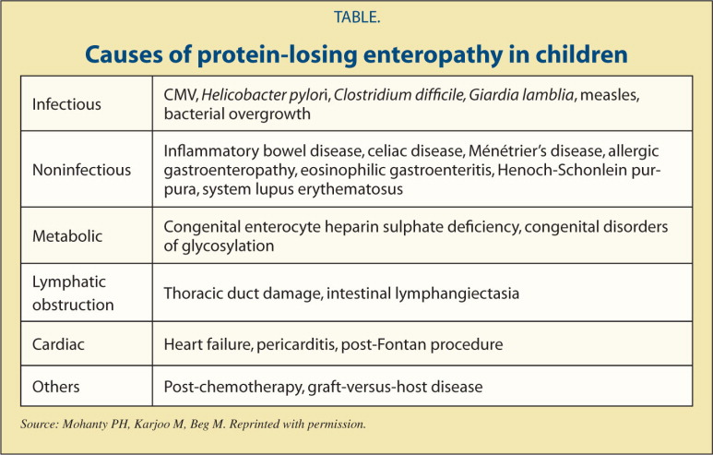

Slide 54
Intestinal lymphangiectasia
Intestinal lymphangiectasia is an uncommon disorder andan important cause of protein-losing enteropathy.
The major symptoms were edema and hypoproteinemia, low serum albumin and gammaglobulin levels.
Biopsies of the small intestine showed variable degrees of dilatation of lymph vessels in the mucosa and submucosa
Treatment of PIL consists of lifelong dietary modification with high protein and low fat substituted with MCT

Slide 55
A 4 year old girl presented with diarrhea for 20 days; stool cx showed this parasite that lives in swimming pools

Slide 56
Giardia lamblia
Giardia lamblia is a flagellated protozoan that is a major cause of diarrhea, especially in patients who travel to endemic areas.
The life cycle consists of 2 stages: the trophozoite (motile form), and the cyst.
IgA deficiency and hypogammaglobulinemia predispose patients to symptomatic infection.
The clinical manifestations are foul-smelling diarrhea, with nausea, anorexia, abdominal cramps, bloating, belching, flatulence, and weight loss. Abdominal distention and cramps can last for weeks to months.
The illness is usually self-limited, lasting 2 to 6 weeks, but may become chronic.

Slide 57
Giardia lamblia
Chronic symptoms can include fatigue, nervousness, weight loss, steatorrhea, lactose intolerance, and growth retardation.
The easiest way to diagnose Giardia is by identifying cysts in a stool specimen. However, these specimens are frequently falsely negative. The diagnosis can also be made by antigen detection tests, endoscopic examination of the upper small intestine, by mucosal biopsy or by collection of jejunal contents.
The treatment of choice for both symptomatic and asymptomatic patients is furazolidone or metronidazole. An alternative drug is quinacrine

Slide 58
Glucose-Galactose malabsorption
Autosomal recessive
Neonatal presentation
Diarrhea persistes on breast feeding as well as on lactose free infant formula, he was admitted so far 3 times with
Hyper-natremic dehydration is often present
Glucose/galactose free diet, fructose is well absorped (fructose based formula)
Intestinal adaptation to glucose and galactose with age

