Slide 1
Meningitis & Encephalitis
Marwan Shalabi, MD, FAAP.
Pediatric Infectious Diseases Consultant

Slide 2
CNS Infection
Meningitis:
Aseptic meningitis:
Encephalitis
Focal suppirative infections of CNS
Para-meningeal infections
Myelitis

Slide 3
Meningitis:
  Inflammation of the meninges
  CSF WBC pleocytosis

Slide 4
Aseptic meningitis:
  Meningeal inflammation with negative CSF bacterial cultures
  No prior antibiotic usage
  Infectious and noninfectious causes .

Slide 5
Encephalitis:
  Inflammation of the brain
  Produces neurologic dysfunction:
    Altered mental status
    Behavior, or personality changes
    Motor or sensory deficits
    Speech or movement disorders
    Hemiparesis
    Paresthesias
.

Slide 6
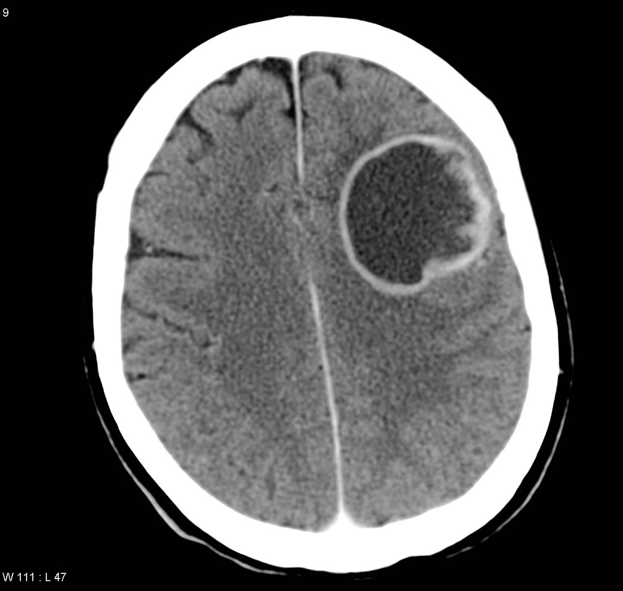
Focal suppurative infections of CNS
  Brain abscess
  Subdural or epidural empyema

Slide 7
Para-meningeal infections:
  Sinusitis
  Mastoiditis
  Cranial osteomyelitis

Slide 8
Myelitis
  Inflammation of the spinal cord
  Symptoms:
    flaccid paralysis and reduced or absent reflexes.

Slide 9
Meningitis

Slide 10
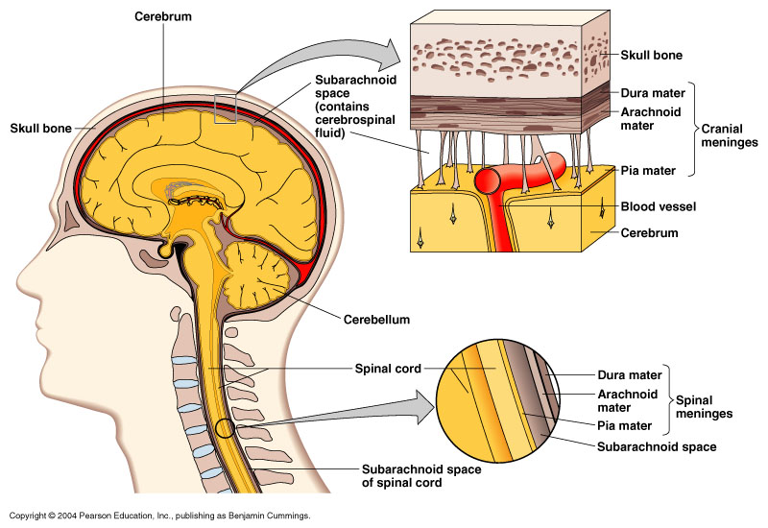
The Meninges and Cerebrospinal Fluid
The Meninges and Cerebrospinal Fluid
Figure 22.2

Slide 11
Etiology oF Bacterial Meningitis by age group
Newborn Period
More than 2/3 are caused by:
  Group B streptococcus
  Gram-negative enteric bacilli
    E. coli, Salmonella, Enterobacter
  Listeria monocytogenes

Slide 12
Etiology of Bacterial Meningitis by age group
Children 1-23 months
Streptococcus pneumoniae
Neisseria meningitidis
Group B streptococcus
E. coli
Haemophilus influenza type B

Slide 13
Etiology of Bacterial Meningitis by age group
Children ≥ 2 years
Streptococcus pneumoniae
Neisseria meningitidis

Slide 14
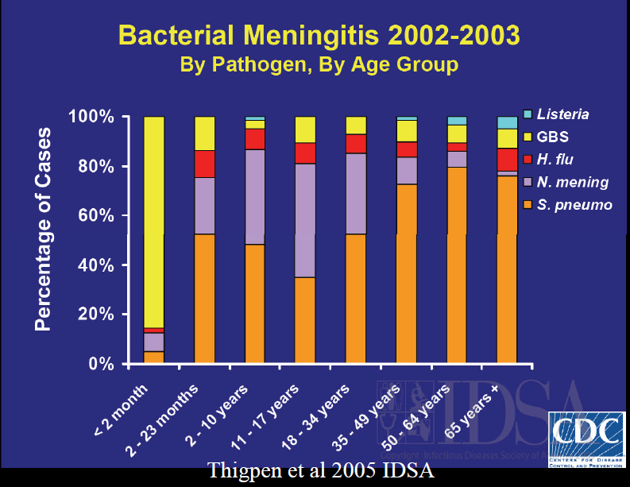

Slide 15
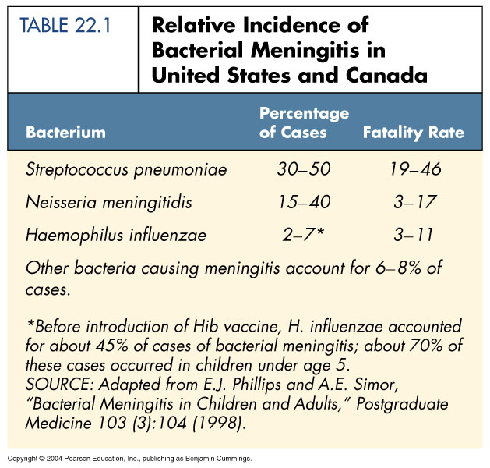
Bacterial Meningitis
Table 22.1

Slide 16
Haemophilus influenzae Meningitis
Occurs mostly in children (6 months to 4 years)
Gram-negative aerobic bacteria, normal throat microbiota
Capsule antigen type b
Prevented by Hib vaccine

Slide 17
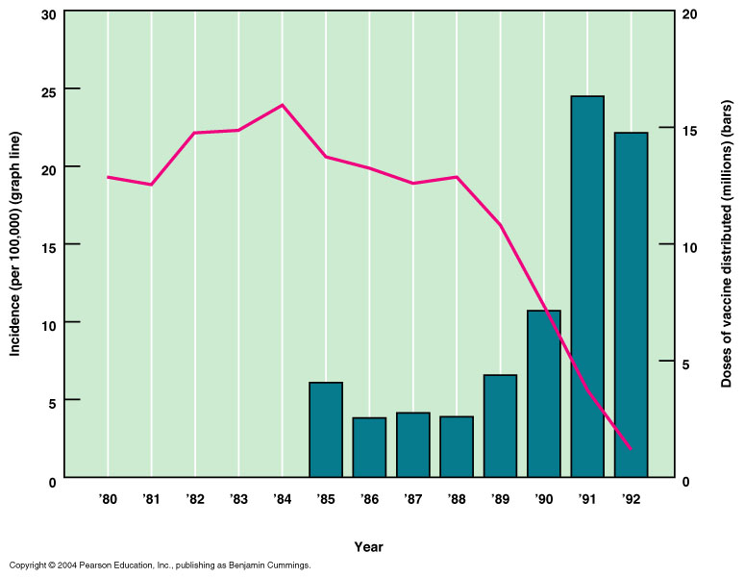
Haemophilus influenzae Meningitis
Figure 22.3

Slide 18
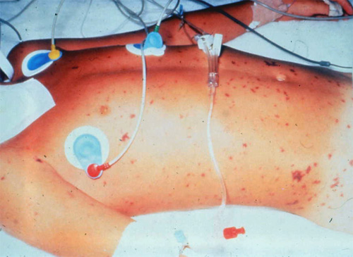

Slide 19
Neisseria Meningitis
(Meningococcal Meningitis)
N. meningitidis
Gram-negative aerobic cocci, capsule
10% of people are healthy nasopharyngeal carriers
Begins as throat infection, rash
Serotype B is most common in the U.S.

Slide 20
Streptococcus pneumoniae Meningitis
Gram-positive diplococci
70% of people are healthy nasopharyngeal carriers
Most common in children (1 month to 4 years)
Mortality: 30% in children, 80% in elderly
Prevented by vaccination (Pneumococcal Conjugated Vaccine, PCV)

Slide 21
Pathogenesis
Bacterial products (endotoxin, lipopolysaccharide)
Mediators: TNF, PAF, IL-1
Activation of WBC
Endothelial injury
Thrombosis
Cytotoxic edema
Vasogenic edema
Decreased
Cerebral blood flow
Increased ICP
Brain
damage

Slide 22
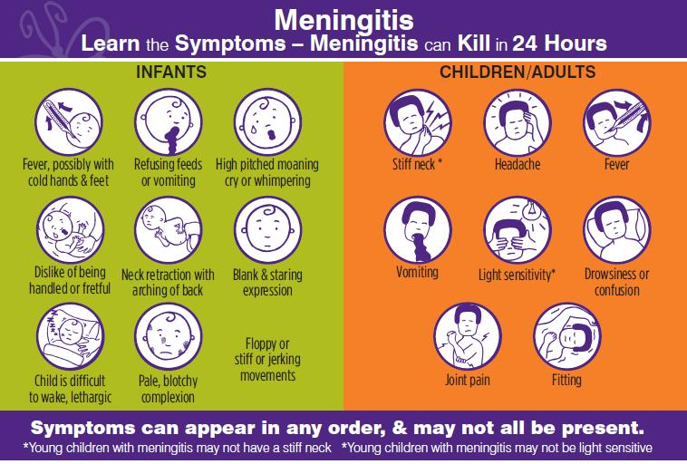

Slide 23
Clinical Manifestations of
Bacterial Meningitis
Young infants
  Proceeded by URTI
  Irritability
  Somnolence
  Fever
  bulging fontanelle and diastasis of sutures in the infant.

Slide 24
Clinical Manifestations of
Bacterial Meningitis
Older Children:
  Increased intracranial pressure is the rule:
    Vomiting, irritability, anorexia, headache, confusion, photophobia and nuchal rigidity
    Nuchal rigidity, positive Kernig and Brudzinski signs

Slide 25
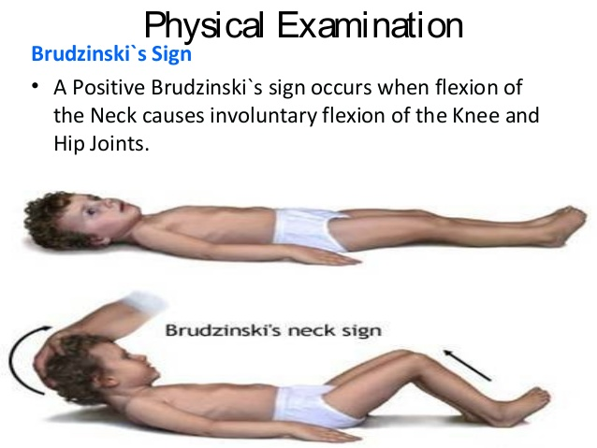
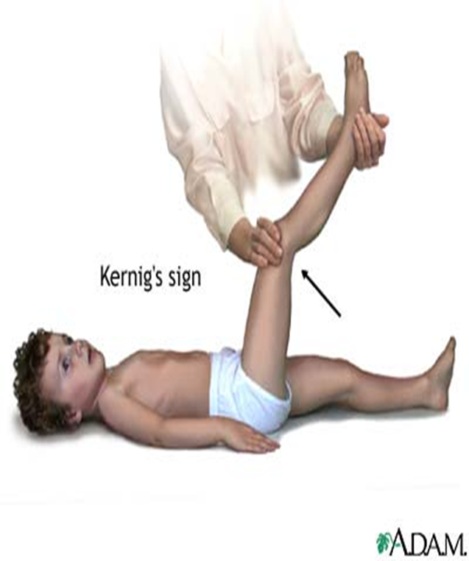
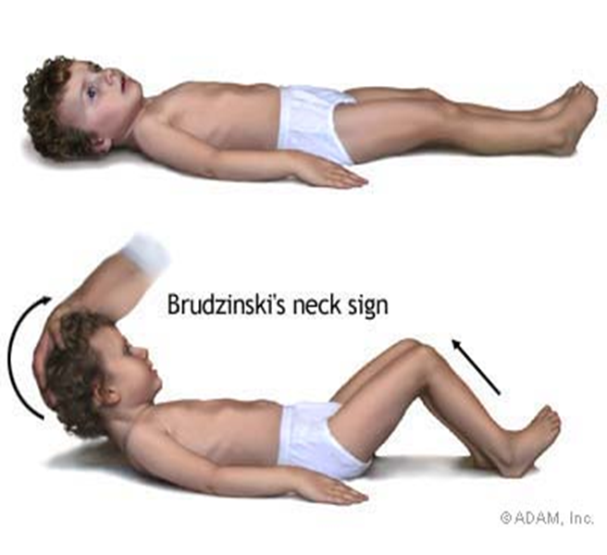

Slide 26
Seizures in Bacterial Meningitis
20% of patients have seizures prior to admission
32% of patients have seizures prior to or during 1st 48 hours of hospitalization
Early, generalized or multifocal seizures of short duration and minimal frequency are related to “toxic encephalopathy” associated with bacterial toxins, hypoperfusion and metabolic derangements; EEG usually not helpful. Usually controlled easily and have no prognostic implications

Slide 27
Seizures in Bacterial Meningitis
Seizures which are difficult to control, which persist beyond the 3rd hospital day or which develop initially after the 3rd hospital day may be associated with permanent sequelae.
Persistent focal seizures or recurrent seizures of varying focality imply:
  venous or arterial thrombosis
  infarction
  subdural effusion.

Slide 28
Clinical Manifestations of
Bacterial Meningitis
Papilledema is an uncommon finding in acute meningitis.
When papilledema is observed:
  venous sinus occlusion
  subdural empyema
  brain abscess

Slide 29

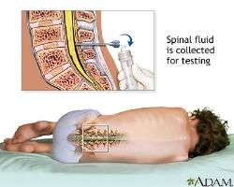
EVALUATION
Hx
Physical examination
Investigation
  CBC , KEF , ELECTROLYTES
  CRP , ESR
  Blood Culture.
  Lumber puncture and CSF analysis
  Imaging study (brain CT)

Slide 30
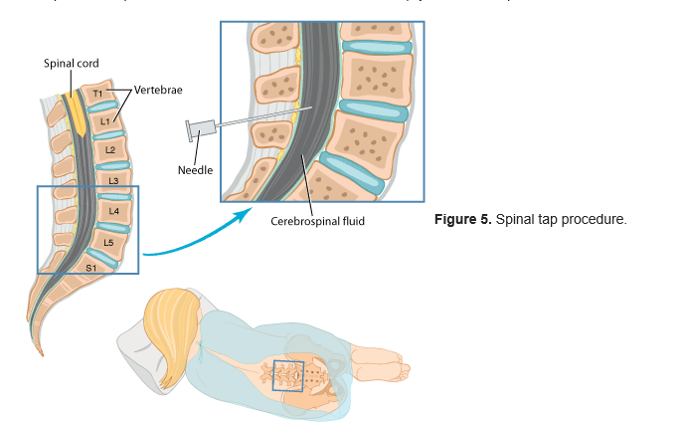
Lumbar Puncture or Spinal Tap

Slide 31
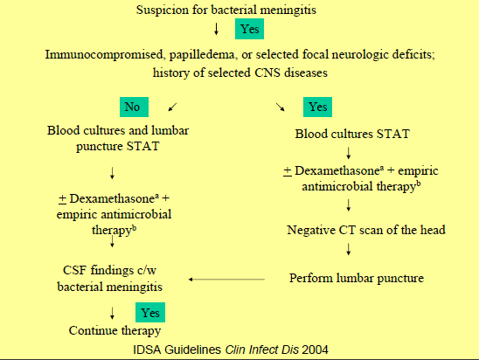

Slide 32
Neuroimaging(CT brain)
Indications for imaging before LP in children with suspected bacterial meningitis include
  Coma
  Papilledema
  Focal neurologic deficit
  The presence of a CSF shunt
  History of hydrocephalus
  Recent history of CNS trauma or neurosurgery

Slide 33
Contraindication for LP
  Suspected brain abscess or subdural empyema (20% herniation)
  Bleeding disorders
  Skin infection at site of LP
  Papilledema? (1-6% herniation after LP)

Slide 34
Cell count, differential and chemistry
 | Normal newborn | Normal children | Bacterial meningitis | Viral meningitis | TB/fungal meningitis
WBC (mm³) | 0-30 | 0-6 in >3months 0-9 in 1-3 months | >1000 | 100-500 | 100-500
PMN (%) | 2-3 | 0 | >50* | <40 | <50
Protein (mg/dl) | 20-150 | 15-45 | >100 | 50-100 | 100-1000
Glucose (mg/dl) | 30-120 | 40-80 | <30 | normal | low-normal
CSF/blood glucose(%) | 40-250 | 60-90 | <50 | normal | low-normal
*10% of bacterial meningitis presents with lymphocyte predominance.

Slide 35
Interpretation of CSF
WBC:
  WBC >6 cells is abnormal(>3 months)
  WBC >9 cells is abnormal(1-3 months)
.

Slide 36
Interpretation of CSF
The presence of a single neutrophil in the CSF is considered abnormal (except in newborns)
Glucose: <40 mg/dL or ratio of the CSF to blood glucose concentration is usually depressed (<0.5)
Traumatic LP: should be treated presumptively for meningitis pending results of CSF culture.

Slide 37
Gram’s stain
Positive in 60-90% of untreated patients
Positive in 97% of cases with organisms > 10⁵ CFU/ml
Positive in pneumococcus > H. influenzae > N. meningitidis >gram-neg bacilli > Listeria
90 % pneumococcal M , 80% meningococcal M , 50% G- bacillary M ,30% listeria M
The yield is lower by 20% in those with prior antibiotic therapy.
As sensitive as (or better than) antigen detection test.

Slide 38
Bacterial culture
Prompt culture to avoid loss of organisms such as Neisseria meningitides
CSF cultures are positive in 85% of untreated patients

Slide 39
Latex agglutination
Not better than gram’s stain
High false-positive.
Maybe most useful in pretreated patients

Slide 40
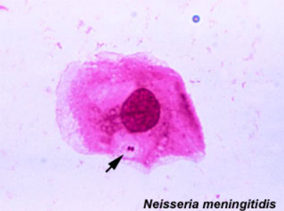
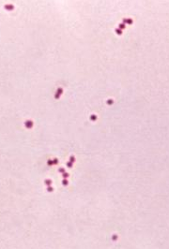

Slide 41
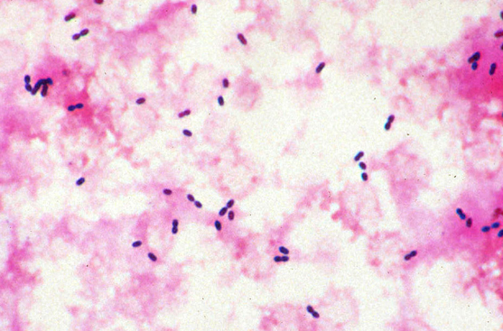
Streptococcus pneumoniae

Slide 42
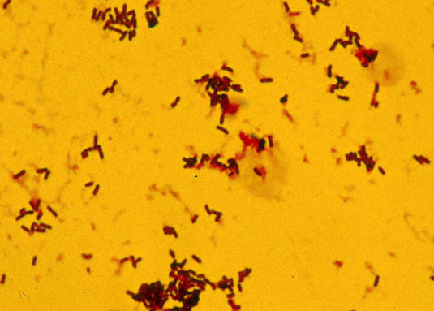
Listeria monocytogenes

Slide 43
Bacterial Meningitis
Normal Child Greater than One Month Old
Expected Organisms:
  Streptococcus pneumoniae
  Neisseria meningitidis
  Haemophilus influenzae type b
Empiric therapy*:
Ceftriaxone or Cefotaxime + Vancomycin
(Ampicillin + Gentamicin for newborns)

Slide 44
Management of Pneumococcal Meningitis
Repeat lumbar puncture
No improvement after 36-48 h
penicillin resistant strep pneumoniae meningitis PRSP
  (Isolate with MIC > 2 to cefotaxime/ceftriaxone)
Follow-up for sequelae (25-30%)
Hearing test
Neurodevelopmental evaluation

Slide 45
Dexamethasone for Bacterial Meningitis
Dexamethasone may be beneficial for treatment of infants and children :
  with Hib meningitis:
  to diminish the risk of neurologic sequelae including hearing loss
  if given before or concurrently with the first dose of antimicrobial agent(s)
  There probably is no benefit if dexamethasone is given more than 1 hour after antimicrobial agent(s).
  Red Book

Slide 46
Management of Pneumococcal Meningitis
Initial regimen for children > 1 mo with possible bacterial meningitis regardless of pneumococcal vaccination:
Vancomycin 60 mg/kg/day
+
ceftriaxone 100 mg/kg/day
( or cefotaxime 300 mg/kg/day)
Dexamethasone is controversial
Treatment duration is 10-14 days

Slide 47
Duration of treatment Bacterial Meningitis
Depended on causative organism and the clinical course:
S. pneumoniae: 10-14 days
N. meningitidis: 5-7 days
Hib: 7-10 days
L. monocytogenes – 14 to 21 days
S. aureus – at least 2 weeks
Gram –ve: 3 weeks

Slide 48
Causes of Prolonged or Recurrent Fever in children with Bacterial Meningitis
Inadequate Treatment
Nosocomial Infection
Phlebitis
Immune mediated arthritis
Drug Fever
Unknown
Suppurative complication: Pericarditis, Pneumonia, Pyogenic arthritis, Subdural empyema
Discontinuation of Dexametahsone

Slide 49
Indications for Repeat Lumbar Puncture
Patient not responding clinically after 48 h of appropriate therapy.
Pneumococcal isolate resistant (MIC >2 μg/ml) to cefotaxime/ceftriaxone
Neonate with Gram-negative meningitis

Slide 50
Indications for Neuroimaging of Head in Bacterial meningitis
Persistent focal neurologic findings
Persistently positive CSF cultures despite appropriate therapy
Persistent elevation in CSF PMN % after >10 days of therapy
Recurrent meningitis

Slide 51
Neuroimaging
Cerebral edema
Transient ventricular dilatation/hydrocephalus
Ventriculitis
Subdural effusion/empyema
Cerebral infarct
Brain abscess
Venous sinus thrombosis
Hemorrhagic stroke
Spinal cord infarction

Slide 52
Poor prognostic factors:
≥2 days of symptoms before admission.
Etiology: Bacterial, especialy pneumococcal.
The number of organisms.
CSF sugar < 20 mg / dl at admission.
Delayed sterilization of CSF : > 24 hours
Coma
Seizure after 72 hrs of admission, prolonged, or difficult to control
Malnutrition
Focal neurologic deficits
SIADH

Slide 53
Neurologic Sequelae of Bacterial Meningitis
mental retardation
  language delay
  learning disorders
behavior disorders
delayed or abnormal motor development
hemiparesis
hearing handicap
ataxia
seizure disorder
blindness
hydrocephalus
Hypothalamic dysfunction

Slide 54
Sensorineural Hearing Loss in
Bacterial Meningitis
Unilateral or bilateral loss
  S. pneumoniae 30%
  H. influenzae type b 6-15%
  N. meningitidis 5-10%
Ataxia commonly associated with deafness
Hearing loss appears to occur early (present at or near admission)

Slide 55
PREVENTION
Vaccines (primary prevention).
Isolation :
  standard precautions + droplet precautions for 24 hours into treatment
Chemoprophylaxis:
  Rifampicin to contacts of patients with meningococcal and Hib
Patient Education.

Slide 56
Prognosis
Mortality: 5%in developed countries and 8 %in developing countries.
Neurological sequele:15 % to 25 %
  Deafness : 11 %
  Mental retardation :4 %
  Spasticity and/or paresis : 4 %
  Seizures : 4%

Slide 57
Encephalitis in Children
Marwan Shalabi, MD

Slide 58
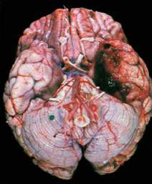
Definition of Encephalitis in Children
Acute CNS dysfunction with radiographic or laboratory evidence of brain inflammation.
CNS dysfunction:
  Seizures
  Focal neurologic findings
  Alteration in mental status.

Slide 59
How do they get there?
Arboviruses: bloodstream infection➔enter the CNS via endothelial cell infection
HSV, rabies, and possibly poliovirus: retrograde transport in neurons.
Amoeba Naegleria fowleri : through the olfactory mucosa.

Slide 60
Where do they stay there?
HSV : temporal lobe (herpes could cause high RBC in CSF)
Rabies : pons, medulla, cerebellum, and hippocampus
Japanese encephalitis virus: brainstem and basal ganglia.

Slide 61
Acute Viral Encephalitis
Children, elderly & the immunocompromised most commonly affected
More than 100 different viruses can cause encephalitis
In the USA, the most frequently reported causes are:
  Enteroviruses
  HSV1 and HSV2
  Arthropod-borne viruses (Arbo Viruses)
  The majority of cases have an unknown cause.

Slide 62
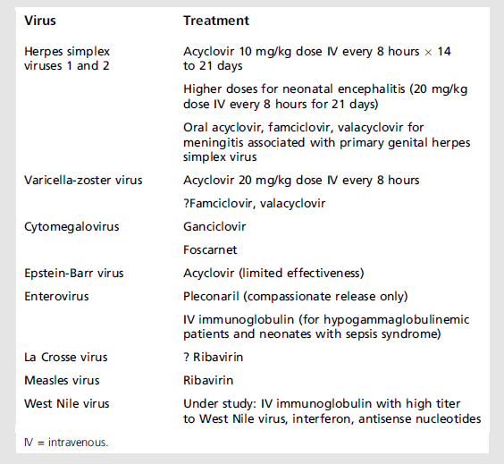
Antiviral Agents for viral CNS Diseases

Slide 63
Thank you

Slide 64
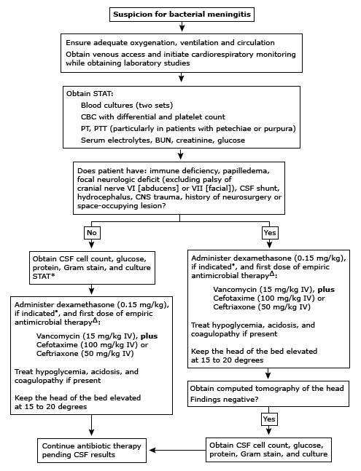

Slide 65
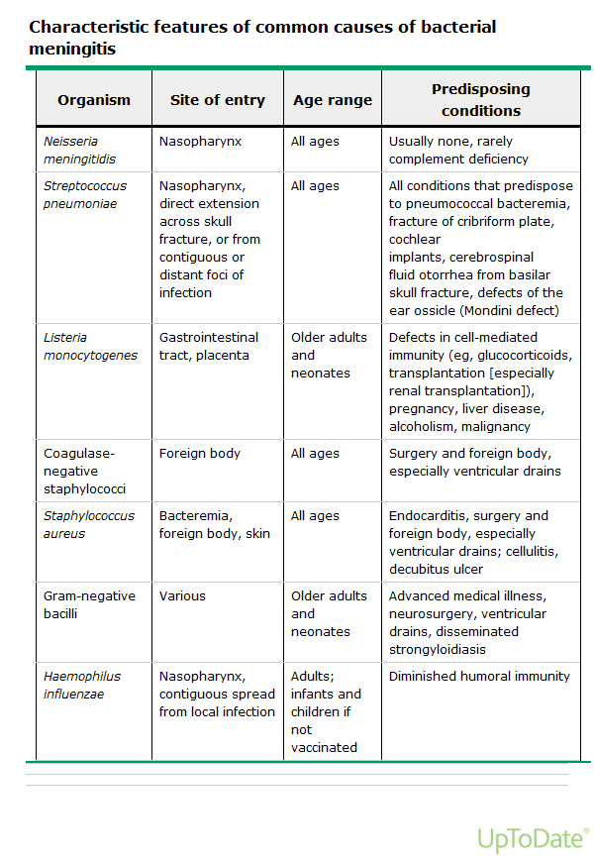
Causes

Slide 66
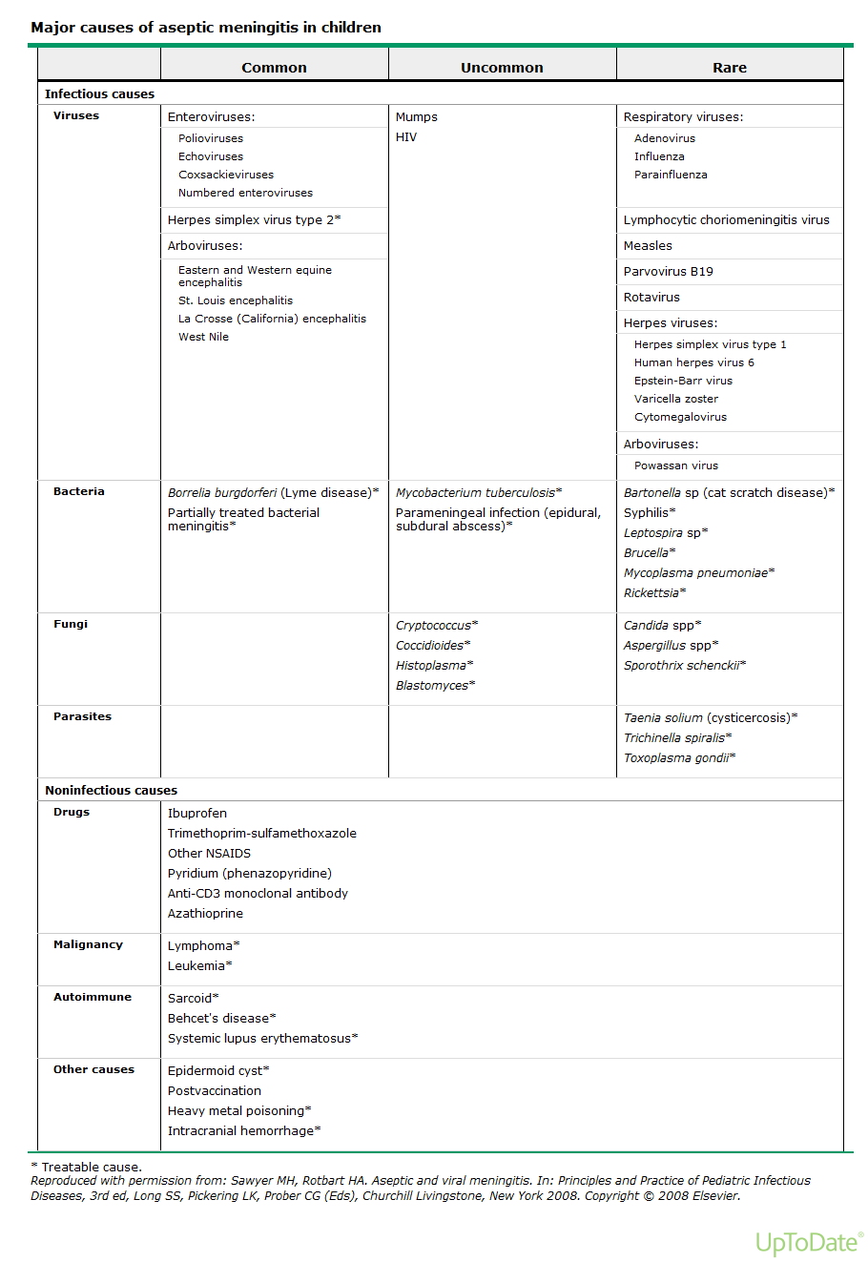

Slide 67
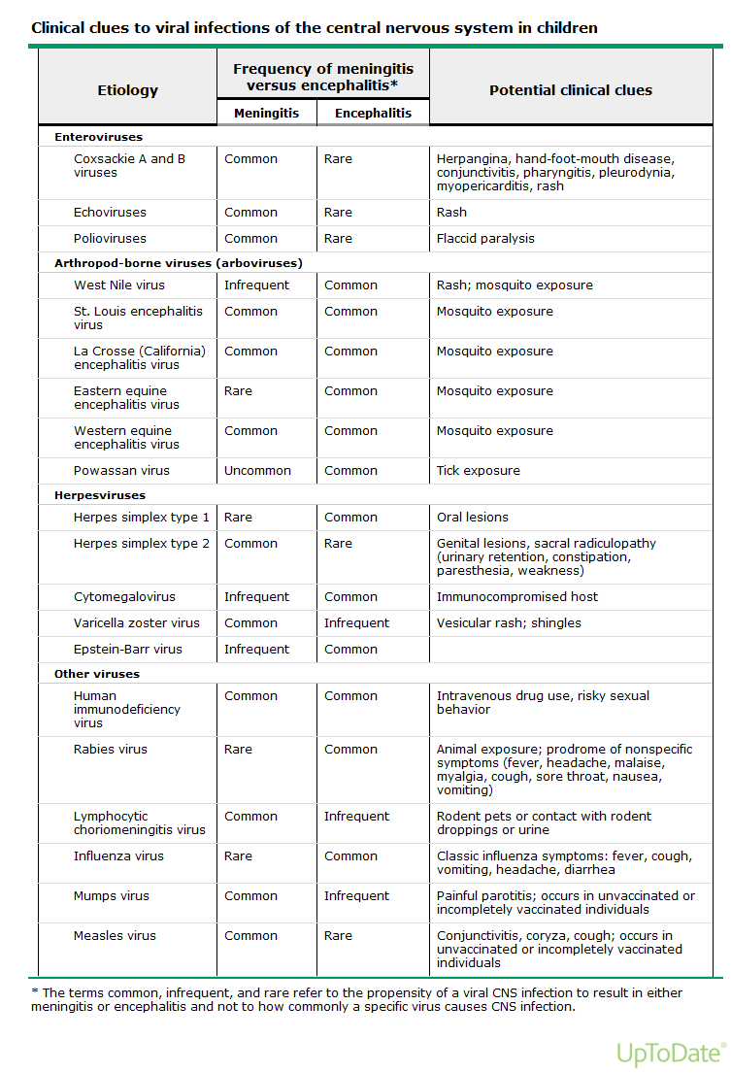

Slide 68
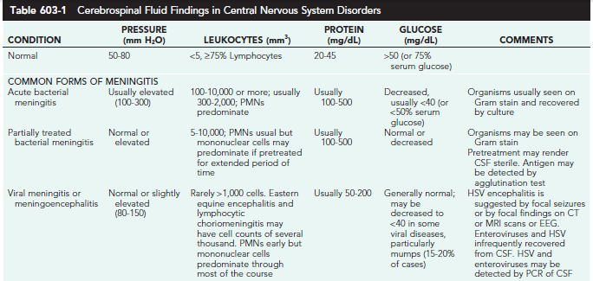

Slide 69
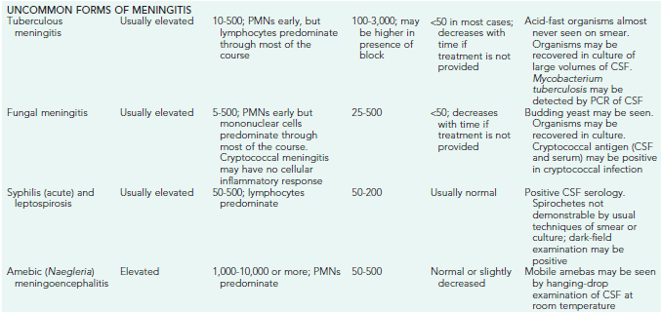

Slide 70
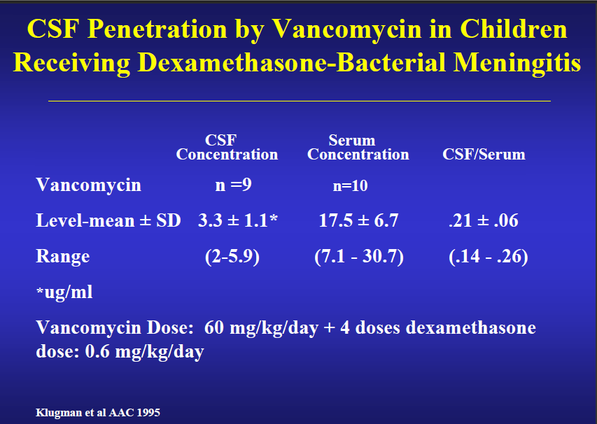
CSF Penetration by Vancomycin in Children Receiving Dexamethasone-Bacterial Meningitis

Slide 71
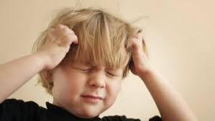
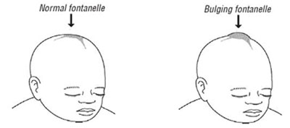
Increased ICP
S&S of high ICP:
headache, emesis,
bulging fontanel or diastasis (widening) of the sutures,
oculomotor (anisocoria, ptosis) or abducens nerve paralysis,
hypertension with bradycardia,
apnea or hyperventilation,
decorticate or decerebrate posturing, stupor, coma, or signs of
herniation.

Slide 72
Causes Encephalitis in Children: Viruses
Adenovirus
Arboviruses
Enteroviruses
Hepatitis A, B
Herpesvirus group
—HSV 1 and 2
—Varicella-zoster virus
—Epstein-Barr virus
—Cytomegalovirus
—Human herpesvirus 6
—Herpesvirus B
Influenza
Lymphocytic choriomeningitis virus
Measles
Mumps
Parainfluenza
Parvovirus
Rabies
Rotavirus
Respiratory syncytial virus
Rubella
Smallpox
Vesicular stomatitis virus

Slide 73
Causes: Bacteria
Actinomyces sp
Bartonella henselae
Brucella sp
Chlamydia sp
Ehrlichia (aka Anaplasma) sp
Listeria monocytogenes
Mycoplasma pneumoniae
Norcardia sp
Q fever
Rickettsia sp
Spirochetes
—Treponema pallidum
—Leptospiria sp
—Borrelia sp
Whipples bacillus

Slide 74
Causes: Fungi
Coccidiodes immitis
Cryptococcus neoformans
Histoplasma capsulatum

Slide 75
Causes: Protozoa
Acanthamoeba sp
Balamuthai mandrillaris
Malaria sp
Naegleria fowleri
Toxoplasma gondii
Trypanosoma sp
Parasites
—Baylisascaris procyonis
—Cysticercosis
—Schistosoma sp
—Strongyloides stercoralis
—Trichinella spiralis

