Slide 1
Connective tissue diseases

Slide 2
Connective tissues
Two protiens:
Collagen: tendons, ligaments, skin, cornea, cartilage, bone, and blood vessels.
Elastin: ligaments and skin

Slide 3
Connective tissue diseases
Rheumatoid Arthritis(RA)
Scleroderma
Granuolomatosis with polyangiitis
Chrug- Strauss syndrome
Systemic Lupus Erythematosus (SLE)
Microscopic polyangiitis(MPA)
Polymyositis/ dermatomyositis
Mixed Connective Tissue Disease (MCTD)
Undeffrentiated connective tissue diseases

Slide 4
Causes
Genetics
Environmental

Slide 5
Arthritis
Swelling or effusion, or presence of two of the following:
  Limitation of range of motion
  Tenderness or pain of motion
  Increased heat in the joint
A manifestation of several disorders

Slide 6
Review of system in the differential diagnosis of childhood joint pain and swelling
Dermatologic | SLE | Malar rash and hair loss
 | Dermatomyositis | Gottron's papules
 | Systemic JIA | Evanescent pink macular rash
 | HSP | Lower extremity purpuric lesions

Slide 7
Ophthalmologic | Oligoarthritis or psoriatic JIA | Asymptomatic chronic anterior uveitis
 | Enthesitis related arthritis | Acute symptomatic uveitis (pain, redness)
 | Kawasaki disease | Conjunctival injection without discharge
 | Sjogren's syndrome | Dry eyes with keratitis
Oral | SLE | Painless oral ulcers on palate
 | Behcet Disease | Large extremely painful oral ulcers

Slide 8
Respiratory | CF or immunodeficiency | Recurrent pneumonia
 | Wegener's granulomatosis | Destructive upper tract lesions
 | SLE or systemic JIA | Pleuritis
 | SLE or scleroderma | Interstitial lung disease
 | Churg-Strauss syndrome | Eosinophilic pneumonia
Cardiovascular | ARF or endocarditis | New heart murmur
 | SLE, systemic JIA, or ARF | Pericarditis
 | SLE or scleroderma | Raynaud phenomenon
 | Takayasu arteritis | Absent pulses

Slide 9
Gastrointestinal | IBD, SLE, or vasculitis | Weight loss or poor growth
 | IBD | Diarrhea and abdominal pain
 | Reactive arthritis | Preceding infectious gastroenteritis
 | HSP | Intermittent colicky abdominal pain
Genitourinary | Gonococcal arthritis | Pustular urethritis or cervicitis
 | Reactive arthritis | Non-gonococcal urethritis
 | Behcet disease or IBD | Large painful genital ulcerations

Slide 10
Hematologic | SLE or hemoglobinopathy (eg, SCD) | Hemolytic anemia
 | SLE | Pancytopenia
 | Bleeding disorders | Hemarthrosis
Neurologic | SLE | Seizures and psychosis
 | SLE or fibromyalgia | Difficulty concentrating
 | SLE, vasculitis, or hypercoagulability | Stroke
 | Vasculitis | Asymmetric polyneuropathy
 | Dermatomyositis and polymyositis | Proximal muscle weakness

Slide 11
Classification of childhood arthritis
American College of Rheumatology ( ACR)
European League Against Rheumatism ( EULAR)
International League of Associations for Reumatology ( ILAR)

Slide 12
Rheumatic diseases
defined by the constellation of results of the physical examination, autoimmune marker and other serologic tests, tissue pathology, and imaging.
-JIA
-SLE
- JUVENILE DERMATOMYOSITIS

Slide 13
Juvenile Idiopathic Arthritis (JIA)

Slide 14
Juvenile Idiopathic Arthritis (JIA)
is a common, rheumatic disease of children and a major cause of chronic disability.
It is characterized by a synovitis of the peripheral joints manifesting in soft tissue swelling and effusion.

Slide 15
JIA classification
Systemic onset JIA (SoJIA)
  arthritis with fever and rash.
Oligoarthritis
  < 5 joints in the first 6 months of illness.
  Polyarthritis
    > 4 joints in the first 6 months of illness.

Slide 16
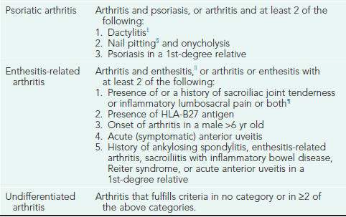

Slide 17
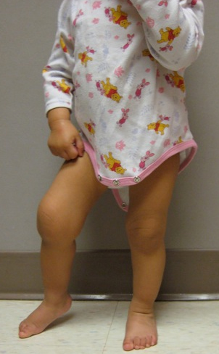
Eighteen-month-old girl with arthritis in her right knee. Note the flexion contracture of that knee.

Slide 18
Criteria for the Classification of Juvenile Rheumatoid Arthritis
Age at onset: <16 yr
Arthritis (swelling or effusion, or the presence of 2 or more of the following signs: limitation of range of motion, tenderness or pain on motion, increased heat) in ≥1 joints
Duration of disease: ≥ 6 wk
Onset type defined by type of articular involvement in the 1st 6 mo after onset:
Polyarthritis: ≥5 inflamed joints
Oligoarthritis: ≤4 inflamed joints
Systemic disease: arthritis with a characteristic intermittent fever
Exclusion of other forms of juvenile arthritis

Slide 19
ETIOLOGY.
Unknown etiology
Autoimmune disease AND Genetic susceptabilty factors
Enviromental (infection,trauma,and stress).
Possible external triggers include viruses (parvovirus B19, rubella, Epstein-Barr virus),
Host hyperreactivity to specific self antigens (type II collagen), and enhanced T-cell reactivity to bacterial or mycobacterial heat shock proteins.

Slide 20
EPIDEMIOLOGY.
Describe in all races and geographical areas
The incidence of JRA is ≈13.9/100,000 children/yr among white children ≤15 yr of age, with a prevalence of ≈113/100,000 children.
Female predominance 2:1

Slide 21
CLINICAL MANIFESTATIONS
Initial symptoms
  subtle or acute
  morning stiffness
  easy fatigability, particularly after school in the early afternoon
  joint pain
  joint swelling
  Joint stiffness
  limp
  Restriction of movement
  Eye symptoms
  Systemic manifestation .

Slide 22
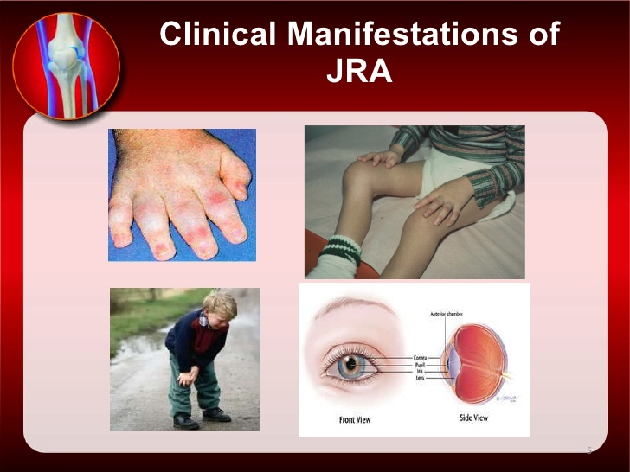

Slide 23
Oligoarthritis (pauciarticular disease)
Persistent vs. extended
predominantly affects the joints of the lower extremities, such as the knees and ankles .
Isolated involvement of upper extremity large joints is not characteristic of this type of onset.
Involvement of the hip is almost never a presenting sign of JRA.

Slide 24
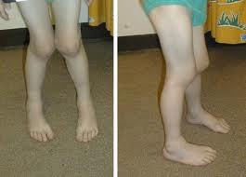

Slide 25
Polyarthritis
is generally characterized by involvement of both large and small joints of both upper and lower extremities .
As many as 20–40 joints may be affected in the more severely involved child, although inflammation of only ≥5 joints is required as a criterion for classification of this type of onset.
Rheumatoid factor (+ve / –ve)
Rheumatoid nodules on the extensor surfaces of the elbows and over the Achilles tendons, while unusual, are associated with a more severe course
Micrognathia reflects chronic temporomandibular joint disease.
Cervical spine involvement of the apophyseal joints occurs frequently with a risk of atlantoaxial subluxation and potential neurologic sequelae.

Slide 26
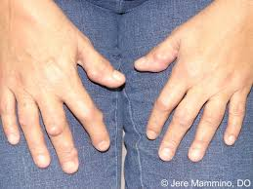
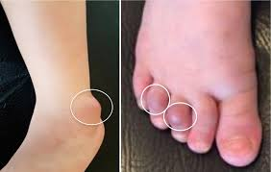

Slide 27
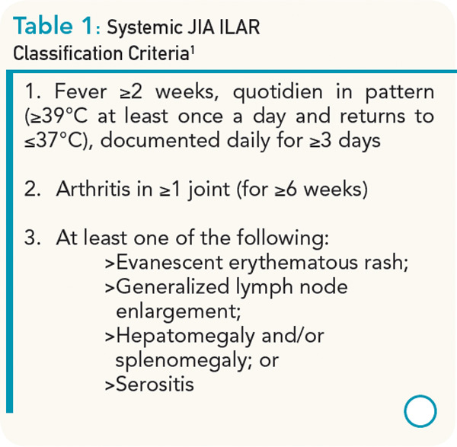

Slide 28
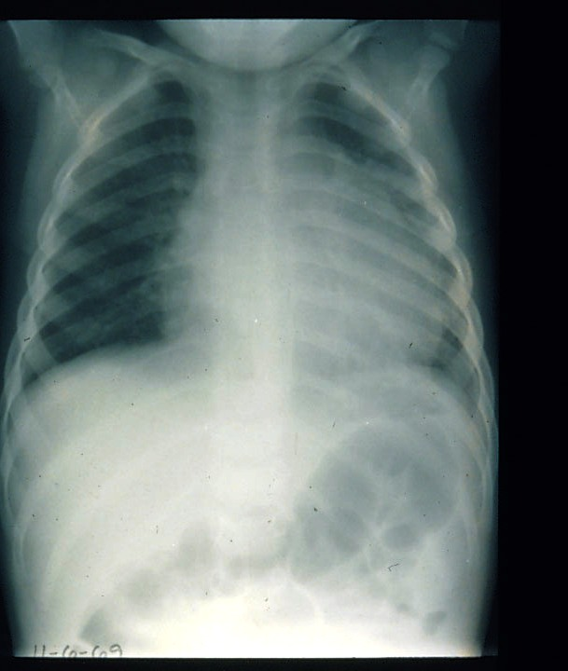
Child with pericardial effusion due to systemic onset juvenile idiopathic arthritis (JIA).
serositis (pericarditis)

Slide 29
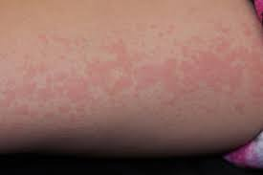
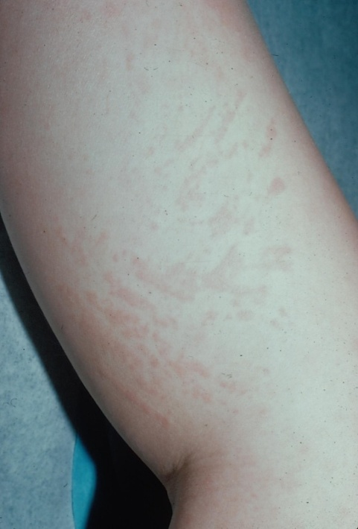
Systemic juvenile idiopathic arthritis (JIA) rash
Salmon-colored, erythomatous non pruritic macules

Slide 30
DIAGNOSIS
Based on a history compatible with inflammatory joint disease and a physical examination that confirms the presence of arthritis
No one pathognomonic finding
The classic intermittent fever , the typical rash and objective arthritis highly suggestive of systemic-onset JRA.

Slide 31
Laboratory abnormalities
  elevated erythrocyte sedimentation rate (ESR) and C-reactive protein (CRP),
  leukocytosis,
  thrombocytosis,
  anemia of chronic disease.
  anti-cyclic citrrullinated peptide (ccp) antibody has very high specificity for rheumatoid arthritis may detected before RF (poor prognosis)
  Carriage of HLA27 antigen is associated with increased risk of developing enthesitis –associated arthritis
  ANA is associated with increased risk of iridocyclitis in pt with oligoarthritis
  RF is positive only in 5% of pt when poly articular disease occur after 8 yrs of age

Slide 32
 | Systemic onset JIA | Pauciarticular onset JIA | Polyarticular onset JIA
Percent of JIA patients | 10 to 15 | 50 | 30 to 40
Sex | F = M | F > M | F > M
Age | any <17 years | peak 2 to 3 years, rare >10 | peaks 2 to 5, 10 to 14 years
Joints | any | large joints, but rarely hips | any, rare to start in hip
Fever, rash, lymphadenopathy, hepatosplenomegaly | yes | no | no
Uveitis | rare | 20 percent, esp ANA + | less frequent

Slide 33
 | Systemic onset JIA | Pauciarticular onset JIA | Polyarticular onset JIA
Laboratory abnormalities
- Leukocytosis | marked | no | no
- Anemia | marked | no | mild
- Elevated ESR | marked | mild | mild
- ANA | absent | low titer common | low titer common in younger
- Rheumatoid factor | rare | absent | 10 to 20 percent in those >10 years
Destructive arthritis | >50 percent | rare | >50 percent
Disease modifying drugs | commonly used | rarely used | commonly used

Slide 34
Differential diagnosis of joint pain or swelling in children
Trauma
Irritable hip and transient synovitis
septic arthritis and osteomyelitis,
Infection: bacterial ,viral ,Lyme disease
Hematologic:leukemia ,bleeding diatheses, and hemoglobinopathies
Tumor: Musculoskeletal neoplasia (eg, osteosarcoma), lymphoma, and neuroblastoma
Leg-Calve-Perthes disease
Slipped capital femoral epiphysis
Diagnosis of JIA requires the exclusion of all the above diagnoses.

Slide 35
Management
Remissions and relapses
No cure but treatable
Relieve pain ,reduce inflammation ,preserve joint function ,maintain normal growth and development

Slide 36
Management
Screen for uveites by periodic slit-lamp ophthalmologic examinations of all patients
Require multidisciplinary team (MDT) approach
  dietary evaluation and counseling to ensure appropriate calcium, vitamin D, protein, caloric intake;
  physical and occupational therapy.
  A social worker

Slide 37
Medical management
    Nonsteroidal anti-inflammatory drugs (NSAIDs) : Ibuprofen ,Naproxin ,Piroxicam
    Disease modifying anti rheumatic drugs (DMAR)
      Under supervision of rheumatologist
      methotrexate the safest, most efficacious, and least toxic given once weekly
      azathioprine and cyclophosphamide, are reserved for the few children who do not respond to less aggressive therapy.
    Joints steroid injections
    Corticosteroid : oral or IV methyleprednisolone
      Toxicity :-
        Cushing syndrome, growth retardation, and osteopenia
    TNF-α blockers :block the immune protein TNF etanercept infliximab

Slide 38
Systemic Lupus Erythematosus (SLE) in children

Slide 39
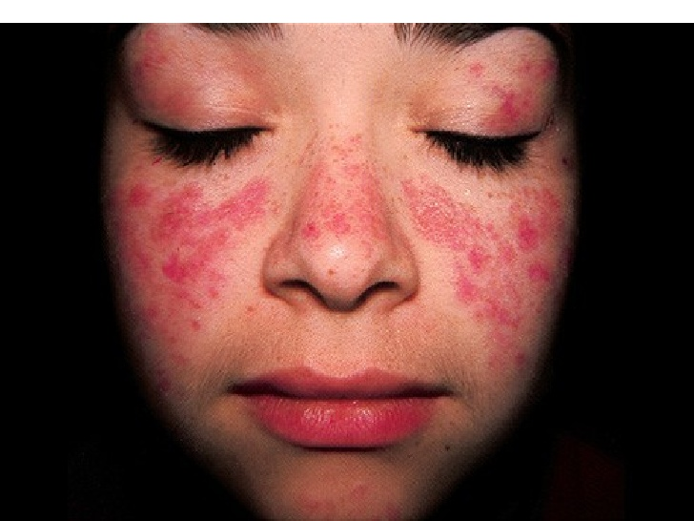

Slide 40
Systemic lupus erythematosus (SLE) in children is fundamentally the same disease as in adults with similar etiology, pathogenesis, clinical manifestations, and laboratory findings.
However, the care of children and adolescents with SLE is very different from that of adults because of the impact of the disease and its therapy on physical and psychological growth and development.

Slide 41
Systemic lupus erythematosis
A chronic inflammatory multi-systemic autoimmune disease characterized by widespread inflammation of blood vessel and connective tissue
The primary pathology is of persistent polyclonal B-cell stimulation resulting in autoantibody production with wide spread tissue antibody production ,with the widespread tissue deposition of immune complex

Slide 42
The pathogenesis of SLE remains largely unknown, but several genetics, hormonal and environmental factors.
Prevalence of SLE in children and adolescents (1-6/100,000) .
More among African-Americans, Asians, Hispanics, Native Americans, and Pacific Islanders for both adult and pediatric populations.
SLE predominantly affects females

Slide 43
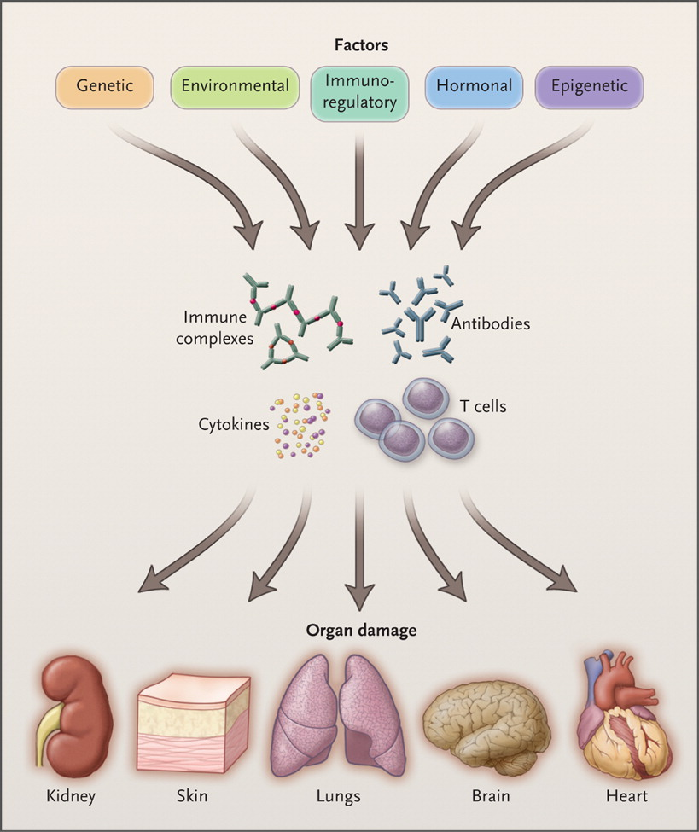

Tsokos GC. N Engl J Med 2011;365:2110-2121.
Overview of the Pathogenesis of Systemic Lupus Erythematosus.
Notes:
Figure 1. Overview of the Pathogenesis of Systemic Lupus Erythematosus. Genetic, environmental, hormonal, epigenetic, and immunoregulatory factors act either sequentially or simultaneously on the immune system. The action of pathogenic factors results in the generation of autoantibodies, immune complexes, autoreactive or inflammatory T cells, and inflammatory cytokines that may initiate and amplify inflammation and damage to various organs. The target organ affected may be further damaged by local factors.

Slide 44
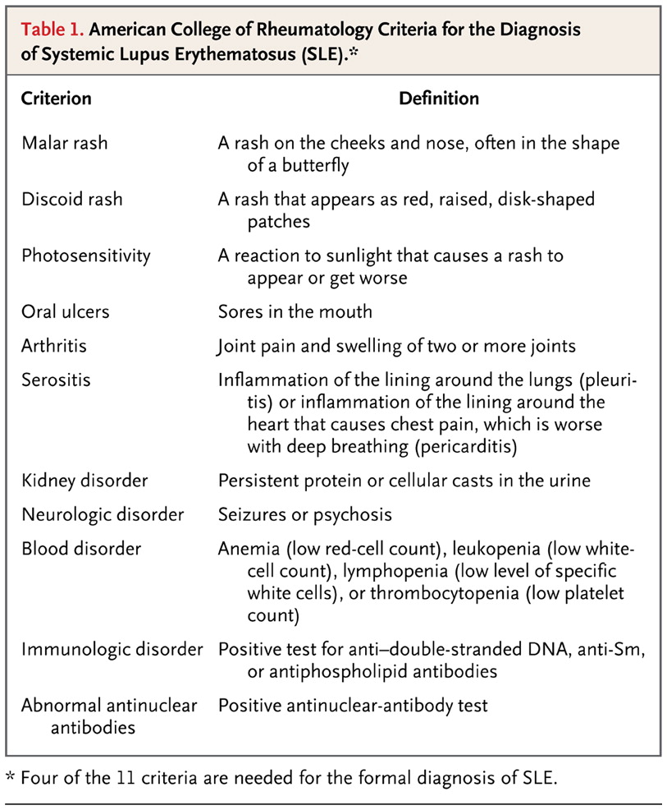
Tsokos GC. N Engl J Med 2011;365:2110-2121.
American College of Rheumatology Criteria for the Diagnosis of Systemic Lupus Erythematosus (SLE).

Slide 45
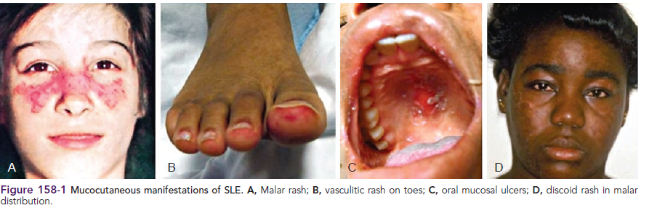

Slide 46
Signs and symptoms
The disease can affect a wide range of organ systems
Generalized symptoms such as fever , weight loss , and malaise are common
Other common signs and symptoms include fever ,anorexia ,Raynauds phenomenon , vasculitis , chorea, neuropathy, depression, and cognitive changes

Slide 47
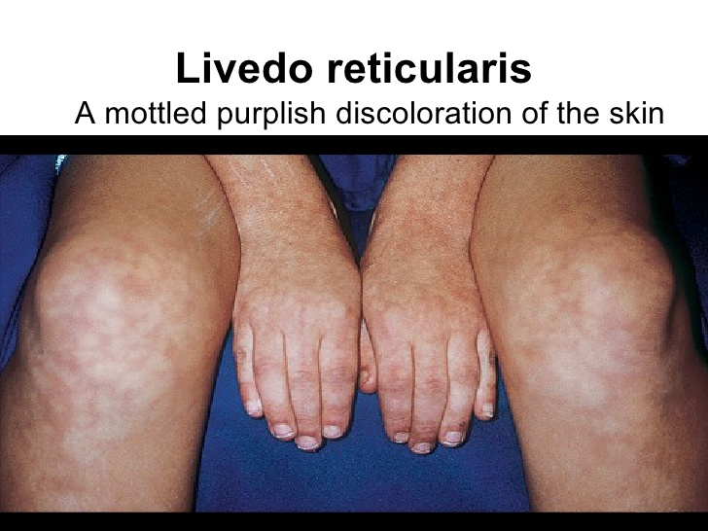

Slide 48
Laboratory findings
Complete blood counts
  Leukopenia ,anemia ,thrombocytopenia
15% coombs test- positive
ESR frequently elevated
CRP with active SLE is normal but elevated may be due to infectious causes especially bacterial infection
Urine analysis for proteinuria and hematuria

Slide 49
Laboratory findings
Complements :- C3& C4 are frequently reduced due to increased consumption
ANA is positive in 95-100% of patients usually at titer 1:320 or above
Anti double -strand DNA sensitive and specific , raised particularly in lupus nephritis
Anti-smith antibody are specific for lupus and are related to CNS involvement, positive in only 30% ,lack sensitivity as diagnostic test
Antiphospholipid antibodies found in approximately 50-60% of pediatric SLE patients , increase risk of thrombosis
Anticardiolipin antibodies are detected in up to 50% of children with lupus ,associated with episode of arterial and venous thrombosis

Slide 50
Autoantibodies Found in Systemic Lupus Erythematosus AntibodyManifestation
Coombs antibodies : Hemolytic anemia
Antiphospholipid antibodies :Antiphospholipid antibody syndrome : Lupus anticoagulant ,Coagulopathy
Antithyroid antibodies : Hypothyroidism
Antiribosomal P antibody : Lupus cerebritis

Slide 51
Treatment
Mild SLE:
  NSAID
  Hydroxychloroquine
Moderate SLE
  High-dose glucocorticoids
  Mycophenolate mofetil
Sever SLE
  Cyclophosphamide
  Prednisone

Slide 52
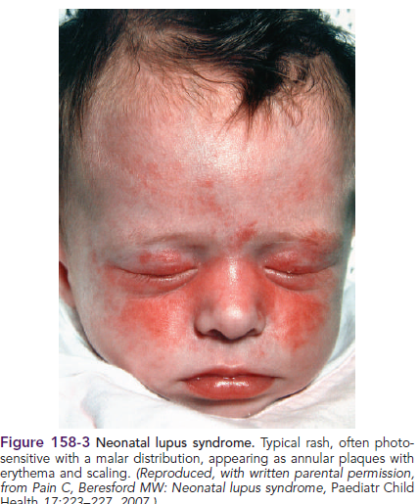
Neonatal lupus

Slide 53
Results from the passive transfer of maternal immunoglobulin G autoantibodies to the fetus.
The vast majority of are associated with maternal anti-Ro and anti-La antibodies

Slide 54
Clinical manifestations of neonatal lupus
Characteristic annular or macular rash typically affecting the face (especially the periorbital area), trunk, and scalp
Typically appears within the 1st 6 wk of life after exposure to ultraviolet light and lasts 3-4 mo.
Infants may also have cytopenias and hepatitis,
Congenital heart block is the most feared complication.
Conduction system abnormalities range from prolongation of the PR interval to complete heart block, with development of progressive cardiomyopathy

Slide 55
Course and prognosis
Cutaneous and hematological manifestations are reversible
Congenital heart block is permanent
Hepatic fibrosis is occasional
Some risk of SLE in teenage or adult year

Slide 56
Management:
Symptomatic for transient manifestations
Heart block may need pace maker

Slide 57
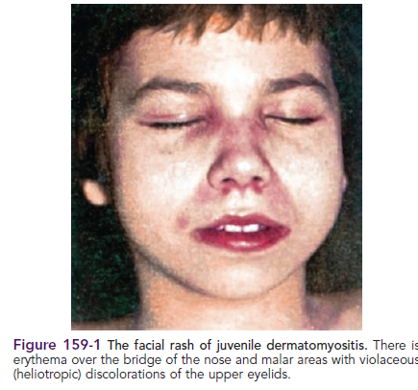
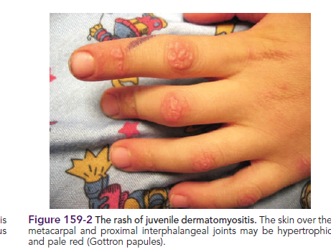
Juvenile dermatomyositis (JDM)and Polymyositis

Slide 58
Non –suppurative myositis with characteristic skin rash and vasculitis
Girls more than boys
Peak incidence 4-10 yrs of age
juvenile polymyositis involves direct T-cell invasion of muscle fibers similar to that seen in adult polymyositis ,accounts 3-6% of cases.

Slide 59
CLASSIFICATION AND DIAGNOSTIC CRITERIA
Classic rash plus 3 of the following:
Weakness
Muscle enzyme elevation
Electromyographic changes
Muscle biopsy

Slide 60
CLASSIFICATION AND DIAGNOSTIC CRITERIA
Characteristic cutaneous changes :-
  heliotrope dermatitis (reddish-purple rash on the upper eyelids with periorbital edema) and
  Gottron's papules (erythematous, papulosquamous eruption over the dorsal surfaces of the knuckles)
Symmetrical weakness of the proximal muscles

Slide 61
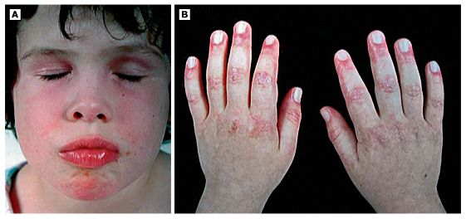
Clinical images of typical juvenile dermatomyositis
A) Heliotrope discolouration of the eyelids, and malar or facial erythema and
(B) scaly, red rash on the knuckles with Gottron's papules.

Slide 62
Elevation of the serum level of one of the muscle enzymes
  Creatine kinase (CK)
  Lactate dehydrogenase (LDH)
  AST
  Aldolase
ANA positive in some
Electromyography: useful to distinguish myopathic from neuropathic causes of muscle weakness (myopathy vs denervation)

Slide 63
Muscle biopsy
Is indicated in cases of myositis without the pathognomonic rash.
Muscle biopsy displaying fiber necrosis and inflammation, small vessel occlusive vasculitis

Slide 64
Magnetic resonance imaging
MRI scan of quadriceps muscle can be used in equivocal cases to confirm the presence of inflammatory myositis

Slide 65
Treatment
Suppression of inflammatory response and prevention of the loss of muscle function and joint range of motion
Assessment of the ventilatory effort and swallowing
Corticosteroids prednisone or pulse methylprednisolone
Methotrexate
In severe cases cyclosporine or cyclophosphamide
For skin manifestation :Hydroxychloroquine and intravenous immunoglobulin

Slide 66
Prognosis
Variable
Usually good with adequate treatment
Recurrent rate 10-20%
Small percent develop extensive muscle wasting ,severe contracture and wide spread calcinosis
Dermatomyositis in children is not associated with increase risk of cancer as in adult

Slide 67
THANK YOU

