Slide 1
Pediatric Asthma
Muna Kilani, MD

Slide 2
Definition of Asthma
Asthma is a heterogeneous disease, usually characterized by chronic airway inflammation.
It is defined by the history of respiratory symptoms such as wheeze, shortness of breath, chest tightness and cough that vary over time and in intensity, together with variable expiratory airflow limitation.
GINA 2016

Slide 3
Airway Inflammation leads to:
  Hyperresponsiveness - responses to triggers
ê
  Obstruction - usually fully reversible
ê
  Symptoms - cough, wheeze, dyspnea

Slide 4
TITANIC
Symptoms
Airway obstruction
HHyperresponsiveness
Airway inflammation

Slide 5
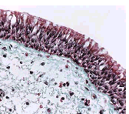
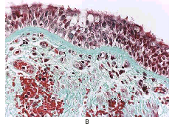
Normal airway
Mild Asthma
Busse et al., N Engl J Med 2001;344(5):350-362

Slide 6
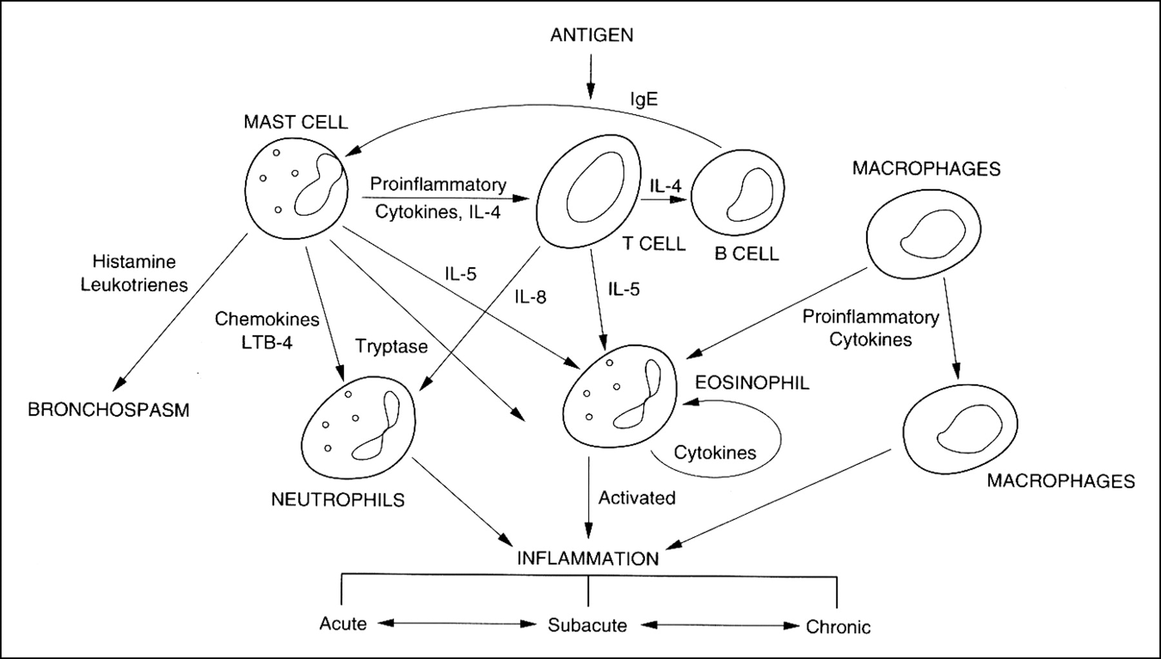

Cellular mechanisms involved in airway inflammation and the interaction of multiple cell types and mediators in airway inflammation
Guill, M. F. Pediatrics in Review 2004;25:299-305
Copyright ©2004 American Academy of Pediatrics

Slide 7
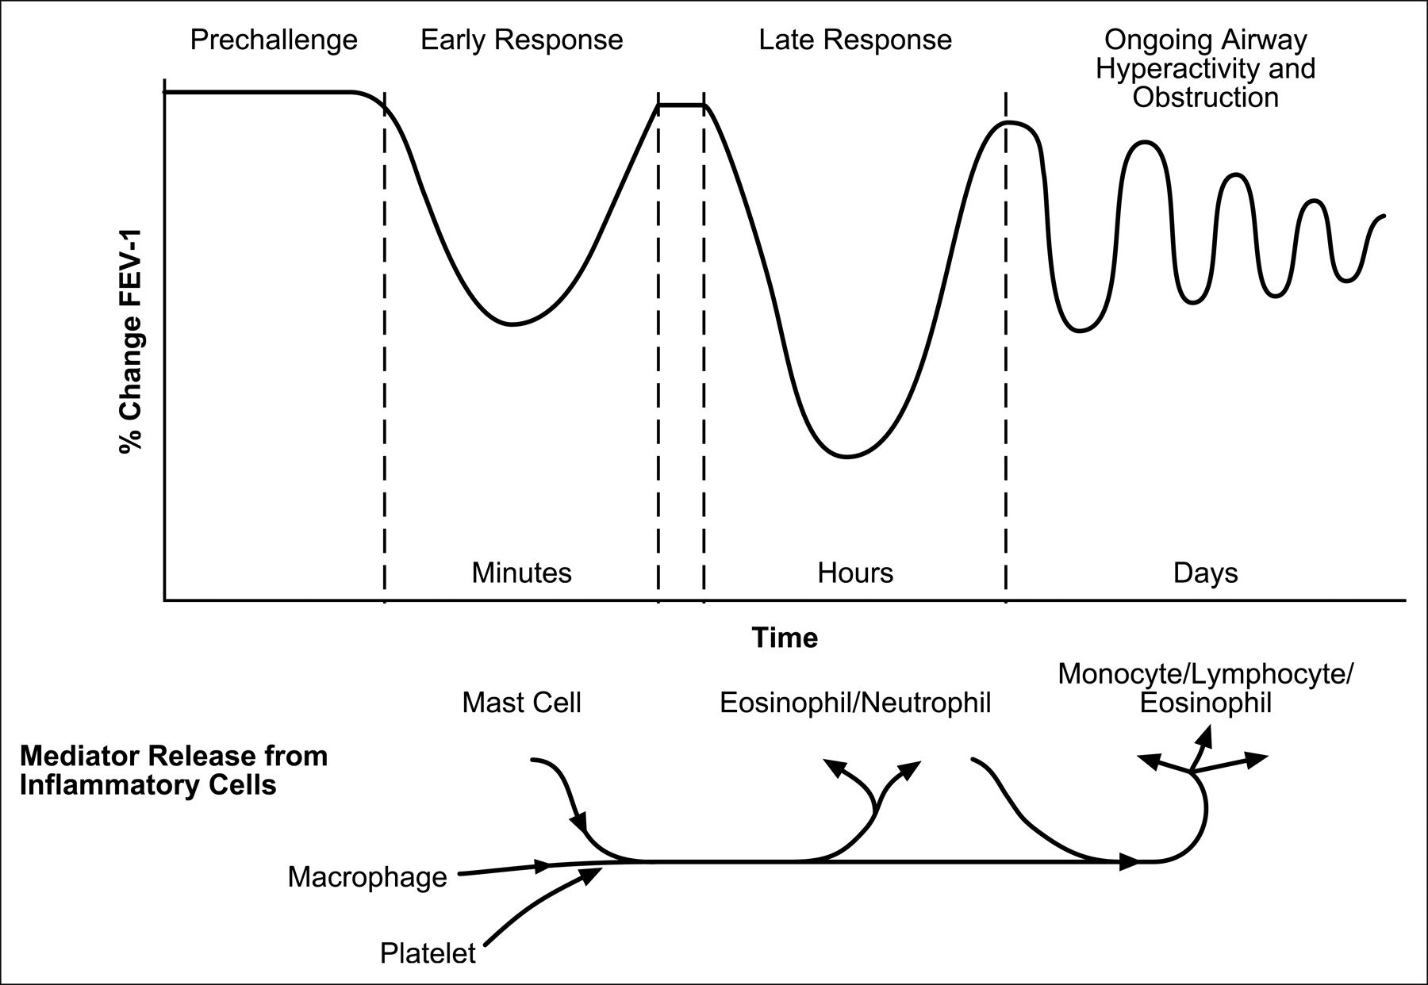
Biphasic airway response to allergen exposure
IgE
Guill, M. F. Pediatrics in Review 2004;25:299-305
Copyright ©2004 American Academy of Pediatrics

Slide 8
Burden of disease
#1 chronic illness in childhood
#1 chronic illness causing school absence
78% of parents report a negative impact on family

Slide 9
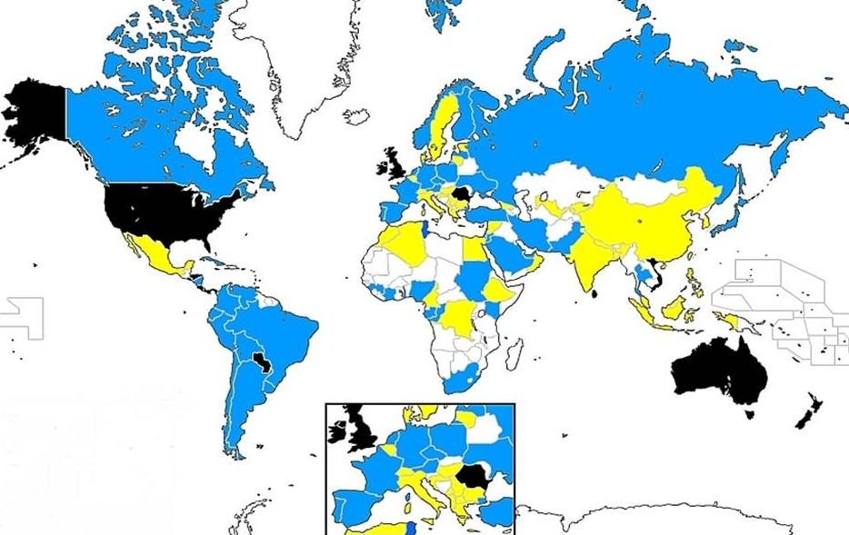
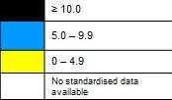
Prevalence of asthma in children aged
13-14 years
© Global Initiative for Asthma
GINA 2016 Appendix Box A1-1; figure provided by R Beasley

Slide 10
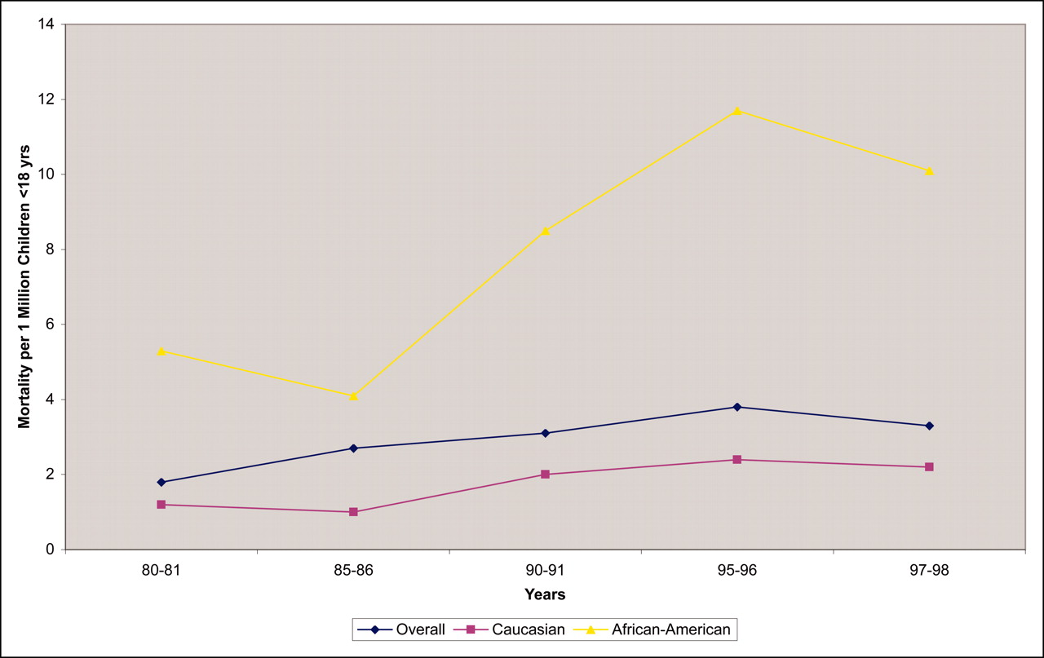
Asthma mortality from 1980 to 1998
Guill, M. F. Pediatrics in Review 2004;25:299-305
Copyright ©2004 American Academy of Pediatrics

Slide 11
Natural History & Prognosis
Remains incompletely understood
Most children do not ultimately “grow out of it”
  “Loss” of symptoms may be related to growth of lungs and not due to a change of airway hyperresponsiveness.
  Disease may go through a silent, asymptomatic period in young adulthood
.
Notes:
The natural history and prognosis of pediatric asthma is incompletely understood.
Most children “don’t grow out of asthma”¹. Instead, the “loss” of symptoms may actually be related simply to growth of the lungs and not due to a change of airway hyperresponsiveness. The “loss” of symptoms may thus represent a period of time when the disease goes through a silent, asymptomatic period only to recur later in life².
¹Martinez, FD. In: Barnes PJ, Leff AR, Grunstein MM, Woolcock AJ., eds. Asthma. Philadelphia PA: Lippincott - Raven; 1997:121-128.
² Weiss ST, Environmental risk factors in childhood asthma. Clin Exp Allergy. 1998;28(suppl 5):29-34.

Slide 12
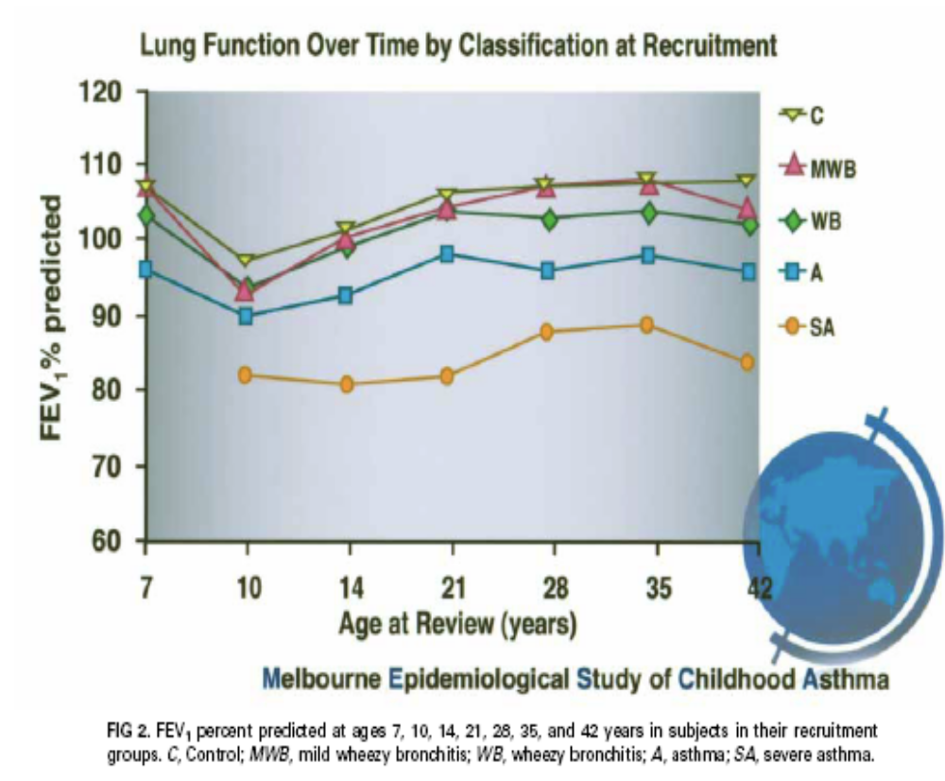
Asthma and Wheezing from 7 to 42 Years
Melbourne Study
Phelan et al JACI 2002 109;189-196

Slide 13
What’s Unique?
Pediatric asthma epidemiology
Asthma and wheezing in the first 6 years of life
  Studied by Martinez and colleagues
  Results from 826 infants followed from birth through age 6
Some risk factors for asthma are common for adults and children, but some clearly differ
  Differences are perhaps most marked in
  the youngest age groups
Martinez et al. N Engl J Med 332:133-8, 1995.
Notes:
Although some risk factors for asthma are in common between adults and children, some clearly differ. The differences are perhaps most marked in the youngest age groups.
Asthma and wheezing in the first 6 years of life were well-studied in a landmark paper published in the New England Journal of Medicine by Dr. Fernando Martinez and colleagues at University of Arizona. In this population-based study, the authors describe characteristics of wheezing in 826 infants followed from birth through age 6, living in Tucson Arizona.
Martinez FD et al. Asthma and wheezing in the first 6 years of life.
N Engl J Med 332:133-8, 1995.

Slide 14
Asthma and Wheezing in the First Six Years
Tucson Children’s Respiratory Study
Category Age 3 Age 6
“Transient” Wheezing (+) (–)
“Persistent” Wheezing (+) (+)
“Late” Wheezing (–) (+)
(+) Age 3: ≥1 lung illness with wheezing before age 3
(+) Age 6: ≥1 wheezing episode during the year before age 6
Martinez et al. N Engl J Med 332:133-8, 1995.
Notes:
In this table,
A “(+)” under “Age 3” means: At least 1 lung illness with wheezing was noted at some time before age 3
A “(+)” under “Age 6” means: At least 1 wheezing episode was noted during the year before age 6
The results of the Tucson Children’s Respiratory Study revealed that children who wheezed at some time before age 6 years could be categorized into one of three wheezing phenotypes:
Transient wheezing was defined as:
≥1 lung illness with wheezing some time before age 3, and
No episode of wheezing during the year before age 6
Persistent wheezing was defined as:
≥1 lung illness with wheezing some time before age 3, and
≥1 wheezing episode during the year before age 6
Late wheezing was defined as:
No lung illness with wheezing before age 3, and
≥1 wheezing episode during the year before age 6
Martinez FD et al. Asthma and wheezing in the first 6 years of life.
N Engl J Med 332:133-8, 1995.

Slide 15
Asthma and Wheezing in the First Six Years
Categories of wheezing: Risk factors
Transient
(+)Age 3, (–)Age 6
Lung function LOW soon after birth
Maternal smoking during pregnancy
Persistent
(+)Age 3, (+)Age 6
Atopy
Elevated IgE
Maternal smoking during pregnancy
Male gender
Late
(–)Age 3, (+)Age 6
Atopy
Male gender
Martinez et al. N Engl J Med 332:133-8, 1995.
Notes:
Survey questionnaires to parents, assessment of pulmonary functions, and total IgE levels yielded the following risk factors that reached statistical significance for each category of wheezing:
Transient: wheezing (+) age 3, (–) age 6
Low lung function soon after birth
Maternal smoking during pregnancy
Persistent: wheezing (+) age 3, (+) age 6
Atopy: History of maternal asthma, rhinitis apart from colds, eczema, and elevated IgE levels when measured at 9 months of age -- each reached statistical significance
Maternal smoking during pregnancy
Male gender
Late: wheezing (–) age 3, (+) age 6
Atopy: History of maternal asthma, and rhinitis apart from colds -- each reached statistical significance
Male gender
Martinez FD et al. Asthma and wheezing in the first 6 years of life. N Engl J Med 332:133-8, 1995.

Slide 16
Asthma and Wheezing in the First Six Years
Categories of wheezing: Transient
Transient: (+)Wheeze <3 y.o.; (–) Wheeze at 6 y.o.
Lung function low after birth: “congenitally smaller airways”
With smaller airways from birth, these children may be predisposed to wheeze during viral respiratory infections
Wheezing was no longer present -- after sufficient lung growth had occurred -- by age 6 years
Martinez et al. N Engl J Med 332:133-8, 1995.
Notes:
Transient wheezing: (+)Wheeze <3 y.o.; (–) Wheeze at 6 y.o.
In this category, lung function was low when measured shortly after birth and before any respiratory tract illness had occurred. The authors labeled these children as having “congenitally smaller airways”.
With documented smaller airways from birth, these children may be predisposed to wheeze in early life during viral respiratory infections.
However, wheezing was no longer present in these children -- presumably after sufficient lung growth had occurred -- by age 6 years.
Risk factors for transient wheezing included:
Low lung function after birth
Maternal smoking during pregnancy: the authors speculated that this intrauterine exposure may have contributed to the smaller airway caliber seen shortly after birth in this group
Martinez FD et al. Asthma and wheezing in the first 6 years of life. N Engl J Med 332:133-8, 1995.

Slide 17

Asthma and Wheezing in the First Six Years
Significance of wheezing at age 3
Of patients who wheezed before age 3,
wheezing persisted through age 6 in about 40%
Transient wheezing
Smaller airway caliber
No bronchial hyperresponsiveness
Wheezing resolved
by age 6
Persistent Wheezing
Atopy
Bronchial hyperresponsiveness
Significant deterioration in lung function by age 6
Martinez et al. N Engl J Med 332:133-8, 1995.
Notes:
There are two different wheezing syndromes that coexist, in different patients, during the first three years of life.
Transient wheezing: smaller airway caliber, no bronchial hyperresponsiveness and resolution by age 6 years. Of patients who wheezed before age 3 years, 60% fell into the category of transient wheezing.
Persistent wheezing. These patients are characterized by the presence of atopy, bronchial hyperresponsiveness, and significant deterioration in lung function by age 6 years. Of patients who wheezed before age 3 years, 40% fell into the category of persistent wheezing.
Thus, an important conclusion from the Tucson Children's Respiratory Study:
More patients (60%) who wheezed before age 3 had transient conditions
But, 40% of children who wheezed before age 3 had persistent wheezing through age 6
It is this relatively substantial proportion who, in effect, have early-onset asthma and are at likely risk of progressive asthma throughout childhood and adulthood.
Martinez FD et al. Asthma and wheezing in the first 6 years of life.
N Engl J Med 332:133-8, 1995.

Slide 18
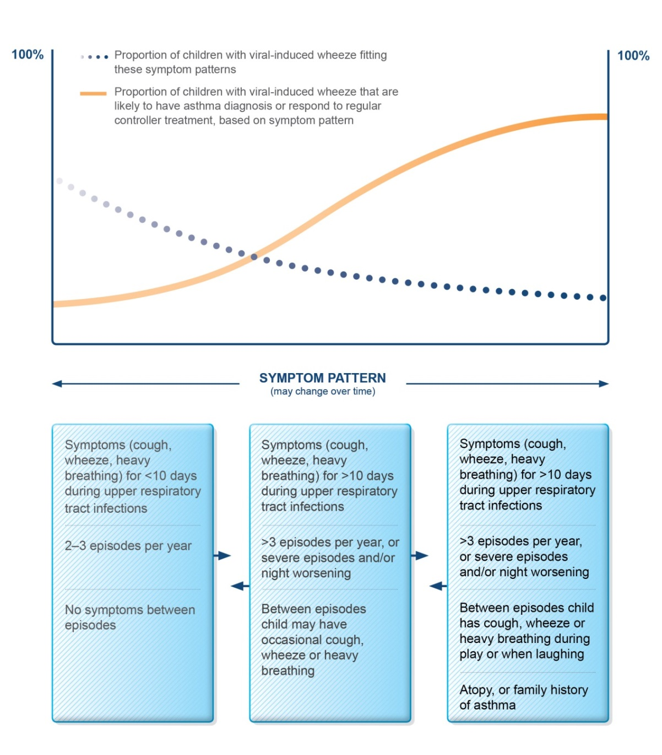
Probability of asthma diagnosis or response to asthma treatment in children ≤5 years
GINA 2016, Box 6-1 (1/2)

Slide 19
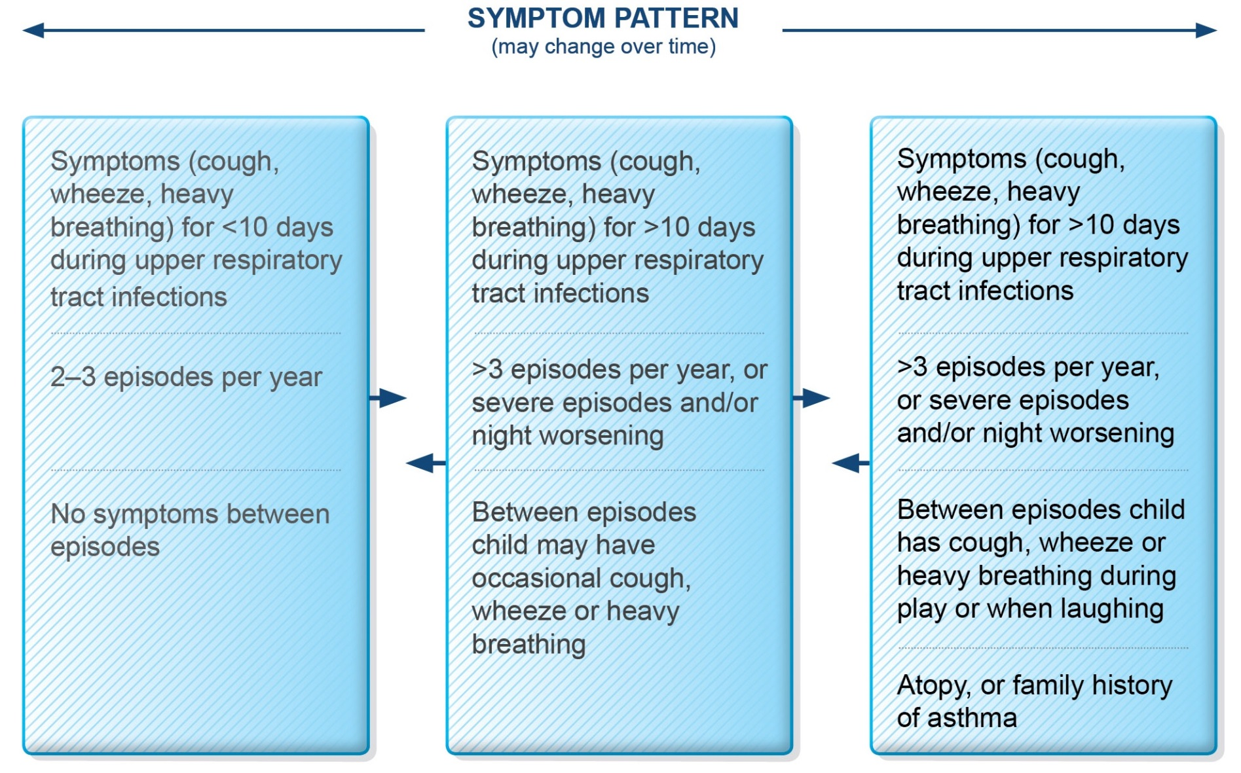
Symptom patterns in children ≤5 years
GINA 2016, Box 6-1 (2/2)

Slide 20
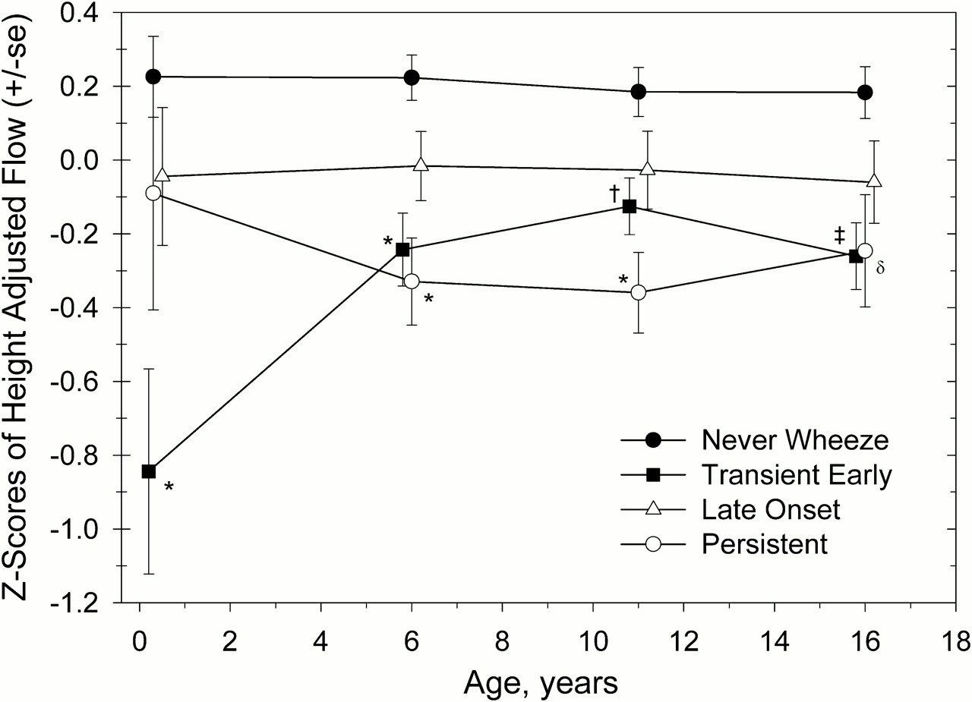
Asthma and Wheezing in the First Six teen Years
Tucson Study: 10 years later
FD Martinez et al. AJRCM Vol 172. pp. 1253-1258, 2005.

Slide 21
When should wheezing be called asthma
When it is recurrent
When other wheezing conditions have been excluded
When a number of risk factors are present
When the child responds to anti asthma therapy

Slide 22
Asthma Predictive Index
Used in children younger than 3 to predict the likelihood of developing asthma in the future
  3 Episodes of wheezing
  Plus 1 major criteria ( Parental history, atopy like eczema, positive sensitization to environmental allergen)
  0r 2 minor criteria like allergic rhitinits, wheezing without URI, or eosinophils >4% in peripheral bld.
Castro-Rodriguez JA. The Asthma Predictive Index: early diagnosis of asthma. Curr Opin Allergy Clin Immunol. 2011;11(3):157–161

Slide 23
Risk factors

Slide 24
Viral infections are both
  Risk factor for developing asthma later in life
  A trigger for an asthma flare up

Slide 25
Asthma Risk Factor
Viral infections
Healthy infant
Child
with asthma
rhino
RSV
PIV
Rhinovirus
Wheezing Illness
Atopy
Asthma exacerbation
Emergency room visit
Hospitalization
Resolution
Asthma
Notes:
For understanding the relationship of viral respiratory infections to pediatric asthma, there are two pathways to consider.
In a healthy infant who has a viral infection (most commonly either respiratory syncytial virus [RSV] or parainfluenza virus [PIV]), these viruses can lead to a wheezing illness, even in a healthy infant. More commonly, the wheezing illness will resolve without sequelae. However, there may be progression from this illness into subsequent development of asthma. Development of asthma is particularly likely in the presence of atopy, as we have seen supported by the Martinez data from Tucson. However, viral infection is a risk factor for pediatric asthma that is independent of atopy [see also next slide].
Alternatively, in a child who already has asthma, viral respiratory infection plays a different role. Common viral infections, with agents such as rhinovirus (the common cold virus), can lead to asthma exacerbations. (Rhinovirus commonly leads to asthma exacerbations in adults, as well.) In this pathway, the viral infection acts as an asthma “trigger” and may not have an important unique effect on the broader pathogenesis / progression of asthma.
Martinez FD et al. Asthma and wheezing in the first 6 years of life.
N Engl J Med 332:133-8, 1995.

Slide 26
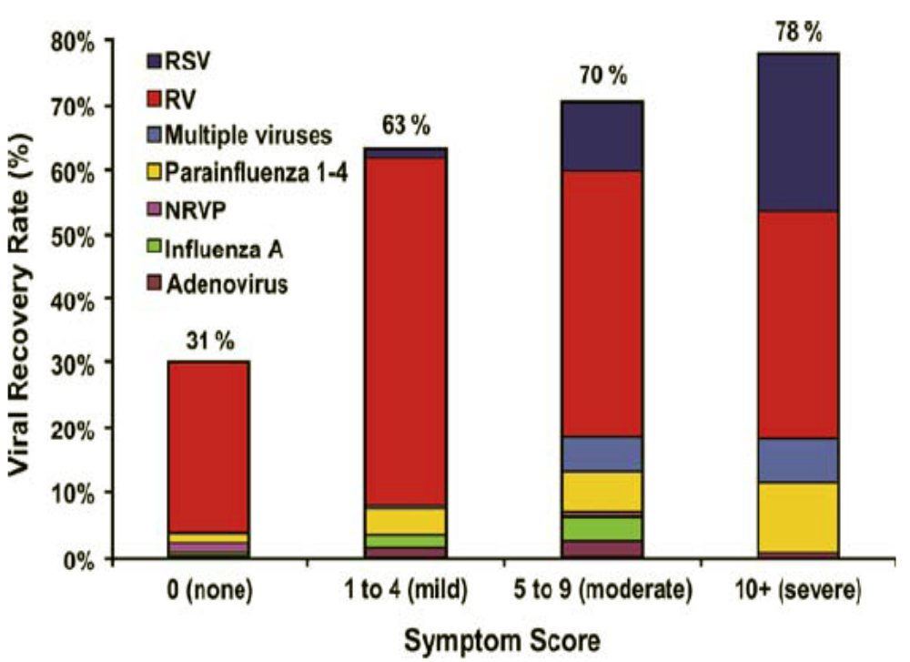
Impact of Viral LRIs Before Age 3 Years
Lemanske et al JACI 116(3):571-577 2005

Slide 27
Asthma Risk Factor
Atopy
Atopy is the most important risk factor for the development of asthma.
  By school age 40-80% of asthmatic children have positive immediate type allergy skin tests.
  Allergic rhinits, eczema, high IgE levels and more than 4% eosinophils.

Slide 28
Asthma Risk Factor
Male gender
In general,
  Female lungs are smaller than male lungs
  Female airways are smaller than male airways
However, relative to lung size,
male airways are smaller than female airways
  This may explain the greater incidence of asthma in boys than in girls
  It is certainly clear from epidemiology that asthma is more common in boys than in girls
Notes:
In general, female lung size is smaller than male lung size, at maximal growth. Also, female airways are smaller than male airways , at maximal growth.
However, when assessed relative to lung size, the male airways are smaller than female airways. The term “dysanaptic growth” was originally defined by Green and colleagues as nonisotropic growth of lung airways and parenchyma.^{1,2} It appears that dysanaptic growth -- or growth of airway caliber that is not as robust as the simultaneous growth in lung size -- is more common in males than in females.³
This may explain the greater incidence of asthma in boys than in girls. It is certainly clear from epidemiologic studies that asthma is more common in boys than in girls.
¹Green M, Mead J, Turner JM. Variability of maximum expiratory flow-volume curves. J Appl Physiol. 1974;37:67-74.
²Weiss ST, Segal MR, Tager IB, et al. Effects of asthma on pulmonary function in children: a longitudinal population-based study. Am Respir Dis. 1992;145:58-64.
³Weiss ST, Early life predictors of adult chronic obstructive lung disease. Eur Respir Rev. 1995;31:303-309.

Slide 29
Asthma Risk Factor
Cigarette smoking in early adolescence
Active smoking reduced the growth in FEV₁
5
Nonsmokers
4.78 L
4.38 L
4
Started Smoking
at Age 15
FEV₁
(L)
3
2
1
4
6
8
10
12
14
16
18
20
Age (years)
As little as 1 cigarette per day reduced the maximal growth in FEV₁ by 5%
Tager et al. Am Rev Respir Dis. 1985;131:752-759.
Notes:
Tager and colleagues studied the effect of active cigarette smoking during early adolescence on maximal percent FEV₁. They found that the initiation of smoking at age 15 was associated with reduced growth in FEV₁. In fact, smoking as little as one cigarette a day was associated with a reduction of approximately 5% in maximal growth in FEV₁.
Tager IB, Munoz A, Rosner B, et al. Effect of cigarette smoking on the pulmonary function of children and adolescents. Am Rev Respir Dis. 1985;131:752-759.

Slide 30
Asthma risk factors
A positive family history of asthma
  Maternal history of asthma had a stronger association with developing asthma than paternal history
  If one parent has asthma the likelihood of asthma in their children increases by 3 times, if both parents have asthma it increases by 6 times

Slide 31
Clinical Presentation

Slide 32
Presentations of Wheezing
The most common cause of wheezing
in young children is viral respiratory infection
BUT
The strongest predictor for wheezing that develops into asthma is ATOPY
  About 70–90% of children with asthma are atopic (i.e., positive skin tests)
Notes:
With regard to presentations of wheezing, it is important to keep in mind that the most common cause of wheezing in young children is a viral respiratory infection.
But, the strongest predictor for wheezing that continues into asthma is atopy. In fact, about 70% to 90% of children with asthma have allergies -- as documented by allergy testing, such as positive skin tests to inhalant allergens.
Pediatric Asthma: Promoting Best Practice, Guide for Managing Asthma in Children. Milwaukee, WI: American Academy of Allergy, Asthma and Immunology (with AAP, NAEPP / NHLBI / NIH), 1999.

Slide 33
Making the diagnosis: History
Symptoms
  Cough, wheeze, dyspnea
  Nocturnal awakenings
Frequency & Severity
  Seasonal, perennial
  Precipitating factors / “Triggers”
  Interference with daily activities
  ER visits or hospitalizations
Medication Usage
Short-acting beta-agonist use
Family History
  Allergy / Atopy
  Asthma
Notes:
Diagnosis starts with history. In evaluating the patient, there are some specifics that are worth keeping in mind.
First, look for a family history of allergy or atopic diseases, as well as a family history of asthma, particularly in the mother.
Second, assess the more familiar symptoms: cough, wheeze, dyspnea, chest tightness. Also, ask specifically about nocturnal awakenings. This is important in assessing the severity of asthma.
Frequency and severity of symptoms are also key. What is the pattern over time? Are symptoms “seasonal” or “perennial” (continuous)? Look for specific precipitating factors or “triggers”, such as viral respiratory infections, allergens, exercise, weather, crying/laughing. Interference with daily activities is important for the physician to assess, and is obviously important to the patient in terms of lifestyle. Of course, emergency room visits and hospitalizations are important to catalog.
Finally, assess medication usage. A quick, easy, and important question is to ask the frequency of short-acting beta-agonist usage.
Pediatric Asthma: Promoting Best Practice, Guide for Managing Asthma in Children. Milwaukee, WI: American Academy of Allergy, Asthma and Immunology (with AAP, NAEPP / NHLBI / NIH), 1999.

Slide 34
Precipitating / Aggravating Factors
Asthma Triggers
Viral upper respiratory infections
Allergen exposure
Exercise, hyperventilation
Irritants (especially smoke)
Weather
Strong emotion
Gastroesophageal reflux???Symptomatic GERD benefits from treatment
Notes:
Here is a selection of asthma triggers that are important in various children with asthma.
At the top of the list, for good reason, is viral upper respiratory infection. Also very important, is allergen exposure.
Exercise and hyperventilation (as part of exercise or for other reasons, such as crying or laughing) can also be asthma triggers. General airborne irritants are also triggers for some patients, especially cigarette smoke or other fumes. Changes in the weather may be important triggers, including cold air or humidity. Strong emotion, leading to laughing or crying, and other conditions, such as gastroesophageal reflux, are all triggers that can be important, at various times for various patients.
Pediatric Asthma: Promoting Best Practice, Guide for Managing Asthma in Children. Milwaukee, WI: American Academy of Allergy, Asthma and Immunology (with AAP, NAEPP / NHLBI / NIH), 1999.

Slide 35
Making the diagnosis: Exam
Wheezing
  A sign of intrathoracic airway obstruction
  A musical sound generated by airway passing at high velocity through an airway narrowed to the point of almost closure

Slide 36
Differential diagnosis of wheezing
  Bronchiolitis
  Cystic Fibrosis
  Foreign body
  Anatomical lesions like vascular rings, mediastinal cysts
  GERD, aspiration
  Heart failure

Slide 37
Making the diagnosis: Physical exam
Decreased air entry bilateral
Prolonged forced expiration
Use of accessory muscles
Retractions
Hyperexpansion of the chest
Signs of other allergic diseases
  Atopic dermatitis
  Allergic rhinitis
Physical examination of the chest may be normal
Notes:
After assessing history, the next step in making the diagnosis is the physical exam.
Looking for coughing and wheezing is important.
Physical findings that may be present during more severe asthma attacks are: prolonged forced expiration, use of accessory muscles, retractions, and hyperexpansion of the chest.
Physical signs of other allergic diseases are also important in assessing the patient: atopic dermatitis or eczema and nasal discharge (particularly clear nasal discharge that might be suggestive of allergic rhinitis).
In relatively mild or moderate patients, it is important to remember that between attacks, the physical examination of the chest may be entirely normal.
Pediatric Asthma: Promoting Best Practice, Guide for Managing Asthma in Children. Milwaukee, WI: American Academy of Allergy, Asthma and Immunology (with AAP, NAEPP / NHLBI / NIH), 1999.

Slide 38
Challenges in Treating Childhood Asthma
Assessing airway function
Spirometry:
An FEV₁ response of ³12% post-bronchodilator is suggestive of asthma
BUT,
Spirometry is difficult in children <4 yrs
Some children cannot perform spirometry adequately until >7 years of age
Notes:
Assessing airway function is the next important piece of the puzzle. Spirometry is the classic way of assessing airway function. An FEV₁ response of at least 12%, after a bronchodilator, is very suggestive of asthma. However, spirometry is difficult in children who are less than four years old and some children have trouble performing spirometry until they are seven years old, or older.
An alternative assessment, although not as ideal or as diagnostic as spirometry, is to assess peak flow once or twice daily, looking for variability over one to two weeks.
Other assessments may be pursued by specialists or other asthma consultants. These assessments may include provocation tests such as methacholine inhalation, and possibly exercise tolerance testing.
Allergy testing can be performed by skin tests, or in vitro RAST tests, as well as total serum IgE. Sinus or chest X-rays can be performed, particularly to rule out other concomitant conditions that may be accompanying asthma.
Pediatric Asthma: Promoting Best Practice, Guide for Managing Asthma in Children. Milwaukee, Wis: American Academy of Allergy, Asthma and Immunology (with AAP, NAEPP / NHLBI / NIH), 1999.

Slide 39
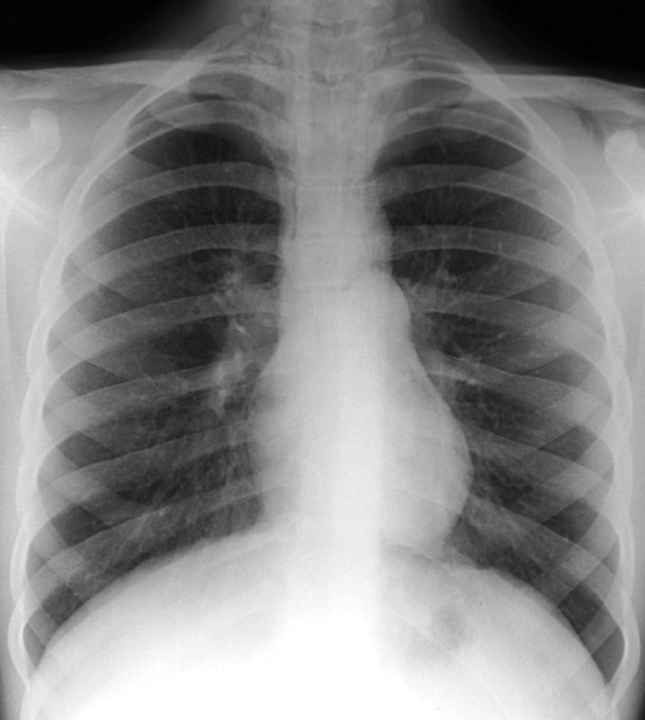
Diagnosis
X rays
When?

Slide 40
First time wheezing
Fever
Unilateral Wheezing
Sever symptoms

Slide 41
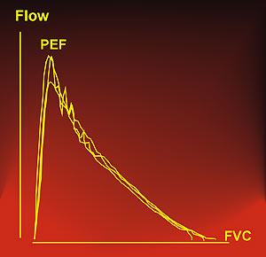
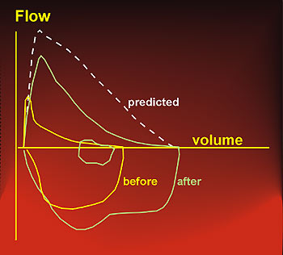
Diagnosis
How often ?
Pulmonary function testing.
  Flow volume curves

Slide 42
Diagnosis
Assessing airway function
Metholine/ Histamine/Exercise challenge test.
Sputum eosinophils.
Exhaled NO.
Allergy testing.
Infant lung testing.
Peak flow??

Slide 43
Peak Flows
  Not routinely indicated
  -Used in moderate and sever asthma

Slide 44
Management

Slide 45
Management of asthma
How important ?
Long term goals
  Maintain child symptom free
  Best lung function at all times
  Avoid need for bronchodilators
  Prevent the restriction of childhood activities
  Prevent the development of irreversible lung disease
  Reduce the risk of death
  Avoid unnecessary side effects.

Slide 46
Treatmen of asthma
Bronchodilators -β agonist SABA
  Relax smooth muscle in the bronchial tree.
  Duration of action around 4 hours, peak 10-30min
  Can cause sympathomimetic effects
  Available as inhalers or nebulizers

Slide 47
Medications
Dosing for albuterol
  MDI 90mcg per puff, 2-4puffs as needed
  For nebulize 2.5mg of albutrol/dose

Slide 48
Medications
Anticholinergic agents: (Atrovent)
  Blocks the postganglionic efferent vagal pathways leading to bronchodilation.
  Additive effect to Β2 agonist in an acute asthma attack.
  Effective in acute asthma management, use in first 24 hours decreased rate of hospital admission.

Slide 49
Medications
Inhaled steroids:
  Anti inflammatory agents that lead to the modification of arachidonic acid metabolism.
  Associated with decreased airway responsiveness.
  Available as beclomethasone, budesonide, fluticasone, and triamcinolone, ciclosinide ( Alvesco)
  Inhaled or nebulized

Slide 50
Medication
Side effects:
  Suppression of hypothalamic-pituitary axis, rarely doses below 800mcg.
  Decrease in height. ( CAMP study).
  Oral thrush, hoarseness.
  Similar to oral steroids in high doses.
Are not believed to prevent the development of asthma

Slide 51
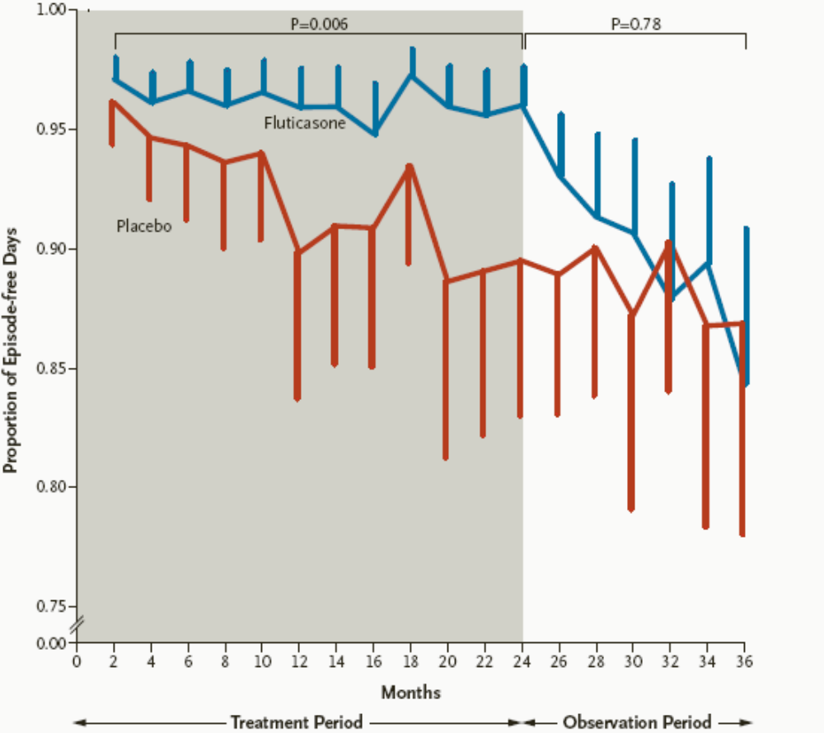
Guilbert et al NEJM 354(5):1198-97 2006

Slide 52
Medications
Oral steroids:
  Most commonly used in the management of an acute attack.
  Also in children with sever chronic asthma.
  Onset of action is after 8 hours.
  Side effects: reduced growth, Hypothalamic pituitary axis suppression, hypertension, cataract…

Slide 53
Treatmen of asthma
Long acting β agonist LABA
  Salmeterol—up to 12 hours
  Formoterol—observed in most patients to last up to 12 hours
  Are steroid sparing
  Black box warning

Slide 54
Medications
Leukotriene-receptor antagonist (Zafirlukast, montelukast), and Leukotrene- receptor inhibitors (Zileuton)
  Block airway response to challenges, lead to improved lung function.
  Oral medication taken ONCE daily.
  Have a role in mild asthma.
  Some pharmaco-genetics involved

Slide 55
Medications
Theophyllin (Methylxanthines):A phophodiesterase inhibitor, increases intracellular cAMP , decreases inflammation
  Narrow therapeutic index, multiple drug interactions, needs drug levels
Cromolyn sodium: Mast cell stabilizer
Nedocromomil Sodium: Long acting mast cell stabilizer
Magnesuim sulphate: Inhibits smooth muscle contraction, stabilizes mast cells, inhibits acetylcholine release.
  A cochrane review 2160, showed that it may reduce the need for hospital admission in children with acute moderate to sever asthma, but the evidence is extremely limited
  Omalizumab: Anti IgE (Xolair)
  Anti IL 5 antibodies

Slide 56
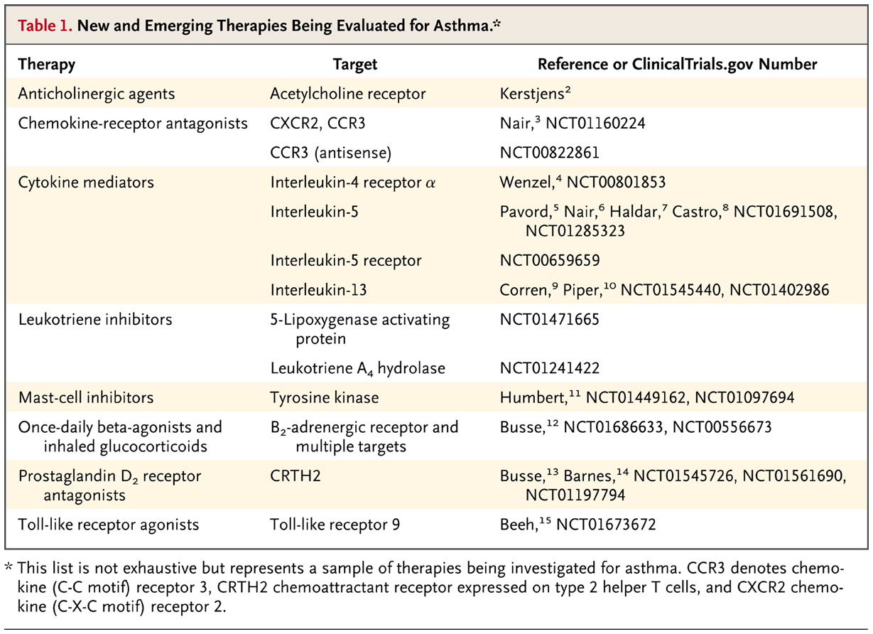

Wechsler ME. N Engl J Med 2013;368:2511-2513.
New and Emerging Therapies Being Evaluated for Asthma.

Slide 57
Treating asthma to control symptoms and minimize risk

Slide 58
Assessing asthma severity
How?
  Asthma severity is assessed retrospectively from the level of treatment required to control symptoms and exacerbations
When?
  Assess asthma severity after patient has been on controller treatment for several months
  Severity is not static – it may change over months or years, or as different treatments become available
Categories of asthma severity
  Mild asthma: well-controlled with Steps 1 or 2 (as-needed SABA or low dose ICS)
  Moderate asthma: well-controlled with Step 3 (low-dose ICS/LABA)
  Severe asthma: requires Step 4/5 (moderate or high dose ICS/LABA ± add-on), or remains uncontrolled despite this treatment
GINA 2016

Slide 59
GINA assessment of asthma control in children ≤5 years
A. Symptom control
In the past 4 weeks, has the child had: | Well-controlled | Partly controlled | Uncontrolled
Daytime asthma symptoms for more than few minutes, more than once/week? Yes No | None of these | 1-2 of these | 3-4 of these
Any activity limitation due to asthma? (runs/plays less than other children, tires easily during walks/playing) Yes No
Reliever needed* more than once a week? Yes No
Any night waking or night coughing due to asthma? Yes No
Level of asthma symptom control
GINA 2016, Box 6-4A

Slide 60
Risk factors for poor asthma outcomes in children ≤5 years
Risk factors for exacerbations in the next few months
Uncontrolled asthma symptoms One or more severe exacerbation in previous year The start of the child’s usual ‘flare-up’ season (especially if autumn/fall) Exposures: tobacco smoke; indoor or outdoor air pollution; indoor allergens (e.g. house dust mite, cockroach, pets, mold), especially in combination with viral infection Major psychological or socio-economic problems for child or family Poor adherence with controller medication, or incorrect inhaler technique
Risk factors for fixed airflow limitation
Severe asthma with several hospitalizations History of bronchiolitis
Risk factors for medication side-effects
Systemic: Frequent courses of OCS; high-dose and/or potent ICS Local: moderate/high-dose or potent ICS; incorrect inhaler technique; failure to protect skin or eyes when using ICS by nebulizer or spacer with face mask
GINA 2016, Box 6-4B (3/3)

Slide 61

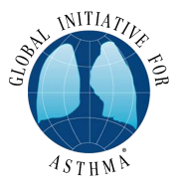

The control-based asthma management cycle
Diagnosis
Symptom control & risk factors
(including lung function)
Inhaler technique & adherence
Patient preference
ASSESS
REVIEW RESPONSE
Symptoms
Exacerbations
Side-effects
Patient satisfaction
Lung function
ADJUST TREATMENT
Asthma medications
Non-pharmacological strategies
Treat modifiable risk factors
GINA 2016, Box 3-2

Slide 62
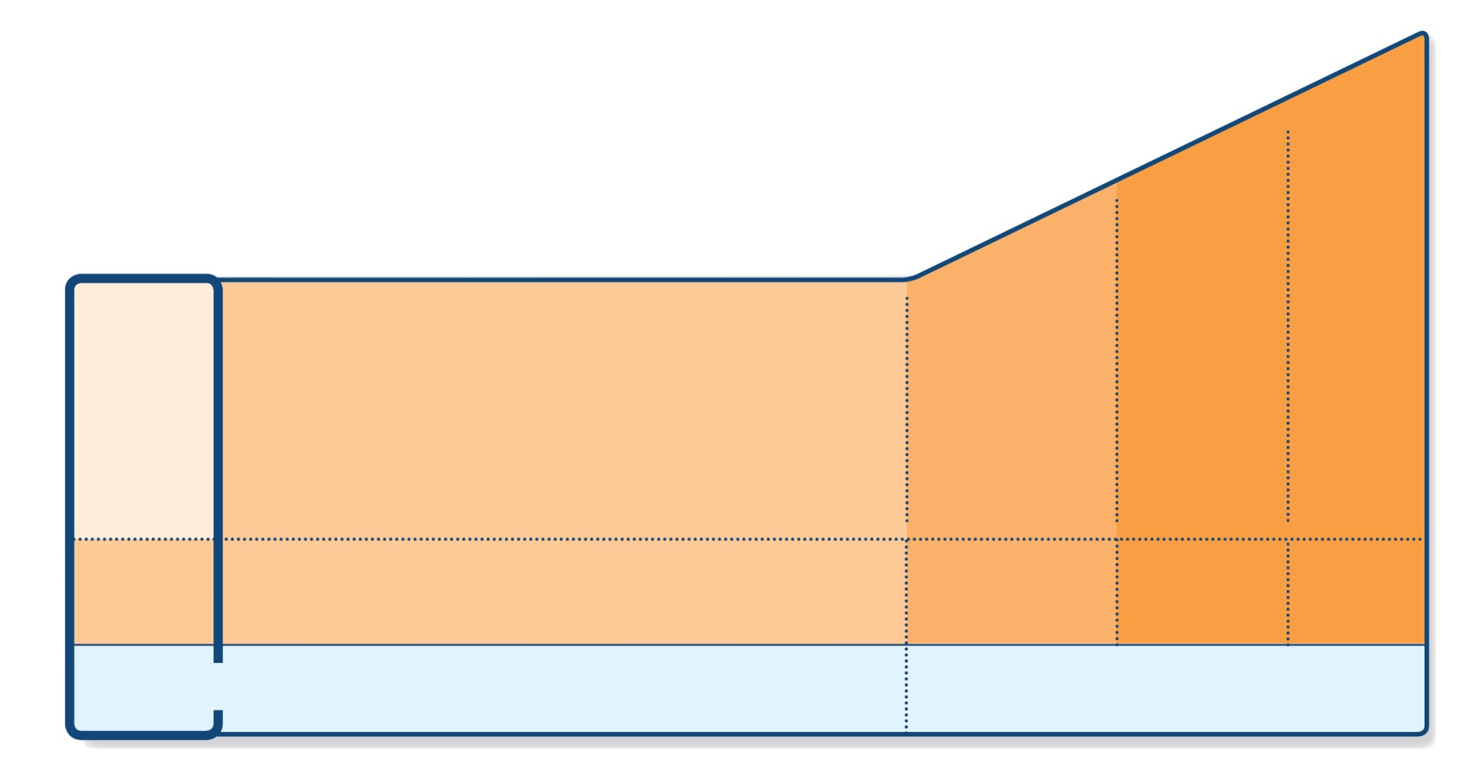
STEP 5
STEP 4
PREFERRED
CONTROLLER
CHOICE
STEP 1
STEP 2
STEP 3
Refer for
add-on treatment
e.g.
tiotropium,* omalizumab, mepolizumab*
Med/high
ICS/LABA
Low dose
ICS/LABA**
Low dose ICS
Other
controller
options
Consider low dose ICS
Leukotriene receptor antagonists (LTRA)
Low dose theophylline*
Med/high dose ICS
Low dose ICS+LTRA
(or + theoph*)
Add tiotropium*
High dose ICS
+ LTRA
(or + theoph*)
Add low
dose OCS
As-needed short-acting beta₂-agonist (SABA)
As-needed SABA or
low dose ICS/formoterol#
RELIEVER
*Not for children <12 years
**For children 6-11 years, the preferred Step 3 treatment is medium dose ICS
#For patients prescribed BDP/formoterol or BUD/ formoterol maintenance and reliever therapy
 Tiotropium by mist inhaler is an add-on treatment for patients ≥12 years with a history of exacerbations
GINA 2016, Box 3-5, Step 1 (4/8)

Slide 63
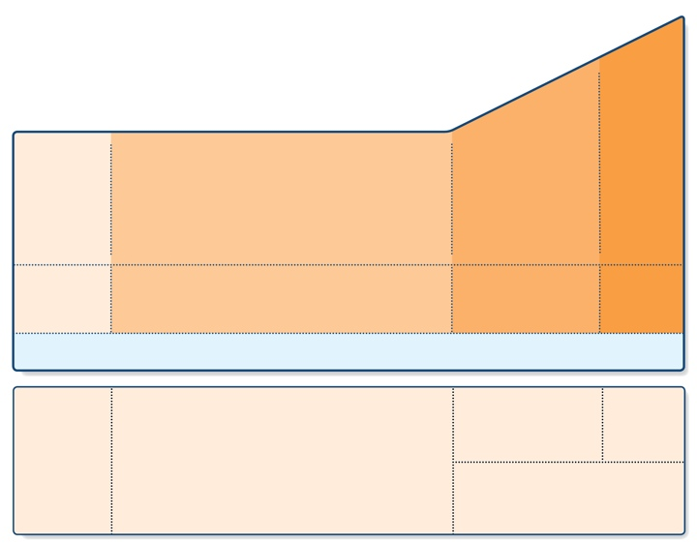
Stepwise approach – pharmacotherapy
(children ≤5 years)
STEP 4
PREFERRED
CONTROLLER
CHOICE
STEP 3
STEP 1
STEP 2
Continue controller
& refer for specialist assessment
Double
‘low dose’
ICS
Daily low dose ICS
Other
controller
options
Leukotriene receptor antagonist (LTRA)
Intermittent ICS
Low dose ICS + LTRA
Add LTRA
Inc. ICS
frequency
Add intermitt ICS
RELIEVER
As-needed short-acting beta₂-agonist (all children)
CONSIDER
THIS STEP FOR CHILDREN WITH:
Infrequent
viral wheezing and no or
few interval symptoms
Symptom pattern consistent with asthma
and asthma symptoms not well-controlled, or
≥3 exacerbations per year
Symptom pattern not consistent with asthma but wheezing episodes occur frequently, e.g. every
6–8 weeks.
Give diagnostic trial for 3 months.
Asthma diagnosis, and not well-controlled on low dose ICS
Not well-controlled on double ICS
First check diagnosis, inhaler skills, adherence, exposures
GINA 2016, Box 6-5 (3/8)

Slide 64
  For children with intermittent viral-induced wheeze and no interval symptoms, if as-needed SABA is not sufficient, consider intermittent ICS. Because of the risk of side-effects, this should only be considered if the physician is confident that the treatment will be used appropriately.
GINA 2016

Slide 65
Assessing asthma severity
How?
  Asthma severity is assessed retrospectively from the level of treatment required to control symptoms and exacerbations
When?
  Assess asthma severity after patient has been on controller treatment for several months
  Severity is not static – it may change over months or years, or as different treatments become available
Categories of asthma severity
  Mild asthma: well-controlled with Steps 1 or 2 (as-needed SABA or low dose ICS)
  Moderate asthma: well-controlled with Step 3 (low-dose ICS/LABA)
  Severe asthma: requires Step 4/5 (moderate or high dose ICS/LABA ± add-on), or remains uncontrolled despite this treatment
GINA 2016

Slide 66
Acute asthma flare up
Starts at home
Asthma management plan

Slide 67
Acute asthma management
Inhaled albuterol, continuous, frequent
Systemic steroids---- Oral or IV
Inhaled anticholinergics
If no improvement consider
  Subcutaneous terbutaline
  Magnesium sulphate
  Heliox
  Intubation and ventilation

Slide 68
Initial management of asthma exacerbations in children ≤5 years
Therapy | Dose and administration
Supplemental oxygen | 24% delivered by face mask (usually 1L/min) to maintain oxygen saturation 94-98%
Inhaled SABA | 2–6 puffs of salbutamol by spacer, or 2.5mg by nebulizer, every 20 min for first hour, then reassess severity. If symptoms persist or recur, give an additional 2-3 puffs per hour. Admit to hospital if >10 puffs required in 3-4 hours.
Systemic corticosteroids | Give initial dose of oral prednisolone (1-2mg/kg up to maximum of 20mg for children <2 years; 30 mg for 2-5 years)
Additional options in the first hour of treatment
Ipratropium bromide |  | For moderate/severe exacerbations, give 2 puffs of ipratropium bromide 80mcg (or 250mcg by nebulizer) every 20 minutes for one hour only
Magnesium sulfate |  | Consider nebulized isotonic MgSO₄ (150mg) 3 doses in first hour for children ≥2 years with severe exacerbation
GINA 2016, Box 6-11 (2/2)

Slide 69
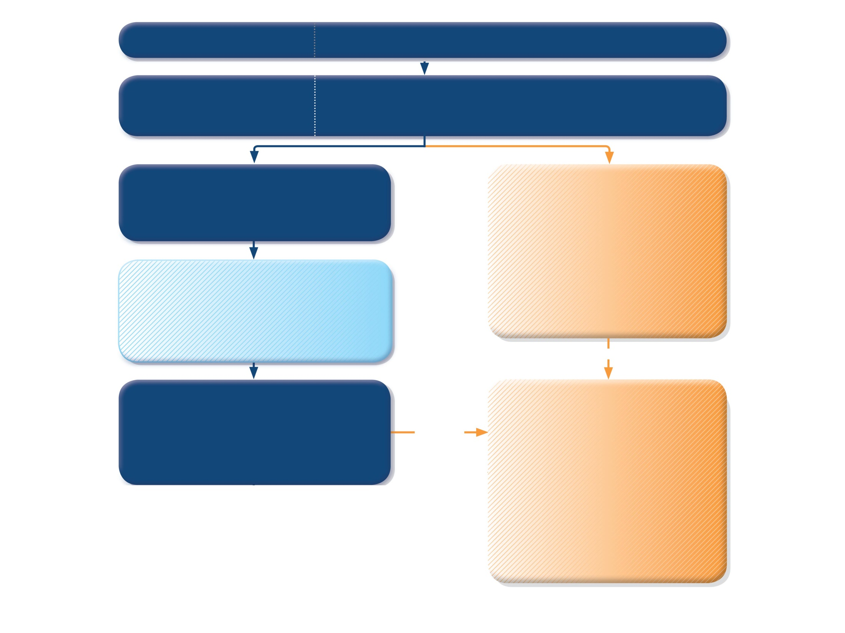
PRIMARY CARE
Child presents with acute or sub-acute asthma exacerbation
or acute wheezing episode
ASSESS the CHILD
Consider other diagnoses
Risk factors for hospitalization
Severity of exacerbation?
MILD or MODERATE
Breathless, agitated
Pulse rate ≤200 bpm (0-3 yrs) or ≤180 bpm (4-5 yrs)
Oxygen saturation ≥92%
SEVERE OR LIFE THREATENING
any of:
Unable to speak or drink
Central cyanosis
Confusion or drowsiness
Marked subcostal and/or sub-glottic retractions
Oxygen saturation <92%
Silent chest on auscultation
Pulse rate > 200 bpm (0-3 yrs)
or >180 bpm (4-5 yrs)
START TREATMENT
Salbutamol 100 mcg two puffs by pMDI + spacer
or 2.5mg by nebulizer
Repeat every 20 min for the first hour if needed
Controlled oxygen (if needed and available):
target saturation 94-98%
URGENT
MONITOR CLOSELY for 1-2 hours
Transfer to high level care if any of:
• Lack of response to salbutamol over 1-2 hrs
• Any signs of severe exacerbation
• Increasing respiratory rate
• Decreasing oxygen saturation
TRANSFER TO HIGH LEVEL CARE
(e.g. ICU)
While waiting give:
Salbutamol 100 mcg 6 puffs by pMDI+spacer (or 2.5mg nebulizer). Repeat every 20 min
as needed.
Oxygen (if available) to keep saturation 94-98%
Prednisolone 2mg/kg (max. 20 mg for <2 yrs; max. 30 mg for 2–5 yrs) as a starting dose
Consider 160 mcg ipratropium bromide
(or 250 mcg by nebulizer). Repeat every
20 min for 1 hour if needed.
Worsening,
or lack of improvement
GINA 2016, Box 6-8 (2/3)

Slide 70

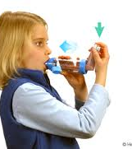

Slide 71
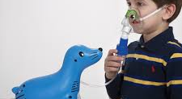

Slide 72
Medication delivery devices
Inhalers
Nebulizers
  Both used with mask if under 4 years and mouth piece after that.
  Always review technique with patient

Slide 73
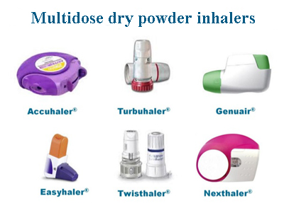
Dry powder inhalers

Slide 74
Thank you!!!!!

