Slide 1
MYCOBACTERL INFECTIONS
Marwan Shalabi, MD

Slide 2
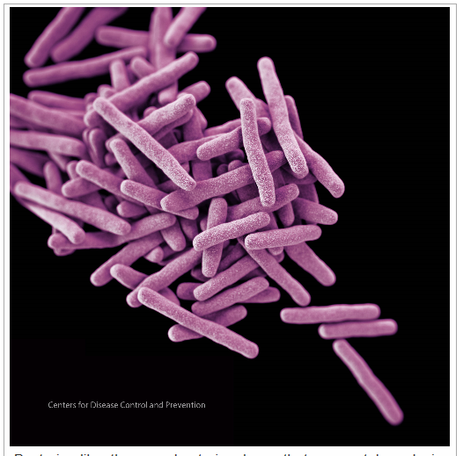
MYCOBACTERIOLOGY
Non-motile, nonspore – forming
Acid Fast positive (Ziehl–Neelsen stain)

Slide 3
MYCOBACTERIOLOGY
Obligate aerobes
Cell wall: 20 to 60 percent lipids
generation time of 12 to 48 hours (except rapid growers)

Slide 4
EPIDEMIOLOGY OF TUBERCULOSIS IN THE WORLD
10 million cases per year
2-3 million deaths per year
600,000 cases dual TB/HIV
2 billion infected individuals
$30 – $50 billion per year direct impact

Slide 5
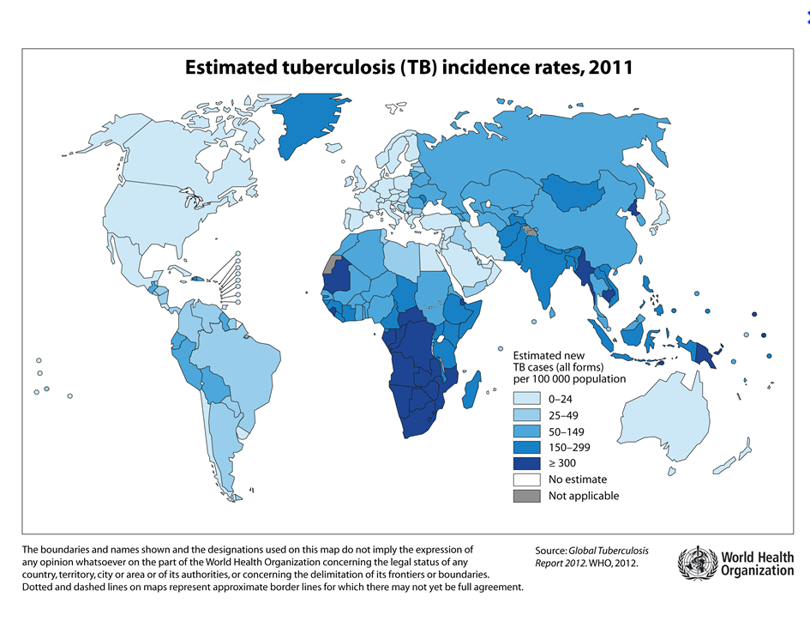

Slide 6
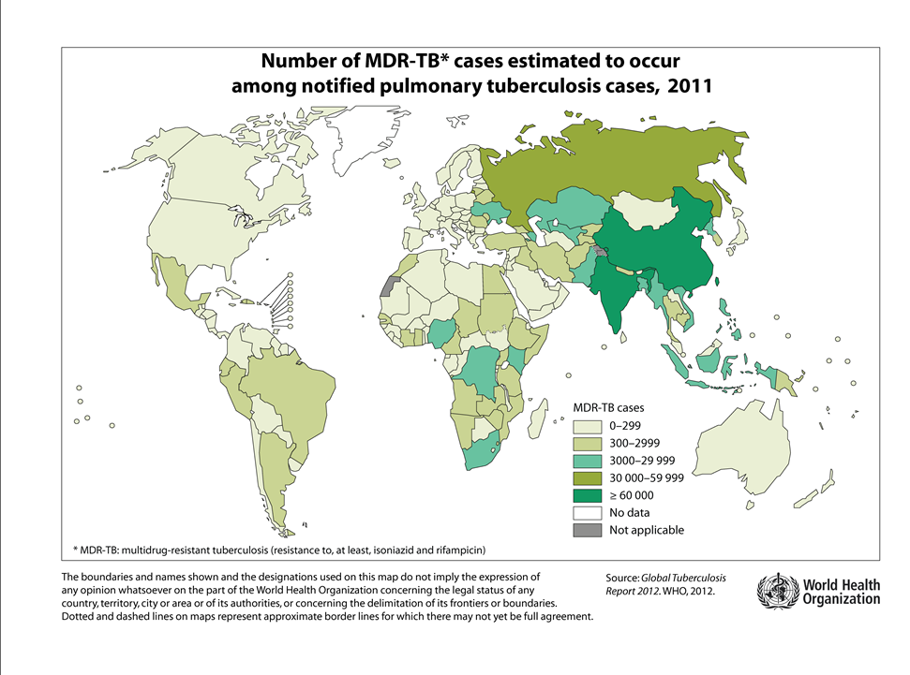

Slide 7
RISK FACTORS FOR
TUBERCULOSIS
Increased risk of acquiring or having infection
  Foreign born from high prevalence country
  Some healthcare workers
  Family history of TB (2-3 generations)
  Intravenous drug or crack cocaine user
  Contact with HIV- infected individuals
  Contact with inmates of prison or jail (past or present)
  Some nursing homes, residential living\\

Slide 8
RISK FACTORS FOR
TUBERCULOSIS
Increased risk of developing disease after infection
  Extremes of ages: infants, elderly
  Recent (<3 years) infection
  HIV infected
  Immune suppression - drugs or disease
  Certain diseases: silicosis, diabetes mellitus

Slide 9
TRANSITIONS INTUBERCULOSIS
Susceptible
Exposed
Infected
Diseased
Sick
Diagnosed
Treated
Cured

Slide 10
STAGES OF TUBERCULOSIS
Exposure
Defined by contact investigation - recent (< 3months) contact with an infectious case
Negative ST, physical exam and chest radiographs
Period during which the skin test may be negative in an infected person
Children < 5 years old should be treated (usually INH) because they may develop disease rapidly
Older children and adults often not treated, but repeat skin test 3 months after exposure over

Slide 11
STAGES OF TUBERCULOSIS
Infection
  Hallmark is a “positive” skin test
  “Germs in the body”
  Chest radiograph is normal
  No symptoms, physical exam is normal

Slide 12
SKIN-TESTING, INFECTION
AND DISEASE
  Tuberculin Skin Test (TST) takes 3 weeks to 3 months to turn positive after infection has occurred
Risk of disease after untreated infection:
  Normal adults: 5-10 percent in lifetime (half of risk in first 2-3 years)
  HIV-infected adults: 5-10 percent per year
  Infants: 40 percent in 1-2 years
  Older children: 5-10 percent (delayed)

Slide 13
STAGES OF TUBERCULOSIS
Disease
  Clinical and/or radiographic manifestations of progressive tuberculosis infection
  Primary: complication of initial infection
  Reactivation: disease occurs after period of dormancy of the infection
  TST is negative in 10 % of disease cases (50 % of meningeal or miliary disease)

Slide 14
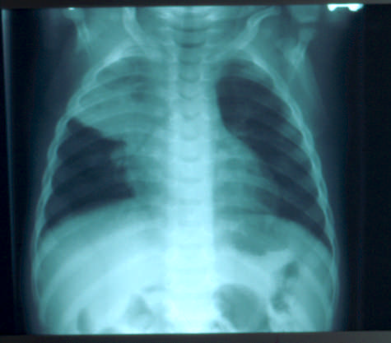
STAGES OF TUBERCULOSIS

Slide 15
TIMETABLE OF PEDIATRIC
TUBERCULOSIS
Miliary and meningeal develop rapidly (1-12 months)
Lymph node (cervical) 2-12months
Pleural effusion 3-9 months
Skeletal 6months - 2 years
Renal 1-5 years

Slide 16
ARE CHILDREN WITH TUBERCULOSIS
EVER CONTAGIOUS?
The quick answer is : NO.
Orphanages – caretaker with TB led to transmission; a child with TB did not
Schools – only 2 reported “epidemics” caused by children <13 years old
Children’s Hospitals – rare case reports of transmission, all with special circumstances, none has been patient -to - patient

Slide 17
FEATURES OF CONTAGIOUS PEDIATRIC TUBERCULOSIS
Pulmonary:
    Cavitary lung lesion
    Sputum production
    Positive acid-fast stain of sputum smear
    Bronchoscopy
Draining lesions or surgical drainage of an abscess
This means Bone or Renal TB is not contagious as long as they not open.

Slide 18
CLINICAL AND RADIOGRAPHIC MANIFESTATIONS OF CHILDHOOD PULMONARY TUBERCULOSIS
The CXR is way worse than how the pt. looks.
Infants more symptomatic: fever, cough, focal wheezing, respiratory distress
Predominance of hilar and/or mediastinal adenopathy
Any lobe of lung involved; 25% multilobar
Local pleural reaction/effusion is common
Collapse-consolidation or segmental pattern most common
Obstructive signs/symptoms with endobronchial lesions
Not contagious

Slide 19
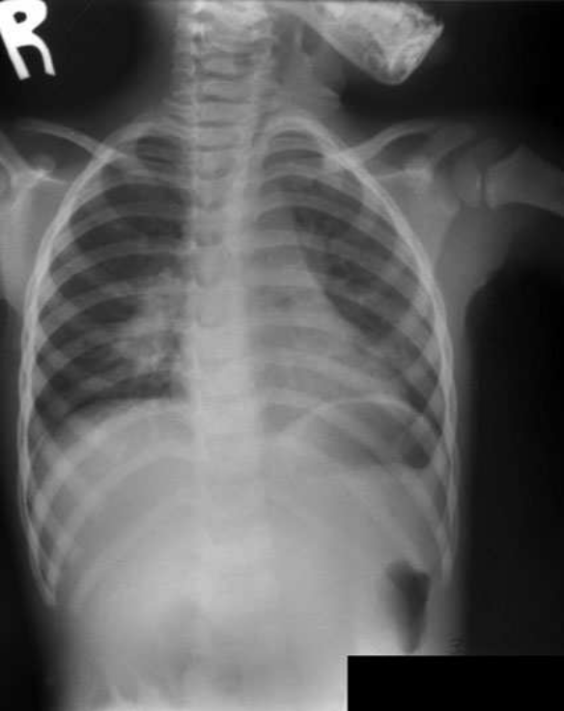

Slide 20
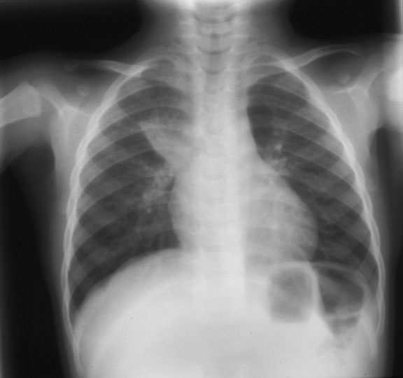

Slide 21
REACTIVATION TUBERCULOSIS IN PEDIATRICS
Adolescents primarily, but can occur in younger children
Same as adult disease: cavity or upper lobe infiltrates; cough, fever, weight loss, hemoptysis
Sputum or gastric aspirates to isolate organism; bronchoscopy occasionally necessary

Slide 22
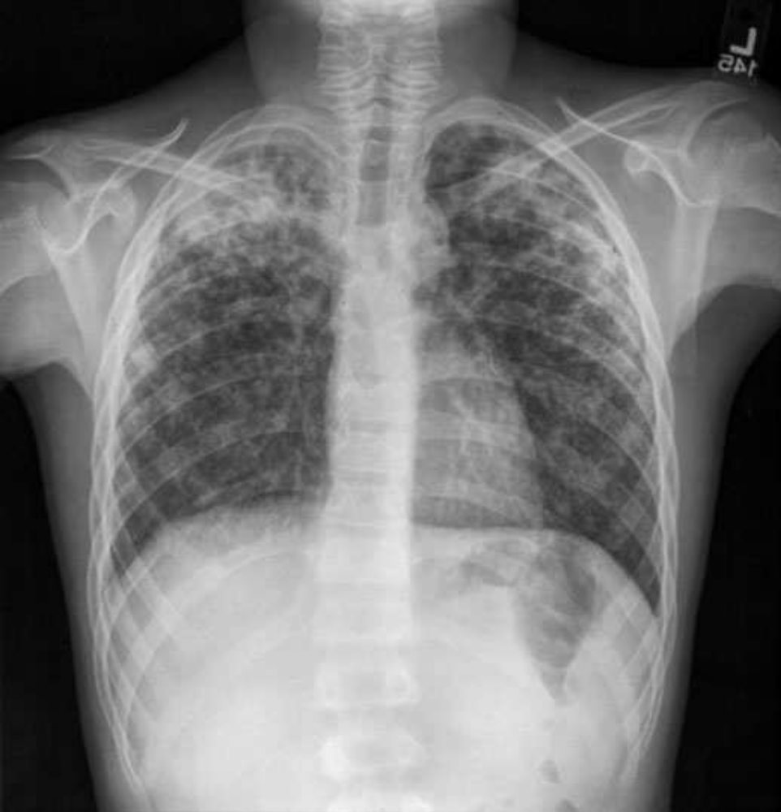

Slide 23
LYMPHADENITIS CAUSED BY
MYCOBACTERIUM TUBERCULOSIS
Most often unilateral; may be bilateral
Chest x-ray usually normal
Usually indolent onset of enlarged, fixed, matted nodes in anterior chains, submandibular
Sub mental, occipital, axillary, supraclavicular nodes less common
Absence of systemic findings; minimal tenderness
Often progress and “break down” - suppuration, sinus tracts
Major differential dx: Non-Tubeculosis Mycobacterium (NTM), Bartonella, malignancy

Slide 24
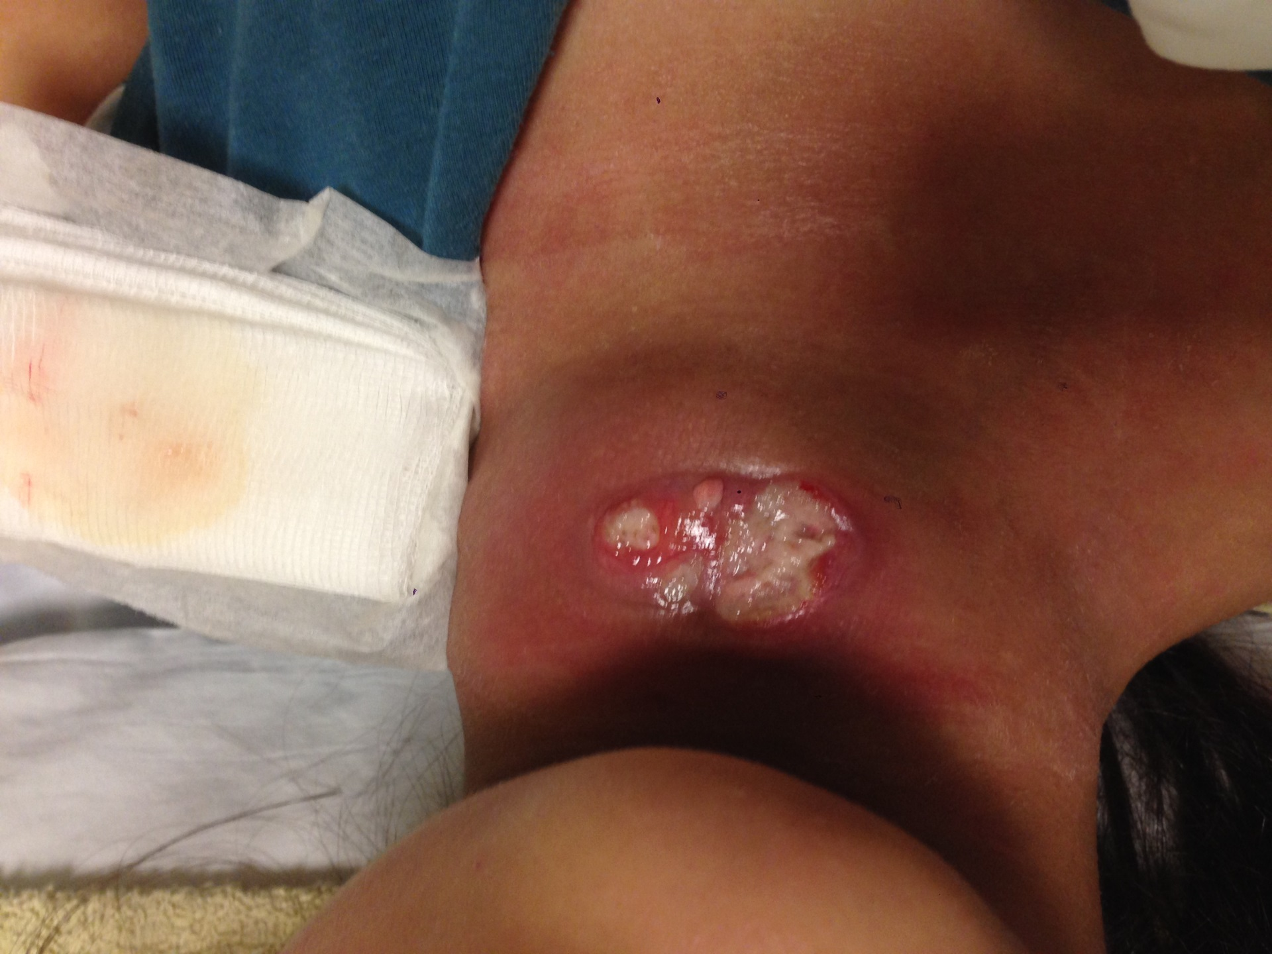

Slide 25
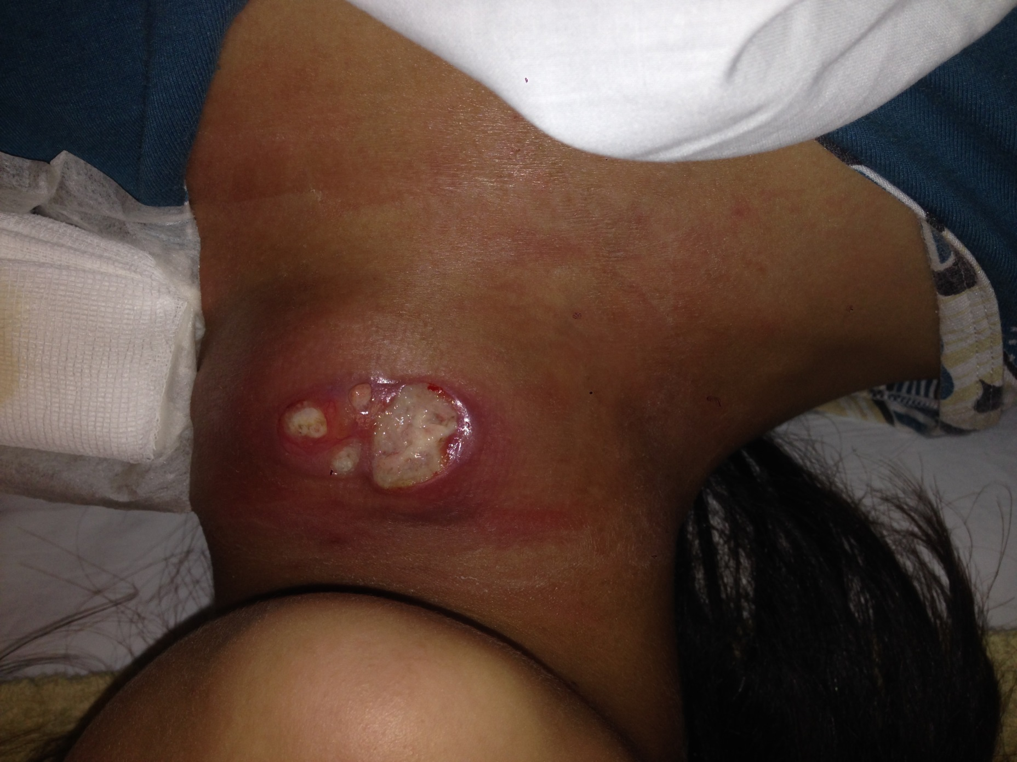

Slide 26
TUBERCULOUS AND NONTUBERCULOUS
MYCOBACTERIAL LYMPHADENITIS
NTM TB
Age (years) 1-5 any
Residence rural suburban urban
Risk factors for TB no yes
TST on family negative often positive
Chest x-ray usually neg. positive in 10-20%
TST (mm) 0-15 usual >10; many >15
Response to anti-TB drugs: no yes but slow

Slide 27
CERVICAL LYMPHADENITIS DUE TONONTUBERCULOUS MYCOBACTERIA
paucity of systemic signs and symptoms
anterior cervical chain and submandibular most common
also preauricular, postauricular, submental
firm, non-tender, fixed to underlying structures or skin
Usually multiple nodes: “tip of the iceberg”
Mycobacterium Avium Complex (MAC) > M. kansasii >M. fortuitum >
others

Slide 28
SURGICAL APPROACH TO MYCOBACTERIAL ADENITIS
Fine needle aspirate can define histology, less helpful for culture (low volume of tissue)
Surgical excision both diagnostic and curative of NTM(if complete)
NEVER do an incision and drainage.
Antibiotics may be effective to prevent or treat recurrence clarithromycin + rifamycin + ethambutol

Slide 29
TUBERCULOUS MENINGITIS IN CHILDREN
Most common in infants, young children
Occurs soon after infection; source case often not yet identified (negative family history)
Pathogenesis: basilar infiltrate, hydrocephalus, vasculitis,
infarct, tuberculoma

Slide 30
DISSEMINATED (MILIARY)
TUBERCULOSIS IN CHILDHOOD
most common in infants, recent after infection
FUO common
usually insidious but may be explosive
chest radiograph usually normal early, then classic
other common features: hepatosplenomegaly, lymphadenopathy, cutaneous lesions, choroid tubercles
TST negative in up to 50% of cases
Dx: gastric aspirate, bronchoscopy, lung biopsy, liver biopsy, bone marrow, urine culture

Slide 31
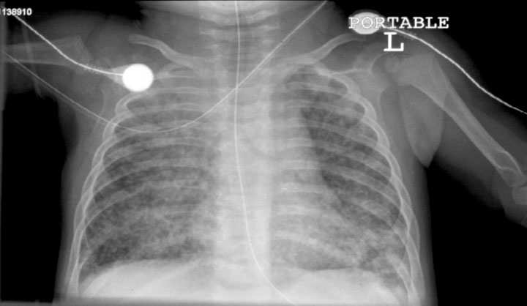

Slide 32
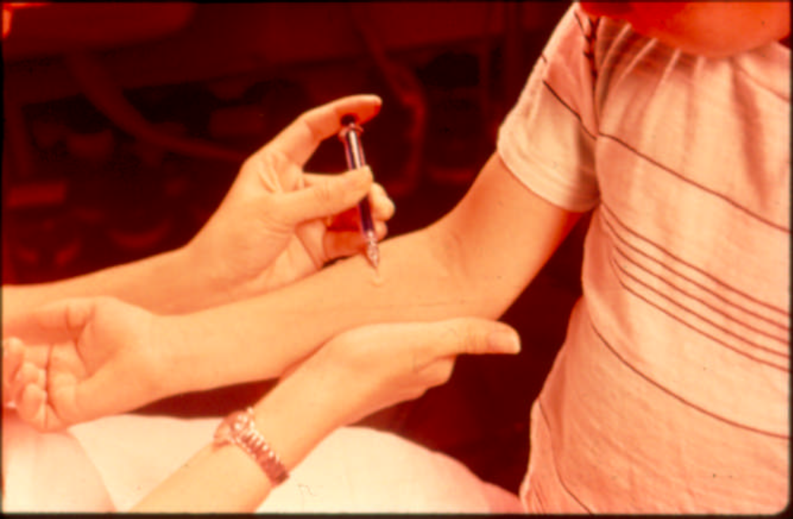
TST I Tuberculin Skin Test
(Or PPD)

Slide 33
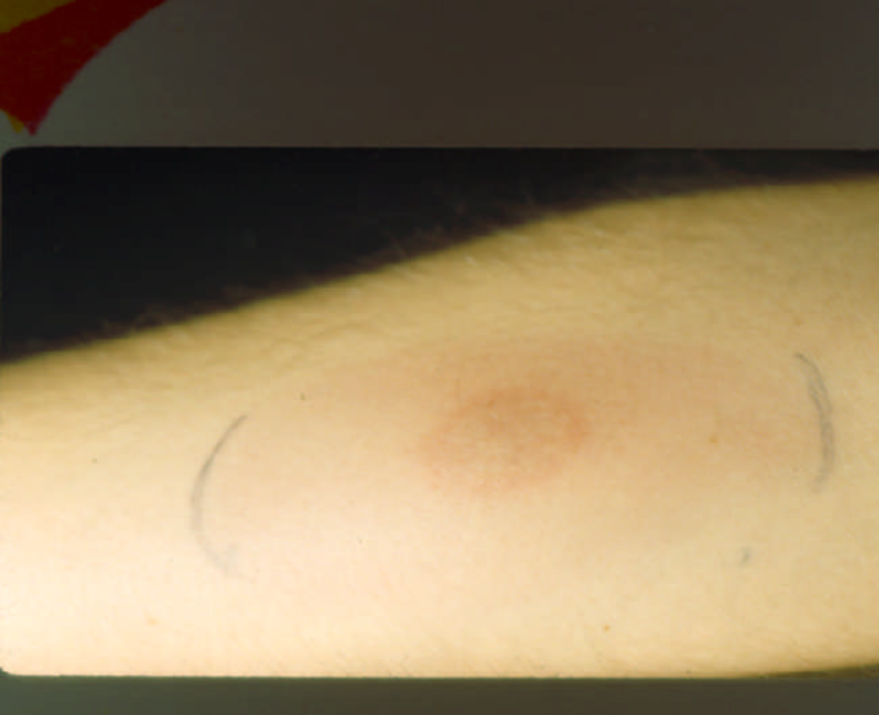
Measure Induration not redness

Slide 34
INDURATION SIZE – POSITIVE
TUBERCULIN SKIN TEST
> 5 mm
  HIV co-infection
  Immune compromise
  Recent contact to TB
  Suspected disease
> 10 mm
  Foreign-born from a HR country (applicable to Jordan)
  Drug users
  Living in HR congregate setting
  Children < 4 yrs old
>15 mm
  No risk factors

Slide 35
Does BCG VACCINES has an effect on positive TUBERCULIN SKIN TEST ?
The quick answer: no or very limited effect.
50% of vaccinated infants do not react to a TST; most of the rest stop reacting within 5 years
most non-infants who get one or more BCG vaccinations will react to a TST (usually < 15 mm), but effect wanes over 5 – 10 years
outside infancy, “positive” TST more likely to indicate infection with M. tuberculosis than be residual from BCG

Slide 36
INTERFERON TESTS (IGRA)
Identifies Latent TB Infection (LTBI) &/or disease
Does not cross react with BGC vaccine or most other mycobacteria
Requires:
  single medical visit
  blood collection
  laboratory equipment and personnel
Results in 24-48 hrs
Alternative test for TST (PPD)

Slide 37
Comparison of Tuberculin Skin Test and Interferon- gamma Release Assays
TST IGRA
Patient visits required Two One
Distinguish between TB infection No No
and TB disease
Specificity in adults 70-95% 90-100%
Sensitivity in adults 75-90% 75-95%
Cross-reactivity with NTM Yes Less Likely
Cross-reactivity with BCG Yes Unlikely
Antigens studied Many -PPD ESAT-6, CFP-10, TB7.7

Slide 38
INTERFERON-GAMMA
RELEASE ASSAYS (IGRA) Vs TST
No preference for one test over the other
Should replace the TST except for immune compromised, children < 5 years
Can be used in contact investigations (just like TST)

Slide 39
DIAGNOSIS OF TUBERCULOSIS
IN CHILDREN
Clinical/epidemiology : gold standard
Acid-Fast Bacilli Stain (AFB) stains positive in < 10% of cases
ABF culture 3 early a.m. gastric aspirates is best:
    all children : sensetive 20% to 40% of cases
    infants : up to 75% of cases
    CSF, pleural fluid, other : average 25% of cases
PCR:
  compared with clinical:
    sensitivity is 40% to 60%
    specificity is 80% to 90%

Slide 40
EVALUATION OF A CHILD WITH SUSPECTED TUBERCULOSIS DISEASE
Evaluate family members, other contacts
Tuberculin skin test
Appropriate radiographs
Sputum (if available) for AFB stain, culture
3 early a.m. gastric aspirates (pulmonary)
Lumbar Puncture (LP) if < 1 year old
Bronchoscopy - if anatomy needs to be defined or diagnosis is in doubt
Report suspicion of disease to Ministry of Health.

Slide 41
TREATMENT OF LTBI (Latent TB Infection) IN CHILDREN
9 months of isoniazid (daily or twice weekly under DOT) is only accepted regimen.
Use isoniazid unless there is documented exposure to a specific case of drug-resistant TB.

Slide 42
TREATMENT OF TUBERCULOSIS DISEASE IN CHILDREN
Pulmonary (and extra pulmonary except meningitis):
  Start with RIPE: Rifampin RIF , Isoniazid INH, Pyrazinamide PZA and Ethambutol EMB for 2 months
  followed by INH, RIF for another 4 months
  Usual length 6 months
  Can be once aday or twice weekly Direct Observed Therapy (DOT)
Meningitis:
  Start with RIP: Rifampin RIF , Isoniazid INH, Pyrazinamide PZA PLUS aminoglycoside or ethionamide for 2 months
  followed by 7–10 mo of isoniazid and rifampin
  usual length: 9-12 months

Slide 43
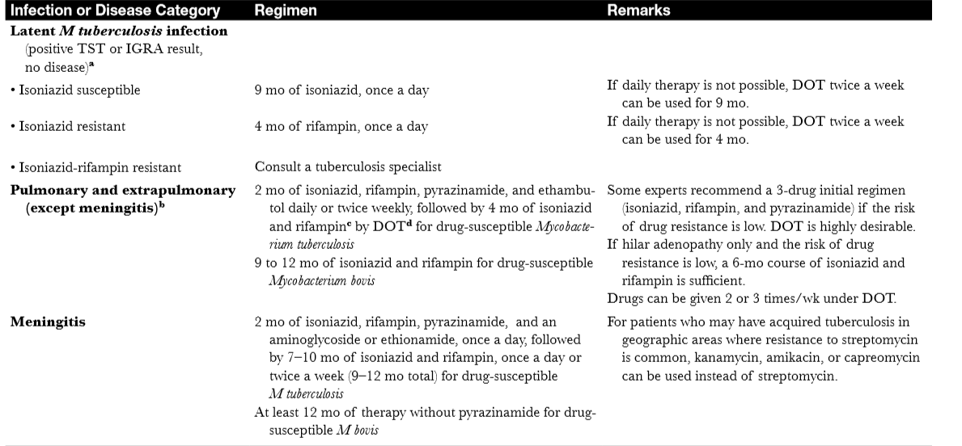
TREATMENT OF TUBERCULOSIS DISEASE IN CHILDREN

Slide 44
CORTICOSTEROIDS IN PEDIATRIC TUBERCULOSIS
Useful when host inflammatory response is contributing to tissue damage or dysfunction
    Meningitis
    Endobronchial
    miliary with alveolar block
    pericardial with constriction
    vertebral with spinal root irritation
Can use prednisone or dexamethasone

Slide 45
BCG VACCINES
Used in all but 2 countries: USA and Notherland
Given in first month of life in Jordan.
Negligible effection on TB epidemiology (Weak Vaccne)
do not prevent infection (LTBI)
little effect on reactivation disease
not instruments of TB control
Major use is preventing life-threatening forms of tuberculosis in infants and children (60% - 90%)

Slide 46


