Slide 1
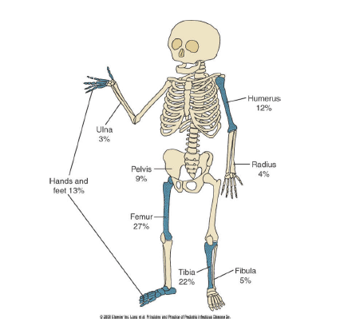
Acute Osteomyelitis and
Septic Arthritis
Marwan Shalabi, MD, FAAP, PIDS
Pediatric Infectious Diseases

Slide 2
Osteomyelitis

Slide 3
Classification
Duration -------- Acute or Chronic
Route of infection- Hematogenous or Exogenous
Host response----- Pyogenic or Granulomatous
Most cases of Osteomyelitis are Acute Hematogenous Osteomyelitis.

Slide 4
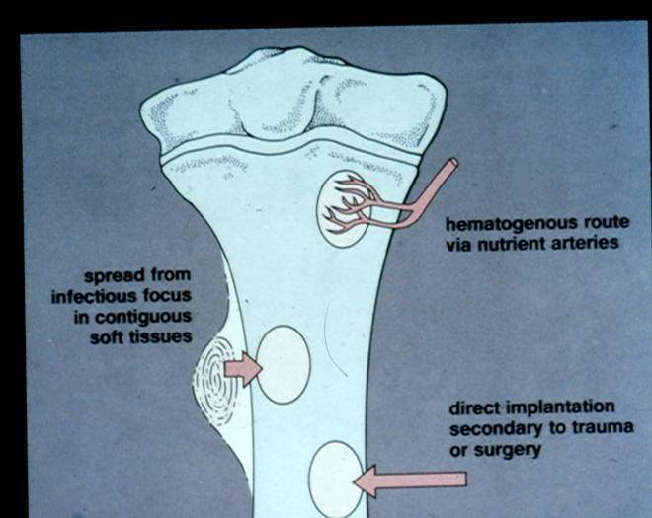
Source of Infection

Slide 5
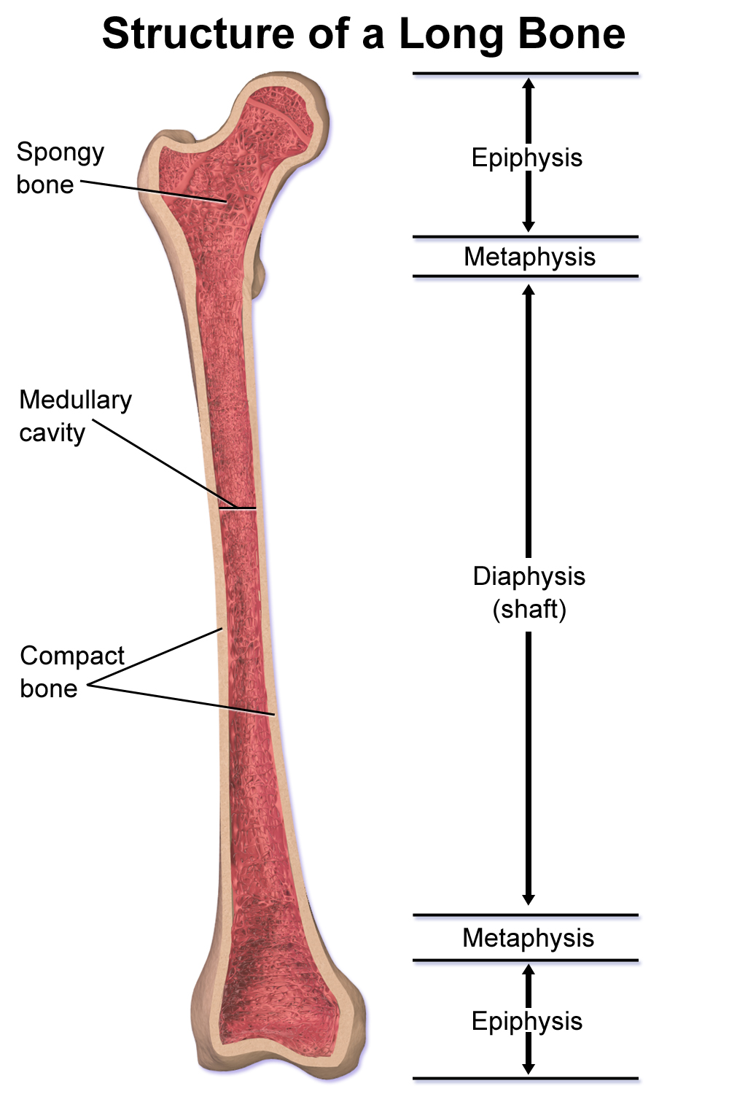
Structure of long bone

Slide 6
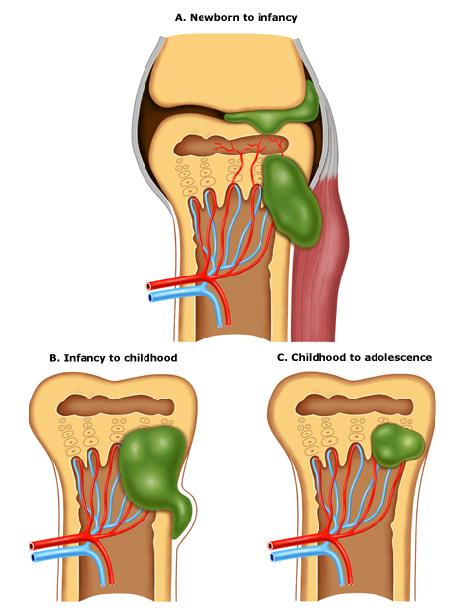
young infants and neonates
joint capsule extends to metaphysis
rupture of the infection leads to septic arthritis.
older infants and young children
thicker cortex and denser periosteum are barrier to infection
Local tenderness from subperiosteal edema or abscess is the rule.
late childhood and adolescence
well localized and rarely penetrates the bony cortex.
windowing or drilling, are necessary to obtain infected material.
Nutrient artery and vein

Slide 7
Osteomyelitis
Pathogenesis
  Organisms enter bone through nutrient artery
  Bacteria are deposited in metaphyseal capillary Loops
  Organisms proliferate and inflammation spreads
  Transphyseal vessels in young children facilitate spread to the epiphysis causing growth issues.

Slide 8
Osteomyelitis
Pathogenesis:
Primary focus of infection
Then---Spread of infection with pus formation
Then--- Formation of subperiosteal abscess
Then--- Pus tracks toward skin to form a sinus
Then--- Bone infarction (Sequestrum)
Then--- New bone formation (involucrum)

Slide 9
Epidemiology of Osteomyelitis
50% of cases occur in children < 5 yrs.
Boys are 2x more likely affected
33% of children have history of trauma to affected bone
all bones (long bone)
Usual site metaphysis of growing bone

Slide 10
Pathogens by Age
Neonates:
Staph aureus, Group B Strep, E coli
Infants:
S. aureus
Streptococcus agalactiae (GBS)
Gram negative enteric bacteria
Children ≤ 3 years old
S. aureus
Kingella kingae
Streptococcus pneumoniae*
Streptococcus pyogenes
Haemophilus influenzae type b*
Children > 3 years old
S. aureus N. gonorrhoeae (adolescent)
S. pyogenes
Staphylococcus aureus is the most common organism recovered.85%
* (in the) unvaccinated or incompletely vaccinated child

Slide 11
Unusual Pathogens in Osteomyelitis
Salmonella sp.
  Sickle cell disease
Bartonella henselae:
  Diaphyseal lesions common
  May look like bone tumor
Serratia sp. or Aspergillus sp.
  Consider Chronic Granulomatous Disease (CGD)
Mycobacterium tuberculosis
  Spine involved in 50% of cases of musculoskeletal disease

Slide 12
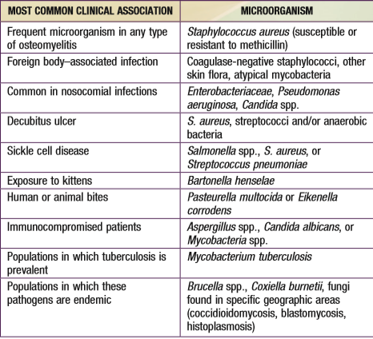
MICROORGANISMS ISOLATED FROM PATIENTS WITH OSTEOMYELITIS AND THEIR CLINICAL ASSOCIATIONS

Slide 13
• Children who are not immunized are at risk for :
  Haemophilus influenzae type b
  Streptococcus pneumoniae

Slide 14
Sites of Infection

Slide 15
Methicillin-susceptible S. aureus MSSA vs. Methicillin-resistant S. aureus MRSA
  MRSA Osteomyelitis is worse than MSSA Osteomyelitis
    Subperiosteal abscess is more common in MRSA infections
    Thrombosis seen with MRSA bone infections

Slide 16
Clinical Characteristics of Acute Osteomyelitis
History of:
  Skin lesion----infection
  Sore throat----URTI
  Trauma

Slide 17
Clinical Characteristics of Acute Osteomyelitis
Fever
Pain ( point tenderness)
Refusal to move affected extremity (pseudo paralysis)
Systemic symptoms may be absent

Slide 18
Physical Examination in Acute Osteomyelitis
Focal swelling
Warmth
Redness
Fistulous tract (rare)

Slide 19
Differential Diagnosis of Osteomyelitis
Septic Arthritis
Acute monoarticular rheumatoid arthritis
Sickle cell crisis: Bone infarction in child with hemoglobinopathy
Neurologic disorder (if infant not moving limb)
Trauma
Malignancy: Ewing’s Sarcoma
Gaucher’s disease

Slide 20
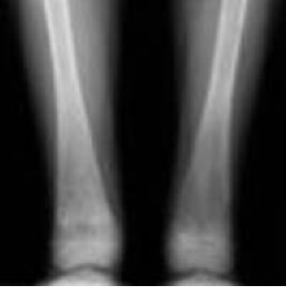
Gaucher’s disease
Bone infarction due to infiltration of Gaucher cells in the intramedullary space

Slide 21
Laboratory Diagnosis
ESR – Elevated in 90%
  Peaks at 3-5 days after treatment initiated
  Normal after 3 weeks on treatment
  Failure of ESR to decrease during the second week of treatment may indicate a need for surgical drainage or the development of chronic osteomyelitis
CRP- Elevated in 98%
  Peaks at 2nd day after treatment initiated
  Normal at 7-10 days on treatment
CBC: WBC normal or elevated

Slide 22
Laboratory Tests:
  CBC
  ESR+CRP
  Blood culture (+ve in 50-70%)
  Aspiration (Gram stain + culture and sensitivity)

Slide 23
Laboratory Diagnosis
With the increase in prevalence of MRSA –cultures are VERY important.
Bacteriologic diagnosis can be made in 50- 80% of cases – enhanced by sending multiple cultures (blood and bone)
Bone abscess cultures WILL grow, even if patient has received several days of intravenous antibiotics prior to drainage.

Slide 24
Radiologic Diagnosis
Plain radiographs:
  show lytic lesions and periosteal new bone formation
  Takes 10-20 days after onset of symptoms
Bone scans:
  Particularly useful if multi-focal osteomyelitis is suspected
  Sensitive but not specific
MRI (test of choice)
Computed tomography

Slide 25
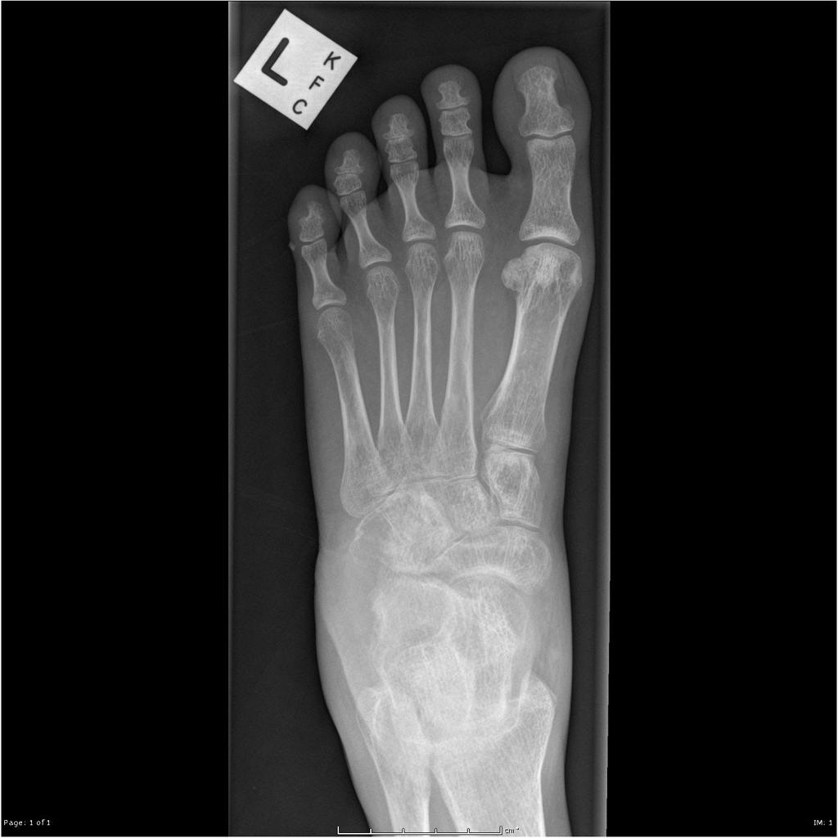
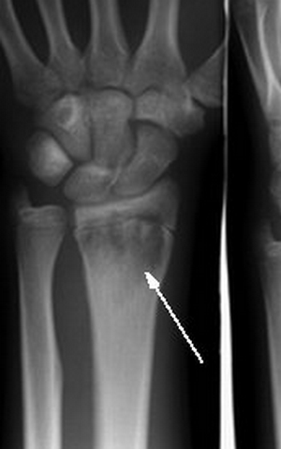
Bony erosion of the anterior calcaneus and cuboid, suggestive of osteomyelitis

Slide 26
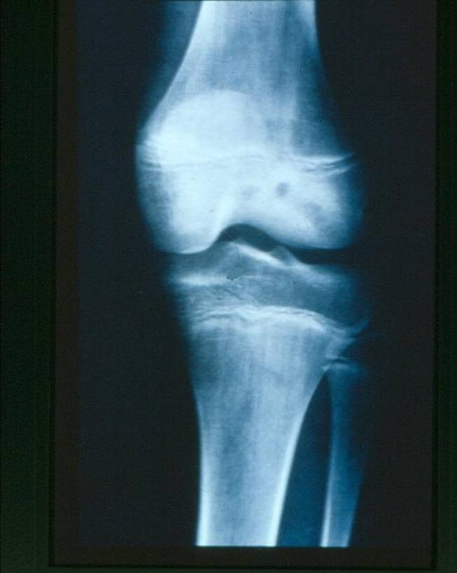

Slide 27
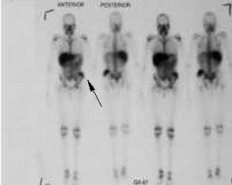
Bone Scan:
Focal area of increased uptake representing osteomyelitis in the region of the left iliac crest (arrow).

Slide 28
Treatment
Medical:
  The use of appropriate antibiotics early is critical for successful Rx
Beta-lactam antibiotics are effective
Clindamycin achieves high concentration in bone
Vancomycin shows good bone penetration in animals however antimicrobial activity may be diminished due to conditions within bone
Aminoglycosides offer less aid due to poor activity in areas of hypoxia and acidosis
Fluoroquinolones have excellent bone penetration (>18 yrs old)

Slide 29
Osteomyelitis Empiric therapy
  Neonate:
    Vancomycin or nafcillin plus cefotaxime
  ≤ 3 years
    Vancomycin or nafcillin or clindamycin plus a third generation cephalosporin
  > 3 years
    Vancomycin or nafcillin or clindamycin

Slide 30
Acute Osteomyelitis Duration of Treatment
Historical data show < 3 weeks of treatment is associated with unacceptably high rates of relapse
Duration usually ranges from 4-6 weeks
Sequential IV to po antibiotic therapy is generally successful

Slide 31
Acute Osteomyelitis Treatment
If organism is MSSA or MRSA susceptible to clindamycin, discontinue vancomycin :
Preferred antibiotics for MSSA:
    IV Nafcillin or oxacillin, transition to PO dicloxacillin
    IV Cefazolin, transition to PO cephalexin
    IV Clindamycin transition to PO Clindamycin

Slide 32
Acute Osteomyelitis Treatment
Treatment of other organisms depends on the ID and susceptibility pattern
K. kingae is generally susceptible to all beta lactam antibiotics but is not susceptible to vancomycin or clindamycin

Slide 33
Complications
Septicemia & metastatic abscesses
Septic arthritis
Growth disturbance (children)
Pathological fracture
Chronic osteomyelitis

Slide 34
Chronic Osteomyelitis

Slide 35
Chronic Osteomyelitis
Defined as S&S > 2 weeks + radiologic+ microscopic evidence.
Uncommon if Acute Osteomyelitis treated well.
DDX:
  nonbacterial osteomyelitis (eg, chronic recurrent multifocal osteomyelitis)
  Langerhans cell histiocytosis
  large cell lymphoma
  primary bone tumor

Slide 36
Chronic Osteomyelitis
S. aureus or Polymicrobial
Biopsy and culture of bone important (fistula tract cultures not helpful)
Relapse rate is high
Antibiotic treatment should be prolonged (4-6 months)
Surgical treatment often necessary

Slide 37
Chronic Osteomyelitis
Diagnosis:
  C/P:
    develop after surgical procedure, major trauma or unsuccessful treatment of Acute Osteomyelitis
    Sinus tract
  Acute Phase reactants usually mildly elevated but can be normal.
  X ray:
    Bone rarefaction surrounded by the dense sclerosis, sequestration and cavity formation
  CT or MRI could differentiate acute from chronic osteomyelitis:
    thickening of the fibular cortex
    sinus tract that contain
    sequestrum.

Slide 38
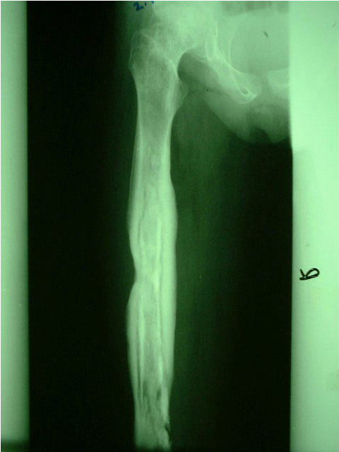
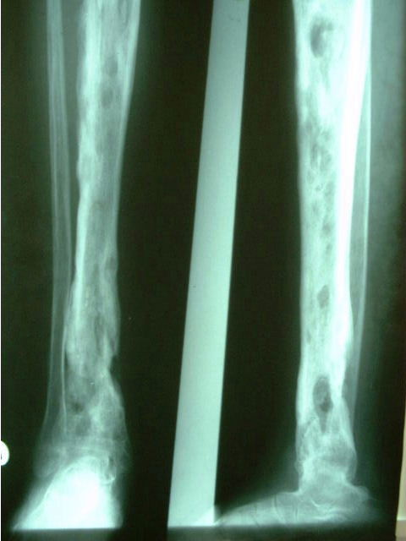

Slide 39
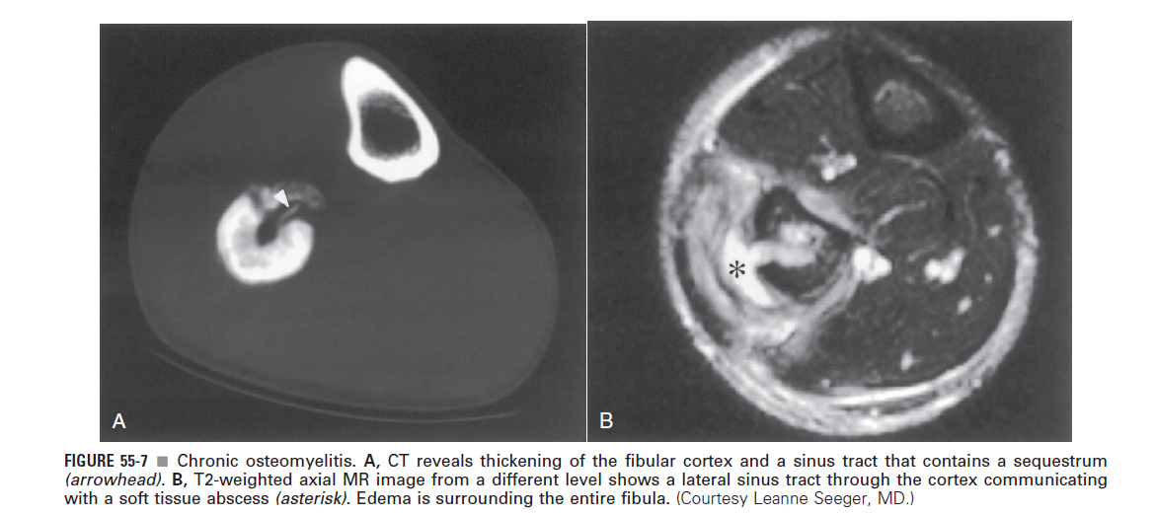

Slide 40
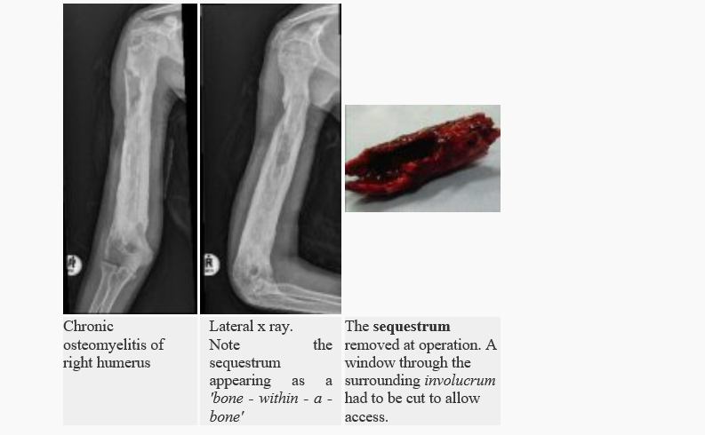

Slide 41
Chronic Osteomyelitis
Treatment:
  Removing devitalized bone
  Long-term antibiotics, 4-12 months duration
  The duration of therapy is determined on a case-by-case basis.
  D/C IV therapy after a four-week interval during which all bony changes are indicative of healing (eg, increased bone density, decrease in the size of lytic areas in bone).
  May need repeated surgical debridement and bone grafting
  Obtain radiographs monthly

Slide 42
Chronic Osteomyelitis
Adjunctive measures:
  ? local irrigation with antimicrobial solutions with or without detergents
surgical implantation of beads impregnated with antibiotics, have not been shown conclusively to affect outcome. (usually gentamicin, tobramycin, and vancomycin)
  local antibiotic delivery via implantable pumps
  suction vacuum devices
  bone grafts, skin grafts, and muscle flaps to eliminate dead space and improve vascularity.

Slide 43
Complications
Recurrence & Recurrence & Recurrence
Pathological fractures
Growth disturbance
Amyloid disease
Epidermoid carcinoma of the fistula

Slide 44

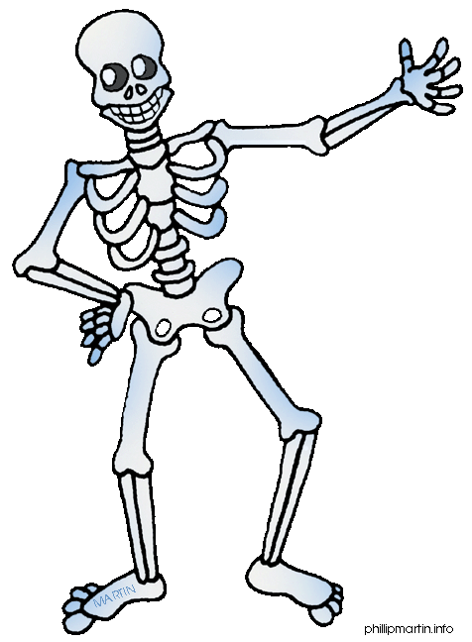

Slide 45
Septic (Pyogenic) Arithrtis

Slide 46
Septic Arthritis
Epidemiology
Occurs at all ages with peak< 3yrs
Risk Factors:
  Trauma
  Recent URI
  Hemoglobinopathy
  Immunodeficiency
  IV Drug Abuse
  Diabetes
  Rheumatoid Arthritis

Slide 47
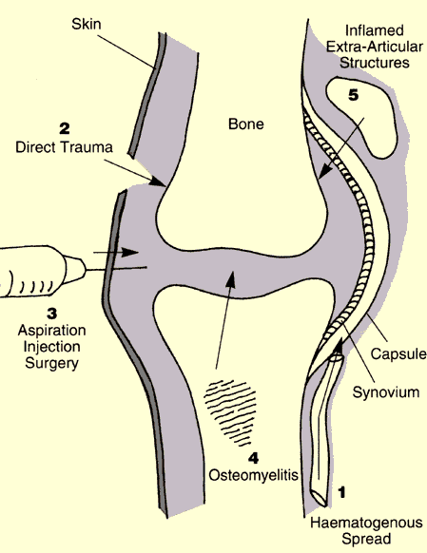
Route of infection
dissemination of pathogens via the blood, from distant site…. (most common)
entry via penetrating trauma
entry via iatrogenic means
dissemination from an acute osteomylitic focus
dissemination from adjacent soft tissue infection

Slide 48
Septic Arthritis: Clinical
Presentation
Systemic Sx: fever, irritability, malaise, anorexia
Pain is an early manifestation
Progression presents with erythema and swelling
Upper extremity: refusal to move arm
Lower extremity: limp, refusal to walk
Exam shows: decreased ROM
Warm, tender, swollen joint

Slide 49
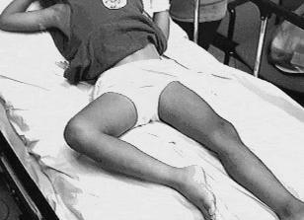

Slide 50
Septic Arthritis
Usually (90%) monoarticular
Polyarticular with certain organisms

Slide 51
Septic Arthritis: Organisms
Staphylococcus aureus is the most common cause of septic arthritis.

Slide 52
Pathogens by Age
Infants:
  S. aureus, Streptococcus agalactiae (GBS), Gram negative enteric bacteria
Children ≤ 3 years old
  S. aureus, Kingella kingae, Streptococcus pneumoniae*, Streptococcus pyogenes, Haemophilus influenzae type b*
Children > 3 years old
  S. aureus, N. gonorrhoeae (adolescent), S. pyogenes
* in the unvaccinated or incompletely vaccinated child

Slide 53
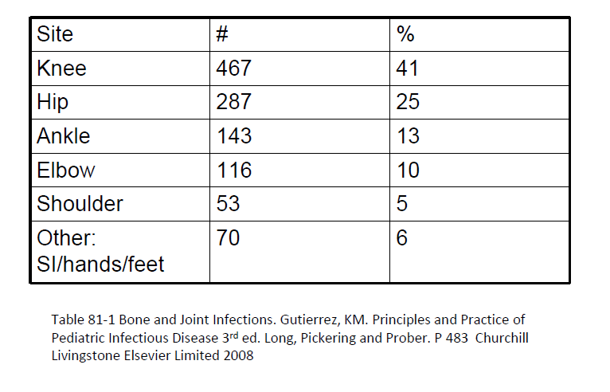
Sites of Septic Arthritis in 1050 children

Slide 54
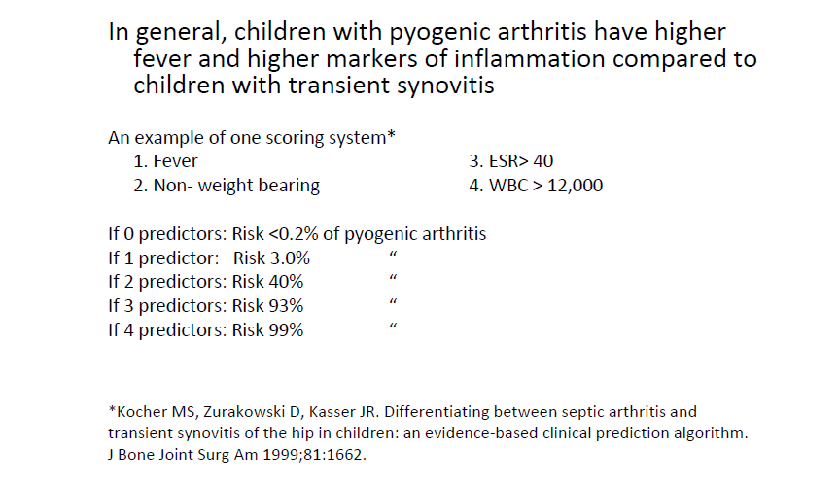
Differentiating Pyogenic Arthritis of the Hip from Transient Synovitis

Slide 55
Laboratory Diagnosis of Septic Arthritis
Elevated ESR, CRP and WBC
Synovial fluid analysis:
  WBC most helpful
  Protein and glucose not specific-
  Culture is positive in 50-60%
Blood culture-positive in 40%

Slide 56
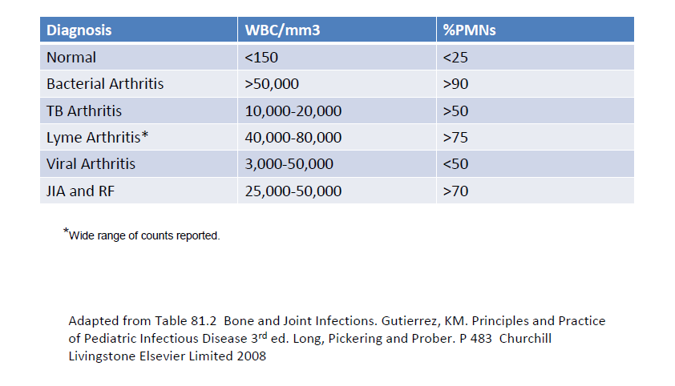
Joint Fluid

Slide 57
Septic Arthritis: Imaging
Limited role for X ray:
  Soft tissue swelling and widening of the joint space can be seen early on plain films
  Erosion of the subchondral bone can be present 2-4 weeks after onset of symptoms
MRI is very sensitive, CT is helpful and bone scan shows increased activity in the blood phase and increased bony uptake on both sides of the joint

Slide 58
Septic Arthritis: Imaging
  Ultrasonography
  The presence of fluid is not specific for joint infection
  Helps to differentiate : septic arthritis from some conditions (e.g., soft tissue abscesses, tenosynovitis) in which treatment may differ.
  Can be used to:
    Define the extent of septic arthritis
    Help guide treatment.

Slide 59
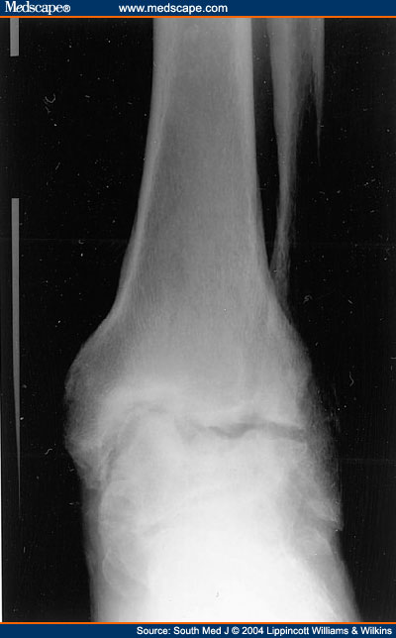
Septic arthritis of the ankle with erosion of margins

Slide 60
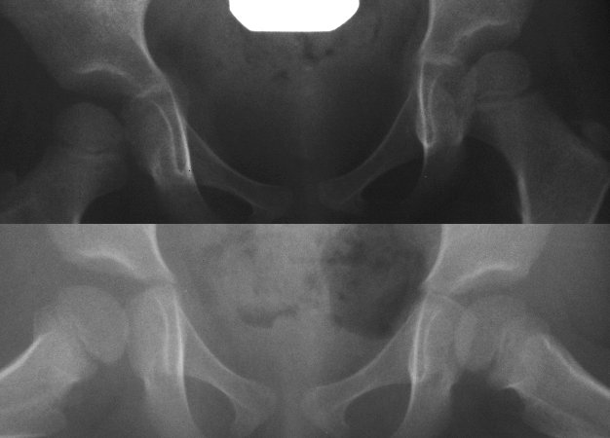
  widening of the joint space

Slide 61
Treatment of Septic Arthritis
Surgical drainage and debridement :
  To decompress the joint space so that blood flow is not compromised and removal of inflammatory debris decreases the inflammatory destruction
  Mandatory for septic arthritis of the hip and shoulder.
  without decompression the blood supply to the head of the femur or humorous may lead to avascular necrosis (surgical emergency)

Slide 62
Deferential diagnosis
Osteomyelitis:
An acute haemarthrosis :
  Post-traumatic or due to a haemophilic bleed.
Transient toxic synovitis
  Milder.
  Diagnosis of exclusion.
Rheumatic fever

Slide 63
Treatment of Septic Arthritis
Medical:
  Neonates:
    Same as Acute Osteomyelitis
  Children ≤ 5 years:
    Antistaphylococcal antibiotic plus cefotaxime or cefuroxime
  Children > 5 years
    Antistaphylococcal antibiotic

Slide 64
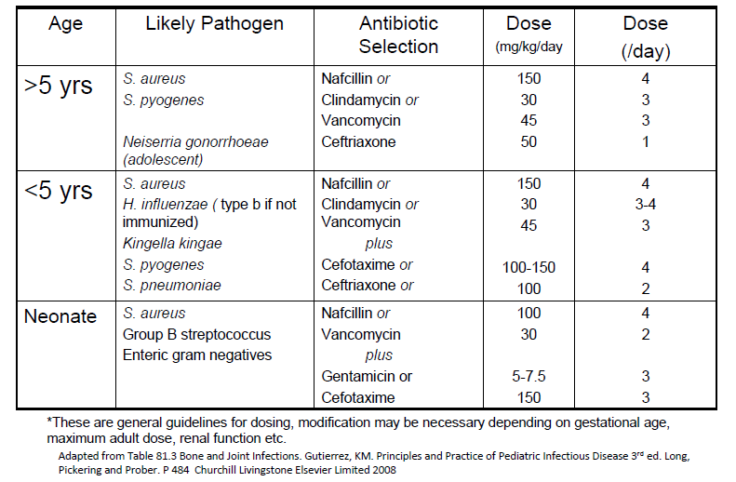
Septic Arthritis: Empiric Antibiotic Therapy*

Slide 65
Treatment of Septic Arthritis
Antimicrobial therapy should be given intravenously until:
  infection controlled
  inflammatory markers are normalizing
  no further need for surgical interventions
  physical examination is improving.
Transition from intravenously to oral therapy follows same guidelines as for Acute Osteomyelitis.
Total duration 4 weeks.

Slide 66
Prognosis of Septic Arthritis
10-25% of children have residual joint dysfunction
  Abnormalities of bone growth
  Limitations to joint mobility
  Unstable articulation of the joint
May not be evident for months to years after infection

Slide 67
Poor prognostic factors of Septic Arthritis
Risk factors:
  Age < 6 months
  Infection of the adjacent bone (less likely in younger children due to epiphysis barrier)
  Infection of the hip or shoulder
  Delay of > 4 days in decompression and antimicrobial Rx
  Prolonged time to sterilization of synovial fluid
  S. aureus and H. influenzae carry higher risks than N. gonorrhoeae and N. meningitidis

Slide 68
Thank you

Slide 69
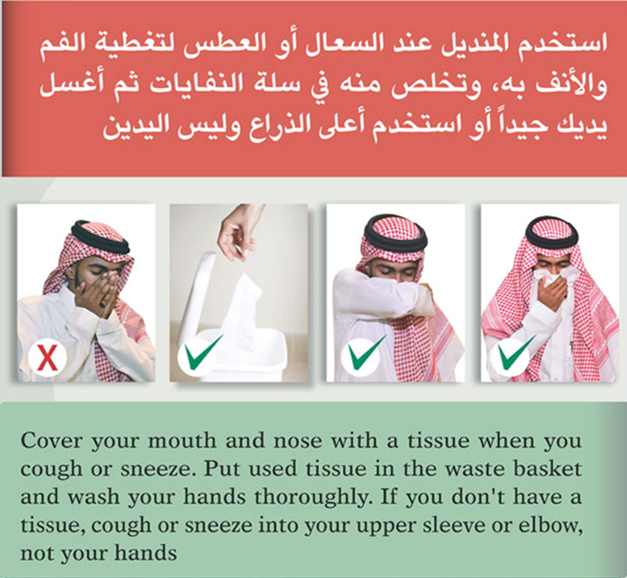

Slide 70
Additional Content Not covered in this lecture
Puncture Wound Osteochondritis
Chronic Recurrent Multifocal
Osteomyelitis (CRMO)
Reactive Arthritis
Diskitis

Slide 71
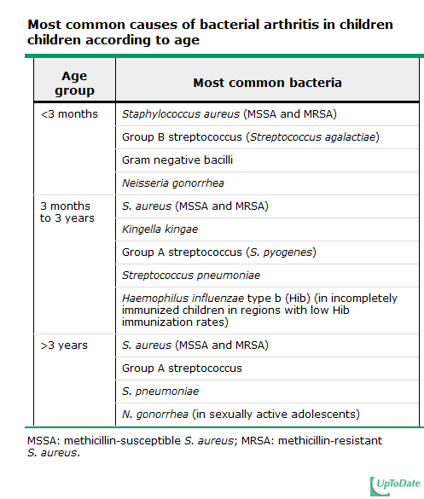

Slide 72
Gram-positive bacteria
Staphylococcus aureus | All ages; may cause polyarticular infection; MRSA may be associated with venous thromboembolism and pulmonary disease; possible associated skin or soft tissue infection
Coagulase-negative staphylococci | Most common cause of bacterial arthritis associated with prosthetic joints
Group A streptococcus (S. pyogenes) | Concurrent varicella zoster virus infection
Streptococcus pneumoniae (pneumococcus) | Children younger than two years of age; children older than two years of age with underlying medical condition (eg, sickle cell disease, immunodeficiency, etc)
Group B streptococcus (Streptococcus agalactiae) | Infants younger than three months of age
Nocardia asteroides | Chronic monoarticular arthritis with a granulomatous reaction

Slide 73
Gram-negative bacteria
Haemophilus influenzae type b (Hib) | Incompletely immunized children in areas with low Hib immunization rates
Neisseria gonorrhoeae | Newborns; usually affects joints below the hip; may cause polyarticular infection
 | Sexually active adolescents; usually occurs as part of disseminated infection with fever and rash; in girls may precede onset of menses
Neisseria meningitidis | May cause polyarticular infection; associated rash
Salmonella species | Children with sickle cell disease or related hemoglobinopathies
Pseudomonas aeruginosa | Puncture wounds; injectable drug use
Borrelia burgdorferi (Lyme disease) | Tick bite; history of erythema migrans rash; travel to or living in an endemic area; intermittent inflammatory arthritis
Brucella | Travel to or living in an endemic area; ingestion of unpasteurized dairy products; chronic monoarticular arthritis with a granulomatous reaction
Mycobacteria (tuberculosis and atypical species) | Chronic monoarticular arthritis with a granulomatous reaction

Slide 74
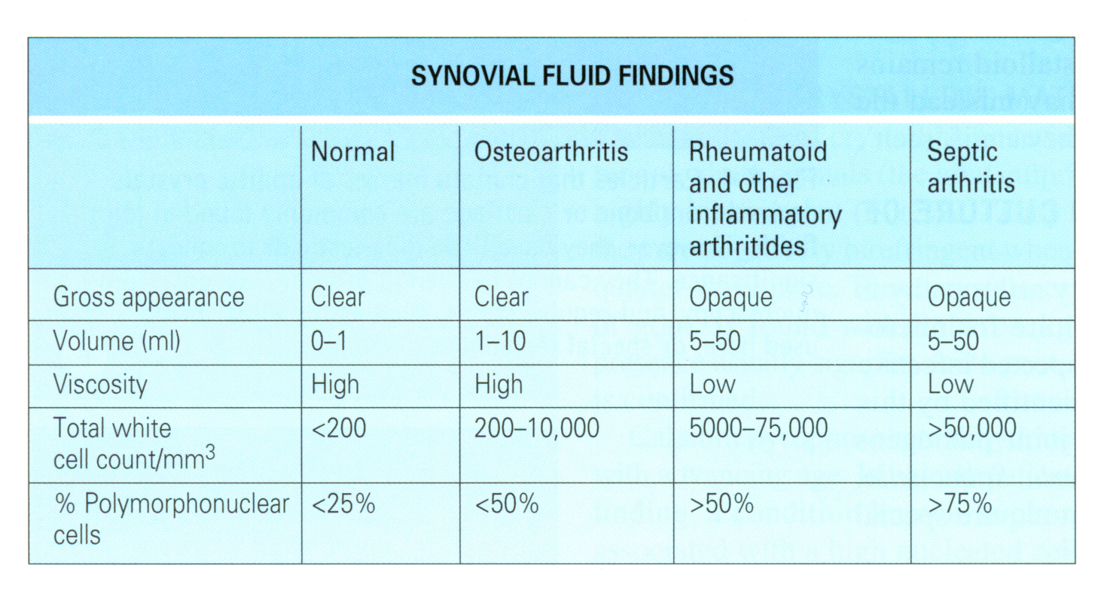

Slide 75
Pathogens causing osteomyelitis in patients with other risk factors:
• Trauma
– Mixed gram negative, gram positive and anaerobic bacteria
• IV Drug Abuse
– Sternal osteomyelitis with S. aureus, P. aeruginosa, Candida species

Slide 76
Pathogens causing osteomyelitis in patients with other risk factors:
Diabetes
  Mixed: S. aureus is usually present, coagulase negative staphylococci, streptococci, enterobacteraciae, anaerobes

Slide 77
Criteria for Changing to Oral Antibiotics
Patient is improving
Laboratory values are normalizing
There is an oral antibiotic that has activity against the organism or the same spectrum of activity as the IV antibiotic
Child can take large frequent doses of oral medicine
Good f/u with a reliable family and PMD

Slide 78
Criteria for Changing to Oral Antibiotics
Sometimes this can be done as early as a few days after initiation of IV therapy
Try to avoid sending patient home with PICC line if patient meets criteria on previous slide
There are good data to support treatment of childhood Acute Osteomyelitis
with transition from IV to po therapy.
Monitor child closely for response to treatment and for drug toxicity

Slide 79
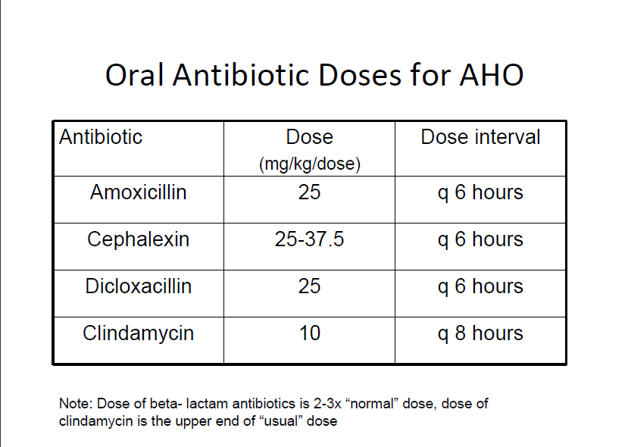
Oral Antibiotic Doses for AHO

