Slide 1
PEDIATRIC ARRHYTHMIAS
Hamzeh Al-momani, MBBS ,MSc
Assistant Professor- Pediatric Cardiology
The Hashemite University

Slide 2
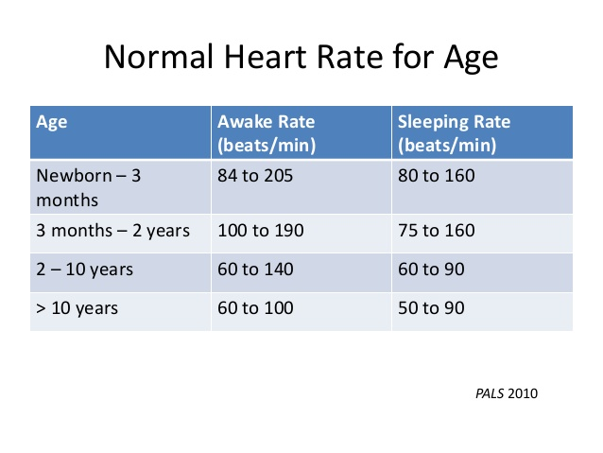
NORMAL HEART RATE RANGES
NEONATAL AND INFACNT HEART WILL INCREASE HEART RATE TO INCREASE CARDIACC OUTPUT AS THEY DON’T’ HAVE MECHANISM TO INCREASE STROKE VOLUME.

Slide 3
INTERVALS
PR INTERVAL LENGTHENS FROM INFANTS TO CHILDREN
  PR – FROM 0.08 -0.12 IN NEOTNATES TO 0.11-0.18 IN ADOLESCENTS
QRS INTERVAL LENGTHENS FROM INFANTS TO CHILDREN
  QRS 0.05 – 0.09 IN NEONATES TO 0.07 – 0.11 IN ADOLESCENTWS

Slide 4
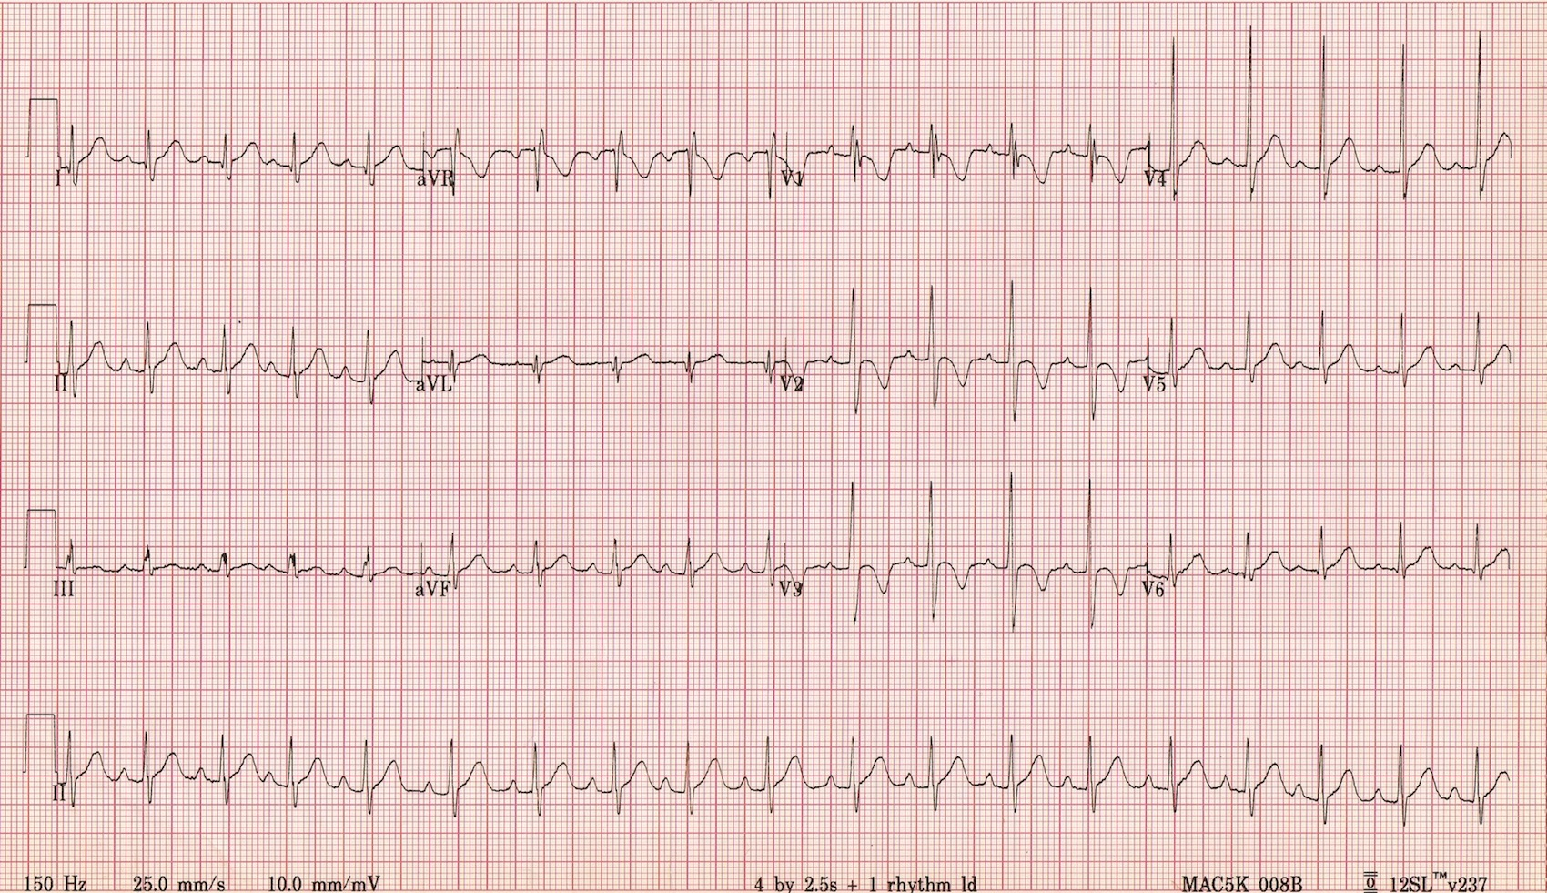
T-WAVES
T WAVES INVERTED in Right Pericardial Leasds-V1(after the first week of life) INTO CHILDHOOD/EARLY ADOLESCENTS

Slide 5
Non – Pathologic Arrhythmia
Sinus arrhythmia
  P-P interval variation
  Exaggerated with respirations
    Increased HR during inspiration and decreased HR during expiration. Caused by changes in parasympathetic input to the hear which is mediated by vagus nerve.
  Maybe more pronounced in infants

Slide 6
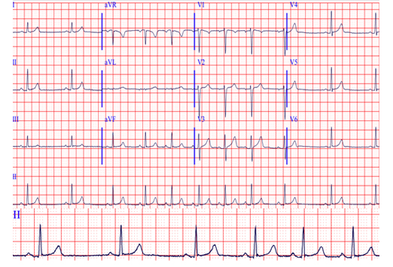

Slide 7
Other benign arrhythmias
Isolated premature ventricular beats -PVCS – uniform morphology (up to 40%)
Isolated supraventricular beats
First degree A-V block
Mobitz I second degree block
Junctional arrhythmias

Slide 8
Mechanism and Pathophysiology of Tachyarrhythmia in Children
Reentry (most common)
Automaticity
Triggered activity
SVT is the most common rhythm disturbance in children.
Most SVTs in children are reentrant rhythms.

Slide 9
Re-entry
Requires a bypass pathway between atria and ventricles in addition to the AV node.
Bypass pathway can be either
  An anatomically separate accessory pathway (the Bundle of Kent as in most cases of Wolf-Parkinson-White)
  Or a functionally separate pathway within the AV node (called AV nodal re-entry tachycardia).
For SVT to occur the two pathways must have at least, temporarily, different conduction and recovery rates.
A circular rhythm down one path and up the other begins when an atrial or ventricular contraction finds one pathway able to conduct while the other is temporarily refractory. If the second path is able to conduct by the time the impulse has passed through the AV node, it may conduct the opposite direction; thus setting up a re-entry tachycardia

Slide 10
Reentry Requires…
Electrical Impulse
Cardiac Conduction Tissue
Fast Conduction Path
Slow Recovery
Slow Conduction Path
Fast Recovery
2 distinct pathways that come together at beginning and end to form a loop.
A unidirectional block in one of those pathways.
Slow conduction in the unblocked pathway.

Slide 11
Reentry Mechanism
Premature Beat Impulse
Cardiac Conduction Tissue
Repolarizing Tissue (long refractory period)
Fast Conduction Path
Slow Recovery
Slow Conduction Path
Fast Recovery
    1. An arrhythmia is triggered by a premature beat
    2. The fast conducting pathway is blocked because of its long refractory period so the beat can only go down the slow conducting pathway

Slide 12
Reentry Mechanism
Cardiac Conduction Tissue
Fast Conduction Path
Slow Recovery
Slow Conduction Path
Fast Recovery
    3. The wave of excitation from the premature beat arrives at the distal end of the fast conducting pathway, which has now recovered and therefore travels retrogradely (backwards) up the fast pathway

Slide 13
Reentry Mechanism
Cardiac Conduction Tissue
Fast Conduction Path
Slow Recovery
Slow Conduction Path
Fast Recovery
    4. On arriving at the top of the fast pathway it finds the slow pathway has recovered and therefore the wave of excitation ‘re-enters’ the pathway and continues in a ‘circular’ movement. This creates the re-entry circuit

Slide 14
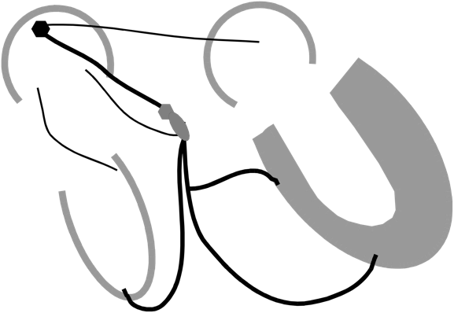
Reentry Circuits
AV Nodal Reentry
SVT
Ventricular Re-entry
ventricular tachycardia
Atrial Reentry
atrial tachycardia
atrial fibrillation
atrial flutter
SA Node
Atrio-Ventricular Reentry
WPW
SVT

Slide 15
Automaticity
When Heart cells other than those of the SA node depolarize faster than SA node cells, and take control as the cardiac pacemaker.
Factors that enhance automaticity include:
  ↑ SANS, ↓ PANS, ↑ CO₂, ↓ O_{2,} ↑ H⁺, ↑ stretch, hypokalemia and hypocalcaemia.
Examples: Ectopic atrial tachycardia or multifocal tachycardia in patients with chronic lung disease OR ventricular ectopy after MI

Slide 16
Triggered activity…
is like a domino effect where the arrhythmia is due to the preceding beat.
  Delayed after-depolarizations arise during the resting phase of the last beat and may be the cause of digitalis-induced arrhythmias.
  Early after-depolarizations arise during the plateau phase or the repolarization phase of the last beat and may be the cause of torsades de pointes (ex. Quinidine induced)

Slide 17
Paroxysmal Supraventricular Tachycardia
An abnormally rapid heart rhythm originating above the ventricles, often (but not always) with a narrow QRS complex
Is the most common rhythm disturbance in children, Up to 13% of pediatric arrhythmias
MOST COMMON FORMS:
  Atrioventricular reentrant tachycardia (AVRT, including the Wolff-Parkinson-White [WPW] syndrome)
    Accounts for the great majority of cases in infancy (>80 percent). It also is the most common category in older children, but the relative frequency is less than in infancy (50 to 60 percent)
  Atrioventricular nodal reentrant tachycardia (AVNRT)
    Is rare before the age of two years and accounts for 20 to 35 percent of SVTs in older children

Slide 18
Other forms of SVT include
  Ectopic atrial tachycardia -EAT
  Junctional tachycardia-JT
  Multifocal atrial tachycardia -MAT
  Atrial flutter
  Atrial fibrillation

Slide 19
CLINICAL FEATURES
Infants
In infants, symptoms of SVT may include pallor, fussiness, irritability, poor feeding, and/or cyanosis. The symptoms can be subtle, and tachycardia may go unrecognized for long periods of time. Because of this, infants often present with symptoms of heart failure (eg, tachypnea, fatigue with feeding, poor weight gain)
Children
Common symptoms of SVT in children and adolescents include palpitations, chest discomfort, fatigue, and lightheadedness.
Syncope is less common and may be a warning sign for increased risk of sudden death

Slide 20
PSVT
Usually paroxysmal.
Abrupt onset and termination.
Mostly occurs at rest.
Average duration of 10 to 15 minutes; however, some episodes last only one to two minutes, while others persist for hours
Most children tolerate episodes of tachycardia well. However, prolonged episodes can precipitate heart failure.

Slide 21
Physical examination typically reveals tachycardia without evidence of decompensation (Some patients appear pale and diaphoretic, and the blood pressure may be reduced)
Heart rates during SVT are age-dependent. Typical ranges are as follows:
  Infants: 220 to 280 beats per minute (bpm)
  Children and adolescents: 180 to 240 bpm.
Infants with sustained SVT may have signs of heart failure .

Slide 22
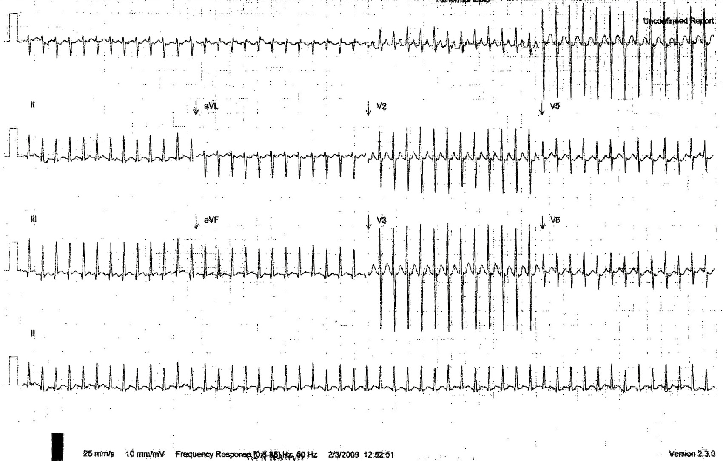
ECG FINDINGS
HR >220 IN INFANTS, >180 CHILDREN
NARROW QRS
AV RATIO 1:1
AVRNT – ? TERMINAL QRS NOTCHING
AVRT - ? INVERTED P WAVES
Narrow complex SVT @ 300 bpm

Slide 23
AVNRT
Re-entrant circuit that involves AV node
2 conduction limbs – fast and slow
Most commonly – anterograde slow pathway activation induced by PAC followed by retrograde activation of the atria via the fast pathway (slow-fast) and anterograde ventricular activation produces a narrow complex QRS tachycardia

Slide 24
AVNRT

Slide 25
Ventricular Pre-excitation-WPW
Pre-excitation refers to early activation of the ventricles due to impulses bypassing the AV node via an accessory pathway.
ECG features of Pre-excitation in sinus rhythm are:
    Short PR interval
    Delta wave – slurring slow rise of initial portion of the QRS
    QRS prolongation
    ST Segment and T wave discordant changes – i.e. in the opposite direction to the major component of the QRS complex

Slide 26
WPW Pattern

Slide 27
WPW Pattern

Slide 28
AVRT
Re-entrant circuit that involves AV node and accessory pathway
2 conduction pathway – normal and accessory
Accessory pathway as been described in the developing human heart and regresses by 20 weeks of gestation, ? if these fail to regress cause of AVRT.
**Subtype – permanent junctional reciprocating tachycardia(pjrt) – only retograde conduction.

Slide 29
AVRT are further divided in to orthodromic or antidromic conduction based on direction of reentry conduction and ECG morphology.

Slide 30
AVRT
AVRT

Slide 31
AVRT with orthodromic conduction
ECG features of AVRT with orthodromic conduction are:
    Narrow QRS Complex (usually <120 ms) unless pre-existing bundle branch block, or rate-related aberrant conduction

Slide 32
Orthodromic atrioventricular re-entry tachycardia (AVRT)
This rhythm is indistinguishable from AV-nodal re-entry tachycardia (AVNRT).

Slide 33
AVRT with Antidromic Conduction
ECG features of AVRT with antidromic conduction are:
    Wide QRS complexes due to abnormal ventricular depolarisation via accessory pathway.

Slide 34
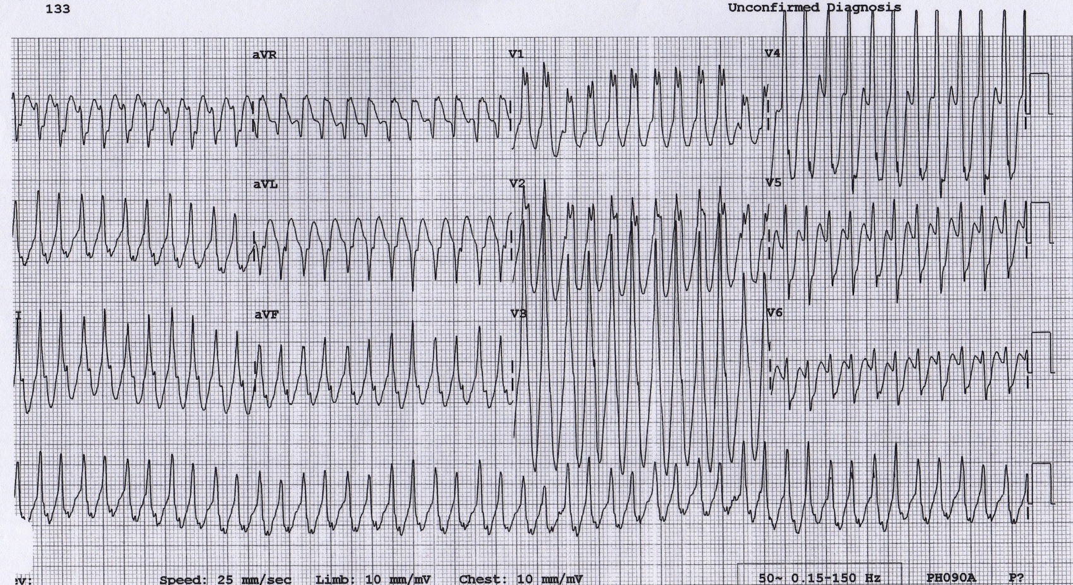
5 YEARS old boy, AVRT resolved with vagal manoeuvres
Broad complex tachycardia at ~280 bpm.
This could easily be mistaken for VT; however, remember that >95% of broad complex tachycardias in paediatrics are actually SVT with aberrancy (usually a re-entrant tachycardia).
This is an antidromic atrioventricular re-entry tachycardia due to WPW.

Slide 35
Diagnostic Assessment
Rapid hemodynamic assessment and initial management: WHY?
    The most important initial clinical determination is whether there are signs of hemodynamic instability, including hypotension, heart failure, shock, or decreased level of consciousness.
    Unstable patients require immediate intervention to terminate the rhythm.

Slide 36
ECG during arrhythmias :
    In most cases, the QRS complex is narrow (<80 msec) An exception is antidromic atrioventricular reentrant tachycardia (AVRT), which is associated with a wide complex tachycardia, Antidromic AVRT accounts for <5 percent of cases of pediatric SVT.

Slide 37
AVNRT v/s Orthodromic AVRT v/s PJRT
The following criteria are useful in making this distinction
    Buried p wave in or just at the end of the QRS complex(create a small "pseudo r' wave" in lead V1 or a "pseudo S wave" in the inferior leads. If such terminal r' or S waves are not present during sinus rhythm, their appearance during SVT can be assumed to be diagnostic of AVNRT ), which is typical of AVNRT
    An RP interval ≥70 msec is more characteristic of AVRT than AVNRT
    An extremely long RP interval and normal PR (RP>>PR), and a P wave axis that is directed superior (negative in leads II, III, and aVF) is seen in permanent junctional reciprocating tachycardia.

Slide 38
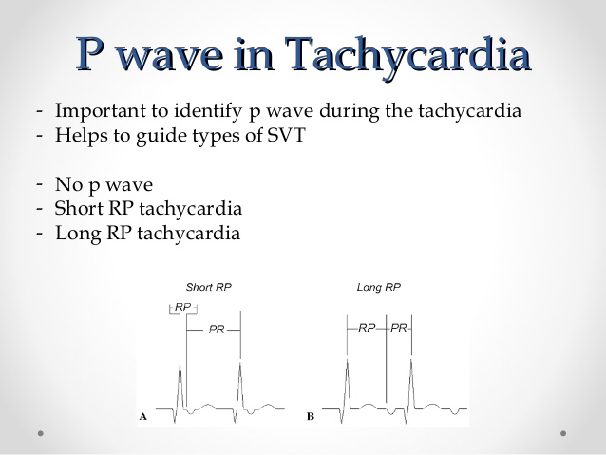

Slide 39
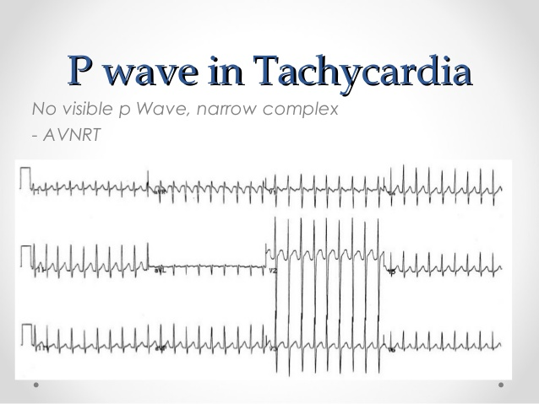

Slide 40
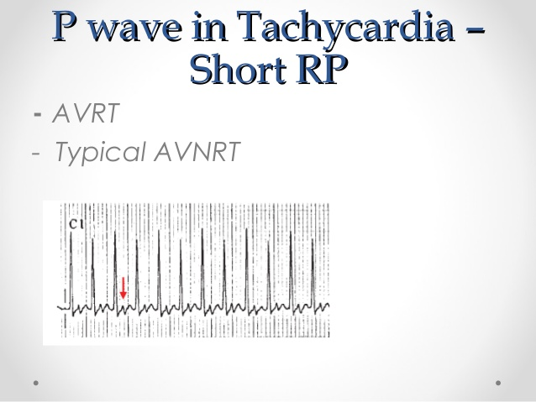

Slide 41
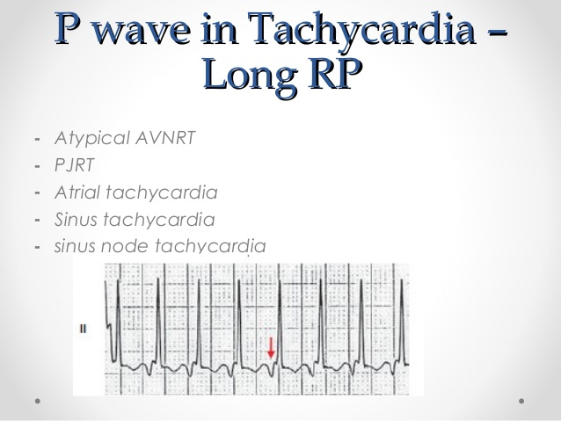

Slide 42
Wide QRS complex tachycardia
Wide QRS complex tachycardia should generally prompt consideration of ventricular tachycardia (VT).
However, in children, most wide QRS complex tachycardia that occurs with a regular rate represents SVT, not VT.
SVT can have a wide QRS complex :
  if the mechanism is antidromic AVRT
  or if there is aberrant conduction (eg, functional bundle branch block or "bundle branch aberration")
The ECG can be helpful in differentiating between VT and SVT. However, making the distinction can be challenging, especially for clinicians unfamiliar with interpreting pediatric ECGs.

Slide 43
Tachycardia with pulse
NARROW QRS COMPLEX
REGULAR
IRREGULAR
P WAVE PRESENT
ATRIAL FIBRILLATION
ATRIAL FLUTTER OR AT WITH VARIABLE CONDUCTION
MAT
QRS DURATION
WIDE QRS COMPLEX
P WAVE ABSENT
SINUS TACYCARDIA
SVT
ATRIAL FLUTTER
FOCAL ATRIAL TACHYCARDIA
SINUS NODE REENTRANT T.
AVNRT OR OTHER MECHANISM WITH ABSENT P WAVE
REGULAR
IRREGULAR
VT
SVT WITH ABBERENCTY
ANTIDROMIC SVT
AF WITH ABBERENCY
AF WITH WPW
POLYMORPHIC VT
TORSADE DE POINT

Slide 44
NARROW QRS COMPLEX TACHYCARDIA
VISIBLE P WAVE
ATRIAL RATE > VENTRICULAR RATE
ATRIAL FLUTTER
ATRIAL TACHYCARDIA
ATRIAL FIBRILLATION
ATRIAL FLUTTER OR AT WITH VARIABLE CONDUCTION
MAT
ANALYZE RP INTERVAL
SHORT RP (SHORTER THAN PR INTERVAL )
LONG(RP LONGER THAN PR INTERVAL )
RP < 70 MS
RP > 70 MS
ATRIAL TACHYCARDIA
PJRT
ATYPICAL AVNRT
AVNRRT
AVRT
AVNRT
AT
REGULAR
IRREGULAR
YES
NO

Slide 45
WIDE COMPLEX TACHYCARDIA
1 TO 1 AV RELATIONSHIP
NO
VENTRICULAR RATE > ATRIAL RATE
ATRIAL FIBRILLATION
OR ( ATRIAL FLUTTER OR AT WITH VARIABLE CONDUCTION ) WITH:
A-BBB
B-ANTEROGRADE CONDUCTION VIA ACCESSORY PATHWAY
ATRIAL RATE > VENTRICULAR RATE
ATRIAL TACHYCARDIA
ATRIAL FLUTTER
WITH:
A-BBB
B-ANTEROGRADE CONDUCTION VIA ACCESSORY PATHWAY
YES
QRS MORPHOLOGY IN PERICARDIAL LEADS
VT
RBBB OR LBBB MORPHOLOGY
CONCORDANT
NO R/S PATTERN
ONSET OF R TO NADIR OF S WAVE MORE THAN 100 MS
RBBB PATTERN:
qR, Rs,Rr in v1
Frontal plane axis from +90- -90
LBBB PATTERN:
R LONGER THAN 30 MS
R TO NADIR OF S MORE THAN 60 MS
qR,qS in V6
SVT
VT
VT
VT
SEE IF IDENTICAL TO BASAL ECG –SVT WITH BBB OR ANTEDROMIC CONDUCTION
SEE RESPONSE TO VAGAL MANUVER AND ADENOSINE--SVT
SEE PREVIUOS HX OF CARDIAC DISEASES OR SURGERY--VT
REGULAR
IRREGULAR

Slide 46
ECG in sinus rhythm
  The ECG in sinus rhythm is normal in patients with concealed accessory pathways or AVNRT and In patients with pre-excitation ECG shows Wolff-Parkinson-White (WPW) pattern
Ambulatory monitoring-Holter 24 hr
  Ambulatory monitoring helps to establish the frequency and duration of SVT; however, it is less useful in making a diagnosis, since only a few ECG leads are used
Exercise testing-stress test
Electrophysiologic evaluation

Slide 47
Acute treatment
15-lead electrocardiogram (ECG)
Hemodynamic assessment
If the child is hemodynamically unstable
  synchronized direct current cardioversion with 0.5-2 J/kg should be performed .
If the child is hemodynamically stable
  vagal maneuvers should be attempted to terminate the tachycardia .
    infants: ice plus water in bag placed on face for up to 10 seconds – often effective.
    Older children: valsalva manoeuvre (30 –60 seconds), deep inspiration/cough/gag reflex, headstand.

Slide 48
Acute treatment
If the child is hemodynamically stable
  If does not convert to normal sinus rhythm with vagal maneuvers, we recommend intravenous adenosine rather than other antiarrhythmic drugs
    Adenosine should be administered in an initial bolus dose of 0.1 mg/kg, followed by a rapid saline flush. If the rhythm does not convert with the initial dose, adenosine is repeated with increases to a maximum dose of 0.25 to 0.35 mg/kg or a total dose of 12 mg.
    Half life: <1.5 seconds: transient AV nodal block as well as sinus node block, negative Chronotrope, inotrope.
    Side effects: flushing, nausea, dyspnea, bronchospasm are short lived.

Slide 49
Further Workup
Repeat ECG once in NSR
LABWORK – ELECTROLYTES, TSH, CBC
ADMISSION IF less than one year , and hemodynamically unstable
FIRST TIME EPISODE – observation overnight
Cardiology consult – management of meds

Slide 50
NARROW QRS SVT
HYMODINAMICALLY STABLE
VAGAL MANUVER
IV ADENOSINE(an initial bolus dose of 0.1 mg/kg, followed by a rapid saline flush. If the rhythm does not convert with the initial dose, adenosine is repeated with increases to a maximum dose of 0.25 to 0.35 mg/kg or a total dose of 12 mg.)
IV ESMOLOL (IV esmolol (loading dose 100 to 500 mcg/kg over 1 minute)
IV VERAPAMIL(an IV infusion in a dose of 0.1 to 0.3 mg/kg with a maximum dose of 10 mg)
IV FLIECANIDE PROPAFENON,PROCIANAMIDE
IV AMIODARONE(a bolus infusion of 5 mg/kg over 20 to 60 minutes, followed by a continuous infusion of 10 to 15 mg/kg per day)
DC CARDIOVERSION
HYMODINAMICALLY UNSTABLE
IV ADENOSINE
DC CARDIOVERSION
12 ECG
HEMODYNAMIC MONITORE
Verapamil should not be used In
infants <1 year old,
and when there IS heart failure, suspected to have WPW syndrome, wide QRS complex tachycardia

Slide 51
WIDE QRS TACHYCARDIA
HYMODINAMICALLY STABLE
SVT PLUS BBB
AS NARROW QRS SVT
HYMODINAMICALLY UNSTABLE
SYNCRONIZED CARDIOVERSION OR DEFIBRILLATION
12 ECG
HEMODYNAMIC MONITORE
VT
SVT
SVT WITH PREEXCITATION
PROCAINAMIDE
FLECAINIDE
IBUTILIDE
PLUS AV BLOCKING AGENT
IV PROCAINAMIDE
IV SOTALOL
IV LIDOCAINE
IV AMIODARONE
DC CARDIOVERSION
DC CARDIOVERSION
OVERDRIVE PACING
Amiodarone in poor myocardial contraction
  Amiodarone is considered contraindicated in preexcited atrial fibrillation, which has an irregular and wide QRS complex.
  Digoxin and calcium channel blockers should not be prescribed in patients with WPW prior to full cardiology evaluation.

Slide 52
ATRIAL FIBRILLATION
Rapid and irregular beating of the atria
Most common in structurally abnormal hearts, prior cardiac surgery.
Structurally normal hearts + association with accessory pathway conduction -----sudden death
Seen in myocarditis, pericarditis, hyperthyroid, genetic causes
Presented with palpitation ,SOB, fainting, or chest pain
Increase risk of heart failure ,dementia and stroke

Slide 53
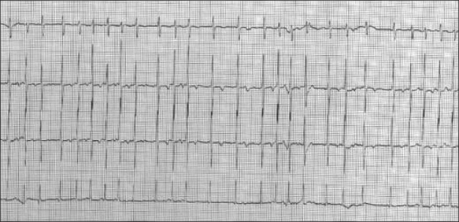

Slide 54
ACUTE MANAGEMENT
unstable – cardioversion 2j/kg
stable – rate vs rhythm control – amiodarone/ibutilide.

Slide 55
FURTHER MANAGEMENT
Labs – cbc, chemistry, thyroid, tox
Further testing if cardiomyopathy is considered – bcs, viral panel, enzymes
Echocardiogram
Admission for obs/treatment
Anticoagulation in most cases

Slide 57
WIDE COMPLEX TACHYCARDIAS
DDX:
  Ventricular Tachycardia
  SVT with aberrant conduction due to bundle branch block
  SVT with aberrant conduction due to the Wolff-Parkinson-White syndrome
  Pace-maker mediated tachycardia
  Metabolic derangements e.g. hyperkalaemia
  Poisoning with sodium-channel blocking agents (e.g. tricyclic antidepressants)

Slide 58
V-TACH
A broad complex tachycardia originating in the ventricles. There are several different varieties of VT — the most common being Monomorphic VT.
Ventricular tachycardia may impair cardiac output with consequent hypotension, collapse, and acute cardiac failure. This is due to extreme heart rates and lack of coordinated atrial contraction (loss of “atrial kick”).
Decreased cardiac output may result in decreased myocardial perfusion with degeneration to VF.
Prompt recognition and initiation of treatment (e.g. electrical cardioversion) is required in all cases of VT.

Slide 59
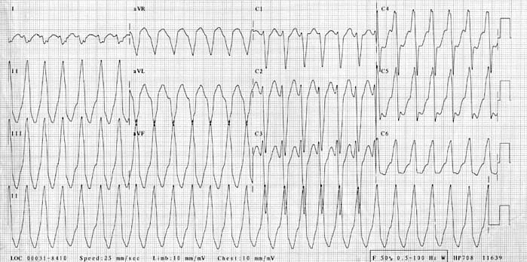

Slide 60
The ultimate goal of antiarrhythmic drug therapy:
Restore normal sinus rhythm and conduction
Prevent more serious and possibly lethal arrhythmias from occurring.
Antiarrhythmic drugs are used to:
decrease conduction velocity
change the duration of the effective refractory period (ERP)
suppress abnormal automaticity

Slide 61
Antyarrhythmic drugs
Most antiarrhythmic drugs are pro-arrhythmic (promote arrhythmia)
They are classified according to Vaughan William into four classes according to their effects on the cardiac action potential
class |  | mechanism | action | ECG QT | Conduction velocity | Refractory period | notes
IA | Quinidine Procainamide | Na⁺ channel blocker | Change the slope of phase 0 | ++ | ↓ | ↑ | Can abolish tachyarrhythmia caused by reentry circuit
IB | lidocaine mexiletine tocainide |  |  | 0 | no | ↓
IC | flecainide propafenone |  |  | + | ↓ | no

Slide 62
Antyarrhythmic drugs
Most antiarrhythmic drugs are pro-arrhythmic (promote arrhythmia)
They are classified according to Vaughan William into four classes according to their effects on the cardiac action potential
class |  | mechanism | action | ECG QT | Conduction velocity | Refractory period | notes
II |  | β blocker | ↓heart rate and conduction velocity | 0 | ↓In SAN and AVN | ↑ in SAN and AVN | Can indirectly alter K and Ca conductance
III |  | K⁺ channel blocker | ↑action potential duration (APD) or effective refractory period (ERP). Delay repolarization. | ++ | No | ↑ | Inhibit reentry tachycardia
IV | verapamil & diltiazem | Ca⁺⁺ channel blocker | Slowing the rate of rise in phase 4 of SA node | 0 | ↓ in SAN and AVN | ↑ in SAN and AVN | ↓conduction velocity in SA and AV node

Slide 63
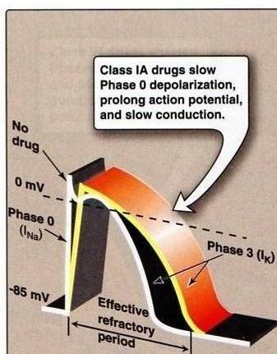
Class IA Drugs
Class IA
Quinidine
Procainamide
Slowing of the rate of rise in phase 0 → ↓conduction velocity
↓of V_{max} of the cardiac action potential
They prolong muscle action potential & ventricular (ERP)
They ↓ the slope of Phase 4 spontaneous depolarization (SA node) → decrease enhanced normal automaticity

Slide 64
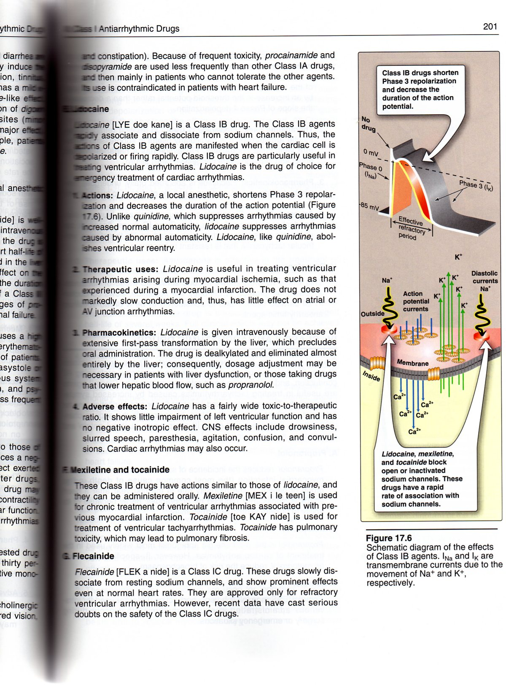
Class IB Drugs
Class IB
lidocaine
mexiletine
tocainide
They shorten Phase 3 repolarization
↓ the duration of the cardiac action potential
They suppress arrhythmias caused by abnormal automaticity
They show rapid association & dissociation (weak effect) with Na⁺ channels with appreciable degree of use-dependence
No effect on conduction velocity

Slide 65
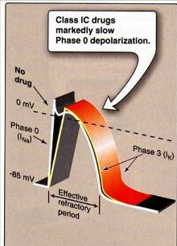
Class IC Drugs
Class IC
flecainide
propafenone
They markedly slow Phase 0 fast depolarization
They markedly slow conduction in the myocardial tissue
They possess slow rate of association and dissociation (strong effect) with sodium channels
They only have minor effects on the duration of action potential and refractoriness
They reduce automaticity by increasing the threshold potential rather than decreasing the slope of Phase 4 spontaneous depolarization.

Slide 66
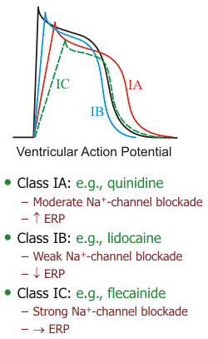
Compare between class IA, IB, and IC drugs as regards effect on Na⁺ channel & ERP
Sodium channel blockade:
IC > IA > IB
Increasing the ERP:
IA>IC>IB (lowered)
Because of K⁺ blockade

Slide 67
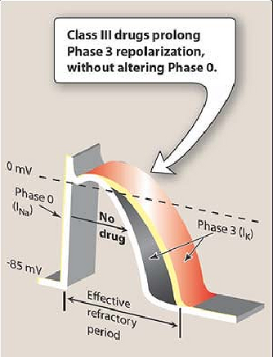
Class III ANTIARRHYTHMIC DRUGS
K⁺ blockers
Prolongation of phase 3 repolarization without altering phase 0 upstroke or the resting membrane potential
They prolong both the duration of the action potential and ERP
Their mechanism of action is still not clear but it is thought that they block potassium channels

Slide 68
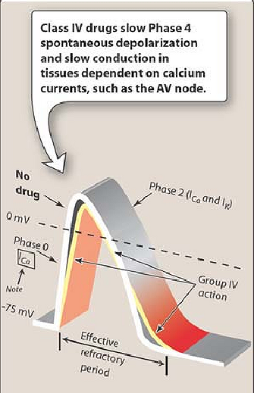
Class IV ANTIARRHYTHMIC DRUGS
(Calcium Channel Blockers)
Calcium channel blockers decrease inward Ca²⁺ currents resulting in a decrease of phase 4 spontaneous depolarization (SA node)
They slow conductance in Ca²⁺ current-dependent tissues like AV node.
Examples: verapamil & diltiazem
Because they act on the heart only and not on blood vessels.
Dihydropyridine family are not used because they only act on blood vessels

Slide 69
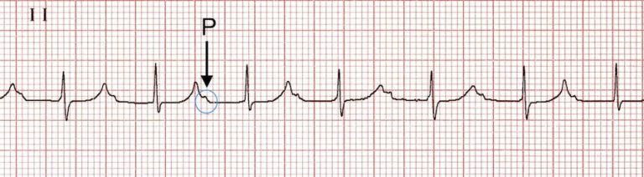
Notes:
Marked first degree heart block
PR interval > 300 ms, P waves are buried in the preceding T wave

Slide 70
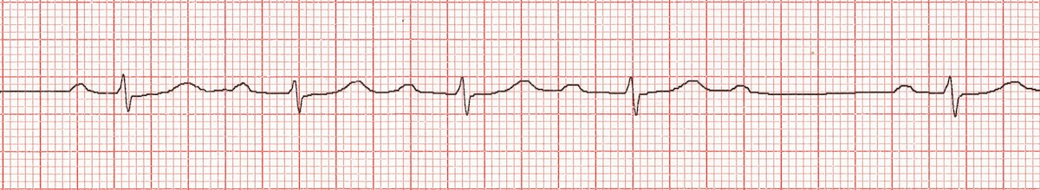
Notes:
Mobitz Type I (Wenckebach AV block)
Progressive prolongation of the PR interval culminating in a non-conducted P wave
PR interval is longest immediately before the dropped beat
PR interval is shortest immediately after the dropped beat

Slide 71
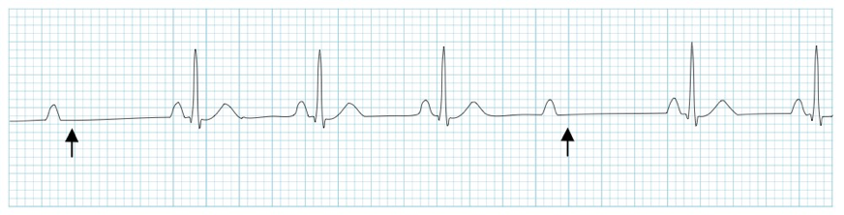
Notes:
Mobitz Type II (Hay AV block)
Intermittent non-conducted P waves without progressive prolongation of the PR interval
PR interval in the conducted beats remains constant.
P waves ‘march through’ at a constant rate.
RR interval surrounding the dropped beat(s) is an exact multiple of the preceding RR interval (e.g. double the preceding RR interval for a single dropped beat, treble for two dropped beats, etc).

Slide 72
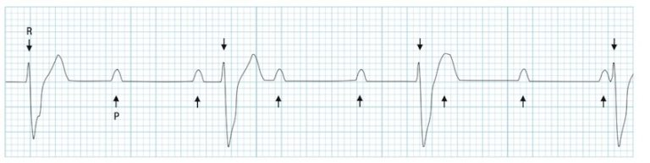
Notes:
The atrial rate is approximately 100 bpm.
The ventricular rate is approximately 40 bpm.
The two rates are independent; there is no evidence that any of the atrial impulses are conducted to the ventricles.

Slide 73
