Slide 1
Epilepsy in children
Dr. Redab Al-Ghawanmeh

Slide 2
Objectives
Definitions
Epidemiology
Classification
Etiology
Epileptic syndroms
Treatment
Prognosis
Disorders that mimic seizures

Slide 3
Definitions
Seizure
Epilepsy
Status Epilepticus
Febrile convulsions

Slide 4
Seizure
Transient occurrence of signs and/or symptoms(change in LOC, motor activity, sensory phenomena or inappropriate behavior) resulting from abnormal excessive or synchronous neuronal activity in the brain

Slide 5
Epilepsy
Epilepsy: two or more unprovoked attacks, in a time frame longer than 24 h.
Epileptic syndrome: one or more specific seizure types, has a specific age of onset and specific prognosis.

Slide 6
Status epilepticus
Continuous seizure >= 30 min, generalized or focal, during which the patient remains unconscious or has two or more sequential seizures without full recovery of consciousness between seizures.
New definition 5 min
Treatment of Status epilepticus

Slide 7
Febrile convulsion
A Seizure is association with febrile illness in the absence of CNS infection, or acute electrolyte imbalance in children between 6-60m without prior afebrile seizures.
Age: 6-60 months (peak 18)
2-5% of children
Most common form of seizures in children.

Slide 8
Febrile convulsion –cont
Classification:
-Simple: generalized
<15 min
not recurring in 24 h
-complex: focal
>15 min
multiple

Slide 9
Febrile convulsion –cont
After first febrile seizure: 30% recurrence of a second febrile seizure.
50% after two or more seizures.

Slide 10
Risk factors for recurrence of FC
Age<12 m
Family history of febrile convulsion.
Height of temperature (the lowest the highest the risk)
Duration of fever (the shorter the higher the risk)
Male gender
Daycare attendance

Slide 11
Risk of developing epilepsy
Risk of developing epilepsy after single FC is not different than the risk in the general population
Complex febrile convulsion
Neurodevelopmental abnormalities.
Family history of epilepsy
Duration of the fever before the seizure

Slide 12
Treatment of FC
Management of the acute febrile illness
Counseling and education of the family
Treatment of the seizure: rectal diazepam
Prophylactic treatment: debate

Slide 13
Epidemiology of epilepsy
Birth-16 year: 4-10% experience at least one seizure, mostly in childhood.
Cumulative risk(risk to develop epilepsy throughout an individual lifetime): 3-5%

Slide 14
Classification of epilepsy
1. according to semiology:
generalized
focal: simple, complex
2. according to etiology:
idiopathic
symptomatic
cryptogenic
3. according to clinical + age+ EEG: syndromic classification

Slide 15
according to etiology
Idiopathic: no cause (genetic)
Symptomatic: cause is found
-Acute symptomatic seizure
-Remote symptomatic epilepsy
Presumed symptomatic/cryptogenic: probably there is an underlying cause but is not evident at the moment

Slide 16
according to semiology:
Generalized: ictal discharge generalized (two cerebral hemispheres), loss of consciousness:
-Tonic clonic
-Tonic
-Clonic
-Astatic
-myoclonic
-absence

Slide 17
according to semiology, cont.:
Focal/partial
-Simple: sensory seizures (auras) or brief motor seizures. DDX tics (partial voluntary control, less often stereotyped than seizure)
-Complex: change in LOC, often proceeded by aura(abd. Pain, sense of fear, visual hallucination, focal sensation), automatisms
-focal onset with secondary generalization

Slide 18
Epilepsy syndromes
Examples of epilepsy syndromes according to age of presentation:
Neonatal:
-Benign familial neonatal seizures, at 2-3d, AD
-Benign neonatal seizures, at age4-6d
-Early infantile epileptic encephalopathy(Ohtahara syndrome)
-Early myoclonic encephalopathy

Slide 19
Epilepsy syndromes, cont.
Infant
-Infantile spasms (West syndrome)
-Benign myoclonic epilepsy of infancy
-Sever myoclonic epilepsy of infancy (Dravet syndrome)

Slide 20
Epilepsy syndromes, cont.
Preschooler
-Sever myoclonic epilepsy of infancy (Dravet syndrome)
-Lennox Gastaut syndrome
-Epilepsy with myoclonic-astatic seizures (Doose syndrome)

Slide 21
Epilepsy syndromes, cont.
Child
-Childhood absence epilepsy
-Epilepsy with myoclonic abscenc
-Benign epilepsy with centrotemporal spikes (Rolandic)
-Childhood epilepsy with occipital paroxysms(Panayiotopoulos type)
-Landau-Kleffner syndrome

Slide 22
Epilepsy syndromes, cont.
Adolescent
-Juvenile absence epilepsy
-Juvenile myoclonic epilepsy
-Grand mal seizure upon awakening

Slide 23
Examples of epileptic syndromes: West syndrom
Peak onset: 4-7 m, but can occur in the late neonatal period or after 12 m
Clinically: spasms (flexion, extension, mixed), associated with variable encephalopathy
Causes: symptomatic(90%), presumed symptomatic. Prognosis strongly influenced by the underlying etiology
EEG:
interictal: hypsarrhythmia
ictal: spasms

Slide 24
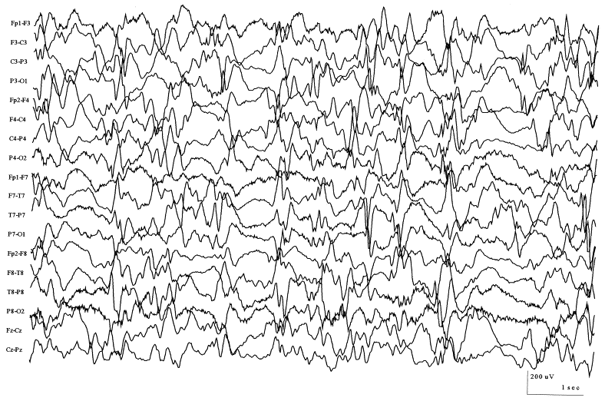
hypsarrhythmia

Slide 25
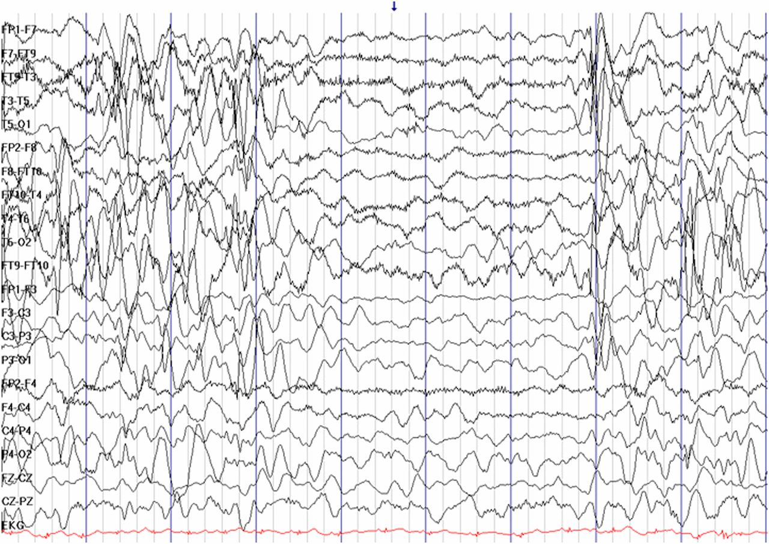
Spasms

Slide 26
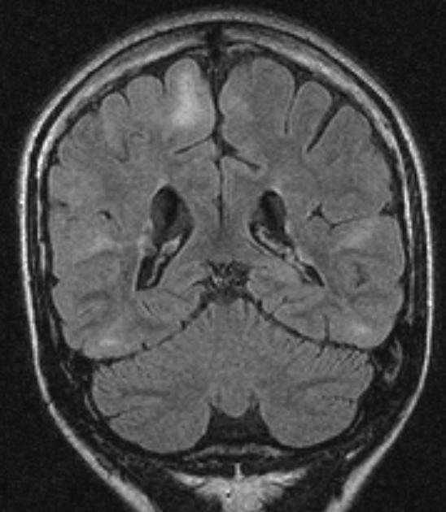
Cortical tubers in tuberous sclerosis

Slide 27
West syndrome, cont
Treatment
-ACTH, most effective
-High dose oral corticosteroid(S/E: immunosuppression, HTN, diabetes)
-Vigabatrin particularly in tuberous sclerosis(S/E: irreversible visual field deficit with prolonged use
Prognosis – developmental delay, many will have seizures later in life, can evolve to Lennox Gastaut Syndrome

Slide 28
Lennox Gastaut Syndrome
Age of onset – 1-7 years of age
Seizure types – tonic (mostly nocturnal), atonic, myoclonic, atypical absence, generalized tonic clonic, focal
Associated EEG patterns – generalized 1-2hz slow spike and wave, generalized slowing, paroxysmal fast activity (recruiting rhythm) during sleep
Common etiologies – variety of etiologies, proceeded by infantile spasms in 9-40% of cases
Treatment – felbamate, clobazam, rufinamide, topiramate, zonisamide, ketogenic diet, valproate, levetiracetam, VNS, corpus callosotomy, focal cortical resection (if there is a focus)
Prognosis – moderate to severe intellectual impairment, usually correlates with etiology and seizure control

Slide 29
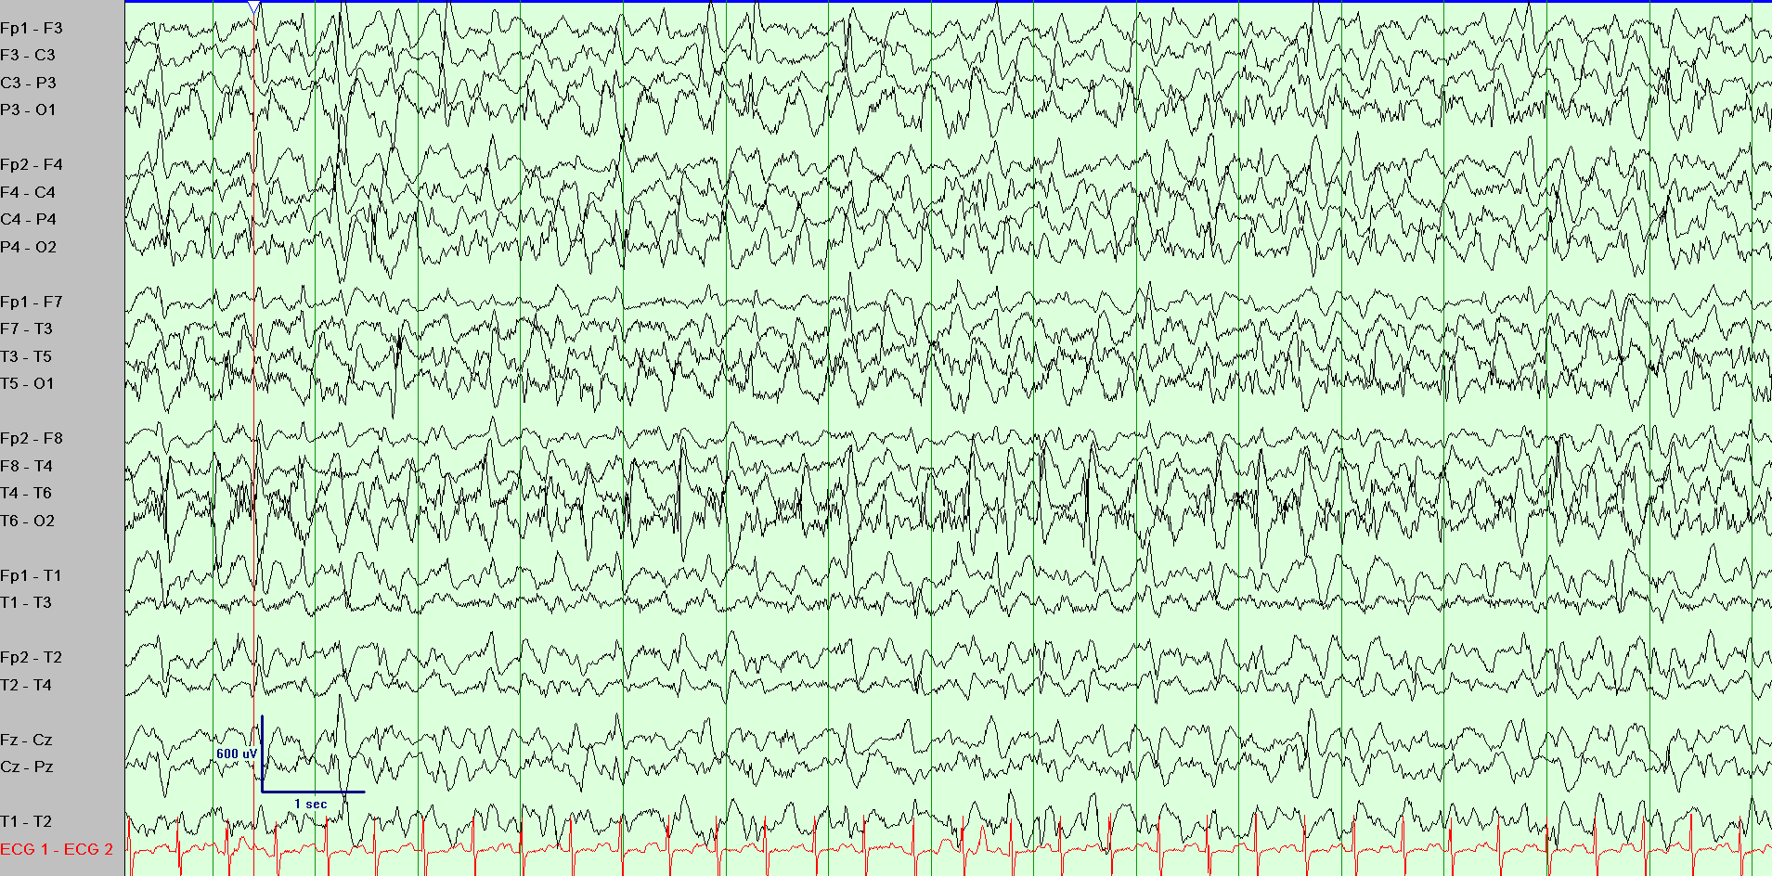
EEG: Slow Spike and Wave

Slide 30
Childhood absence epilepsy
Age of onset: 3-10 years, peak at 6-7 years; onset before age 3 years likely represents different epilepsy syndrome
Seizures:
  Type: generalized absence seizures, can be provoked by hyperventilation in up to 90%; 3% will also have generalized convulsive seizures
  Semiology: staring, behavioral arrest, unresponsiveness. Infrequent associated automatisms, clonic jerks, loss of postural tone.
  Duration: brief, up to to 5 seconds
  Frequency: high, hundreds per day if untreated
EEG: Typical absence seizure, 3 Hz spike and wave

Slide 31
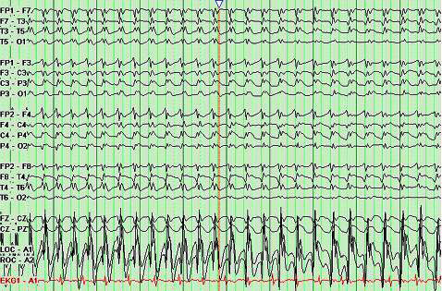
EEG: Typical absence seizure, 3 Hz spike and wave

Slide 32
Rolandic (BECTS)
Etiology: Unknown, although a family history of epilepsy is common
Age of onset: 4-10 years
Seizures
  Type: focal seizures, typically out of sleep
  Semiology: drooling, dysarthria, speech arrest, tingling or clonic activity of unilateral face with spread to arm, may progress to hemiclonic or generalized convulsive
  Duration: self-limited, status epilepticus is uncommon
  Frequency: typically low

Slide 33
Rolandic Epilepsy
Interictal EEG: High amplitude centrotemporal spikes and sharp waves with dramatic activation during sleep Serial EEGs may show shifting asymmetry of spike wave discharges
Imaging: normal
Treatment: pharmacoresponsive, may not require preventative medications if seizures are infrequent.
Clinical course: self limited epilepsy with spontaneous remission, usually by age 15-17 years
Comorbidities: Normal cognition, although learning and behavioral disorders can occur

Slide 34
What to do
History and Examination
Rule out disorders that mimic seizures
Role of neuroimaging (Brain MRI superior to CT scan): tumors, vascular malformation, inflammation, metabolic disease
EEG
Metabolic work up
Genetic studies

Slide 35
Causes of seizure
Unknown
Perinatal complications
Electrolyte imbalance
Inborn errors of metabolism
Infections trauma
Tumors
Cerebrovascular diseases

Slide 36
Disorders that mimic seizures
Arrhythmias
  Long QT and torsades
  VTach
  Anytime there is poor cardiac output impairing cerebral perfusion, you can see motor activity / hypoxic convulsions.
Breath-Holding Spells
  Actually not associated with inspiratory hold. The child typically screams/cries and exhales fully.
  They can loose postural tone and have motor activity.
  Up to 15% will have generalize hypoxic convulsions

Slide 37
Disorders that mimic seizures
Migraine Syndromes
  Basilar Migraine
  Familial Hemiplegic Migraine
Gastroesophageal reflux may cause generalized stiffness or posturing.
  Can have apnea also.
  Often occurs 20-30 min after a meal.
Dystonic Reactions
  Always look at the medication list!!

Slide 38
Disorders that mimic seizures, cont.
Sleep-Related Phenomena
  Benign sleep myoclonus
  Periodic sleep jerks
  Narcolepsy
  Sleep terrors
Tics
Benign paroxysmal vertigo
pseudoseizure
Jitteriness in newborn

Slide 39
Recurrence of unprovoked seizures
First seizure: 20-40% will have recurrence
Second seizure: up to 80% will have recurrence
Recurrence usually within the first 6 m, rare after 2 y
Factors that enhance recurrence in epileptic patient:
Poor compliance on medication
Fever
change in sleep pattern
Choice of wrong drug

Slide 40
Treatment goals
Prevent occurrence of seizure
Prevent or reduce drug S/E, drug interaction
Improve quality of life
Provide simple, cost effective care

Slide 41
Modalities of treatment
AED: old and new
Ketogenic diet
Epilepsy surgeries
Vagal nerve stimulation

Slide 42
Drugs, old
Phenobarbital
Phenytoin
Valproic acid
Carbamazepine
Clonazepam
ethosuxamide

Slide 43
New drugs
Lamotrigine
Topiramat
Levetiracetam
Zonisamide
Felbamate
Gabapentine
Oxcarbamazepine
Vegabatrin
Tigabine

Slide 44
AED- some S/E
Valproic acid: weight gain, tremor hair loss, hepatitis, thrombocytopenia
Carbamezapine: bone marrow suppression, steven Johnson, hyponatremia, liver toxicity
Ethosuxamide: bone marrow suppression, steven Johnson
Lamotrigine: steven Johnson, liver toxicity
Topiramat: kidney stones, glaucoma, hyperhidrosis, weight loss
Levetracitam: behavioral symptoms

Slide 45
AED- some S/E
Phenobarbital: sedation, hyperactivity, liver toxicity, steven Johnson
Phenytoin: gingival hyperplasia, liver toxicity, steven Johnson
vigabatrin: irreversible visual field deficit
Zonisamide: hyperhidrosis, fever, kidney stones
Gabapentine: aggression and hyperexcitability
Oxcarbazepin: somnolence, headache, hyponatremia
Felbamate: aplastic anemia, hepatic toxicity, rarely used(lennox Gastaut)

Slide 46
Treatment ..
When to treat
Which drug to choose:
- depends on type of seizure and epileptic syndrome
-depends on patient age
-depends if presence of other disease (eg. kidney stones avoid topiramate and zonisamide)
Old or new
Refractory epilepsy

Slide 47
Treatment ..
Monotherapy should be used if possible
Combination therapy should only be used if monotherapy is ineffective
Consider AED withdrawal after 2 seizure free years. Bear in mind epileptic syndrome (eg. Not in JME) and child and family psychosocial factors.
AED withdrawal must take place gradually

Slide 48
Surgical treatment of epilepsy
Resective surgery: removal of the brain parenchyma that is considerd to be the source of seizures; it is an option where
-Focal onset
-radiological evidence
-minimal predicted morbidity
-must only be performed in specialized centers after an extensive evaluation

Slide 49
Surgical treatment of epilepsy
Corpus callosotomy
Hemispherectomy
Vagal nerve stimulation :-pacemaker behind left carotid, transmit intermittent electrical stimulation to an electrode wrapped around the left vagus nerve decrease in seizure frequency 20-30% -adjunctive treatment to AED - S/E: hoarsness of voice, cough, dysphagia, chest/arm pain or paresthesia
Deep brain stimulation

Slide 50
Ketogenic diet
High fat 80%, low carbohydrate, adequate protein 20%
Supplemented with vitamins and calcium
Needs admission to hospital few days to induce ketosis
Common s/e: non compliance, acidosis, constipation, failure to gain weight, increase cholesterol
Successful control of seizure equal that of AED
Children who become seizure free will continue to be seizure free when diet discontinued
Treatment of choice in children with Glucose transport(GLUT1)
protein deficiency. Option for LGS. Contraindicated in FAO disorders

Slide 51
Thank you

