Slide 1
OB/GYN History and Physical exam
Rami Kilani
15/9/13

Slide 2
Obstetric History
Age
Gravidity
Parity- (Preg>24 wks)+(Preg< 24wks)
LMP; menstural cycle; conceived on pill; EDD
History of this pregnacy :
Presenting complaints- when did they occur & how long they lasted, any investigation or treatment already ?
Low/high risk pregnancy?
Any problems in antenatal care so far ?
Fetal movements

Slide 3
Examination
Consent, explanation & beware of supine hypotension
General examination
-Colour
-Hand, eyes & mouth
-Presence of oedema
-BP & Urine
-CVS & Respiratory system examination

Slide 4
Obstetric History
Previous pregnancy:
- Previous miscarriages
- Gestation & mode of delivery
- Length of labour & complications
- Third stage complications
- Postnatal problems
Medical & surgical history
Drug history & allergies
Family history- hereditary disorders, HTN,DM, twins or congenital malformation
Social history- smoking, alcohol, drug misuse, occupation, housing & marital status

Slide 5
Abdominal Examination
Inspection: abdominal scars
striae gravidarum
linea nigra
oedema

Slide 6
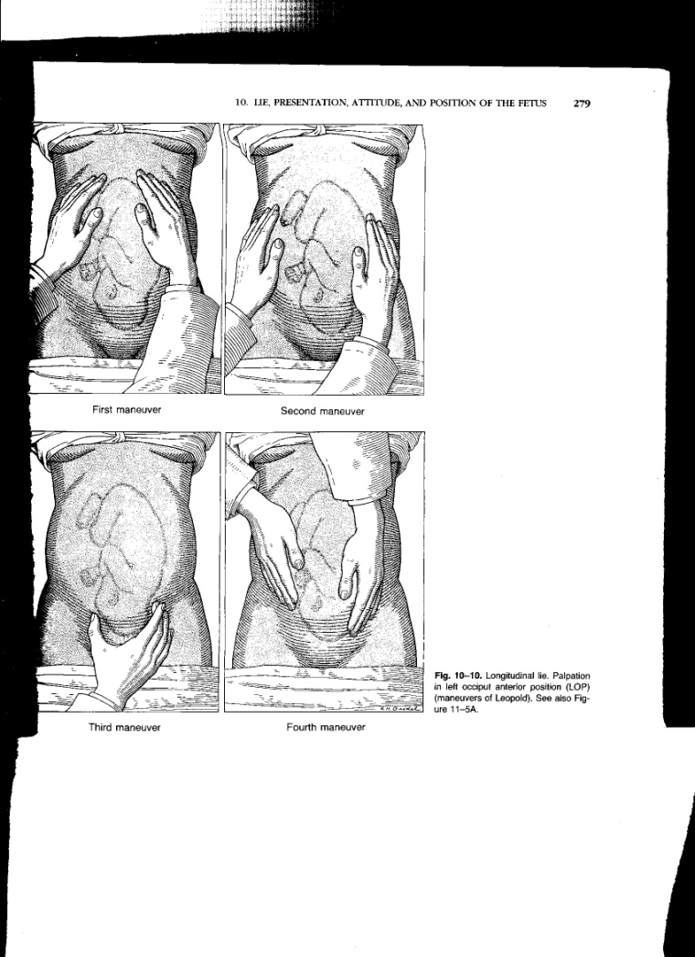
Abdominal palpation
alpation of pregnant abdomen:
P
Examination of uterine fundus
Symphysio- fundal height(cm)
Fetal back
Presenting part e.g vertex, breech
4. Engagement of presenting part
Four maneuvers
of leopold

Slide 7
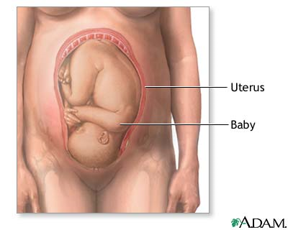
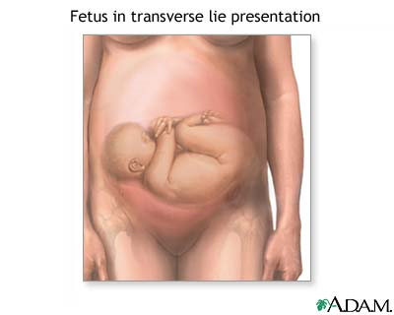
Lie of Fetus
Lie: relationship of long.
axis of fetus to long.axis
of uterus e.g longitudinal,
transverse, oblique
Longitudinal lie
Transverse lie

Slide 8
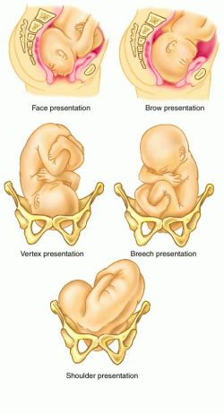
Presentation of fetus
Presentation:
presenting part of fetus
occupying the lower pole
of uterus i.e ceph(vertex),
breech,face,brow or
shoulder

Slide 9
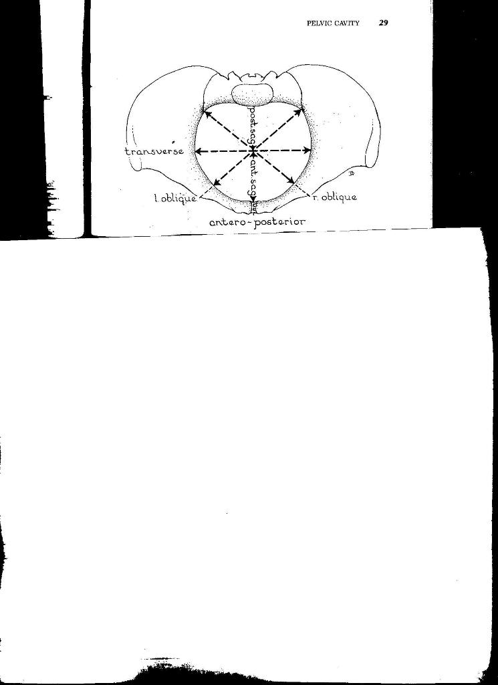
Female bony pelvis
Right
Side
Left
side
Pelvic diameters:
Anterio-posterior
Transverse
Oblique

Slide 10
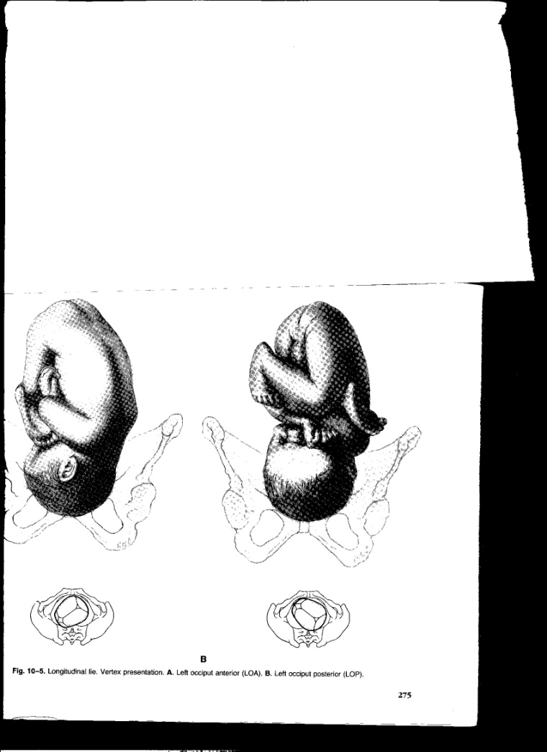
Abdominal Examination
Left Occipito- anterior
Left Occipito- posterior
Position: Relation of denominator (occiput/ sacrum) of presenting part to the quadrants of pelvis e.g
LOA,LOP

Slide 11
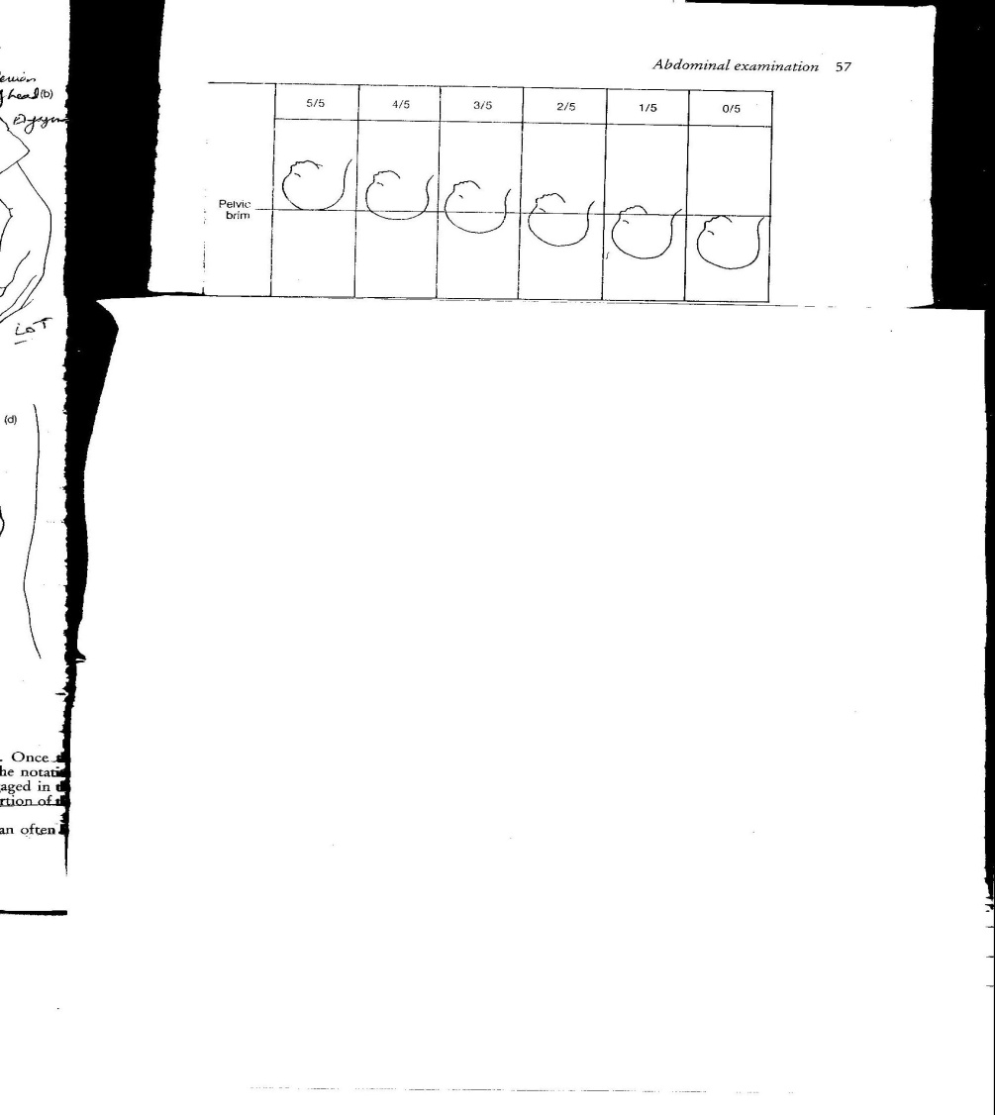
Abdominal Examination
G
Engagement: Widest diameter of head below the pelvic brim.
No. of 5th head palpable above the pelvic brim e.g 4/5th , 3/5th
Amniotic fluid
Auscultation: FETAL HEART

Slide 12
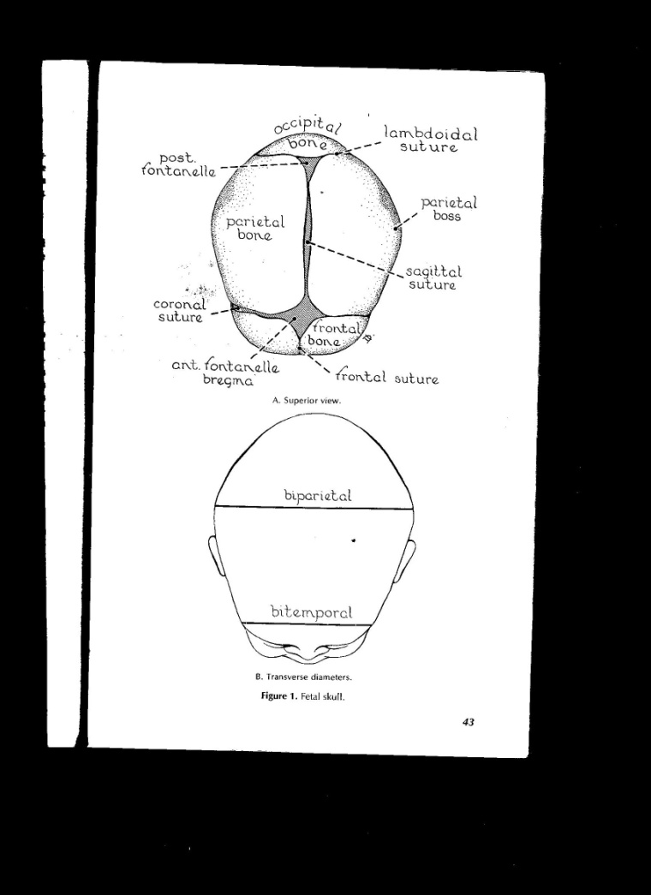
Fetal skull
s

Slide 13
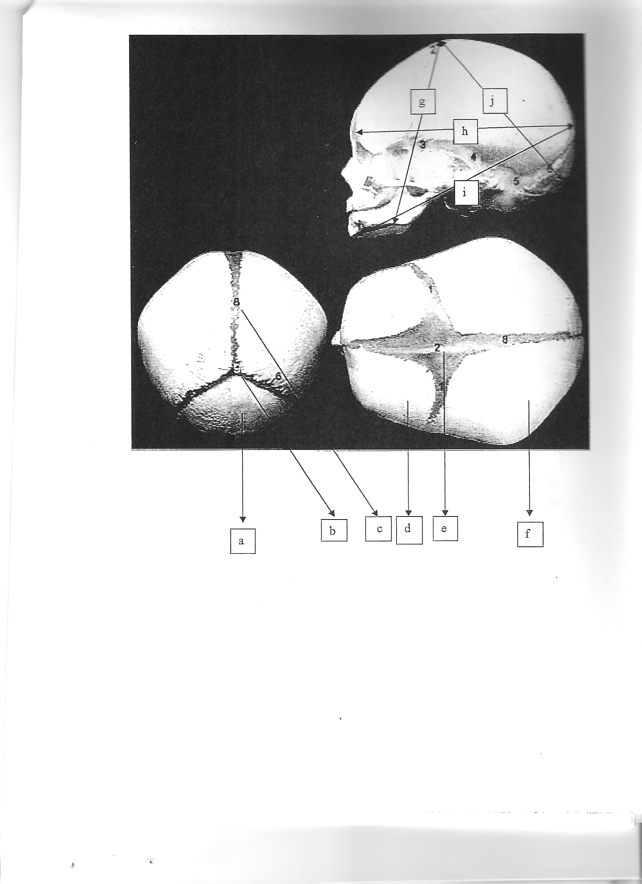
Bregma
Occiput
Mentum
Parts of fetal skull:
Occipital bone
Posterior fontanella
Saggital suture
Frontal bone
Anterior fontanelle
Parietal bone
Presenting diameters:
g) Face presentation
Submento-bregmatic
h) Deflexed OP
Occipito-frontal
i) Brow presentation
Occipito-mental
j) Normal vertex
Sub-occipito bregmatic

Slide 14
Vaginal Examination
Vulva & vagina
Cervix-dilatation ,effacement, position & consistency
Presenting part i.e Vertex
Station-cm in relation to the ischial spine
Caput-swelling on the scalp superficial to periosteum of cranium ,as a result of venous congestion, on the part of head most in advance
Moulding- Overriding of the bones of skull
Membranes & Liquor

Slide 15
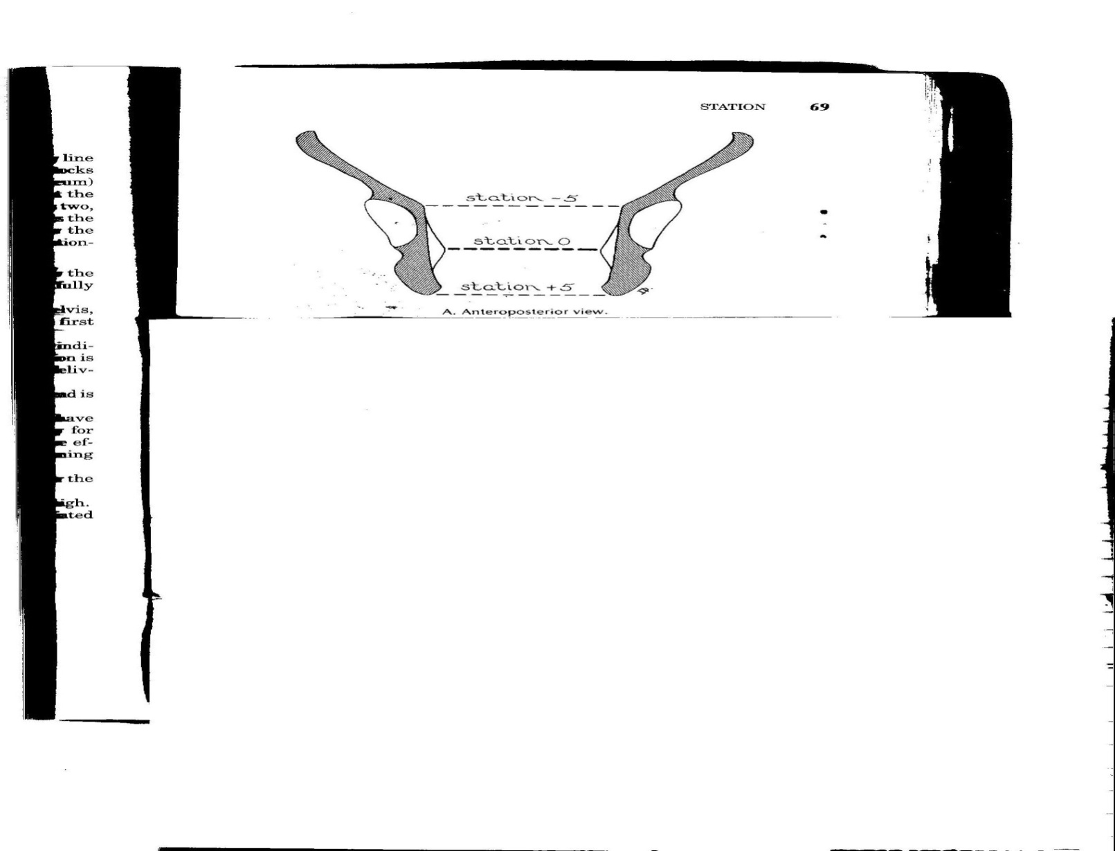
Vaginal Examination
s
Station -3
Station +3
Station- position of presenting part (PP) in cm in relation to the ischial spine

Slide 16
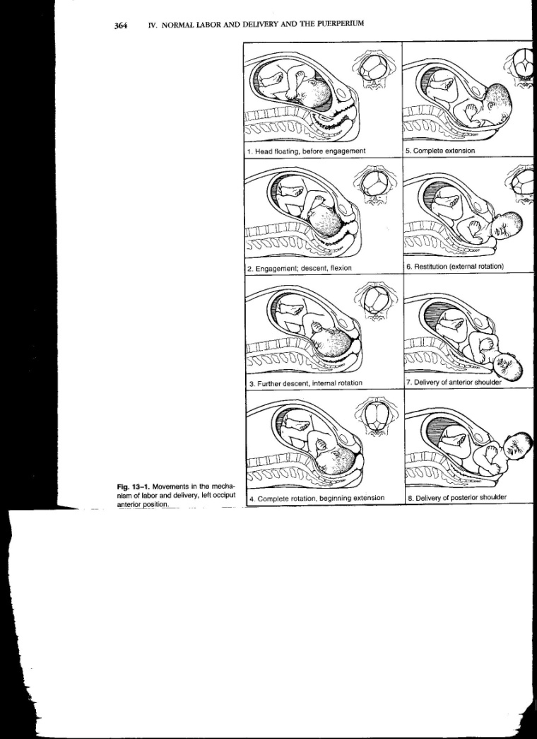
Mechanism of labour
LOA position:
Free head
Descent & engagement
Descent & Flexion
Internal rotation
Extension
External rotation
Restitution
Delivery of shoulder

Slide 17
Gynaecological History
Age, Gravidity, Parity, LMP
Contraception
Last cervical smear
Presenting complaints: Nature & duration
Relation to menstrual cycle
Bowel symptoms
Urinary symptoms
Vaginal discharge
Vaginal bleeding

Slide 18
Gynaecological History
Previous Gynaecological & Obstetric History:
PID/STI
Endometriosis
Previous miscarriages / preg<24 wks
Ectopic pregnancy
Pregnancies>24 wks & outcome
Menstrual history

Slide 19
History cont….
Medical
Surgical
Family history- Fibroids, endometriosis, cancers, DVT/PE
Medications
Allergies
Social History

Slide 20
Examination
General- Conjunctiva, pulse
Abdomen:
Inspection- distension of abdomen
mass
previous scar
Palpation- tenderness
mass( size, consistency)
ascites
lymph nodes
Percussion
Auscultation

Slide 21
Vaginal Examination
Vulva
Speculum (Cusco’s & Sim’s)
- vagina (atrophy, mass, trauma, prolapse)
- cervix (ectropion, polyp, growth, contact bleeding,
- uterine prolapse
Bimanual pelvic exam. – uterine/ adenexal masses tenderness

Slide 22
Competencies (Mandatory)
Examination of pregnant abdomen
Examination of non-pregnant abdomen
Speculum(Cusco’s speculum) examination

Slide 23
