Slide 1
Normal labor and delivery:

Slide 2
Contents:
Introduction.
Mechanical factors of labor.
Stages of labor.
Labor management.

Slide 3
Introduction:
Labor: the process whereby the fetus and the placenta are expelled from the uterus, normally b\w 37 - 42 weeks.
Diagnosis: when painful uterine contractions accompany diltation and effacement of the cervix.
Divided into stages.

Slide 4
Normal labor:
Spontaneous on onset.
Low risk.
Infant is born spontaneously.
In vertex position.
Between 37 - 42 completed weeks.
After birth the moth

Slide 5

Mechanical factors of labor:
Three determine progress:
The power.
The passage.
The passenger.

Slide 6
The powers:
Once labor established, the uterus contracts for 45–60 seconds about every 2–4 minutes.
Irregular, painless, of mild intensity contractions of uterine smooth muscle occur throughout the third trimester and are often felt as Braxton Hicks contractions, not result in cervical changes.

Slide 7
The passage:
The bony pelvis:
Three planes:
- Inlet: the transverse diameter is about 13 cm, antero-posterior (AP) diameter 11 cm
-The midcavity is almost round, the transverse and AP diameters are similar.
- The outlet: the AP diameter (12.5 cm), transverse diameter (11 cm).
In the lateral wall of the mid-pelvis, ischial spines are palpable vaginally. Used as landmarks to assess the descent of the head on vaginal examination, STATION.
Measured in centimetres in relation to the spines.
A variety of pelvic shapes have been described.

Slide 8
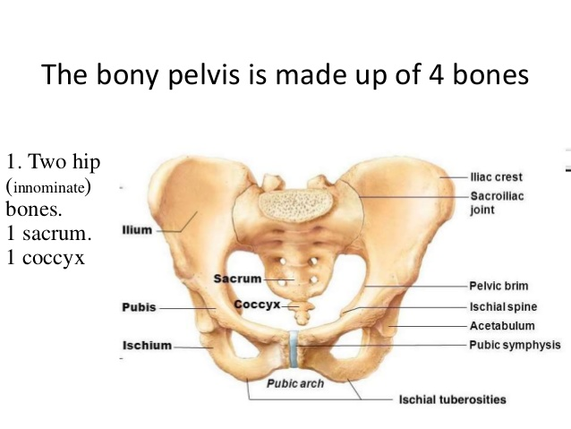

Slide 9
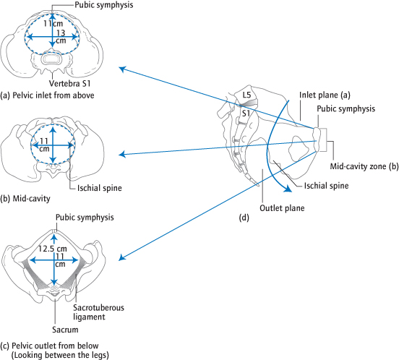

Slide 10
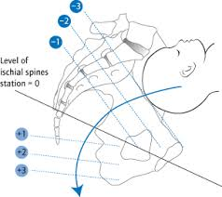
Station: the level of the presenting part above or below the plane of the ischial spine.
Engagement: when the widest diameter of the fetal presenting part has passed through the pelvic inlet.

Slide 11
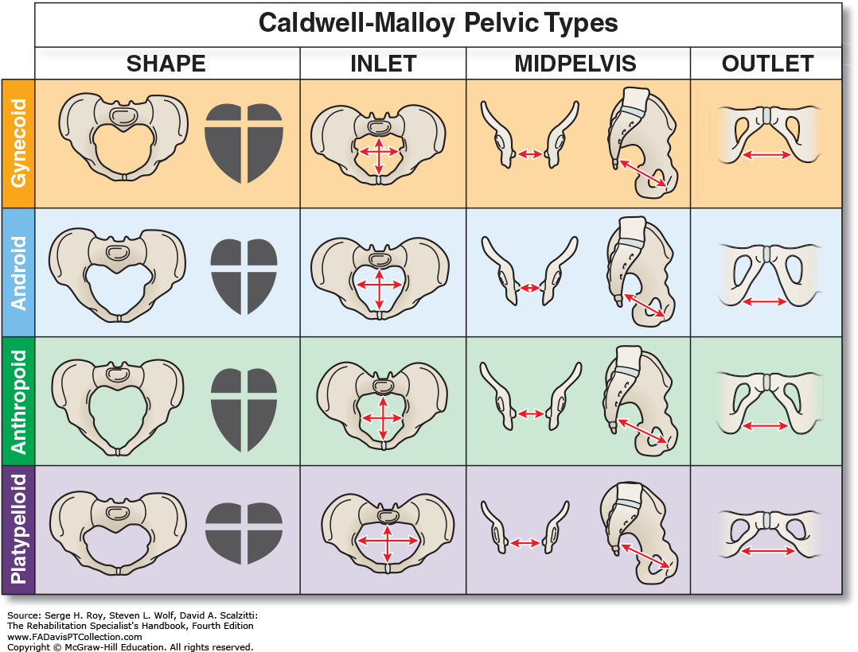

Slide 12
The passage:
Soft tissue:
The soft tissues of the vagina and perineum in the second stage.
The perineum often tears or is cut (episiotomy) to allow the head to deliver.

Slide 13
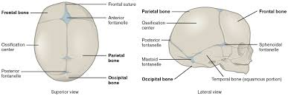
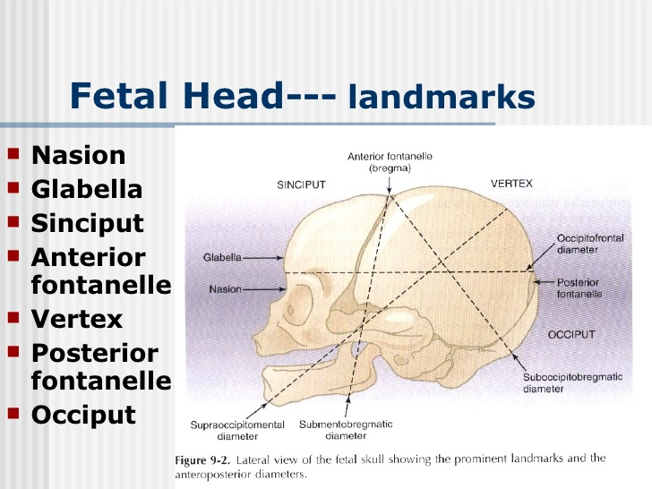
The passenger:
The fetal head is the largest and least compressible part of the fetus.

Slide 15
Terms describing the fetal head:
Presentation: the part of the fetus that occupies the lower segment or pelvis, i.e. head (cephalic) or buttocks (breech)
Presenting part: the lowest part of the fetus palpable on vaginal examination: For a cephalic presentation, this can be the vertex, the brow or the face, depending on the attitude.
Position : the degree of rotation of the head on the neck. occipito-transverse (OT), occipito-posterior (OP) or occipito-anterior (OA)
Attitude of the head describes the degree of flexion:
vertex, brow or face.

Slide 16
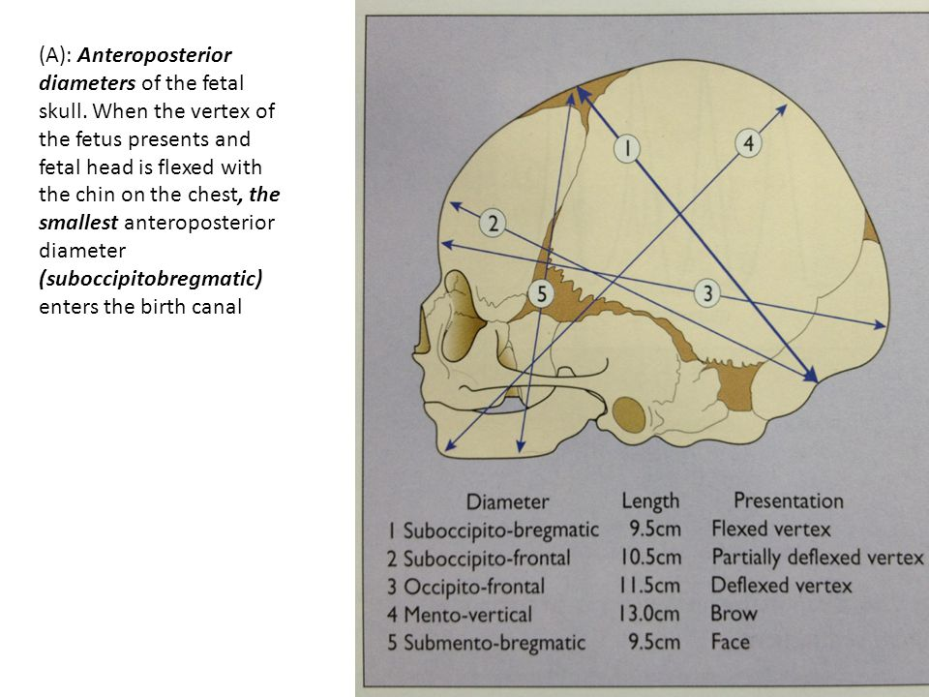
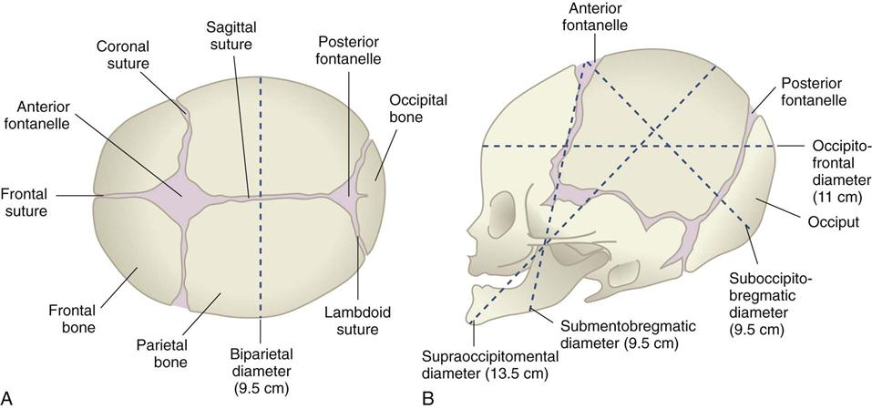
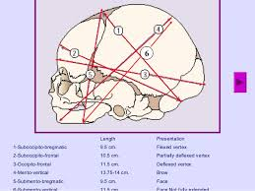

Slide 17
Movements of the head:
Engagement in occipito-transverse (OT)
Descent and flexion
Rotation 90° to occipito-anterior (OA)
Descent
Extension to deliver
Restitution and delivery of shoulders

Slide 18
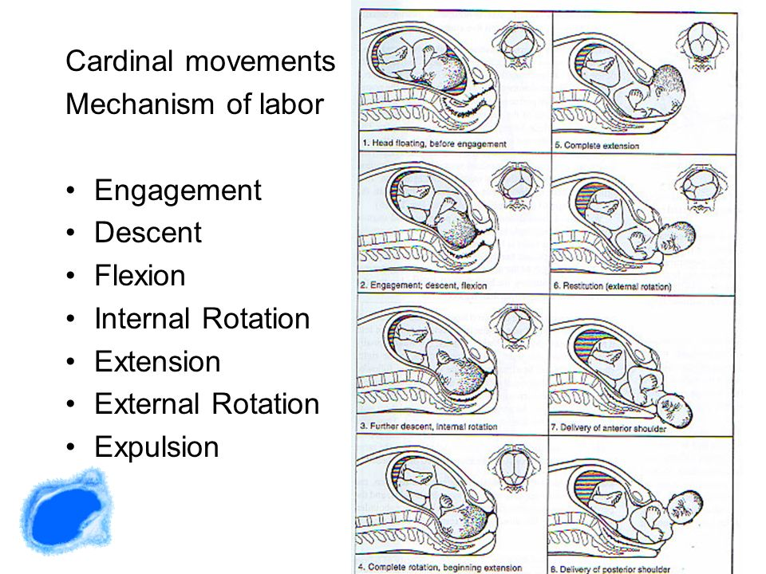

Slide 19
Initiation of labor:
Labor is a release from the state of functional quiescence maintained during pregnancy.
Decreased myometrial responsiveness to progesterone due to increased PRA.
Increased responsiveness to estrogen due to increased ERalpha.
Activation of the fetal hypothalamic pituitary axis, results in increased release of cortisol, increasing the synthesis and release of prostaglandins, and formation of myometrial gap junctions and activation of oxytocin receptors.

Slide 20
Preparation for labor:
Lightening:
False labor:
Cervical effacement

Slide 21
Diagnosis of labour:
Labour is diagnosed when painful regular contractions lead to effacement and dilatation of the cervix.
This is commonly accompanied by a ‘show’ ( pink/white mucus plug) from the cervix and/or rupture of the membranes, causing release of liquor.
Effacement: normally tubular cervix is drawn up into the lower segment until it is flat . Due to increased water content and collagen lysis.

Slide 22
Stages of labor:

Slide 23
The first stage:
From the diagnosis of labour until the cervix is dilated by 10 cm (fully dilated).
The descent, flexion and internal rotation described occur to varying degrees.
The latent phase: where the cervix usually dilates slowly for the first 4 cm.
The active phase follows.
Average cervical dilatation is at the rate of 1 cm/h in nulliparous women and about 2 cm/hour in multiparous women. With an average duration of 6-18 hrs in primipara and 2-10 hrs in multipara.

Slide 24
The second stage:
Lasts from full dilatation of the cervix to delivery.
Descent, flexion and rotation are completed and followed by extension as the head delivers.
Duration 30-3 hrs in primipara and 5-30 mins in multipara.

Slide 25
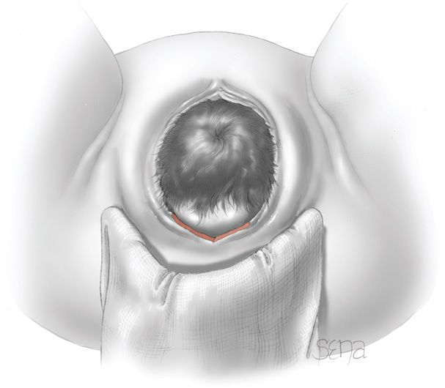
Crowning: when the largest diameter of the fetal head is encircled by the vulvar ring.

Slide 26
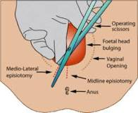

Slide 27
The third stage:
From delivery of the fetus to delivery of the placenta.
It normally lasts about 15 minutes. (0-30 mins).
Normal blood loss is up to 500mL.
Signs of placental separation:
- fresh show of blood from the vagina.
- the umbilical cord lengthens outside the vagina.
- the fundus rises up.
- the uterus become firm and globular.

Slide 28
Active management of the third stage of labor:
- administration of uterotonics.
- controlled cord traction.
- early clamping of the cord.

Slide 29
Perineal lacerations:
First degree: vaginal epithelium or perineal skin.
Second degree: sub epithelial tissue.
Third degree: anal sphincter.
Fourth degree: rectal mucosa.

Slide 30
General care of the woman in labour:
Physical health in labour observations:
The temperature and blood pressure every 4 hours, the pulse every hour (first stage) and then every 15 minutes (second stage).
Contraction frequency recorded every 30 minutes.
Mobility and delivery positions: Freedom of movement is encouraged.
Most women deliver semi-recumbent:
squatting, kneeling or the left-lateral position all probably increase the dimensions of the pelvis.
The supine position avoided: the gravid uterus compresses the main blood vessels, reducing cardiac output and causing hypotension, and often fetal distress. Aortocaval compression, prevented by maintaining at least 15° of left lateral tilt.

Slide 31
Hydration: encouraged to drink isotonic drinks or water. Intravenous fluid may be necesary if labour is prolonged.
Stomach and food: Eating is appropriate during labour, although only small amounts are usually eaten. Eating is often discouraged if the labour is high risk, and ranitidine is often given to reduce the stomach acidity.

Slide 32
The urinary tract: Neglected retention of urine can irreversibly damage the detrusor muscle. The woman must be encouraged to micturate frequently in labour; if she has an epidural, catheterization may be needed, routine catheterization is unnecessary.

Slide 33
Progress in labour:
Monitoring progress: the partogram:
Used to record progress in dilatation of the cervix and descent of the head. This is assessed on vaginal examination and plotted against time.
‘alert’ and ‘action’ lines on the partogram indicate slow progress.
NICE recommends that slow progress is diagnosed if there is <2 cm dilatation in 4 hours.

Slide 34
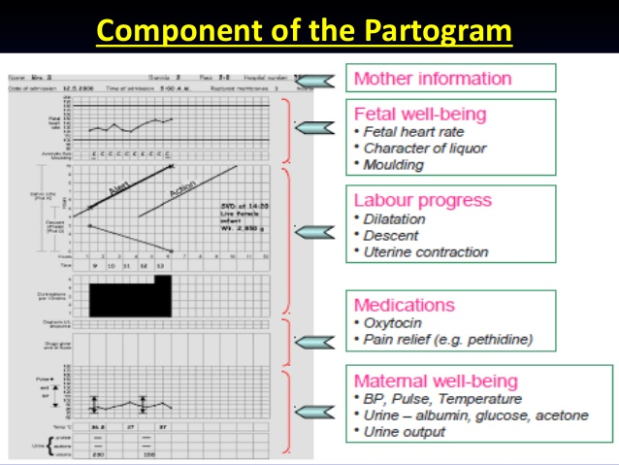

Slide 35
Fetal heart monitoring:
Fetal heart rate auscultation:
- For low risk pregnancies.
- every 15 minutes during the first stage, and every 5 minutes in the second, with a Pinard’s stethoscope or a hand-held Doppler for 60 seconds after a contraction.
Cardiotocography ( CTG)
- if abnormalities are detected or risk factors develop.
- records the FHR on paper and electronically, either from a transducer placed on the abdomen or from a probe in the vagina attached to the fetal scalp.Another transducer synchronously records the uterine contractions.

Slide 36
CTGs are classified as normal, suspicious or pathological, according to four key features:
1- Baseline rate: 110–160 beats/minute.
Tachycardias are associated with fever, fetal infection
and, if in conjunction with other abnormalities, fetal
hypoxia.
2- Baseline variability: the short-term variation in FHR
should be >5 beats/minute, except
during episodes of fetal sleep, usually last less
than 45 minutes. Prolonged reduced variability, with other abnormal features, suggests hypoxia.
3- Accelerations of the fetal heart with movements or
contractions are reassuring.
4- Decelerations:

Slide 37
• Early decelerations are synchronous with a contraction as a normal response to head compression, usually benign.
• Variable decelerations’vary in timing and classically reflect cord compression, which can ultimately cause hypoxia.
• Late decelerations persist after the contraction is completed and are suggestive of fetal hypoxia.

Slide 38
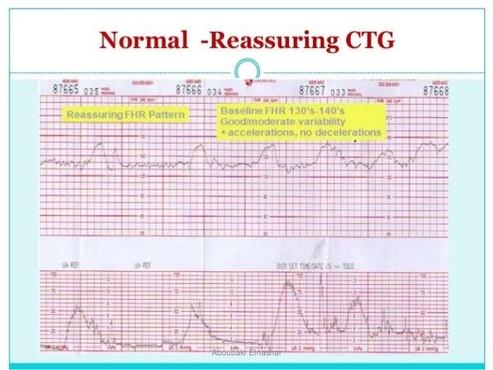

Slide 39
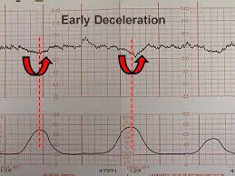

Slide 40
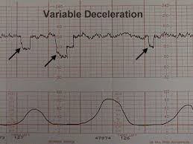

Slide 41
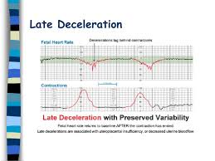

Slide 42
Management of fetal distress
Improve placental blood supply:
- correct hypovolemia and/or hypotension: left lateral
position to avoid aortocaval compression,
intravenous fluid and vasoconstrictors
- diminish uterine activity: Any oxytocin infusion is stopped, use bolus tocolytics.
- A vaginal examination: to exclude cord prolapse or very rapid progress.
Confirmation of distress and delivery: If simple measures fail, fetal blood sampling is performed:
- delivery if the pH is <7.20. If the pH is >7.20 but
the abnormal FHR pattern continues or deteriorates, a second sample in about 30 minutes.

Slide 43
THANK YOU

