Slide 1
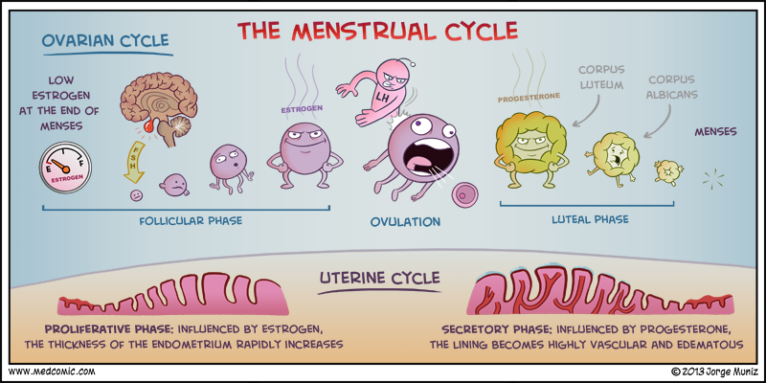

Menstrual cycle and its disorders
Dr Fida Al-Asali

Slide 2
Menstruation
Menstruation is a woman's monthly bleeding from her reproductive tract induced by hormonal changes of the menstrual cycle.
For menstruation to occur:
Coordinated HPO axis
Responsive endometrium
Patent outflow

Slide 3
Cycle interaction
GnRH
Sex steroids
- Esradiol
- Progesterone
Gonadotropins
- FSH
- LH

Slide 4
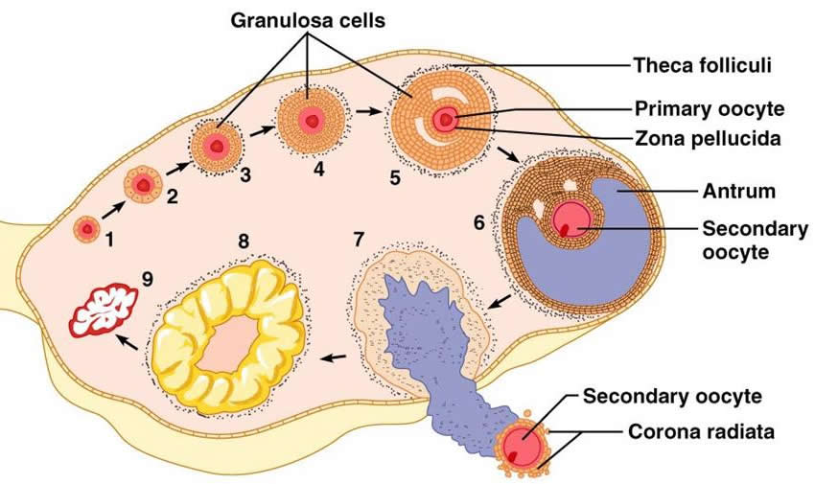
Dominant follicle

Slide 5
Ovarian Cycle
Follicular phase(preovulatory)
Recruitment
Selection of a dominant follicle
Increasing levels of estradiol & inhibin B
Ovulatory phase
LH surge
Rupture of preovulatory follicle wall
Release of viable ovum
Luteal phase(postovulatory)
Corpus luteum
Increasing levels of progesterone
Secretory changes in endometrium

Slide 6
Ovulation
Event in the menstrual cycle by which a selected mature follicle breaks and releases a viable oocyte from the ovary.
Each month, one egg is released in humans; but occasionally, two or more can erupt during the menstrual cycle.
If pregnancy does not occur, the menstruation appears after exactly two weeks

Slide 7
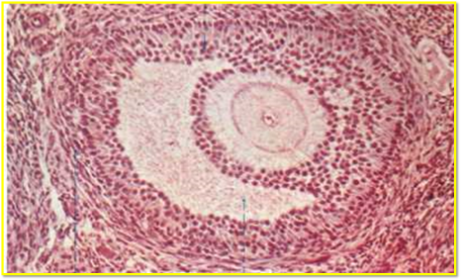
Follicular Phase
A group of the most mature follicles (called “antral follicles”) are recruited.
Only the follicles most sensitive to FSH undergo a further development.
The follicle most sensitive to FSH continue to develop and produce a large amount of estradiol and inhibin B.
The remaining follicles become atretic.(99%)

Slide 8
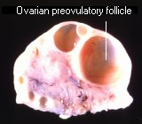
Mechanism of follicle rupture
An increase of intrafollicular pressure
Perifollicular ovarian smooth muscle contractions
Vascular alterations in the perifollicular vessels.
Prostaglandins and proteolytic enzymes are responsible for the digestion and rupture of the follicle wall
Some factors, such as cytokines, O2 free-radicals,
nitric oxide and angiotensin II could contribute to these actions, but this issue is still unclear (Homburg 2005).

Slide 9
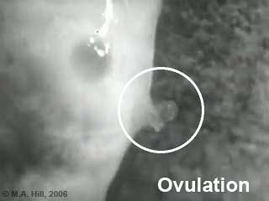
Ovulation
The onset of the LH surge occurs 34-36 hours before ovulation & reliably indicates the timing of ovulation

Slide 10
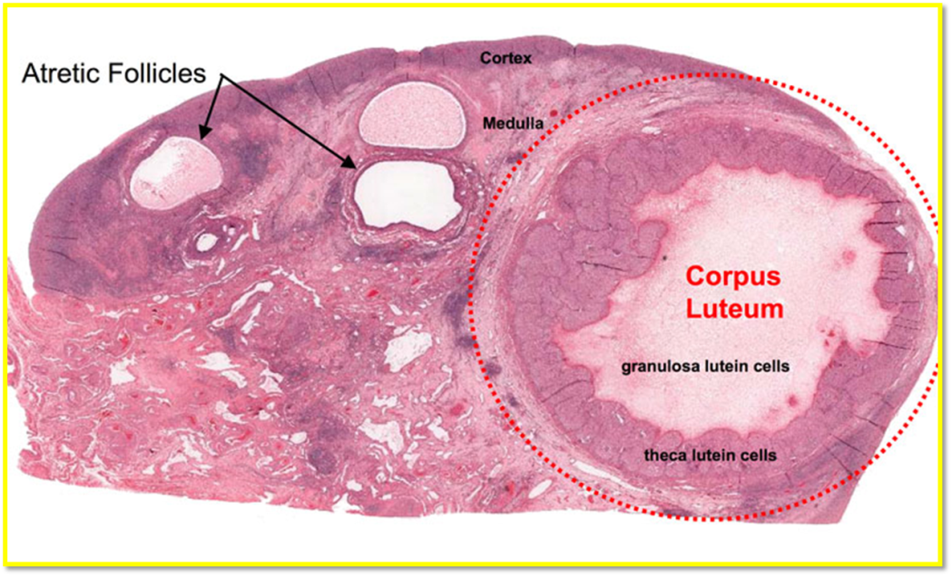
Luteal phase
Peak levels of progesterone are attained 7 days after ovulation which approximates the time of implantation of the embryo
In early pregnancy, hCG maintains luteal function with secretion of progesterone until placental steroidogenesis is established

Slide 11
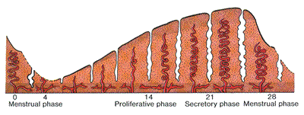
Phases of the endometrium
Progesterone
Fixed 14 days
gland tortuosity & secretion, stromal oedema ,decidual reaction of the endometrium
Estrogen
variable
Vascular growth
Duration
2-8 days

Slide 12
Cervical changes
Follicular phase | Luteal phase
Internal os- funnel shape | Tightly closed
Mucus- thin &watery | Thick & viscid
Stretchabilty- increased | lost

Slide 13
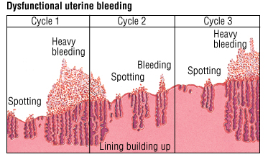
E
proliferative changes
E dominant endometrium is UNSTABLE

Slide 14
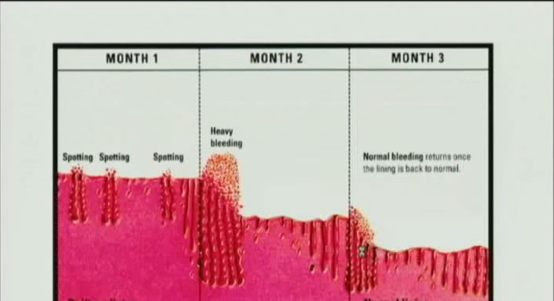
P
Secretory changes
P dominant endometrium is STABLE

Slide 15
Menstrual phase
Rapid ↓ in steroids → shedding of the unused endometrium.
Inflammatory mediators (PGs, ILs, and TNF) → vasospasm in spiral end arteries → hypoxia and endometrial devitalization.
Complex vascular changes controlled by above secondary messengers, also → natural haemostatic mechanisms including platelet plugs, coagulation cascade, and fibrinolysis.
Endometrium lost down to basalis layer

Slide 16
Endometrial breakdown
Basalis layer remains repair
The endometrium is protected from the lytic enzymes in the menstrual fluid by mucinous layer of carbohydrate products discharged from glands and stromal cells

Slide 17
Menstrual Fluid
Autolysed functionalis
Inflammatory exudate
RBC
Proteolytic enzymes ( mainly plasmin)
If rate and flow is high clots are formed

Slide 18
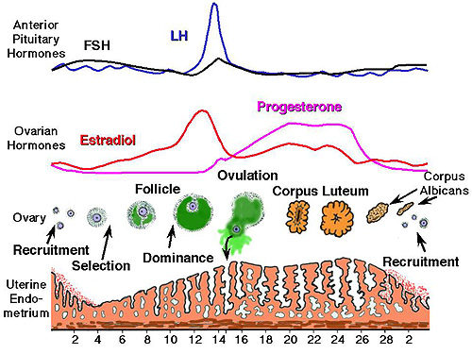

Slide 19
Normal menstrual cycle
The menstrual cycle (as well as AUB) should be described according to four specific symptomatic components (cycle frequency, duration, volume, regularity of cycle).

Slide 20
Normal Menstrual Cycle
Frequency of menses (or length of menstrual cycle)
Mean is 28 days +/- 7 days
menstrual cycle tends to shorten with age
initially irregular
Duration of menstruation
Normal 4.5–8.0 days; prolonged >8 days, shortened <4.5 days.
Mean is 5 days
As age increases, the duration of menstruation decreases
Volume of monthly menstrual blood loss (ml)
Mean 40 ml; heavy is >80 ml; light is <5 ml.
In women with no pre-existing menstrual problems, the normal amount of monthly menstrual blood loss (MBL) is 25–50 ml.
Regularity of menstrual cycle (cycle to cycle variation over 12 months, measured in days)

Slide 21
Menstrual Disorders

Slide 22
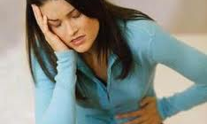
Dysmenorrhea: painful menses

Slide 23
Primary Dysmenorrhoea
Intrinsic, essential, Idiopathic
Usually begins with ovulatory menstrual periods
Most common medical problem in young women

Slide 24
Pathophysiology
Theories:
Uterine contraction and vasoconstriction
Modulation and stimulation of pain fibres
Psychological and behavioural causes

Slide 25
Clinical picture
Pain
Typically presents 6–12 months after menarche.
Pain is usually cramping in nature and occurs in the lower abdomen or pelvis but may radiate to the back or down the thighs.
It may commence before the onset of bleeding and usually lasts 8–72 hours.
Associated symptoms include nausea and vomiting, fatigue and headache.

Slide 26
Secondary dysmenorrhoea
Due to organic or psycho-sexual causes
Usually occurs years after the menarche & pain may occur throughout the luteal phase as well as during menstruation.
Deep dyspareunia may also be present
Causes
Endometriosis
Adenomyosis
PID
IUCD in utero
Pelvic adhesions
Fibroids (though not always causal)
Cervical stenosis (iatrogenic LLETZ/instrumentation)
Congenital abnormalities causing genital tract obstruction, e.g. non-communicating cornua

Slide 27

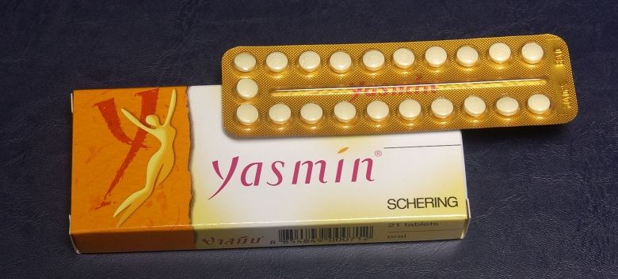
Management
Appropriate reassurance and analgesia
Symptom control:
• PGSI
mefenamic acid 500mg tds with each period is effective
COX-1, COX-2
• COCP to abolish ovulation
• data on Mirena IUS demonstrate benefit
• Paracetamol, hot-water bottles, etc., may be helpful for some

Slide 28
Treat any underlying causes:
• Endometriosis—COCP, progestagens, GnRH analogues
• antibiotics for PID
• relief of obstruction (usually surgical)
• Therapeutic laparoscopy: gold standard for diagnosis + management of endometriosis/adhesions/ PID

Slide 29
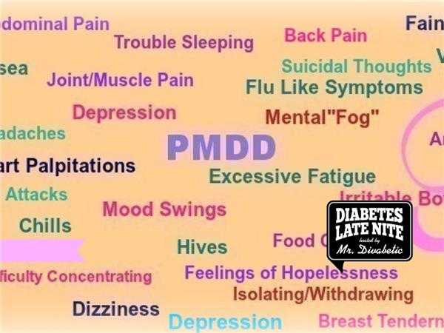
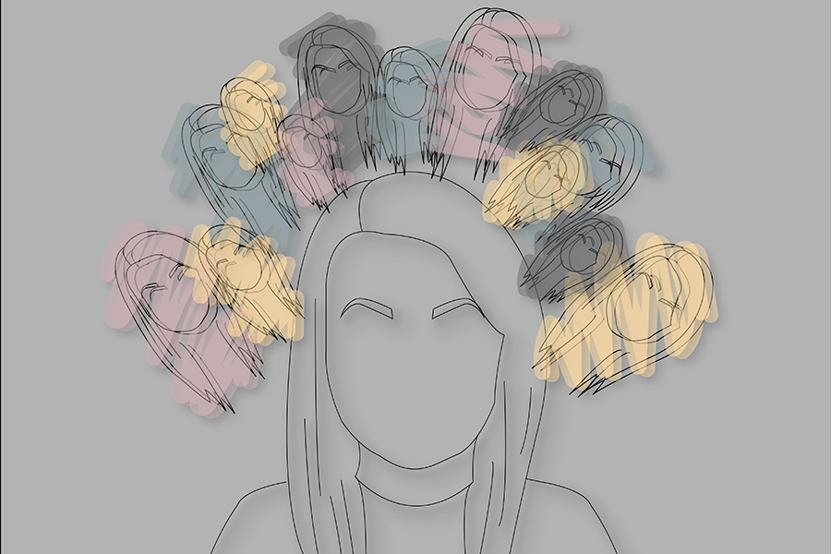

Slide 30
Premenstrual disorders
Premenstrual tension (PMT)!
Premenstrual syndrome (PMS)!
Most women experience a certain degree of premenstrual symptoms before menstruation.
Physiological when the severity of symptoms is not enough to have a serious impact on the quality of life, but is noticeable to the woman.
Symptoms occur in a cyclical nature with a symptom free week in the follicular phase.

Slide 31
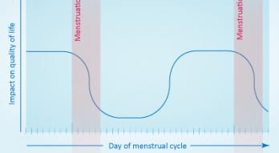
Physiological premenstrual symptoms (mild premenstrual disorder)

Slide 32
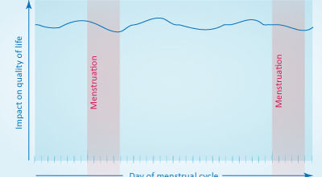
Symptoms are not cyclical require appropriate non-gynaecological treatment

Slide 33
Premenstrual disorders (PMD)
Impairment of daily activities and interpersonal relationships
Impact on many aspects of a woman's everyday life for most of their reproductive years
The International Society for Premenstrual Disorders (ISPMD)
Core and Variant

Slide 34
On the basis of the ISPMD, the criteria for diagnosing Core PMD include:
Cyclical
Symptoms resolved during or shortly after menstruation (1 week free from menstruation to ovulation)
Symptoms must be prospectively rated
Symptoms are not an exacerbation of an underlying psychological or physical disorder.
Impairment of daily activities including work, social interactions and family activities.

Slide 35
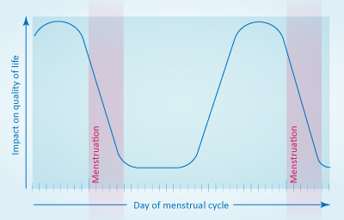
Core premenstrual disorder
Based on symptoms, core premenstrual disorders are further subdivided into:
Predominantly physical symptoms
Predominantly psychological symptoms
Mixed - both psychological and physical symptoms

Slide 36
Variant premenstrual disorder
Premenstrual exacerbation (PME)
Worsening underlying medical, psychological or physical condition (e.g. depression, diabetes, migraine, asthma, epilepsy, etc) during the premenstrual phase
Symptoms throughout the cycle, with worsening before and reduction after menstruation
Premenstrual disorder with absent menstruation
Hysterectomy, endometrial ablation or IUS
Progestogen-induced premenstrual disorder
Exogenous progestogens, e.g. HRT / hormonal contraception
Premenstrual disorder due to non-ovulatory ovarian activity (rare)

Slide 37
Symptoms and diagnosis
200 reported symptoms
Timing of these symptoms is more important than their character and severity
Prospective symptom rating over two consecutive menstrual cycles

Slide 38

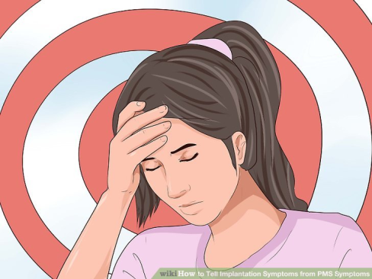
Clinical features
Physical symptoms:
breast tenderness or pain
abdominal swelling / bloating
headaches
skin disorders
weight gain
swelling of extremities (hands or feet or both)
joint pain, muscle pain, back pain.
Psychological and behavioural symptoms:
mood swings
Irritability/ anger, aggression
Anxiety/ depressed mood
Confusion/ tension
sleep disturbances
changes in appetite
fatigue, lethargy, or lack of energy
restlessness
poor concentration
social withdrawal/ not in control
lack of interest in usual activities
Loneliness/ hopelessness

Slide 39
Aetiology
Unknown
Following menstruation, women often report a positive mood leading up to and culminating around the same time as the estradiol peak prior to ovulation (Backström et al 1983). Therefore, it is thought that the corpus luteum produces a symptom-provoking factor (Backstrom 2011).
Concept of hormonal imbalance has been popular, but there is no supportive evidence/ hormonal profile same as asymptomatic
Women with PMS are more susceptible to their normal ovarian hormone cycle (especially progesterone). The increased sensitivity may be due to neurotransmitter dysfunction (possibly serotonin)

Slide 40
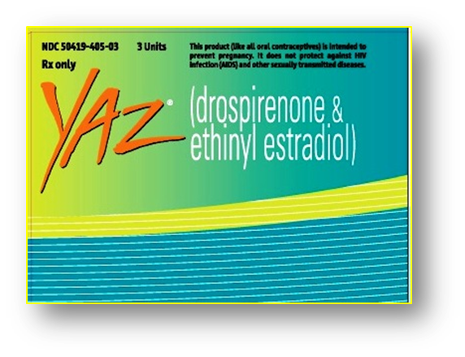

Treatment
Symptom-based treatment strategy
Mild- support, reassurance and good nutrition, exercise and stress reduction
Core- 2 approaches:
Suppression of ovulation
GnRha/ COCP/ Danazol/ Estrogen
Surgery
Treatment w/o suppression of ovulation
SSRI/ Diuretics
Non-pharmaceutical treatment
Herbal supplements
Cognitive behavioural therapy
Vitamin B6/ Calcium
Exercise

Slide 41
Heavy menstrual bleeding (HMB)
Clinically defined as menstrual blood loss (MBL) that is subjectively considered to be excessive by the woman and interferes with her quality of life.
Subjective assessment: combines information of sanitary protection usage, flooding, clots, duration of menstruation and the woman's personal opinion of her menstrual loss.
inaccurate
Objective assessment: does not improve clinical care and is not undertaken in modern clinical practice.

Slide 42
Causes of HMB
40–60% idiopathic
formerly termed DUB of ovulatory /anovulatory
Most HMB is due to a combination of coagulopathy, ovulatory or endometrial dysfunction
Pathological causes of HMB include:
uterine fibroids (20–30%)
uterine polyps (5–10%)
adenomyosis (5%)
endometriosis rarely presents as AUB, but is identified in <5% of cases of AUB
Gynaecological malignancy rarely presents as HMB, but can present as prolonged IMB, PCB, PMB and as a pelvic mass

Slide 43
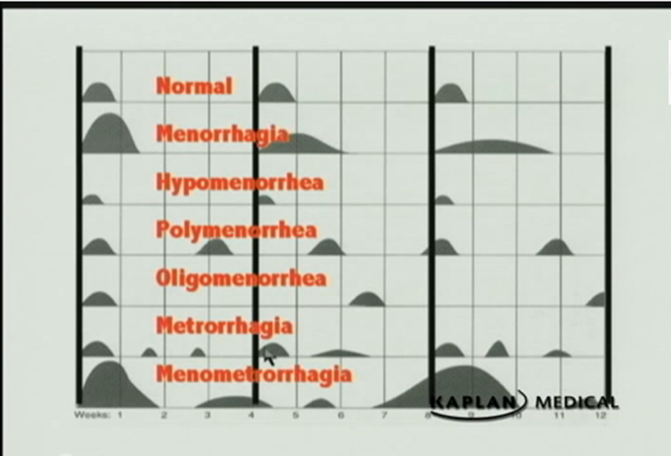
Old Terminology

Slide 44
Terminology to describe AUB
Terms to be kept in new terminology
Abnormal uterine bleeding (AUB) | Any menstrual bleeding from the uterus that is either abnormal in volume , regularity, timing or is non-menstrual (IMB, PCB or PMB)
Heavy menstrual bleeding (HMB) | subjective diagnosis as it is defined by the woman based on how it interferes with her quality of life.
Intermenstrual bleeding (IMB) | Uterine bleeding that occurs between clearly defined cyclic and predictable menses.

Slide 45
Postmenopausal bleeding (PMB) | Genital tract bleeding that recurs in a menopausal woman at least one year after cessation of cycles
Postcoital bleeding (PCB) | Non-menstrual genital tract bleeding immediately (or shortly after) intercourse
Chronic AUB | AUB has been present for the majority of the past 6 months.
Acute AUB | Excessive AUB bleeding that requires immediate intervention to prevent further blood loss. Acute AUB may present in the context of existing chronic AUB or might occur without such a history

Slide 46
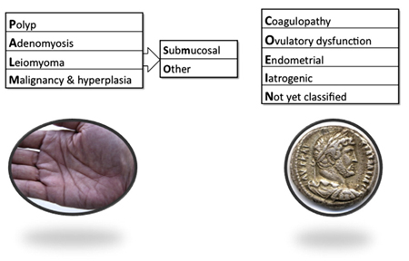
FIGO classification of the causes of AUB
R/O Pregnancy
New classification system PALM-COEIN:
• Structural causes for AUB: polyp; adenomyosis; leiomyoma; malignancy &hyperplasia
• Non-structural causes for AUB: coagulopathy; ovulatory dysfunction; endometrial; iatrogenic; and not yet classified.

Slide 47
Examples
Non-structural
C | Systemic coagulopathy, e.g. thrombocytopenia, von Willebrand's disease, leukaemia, warfarin
O | Disorders of ovulatory function, e.g. PCOS, CAH, hypothyroidism, Cushing's disease, hyperprolactinaemia
E | Primary endometrial disorders, e.g. disturbances of local endometrial haemostasis, vasculogenesis or inflammatory response (chronic endometritis)
I | Iatrogenic causes, e.g. combined oral contraceptives, progestins, tamoxifen, IUCD, traumatic uterine perforation
N | Generally rare causes, e.g. arteriovenous malformations, myometrial hypertrophy, sex steroid secreting ovarian neoplasm, chronic renal or hepatic disease, endometriosis

Slide 48
PMB
Causes of vaginal bleeding in postmenopausal women
Endometrial atrophy | 30%
Endometrial carcinoma | 8–10%
Polyps | 30%
Submucosal fibroids | 20%
Hyperplasia | 8–15%
Ovarian, tubal, cervical malignancy | 2%

Slide 49
IMB-causes
Infection
Endometritis/ Cervicitis/ Vulvovaginitis
Iatrogenic
Breakthrough bleeding/ Secondary to examination/smear test
Structural (benign)
Uterine/cervical polyps/fibroids
Ectropion
Vaginal adenosis
Structural (premalignant/malignant)
Uterine/cervical/vaginal/vulval cancer
CIN/VaiN/VIN
Ovarian estrogen secreting tumours
Natural
1–2% of women will have midcycle spotting, associated with ovulation

Slide 50
Endometrial polyps
Localised hyperplastic overgrowths of endometrial glands & stroma.
HMB, PMB, IMB & abnormal vaginal discharge
Large or multiple are implicated in subfertility
Diagnosis is achieved with USS, SIS & hysteroscopy.
Mx removed hysteroscopically in postmenopausal patient or >1cm in size in an asymptomatic premenopausal patient

Slide 51
Assessment
History
P/E
Investigations
Management

Slide 52

Symptoms
Heavy menstrual loss
Detailed history of the menstrual cycles/bleeding
IMB, PCB
Tiredness, weakness, or easy fatigability
Associated symptoms
Dysmenorrhea primary vs secondary
Dyspareunia endometriosis or PID
Pressure symptoms
Offensive vaginal discharge may be present in pelvic infections.
The influence patients lifestyle

Slide 53
Other relevant history
Detailed past gynaecological history contraception(&fertility plan), pap smear ..
Obstetric history
Past medical history
pre-existing bleeding tendencies/FH
Anticoagulant medications/ Tamoxifen
Weight gain, constipation, and hair loss suggest thyroid disorder.
Past surgical history may influence the treatment.
Risk of STI
Family history of gynaecological history

Slide 54
Signs
General examination
BMI
look for tachycardia, hypotension, and pallor
signs of hypothyroidism
bruises or gum bleeding
Abdominal examination
look for any tenderness or masses
• Tenderness - endometriosis or pelvic infection
• Large fibroids, endometriotic cysts, and tumours could present as abdominal masses.

Slide 55
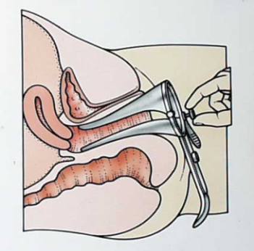
Speculum examination
look for any local cervical or vaginal lesions
Assess the severity of the blood loss
Bimanual examination
uterine size, shape, tenderness & mobility
• Enlarged uterus -fibroids / adenomyosis
• Restricted mobility - endometriosis and pelvic infections
• Tenderness – adenomyosis/ endometriosis/ PID

Slide 56
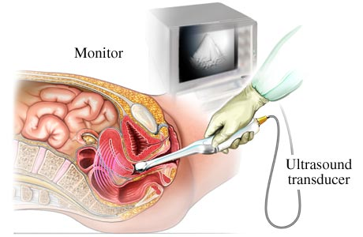
Investigations
TVS USS— good to identify fibroids , polyps, and measuring endometrial thickness.

Slide 57
Endometrial thickness ET
96% of postmenopausal women with endometrial cancer will have an endometrial thickness (ET) >4 mm
Women with PMB whose ET is <4 mm still have a 1–2% risk of having endometrial cancer.
endometrial biopsy is required if ET is:
>4 mm in postmenopausal women
May be selectively performed in postmenopausal women with ET <4 mm if other historical, clinical or sonographic risk factors are present.

Slide 58
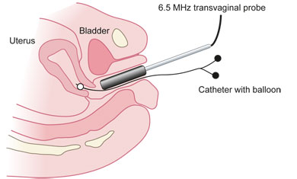
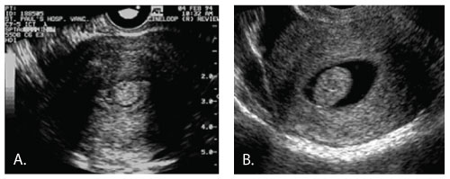
Saline infusion sonography(SIS)
Visualisation of uterine and endometrial pathology.

Slide 59
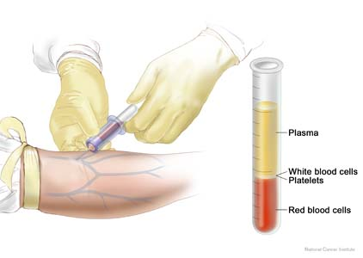
Investigations…….
R/O Pregnancy
• FBC (Hb + MCV).
• TFTs
clotting screens are not routine
• Cervical smears
• STI screen including Chlamydia.
• Endometrial biopsy to exclude hyperplasia or cancer

Slide 60
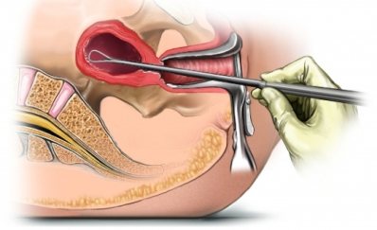
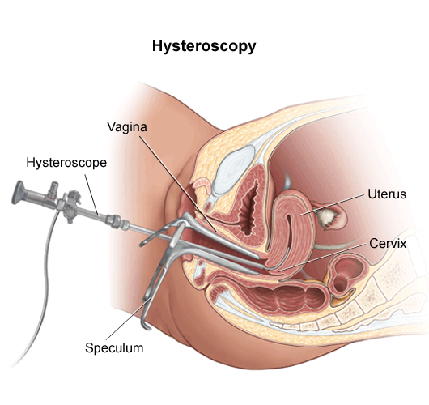
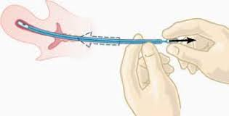
Endometrial sampling
D&C
Hysteroscopy
Pipelle

Slide 61
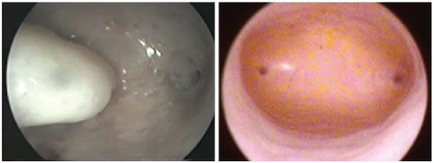

Slide 62
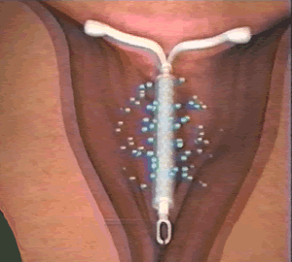
Treatment-Medical
Hormonal
Mirena IUS
levonorgestrel atrophic endometrium
Blood loss ↓ by up to 90% and ~ 30% will be amenorrhoeic at 12mths.
Provides contraception
▶ This IUS has resulted in a major ↓ in number of hysterectomies.
Progesterone from day 5 to 26 in a cyclical manner.
from day 15 or 19 to day 26 of the cycle
Cyclical progesterone for 21 days of the cycle results in a significant reduction in menstrual blood loss.
Combined oral contraceptive

Slide 63
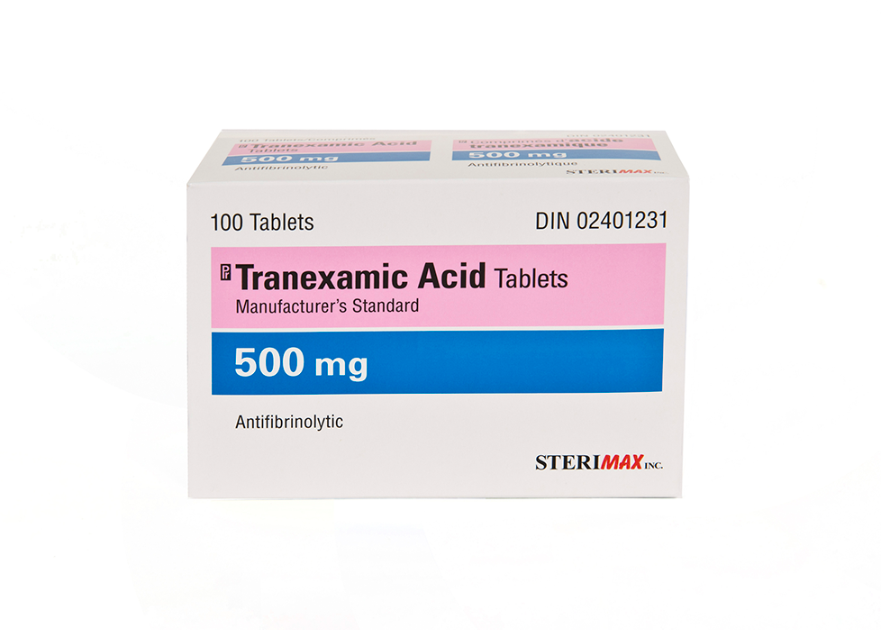

Non-hormonal
Antifibrinolytics: tranexamic acid 1g tds days 1–4 (50%↓ in loss)
NSAIDS: mefenamic acid 500mg tds days 1–5 (30-40 ↓ in loss and significant ↓ in dysmenorrhoea)

Slide 64
Surgical treatment
Endometrial Ablation
Hystrectomy

Slide 65
Age specific issues in evaluation:
Children
6 year old girl presents with bleeding

Slide 66
If there is AUB before menarche then a pelvic examination (usually under anaesthesia) should be performed.
D.Dx:
trauma, sexual abuse, assault or congenital malformations, malignancy.

Slide 67
Age specific issues in evaluation:
Adolescents
15 yr noted menarche at the age of 14 but has only had 3 or 4 periods since. She has missed school because of “massive bleeding”

Slide 68
Age specific issues in evaluation:
Reproductive Age
24 yr woman who can’t predict when her period will come and when it does it is very heavy. Some months it’s ok though.

Slide 69
Age specific issues in evaluation:
Perimenopausal
49 yr woman now with heavy irregular menses but they used to be “like clockwork”

Slide 70
Age specific issues in evaluation:
Post-Menopausal
69 yr woman, no vaginal bleeding for last 10 years noted two days of spotting like light period

Slide 71

Thank you

