Slide 1

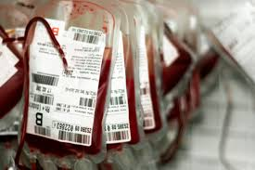

Obstetric Haemorrhage
Dr Fida Al-Asali

Slide 2
Obstetrics haemorrhage
Antepartum haemorrhage (APH)
Postpartum haemorrhage (PPH)

Slide 3
Antepartum Haemorrhage (APH)
Def.
Bleeding of the genital tract, occurring from 20 weeks of gestation until birth.
Epidemiology
2-5% of all pregnancies
3X commoner in multi than primiparous

Slide 4
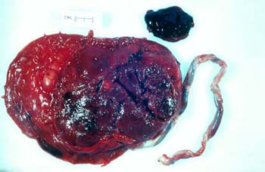
APH: Causes
Abruptio Placenta (30%)
Placenta praevia (20%)
Uterine rupture (rare)
Vasa Previa (rare)
Others
  Local causes cervical ectropion, polyp/trauma
  Genital tract tumours
  Unknown origin

Slide 5


NO PV

Slide 6
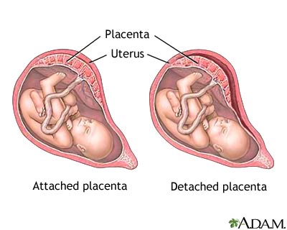
Placental Abruption
Def.
Premature separation of a normal-sited placenta from the uterus

Slide 7
Epidemiology
Prevalence in European countries is 3-6/1000 pregnancies and 70% of cases of placental abruption have been found to be in low-risk pregnancies.
Abruption is usually an unanticipated emergency
Bleeding is often concealed
Perinatal mortality rate 48%

Slide 8
Pathophysiology of placental abruption
2 potential mechanisms
acute inflammation & chronic vascular dysfunction
Bleeding begins in the decidua basalis and leads to the separation of the placenta from its attachment to the uterine wall
This separation can be partial and self-limiting or can extend until there is fetal hypoxia and, ultimately, demise.

Slide 9
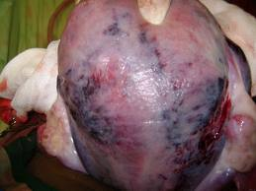
Couvelaire uterus
Bruised uterus

Slide 10
Clinical presentation of placental abruption
Vaginal bleeding–﻿ concealed or revealed
Abdominal pain– usually constant
Uterine contractions– abruptions can occur in labour or stimulate labour to begin
Fetal distress or intrauterine death
Disseminated intravascular coagulopathy – non-clotting vaginal bleeding, bleeding from drip sites and skin bruising.
Maternal circulatory shock

Slide 11
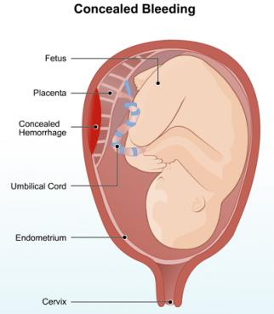
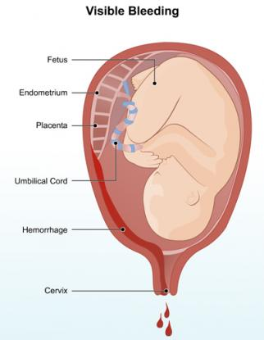

Slide 12
Examination findings of placental abruption
uterine tenderness
abnormal uterine contractions (e.g. hypertonic, high frequency) are found in 35% of cases
fetal distress
idiopathic premature labour is found in 25% of cases
fetal death is found in 15% of cases.

Slide 13
Classification is based on clinical presentations﻿:
Grade | Blood loss | Clinical features
1 | 150–500 ml | Retroplacental clot at delivery (may be incidental finding)
2 | Average retroplacental clot volume 150–500 ml 25% of patients can have a volume >500 ml | APH with classical clinical features: live fetus a vast majority (92%) present with fetal heart rate (FHR) abnormalities
3a | Coagulopathy | Fetal demise
3b | No coagulopathy | Fetal demise

Slide 14
Severe abruption
A retrospective study by Ananth (2016) defined severe abruption as an event accompanied by at least one of the following:
Maternal (DIC, hypovolemic shock, blood transfusion, hysterectomy, renal failure, or in-hospital death)
Fetal (nonreassuring fetal status, IUGR, or fetal death),
Neonatal (neonatal death, preterm delivery or small for gestational age)
Abruption cases that did not qualify as being severe were classified as mild

Slide 15
Abruption: Diagnosis
Clinical
Ultrasound
  Exclude placenta praevia
  Confirm GA
  Assess fetal viability/liquor
  Retroplacental haematoma may be recognised in 2–25% of all abruptions. Recognition of retroplacental haematoma (15% of cases)depends on the degree of haematoma and on the operator's skill level

Slide 16
Laboratory studies
Full blood count
Blood group and crossmatch
Urea, creatinine and electrolytes
Liver function tests
Fibrinogen concentration
Coagulation screen
Kleihauer–Betke test

Slide 17
Abruption: Risk factors
Previous abruption 10x, 25%
Folic acid deficiency
Cocaine
Smoking
Hypertension/PET
Thrombophilia
PROM
Multiple pregnancy
Social deprivation
Trauma
Advanced maternal age
First trimester bleeding
Low BMI
Pregnancy following assisted reproduction techniques

Slide 18
Maternal complications
Infection
Anaemia
Hypovolaemic shock secondary to haemorrhage
DIC
Acute renal failure
Couvelaire uterus
Postpartum haemorrhage
Ischemic necrosis of distal organs (adrenal, pituitary)
Feto–maternal haemorrhage
Psychological sequelae

Slide 19
Fetal complications
Intrauterine death(IUFD)
Hypoxia and its sequelae
Anaemia
Fetal growth restriction (IUGR)
Risks of preterm birth

Slide 20
Abruption: Management
Depends on
  Amount of blood loss
  Status of the fetus & mother
  Gestational age(GA)
Resuscitate as indicated
Conservative: consider Steroids
Delivery

Slide 21
Management
Maternal or Fetal Jeopardy
Term, stable, in labour
Preterm, stable
Emergency C/S
Vaginal delivery
Conservative in hospital/steroids

Slide 22
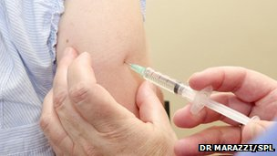
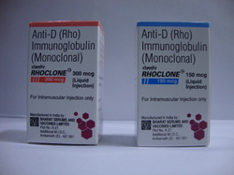
& if indicated
Anti-D

Slide 23
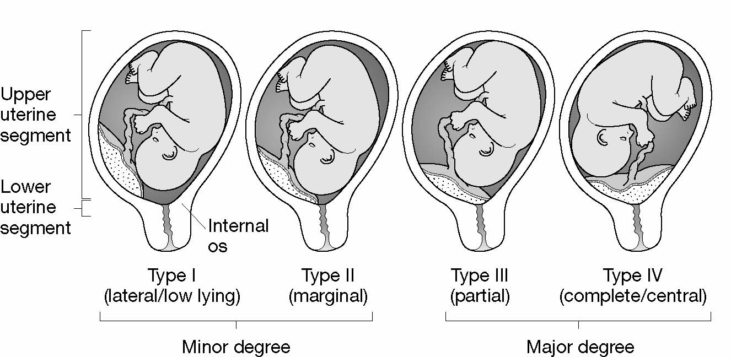
Placenta Previa
Def. Insertion of the placenta, partially or fully, in
the lower uterine segment

Slide 24
Placenta Praevia: grading
Grade I= minor praevia: Encroaches lower segment but does not reach cervical os
Grade II= marginal praevia: Reaches os but does not cover it
Grade III= partial praevia: Covers part of the os
Grade IV= complete praevia: Completely covers the os
Minor PP: grade I +II
Major PP: grade III + IV

Slide 25
Incidence
Variable depending on the population and the background caesarean section rate
Symptomatic placenta praevia 0.4 and 0.8%
Routine ultrasound examination
5–28% during the second trimester
Only 3% at term

Slide 26
PP: Risk factors
Hx of PP with a previous pregnancy
Uterine scars: previous C/S , D&C, myomectomy
Artificial reproductive techniques (ART)
Large placenta: multiple pregnancy
Abnormally shaped uterus
Age >35 (9x > 40yrs)
Asian
Smoking

Slide 27
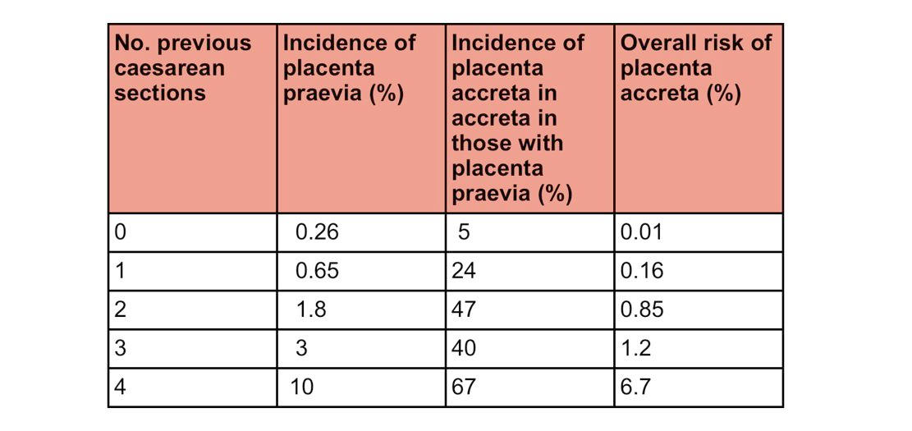

Slide 28
Symptoms
Vaginal bleeding
Painless (contrast with abruptio placenta)
Bright red (the blood is still oxygenated)
Variable in amount from 'spotting' to torrential/life-threatening
May be recurrent
Provoked by sexual intercourse or the onset of labour
Malpresentation 35% of cases(e.g. breech or transverse)
The fetus is usually well and in good condition

Slide 29
Signs
Shock- usually proportional to the amount of blood lost vaginally
Presenting part is usually high/non-cephalic
Soft and non-tender uterus
Digital vaginal examination is contraindicated
Speculum examination is useful if there is only slight bleeding (to exclude local causes). If there is heavy bleeding, a speculum examination is unlikely to be of use.

Slide 30
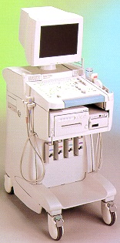
PP: Diagnosis
Ultrasound
  Transabdominal (TA) / Transvaginal (TV)
  Safe
  More accurate
  TV does NOT provoke vaginal bleeding
MRI
Expensive/not superior
may be considered in cases of suspected accreta when the ultrasound is inconclusive.

Slide 31
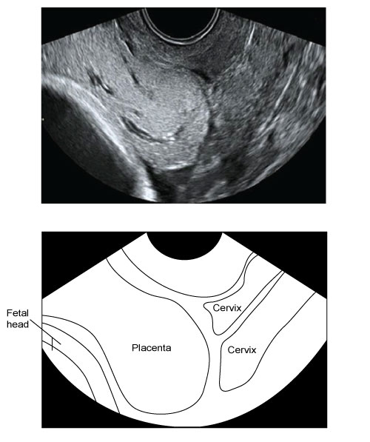
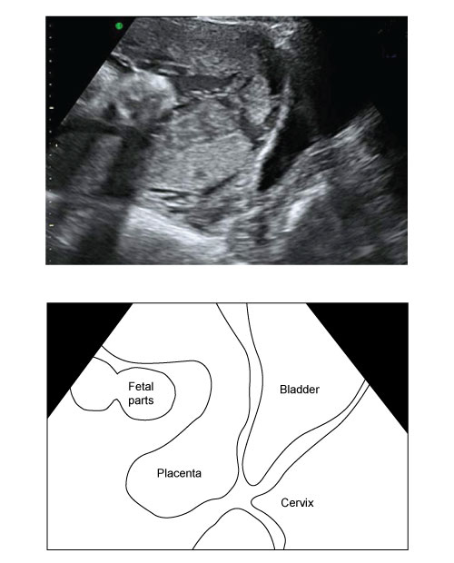
TV scan
TA scan

Slide 32
Management in the third trimester
Not all patients with placenta praevia will require in-patient management
Individualised
VTE prophylaxis
Manage antenatal anaemia

Slide 33
Management of PP
Maternal or fetal jeopardy
Preterm stable mum & fetus
Term, stable mum & baby
Emergency C/S
Conservative in hospital(steroids)
Elective C/S

Slide 34
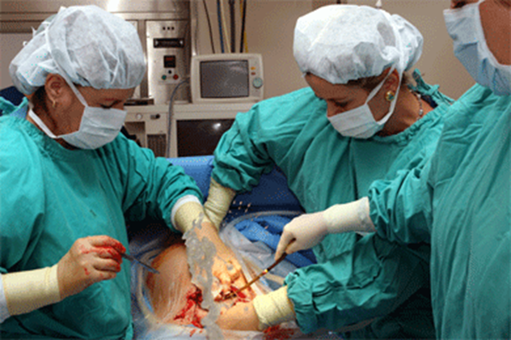
Timing of delivery
36 - 37 weeks
Indications for delivery before 37 weeks
Onset of labour
Fetal distress
Severe growth restriction
Intrauterine death
Severe bleed
In the case of suspected placenta accreta, delivery is advisable before 36–37 weeks of gestation.

Slide 35
Don’t forget
Anti-D

Slide 36
Morbidly adherent placenta
Abnormal invasive placentation that can be categorised by depth of invasion
Placenta accreta: chorionic villi attach directly to the myometrium in the absence of decidua
Placenta increta: placental villi invade deeper into the myometrium, but do not extend to the outermost layers of the uterus
Placenta percreta: chorionic villi penetrate through the myometrium up to the serosa

Slide 37
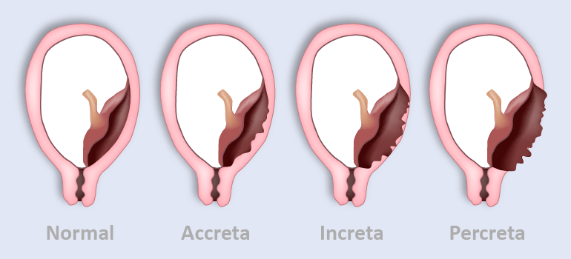
Placenta accreta spectrum

Slide 38
Vasa praevia
Def. Fetal vessels crossing the internal cervical os through the free placental membranes
1/3000 deliveries
60% of women with vasa praevia at delivery have placenta praevia or low-lying placenta identified during the second-trimester ultrasound scan

Slide 39
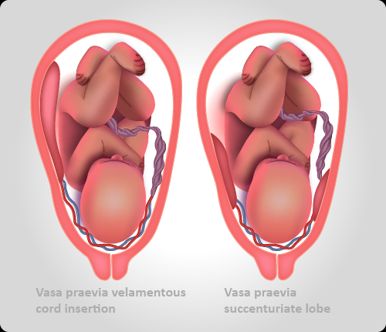

Slide 40
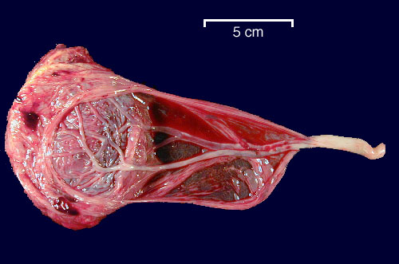
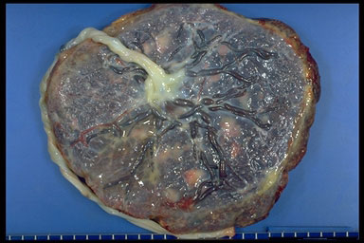

Slide 41
Vasa praevia: Diagnosis
Transabdominal and transvaginal colour Doppler ultrasonography
The classic triad of the vasa praevia
  Membrane rupture
  Painless vaginal bleeding
  Fetal bradycardia

Slide 42
Vasa Previa
Velamentous cord
Accessory placental lobe
Multiple pregnancy
IVF
Emergency C/S
Fetal death
From hypovolaemia
Risk Factors
Management
Complications

Slide 43
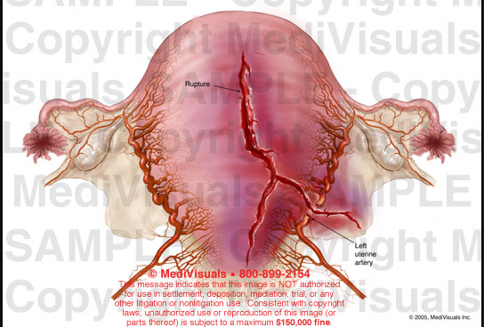
Rupture uterus
Def. full-thickness loss of integrity of the uterine wall and visceral peritoneum
0.5–2.0 / 10,000 unscarred uterus
7/10,000 VBAC

Slide 44
Risk factors
High parity
Previous uterine surgery
Induction or augmentation of labour
Hyperstimulation
Malpresentation
Macrosomia
Uterine abnormalities
Trauma including RTA & obstetric manoeuvres
5% risk of recurrence

Slide 45
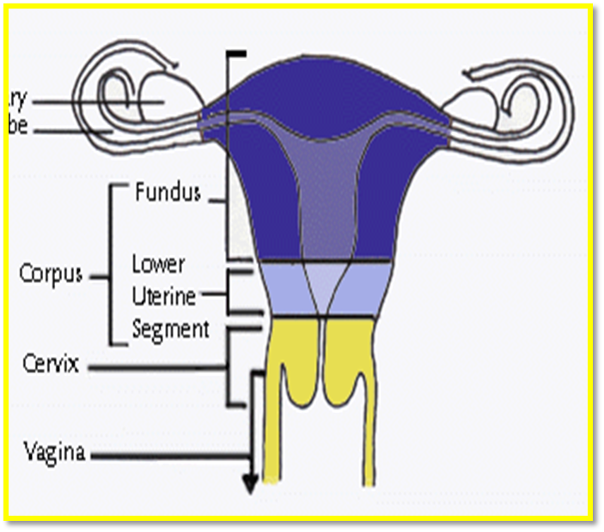
Unscarred uterus
0.5–2.0 / 10 000
Classical C/S 5%
LUSCS 0.5%

Slide 46
Signs and symptoms
Symptoms are often non-specific
Abdominal pain between uterine contractions
+/- bleeding
Loss of station(fetal head)
Inability to identify uterine contractions
Haematuria and blood-stained liquor
CTG abnormalities/ Lost FHR

Slide 47
Rupture uterus
Management
Complications
Uterine Repair
(hysterectomy)
Maternal & Fetal death

Slide 48
Clinical assessment for patients presenting with APH
Is urgent intervention required to manage maternal or fetal compromise?
Process of triage includes
History of pain
Extent of vaginal bleeding
Cardiovascular condition of the mother
Fetal wellbeing
Remember bleeding can be concealed!

Slide 49
Assessment of women presenting with APH
Rapid assessment of both mother & fetus
Quick history initially then detailed
Dates by scan/position of placenta
Amount of bleeding
Associated or initiating factors
Abdominal pain
Coitus
Trauma
Leakage of fluid
Previous episodes of bleeding
Previous uterine surgery
Smoking/drugs
Fetal movement
BG,Rh
Cervical smear

Slide 50
Maternal & Fetal assessment
Maternal
V/S
Abd: SFH, tenderness, lie & presentation
NO Vaginal examination until a placenta previa has been excluded
Assess bleeding

Slide 51
Maternal & Fetal assessment
Fetal
Establish if fetal heart is present or not
Make sure what you are hearing is not a
maternal heart rate as it can be tachycardic
If gestational age is> 26 weeks: CTG

Slide 52

"The APH weakens, the PPH kills"

Slide 53
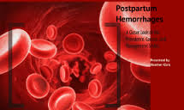
Post Partum Haemorrhage
(PPH)

Slide 54
Definition
The traditional definition of primary PPH is the loss of 500 ml or more of blood from the genital tract within 24 hours of the birth of a baby.
Primary postpartum haemorrhage (PPH) is either:
Minor – 500 ml to 1000 ml
Major – more than 1000 ml
Moderate (1000–2000 ml)
Severe (more than 2000 ml)

Slide 55
PPH: Definition?
Blood Loss
> 500 ml following vaginal delivery
OR
> 1000 ml following C Section
HCT drop of 10 %
or Need for blood transfusion
Incidence
5 % of all deliveries for primary PPH

Slide 56
Definition?
Excessive bleeding that makes patient symptomatic
Light-headedness, vertigo, syncope
Results in signs of hypovolemia
Hypotension, tachycardia, or oliguria
N.B: These changes will only occur after the patient has lost a significant amount of blood

Slide 57
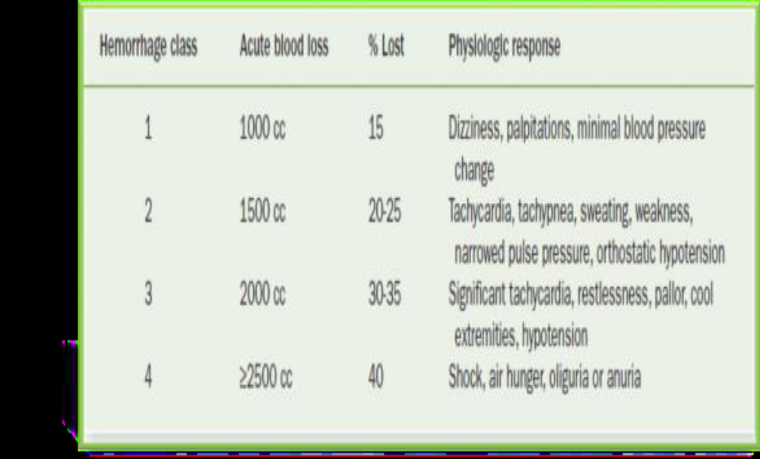
PPH Classification

Slide 58
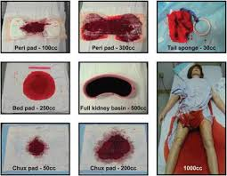
Diagnosis
Estimation of blood loss
1 ml of blood weighs approx one gm
Visual estimates underestimate by 33-50%

Slide 59
Primary vs Secondary PPH
Primary
PPH within 24 hrs
Secondary
excessive vaginal bleeding from 24 hours after delivery up to 12 weeks postpartum.

Slide 60

PPH: Major causes
Remember –PPH is not the diagnosis
4Ts: Tone, Tissue, Trauma,Thrombin

Slide 61
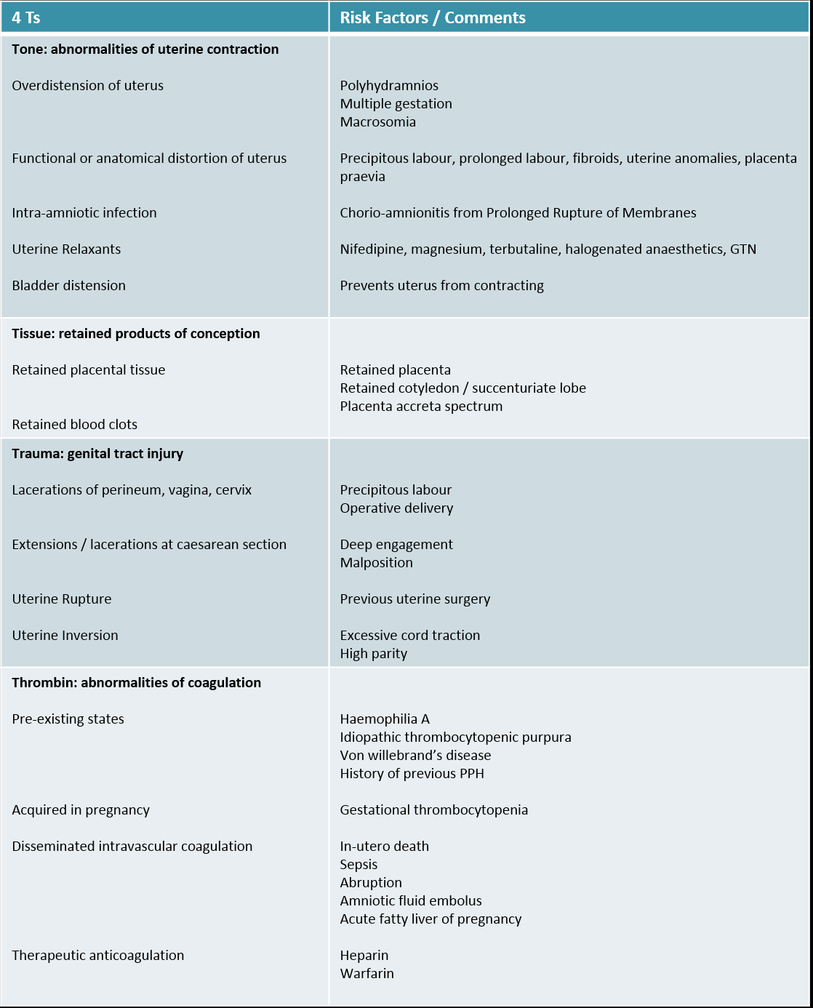

Slide 63
Secondary PPH
> 24 hours after delivery
Causes :
Endometritis
Retained placental tissue
Sub-involution of placental site
Pseudo-aneurysms and arteriovenous malformations (rare)

Slide 64

Prevention
Care plans should be modified accordingly.
Give birth is in a unit with a blood bank on site
Minimise risk in antenatal period
screen & manage anaemia
Minimise risk intrapartum
Active management: prophylactic uterotonics & controlled cord traction

Slide 65

Management
Team Work!
Multidisciplinary effort
OBs, RNs & Anaesthesiologists…..
Organize early
Involve other services as necessary
Lab, blood bank, ICU…
Professionals work in their fields of expertise

Slide 66


Management
Call for HELP
ABC
2 IV lines & Replacing blood loss, fluids
Bloods for CBC, clotting profile,…..
Cross match 4-6 units of blood
Palpate uterine fundus
Foley’s catheter
Uterotonic Medications:
Syntocinon
Ergometrine
Syntometrin
Haemabate
Misoprostol

Slide 67
Surgical Management
Examination under anaesthesia in theatre
Examine the vagina and cervix to rule out lacerations; repair if present
Explore the uterus to rule out retained placenta
Intrauterine balloon tamponade should be considered as a first-line surgical measure where atony is the main cause of haemorrhag

Slide 68
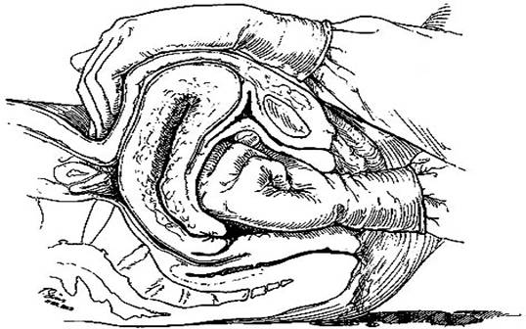

Slide 69
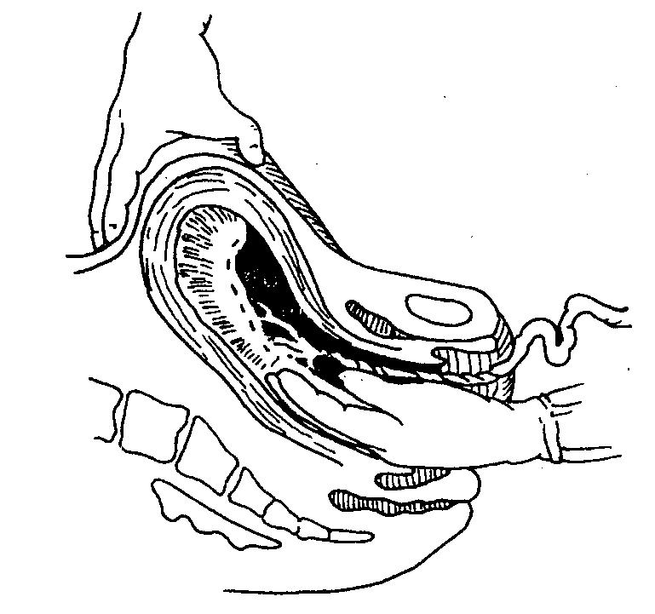

Slide 70
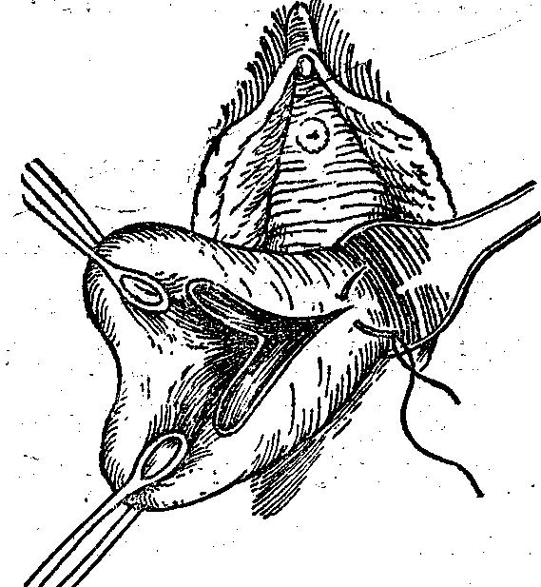

Slide 71
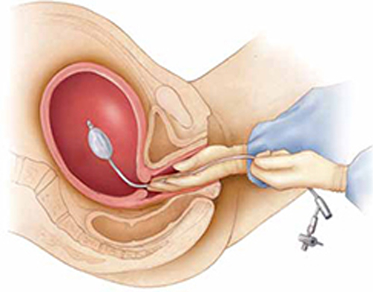
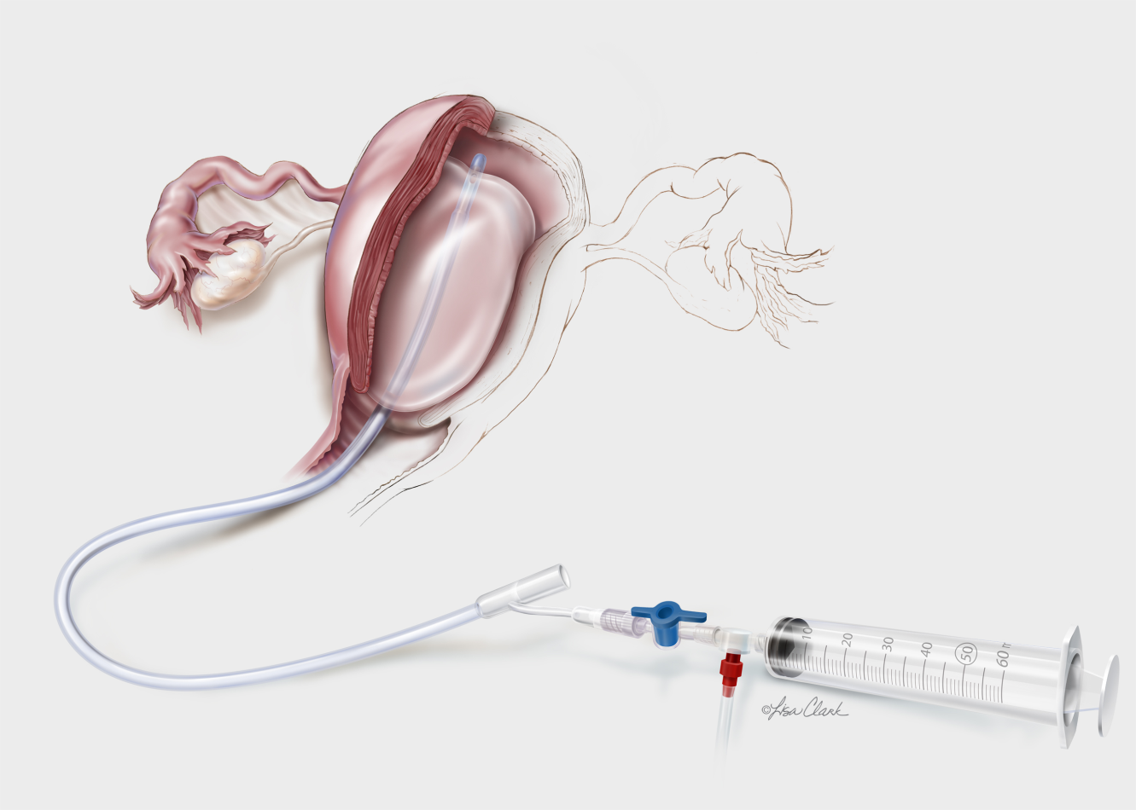

Slide 72
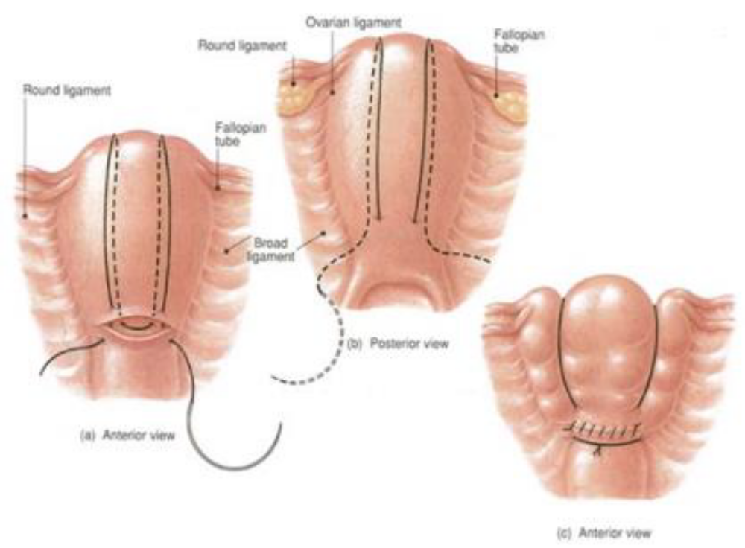
B- lynch suture

Slide 73
If a compression sutures are ineffective, then vascular ligation can be tried next.
Stepwise uterine devascularisation
Bilateral ligation of internal iliac (hypogastric) arteries

Slide 74
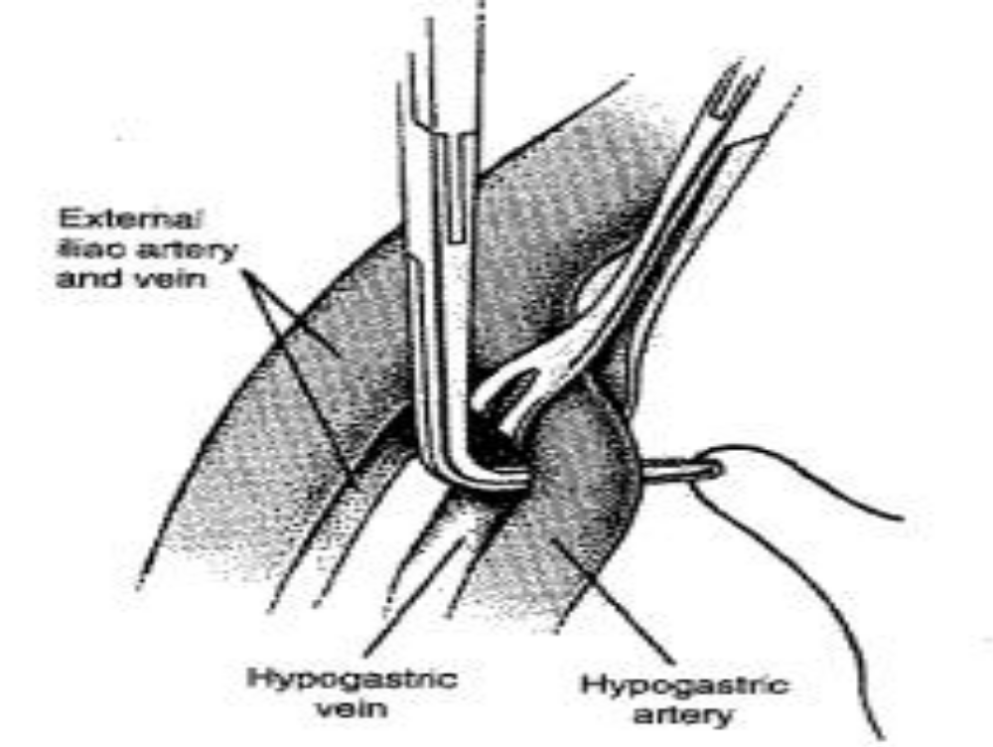

Slide 75
Consideration should be given to the use of tranexamic acid in the management of PPH

Slide 76
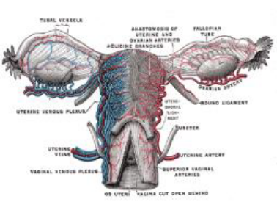
Arterial embolization
If the patient is stable and bleeding is not
“torrential”, and if interventional
radiology is available, then pelvic
arteriography may show the site of
bleeding and therapeutic arterial
embolization may stop bleeding

Slide 77

Recombinant Activated Factor VIIa (Novoseven)
Enhances platelet aggregation
Promotes clotting through extrinsic pathway (binds to tissue factor)
Complexes with TF activates Factor IX & X, & generates thrombin
Controls bleeding rapidly –10 minutes!
Adverse effects < 1%
Short ½ life (2 hours)
High cost

Slide 78
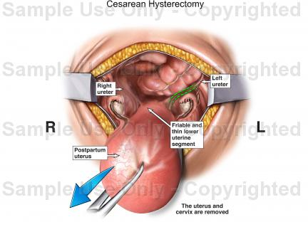
Hysterectomy
Definitive therapy –don’t delay!
Refractory atony
Irreparable uterine rupture/vessel lacerations
Placental invasion

Slide 79
Complications of PPH
Sheehan’s syndrome : Pituitary ischemic injury (necrosis of the anterior lobe of the pituitary gland)
Postpartum infection
DIC
Anemia
Transfusion hepatitis
Asherman’s syndrome

Slide 80
Documentation
Accurate documentation of a delivery with PPH is essential.
Debriefing
An opportunity to discuss the events surrounding the obstetric haemorrhage should be offered
to the woman (possibly with her birthing partner/s) at a mutually convenient time.

Slide 81
Stages in development of a DIC
Stage | Pathophysiology | Clinical | Labatory test
Stage 1 Hypercoagulable state | Activation of clotting factors and development of microthrombi | Hypercoagulation | Decresed clotting Inceased platlet adherence
Stage 2 Consumptive hypercoagulable state | Increased comsumption of platelets and clotting factors | Bleeding | Increased clotting Decreased platelets Greatly decreased fibrinogen
Stage 3 Secondary fibrinolytic state | Substantial formation of fibrin degradation products and plasmin | Marked bleeding | Increased thrombin time Decreased clot lysis time Increased fibrin degradation products

Slide 82
PPH: Remember
Active Mx of third stage decreases risk of PPH
Anticipate
Early identification of PPH with accurate estimation of blood loss is essential
Acute management requires a multi-disciplinary approach with the involvement of senior clinicians
Early transfusion and correction of coagulopathy is fundamental

