Slide 1
AUB discussion

Slide 2
Normal Menstrual Cycle
Parameter | Normal Limits (5th to 95th centile)
Frequency of menses (cycle length) | 24–38 days Cycle length is the number of days from the first day of bleeding in one menstrual cycle to the first day of bleeding in the next
Regularity | ≤7–9 days No more than between 7–9 days' difference between the shortest to longest cycles
Duration (days of bleeding in a single menstrual period) | ≤8 days
Volume (monthly blood loss) | Clinical definition is subjective and defined as a volume of menstrual blood loss that does not interfere with a woman's physical, social, emotional, and/or quality of life Normal volume is between 5–80 ml.

Slide 3
Abnormal uterine bleeding
Parameters | Terminology | Out with 5th to 95th centile
Frequency of menses (cycle length) | Absent | Amenorrhoea – primary or secondary
 | Infrequent | >38 days
 | Frequent | <24 days
Regularity | Irregular | Variation 10 days
Duration (days of bleeding in a single menstrual period) | Prolonged | > 8 days
Volume (monthly blood loss) | Heavy or light | Subjectively defined
Intermenstrual bleeding(IMB) | AUB occurs between well-defined cyclical menses
Postcoital bleeding (PCB) | Non-menstrual genital tract bleeding immediately (or shortly after) intercourse

Slide 4
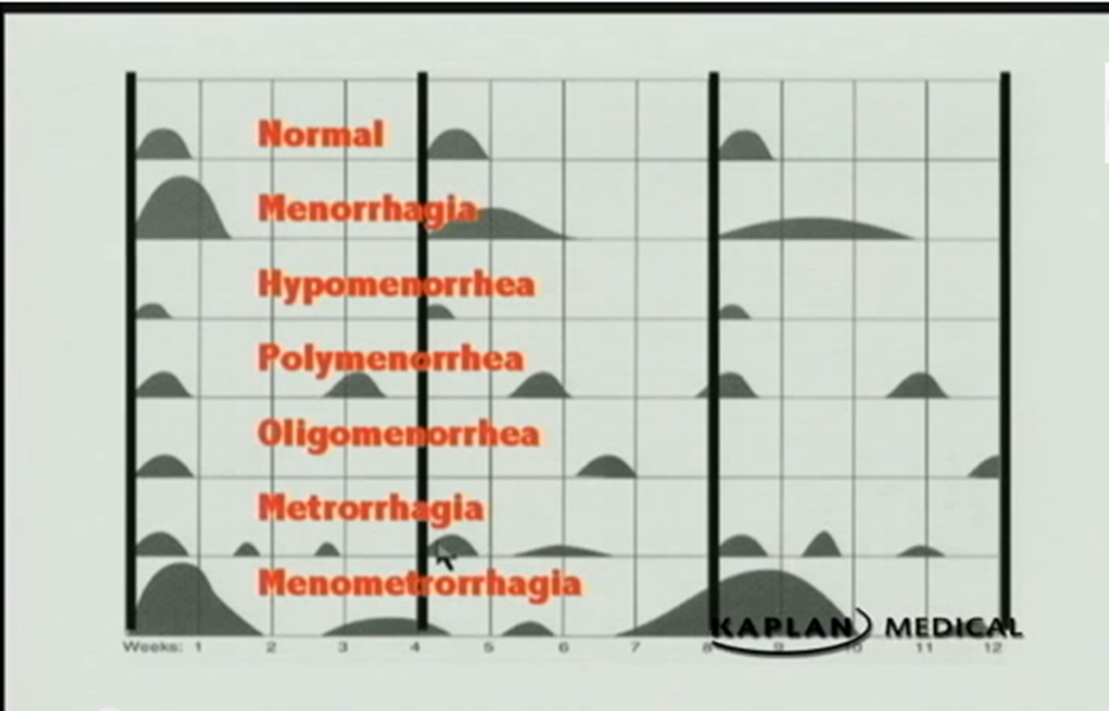
FIGO Committee for Menstrual Disorders recommends the following terms should no longer be used

Slide 5
Prevalence of AUB
Common
often chronic and debilitating
14–25% of women of reproductive age

Slide 6
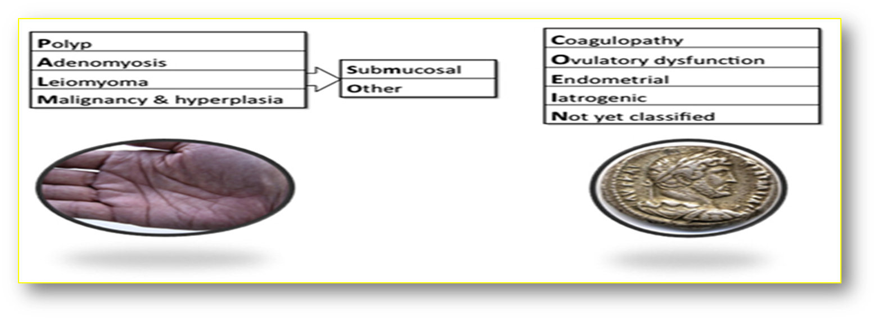
Causes of AUB

Slide 7
Assessment
History
P/E
Investigations
Management

Slide 8

Symptoms
Heavy menstrual loss
Detailed history of the menstrual cycles/bleeding
IMB, PCB
Tiredness, weakness, or easy fatigability
Associated symptoms
Dysmenorrhea primary vs secondary
Dyspareunia endometriosis or PID
Pressure symptoms
Offensive vaginal discharge may be present in pelvic infections.
The influence patients lifestyle

Slide 9
Other relevant history
Detailed past gynaecological history contraception(&fertility plan), pap smear ..
Obstetric history
Past medical history
pre-existing bleeding tendencies/FH
Anticoagulant medications/ Tamoxifen
Weight gain, constipation, and hair loss suggest thyroid disorder.
Past surgical history may influence the treatment.
Risk of STI
Family history of gynaecological history

Slide 10
Signs
General examination
BMI
look for tachycardia, hypotension, and pallor
signs of hypothyroidism
bruises or gum bleeding
Abdominal examination
look for any tenderness or masses
• Tenderness - endometriosis or pelvic infection
• Large fibroids, endometriotic cysts, and tumours could present as abdominal masses.

Slide 11
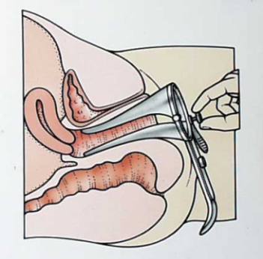
Speculum examination
look for any local cervical or vaginal lesions
Assess the severity of the blood loss
Bimanual examination
uterine size, shape, tenderness & mobility
• Enlarged uterus -fibroids / adenomyosis
• Restricted mobility - endometriosis and pelvic infections
• Tenderness – adenomyosis/ endometriosis/ PID

Slide 12
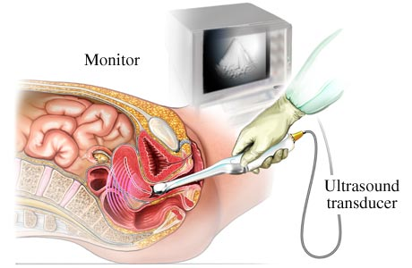
Investigations
TVS USS— good to identify fibroids , polyps, and measuring endometrial thickness.

Slide 13
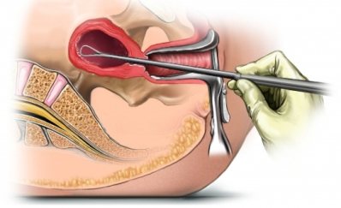
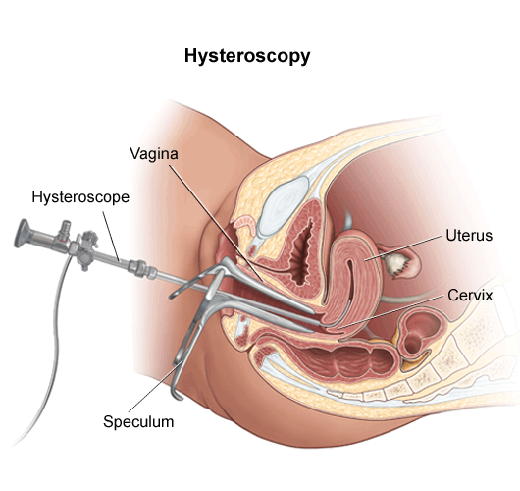
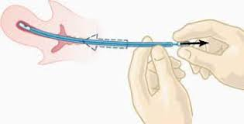
Endometrial sampling
D&C
Hysteroscopy
Pipelle

Slide 14
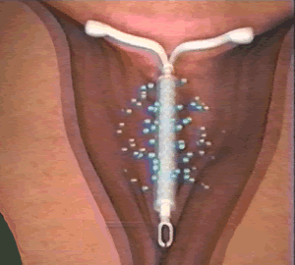
Treatment-Medical
Hormonal
Mirena IUS
levonorgestrel atrophic endometrium
Blood loss ↓ by up to 90% and ~ 30% will be amenorrhoeic at 12mths.
Provides contraception
IUS has resulted in a major ↓ in number of hysterectomies.
Progesterone from day 5 to 26 in a cyclical manner.
from day 15 or 19 to day 26 of the cycle
Cyclical progesterone for 21 days of the cycle results in a significant reduction in menstrual blood loss.
Combined oral contraceptive

Slide 15
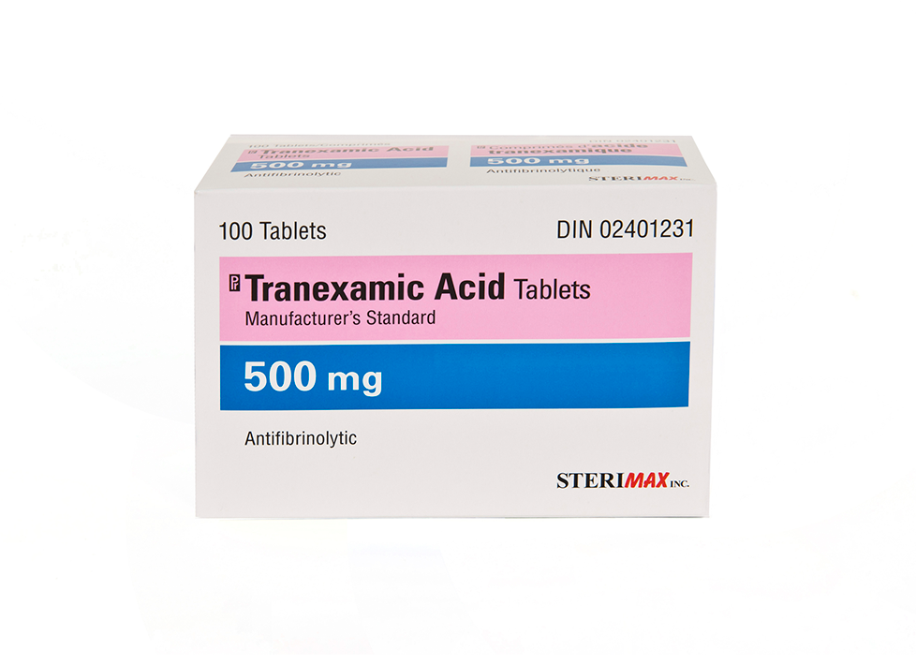

Non-hormonal
Antifibrinolytics: tranexamic acid 1g tds days 1–4 (50%↓ in loss)
NSAIDS: mefenamic acid 500mg tds days 1–5 (30-40 ↓ in loss and significant ↓ in dysmenorrhoea)

Slide 16
Surgical treatment
Endometrial Ablation
Hystrectomy

Slide 18
A 46-year-old woman has a 3-year history of worsening heavy menstrual bleeding (HMB) with regular cycles and dysmenorrhoea.

Slide 19
Adenomyosis
Adenomyosis is a benign, common gynaecological condition causing heavy, painful periods in premenopausal women who tend to be multiparous and between 40 and 50 years of age. Overall it is considered to contribute to approximately 10% of all cases of HMB and 30% of all cases of HMB with dysmenorrhoea.
It is defined histologically (usually on a hysterectomy specimen) as the presence of non-neoplastic endometrial glands and stroma in the myometrium. It is often associated with hypertrophy and hyperplasia of the myometrium surrounding the ectopic endometrial tissue.

Slide 20
On USS it is represented by an enlarged globular regular uterus with no fibroids, myometrial cystic areas and decreased myometrial echogenicity.
MRI diagnostic rates are higher than USS.
There are no serum markers available.
Management options include:
medical – mefanamic, tranexamic acid, COC, high dose continuous progesterones, GnRHa agonists and the Mirena LNG-IUS
uterus conserving – balloon ablation and uterine artery embolisation
Hysterectomy

Slide 21
Leiomyoma (fibroids)
Uterine fibroids are smooth muscle tumours of the uterus
Age-related and are a commonly occurring pathology.
Variable size from millimetres to tens of centimetres
Asymptomatic, heavy periods, pressure symptoms and occasionally pain.
Responsive to the female hormones (estrogen and progesterone), generally shrinking to a degree at menopause.
Site, size and number of fibroids are linked to the level of MBL.

Slide 22
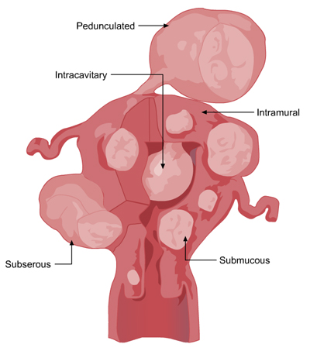
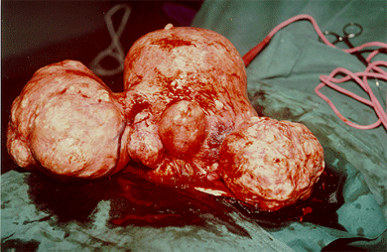

Slide 23
A 42-year-old woman presents with a 2 year history of AUB. She is nulliparous with a history of PCOS.

Slide 24
Ms Green, a 43-year-old nulliparous woman, presented with recent onset irregular menstrual bleeding. The bleeding was heavy and erratic with a variable cycle length of 24-48 days, with a duration between 4 and 12 days. Prior to this, her cycle had been regular.
Her periods were largely pain free. She is sexually active and no associated dyspareunia or postcoital bleeding. Her last smear had been normal. She used condoms for contraception. Ms Price herself felt well with no associated mood changes or hot sweats. She was a non-smoker.

Slide 25
Endometrial hyperplasia
Defined as a proliferation of glands of irregular size and shape with an increase in the glands/stroma ratio.
simple hyperplasia is a proliferative lesion with minimal glandular complexity and crowding with abundant stroma between glands
complex hyperplasia represents a proliferative lesion with severe glandular complexity and crowding as well as minimal stroma between glands.
Cytologic atypia refers to enlarged epithelial cells that are hyperchromatic with prominent nucleoli and an increased nuclear-to-cytoplasmic ratio. Cytologic atypia is the most important prognostic factor for progression to carcinoma.

Slide 26
< 2% of hyperplasias without atypia progress to carcinoma and the mean duration of progression to carcinoma takes almost 10 years.
Atypical hyperplasia progresses to carcinoma in 23% of cases over a mean duration of 4 years.
Importantly, endometrial cancer may co-exist in 30–50% of atypical endometrial hyperplasias.

Slide 27
A 66-year-old nulliparous woman who underwent menopause at 55 years complains of a 2-week history of vaginal bleeding. Prior to menopause, she had irregular menses. She denies the use of estrogen replacement therapy.
PMH is significant for diabetes mellitus controlled with an OHD
O/E BMI 35
BP is 150/90 mm Hg, Temp 99°F (37.2°C).
The heart and lung examinations are normal. The abdomen is obese, and no masses are palpated. The external genitalia appear normal, and the uterus seems to be of normal size without adnexal masses.
What do you call this bleeding?
What is your main concern?
What are the risk factors for this patient?
Which investigations will you arrange for?

