Slide 1

DR.Firas Al-Rshoud
Assistant Professor of Reproductive Medicine and Infertility

Slide 2

PCOS
Polycystic Ovary Syndrome

Slide 3
Stein and Leventhal : 1935
Since then our understanding of the
disorders involved in the condition has
evolved dramatically.

Slide 4
Significance and genetics
Common endocrine disorder
A leading cause of infertility
May have a profound adverse impact on the
health-related quality of life (HRQOL).
Tends to cluster in families, and multiple candidate genes have been implicated.
  Chromosome 19p13.3 as the likely candidate.
  The same chromosome responsible for premature
  male bolding

Slide 5
Prevalence
5-10% % of women worldwide, 25% of IVF patients.
higher in certain ethnic groups, e.g. South Asians
PCOS is higher in those with:
  gestational diabetes.
  premature adrenarche
  in those with first-degree relatives who have PCOS

Slide 6
Criteria for Defining PCOS
ESHRE/ASRM (Rotterdam) 2003
Two of the following in addition to exclusion of related disorders:
  Oligo and/or anovulation
  Hyperandrogenism and/or hyperandrogenemia
  PCO on U/S
  ≥12 follicles in each ovary, 2-9mm and/or ovarian volume (>10ml)
NIH, National Institutes of Health; ESHRE, European Society for Human Reproduction and Embryology; ASRM, American Society of Reproductive Medicine;

Slide 7
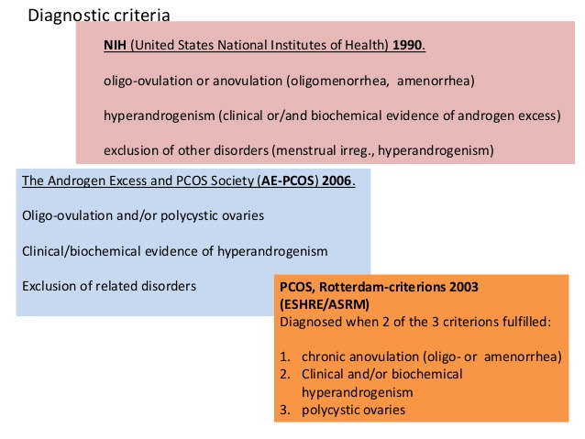

Slide 8
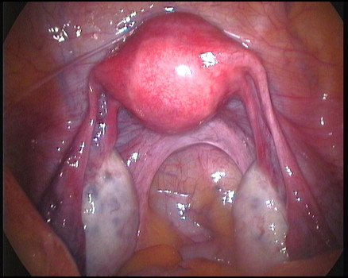
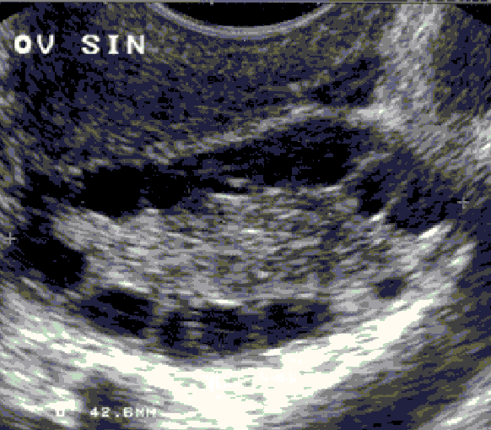

Slide 9
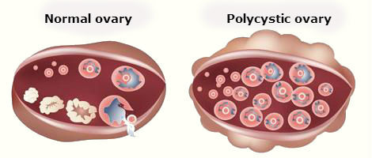

Slide 10
Aetiology
Unknown
PCOS is a multifactorial and polygenic....... A.D?? 40% family Hx.
..... Hyperinsulinaemia and hyperandrogenisim are in the heart of this condition!!!!!!

Slide 11
Pathophysiology
Dysfunction in ovarian function leading to increase androgen production....arising from exaggerated response of LH by theca cells and augmented by the effect of insulin binding to IGF-1&2( important regulator for follicular maturation and steroidogenesis)
Dysfunction in hypothalamic function leading to increased LH which stimulates androgen production
Insulin resistance... From physphorylation of tyrosine and serine residues on receptors ......leading to compensatory hyperinsulinaemia , that also ↓ hepatic production of IGF-1&2 BP....
that will ↑ the bioavailability of IGF-1&2

Slide 12
Insulin resistance
Insulin stimulates androgen production from ovary and adrenal and may alter gonadotrophin secretion.
SHBG synthesis in the liver thus free testosterone
In patients with PCOS, there is selective tissue insulin sensitivity (skeletal muscle is resistant but ovary and adrenal are sensitive).

Slide 13
Other manifestations of PCOS
Obesity
≥ 50% of PCOS patients
Metabolic syndrome
Type 2 Diabetes, HTN, dyslipidaemia, atherosclerosis & IHD
Dermatological
Hirsutism, oily skin, acne, alopecia
Acanthosis nigricans

Slide 14
Long term effects
Obesity
DM
Cardiovascular diseases.
Ca endometrium
PCOS and pregnancy
Hirsutism
Infertility

Slide 15
Obesity
≥ 50% of patients with PCOS
Most often a central obesity with an android appearance and an increased waist-to-hip ratio >0.8
Related to insulin resistance.
Women with PCOS find it more difficult to lose weight and appear to gain weight more easily.

Slide 16
Treatment of Obesity
Lifestyle changes
Pharmacological agents
1. Centrally acting serotonin & norepinephrine
uptake inhibitor, Sibutramine
2. Peripherally acting lipase inhibitor, Orlistat
Bariatric surgery

Slide 17
Work up
  TSH
  FBS and lipid profile
  PRL elevated in 40% of patients with PCOS, secondary to stimulation of the prolactin-producing cells by chronic oestrogen and not related to the cause of the disease state
  Free androgen index
  FSH and oestradiol to exclude the possibility of premature ovarian failure
    FSH should be elevated greater than 25 pg/mL.
    Associated with a suppressed oestradiol less than 30 pg/mL

Slide 18
Management of PCOS
Treatment depends on needs of patient and preventing long term health problems
Weight reduction results in improvement in all symptoms of PCOS ...... 10% wt. Loss will restore normal hormones level and spontaneous ovulation in 40% of women.

Slide 19
Ovulation induction
. Metformine.... Ovulation rate is 8%
Anti-oestrogens....e.g. Clomiphen citrate..
75% will ovulate within 6 months.
Gonadotropins ( Risk of M.P &OHSS 15% in PCOS vs. 0.3-5% non-PCOS)
Aromatase inhibitors...for clomid ROS ( 25%)
Pulsatile GnRH.....???????

Slide 20
Insulin sensitizing agents
Metformin
If MBI ≥ 25?????????, life long
Pregnancy rate 8%
Weight loss- controversial
Safe if continued into the 1st trimester, may decrease the risk of miscarriage in obese pts

Slide 21
Laparoscopic ovarian drilling
LOD
When medical Rx. failed
4 punctures , 2–4 mm deep in the cortex of each ovary. 40 W for 4 seconds
Ovulation rate of 80% & clinical pregnancy 60%
Mechanism unknown, destruction of luteinized follicles??
Thermal damage leads to release of inflammatory intra-ovarian cytokines

Slide 22
Cont.
. LOD has a similar outcome to Gonadptropins in term of Ovulation and pregnancy rate, but it’s preferred option because it is free of side effects of gonadotropins(MP&OHSS)
. Long term consequences......POF, no any evidence.
. Cheaper overall

Slide 23
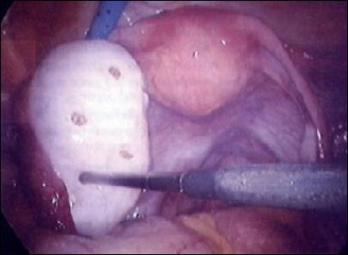

Slide 24
Thank you

