Slide 1

DR.Firas Al-Rshoud
Ass. Professor of Reproductive Medicine and Infertility.
Medical School of Hashemite University.

Slide 2

Introduction
Definition of early pregnancy : pregnancy until 12 weeks gestation.
Symptoms: amenorrhea, pain, bleeding and vomiting.
Differential Diagnosis: related to pregnancy or other ass. Conditions.
Investigations: Routine plus US scan ± serum βhCG

Slide 3
Differential Diagnosis | Symptoms
. Miscarriage .Ectopic pregnancy .PUL .GTD .Cervical polyp | Amenorrhoea, pain, bleeding
. Ectopic pregnancy .PID .IUD in-situ .Ovarian cyst in pregnancy .Appendicitis | Amenorrhea, acute pelvic pain
Hyperemesis gravidarum | Amenorrhea, vomiting

Slide 4
Early Pregnancy Complications
& Miscarriage
- Gestational sac increases by 1.3mm/day.
- Yolk sac should be seen next
(CRL 4-10mm) - Fetal pole (GS 18mm), FH at 6 weeks
Scan terminology : first scan report
1. Viable IUP
,GS ≤ 25 mm) 2. IUP of uncertain viability 10%(CRL <7mm
3- Miscarriage
4- Ectopic
5- PUL 10%

Slide 5
Management based on USS appearances
Plans of management | Diagnosis | US appearance
Rescan 1 week | IUP of uncertain Viability | GS≤25mm or CRL≤7mm and no FH
Manage as non-viable ???? Rescan 7-10 days | Empty sac | GS≥25mm and no FH or CRL≥ 7mm and no FH
Manage as discussed later | PUL | Empty uterus and no adnexal abnormality
 | Un-ruptured Ectopic | Empty uterus, adnexal mass and no fluid
Admit for assessment and surgery | Ruptred ectopic | Empty uterus, adnexal mass and fluid in POD

Slide 6
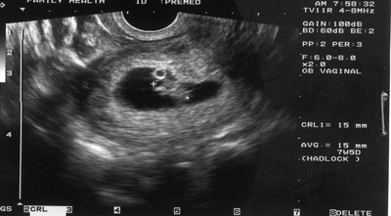

Slide 7
Human chorionic gonadotrophin βhCG
.Double approximately every 48 hrs up to 8 wks
.Increases ≤ 66% over 48hr is associated with EP and Miscarriage
.15% of normal pregnancy will have abnormal doubling time
.13% of ectopic pregnancy will have a normal doubling time
.Discriminatory zone 1000-2000IU/L at TVS
. MOST useful for : diagnosis of asymptomatic ectopic pregnancy

Slide 8
Miscarriage
.Vaginal Bleeding and/or Loss of pregnancy before fetal viability 24 weeks gestation(UK)
. Early miscarriage ≤ 12 weeks
. Late Miscarriage ≥ 12 weeks
.Bleeding complicate 21% of clinically detected pregnancies
.15% of clinically recognized pregnancies spontaneously miscarry

Slide 9
Aetiology
Genetic: 50% of clinically identifiable first trimester miscarriages are chromosomally abnormal. The risk falls with advancing G.A,the most common is Trisomy, followed by monosomy X and triploidy.
Second Trimester: Uterine abnormality, Cx. Weakness, bacterial vaginosis and multiple pregnancy.
Infection (rare) : lesteria monocytogenes, CMV, rubella andmycoblasma hominis.
Unexplained: 20% of miscarriages have no identifiable cause

Slide 10
Types of miscarriages
1- Threatened miscarriage
2- Missed miscarriage(early embryonic demise)
3- Incomplete miscarriage
4- Complete miscarriage
5- Septic miscarriage
6- Recurrent miscarriage

Slide 11
Threatened miscarriage
Any vaginal bleeding, painful or painless before 24 completed weeks
Management:
. U/S : majority will have viable pregnancy
. BG & Rh , Reassurance
.Speculum…..R/O local causes, confirm Dx.( closed Cx.)
Septic miscarriage
Occasionally, RPOC may become infected. Will present with general malaise, offensive v.discharge and fever
Management: Admission for IV antibiotics and surgical evacuations of the uterus

Slide 12
Continuo
Missed Miscarriage :This occurs when the embryo has died or has not developed normally.
Diagnosis: U/S when the G.S ≥ 25 mm in diameter with no identifiable embryo
or there is no FHB when CRL ≥7mm.
- This may be entirely asymptomatic
Incomplete miscarriage : this occurs when some of the product of the conception have been passed and some are left in the uterine cavity.
- Diagnosis: clinically if tissue seen passing through open Cx. Os or by U/S
!!! .Vagal shock…..removal of tissue from Cx. Os
Complete miscarriage : this is the endpoint of all miscarriages and implies that all product of conception have passed.
- Diagnosis is made clinically when bleeding stops and pregnancy symptoms disappear or on U/S when the uterine cavity is empty.

Slide 13
Management Options
a. Expectant
b. Medical
c. Surgical
. Patient makes specific request
. Changes mind during conservative management.
. Heavy bleeding and/or sever pain
. Infected tissue

Slide 14
Expectant
Requirements
-Motivation and preparation
-Thorough explanation on what to expect and what to do
-90% will miscarry within 3 weeks of expectant mang.
-Rescan 2-3 weeks, contact number of EPU.
-Complications
. Infection 3%( same Med. & surg.)
. Hemorrhage 3%

Slide 15
Medical management
Uterotonic agent to facilitate the evacuation of the uterus (i.e. misoprostol)
Associated with pain, bleeding, fever and diarrhea .
U/S : to confirm completion of miscarriage.
Efficacy for less than 10 weeks .....92-94%
C.I ..... Mitral stenosis, hypertension, haemogloinopathy, anticoagulation and asthma.
SMM....... Vacuum aspiration, E&C and D&C
Anti-D Ig.... For all threatened or spontaneous miscarriages ≥ 12 wks and all the miscarriages where the uterus evacuated surgically.
Antibiotics..... Not for all women , if clinically indicated.

Slide 16
Pregnancy of unknown location
PUL
Positive pregnancy test but no demonstrable IU or extrauterine pregnancy on TVS
. Very early IU pregnancy ...27%
. Complete miscarriage ...9%
. Early ectopic pregnancy...14%
50% likely to be failing pregnancy
Management:
. Serum hCG and repeat in 48 hrs
. Repeat TVS when hCG ≥ 1000 IU/L
. Follow-up until IUP identified, ectopic diagnosed or hCG spontaneously falls.

Slide 17
Recurrent pregnancy loss
Definition: Tow or more consecutive pregnancy losses ≤ 24 wks gestation.
Incidence: 1% of women suffer from recurrent miscarriage
Aetiology :
. Unexplained....majority will have no identifiable cause.
. Age..... Chromosomal abnormality
. Abnormal parentral karyotype...3-5% , balanced translocation in 2/3 and Robortsonian translocation in 1/3
. Antiphospholipid antibody syndrome...15% of R.M ..abnormal placentation.
. Genetic thrombophilia...up to 5%.... Activated protien C resistance, antithrombin ③ deficiency , protien C and S deficiencies.
. Uterine anomalies.....5% in infertility and up to 15% in RPL...... Septate uterus has the worst reproductive outcome

Slide 18
Clinical assessment
Investigation
. Karyotype for both partners
. HSG +- Hysteroscopy
. Pelvic U/S
. Antiphospholipid syndrome screen( Anticardiolipn abs, and lupus anti-coagulant...DRVVT)
, pro.C & S). activated protien C resistance, Antith.3). Thrombophilia screen

Slide 19
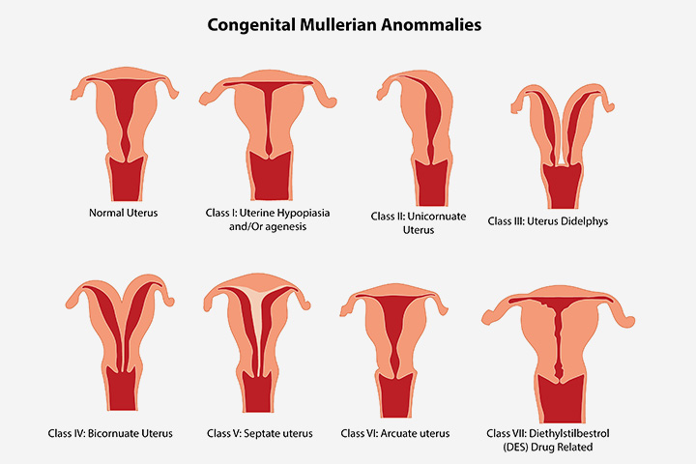

Slide 20
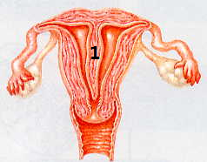
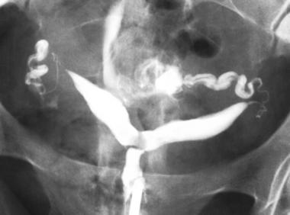
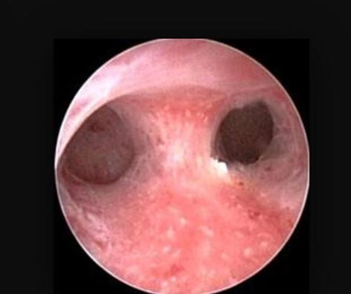

Slide 21
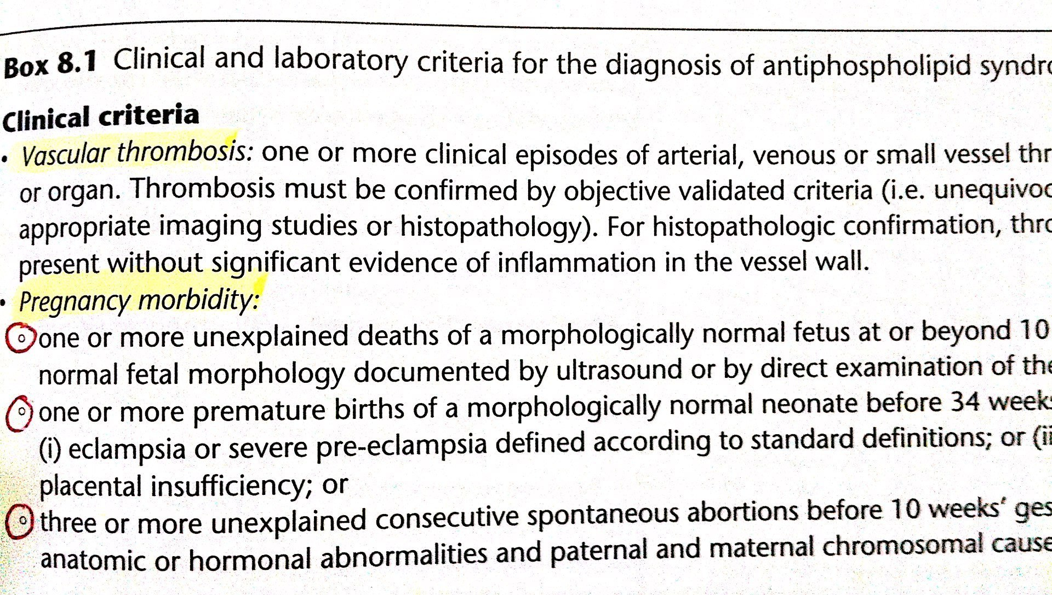

Slide 22
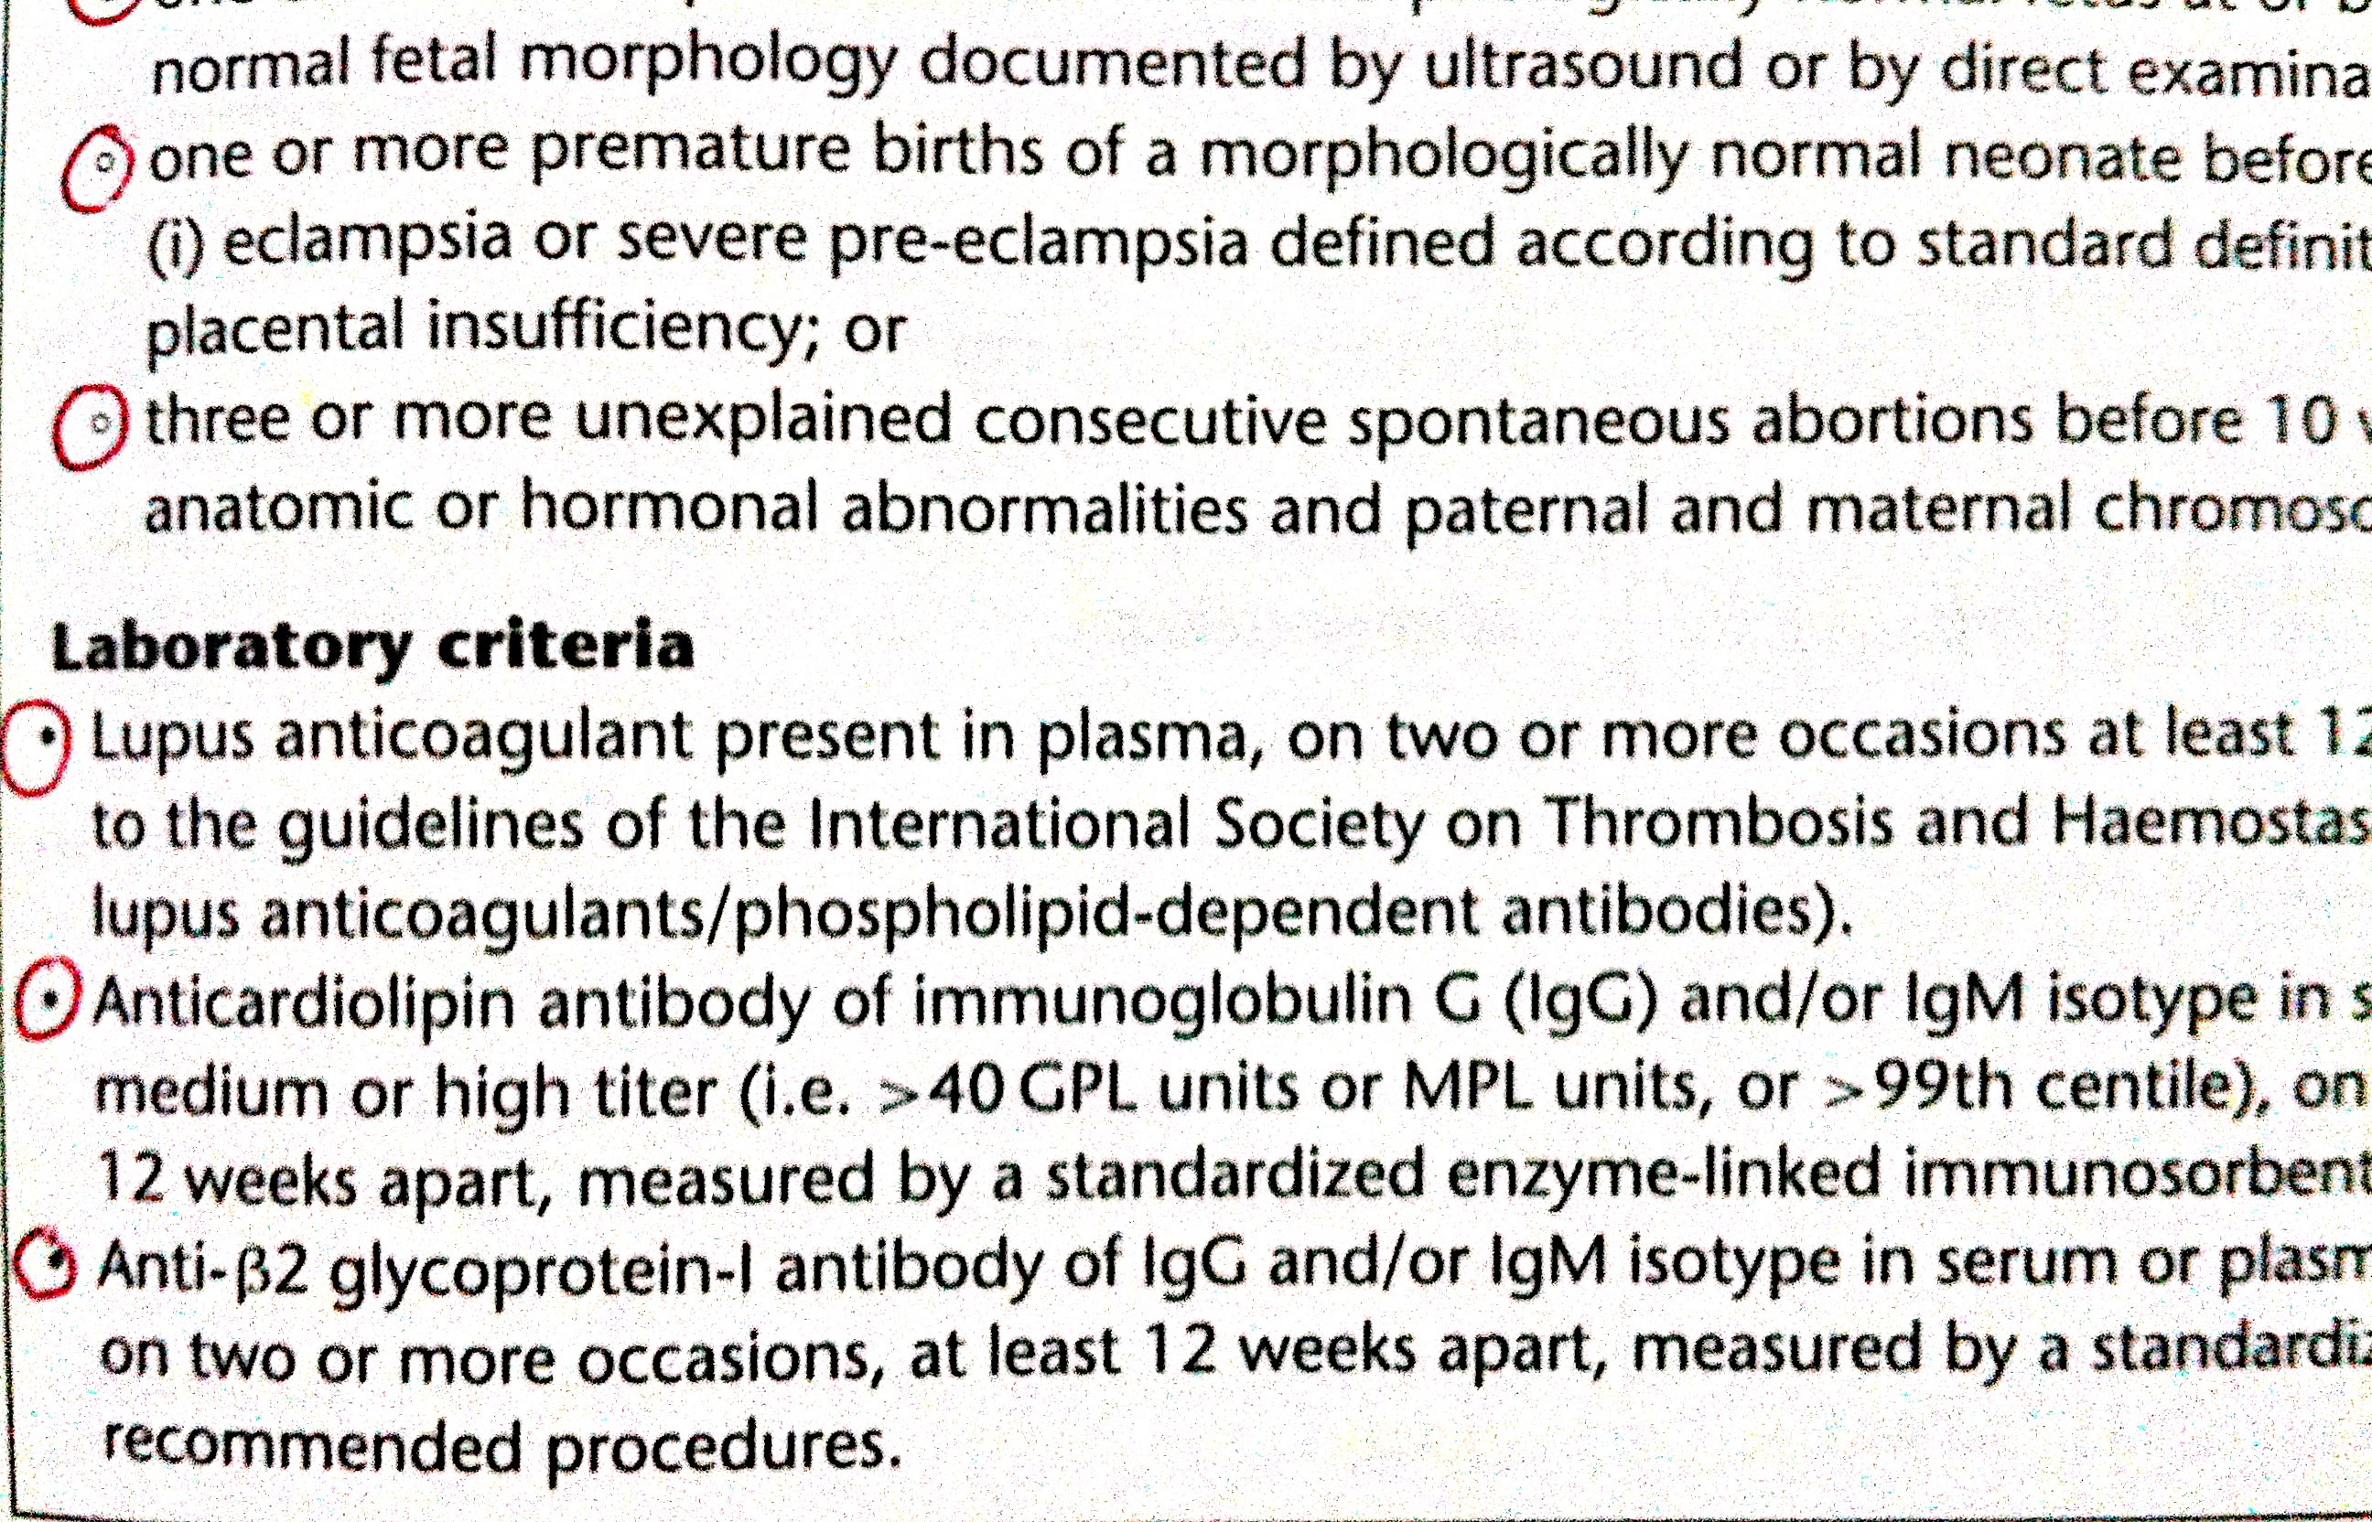

Slide 23
Management
- Parental chromosomal abnormality
. Refer to genetics for counseling, no Rx., PGD or PGS
- Antiphospholipid Ab. syndrome
. LMWT heparin and low dose Aspirin from positive FH (6 weeks)
LBR 70% Vs. 10% if untreated ..... S.E of long term heparin
- Congenital uterine anomalies
. Hysteroscopic resection of septum
-Unexplained
. 75% chance of LB following three consecutive miscarriages with no Rx.

Slide 24
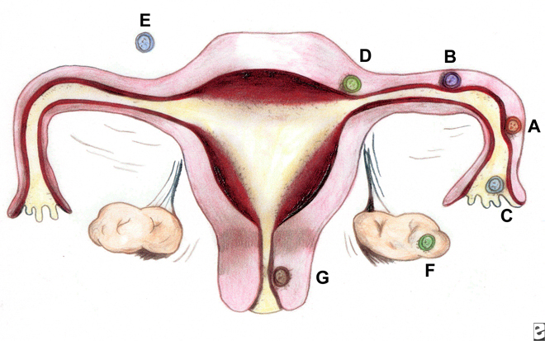
Ectopic pregnancy
11/1000 of all pregnancies (UK).
The fallopian tubes (approximately 97.7%)
-The ampulla is the most common site of implantation (80%), followed by the isthmus (12%), fimbria (5%), cornua (2%), and interstitia (2-3%).
-Cervix, ovary, cornual region of the uterus, and abdominal cavity.

Slide 25
Risk Factors:
1.Tubal damage
2.History of previous ectopic pregnancy
3.Smoking
4.Altered tubal motility
5.History of 2 or more years of infertility (whether treated or not)
6.History of multiple sexual partners….. PID
1 previous ectopic pregnancy … 50-80% IUP….
only the progesterone IUD has a rate of ectopic pregnancy higher than that for women not using any form of contraception. The modern copper IUD does not increase the risk of ectopic pregnancy
IVF increase the risk of EP 4 folds

Slide 26
Ectopic pregnancy can lead to
1.Massive hemorrhage
2.infertility
3.Death
Clinical triad
1. pain
2. amenorrhea
3.vaginal bleeding
Management:
1- Expectant
2- Medical( MTX)
3- Surgical

Slide 27
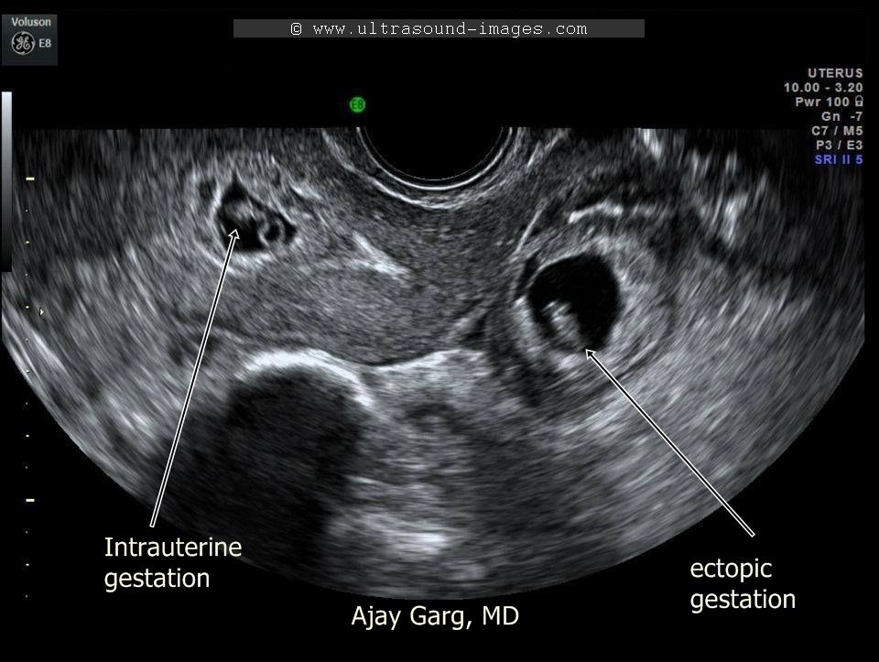

Slide 28
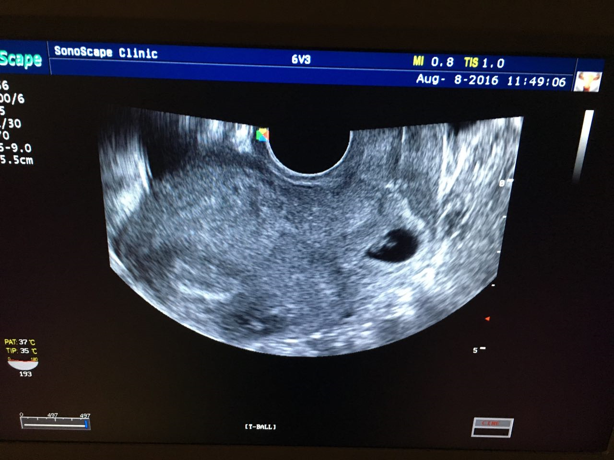

Slide 29
The End
Best of luck

