Slide 1

DR.Firas Al-Rshoud
Ass. Professor of Reproductive Medicine and Infertility.
Medical School of Hashemite University

Slide 2

Puberty
Definition: is the period between childhood and adulthood when reproductive and sexual development and maturation occurs.
Anatomical and Physiological Changes that occurs:
. Breast development(thelarche)
.pubic hair development(adrenarche)
.Axillary hair growth.
.Growth spurt.
.Onset of menstruation(menarche)
Demographic details
The average age is 12.3 years in African and 12.8 in Caucasian girls.

Slide 3
Physiology
-During childhood the hypothalamic-pituitary- ovarian axis remains quiescent..... GnRH, FSH and LH undetectable.
- Puberty initiated by intrinsic and extrinsic factors; heredity, race, ethnicity, gender, body weight, fat mass, nutrition and exercise level.
- Leptin, metabolic hormone from adipose tissue
- Breast and Pubic hair......Tanner stages.
-Between the ages of 7 and 9 years the GnRH secreted in pulsation of higher amplitude and frequency( initially nocturnally) ...FSH &LH secreted by pituitary, so it will , promote follicular growth and steroidogenesis in the ovary, that lead to breast budding, the first sign of puberty, and it precedes menarche by 2-3 years as it is only after the GnRH pulsation extend to daytime.

Slide 4
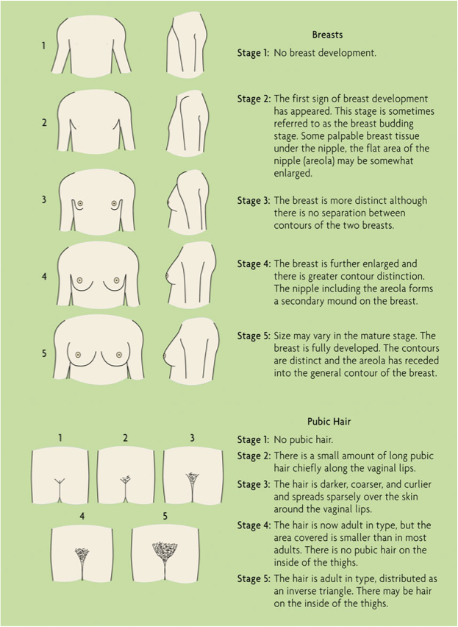
Tanner stages
-

Slide 5
Cont.
-Pubic hair in girls is dependent primarily on Adrenal androgen, so it is independent from pituitary-ovarian maturation. And usually follow thelarche by few months. The opposite can occur in African girls.
- During puberty ,and parallel to the adrenal and gonadal maturation, growth hormone production also rises. This leads to pubertal growth spurt.

Slide 6
Precocious Puberty
-Precocious puberty is defined as onset of pubertal development before the age of 8 years (girls) and 9 years (boys), incidence 1/10,000
-F:M ratio = 10:1
-Pathophsiology: it is classified as the following
1- Central, gonadotrophin-dependent or true PP
. 80% of cases
.may caused by brain tumours or CNS malformation.
. Majority of cases( 75% ) idiopathic
2- Peripheral precocious puberty or pesudopuberty
. 20% of cases.
. Pseudopuberty is always pathological and is caused by
A- Hormone-producing ovarian tumours
B- Exogenous administration of oestrogen
C- McCune Albright syndrome( poloyostotic fibrous dysplasia, café’-au-lait lesions and precocious puberty

Slide 7
Clinical evaluation
-Investigation
1- Serum gonadotrophin levels (FSH & LH ); these suppressed in peripheral and elevated in central.
2- Brain Imaging in case of central puberty, to detect lesion( e.g. a tumour or hahartoma)
3- Pelvic and abdominal imaging......ovarian or adrenal tumours.

Slide 8
Management
- Treatment is required to slow growth velocity and avoid early skeletal maturation. Furthermore, early development of sexual characteristic is distressing to a young girl.
- If it produced by surgical lesion...resection
-Pubertal development may be suppressed by GnRH analogues ( longer acting than endogenous GnRH) , when given continuously will lead to down regulation of receptors in pituitary that suppress FSH and LH.

Slide 9
puberty Delayed
Delayed puberty is the absence of all secondary sexual characteristics by the age of 14 years.
Pathophysiology:
It is caused either by a central defect or the result of non-functioning gonads. These classified as:
. Hypogonadotropic hypogonadisim
. Hypergonadotropic hypogonadisim

Slide 10
Pathophysiology
Hypogonadotropic hypogonadisim
No pituitary or hypothalamic stimulation of the gonad, and low FSH.
.Constitutional delay, often following a familial pattern
.Chronic illness, such as Diabetes, chronic renal failure or cystic fibrosis. Optimizing the underlying condition usually allows for puberty to progress
.Anorexia nervosa
. Excessive exercise
.Kallman’s syndrome
.Hydrocephalus or CNS tumour.
.Pituitary adenoma( usually prolactinomas)
.Panhypopituitarisim

Slide 11
Cont.
Hypergonadotrophic hypogonadisim
Non-functioning gonad with high FSH
.Abnormal gonadal development.
.Turner syndrome
.swyer syndrome
.POF
.Following chemotherapy or radiotherapy.
.Galactosaemia
.Autoimmune
.Infections

Slide 12
Management
Induction of puberty is usually achieved by administering small doses of ethinyal oestradiol i.e 2 microg.( 1/10 the COCP ), initially at night time. the dose increased at 6-monthly intervals until breakthrough vaginal bleeding occurs. At that point the girl should be started on a standard combined pills( oestrogen and progestogen ).
Hypogonadotropic hypogonadisim:
Pulsatile gonadotropins via subcutaneous pump or FSH and LH.
Long term hormone replacement is required ( COCP or HRT )

Slide 13
Kallman’s syndrome
Female 1/7500, F: M 7:1
. Genetics : X-linked disorder
.Pathophysiology :
Dysgenesis of the olfactory bulbs and abnormal development of GnRH neurons, which also originate from the nasal region during embryogenesis.
Clinical features:
.Delayed puberty
.Anosmia or hyposmia
.Commonly there are associated midline structural defect nd mental restriction.

Slide 14
Turner syndrome
.1/2500 live births, have female gender identity.
. 45XO, mosiaciasm 46xx,45xo
.Clinical features:
. Prenatal: cystic hygroma, non-immune hydrops and IUGR
.Postnatally:
1-short stature, 20 cm below the female average
2- gonadal failure( 1/3 occurs after menarche )
3-widely spaced nipple( shield chest)
4-short and webbed neck, low hair line
5-lymphoedema
6-Ass. Cardiac and renal anomalies( coarctation of the aorta and horseshoe kidney)
7-endocrine problems( hypothyrodisim and insulin resistance)

Slide 15
Cont.
Diagnosis
Karyotype, at least 20 cells should be examined because of likelihood of mosaicism.
Management :
1- Growth hormone to improve adult height
2- Induction of puberty
3-Long-term hormone replacement
4-Childbearing is possible with ovum donation

Slide 16
During week 6 of fetal life, the primitive gonads appear on the urogenital ridge, medial to the mesonephros, and the mesonephric (Wolffian) and paramesonephric (Müllerian) ducts develop. It has been suggested that Wolffian ducts act as a precursor/inducer for Müllerian formation or as a guide in the downward growth of the Müllerian ducts . By the seventh week, the SRY gene (the sex-determining region of the Y-chromosome) in male embryos stimulates gonadal differentiation into testes; these produce androgens and anti-Müllerian hormone, which promote the development of male internal genitalia from the Wolffian ducts, cause regression of Müllerian structures and cause virilization of the indifferent external genitalia. Conversely, absence of the SRY gene in female embryos allows the gonads to develop into ovaries. The subsequent lack of anti-Müllerian hormone causes regression of the Wolffian ducts and allows Müllerian ducts to develop into fallopian tubes, the uterus and upper vagina, while the lack of androgens permits differentiation of the indifferent external genitalia into the labia majora, labia minora and the clitoris. Müllerian development occurs separately from gonadal development, and women with Müllerian anomalies usually have normal ovaries and ovarian hormone production . By contrast, Müllerian development occurs in close association with the development of the urinary tract, and renal anomalies are commonly identified in those with Müllerian anomalies

Slide 17
Swyer syndrome
Genetics : 46 XY, Mutation in Sry gene in 10%, remaining unknown cause.
Clinical Features:
. Gonadal dysgenesis, failure of testes to develop in embryonic life, no testosterone or AMH is produced.
. External genitalia of female.
. Uterus and fallopian tubes are present
. Absence of pubertal development
.Tall stature
. 30% risk of development a gonadal malignancy(Dysgerminoma), at any age
Diagnosis: Karyotype, assessment of Sry mutation
Management :
1- Induction of puberty
2- Gonadectomy as risk of malignancy
3- Long-term hormone replacement
4-Childbearing is possible with ovum donation

Slide 18
The End
Keep reading

