Slide 1
Normal labor and delivery:

Slide 2
Contents:
Introduction.
Mechanical factors of labor.
Stages of labor.
Labor management.

Slide 3
Introduction:
Labor: the process whereby the fetus and the placenta are expelled from the uterus, normally b\w 37 - 42 weeks.
Diagnosis: when painful uterine contractions accompany dilatation and effacement of the cervix.
Divided into stages.

Slide 4
Normal labor:
Spontaneous on onset ( not induced or augmented).
Low risk.
Infant is born spontaneously (without instruments or vacuum).
In vertex position.
Between 37 - 42 completed weeks+of average birth weight (between205kg-4kg).
With no complications with/without episiotomy.
(episiotomy is not a criteria in normal labor)

Slide 5

Mechanical factors of labor:
Three determine progress:
The power.
The passage.
The passenger.

Slide 6
The powers:
Once labor established, the uterus contracts for 45–60 seconds about every 2–4 minutes.(this the definition of effective uterine contraction)
Irregular, painless, of mild intensity contractions of uterine smooth muscle occur throughout the third trimester and are often felt as Braxton Hicks contractions, not result in cervical changes.

Slide 7
The passage:
The bony pelvis(true pelvis):
Three planes:
1 - Inlet:
the transverse diameter is about 13 cm, antero-posterior (AP) diameter 11 cm (transverse is larger than AP)
2 -The midcavity:
is almost round, the transverse and AP diameters are similar. (area of smallest diameter, and we feel ischial spine in this area. Also it’s the area where most of arrest of progress happens and the area where in which we can say the fetal head is engaged or not.)
3 - The outlet:
the AP diameter (12.5 cm), transverse diameter (11 cm). (AP larger than transverse)
In the lateral wall of the mid-pelvis, ischial spines are palpable vaginally. Used as landmarks to assess the descent of the head on vaginal examination, STATION.
Measured in centimetres in relation to the spines.
variety of pelvic shapes have been described.

Slide 8
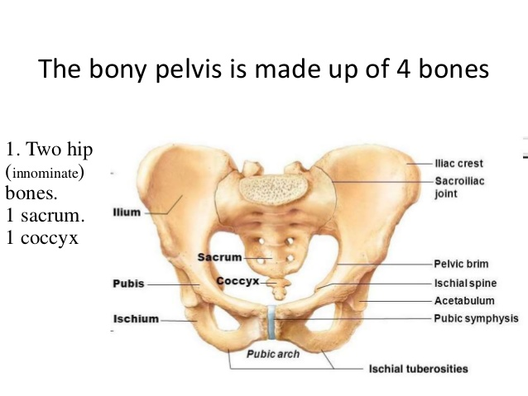

Slide 9
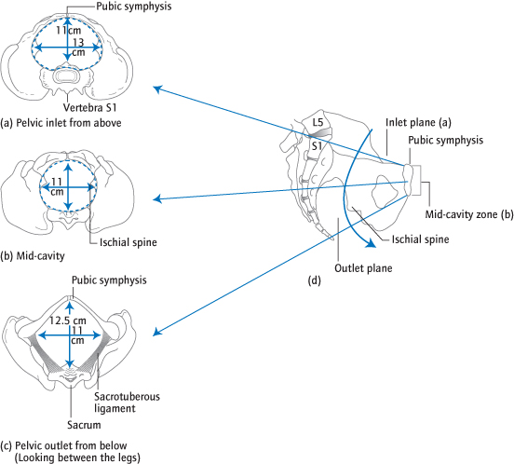

Slide 10
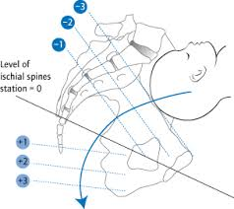
Station: the level of the presenting part above or below the plane of the ischial spine.
Engagement: when the widest diameter of the fetal presenting part has passed through the pelvic inlet.

Slide 11
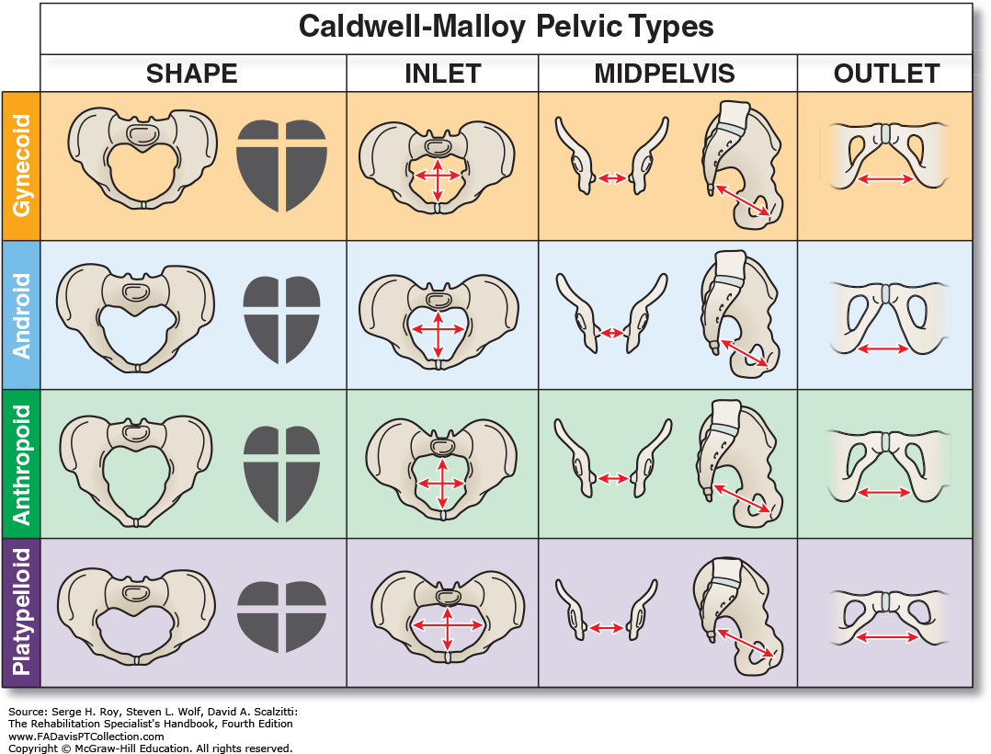

Slide 12
The passage:
Soft tissue:
The soft tissues of the vagina and perineum in the second stage.
The perineum often tears or is cut (episiotomy) to allow the head to deliver.

Slide 13
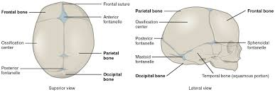
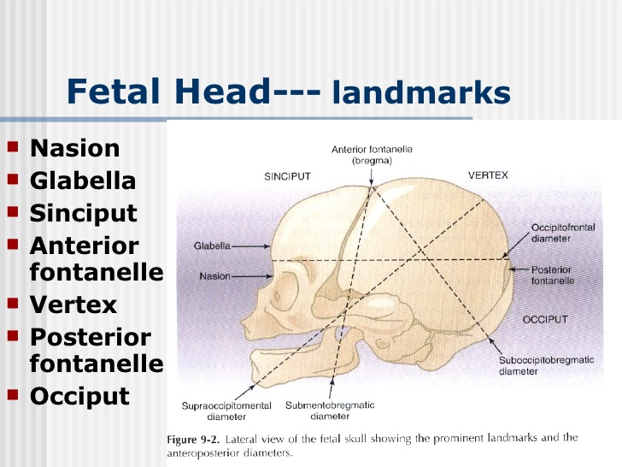
The passenger:
The fetal head is the largest and least compressible part of the fetus.

Slide 14
Notes:
1) The cranial bones at birth are thin, weakly ossified, easily compressible, and interconnected only by membranes. These features allow them to overlap under pressure and to change
shape to conform to the maternal pelvis, a process known as molding.
2) Minimal molding is normal, but excessive molding is a sign of obstruction.
3) The posterior fontanelle closes at 6 to 8 weeks of life and its Y- or T-shaped and found at the junction of the sagittal and lambdoid sutures.
whereas the anterior fontanelle(bregma) does not become ossified until approximately 18 months. This allows the skull to accommodate the tremendous growth of the infant’s brain after birth.
Bregma is found at the intersection of the sagittal, frontal, and coronal sutures. It is diamond-shaped, measures approximately 2 ×3 cm, and is much larger than the posterior fontanelle. The posterior fontanelle

Slide 16
1. Nasion: the root of the nose
2. Glabella: the elevated area between the orbital ridges
3.Sinciput (brow): the area between the anterior fontanelle and the glabella
4. Anterior fontanelle (bregma): diamond-shaped
5. Vertex: the area between the fontanelles and bounded laterally by the parietal eminences
6. Posterior fontanelle (lambda): Y- or T-shaped
7. Occiput: the area behind and inferior to the posterior fontanelle and lambdoid sutures

Slide 17
Terms describing the fetal head:
Presentation: the part of the fetus that occupies the lower segment or pelvis, i.e. head (cephalic) or buttocks (breech)
Presenting part: the lowest part of the fetus palpable on vaginal examination: For a cephalic presentation, this can be the vertex, the brow or the face, depending on the attitude.
Position : the degree of rotation of the head on the neck. occipito-transverse (OT), occipito-posterior (OP) or occipito-anterior (OA)
Attitude of the head describes the degree of flexion:
(vertex, brow or face.)

Slide 18
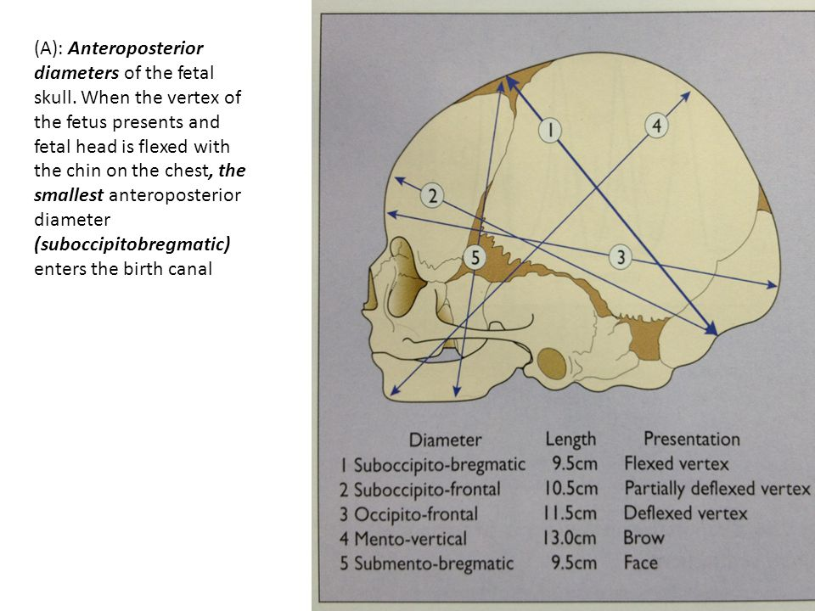

Slide 19
Movements of the head:
Engagement in occipito-transverse (OT) (the baby rotates his head laterally)
Descent and flexion
Rotation 90° to occipito-anterior (OA) (the baby rotates his head medially)
Descent
Extension to deliver
Restitution and delivery of shoulders

Slide 20
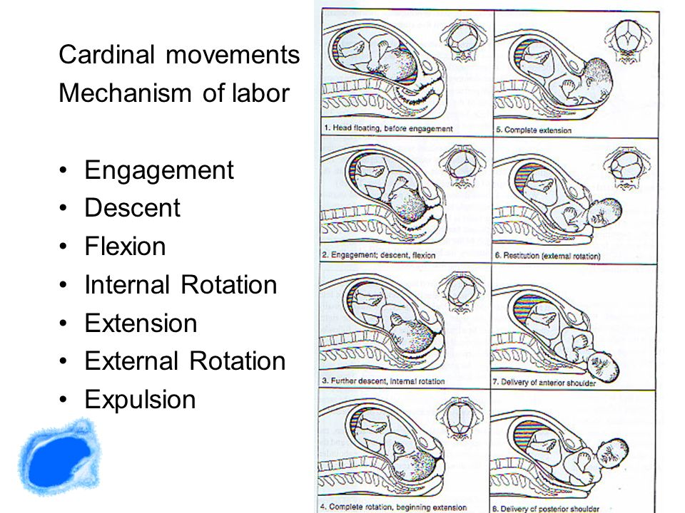

Slide 21
Descent. Descent is brought about by the force of the uterine contractions, maternal bearing-down (Valsalva) efforts, and, if the patient is upright, gravity.
Flexion. Partial flexion exists before labor as a result of the natural muscle tone of the fetus. During descent, resistance from the cervix, walls of the pelvis, and pelvic floor causes further flexion of the cervical spine, with the baby’s chin approaching its chest. In the occipitoanterior position, the effect of flexion is to change the presenting diameter from the occipitofrontal to the smaller suboccipitobregmatic In the occipitoposterior position, complete flexion may not occur, resulting in a larger presenting diameter, which may contribute to a longer labor.
Internal Rotation. In the occipitoanterior position, the fetal head, which enters the pelvis in a transverse diameter, rotates so that the occiput turns anteriorly toward the symphysis pubis. It is often not accomplished until the presenting part has reached the level of the ischial spines (zero station) and therefore is engaged.
Extension. The flexed head in an occipitoanterior position continues to descend within the pelvis. Because the vaginal outlet is directed upward and forward, extension must occur before the head can pass through it. As the head continues its descent, there is bulging of the perineum followed by crowning
Crowning occurs when the largest diameter of the fetal head is encircled by the vulvar ring. At this time, the vertex has reached station +5. When indicated, an incision in the perineum (episiotomy) may aid in reducing perineal resistance.

Slide 22
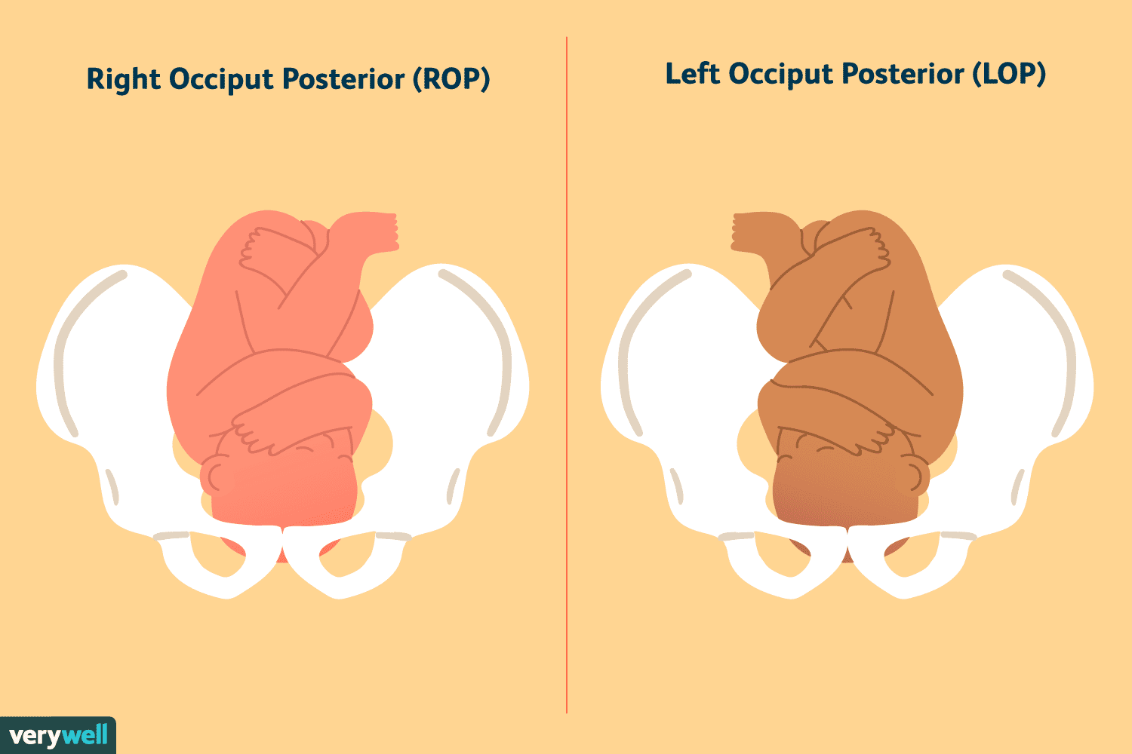
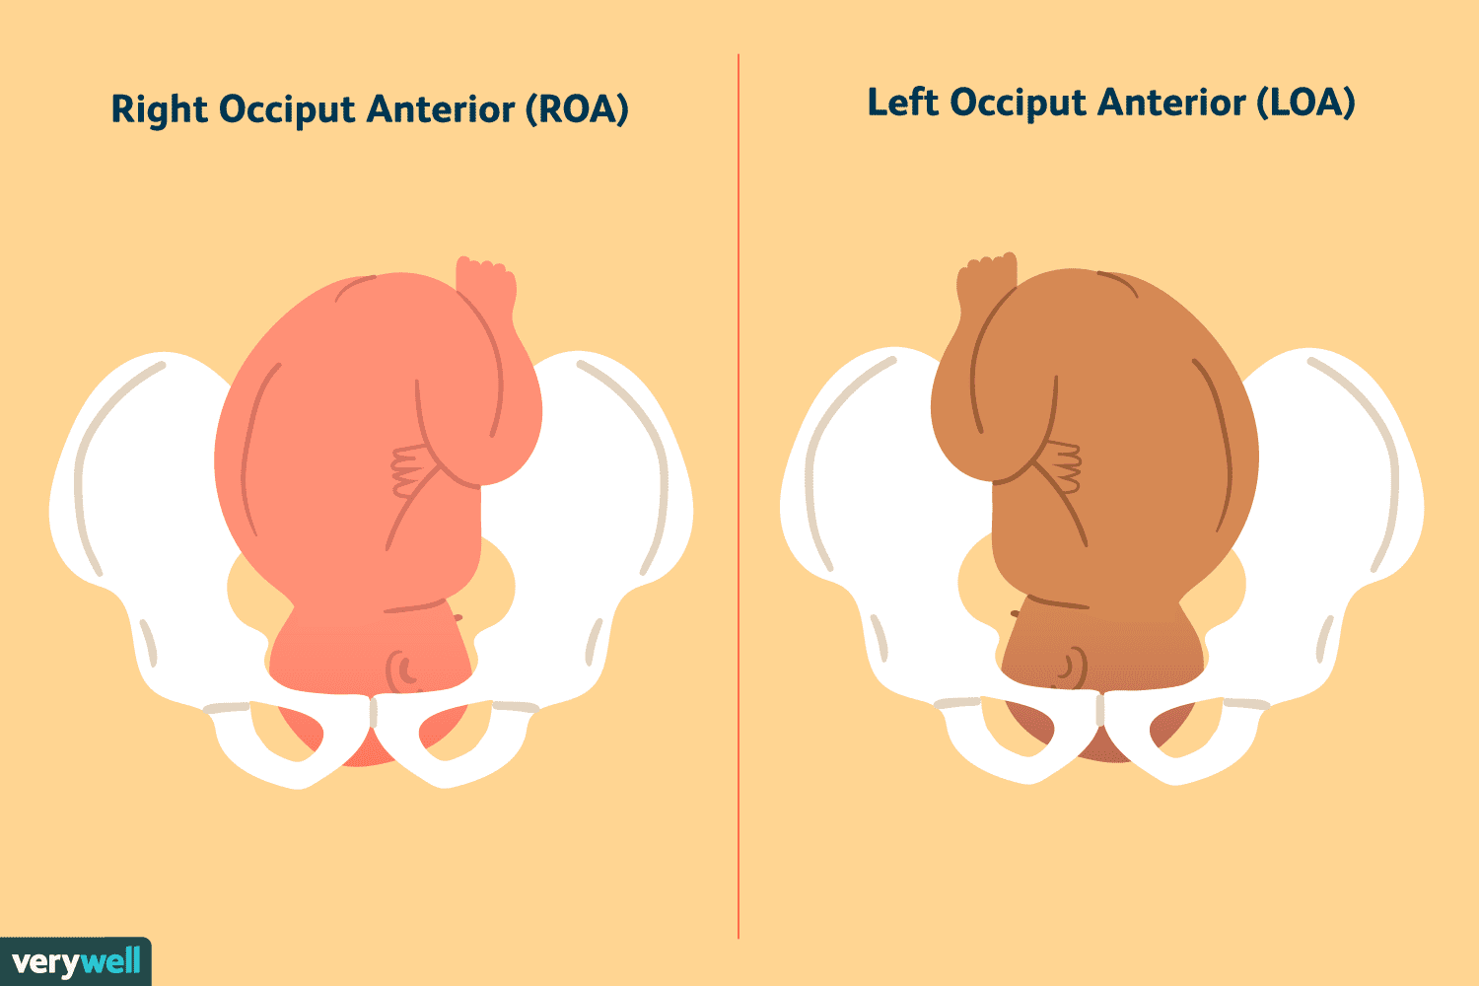
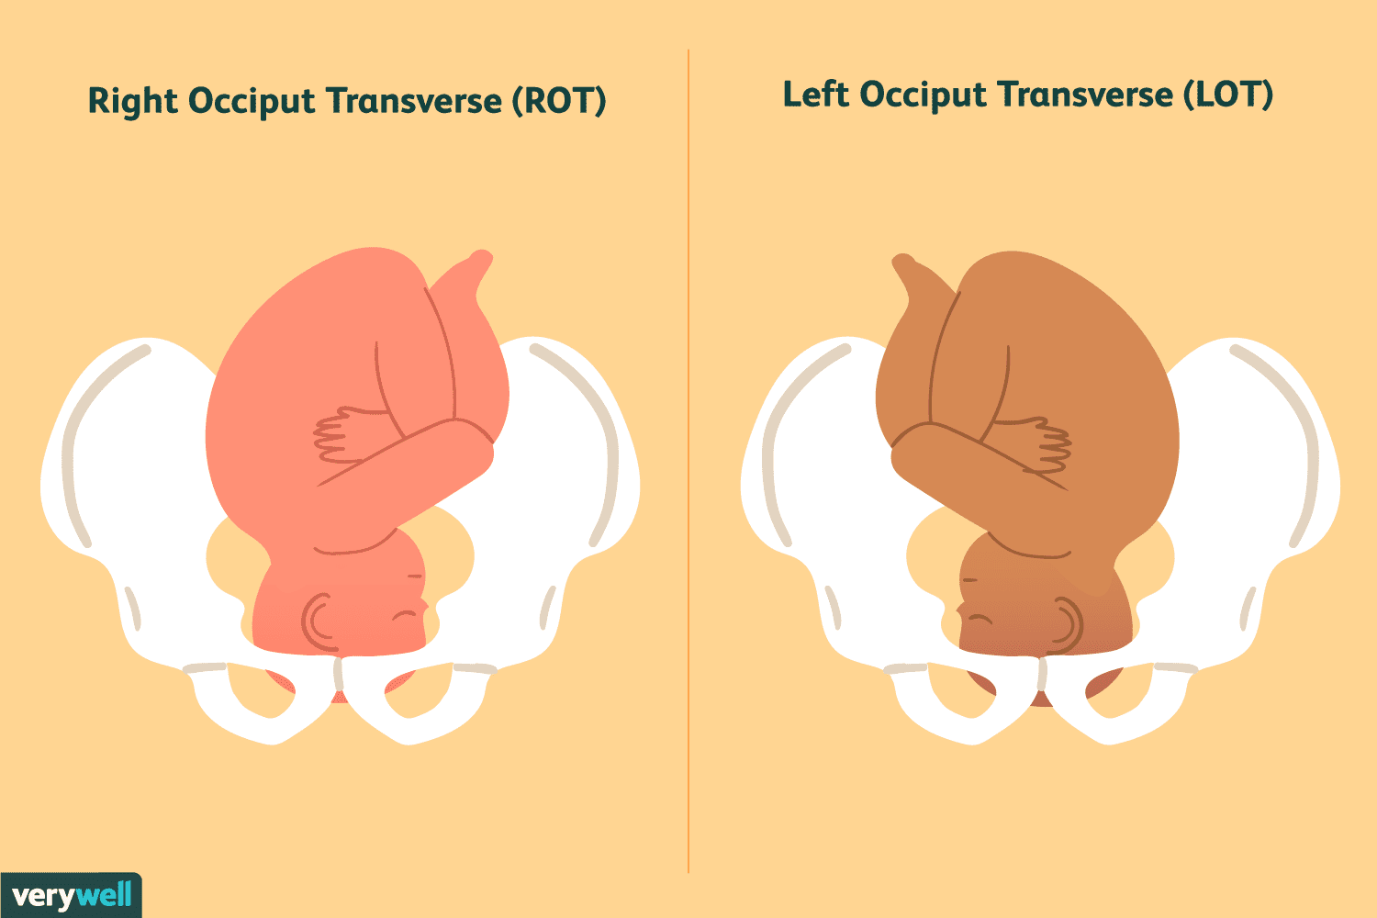

Slide 23
Initiation of labor:
Labor is a release from the state of functional quiescence maintained during pregnancy.
Decreased myometrial responsiveness to progesterone due to increased PRA.
Increased responsiveness to estrogen due to increased ERalpha.
Activation of the fetal hypothalamic pituitary axis, results in increased release of cortisol, increasing the synthesis and release of prostaglandins, and formation of myometrial gap junctions and activation of oxytocin receptors.

Slide 24
Preparation for labor:
Lightening:
Two or more weeks before labor, the fetal head in most primigravid women settles into the brim of the pelvis. In multigravida, this often does not occur until early in labor. Lightening may be noted by the mother as a flattening of the upper abdomen and an increased prominence of the lower abdomen.
False labor:
Cervical effacement

Slide 25
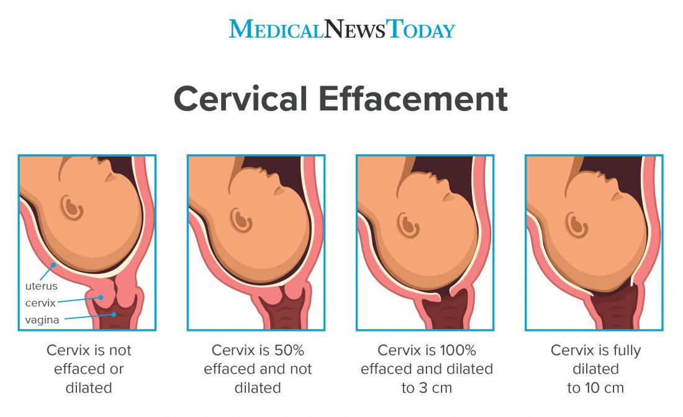
Diagnosis of labour:
Labour is diagnosed when painful regular contractions lead to effacement and dilatation of the cervix.
This is commonly accompanied by a ‘show’ ( pink/white mucus plug) from the cervix and/or rupture of the membranes, causing release of liquor.
Cervical Effacement:
Before the onset of parturition, the cervix is frequently noted to soften as a result of increased water content and collagen lysis. Simultaneous effacement, or thinning of the cervix, occurs as the internal os of the cervix is taken up into the lower uterine segment. Consequently, patients often present in early labor with a cervix that is already partially effaced. As a result of cervical effacement, the mucous plug within the cervical canal may be released. The onset of labor may thus be heralded by the passage of a small amount of blood-tinged mucus from the vagina (“bloody show”).

Slide 26
Stages of Labor
The first stage:
From the diagnosis of labor until the cervix is dilated by 10 cm (fully dilated).
The descent, flexion and internal rotation described occur to varying degrees.
The latent phase: where the cervix usually dilates slowly for the first 4 cm.
The active phase follows.
Average cervical dilatation is at the rate of 1 cm/h in nulliparous women and about 2 cm/hour in multiparous women. With an average duration of 6-18 hrs in primipara and 2-10 hrs in multipara.

Slide 27
The second stage:
Lasts from full dilatation of the cervix to delivery.
Descent, flexion and rotation are completed and followed by extension as the head delivers.
Duration 30-3 hrs in primipara and 5-30 mins in multipara.

Slide 28
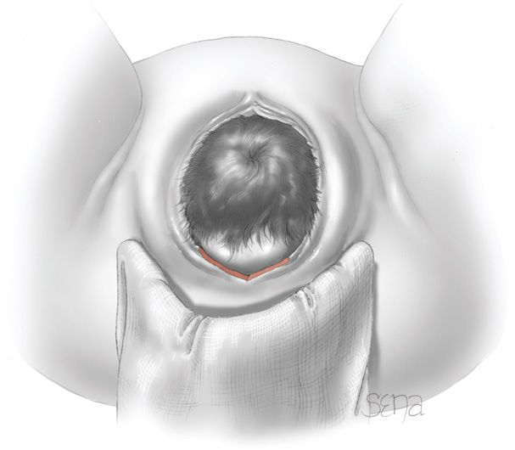
Crowning: when the largest diameter of the fetal head is encircled by the vulvar ring.

Slide 29
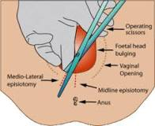

Slide 30
The third stage:
From delivery of the fetus to delivery of the placenta.
It normally lasts about 15 minutes. (0-30 mins).
Normal blood loss is up to 500mL.
Signs of placental separation:
- fresh show of blood from the vagina.
- the umbilical cord lengthens outside the vagina.
- the fundus rises up.
- the uterus become firm and globular.

Slide 31
Active management of the third stage of labor(to prevent post partum hemorrhage):
- administration of uterotonics.
- controlled cord traction.
- early clamping of the cord.

Slide 32
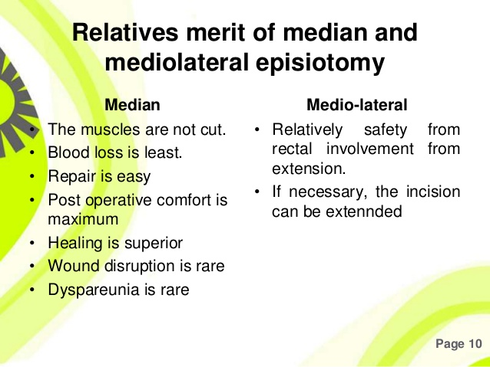
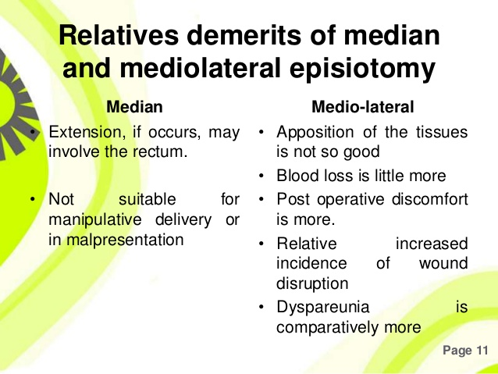

Slide 33
Perineal lacerations:
First degree: vaginal epithelium or perineal skin.
Second degree: sub epithelial tissue.
Third degree: anal sphincter.
Fourth degree: rectal mucosa.

Slide 34
General care of the woman in labor:
Physical health in labor observations:
The temperature and blood pressure every 4 hours, the pulse every hour (first stage) and then every 15 minutes (second stage).
Contraction frequency recorded every 30 minutes.
Mobility and delivery positions:
Freedom of movement is encouraged.
Most women deliver semi-recumbent:
squatting, kneeling or the left-lateral position all probably increase the dimensions of the pelvis.
The supine position avoided: the gravid uterus compresses the main blood vessels, reducing cardiac output and causing hypotension, and often fetal distress. Aortocaval compression, prevented by maintaining at least 15° of left lateral tilt.

Slide 35
Hydration: encouraged to drink isotonic drinks or water. Intravenous fluid may be necesary if labour is prolonged.
Stomach and food: Eating is appropriate during labour, although only small amounts are usually eaten. Eating is often discouraged if the labour is high risk, and ranitidine is often given to reduce the stomach acidity.

Slide 36
The urinary tract:
Neglected retention of urine can irreversibly damage the detrusor muscle.
The woman must be encouraged to micturate frequently in labour;
if she has an epidural, catheterization may be needed, routine catheterization is unnecessary.

Slide 37
Monitoring progress in labor: the partogram:
Used to record progress in dilatation of the cervix and descent of the head. This is assessed on vaginal examination and plotted against time.
‘alert’ and ‘action’ lines on the partogram indicate slow progress.
NICE recommends that slow progress is diagnosed if there is <2 cm dilatation in 4 hours.

Slide 38
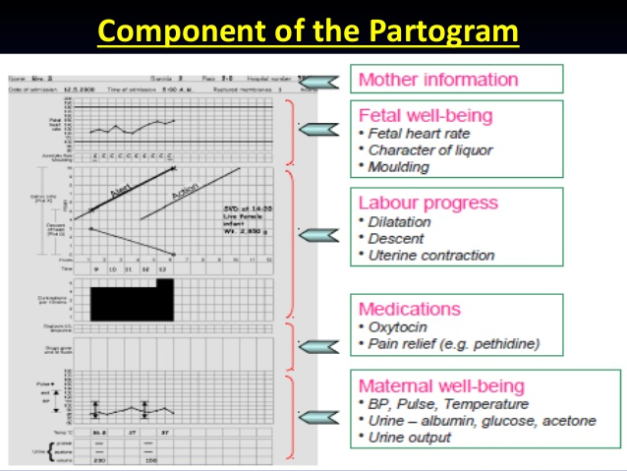

Slide 39
Fetal heart monitoring:
Fetal heart rate auscultation:
- For low risk pregnancies.
- every 15 minutes during the first stage, and every 5 minutes in the second, with a Pinard’s stethoscope or a hand-held Doppler for 60 seconds after a contraction.
Cardiotocography ( CTG)
- if abnormalities are detected or risk factors develop.
- records the FHR on paper and electronically, either from a transducer placed on the abdomen or from a probe in the vagina attached to the fetal scalp.Another transducer synchronously records the uterine contractions.

Slide 40
CTGs are classified as normal, suspicious or pathological, according to four key features:
1- Baseline rate: normally its 110–160 beats/minute.(above 160 is tachycardia and below 110 is bradycardia) Tachycardia's are associated with fever, fetal infection
and, if in conjunction with other abnormalities, fetal
hypoxia.
2- Baseline variability: the short-term variation in FHR
should be >5 beats/minute, except during episodes of fetal sleep, usually last less than 45 minutes. Prolonged reduced variability, with other abnormal features, suggests hypoxia.
3- Accelerations of the fetal heart with movements or
contractions are reassuring.( 2 accelerations every 20min)

Slide 41
4-) decelerations:
• Early decelerations are synchronous with a contraction as a normal response to head compression during fetal descent which cause vagal stimulation, usually benign.
• Variable decelerations’ vary in timing and classically reflect cord compression, which can ultimately cause hypoxia.
• Late decelerations persist after the contraction is completed and are suggestive of placental insufficiency or fetal hypoxia.

Slide 42
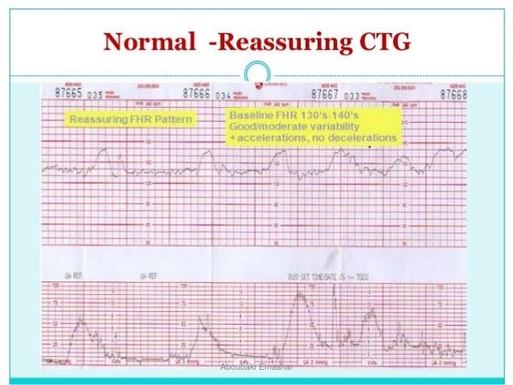

Slide 43
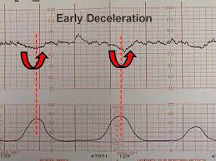

Slide 44
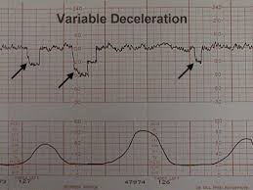

Slide 45
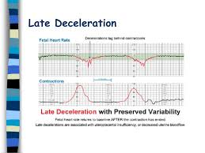

Slide 46
Management of fetal distress
Improve placental blood supply:
- correct hypovolemia and/or hypotension: left lateral
position to avoid aortocaval compression, intravenous fluid and vasoconstrictors.
- diminish uterine activity: stop oxytocin and use bolus tocolytics.
- A vaginal examination: to exclude cord prolapse or very rapid progress.
Confirmation of distress and delivery: If simple measures fail, fetal blood sampling is performed:
- delivery if the pH is <7.20(acidosis).
. If the pH is >7.20 but the abnormal FHR pattern continues or deteriorates, a second sample in about 30 minutes.

Slide 47
THANK YOU

