Slide 1

PRENATAL DIAGNOSTIC TECHNIQUES
Assessing chromosomal abnormalities in 1st & 2nd trimesters

Slide 2
FIRST TRIMESTER SCREENING
11- 13+6 weeks
CRL of 45- 84mm.
Maternal age
Nuchal translucency
Maternal serum beta hCG
Maternal serum PAPP-A level
Additional ultrasound markers

Slide 3
Maternal age
Trisomy 13,18 ,21 - ↑with maternal age detection rate ↑ to 75-80%(maternal age+ NT)
Nuchal translucency
maximum thickness of subcutaneous translucent area between skin and soft tissue overlying fetal spine at the back of neck.
CRL 38- 84mm

Slide 4
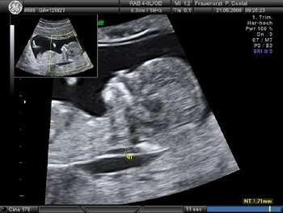
NUCHALTRANSLUCENCY
Details not imp
Mid sagittal view
Head in neutral position in
line with spine
Fetal neck skin differentiated from amnion by fetal movt
Widest part should be measured
Callipers should be placed in inner border of white line

Slide 5
BIOCHEMICAL MARKERS IN FIRST TRIMESTER
Numbers not imp
beta hCG and PAPP-A
Beta hCG | MoM
normal | 1
Trisomy 21 | 2 (increased)
Trisomy 18 | 0.2 (decreased)
Trisomy 13 | 0.5 (decreased)
PAPP-A | MoM
Normal | 1
Trisomy 21 | 0.5 (decreased)
Trisomy 18 | 0.2 (decreased)
Trisomy 13 | 0.3 (decreased)
Beta hCG is lower in women who are HIV positive

Slide 6
COMBINED FIRST TRIMESTER SCREENING
NT+ β Hcg +PAPP-A
79-87%
Maternal age affects first trimestic aneuploidy scan
<35years :- 67-75%
>35years :- 90-95%

Slide 7
SECOND TRIMESTER SCREENING
Between15 and 20 weeks of gestation
Detailed ultrasound scan
Maternal serum beta hCG
Maternal serum AFP
Maternal serum uE3 level
Maternal serum inhibin A level

Slide 8
Beta hCG- peaks at 15 wks→ gradually falls at17-22wks Trisomy 21- increased in both trimesters
Alpha fetoprotein- produced by liver and gastrointestinal tract of fetus
- marker of open spina bifida
- Trisomy 21 ↓ by 25%
Free Estriol- Trisomy 21 ↓ by 25%
Inhibin A- increased in trisomy 21
US provides higher detection rate than AFP (lemon sign & banana sign) – AFP is no longer used for spina bifida Dx

Slide 9
COMBINED FIRST AND SECOND TRIMESTER SCREENING
Integrated screening
NT+ serum analysis at 11 to 14 weeks+ quadruple
markers at 15 to 20 weeks
Highest Down syndrome detection rate( 94-96%)

Slide 10
CELL FREE FETAL DNA SCREENING
not imp
Non invasive prenatal screening
Not recommended for multiple gestation
High specificity and sensitivity for trisomy 18 and 21
Does not assess risk of fetal anomalies such as neural tube defects or ventral wall defects
Recommended for women >35 yrs
usg findings of increased risk of aneuploidy H/O trisomy affected offspring
positive first or second trimester screening result
parent with balanced translocations
ACOG 2015

Slide 11
GENETIC COUNSELING
3% of newborns have major congenital anomalies.
Etiologic factors:
Chromosomal abnormalities
Single gene disorders
Polygenic or multifactorial disorders
Teratogenic disorders due to exposure of exogenous factors

Slide 12
MATERNAL RISK FACTORS
Maternal age > 35 years
Family history of neural tube defects
Previous baby born with neural tube defect
Previous child with chromosomal anomaly
One or both parents – carriers of sex linked or
autosomal traits
One parent is known to carry a balanced translocation
History of recurrent miscarriage

Slide 13
PRENATAL RISK FACTORS
Oligohydramnios
Polyhydramnios
Severe early onset symmetrical IUGR
Abnormal USG findings
= soft tissue markers
Not v imp but any abnormality is suggestive of chromosomal abnormality

Slide 14
Uncontrolled diabetes mellitus in the periconceptional period
Contact with infection
Presence of soft tissue markers
Abnormal maternal serum screening
Abnormal anatomic finding on US

Slide 15

INVASIVE PROCEDURE FOR PRENATAL DIAGNOSIS
Chorionic villus sampling
Amniocentesis
Cordocentesis or percutaneous umbilical blood
sampling

Slide 16

CHORIONIC VILLUS SAMPLING
Diagnosed by italian biologist Giuseppe simoni, 1983
Diagnosis of genetic disorders
10-14 wks
2 approaches:
Transcervically
Transabdominally

Slide 17
ADVANTAGES OF CVS
Genetic diagnosis is achieved at an early gestational age.
Early = Can terminate pregnancy if anomaly is incompatible with life

Slide 18

DISADVANTAGES
High risk of fetal loss than traditional amniocentesis
Chromosome composition & enzyme composition of the chorionic villus is ocassionally different from the fetal cells ( placenta mosaicism ) 2-3%

Slide 19
CONTRAINDICATIONS
-Positive N.gonorrhoea culture of the cervix (transvaginal)
-Active genital herpes (transvaginal)
-Active bleeding
-Maternal coagulopathy
-Cervical stenosis (transvaginal)
-Severe cervicitis (transvaginal)

Slide 20

Transvaginal vs Transabdominal CVS
The transvaginal….
Technically easier if placenta is low or posterior
More infection if there is evidence of lower genital tract infection
More tissues can be gathered
Less discomfort to the patient

Slide 21
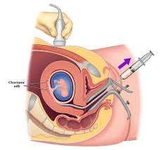
PROCEDURE OF TRANSCERVICAL

Slide 22
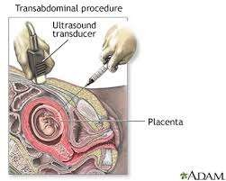
PROCEDURE

Slide 23
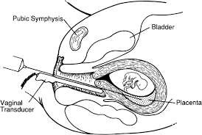
Chorionic villus is obtained by transvaginal aspiration under guidance with an endovaginal probe.

Slide 24
COMPLICATIONS
Earlier (<10 weeks) should be avoided due to higher risk of complications
Absolutely CI before 9 weeks, be very cautious between 9-10 weeks, okay after 10 weeks
Fetal loss(1-2%)
Oromandibular limb deformities ( early CVS )
Vaginal bleeding
Limb reduction deformity
ANTI-D 500 IU should be given

Slide 25
Amniocentesis :
Amniocentesis can be performed after 10 weeks of gestation (early amniocentesis) but should be avoided. usually should be done after 15 weeks of gestation.
Early amniocentesis is ass. with a pregnancy loss rate of 1 – 2 % & an increased incidence of clubfoot.
A 22-gauge needle is passed through the mother's lower abdomen into the amniotic cavity inside the uterus, & 10- 20 mL of amniotic fluid ( that is replaced by fetus within 24hrs ) that contains cells from amnion, fetal skin, fetal lungs, and urinary tract epithelium are collected.
Amount of amniotic fluid at this age is already very little – similar to early onset oligohydramnios

Slide 26
Amniocentesis :
The Cells are grown in culture for chromosomal, biochemical, & molecular biologic analyses.
The Supernatant amniotic fluid is used for the measurement of substances such as AFP, AChE,bilirubin & pulmonary surfactant
In the third trimester of pregnancy, the amniotic fluid can be analyzed for determination of fetal lung maturity.
The results of cytogenetic and biochemical studies on amniotic cell cultures are more than 90% accurate.
Risks with amniocentesis are rare but include 0.5-1.0% fetal loss and maternal Rh sensitization.
If done >15 weeks

Slide 27
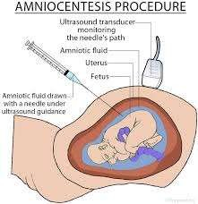

Slide 28
Main risk factors:
-Rh isoimmunization in Rh negative mothers.
-Infection

Slide 29
Disadvantages:
-Pregnancy loss
-Amniotic fluid leakage
-Fetal trauma

Slide 30
PRECAUTIONS
Prior sonographic localisation of placenta is desirable to prevent bloody tap and fetomaternal bleeding
Prophylatic administration of 500 IU of anti-D immunoglobulin in Rh-negative nonimmunized mother.

Slide 31

CORDOCENTESIS
Requires high expertise
Described in 1983 by Fernand Daffos.
Procedure to obtain fetal blood.
INDICATIONS:
-Fetal transmission of toxoplasmosis
T.Gondii IgM specific AB.
-Rapid karyotype of the fetus with anatomic deformities
-Chromosomal abnormalities

Slide 32
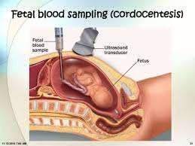
CORDOCENTESIS

Slide 33
ADVANTAGES
High quality karyotype in 48-72 hrs rather than 10- 14 days that is needed for amniotic tissue culture.

Slide 34
COMPLICATIONS
Bleeding from the puncture site(30%)
Fetal bradycardia(5%)

Slide 35


CORDOCENTESIS
CVS
AMNIOCENETESI
S
TIME
10-14 weeks
After 15
weeks(early 12-14 weeks)
18-20 weeks
MATERIALS FOR STUDY
Trophoblast cells
Fetal fibroblasts Fluid for biochemical study
Fetal white blood cells(others-infection and biochemical study)
KARYOTYPE RESULT
Direct preparation: 24-48 hrs
Culture: 10-14 days
Culture:3-4weeks
24-48hrs
FETAL LOSS
0.5-1%
0.5%
1-2%
ACCURACY
Accurate
Highly accurate
Highly accurate
TERMINATION OF PREGNANCY
1st trimester-safe
2nd trimester-risky
2nd trimester-risky

Slide 36


