Slide 1

Postpartum Care

Slide 2
  Puerperal women
The puerperium is the period beginning after delivery and ending when the woman’s body has returned as closely as possible to its prepregnant state.
The period lasts approximately 6 weeks.

Slide 3
Physiologic Changes of the puerperium
Uterine changes
The fundus is usually midline and about at the level of the woman’s umbilicus after delivery.
Within 12 hours of delivery, the fundus may be 1cm below the umbilicus.
After this, the level of the fundus descends about 1 finger breadth (or 1 cm) each
day, until by the 10th day, it has descended into the pelvic cavity and can no longer be palpated.

Slide 4
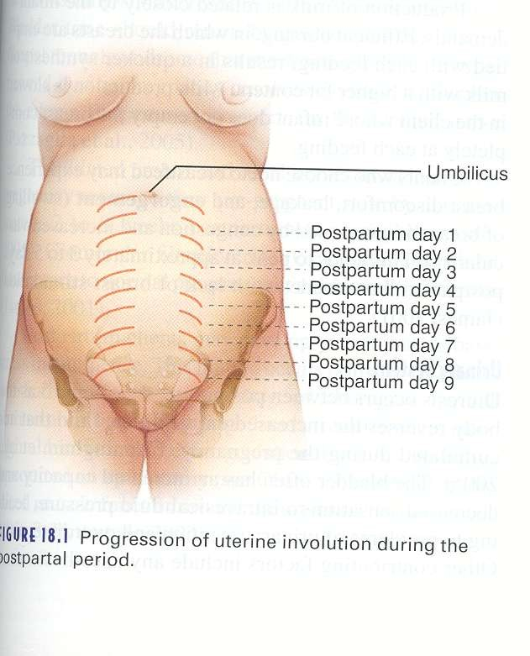
Level of fundus height

Slide 5
Lochia
Vaginal discharge consisting of fatty epithelial cells, shreds of membrane, decidua, and blood, is red color (lochia rubra) for about 2 or 3 days.
It then progresses to a pale or brownish color (lochia serosa), followed by a whitish or yellowish color (lochia alba) in the 7th to 10th day.
Lochia usually ceases by 3 weeks, and the placental site is completely healed by the 6th week

Slide 6
Vagina
The vaginal walls, uterine ligaments, and muscles of the pelvic floor and abdominal wall regain most of their tone during the puerperium.
Urination
Postpartum diuresis occurs between the 2nd and 5th postpartum days, as extracellular water accumulated during pregnancy begins to be excreted. Diuresis may also occur shortly after delivery
if urinary output was obstructed because of the pressure of the presenting part(less sensitive of bladder)

Slide 7
Breasts
With loss of the placenta, circulating levels of estrogen and progesterone decrease while levels of prolactin
increase, thus initiating lactation in the postpartum woman.
Colostrum, a yellowish fluid containing more minerals and protein and immunologic component(IgA) but less sugar and fat than mature breast milk and having a laxative effect on the infant, is secreted for the first 2 days postpartum.
Mature milk secretion is usually present by the third postpartum day but may be present earlier if a woman breast- feeds immediately after delivery.
Breast engorgement with milk, venous and lymphatic stasis, and swollen, tense, and tender breast tissue may occur between days 3 and 5 postpartum.

Slide 8
NURSING ASSESSMENT
Immediate Postpartum Assessment
The first 1 hour after delivery of the placenta (fourth stage of labor) is a critical period; post partum hemorrhage is most likely to occur at this time.

Slide 9
Subsequent Postpartum Assessment
Check firmness of the fundus at regular intervals.
Inspect the perineum regularly for frank
bleeding.
  Note color, amount, and odor of the lochia.
  Count the number of perineal pads that are saturated in each 8 hour period.
Assess vital signs at least twice daily and more frequently if indicated.
Notes:
Palpating the uterine fundus
Firm or “ *Boggy”
– not palpable by 10 days PP

Slide 10
Subsequent Postpartum Assessment
Assess for bowel and bladder elimination.
Assess for breast engorgement and condition of nipples if breast-feeding.
Assess perineal incisions(episiotomy wound) for signs of infection and healing.
Inspect legs for signs of thromboembolism, and assess Homan’s sign.
Evaluate interaction and care skills of mother and family with infant.

Slide 11
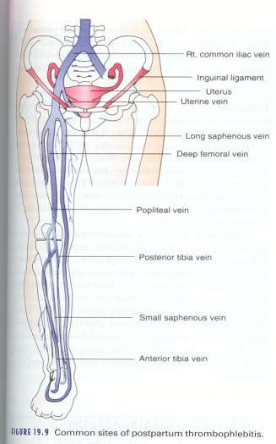
Common site of thrombophlebitis

Slide 12
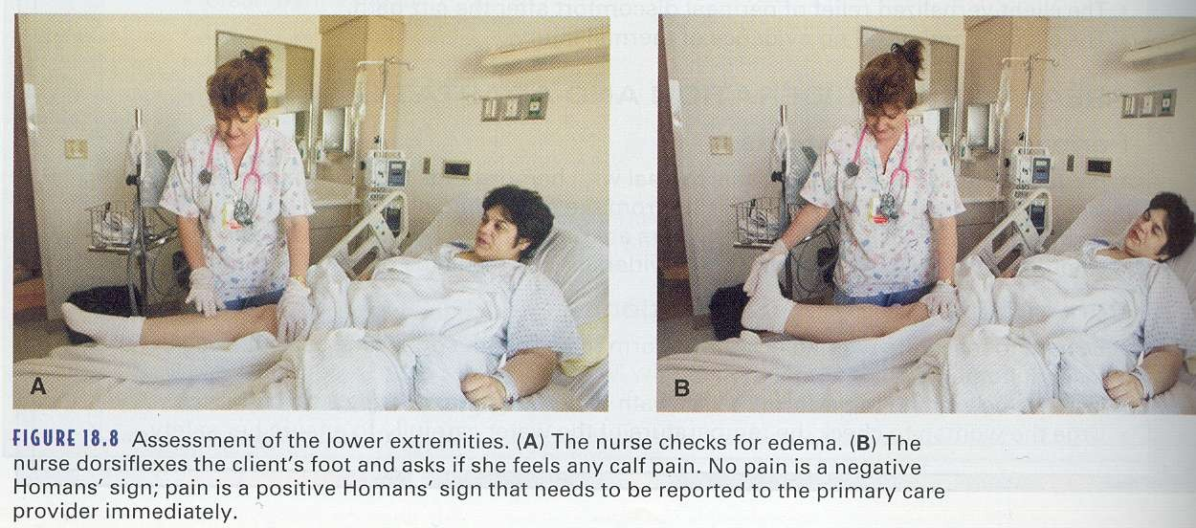
Homan’s sign

Slide 13
Postpartum blue/depression
Many women may experience temporary mood swings during this period because of the discomfort, fatigue, and exhaustion after labor and delivery and because of hormonal changes after delivery(decrease of Estrogen).
Some mothers may experience “postpartum blues” at about the third postpartum day and exhibit irritability, poor appetite, insomnia, tearfulness, or crying.
This is a temporary situation. Severe or prolonged depression is usually a sign of a more serious condition

Slide 14
Contributing factors of postpartum
blue/depression
Difficult of Coping with:
The physical changes and discomforts of the puerperum, including a need to regain their prepregnancy figure.
Changing family relationships and meeting the needs of family members, including the infant.
Fatigue emotional stress, feelings of isolation, and being “tied down.”
A lack of time for personal needs and interests.

Slide 15
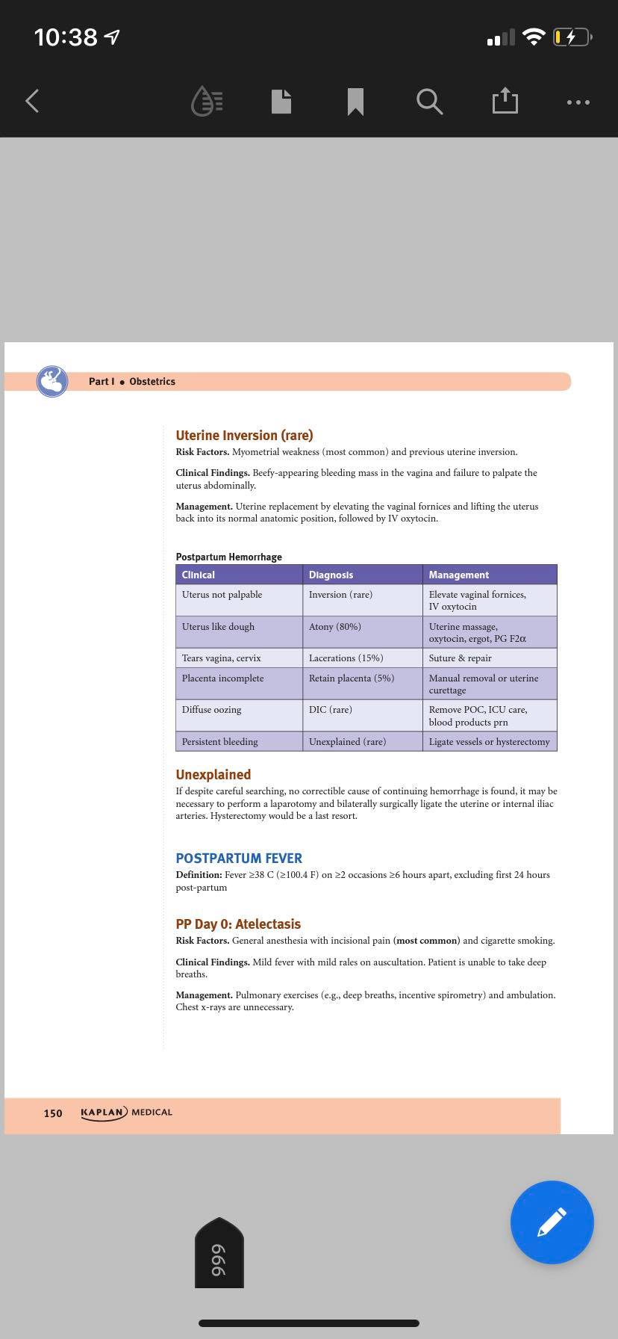
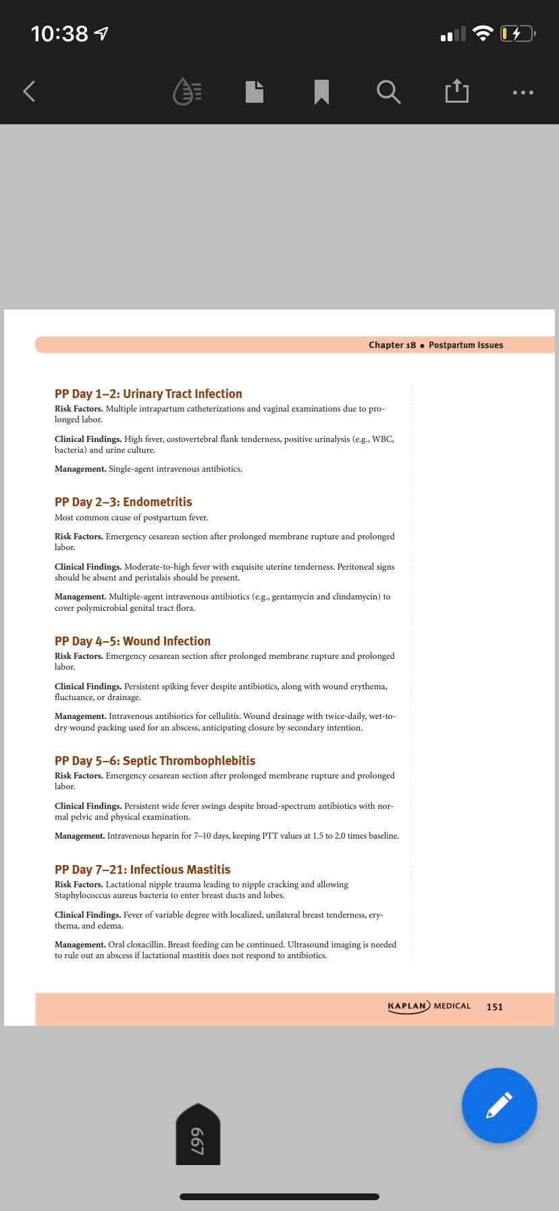

Slide 16
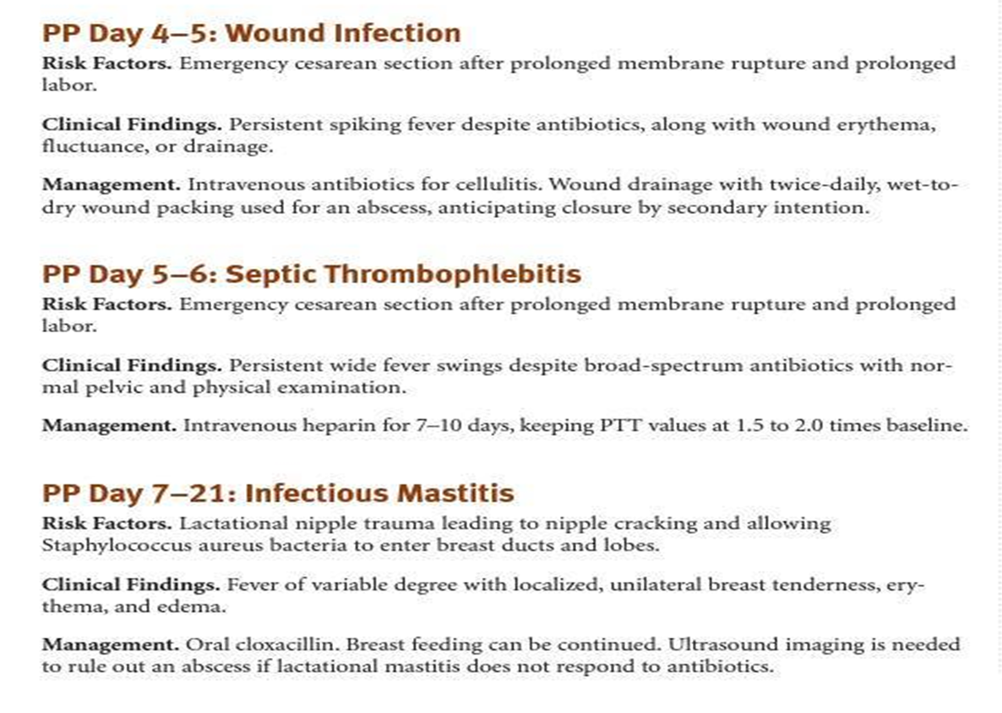

Slide 17
Postpartum Endometritis.
Postpartum infection of the uterus, the most common cause of puerperal sepsis
Cesarean delivery, particularly after labour or rupture of the membranes of any duration, is the most accurate predictor of postpartum endometritis (PPE)
The pathogenesis of this infection involves inoculation of the amniotic fluid after membrane rupture or during labour with vaginal microorganisms. The myometrium, leaves of the broad ligament, and the peritoneal cavity are then exposed to this contaminated fluid during cesarean surgery.
The reported incidence of PPE after cesarean delivery is less than 10% in patients receiving appropriate antibiotic prophylaxis.

Slide 18
Risk factors
prolonged labor
rupture of the membranes
presence of bacterial vaginosis
frequent vaginal examinations
use of internal fetal monitoring

Slide 19
CLINICAL SYMPTOMS
Temperature elevation › 38° on 2-5th day following delivery.
Chills.
Abdominal pain.
Foul-smelling, pus-containing lochia.
Headache.

Slide 20
Antimicrobial prophylaxis is associated with a 50% reduction in infection in all populations studied. All patients undergoing cesarean delivery, either elective or emergent, are candidates for antibiotic prophylaxis. When given before the skin incision rather than after cord clamping, the incidence of postcesarean infectious morbidities are decreased, without adversely affecting neonatal outcome.
PPE is a polymicrobial infection caused by a wide variety of bacteria:
Group B streptococci, enterococci, other aerobic streptococci, G.vaginalis, E. coli, Bacteroides spp., and are the most common endometrial isolates, with group B streptococci and G. vaginalis the most common isolates from the blood.
Clindamycin plus gentamicin has proved to be the most effective regimen in treating PPE, especially if PPE occurs after cesarean delivery.

Slide 21
