Slide 1







Slide 2
Introduction
Hydrops fetalis (Latin) = Edema of the Fetus
  Defined as a collection of fluid in at least two serous compartments
Is of 2 types
  Immune hydrops and
  Nonimmune hydrops
    More common
2

Slide 3
Nonimmune Hydrops
Nonimmune Hydrops
  Heterogeneous disorder with a large number of possible causes and associations
  Elucidation of the cause is of primary importance,
  Perinatal mortality rate of 52% to 98% is typical

Slide 4
Etiology
Challenging
Causes are many
  - Cardiovascular
    Functional Vs Structural abnormalities
  - Chromosomal abnormalities
    7-45%
  - Thoracic compression
    Cystic adenomatoid malformation
- Twining
  . Twin-to-Twin-Tansfusion Syndrome

Slide 5
Metabolic Diseases
  Lysosomal storage diseases
  DM
Infection
  TORCH
  Parvovirus B19
Other malformations
  Chondrodysplasias
  Fatal dwarfing syndromes

Slide 6
Management
  Depends on etiology, gestational age, and signs and symptoms
  Maternal compromise, such as preeclampsia or antenatal hemorrhage - terminate the pregnancy regardless of the outocme

Slide 7


Immune Hydrops
Red Cell Alloimmunization
  Formation of antibodies for red cell antigens
  Perinatal consequence
    Hemolysis
    Anemia
7

Slide 8
Diagnostic Methods
Maternal antibody determination ( indirect coombs test ) +- titre
Paternal homozygosity study
Fetal blood typing
non-invasive = cffDNA
invasive
Follow up :
Titre level
Ultrasound signs of hydrops
MCA-PSV to detect fetal anemia
PUBS
If the father is homozygotic, the child is 100% with Rh+ and we can skin foetal blood sampling
Cell-free foetal DNA
Like chorionic villi sampling / amniocentesis
If below critical value >> follow up every 4 weeks until 28 GA and every 2 weeks after 28 GA
Middle cerebral artery peak systolic velocity
Per-cutaneous umbilical blood sampling
8

Slide 9
U/S :
Hydrops fetalis :
2 serous compartments : ascites
pericardial
pleural
skin
Hepatomegaly
Placentomegaly
Abberant liquor volume
Oligo or poly-hydramneous

Slide 10
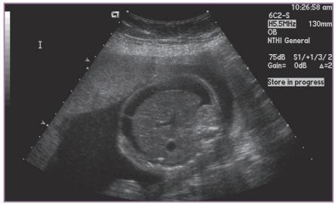
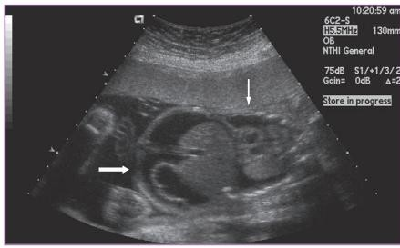
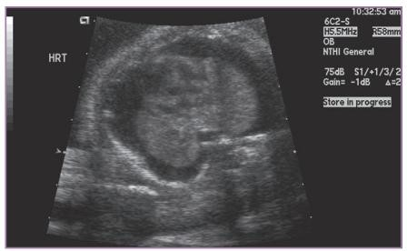
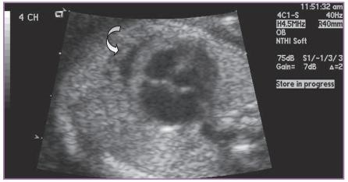
ascites
Pericardial effusion

Slide 11
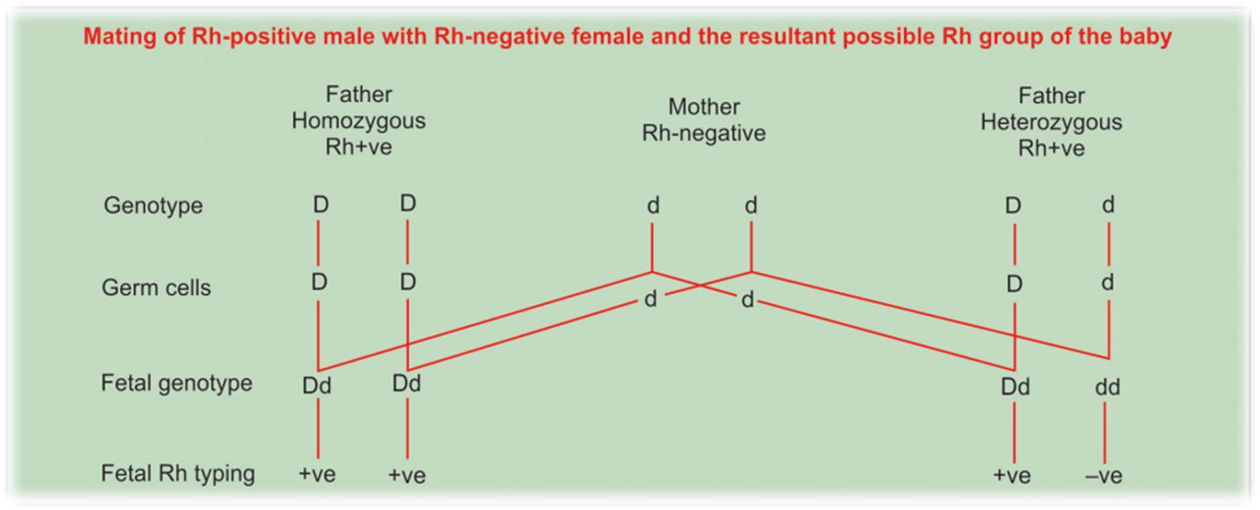
Rh-ve Mother, Rh +ve Partner
11

Slide 12
Epidemilogy
  15% of world population Rh negative
  Sensitization declining currently
    Antental and Postpartum administration of RhIG
  Why do cases still continue to occur?
    Maternal sensitization in the first two trimesters of pregnancy and it could be silent (asymptomatic) = RAADP
    Inadvertent omission of RhIG
    Inadequate dosing after delivery
    Low ANC attendane and Low socioeconomic status
    No immune globulins to prevent alloimmunization to other
red cell antigens
Routine antenatal anti-D prophylaxis
In massive bleeding – abruption / previa
12

Slide 13
Pathogenesis
  Fetal-maternal interface is not an absolute barrier
    Considerable cell trafficking
  Fetomaternal Hemorhage
    Adequate dose of putative antignes (foreign fetal red cell antigens) → Stimulate the maternal immune system → B- Lymphocyte clones that recognize the foreign fetal red cell antigens established → antibodies were produced → titer detected 5 to 16 weeks after the sensitizing event
13

Slide 14
In subsequent pregnancies
– B-lymphocytes will have the memory of foreign invasion (by foreign fetal antigens) → Upon second exposure B-lymphocytes will be transformed into Plasma Cells → Proliferate rapidly and a large mass of IgG is produced →Readily crossess the placenta →Attaches to fetal erythrocytes → Sequestered by fetal spleen → Extravascular hemolysis → Anemia
14

Slide 15
Anemia - hallmark of red cell alloimmunization
  Enhanced hematopoiesis
    Bone marrow
    Liver
  Cardiac output increases
15

Slide 16
Why hydrops fetalis in red cell alloimmunization?
  Proposed mechanisims
    Liver shifted to erythrocyte production
      Decreased plasma colloid osmotic pressure
    Tissue hypoxia
      Increased capillary permeability
    Iron overload from hemolysis
      Free radical formation
    Increased central venous pressure
      Impaired lymphatic drainage
16

Slide 17
Male fetus
  Bad prognositic factor
    13 fold increased risk of hydrops
    3.38 fold increased risk of perintal mortality
17

Slide 18
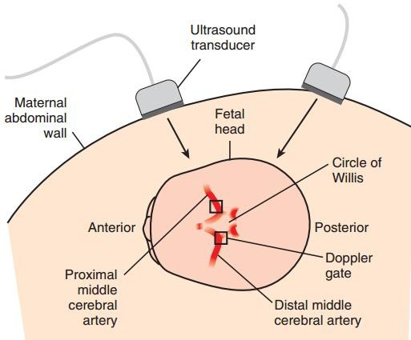
Hale T., M.D., Resident Physician
13

Slide 19
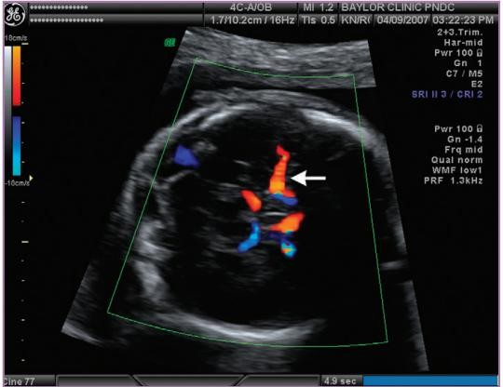

Slide 20
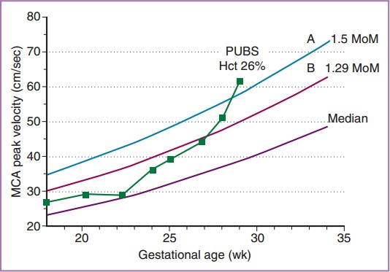
If MCA-PSV increased 1.5 MoM >> 100% foetal anaemia

Slide 21
First Sensitized Pregnancy
  Sesitized ➔ follow titer till it reaches critical titer ➔ Once critical titer is reached start follow up with MCA PSV ➔ If PSV > 1.5 MoM take cord blood (cordocentesis) for hct determination ➔ If cord blood hct < 30 start intrauterine transfusion ➔ Then deliver at 35 weeks of gestation.
Previsouly sensitized pregnancy
  Start MCA PSV at 18 weeks of gestation

Slide 22
Intrauterine Transfusion
Intravascular
  Umbilical cord
  Intrahepatic
  intracardiac
Intraperitoneal
  In nonhydropic fetuses
  Gestational age earlier than 22 wks
  Slow and stable
    Absroved 7-10 Days
    Serves as a reservior
between transfusions

Slide 23
Complications of IUT
Perinatal loss ➔ 1.2 – 3.8%
Fetal distress needing emergent delivery ➔ 5%
Rare
  PPROM
  Chorioamnionitis
The need for neonatal transfusion because of bone marrow suppression by donor antibodies
Neurodevelopmental impairement ➔ 4.8%
Hearing loss

Slide 24


Prevention of Sesitization
O neg universal donor during emergency for blood transfusion
RhIG
  Blunt abdominal trauma in pregnncy
  Early pregnancy complications
  Obstetric prcedures
  Routine : RAADP
    at 28 weeks and 34 weeks or once at 28-30 weeks
    after delivery if baby blood group is confirmed to be positive
RAADP must be given as usual + for any sensitising event you must give anti-D

Slide 25

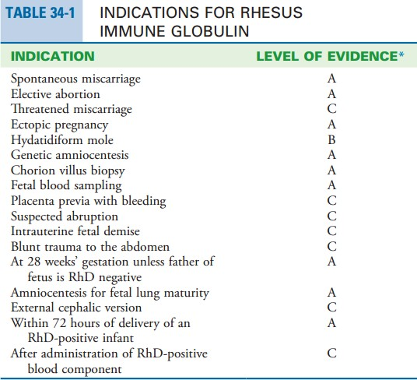


Slide 26
Maternal complications :
  Abberant liquor volume,
  Pregnancy-induced hypertension,
  Severe anemia and IUFD
  Postpartum hemorrhage,
  Preterm labor,
  Birth trauma,
  Gestational diabetes,
  A retained placenta, or difficult delivery of the placenta are all frequently mentioned in large series

Slide 27

Pre-eclampsia on top of hydropic baby
Mirror syndrome (Pseudotoxemia)
  Rare
  Patients generally experience edema or pulmonary edema, and
they may have hypertension and proteinuria
  The patients may be gravely ill but recover after delivery
  The syndrome may also develop after the birth
  As the fetal hydrops reversed,so did maternal symptoms, and a term delivery subsequently occurred
If we treat hydrops with intra-uterine infusions, symptoms of pre-eclampsia resolve
So, we can prevent early delivery

Slide 28
References
Robert K. Creas, et al., CREASY & RESNIK'S MATERNAL-FETAL MEDICINE Principles and Practice 7ed2014: Saunders, an imprint of Elsevier Inc.
Gabbe, et al., Obstetrics: Normal and Problem Pregnancies 7ed2017: Elsevier, Inc.
DUTTA, D., DC Dutta's Textbook of Obstetrics including Perinatology and Contraception. 7th ed2013, India: Jaypee Brothers Medical Publishers (P) Ltd.
UpToDate 21.2

